Slide 1
Muon Campus Operation Report
Jim Morgan
Friday 09:00 Operations Meeting
January 26, 2024

Slide 2
Muon Campus status
SAD/ASE reviews for Muon Campus and Switchyard this week
Review team toured Delivery Ring, Extraction and M4 Enclosures on Wednesday
ESS1 Electrostatic Septum at A0
Internal components have been removed and inspected
Progress and plans will be summarized in following slides
TD mostly finished with installing rad hard water lines on D30 quadrupoles
Q206 needs modifications to accommodate M4 Line vacuum pipe
Preparations for Electrostatic Septa installation
Extraction Kicker has been removed and stored in Stub Room
Will install new vacuum layout between Q202 and Q204 for electrostatic septa
Need to remove blocks from D40 Hatch for incoming and outgoing magnets
8Q24 with rad hardened water lines at AP-50, ready to be lowered into tunnel
Forklift and rad hard 8Q24 will be lowered into tunnel for installation
Existing 8Q24 and four NSA sextupoles that had water leaks go to TD
Investigating source of chronic D50 ceiling tunnel ceiling leak
ICW the remaining suspect, would eventually like it valved out to AP-50 as test
AP-0 A/C work was supposed to resume this week
Study – M1-M3 Optics
Study – Alternative M5 optics
KPS5A PFL Repair
MC-1 Controlled Access
G-2 Trolley Run
Intentional Accelerator
Standby Period
<------------Week Days -------------------→

Slide 3
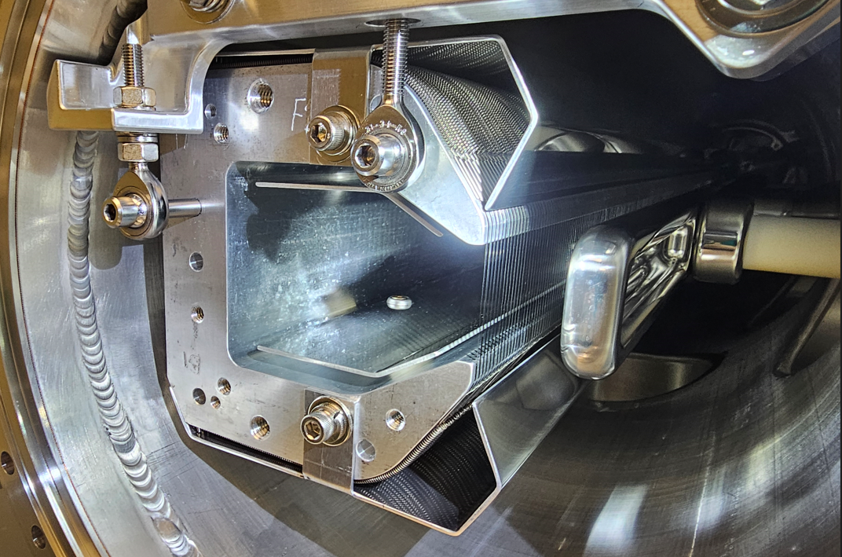
ESS1 end view

Slide 4
ESS1 disassembly and inspection
ESS1 frame and cathode were removed an inspected
Work began in early January
Three metallic objects were found on interior surfaces and are described below
One cathode stand-off and high voltage feedthrough had discoloration
Several foils had discoloration, some dust on foil frame
Metallic object on cathode, identified through quartz window in December
Fell off when cathode was removed from tank
Metallic object on back of septum foil frame
Metallic object on high voltage feedthrough
Stayed attached after feedthrough removed from tank
Thought to be cause of voltage break-down, identified as X-Ray source
Discoloration on ceramic thought to be from X-Ray emissions
Metallic objects thought to be burrs from plated flange screws
Flanges removed and reinstalled several times after initial assembly
Will be analyzed as to whether they are silver, aluminum or stainless steel
Vacuum vessel cleaned after it was opened up

Slide 5
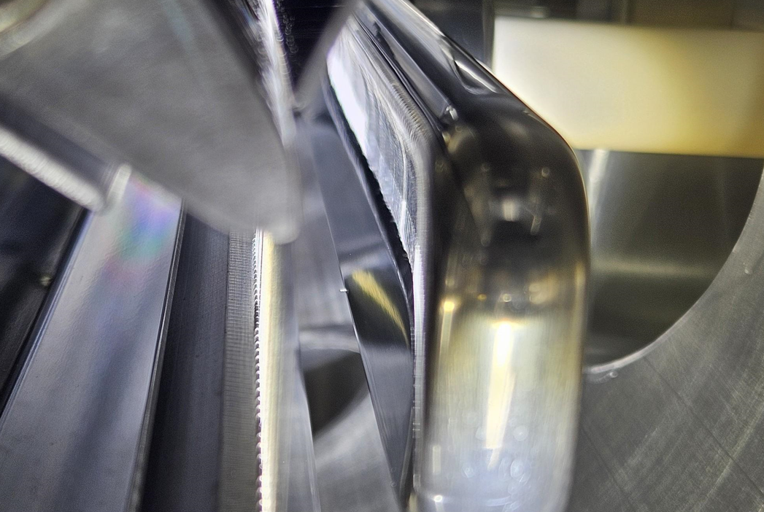
Mu2e Electrostatic Septa ESS1 object on cathode

Slide 6
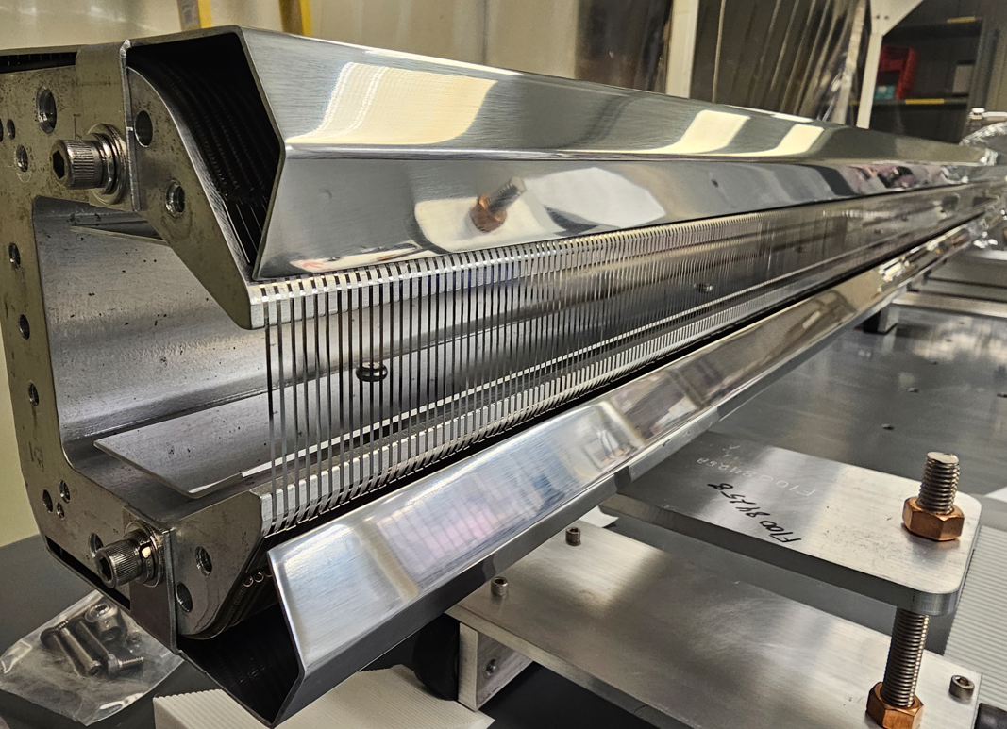
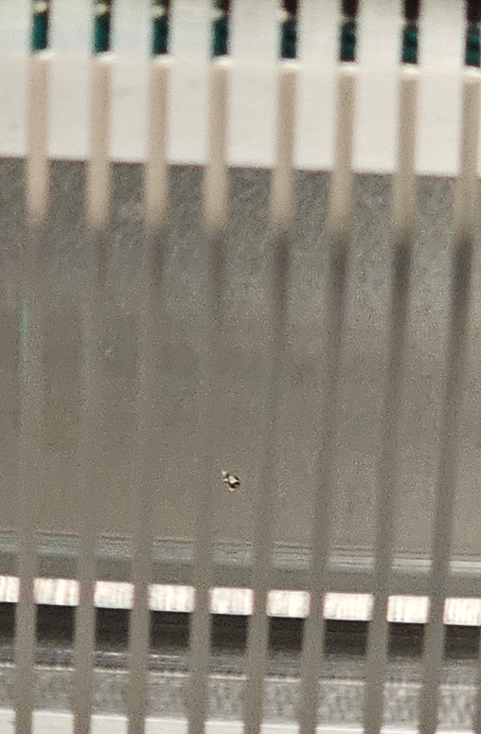
Mu2e Electrostatic Septa ESS1 object on frame

Slide 7
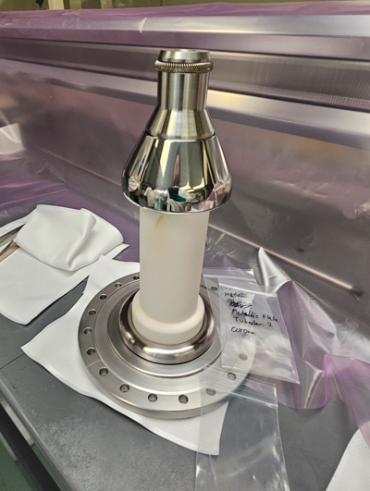
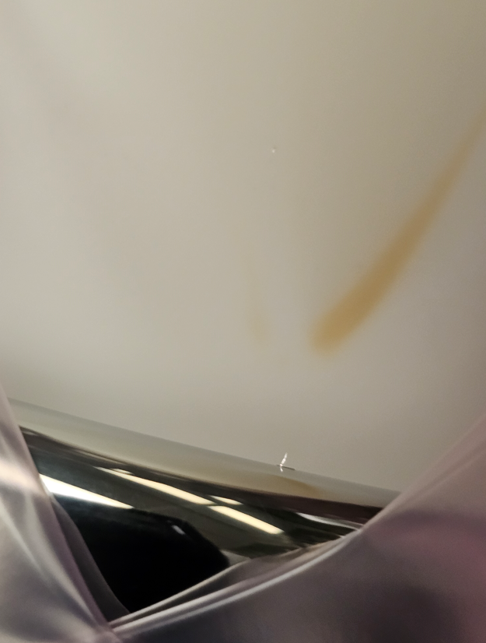
Mu2e Electrostatic Septa ESS1 object on HV feedthrough

Slide 8
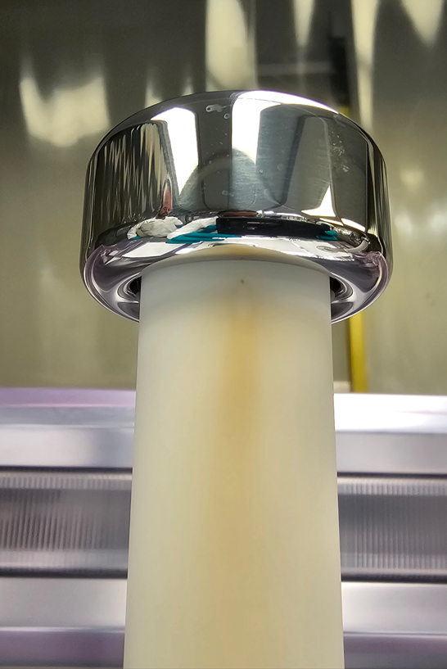
ESS1 tentative repair plan
Repair and cleaning (3 – 4 weeks)
Replace foils that have discoloration
Clean cathode with alcohol (polish looks okay)
Replace high voltage feedthrough with a tested spare
Replace cathode standoff that has discoloration
Reassemble components in tank ( 1 week)
Use different flange fasteners to avoid future burrs
Reference and align internal components (1 week)
Transport to NWA and prepare for testing (1 week)
Make electrical connections in cave, pump down vacuum
Ready for high voltage conditioning around mid March
High voltage conditioning (two options under consideration)
Full conditioning at NWA (4 – 8 weeks)
Alternative conditioning plan (1 week at NWA, remainder after tunnel installation)
Transport to tunnel and installation (1 -2 weeks)
Present plan is to leave prototype ESS2 installed in tunnel

