Slide 1
AD Controls Department Report
Adam Watts
26 January 2024

Slide 2
Java Engine Upgrade to Alma Linux 9
22-Jan | AM | dse07
22-Jan | AM | due05
22-Jan | AM | dce47
22-Jan | PM | dse08
22-Jan | PM | due23
23-Jan | AM | dse09
23-Jan | AM | due40
23-Jan | AM | due01
23-Jan | PM | dse10
23-Jan | PM | due02
24-Jan | AM | due04
24-Jan | AM | due06
24-Jan | AM | due07
24-Jan | PM | due08
24-Jan | PM | due09
25-Jan | AM | due10
25-Jan | AM | due11
25-Jan | AM | due12
25-Jan | PM | due13
25-Jan | PM | due14
26-Jan | AM | due15
26-Jan | AM | due16
26-Jan | AM | due17
26-Jan | PM | due18
26-Jan | PM | due19
All 120 Java engine servers need to migrate from Scientific Linux 7 (end of life) to Alma Linux 9
Affects a wide range of central services
Some beam-critical (Autotune, Data Pool Manager)
Others less critical (specific dataloggers)
Planning for 4-5 per day. Beam-critical systems will be coordinated for opportunistic downtimes.
Specific data loggers may go down for an hour during each day; we’ll give everyone a warning at each 0900 meeting.
Schedule on next page indicates AM (0900-1200) or PM (1300-1700) window for each machine to be down for about an hour.
Schedule will certainly need to be adjusted as we progress: “Plans are nothing; planning is everything.”
Daily notification via the Elog and all-hands email.
Notes:
We are working on another robot that used to be part of the MARV family. It is now called HERMES, short for Helpful Robotic Messenger). It is the smallest robot that we have that can be used for confined spaces and high radiation areas. A co-op engineering student designed a 3D printed chassis. Curently, under Susanna Stevenson's and Adam Watt's guidance, a senior engineering design group at Northern Illinois University is buidling a payload for autonomous photographic mapping of enclosures.

Slide 3
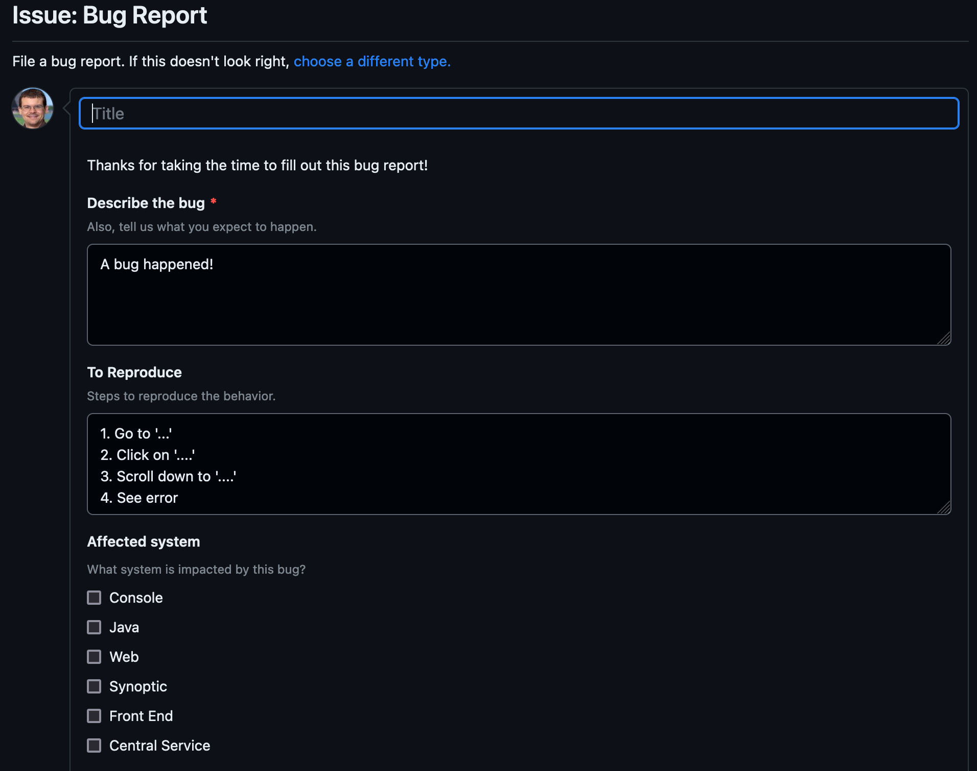
Issue reporting
On AD GitHub: https://github.com/fermi-ad/controls/issues/new?assignees=&labels=bug&projects=fermi-ad%2F13&template=bug_report.yaml
Or, https://github.com/fermi-ad/controls -> Issues -> Green “New Issue” button -> Bug report green “Get Started” button
Will add “Feature Request” option soon
Simple form for reporting operational issues with enough information for us to get started
Automatically tracks on the project board (previous slide)
Only requires (free) GitHub account to use
Not required, just convenient. You can always reach out to us to report issues directly.
Credit: Beau Harrison
Notes:
We are working on another robot that used to be part of the MARV family. It is now called HERMES, short for Helpful Robotic Messenger). It is the smallest robot that we have that can be used for confined spaces and high radiation areas. A co-op engineering student designed a 3D printed chassis. Curently, under Susanna Stevenson's and Adam Watt's guidance, a senior engineering design group at Northern Illinois University is buidling a payload for autonomous photographic mapping of enclosures.

