Slide 1
E-906/SeaQuest:
Experimental Readiness Review
Paul E. Reimer
Argonne National Laboratory
8 February 2013

Slide 2
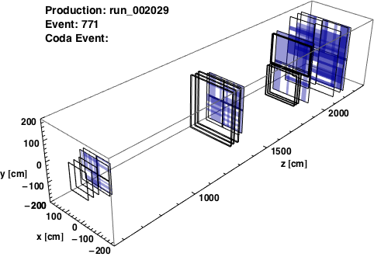
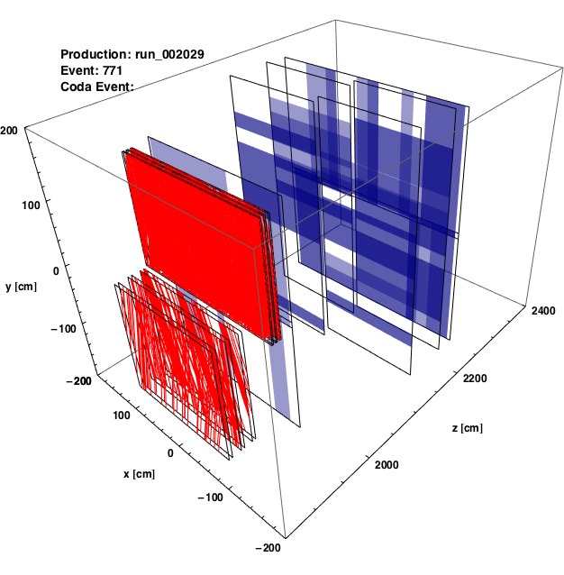
Commissioning Run 2012
Brief 2-month run after many interesting diversions
Large intensity variations within spill
  Caused entire detector to turn “on”
  More prominent in data with dimuon trigger than single muon trigger
DAQ TDC firmware not quite ready
  Lacked hardware zero suppression (zero suppression in front-end CPU)
  Large dead times, especially with large events
PMTs at St. 1 need better rate capabilities
Interim St. 1 and 3- Tracking
full detector (hodoscope hits)
Stations 3+4 (all hits)

Slide 3
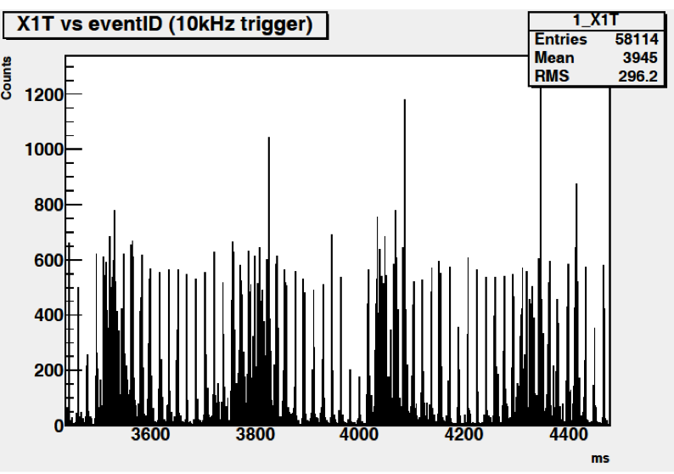
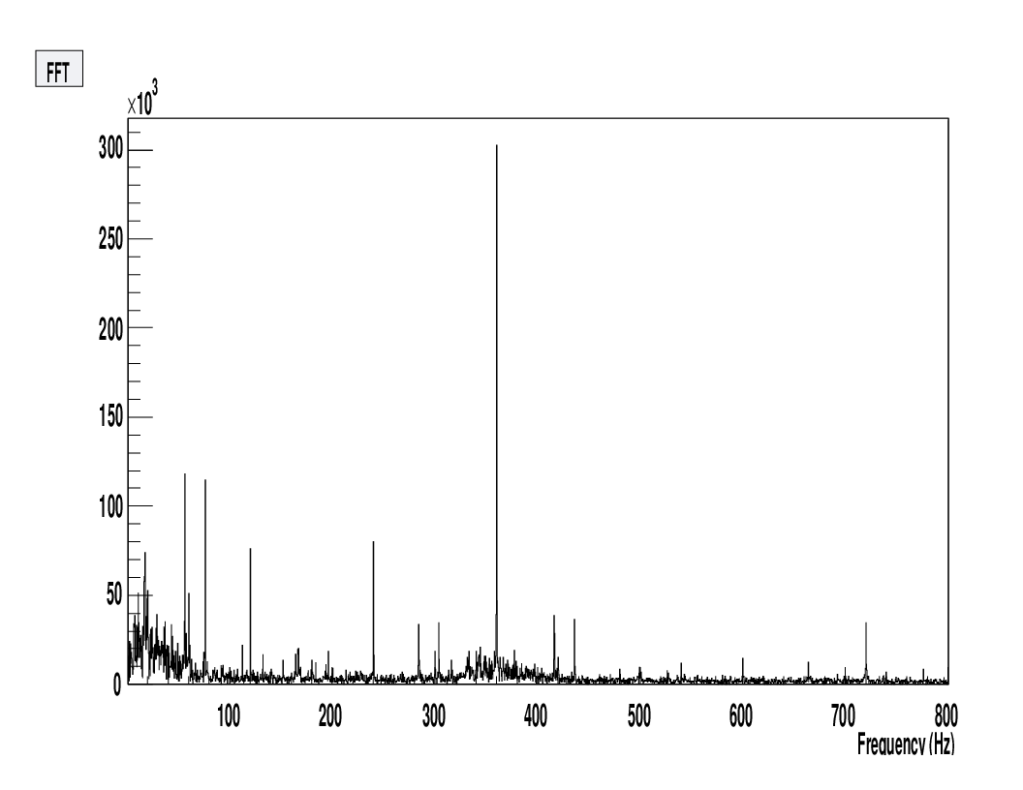
Commissioning Run
Average intensity normal, measured by beamline instrumentation
Independent 10kHz pulsed DAQ read out raw hodoscope rates
Bins are integrated counts over 100µs (≈5000 RF buckets)
Large variation in Instantaneous intensity, duty factor very low.
Periodic structure—Phase locked to AC 60 Hz
Conclusion:
  The MI extraction was also being commissioned.
AD believes that these problems have been addressed.
300 x 10³

Slide 4
“Splat” Block
A card was developed to keep a running average of the multiplicity over a 160 ns window (8 RF buckets).
If average multiplicity above threshold, raises a trigger veto
Luminosity greatly reduced, but trigger suppresses windows of time with large beam intensities.

Slide 5
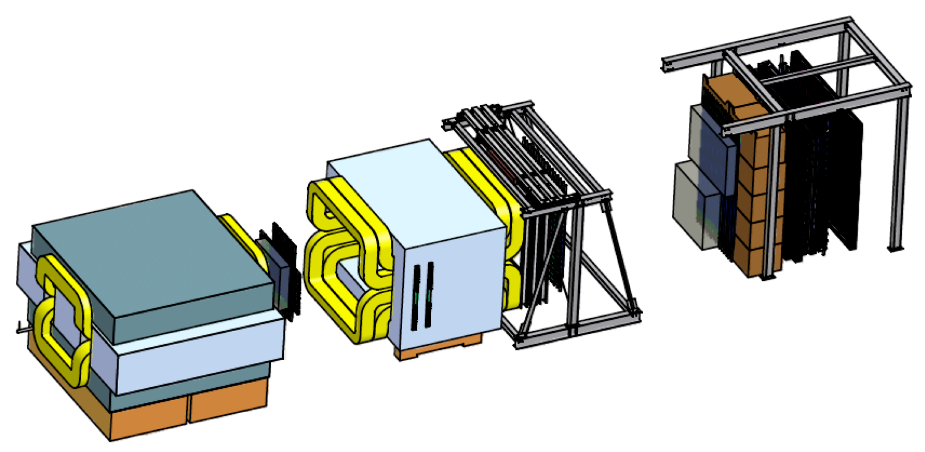
Shutdown Activities: Critical Operations
Beam Cherenkov & Duty factor veto
St. 3:
Reinstall St 3+
Complete and install St. 3-
St. 1
New PMT Bases
Tracking Chamber Repair
TDC Micro Code
new
DAQ:
Integrate new TDC

Slide 6
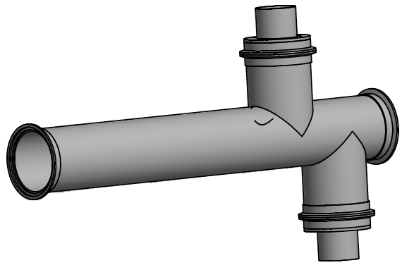
Beam Intensity Monitor
Input from N₂ Cerenkov Counter upstream of the targets. (NM3)
Three functions:
Instantaneous Luminosity—Event readout
  On trigger, output beam intensity for M rf buckets (number & offset from trigger are adjustable)
Spill readout
  At end of spill, output entire spill record + total intensity, intensity while DAQ dead, record of splat block. Feedback for MCC (used to produce FFT)
“Splat block”
  Compute running sum of beam intensity for N rf buckets (equivalent to an average)
  Inhibit triggers if sum>threshold
Readout
8-stage (ET 9215B) phototube w/fully transistorized base (large dynamic range)
Digitization by a QIE-10
  Clocked by Main Injector rf (53 MHz)
  10 bits output each clock cycle (~17-bit dynamic range)
Useful dynamic range: 400/bucket – 5.7M/bucket (ave = 10k/bucket @1.75E12 in 4sec)

Slide 7
Beam Intensity Monitor Status
Cerenkov design ~95% complete, fabrication ~50% complete.
  Well off critical path—vacuum bypass for maintanence
Phototube & base in hand.
  Will be rate tested at U. of I. in late Feb.
QIE-10p4s in hand & packaged.
  Plenty of spares
Readout module:
  Specification/conceptual design complete (will also be used by AD w/modified microcode – scintillation counter upstream of split between SeaQuest & Meson)
  Schematic design started this week; layout to follow.
    Expect ~3 weeks for layout; 1 week for verification.
  PCB production follows
    2 weeks for bids & production
  Assembly follows
    7 – 8 weeks to 1st complete module (~4/1)
  R/O tests will proceed in parallel with microcode testing after ~2 weeks of software development. → R/O tests start ~4/15.
  Commissioning with beam is expected to take 1 – 2 weeks after beam returns to NM4.

Slide 8
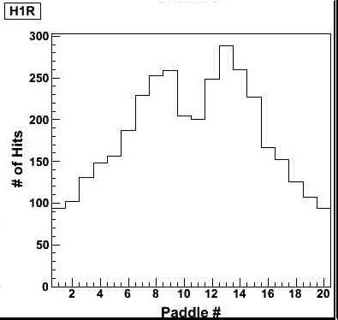
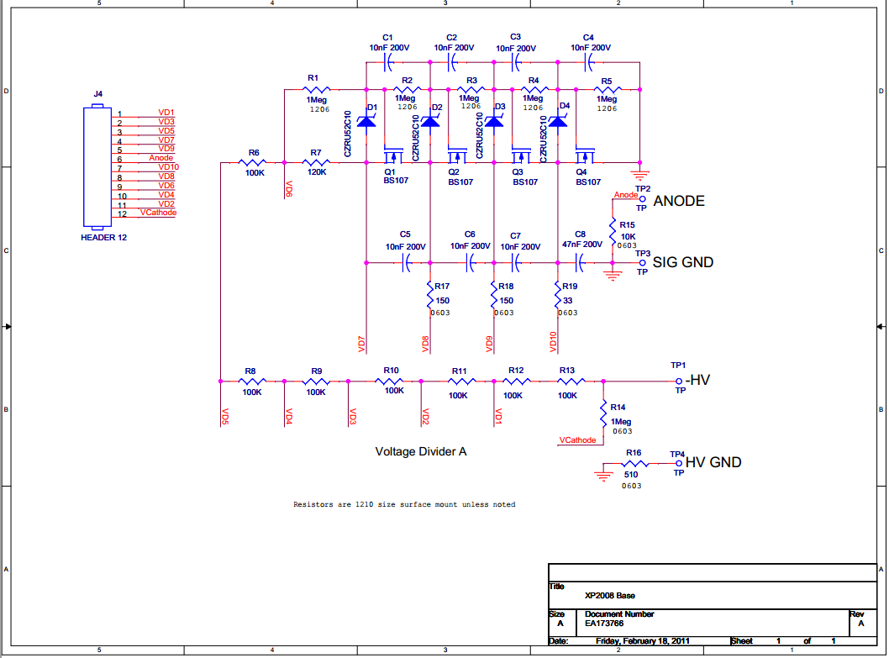
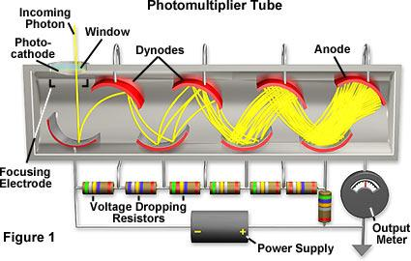
PMT Performance Sag
Anomalous drop in performance in high-intensity, high-rate events in the hot region of hodoscopes
PMT "sag" is due to signal current drawing away most of supply current
Causes destabilization of voltage diff. over latter dynode stages
Solution: New PMT base with
  Higher supply current draw
  Voltage stabilization features
Funding:
  Provided by Illinois at Urbana-Champaign
  $5,000 commitment for printed circuit boards
  Labor for construction and installation

Slide 9
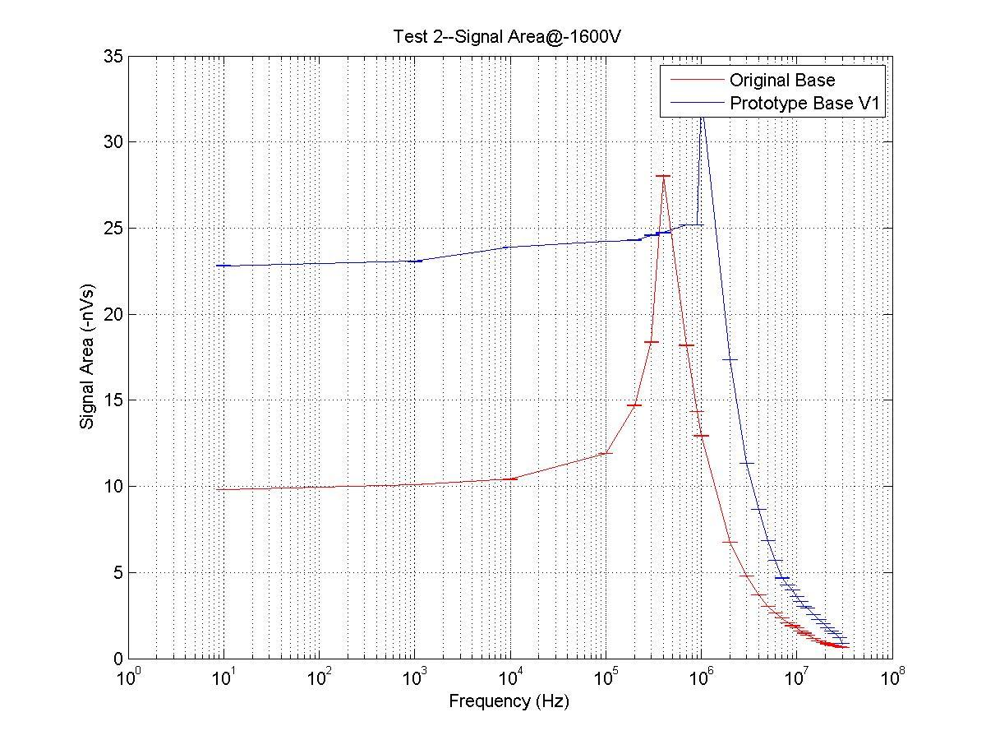
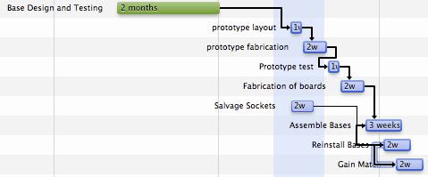
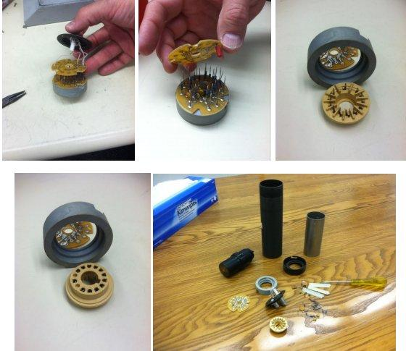
Prototype Development
Pulser tests of new and old base at UIUC
Prototype design provided by Fermilab
  Lower resistance (higher current)
  Transistorized dynode stages
  (voltage stabilization)
Optimal design of several variants chosen
  ~3x rate improvement
  ~2x amplitude improvement
  Now able to bypass amplifiers
1 May Comp.
1 Feb

Slide 10
New St. 1 Tracking
Current St. 1 Tracking was interim solution
New chamber constructed by Colorado
Wider (physically and kinematicly) acceptance—Critical for large x₂ bins
Chamber delayed for a variety of reasons, most associated with funding
Now under construction at Colorado
Will not be ready on 1 May 2013
Estimated completion date is July/August 2013
Installation will be scheduled depending on accelerator and experimental status.

Slide 11
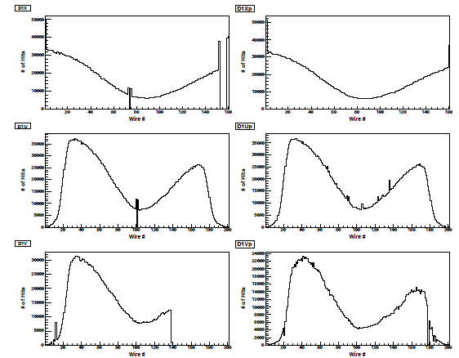
Old St 1 Tracking Repair
St1 Hit Distributions (run 2173)
Third of the D1V plane was dead.
Two identical sense planes; D1V and D1Vp. No half drift cell shift between them!
Two wires of D1X and one wire of D1U accidentally broke during Run I
The two planes were drawing steady high leak current during Run I.
As a solution that minimizes risk to the chambers:
  We will disconnect the broken wires from the HV bus for Run II data taking.
  This solution worked well with the two D1V wires that broke before Run I.

Slide 12
St. 1V/V’ repair
In January V/V’ chamber repair at Lab 6, two problems with D1V plane were solved:
Fixed the broken HV bus responsible of not getting any signal from a third of this plane.
Repair the two wires that were disconnected earlier from the HV bus.
Identical Sense Plane Investigation
Require un-stack more planes to reach the bottom sense plane.
Method of construction makes this difficult, risky and time consuming
  but we have done it before during E866 and prior to E906 commissioning run
Estimate a maximum of 15 days for disassembly, repair and
The V/Vp chamber could be moved to NM4 (half day task), hanged back on the spectrometer and cabled (half day task) on the last week of this month.
D1X/Xp and D1U/Up chambers will be pulled one by one to fix their high leak current issue on the NM4 loading dock
Bottom line—All work on temporary St. 1 chamber will be complete by April

Slide 13
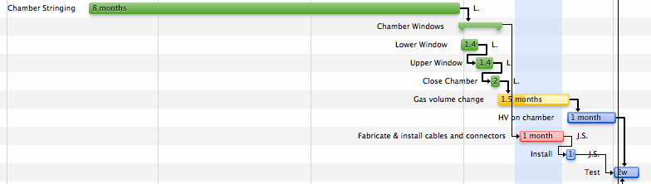
Tracking Station 3-
New St 3-
Part of initial plan, but insufficient funding profile to complete
Replaces old, smaller E866, 789, 772, . . . chamber that was in use
Identical to St. 3+ chamber manufactured by industry in Japan
Assembled at Fermilab Lab 6
Status:
- Work in gas volume complete | - fabrication of cables/connectors in progress
- Ar flowing in chamber | - HV “training” in April
- Install in SeaQuest Hall in April
15 April Comp.
1 Feb

Slide 14
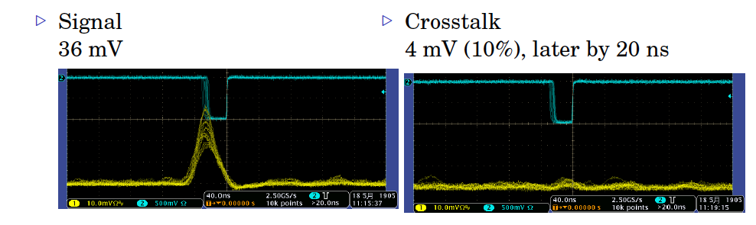
Tracking St. 3+ Cross Talk
Timing and simulation showed that cross talk was from a reflection due to impedance mismatch at end of wires
Simplest solution was to move the HV bus on the chamber
Verified with test-chamber and source at Tokyo Tech
Modifications complete on St. 3+ at SeaQuest Hall
Chamber is waiting to be reinstalled

Slide 15

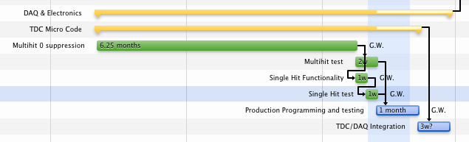
TDC Microcode Upgrade
Background:
SeaQuest uses a custom FPGA-based VME module for all DAQ—Academia Sinica
Modules may be programmed in many ways. SeaQuest using them as a multihit TDC
Microcode for commissioning run
  off board 0-suppression (extreme dead times)
  2.5 ns resolution (Not great, but OK for required resolution)
Upgrade:
0’s not recorded on board
0.44 ns (approx) resolution
Multihit Suppression
1 April Comp.
1 Feb

Slide 16
DAQ Modifications
Background:
CODA system written and maintained by JLab
VME-based Front ends
2 separate systems
  Event DAQ (or Main DAQ)
  Scaler DAQ for beam monitoring
Both DAQ systems used in previous run
Main DAQ
New event format from TDC micro code
Integration and testing scheduled in March (previous page)
Scaler DAQ (feedback to Accelerator on duty factor)
Added additional scalers (not a significant change)
Readout of Beam Intensity Monitor

Slide 17
Shutdown Activities: Other Activities
St. 4:
Service beam
Targets:
iFIX on Target Computer
Spare flasks
St. 1
New Chamber
Magnets:
Neutron blocking

Slide 18
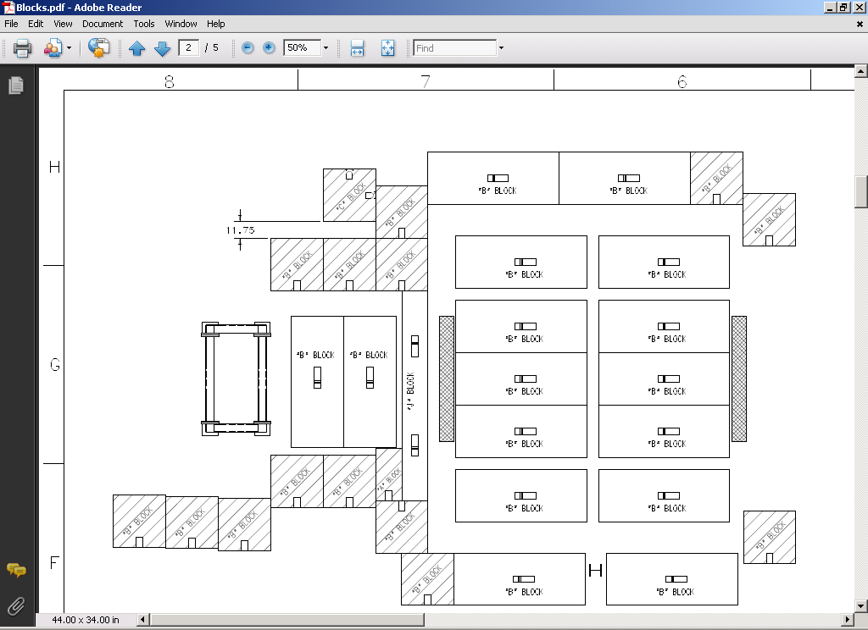
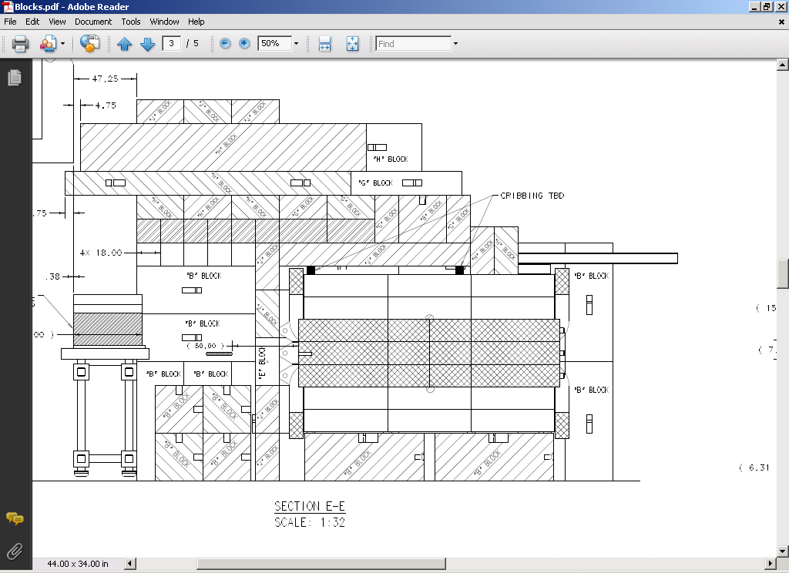
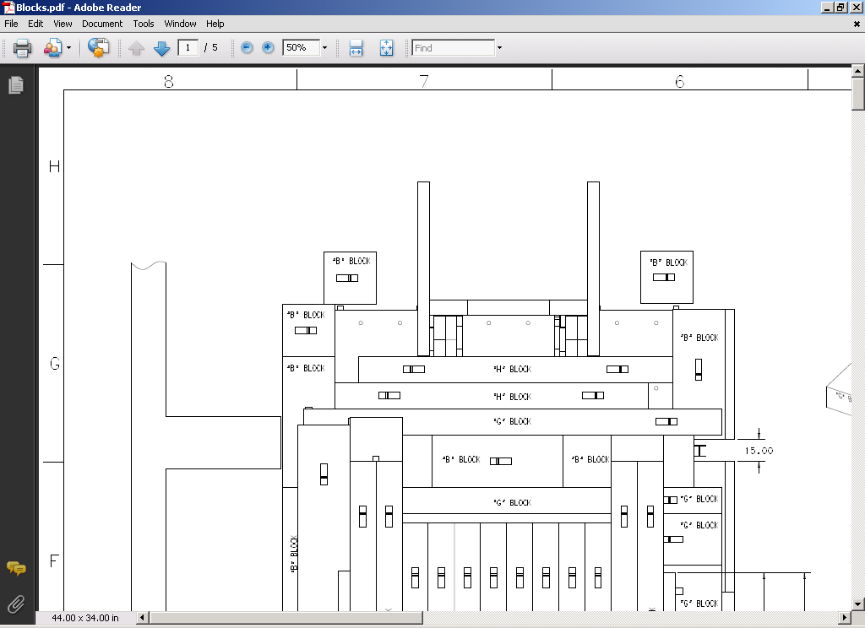
Blocking Openings
Plan View, Y= -72”
Elevation View, X=0
6 J-blocks
8-10 F-blocks
Between long. I-beams
5 J-blocks
Stabilized w/angle iron weld to I-beams
Top View
Hand-stacked concrete
5 J-blocks
Hand-stacked concrete
J-blocks
NOT Radiation Safety Shielding—Present Safety Assessment OK
Reduce Random hits at St. 1
“hand stacked” blocks done
Fill-in job for John Vorin’s group—not needed at beg. of run.
Approx. 3 days for 2 person crew.

Slide 19
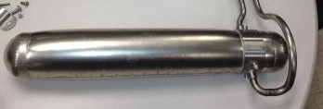
Targets
Cryogenic Flasks
Commissioning run had no spares
  E866 target flasks
Fabrication Set of 6 spares
  Significant development to regain skills lost at Fermilab
  Slightly different design
  4 of 6 complete (hydraulically tested), 2 additional under fabrication
  All 6 will need pneumatic testing
Computer monitoring of targets
Recent power outage revealed flaw
Computer and target system on UPS—Good
Computer on FNAL.gov network to access data from accelerator
Cannot logon without credentials obtained over network—which is down in power outage
Need 1 local (Kerberos-free login account) on this machine

Slide 20
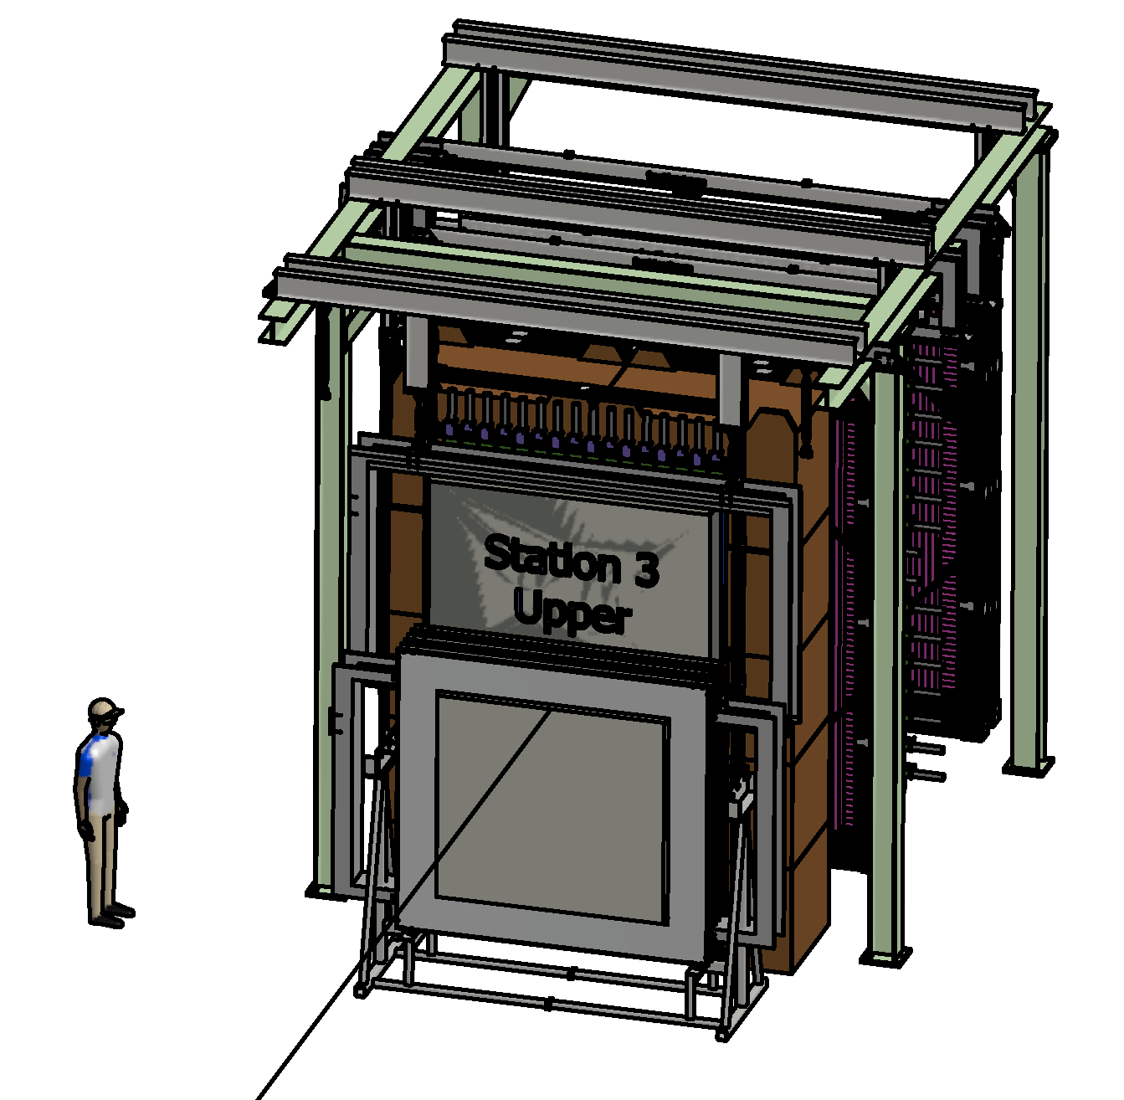
Service Beam
Add ability to roll out individual hodoscope planes for service
Already in Safety documentation
Also fill-in job for Vorin Techs

Slide 21
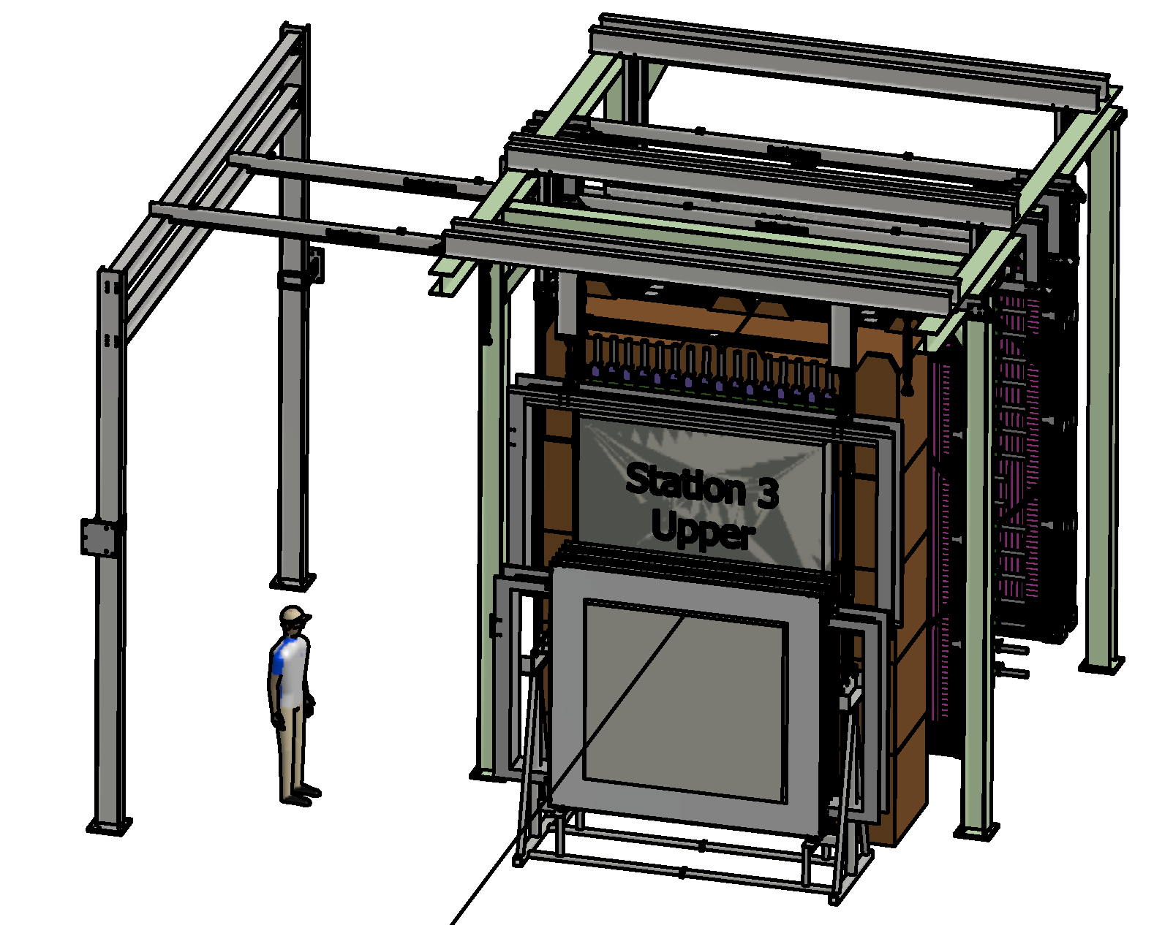
Service Beam
Add ability to roll out individual hodoscope planes for service
Already in Safety documentation
Also fill-in job for Vorin Techs

Slide 22
Concerns with Critical Items
Survey and alignment group
We—like everyone else—will need to know where our equipment is located
Cannot be done until equipment is in place
Best done in two phases, since some elements blocks the view of other elements.
Likely late March through April—when survey will be in high demand
PREP
SeaQuest depends heavily on PREP electronics as per or MOU
  Examples: LeCroy 1440 HV, NIM Logic/signal translation

Slide 23
Offline Software Status
Geometry and alignment from Run I well understood. Alignment procedure established
plane-by-plane alignment adjustments by iteration
plane-by-plane track residuals

Slide 24
Offline Software Status
Chamber calibrations from Run I complete.
Calibration procedure established
wire chamber drift correlations understood (to reject out-of-time events and resolve drift ambiguity)
time-to-distance mapping

Slide 25
Offline Software Status
Track reconstruction working for low-multiplicity data. Sufficient for monitoring kinematic coverage
measured single momentum spectrum consistent from expectations from MC
J/𝛹 peak observed in dimuon spectrum for low-multiplicity events

Slide 26
Data Storage and Processing
Depends significantly on beam quality
w/excellent beam quality, E866 give lower limit of 5 TB raw data
Currently we have approx. 40 TB of data space at SeaQuest.
Run I (03/07/12—04/30/12) | Run II (two years)
1TB of raw data | size++ | higher event rate
 | size-- | more compact format
 | → 12 TB of raw data → stored on dCache and local RAID
8TB of MySQL data productions file size domínated by hit information | size++ | higher event rate
 | size-- | storage of physics information only (substantial reduction)
 | → 10 TB of MySQL data → storage on FNAL and UIUC servers
real-time decoding | real-time decoding online tracking on sample full reconstruction on Grid

Slide 27
Commissioning Plans
Follow same plans as March-April 2012
Commissioning Team with representatives from each detector element
Approx. 6 weeks in 2012 run—presume it will be shorter now because:
  Better understanding of beam structure
  Better understanding of previously commissioned spectrometer elements

Slide 28
1 Commissioning before Beam
Operational Readiness Clearance (ORC) for entire spectrometer
Extended DAQ tests (runs for long periods at high and low rate)
Cosmic, source and pulse injection triggers to ensure all scintillator and wire chamber channels are working—need Working TDC’s
Scalers set up and ready
Geometry and alignment checks
  Measure as built
Target—All Still OK
Hodoscopes
  Cross Check Hodoscope and Trigger Mapping (once again)
  Gain match tubes
Trigger
  Sync timing of all triggers(v1495, NIM) –perhaps need beam
  Sync v1495 internal TDC with other TDCs—perhaps need beam

Slide 29
2. With tuning beam
FMag ON
KMag OFF
Accelerator Operators are in complete control of the program—we are parasitic to their getting beam to our experiment
Intensity & duty factor will be on a best effort basis
Beam Cherenkov
  PMT signal and voltage
  3 readout modes
DAQ commissioning in parallel with all work
  I would be ecstatic if it worked perfectly, but. . .
  Priority determined by Commissioning Team and Spokespersons
Scintillator Gain Checkout
  Hodoscopes as function of voltage or threshold (need CAMAC controller)
  efficiency calculation using well-tested hodoscope tracking, requiring KMAG off and so decoupled from wire-chamber commissioning determine thresholds to optimize efficiency
  re-gain-match PMT (to get rid of NIM amplifiers)?
  monitor efficiency (poor man's gain-monitoring)
Scintillator Timing
  In parallel with gain, but must check after gain measurement

Slide 30
2. With tuning beam
FMag ON
KMag OFF
NIM trigger timing (in parallel with FPGA trigger timing)
FPGA Trigger timing (in parallel with NIM trigger timing)
  Both need reasonably stable scintillator timing
Wire Chambers (in parallel with Hodoscopes as much as possible)
  Check Plateau chamber voltages
  Check TDC timing
  Straight through tracks
  Alignment
  Chamber efficiencies
  R-T curve calibration
Foil Activation/Beam Intensity calibration
  When?
    Worry about access/activation of target area
    Need for stable well tuned beam

Slide 31
Fermilab E906/Drell-Yan Collaboration
Abilene Christian University
Donald Isenhower, Tyler Hague, Rusty Towell, Shon Watson
Academia Sinica
Wen-Chen Chang, Yen-Chu Chen, Shiu Shiuan-Hal,
Da-Shung Su
Argonne National Laboratory
John Arrington, Don Geesaman*, Kawtar Hafidi,
Roy Holt, Harold Jackson, David Potterveld,
Paul E. Reimer*
University of Colorado
Ed Kinney, J. Katich, Po-Ju Lin
Fermi National Accelerator Laboratory
Chuck Brown, Dave Christian, JinYuan Wu
University of Illinois
Bryan Dannowitz, Markus Diefenthaler, Bryan Kerns, Naomi C.R Makins, R. Evan McClellan, Jen-Chieh Peng
KEK
Shin'ya Sawada
Ling-Tung University
Ting-Hua Chang
*Co-Spokespersons
Los Alamos National Laboratory
Gerry Garvey, Mike Leitch, Han Liu, Ming Liu, Pat McGaughey, Joel Moss, Andrew Puckett
University of Maryland
Betsy Beise, Kazutaka Nakahara
University of Michigan
Christine Aidala, Wolfgang Lorenzon, Richard Raymond, Josh Rubin, Michael Stewart
National Kaohsiung Normal University
Rurngsheng Guo, Su-Yin Wang
RIKEN
Yoshinori Fukao, Yuji Goto, Atsushi Taketani, Manabu Togawa
Rutgers University
Lamiaa El Fassi, Ron Gilman, Ron Ransome, Brian Tice,
Ryan Thorpe, Yawei Zhang
Tokyo Tech
Shou Miyaska, Ken-ichi Nakano, Florian Sanftl,
Toshi-Aki Shibata
Yamagata University
Yoshiyuki Miyachi

Slide 32
Fermilab E906/Drell-Yan Collaboration
Abilene Christian University
Donald Isenhower, Rusty Towell, Shon Watson
Army of Undergraduates
Academia Sinica
Wen-Chen Chang, Yen-Chu Chen, Shiu Shiuan-Hal,
Da-Shung Su
Argonne National Laboratory
John Arrington, Don Geesaman*, Kawtar Hafidi,
Roy Holt, Harold Jackson, David Potterveld,
Paul E. Reimer*
University of Colorado
Ed Kinney, J. Katich, Po-Ju Lin
Fermi National Accelerator Laboratory
Chuck Brown, Dave Christian, JinYuan Wu
University of Illinois
Bryan Dannowitz, Markus Diefenthaler, Bryan Kerns, Naomi C.R Makins, R. Evan McClellan, Jen-Chieh Peng
KEK
Shin'ya Sawada
Ling-Tung University
Ting-Hua Chang
*Co-Spokespersons
Los Alamos National Laboratory
Gerry Garvey, Mike Leitch, Kun Liu, Han Liu, Ming Liu, Pat McGaughey, Joel Moss
University of Maryland
Betsy Beise, Kazutaka Nakahara
University of Michigan
Christine Aidala, Wolfgang Lorenzon, Richard Raymond, Josh Rubin, Michael Stewart
National Kaohsiung Normal University
Rurngsheng Guo, Su-Yin Wang
RIKEN
Yoshinori Fukao, Yuji Goto, Atsushi Taketani, Manabu Togawa
Rutgers University
Lamiaa El Fassi, Ron Gilman, Ron Ransome, Arun Tadepalli Brian Tice, Yawei Zhang
Tokyo Tech
Shou Miyaska, Ken-ichi Nakano, Florian Sanftl,
Toshi-Aki Shibata
Yamagata University
Yoshiyuki Miyachi
Graduate Students, Postdocs and Research Scientists

Slide 33
Conclusion
SeaQuest will be ready to use beam
All elements of spectrometer in place by end of April
Critical item for Fermilab support is access to Survey Crew in late April/May.
Alignment and calibration procedures well established
Sufficient infrastructure to handle anticipated data
  depends on factors related to beam quality and detector performance
  relatively small (by Fermilab standards) data set, so we can expand
Data Analysis computing planned using Grid computing if necessary

Slide 34
Additional Slides

Slide 35
Shutdown Activities
St. 4:
Service beam
Targets:
iFIX on Target Computer
Spare flasks under construction
Cool down test December ‘12
St. 2:
No changes
Beam Cherenkov & Duty factor veto
St. 3:
Reinstall St 3+
Complete and install St. 3-
St. 1
New PMT Bases
Tracking Chamber Repair
New Chamber
Magnets:
Neutron blocking
Power test in March
TDC Micro Code
New
DAQ:
Integrate new TDC
Scaler Setup

Slide 36
Elevation View, X=0
6 J-blocks
8-10 F-blocks
Fit between longitudinal I-beams
5 J-blocks
Stabilized with angle iron and weld to I-beams
5 J-blocks

Slide 37
Plan View, Y= -72”

Slide 38
Top View
Hand-stacked concrete
Hand-stacked concrete
J-blocks

