Slide 1
DUNE Computing Requests for 2024
Computing Contributions Board Meeting
Heidi Schellman and Michael Kirby

Slide 2
Basics of the resource model
Keep raw data on disk for 1 year, on tape to end of expt.
For protoDUNE – 1 copy each at CERN/FNAL
For DUNE 1 copy at FNAL, 1 copy at other institutions
Reconstruct full sample every year (protoDUNE for 4 years, DUNE to end of expt.)
Do new simulation campaigns each year
Keep simulation and reconstructed data on disk for 2 years (always have 2 versions)
One copy in Americas, one in Europe where possible (model assumes 1.5 copies)
No need to stage from tape until it ages out
One copy of reconstruction/simulation -> tape as it can be redone if necessary.
CPU estimates are based on measurements from ProtoDUNE data and existing simulations ND estimates have large uncertainties.

Slide 3
Updates to the model
Delayed ProtoDUNE II operations until Spring 2024
With the successful large-scale FD simulation campaigns, we have considerably better understanding of both our processing time expectations and our simulation needs
not all of that additional information has been included in the model just yet (minor tweaks)
new estimates for FD processing time based upon multithreaded processing and subsequent smaller memory footprint
updated files sizes for reconstruction and simulation output – no longer estimate based upon retention of the raw waveforms in data or all rawdigits in the simulation
still working on understanding the GPU requirements for 2x2 and ND-LAr and how those estimates can be translated
We are transitioning from MWC to HEPScore23 (HS23) as the metric for CPU resources

Slide 4
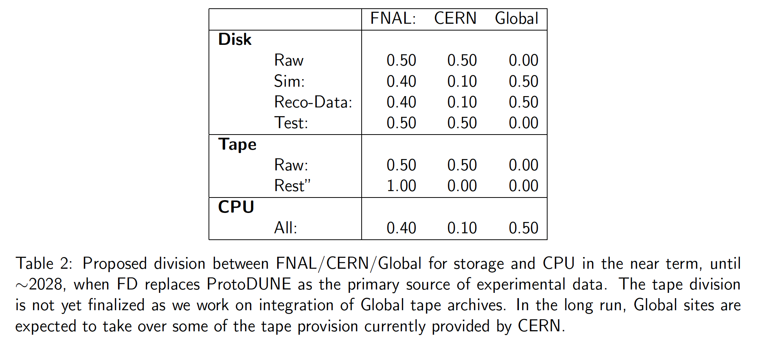
Proposed divisions between nations/labs
Global here means non-CERN, non-FNAL.
Includes other US national labs

Slide 5
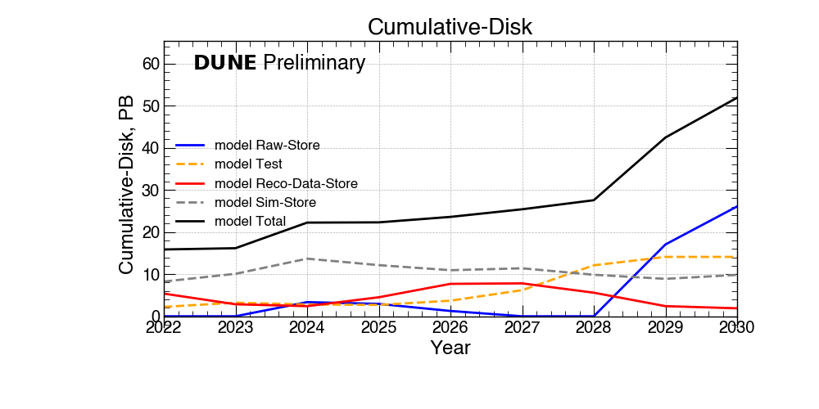
Projected Disk Needs Needs

Slide 6
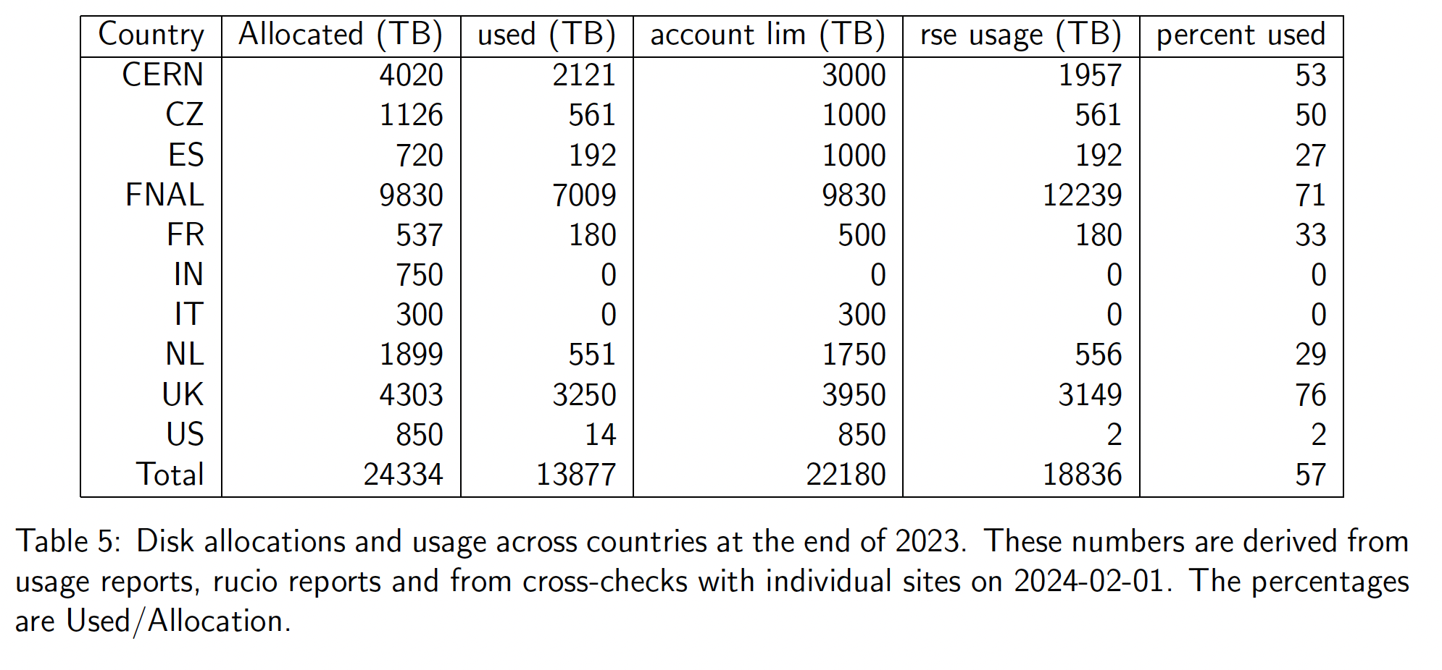
Summary of allocation/use as of February 1
Data from Physical disk reports and Rucio
Rucio allocations and physical sizes – TiB vs TB in some cases?

Slide 7
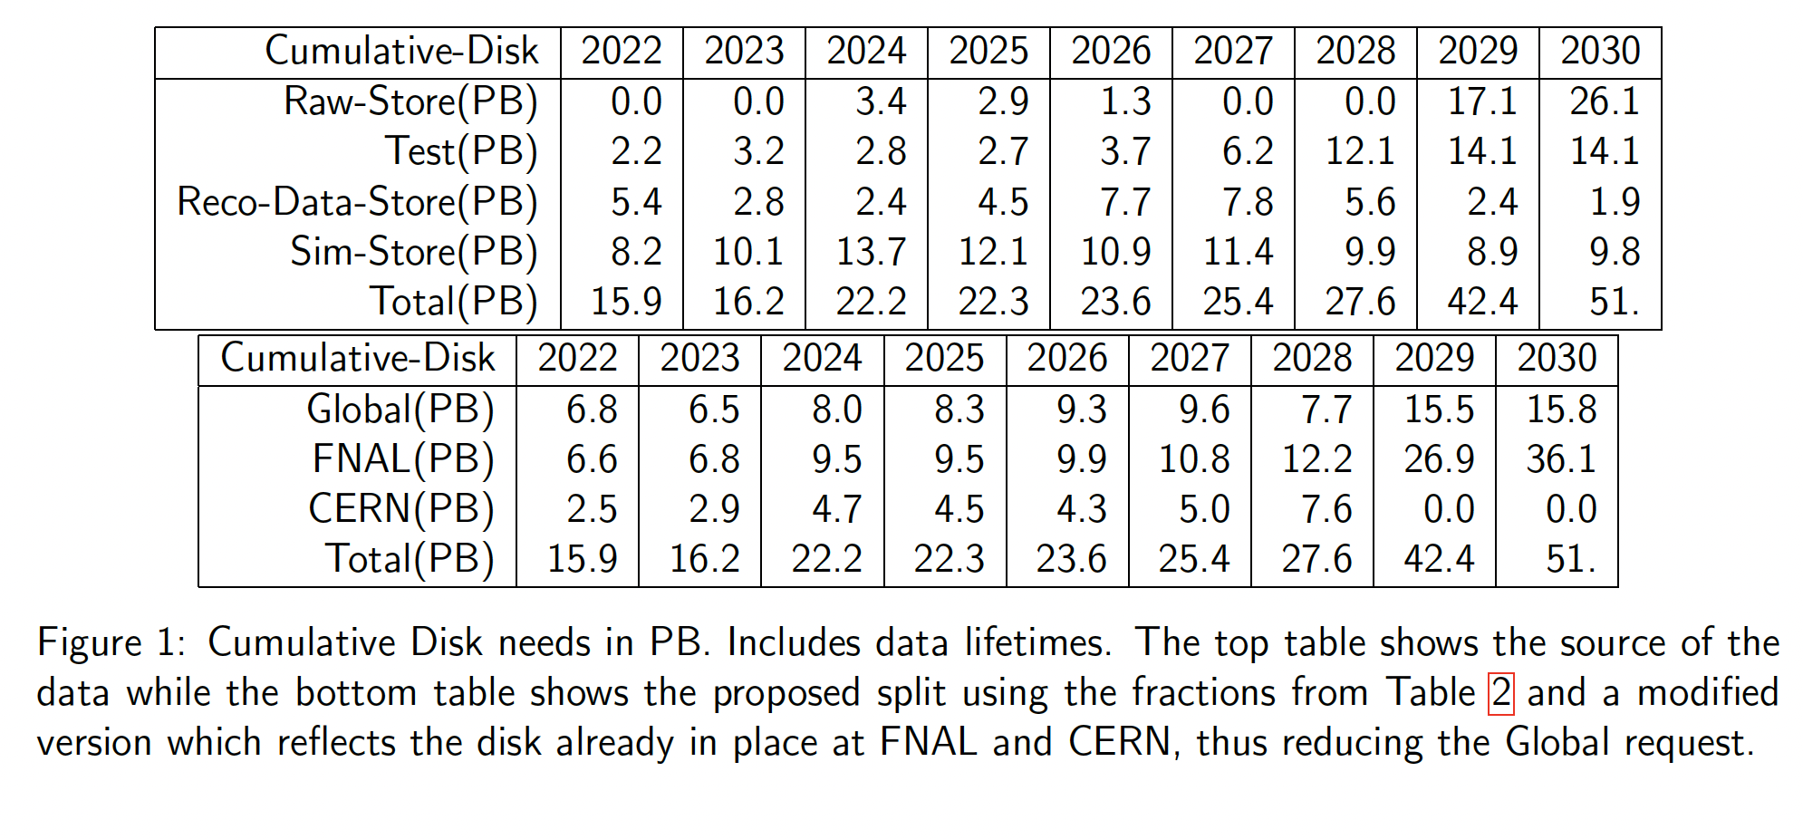
Disk requests from the model

Slide 8
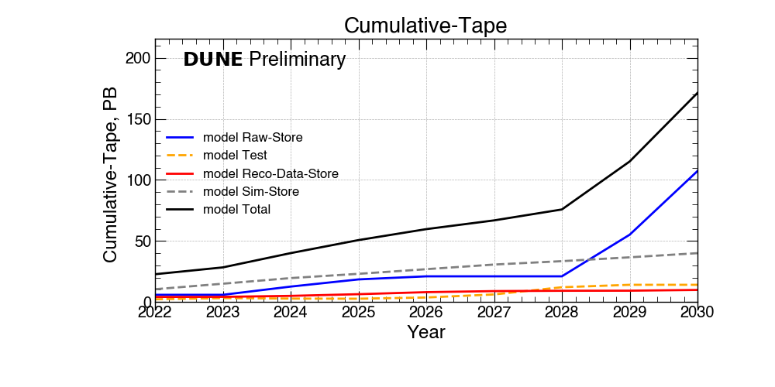
Projected Tape Needs

Slide 9
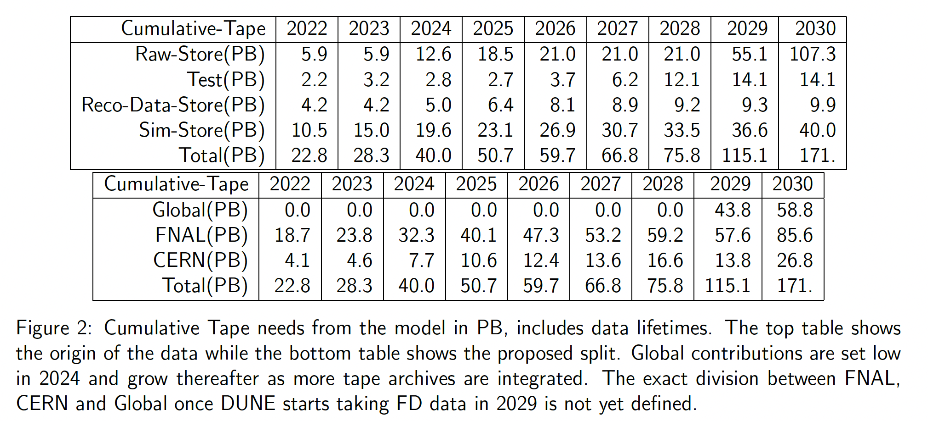
Numbers for tape needs

Slide 10
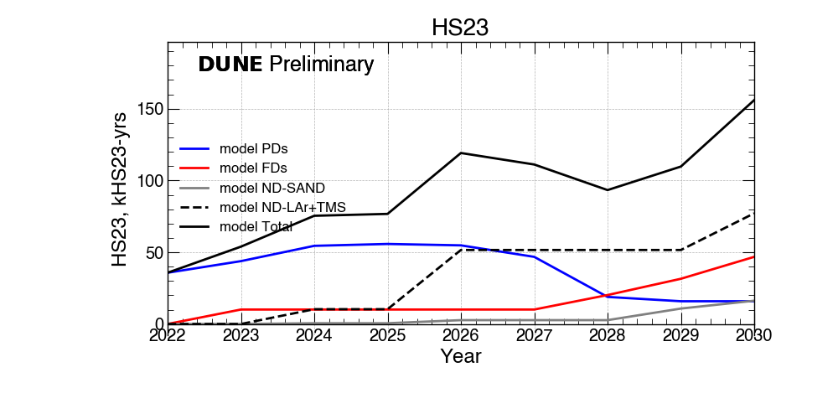
Projected CPU needs updated to HS23

Slide 11
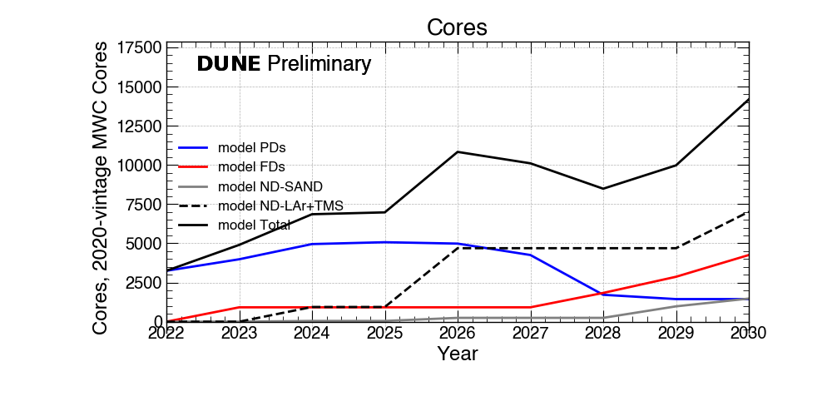
CPU needs in cores

Slide 12
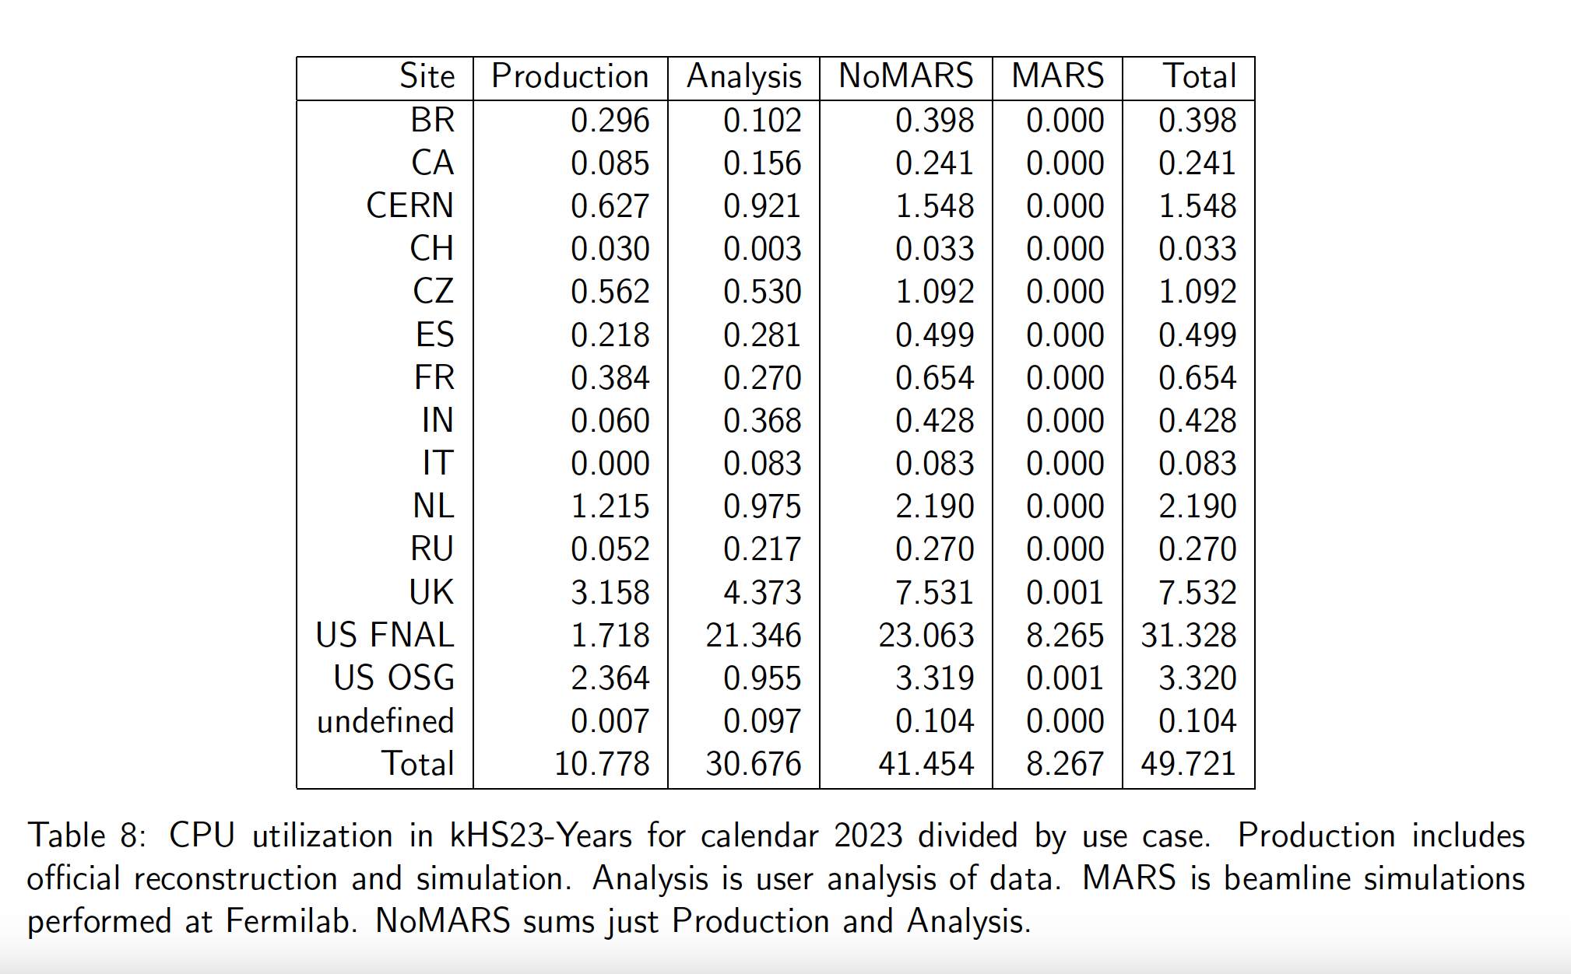
Actual CPU usage in 2023

Slide 13
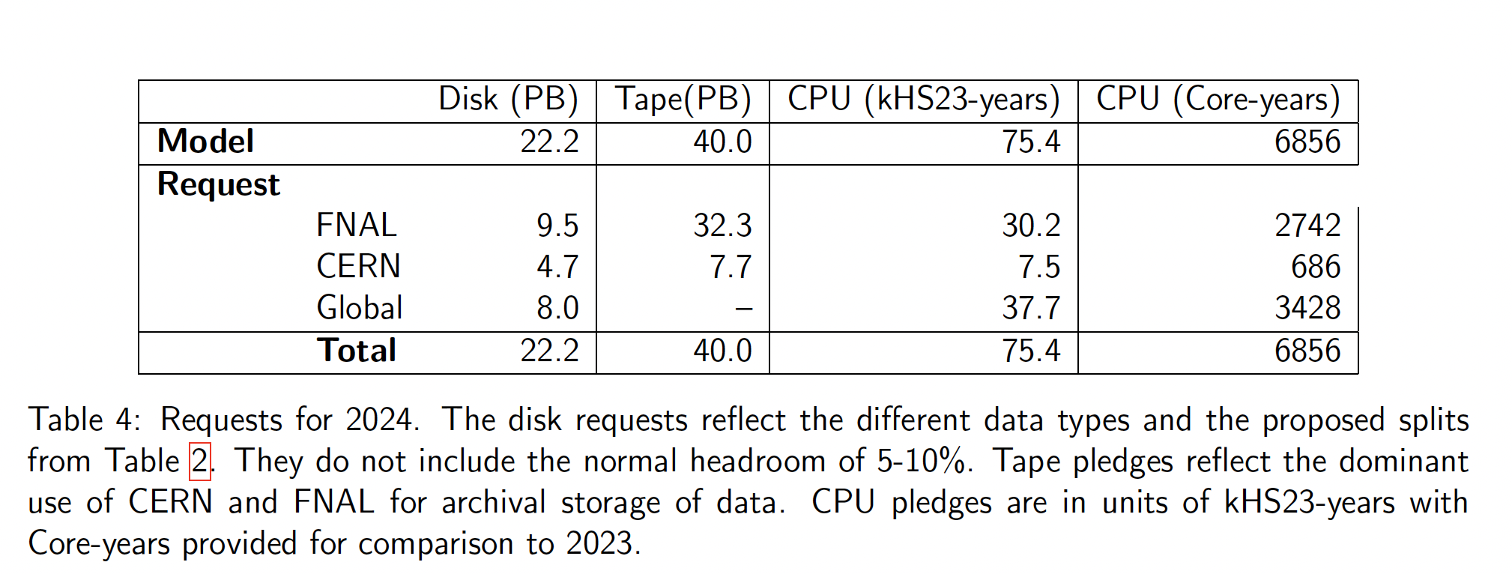
Summary of DRAFT request for 2024
Disk request includes existing FNAL and CERN contributions
Tape request reduced to 100 TB from Global sites for testing, will increase in later years.
CPU request is no-longer memory-weighted, assumes data taking in 2024.

Slide 14
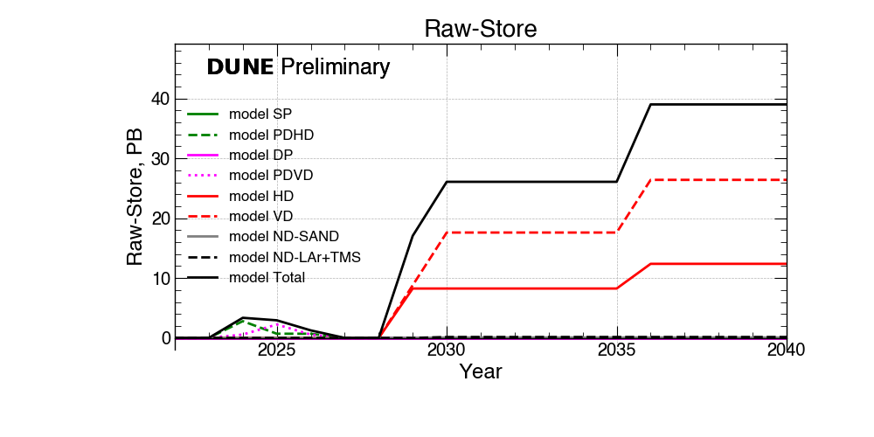
The longer term
We are still doing R+D on Near Detector Computing and optimizing Far Detector codes.
As a result, CPU estimates are difficult
But storage is largely driven by raw data. This shows estimated raw data per year
Cumulative needs on the next slide.

Slide 15
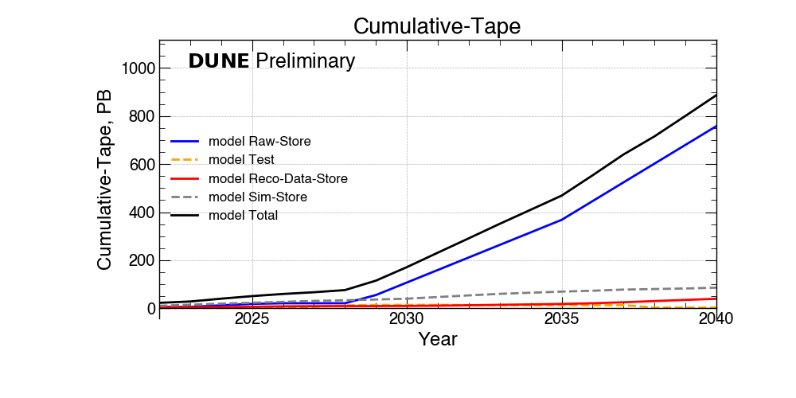
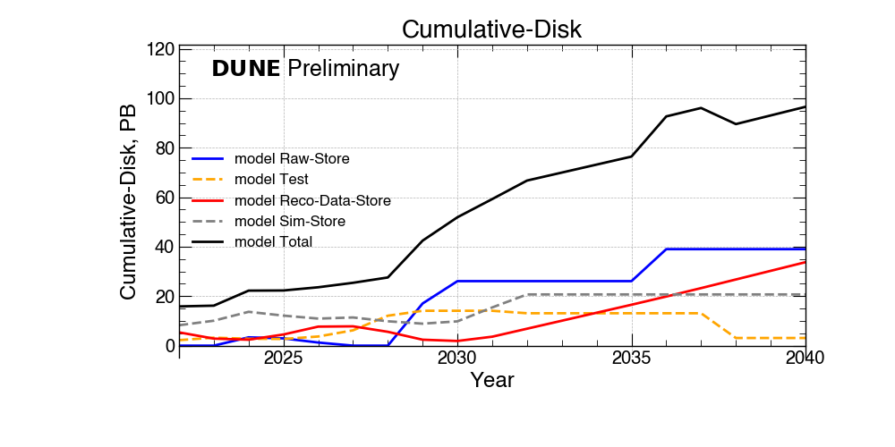
Cumulative storage projections
These are rough estimates
Include a 3rd detector added in 2036
With testing/calibration of that detector causing a short-term blip in maximum disk needs

