Slide 1
Safety Assessment Document Updates for DOE O 420.2D
SAD Section III Chapter 01 - Linac
John Stanton
Accelerator Readiness Review
19 – 21 March 2024

Slide 2
Outline
Linac Overview
Hazard Inventory
Non-Accelerator Specific Hazards
Accelerator Specific Hazards
Maximum Credible Incident (MCI) Discussion
Summary of Credited Controls

Slide 3
Outline
Linac Overview
Hazard Inventory
Non-Accelerator Specific Hazards
Accelerator Specific Hazards
Maximum Credible Incident (MCI) Discussion
Summary of Credited Controls

Slide 4
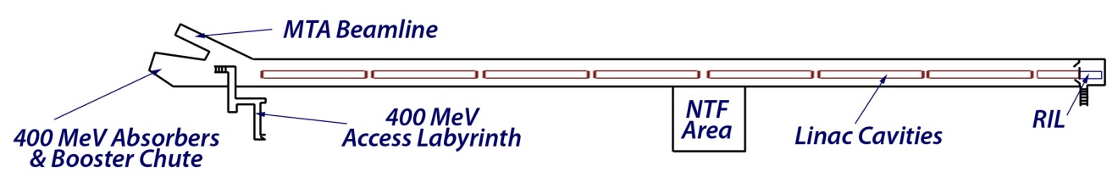
Linac Overview
SCL Cavities
DTL Cavities
Radio Frequency Quadrupole Injection Line (RIL) is the Linac front end
  Contains two 35 keV magnetron sources
  Followed by a 750 keV Radio-Frequency Quadrupole (RFQ)

Slide 5
Linac Overview
SCL Cavities
DTL Cavities
First 80 m of the Linac is the Drift Tube Linac (DTL)
  It is made up of five 201.25 MHz cavities, referred to as tanks
  Accelerates the beam from 750 keV to 116 MeV

Slide 6
Linac Overview
SCL Cavities
DTL Cavities
Neutron Therapy Facility (NTF) was an extraction area
  Beamline splits off from Linac between DTL Tank 4 and DTL Tank 5
  Beam was extracted at 66 MeV and sent to a target area
  NTF is now Non-Operational

Slide 7
Linac Overview
SCL Cavities
DTL Cavities
Last 120 m of the Linac is the Side Coupled Linac (SCL)
  It is made up of seven 805 MHz modules
  Accelerates the beam from 116 MeV to 400 MeV

Slide 8
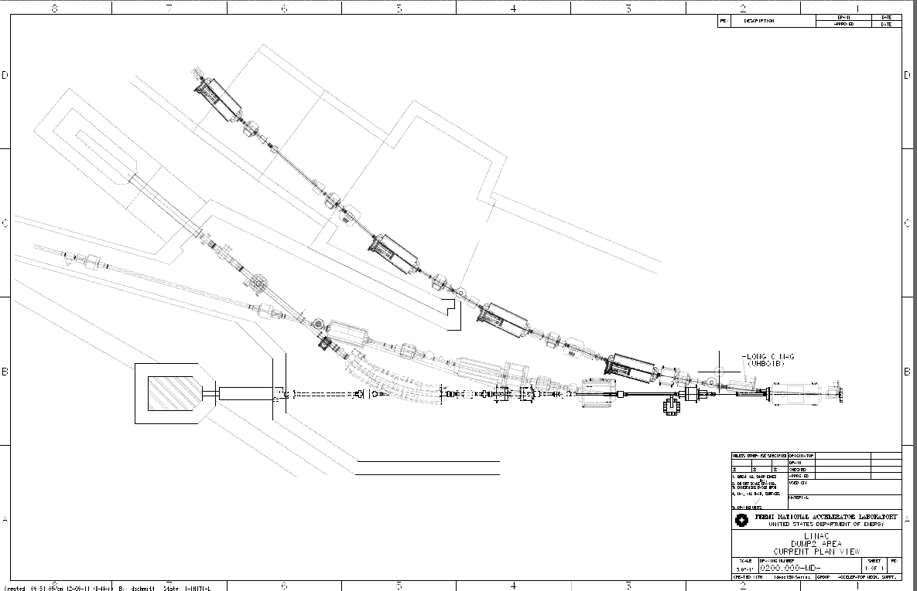
Linac Overview
SCL Cavities
DTL Cavities
There are four possible extraction areas for Linac beam at 400 MeV:
  Booster synchrotron accelerator
  Either of two Beam Absorbers
  400 MeV Test Area (MTA)
    Begins with two C magnets that extract beam from Linac
    Separate segment discussed in SAD Section III Chapter 02
MTA Beam Line
Beam absorber #2:
Momentum Absorber
Transfer line to
Booster synchrotron
Beam absorber #1:
Straight Ahead Absorber

Slide 9
Outline
Linac Overview
Hazard Inventory
Non-Accelerator Specific Hazards
Accelerator Specific Hazards
Maximum Credible Incident (MCI) Discussion
Summary of Credited Controls

Slide 10
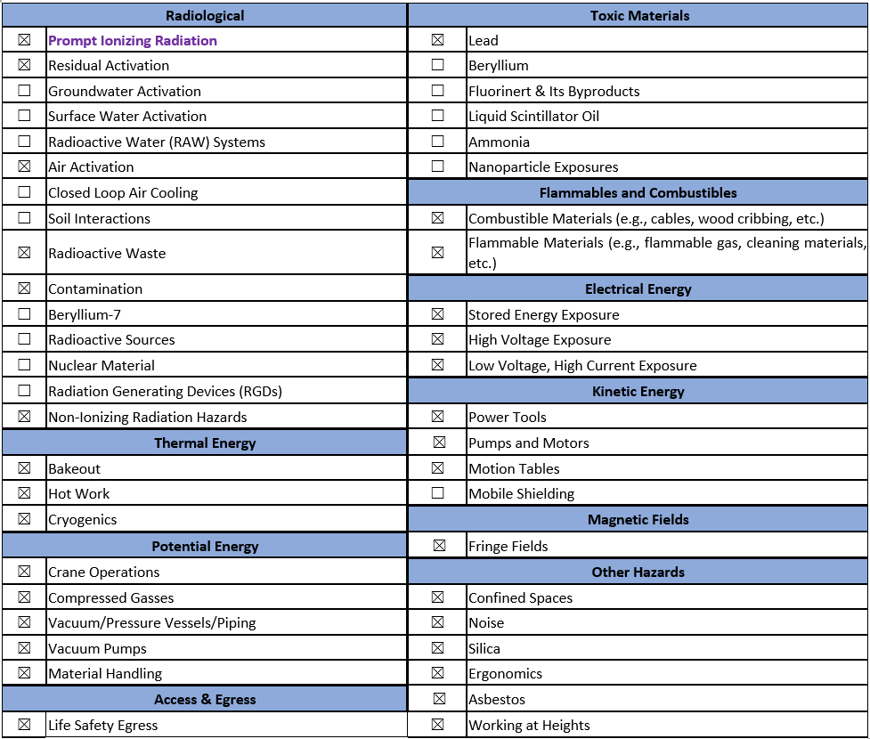
Hazard Inventory for Linac
Accelerator specific hazards are purple
Hazards not discussed today are evaluated via the common Risk Matrix tables
  Covered in SAD Section I, Chapter 4
Hazards evaluated via risk assessment methodology per DOE-HDBK-1163-2020
  Likelihood (L):
    Anticipated (A),
    Unlikely (U),
    Extremely Unlikely (EU), Beyond Extremely Unlikely (BEU)
  Consequence (C):
    High (H), Moderate (M), Low (L), Negligible (N)
  Risk (R):
    I , II, III, IV (descending order of concern)

Slide 11
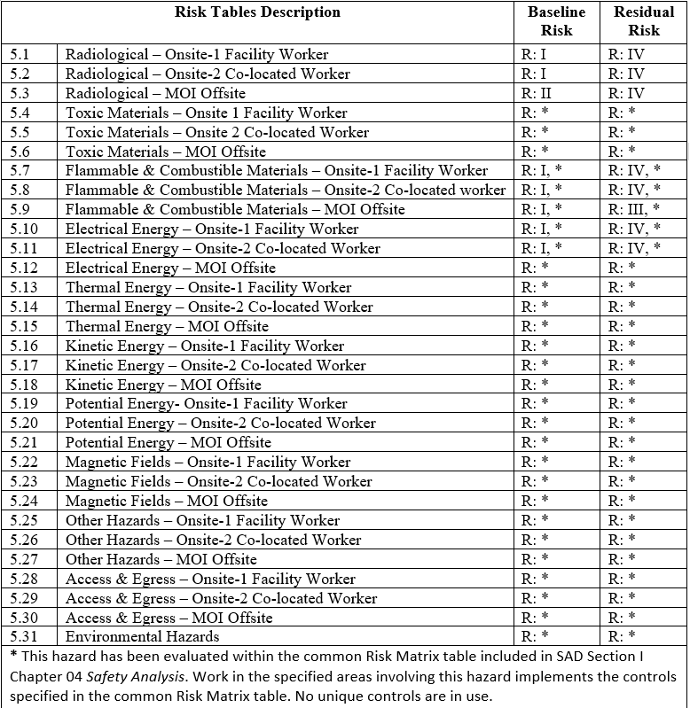
Risk Table Summary Page

Slide 12
Outline
Linac Overview
Hazard Inventory
Non-Accelerator Specific Hazards
Accelerator Specific Hazards
Maximum Credible Incident (MCI) Discussion
Summary of Credited Controls

Slide 13
Non-Accelerator Specific Hazards - Radiological
Residual Activation
  High intensity beam delivery will produce activated materials inside the Linac enclosure
  The residual dose rate found in the Linac from initial entry surveys is historically less than 5 mrem/hr, exceptions include:
    <20 mrem/hr at the transition region between the DTL and SCL
    <200 mrem/hr at the Lambertson magnet, which sets the start of the 400 MeV transfer line to the Booster synchrotron
Baseline Qualitative Risk (without controls) | Controls Preventive (P)/Mitigative (M) | Residual Qualitative Risk (with controls)
L: A C: H R: I | P – Employee Rad Worker training P – ALARA plan M – Shielding to reduce activation M – Proper dosimetry | L: EU C: L R: IV

Slide 14
Non-Accelerator Specific Hazards - Radiological
Air Activation
  High intensity beam delivery can interact with air in the Linac enclosure
Baseline Qualitative Risk (without controls) | Controls Preventive (P)/Mitigative (M) | Residual Qualitative Risk (with controls)
L: A C: H R: I | P – Air Monitoring P – Radiation Safety Interlock System P – Beam loss Monitoring M – Engineered air flow to dilute activated air and provide cool off (decay) time prior to release. Enclosure air flow design to give the activated air time to decay before exiting the enclosure. M – Run Conditions | L: BEU C: L R: IV

Slide 15
Non-Accelerator Specific Hazards - Radiological
Radioactive Waste
  Radioactive waste produced during Linac operations will be managed within the established Radiological Protection Program (RPP) as prescribed in the Fermilab Radiological Control Manual (FRCM)
Baseline Qualitative Risk (without controls) | Controls Preventive (P)/Mitigative (M) | Residual Qualitative Risk (with controls)
L: A C: H R: I | P – Postings P – Beam tuned to reduce beam loss M – Shielding to reduce generation of waste M – Material survey and release process | L: EU C: L R: IV

Slide 16
Non-Accelerator Specific Hazards - Radiological
Contamination
  Although not typically encountered, contamination has been noted previously at the 400 MeV extraction region
Baseline Qualitative Risk (without controls) | Controls Preventive (P)/Mitigative (M) | Residual Qualitative Risk (with controls)
L: A C: H R: I | P – Radiological controls personnel survey and decontamination P – Postings place in the event contamination is identified M – Shielding to reduce activation M – Proper PPE specified in RWP | L: EU C: L R: IV

Slide 17
Non-Accelerator Specific Hazards - Radiological
Non-Ionizing Radiation – Radio-Frequency (RF)
  Hazardous levels of RF electromagnetic energy are generated by the RF power sources in the Linac
Baseline Qualitative Risk (without controls) | Controls Preventive (P)/Mitigative (M) | Residual Qualitative Risk (with controls)
L: A C: M R: II | P – RF Shielding P – ES&H periodic monitoring P – LOTO procedure performed by facility worker P – Affected area postings | L: BEU C: M R: IV

Slide 18
Non-Accelerator Specific Hazards - Radiological
Non-Ionizing Radiation – Laser (Class 3B and 4)
  The Linac Laser Notcher (LLN) System installed at the downstream end of the 750 keV RFQ
Baseline Qualitative Risk (without controls) | Controls Preventive (P)/Mitigative (M) | Residual Qualitative Risk (with controls)
L: A C: H R: I | P – Class 1 (light tight) enclosures P – ORC and work planning processes P – Locked/Interlocked system P – LOTO procedure or other procedure approved by the LSO P – Affected areas are posted M – Use of PPE | L: BEU C: M R: IV

Slide 19
Non-Accelerator Specific Hazards - Radiological
Non-Ionizing Radiation – Laser (Class 3R)
  The Linac Laser Notcher (LLN) System installed at the downstream end of the 750 keV RFQ
Baseline Qualitative Risk (without controls) | Controls Preventive (P)/Mitigative (M) | Residual Qualitative Risk (with controls)
L: A C: L R: III | No analysis required | L: A C: L R: III

Slide 20
Non-Accelerator Specific Hazards - Radiological
Non-Ionizing Radiation – Laser (Class 1 and 2)
  The Linac Laser Notcher (LLN) System installed at the downstream end of the 750 keV RFQ
Baseline Qualitative Risk (without controls) | Controls Preventive (P)/Mitigative (M) | Residual Qualitative Risk (with controls)
L: A C: N R: IV | No analysis required | L: A C: N R: IV

Slide 21
Non-Accelerator Specific Hazards –
Flammable & Combustible Materials
Flammable Materials
  The injector source installation contains less than 0.6 kg or 250 standard cubic feet (SCF) of hydrogen which corresponds to a Flammable Gas Risk Class 0 area in accordance with the Fermilab Environment, Safety and Health Manual (FESHM).
Baseline Qualitative Risk (without controls) | Controls Preventive (P)/Mitigative (M) | Residual Qualitative Risk (with controls)
L: A C: H R: I | P – Biannual leak inspections M – Hydrogen leak detectors M – Fire department response | L: U C: L R: III

Slide 22
Non-Accelerator Specific Hazards - Electrical
Stored Energy Exposure
  The modulators for the 201.25 and 805 MHz RF systems represent sources of high stored electrical energy
  Replacement capacitors for Linac RF systems can passively store charge when unattended and present a shock hazard if not properly stored
Baseline Qualitative Risk (without controls) | Controls Preventive (P)/Mitigative (M) | Residual Qualitative Risk (with controls)
L: A C: M R: II | P – Store capacitors with terminals grounded P – Capacitor storage away from common areas P – Electrical worker training | L: BEU C: M R: IV

Slide 23
Non-Accelerator Specific Hazards - Electrical
Low Voltage, High Current Exposure - Burns
  Both the 7835 & 4616 power tubes for DTL RF systems have high current filament power supplies with exposed conductors which could cause burns if contacted
Baseline Qualitative Risk (without controls) | Controls Preventive (P)/Mitigative (M) | Residual Qualitative Risk (with controls)
L: U C: M R: II | P – Insulating guards/closed cabinets prevent incidental contact P – Electrical worker training P – Removal of metallic jewelry P – Conductors are posted as: “Caution High Current” | L: BEU C: M R: IV

Slide 24
Non-Accelerator Specific Hazards - Electrical
Low Voltage, High Current Exposure – Arc Flash
  Both the 7835 & 4616 power tubes for DTL RF systems have high current filament power supplies with exposed conductors which could result in arc flash
Baseline Qualitative Risk (without controls) | Controls Preventive (P)/Mitigative (M) | Residual Qualitative Risk (with controls)
L: U C: H R: I | P – Insulating guards/closed cabinets prevent incidental contact P – Electrical worker training P – Conductors are posted as: “Caution High Current” M – Overcurrent protection | L: BEU C: M R: IV

Slide 25
Outline
Linac Overview
Hazard Inventory
Non-Accelerator Specific Hazards
Accelerator Specific Hazards
Maximum Credible Incident (MCI) Discussion
Summary of Credited Controls

Slide 26
Accelerator Specific Hazards - Radiological
Prompt Ionizing Radiation – Beam Loss
  Ionizing radiation due to beam loss in the Linac enclosure
  Analyzed maximum credible incident (MCI) to determine credited controls

Slide 27
Outline
Linac Overview
Hazard Inventory
Non-Accelerator Specific Hazards
Accelerator Specific Hazards
Maximum Credible Incident (MCI) Discussion
Summary of Credited Controls

Slide 28
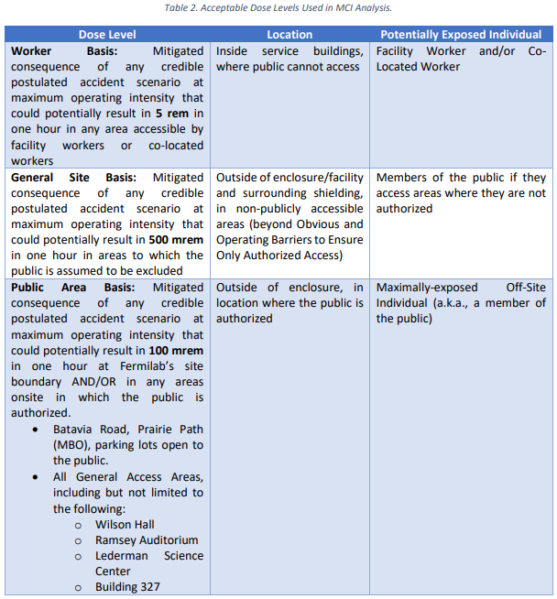
Maximum Credible Incident (MCI) – Radiological
The MCI analysis determines the worst-case exposure to an individual due to prompt ionizing radiation from beam loss
Incident bounds all postulated accident scenarios for the Linac
Fermilab uses Credited Controls that flow down to the Accelerator Safety Envelope (ASE) to mitigate the consequences of an MCI to the following conditions:

Slide 29
Maximum Credible Incident (MCI) – Radiological
The MCI for the Fermilab Linac is a beam with a theoretical maximum intensity persistently incident on a beamline component
Maximum intensities are defined separately for the DTL and SCL and are a product of the following parameters:
  130 mA beam current from ion source
    Child Langmuir Limit (space charge limit) out of the Ion Source based on the extraction gap
  15 Hz repetition rate
    Hardware limit of ion source arc modulator, ion source gas valve pulser, Marx modulator and quadrupole power supplies
  60 µs beam pulse length through the SCL
    Pulse length limit of the SCL cavities
  116 µs beam pulse length through the DTL
    Pulse length limit of the RFQ
  RFQ design efficiency of 98%
  Linac transmission efficiency of 100%

Slide 30
Maximum Credible Incident (MCI) – Radiological
These values contribute to the following calculations for the maximum credible beam intensities of the Linac:
  Through the DTL (beam energy 750 keV to 116 MeV):
    130mA * 0.98 * 15Hz * 116µs * 2.25E13 (conversion factor) = 4.98E18 protons/hour
  Through the SCL (beam energy 116 MeV to 400 MeV):
    130mA * 0.98 * 15Hz * 60µs * 2.25E13 (conversion factor) = 2.58E18 protons/hour
The Linac MCI Justification document evaluates the consequences of an MCI beam loss event for both the DTL and SCL intensities
  Utilizes MARS simulations and measurements from previous shielding assessments to determine dose rates during an event
  Determines credited control trip limits for interlocked radiation detectors to protect individuals during an event to the previously defined levels

Slide 31
Outline
Linac Overview
Hazard Inventory
Non-Accelerator Specific Hazards
Accelerator Specific Hazards
Maximum Credible Incident (MCI) Discussion
Summary of Credited Controls

Slide 32
Credited Controls – Passive Engineering
Credited Control: Permanent Shielding
  Shielding between the interior surface of the enclosure walls and the surface of the berm up to 9.6 effective feet of dirt.
  The wall between the Linac enclosure and the Linac upper and lower gallery.
Credited Control: Movable Shielding
  The concrete block wall separating the Linac enclosure and the ITA experimental hall.
Credited Control: Penetration Shielding
  Concrete shielding blocks that fill the utility and RF waveguide penetrations between the Linac enclosure and the lower Linac gallery.
  Poly beads that fill the upper waveguide penetrations for the 400 MeV Linac upgrade.

Slide 33
Credited Controls – Active Engineering
Credited Control: Radiation Safety Interlock System (RSIS)
  Inhibits beams using controlled redundant critical devices
  Enforces the Search and Secure process
  Uses interlock hardware to ensure personnel are not within the area and to establish the Exclusion Area prior to beam operations
  Uses interlock hardware to maintain the Exclusion Area and prevent inadvertent access during beam operations
  Uses interlocked radiation detectors in areas that do not have adequate permanent shielding to protect an individual outside of the shielding during beam operations

Slide 34
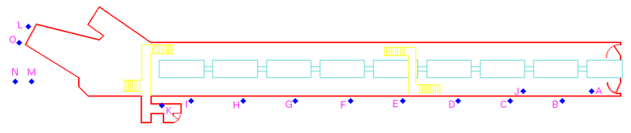
Credited Controls – Active Engineering
Interlocked Radiation Detectors
  Linac does not have enough shielding for the MCI, interlocked radiation detectors are required
  The credited control trip limits for these interlocked radiation detectors are sufficient to protect against the MCI
    These are maximum values, not the levels at which we operate
  Trip levels are set by the Radiation Physics Operations Department (RPO) to satisfy occupancy requirements per 10 CFR Part 835
Detector Location | CC Limit (mrem/hr)
A: Linac Enclosure Tank #1 | 1000
B: Linac Gallery Tank #2 | 250
C: Linac Gallery Tank #3 | 250
D: Linac Gallery Tank #4 | 250
E: Linac Gallery Tank #5 | 250
F: Linac Gallery Tank #6 | 90
G: Linac Gallery Tank #7 | 90
H: Linac Gallery Tank #8 | 90
I: Linac Gallery Tank #9 | 90
J: Linac Enclosure Tank #3 | 175,000
K: Linac Enclosure 400 MeV Labyrinth | 10,000
L: Booster Chute | 90
M: Linac Dump #1 Berm US | 90
N: Linac Dump #1 Berm DS | 90
O: Booster Tunnel Dump #1 | 90

Slide 35
Credited Controls – Administrative
Credited Control: Operation Authorization Document
  An approved Linac Beam Permit & Running Condition shall be issued prior to Linac beam operations
Credited Control: Staffing
  The following staffing shall be in place during applicable beam operation:
    At least one member of the AD Operations Department who has achieved the rank of Operator II or higher shall be on duty and on site
    At least one member of the AD Operations Department shall be present in the Main Control Room (MCR)
    These requirements could be satisfied by a single person
Credited Control: Accelerator Operating Parameters
  The following intensity shall not be exceeded:
    2.58E18 protons/hour at 116 MeV
    4.98E18 protons/hr at 750 keV

Slide 36
Questions?

Slide 37
Outline
Linac Overview
Hazard Inventory
Non-Accelerator Specific Hazards
Accelerator Specific Hazards
Maximum Credible Incident (MCI) Discussion
Summary of Credited Controls
Backup Slide(s)

Slide 38
Maximum Credible Incident (MCI) – Radiological
Event Causes (all numerical steps must happen simultaneously for MCI to occur):
Source running at 130 mA (maximum design output)
Either:
  Einzel lens chop timers (HEP or studies) set to 60 µs or greater by one of two consoles in the main control room (MCR)
  Einzel lens complete failure, allowing full source pulse width to the RFQ, only limited to 60 µs by SCL cavities
Low energy beam transport (LEBT) tuned perfectly to maximize RFQ transmission
Linac tuned perfectly to maximize transmission efficiency
Beam requested at 15 Hz rep rate continually
Beam mis-steered at 400 MeV continually via any of the following events:
  Failed magnet
  Operator error
  Autotune error

