Slide 1
MeV Test Area (MTA) Safety Assessment Document Updates for
DOE O 420.2D
Sue McGimpsey
MTA Accelerator Readiness Review
20 March 2024

Slide 2
Outline
MTA Overview
MTA Hazard Inventory
MTA Risk Table Summary
Non-Accelerator Specific Hazards
Accelerator Specific Hazards
Maximum Credible Incident (MCI) Discussion
Summary of Credited Controls

Slide 3
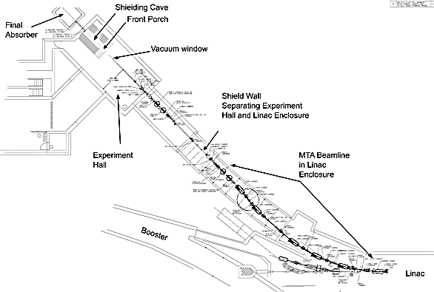

Slide 4
The 400 MeV Test Area (MTA) Overview
The MTA beam line begins at the first C magnet in the Linac enclosure and extends down to the final absorber
The MTA beam line is approximately 200 ft in length
The MTA beam line receives 400 MeV H- ions extracted from the Linac
Through a series of dipoles and quadrupoles, beam is directed through the shield wall separating the Linac and MTA enclosures and then to the Irradiation Test Area (ITA) experimental area and final absorber
The MTA beamline also utilizes other components such as ion pumps and diagnostic equipment

Slide 5
The 400 MeV Test Area (MTA) Overview
The purpose of the MTA is to study the effects of radiation on various materials and components
The ITA experiment requests are facilitated through the Technical Scope of Work (TSW) process and if approved, goes through an Operational Readiness Clearance (ORC)
The TSW includes a description of the experimental set-up and required beam parameters. e.g. number of pulses/min, pulse length
Reviewed and approved by AD and ES&H management before beam can be delivered

Slide 6
Hazard Inventory for MTA
Accelerator specific hazards are purple
Hazards not discussed today are evaluated via the common Risk Matrix tables
  Covered in SAD Section I, Chapter 4
Hazards evaluated via risk assessment methodology per DOE-HDBK-1163-2020
  Likelihood (L):
    Anticipated (A), Unlikely (U), Extremely Unlikely (EU), Beyond Extremely Unlikely (BEU)
  Consequence (C):
    High (H), Moderate (M), Low (L), Negligible (N)
  Risk (R):
    I , II, III, IV (descending order of concern)

Slide 7
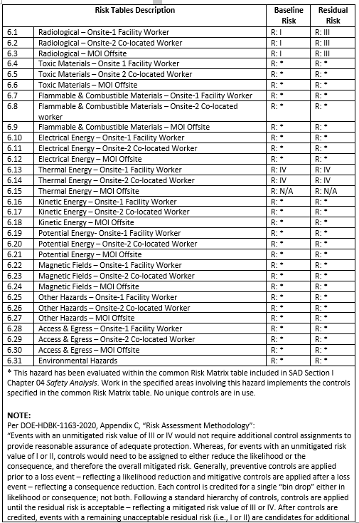
Risk Table Summary for MTA

Slide 8
Non-Accelerator Specific Hazards - Radiological
Residual Activation
  High intensity beam delivery will produce activated materials inside the MTA enclosure
  The residual dose rate found from MTA initial entry surveys is historically less than 2 mrem/hr.
  Although the ITA target materials/sample box could have higher dose rates depending on the irradiation parameters
  Hazard applies to onsite facility workers and onsite co-located workers
Baseline Qualitative Risk (without controls) | Controls Preventive (P)/Mitigative (M) | Residual Qualitative Risk (with controls)
L: A C: H R: I | P – Employee Rad Worker training P – General/Specific RWPs P – Use of an LSM M – Radiological Signage M – Run Condition M- Radiological Shielding | L: BEU C: N R: IV

Slide 9
Non-Accelerator Specific Hazards - Radiological
Ground/surface Water Activation
  High intensity beam delivery can interact with soil and leach into ground water
  Cooling water systems such as low conductivity water interact with activated beam line components
  The radioisotopes of concern for leaching are tritium and Na-22
  Hazard applies to onsite facility workers and onsite co-located workers
Baseline Qualitative Risk (without controls) | Controls Preventive (P)/Mitigative (M) | Residual Qualitative Risk (with controls)
L: A C: H R: I | P – Sump/water monitoring programs P – General/Specific RWPs P – Beam Loss Monitoring M – Radiological Signage M – Run Condition M- Radiological Shielding | L: BEU C: L R: IV

Slide 10
Non-Accelerator Specific Hazards - Radiological
Soil Interactions
  High intensity beam delivery interacting with beam line absorbers
  The radioisotopes of concern for leaching are tritium and Na-22
  Hazard applies to onsite facility workers and onsite co-located workers
Baseline Qualitative Risk (without controls) | Controls Preventive (P)/Mitigative (M) | Residual Qualitative Risk (with controls)
L: A C: N R: IV | M – Engineered Beam Absorber M – Engineered Beam Line Design Optics M – Run Condition | L: A C: N R: IV

Slide 11
Non-Accelerator Specific Hazards - Radiological
Air Activation
  High intensity beam delivery can interact with air in the MTA enclosure
  The radioisotopes of concern are C-11, O-15, N-13 and Ar-41
  Hazard applies to onsite facility workers and onsite co-located workers
Baseline Qualitative Risk (without controls) | Controls Preventive (P)/Mitigative (M) | Residual Qualitative Risk (with controls)
L: A C: H R: I | P – Air monitoring program P – RSIS P – Beam Loss Monitoring M – Engineered Air Flow M – Radiological Signage M – Run Condition | L: BEU C: N R: IV

Slide 12
Non-Accelerator Specific Hazards - Radiological
Radioactive Waste
  Radioactive waste produced during MTA operations will be managed within the established Radiological Protection Program (RPP) as prescribed in the Fermilab Radiological Control Manual (FRCM)
  Hazard applies to onsite facility workers and onsite co-located workers
Baseline Qualitative Risk (without controls) | Controls Preventive (P)/Mitigative (M) | Residual Qualitative Risk (with controls)
L: A C: H R: I | P – Fencing/Postings P – Locked Gates M – Run Condition M – Material survey and release process | L: BEU C: L R: IV

Slide 13
Non-Accelerator Specific Hazards - Radiological
Contamination
  Although not typically encountered throughout the beam line, contamination can be found around the “front porch” experimental area
  The radioisotope of concern is Be-7
  Hazard applies to onsite facility workers and onsite co-located workers
Baseline Qualitative Risk (without controls) | Controls Preventive (P)/Mitigative (M) | Residual Qualitative Risk (with controls)
L: A C: H R: I | P – Radiological controls – RWP and RCT present P – Postings place in the event contamination is identified M – Radiological Training M – Run Condition | L: BEU C: N R: IV

Slide 14
Non-Accelerator Specific Hazards - Radiological
Radioactive Sources
  Not encountered throughout the beam line
  Could be needed as part of an experimental set-up
  Hazard applies to onsite facility workers and onsite co-located workers
Baseline Qualitative Risk (without controls) | Controls Preventive (P)/Mitigative (M) | Residual Qualitative Risk (with controls)
L: A C: H R: I | P – Radiological controls – RWP and RCT present P – Radiological Training P – Kept in locked cabinets when not in use M – Shielded containers | L: BEU C: L R: IV

Slide 15
Accelerator Specific Hazards at the MTA
Prompt Ionizing Radiation
  Significant radiation hazard when beam is transported though the MTA beam line.
  Creates beam interactions with the beam line, beam line components and experimental target materials
  Prompt radiation includes protons, neutrons, muons and other energetic particles
  This hazard has been previously evaluated in a detailed shielding assessment
Credited Controls are needed

Slide 16
Accelerator Specific Hazards - Radiological
Prompt Ionizing Radiation – Beam Loss
  Ionizing radiation due to beam loss in the MTA enclosure
  Analyzed maximum credible incident (MCI) to determine credited controls
  Hazard applies to onsite facility workers, onsite co-located workers

Slide 17
Accelerator Specific Hazards at the MTA
Cryogenic Systems – Oxygen Deficiency Hazards (ODH)
  It’s possible that ITA experiments may require cryogenic liquids
  This hazard has been evaluated at the MTA and documented in Engineering Note EN08855
  The amount of cryogens brought in the MTA enclosure will not exceed a liquid volume of 34L (verified through the TSW and ORC processes)
  Due to this amount of cryogenic liquid, the oxygen concentration in the enclosure can never be lower than 19.5%
  As a result, the ODH remains negligible (category IV) at all times
  No credited controls are needed
Verified during the TSW and ORC processes

Slide 18
Maximum Credible Incident (MCI) at the MTA
The MCI would be one where the MTA maximum credible intensity is lost and continuously incident on a magnet or beam pipe in the enclosure
Highest radiation losses are generated by accidents at locations with reduced passive shielding
This MTA MCI beam intensity is the same as the Linac MCI beam intensity
This has been determined to be 2.58E18 protons/hr or 4.78E13 protons/pulse
  400 MeV beam energy
  130 mA beam current
  60µs beam pulse length
  15 Hz cycle time

Slide 19
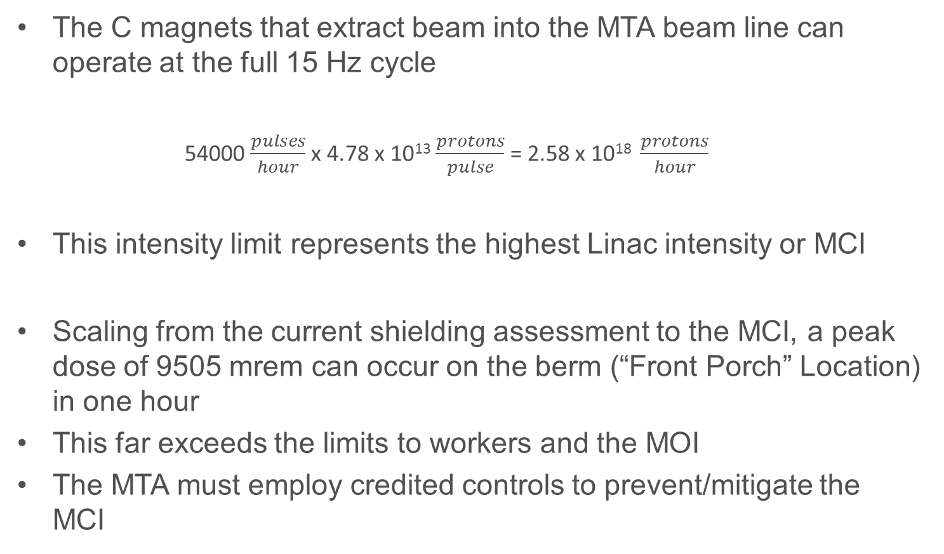
Maximum Credible Incident (MCI) at the MTA
The C magnets that extract beam into the MTA beam line can operate at the full 15 Hz cycle
  54000 $\frac{pulses}{hour}$ x 4.78 x 10¹³ $\frac{protons}{pulse}$ = 2.58 x 10¹⁸ $\frac{protons}{hour}$
This intensity limit represents the highest Linac intensity or MCI
Scaling from the current shielding assessment to the MCI, a peak dose of 9505 mrem can occur on the berm (“Front Porch” Location) in one hour
This far exceeds the limits to workers and the MOI
The MTA must employ credited controls to prevent/mitigate the MCI

Slide 20
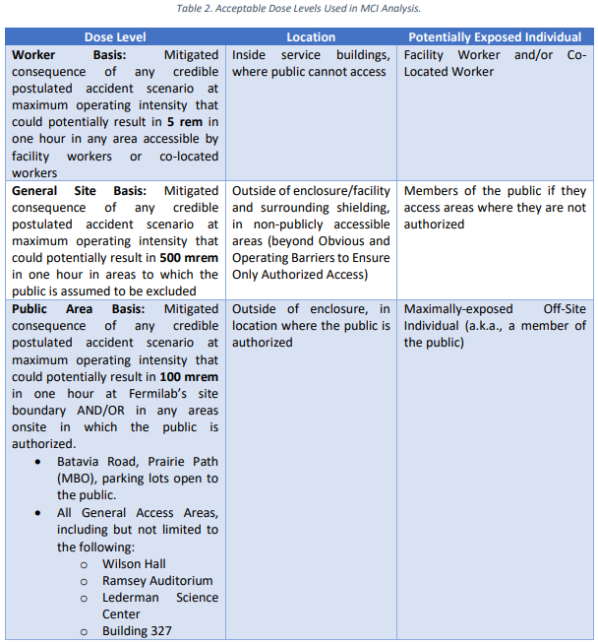
Acceptable Dose Levels Used In MCI Analysis

Slide 21
MTA passive credited controls
Permanent shielding
  To protect against the MCI, the MTA enclosure is constructed as a permanent concrete and earth covered shield
  This permanent shielding is contiguous with the Linac and extends to the MTA absorber
  17.2 effective feet of dirt (e.f.d.) is required to keep the dose on the berm to less than 500 mrem in one hour for the MCI
  The hatch area on the berm and the MTA absorber have this required 17.2 e.f.d and this is a credited control
  In areas with less than 17.2 e.f.d the existing shielding is a credited control along with active controls

Slide 22
MTA passive credited controls
Beam Type | Longitudinal Range | Location | Fixed Shielding (efd) | Movable Shielding (efd) | Current Shielding (efd) | Req. Shielding
 | (z)
P | 0-41 | Main Linac enclosure | 14.9 |  | 14.9 | 17.2
P | 41-55 | Linac high ceiling | 13.3 |  | 13.3 | 17.2
P | 55-103 | Linac ramp | 15.7 |  | 15.7 | 17.2
P | 103-106 | Beam stop alcove |  | 18.1 | 18.1 | 17.2
P | 106-115 | Hatch |  | 21.7 | 21.7 | 17.2
P | 115-147 | MTA upstream stub | 10.4 |  | 10.4 | 17.2
P | 147-187 | MTA main hall | 10.6 |  | 10.6 | 17.2
P | 187-193 | Pipe to absorber | 19.0 |  | 19.0 | 17.2
P | 193-203 | Absorber in berm | 21.7 |  | 21.7 | 17.2
Beam Type | Transverse Station (ft) | Location | Fixed Shielding (efd) | Movable Shielding (efd) | Current Shielding (efd) | Req. Shielding
P | 15 | C-Magnet | 13.0 |  | 13.0 | 17.2
P | 45 | 13-ft Ceiling | 11.9 |  | 11.9 | 17.2
P | 57 | 10-ft Ceiling | 14.2 |  | 14.2 | 17.2
P | 104 | Beam Stop Alcove |  | 18.1 | 18.1 | 17.2
P | 110 | Hatch Waveguide |  | 21.7 | 21.7 | 17.2
P | 110 | Hatch Waveguide |  | 21.7 | 21.7 | 17.2
P | 112 | Hatch Waveguide |  | 21.7 | 21.7 | 17.2
P | 115 | Hatch Waveguide |  | 21.7 | 21.7 | 17.2
P | 135 | MTA Stub | 10.4 |  | 10.4 | 17.2
P | 157 | MTA Exp Hall | 10.2 |  | 10.2 | 17.2
P | 167 | MTA Rollup Door |  | 15.0 | 15.0 | 17.2

Slide 23
Movable Shielding and Penetrations
This shielding also includes movable shielding in the ceiling vent vertical penetration leading to the MTA berm and the six single leg penetrations leading to the counting house
  The single leg penetrations leading to the counting house are completely filled with sand and polyethylene
The ceiling vent leading to the berm
  This is completely filled with sand and polyethylene
This moveable shielding is a credited control

Slide 24
Passive Credited Controls
Obvious and Operating Barriers
To permit entry to only authorized individuals into the area where the General Site Basis applies surrounding the MTA segment of the Fermilab Main Accelerator
Obvious and Operating Barriers shall be established to the following locations to permit only authorized access:
  Wilson Hall West
  Wilson Hall East
  Site 55

Slide 25
MTA active engineered controls
Radiation Safety Interlock System (RSIS)
  Inhibits beam by controlled redundant critical devices
  Enforces the search and secure process
  Interlocked doors are present at both of the access points into the MTA enclosure
  The ES&H Radiation Physics Engineering Dept. (RPE) ensures that all requirements for hardware and system testing are completed semi-annually with a four-month grace period
  RPE also verifies the inventory of interlock keys and updates procedures for maintenance and testing of interlock systems.

Slide 26
MTA active engineered controls
Interlocked Radiation Detectors
  All interlocked detectors are part of standard RSIS used throughout Fermilab and are calibrated on an annual basis
  For areas that do not have the required amount of permanent shielding these detectors can be used to provide the same level of protection to an individual outside of the shielding

Slide 27
MTA active engineered credited controls
Interlocked Radiation Detector Location | Credited Control Detector Trip Limit
Linac High Ceiling | < 500 mrem/hr
Linac Ramp – top of berm Upstream | < 500 mrem/hr
Linac Ramp – top of berm Downstream | < 500 mrem/hr
Beam Stop Alcove – top of berm upstream of hatch | < 500 mrem/hr
MTA Upstream Stub- above UVB11 (SQA) | < 500 mrem/hr
MTA Hall – Ceiling Vent | < 500 mrem/hr
MTA Hall Mid-Hall | < 500 mrem/hr
MTA Hall “Front Porch” | < 500 mrem/hr
Pipe to Absorber | < 500 mrem/hr
MTA Counting House | < 5 Rem/hr

Slide 28
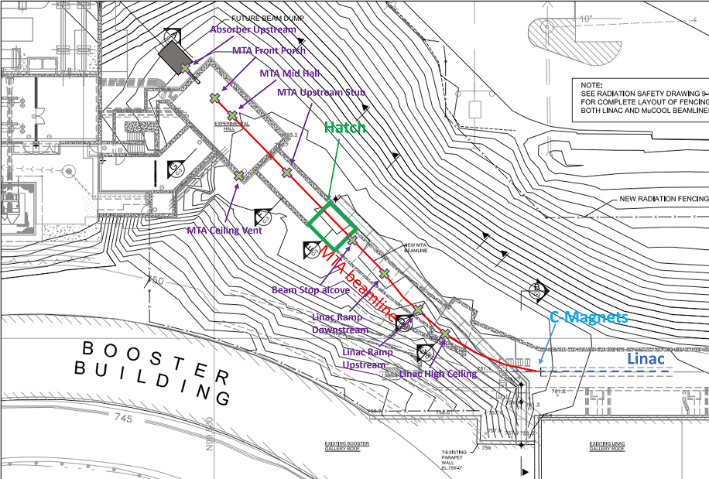
Credited Control Detector Locations

Slide 29
Credited Controls - Administrative
Credited Control: Operation Authorization Document
  Machine Beam Permit
  Machine Run Condition
  Beam will not be transported through the MTA beam line without approval of these documents
Credited Control: Staffing
  To ensure accelerator operations are disabled and initiate an immediate
  response in the event of a determined ASE violation.
  The following staffing shall be in place during applicable beam operation:
    At least one member of the AD Operations Department who has achieved the rank of Operator II or higher shall be on duty and on site.
    At least one member of the AD Operations Department shall be present in the Main Control Room (MCR).
    Note: these requirements could be satisfied by a single person
Credited Control: Accelerator Operating Parameters
  The MCI intensity of 2.58E18 protons/hr shall not be exceeded

Slide 30
Thank you for your attention

