Slide 1
Safety Assessment Document Updates for DOE O 420.2D
SAD Section III Chapter 04 - Booster
Salah Chaurize
Accelerator Readiness Review
19-21 March 2024

Slide 2
Outline
Booster Overview
Hazard Inventory
Non-Accelerator Specific Hazards
Accelerator Specific Hazards
Maximum Credible Incident (MCI) Discussion
Summary of Credited Controls

Slide 3
Outline
Booster Overview
Hazard Inventory
Non-Accelerator Specific Hazards
Accelerator Specific Hazards
Maximum Credible Incident (MCI) Discussion
Summary of Credited Controls

Slide 4
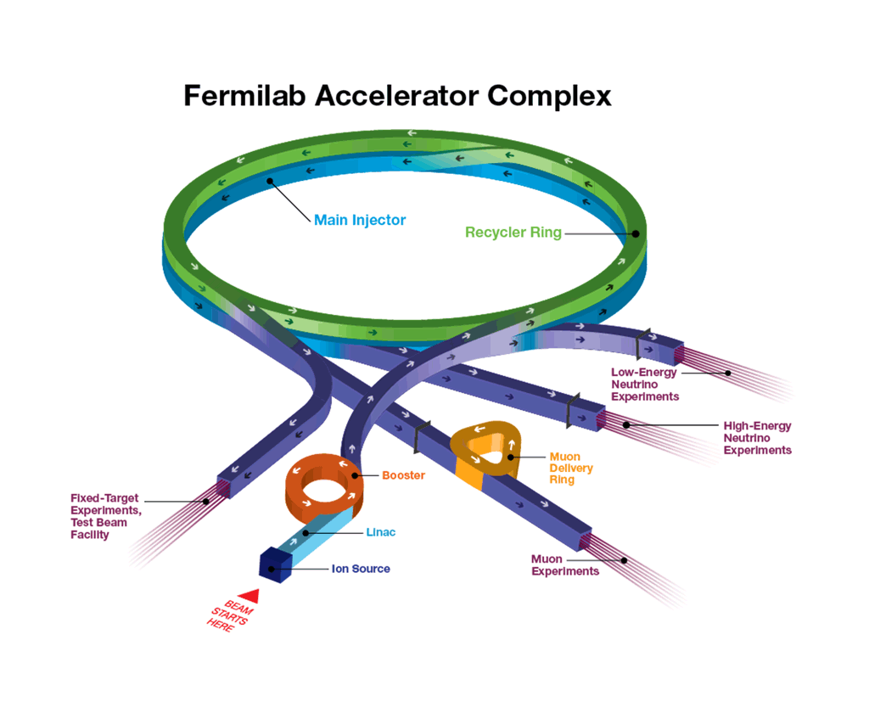
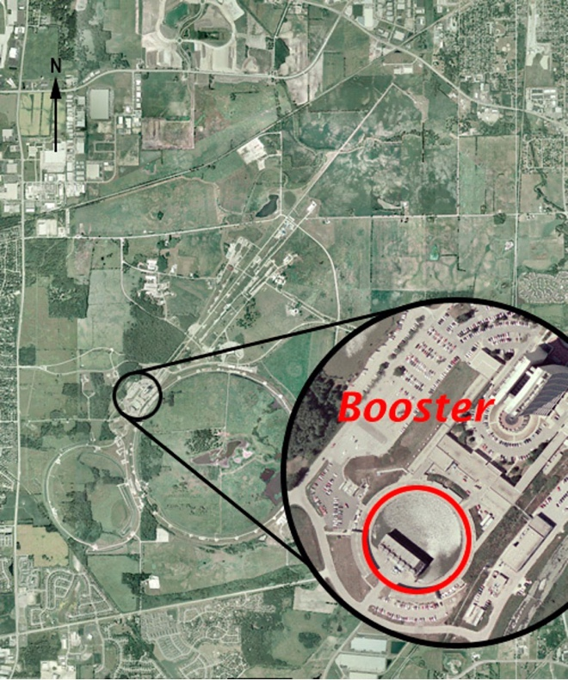
Booster Overview
Booster is a 15Hz alternating gradient Proton Synchrotron that accelerates beam received from the Linac at 400 MeV to 8 GeV.
Booster has an average radius of 75.5 meters.
The FOFDOOD lattice consists of 96 combined function magnets that bend and focus the beam during the 33-ms long “beam cycle” (acceleration).

Slide 5
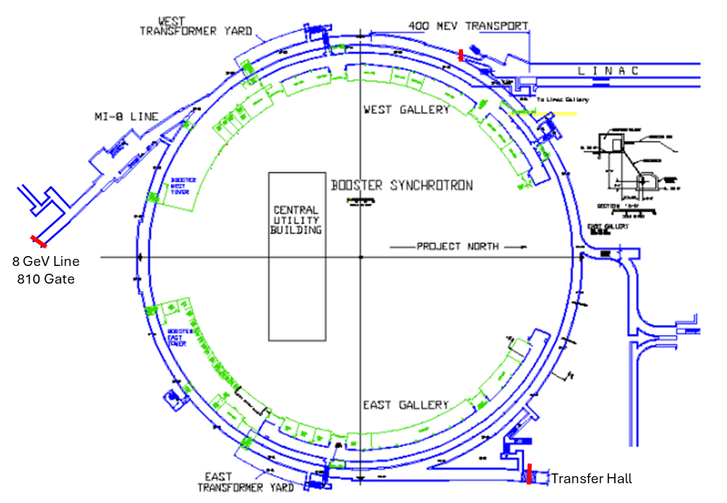
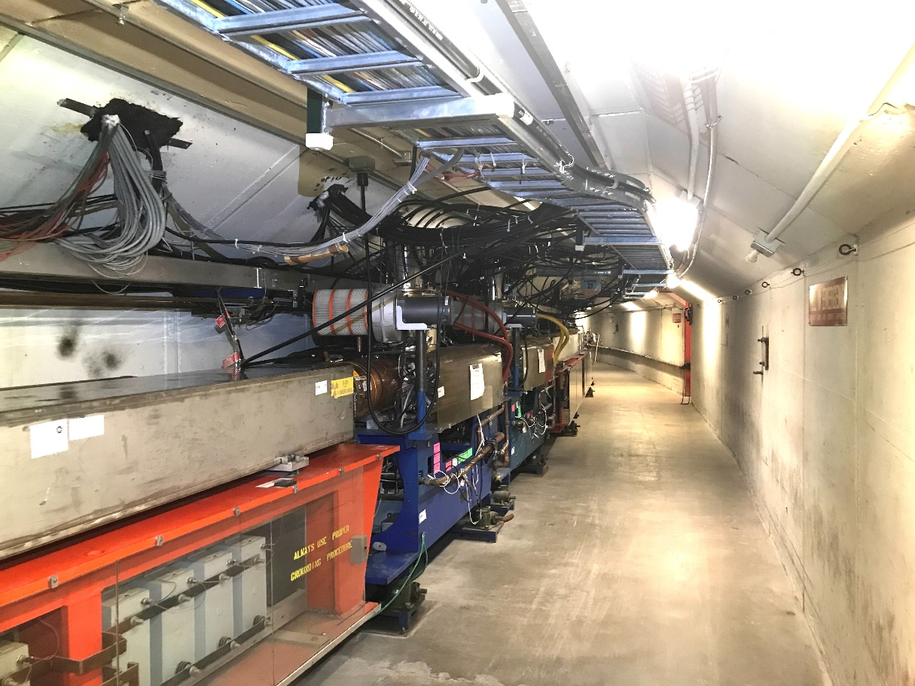
Booster Overview
Injection (400 MeV)
Extraction (8 GeV)
Booster Layout
Booster Gradient Magnet and RF cavities
The resonant magnet system ramps down for the remaining 33 ms to accept beam once again as needed completing the 66 ms machine cycle.
This constitutes the 15Hz mode of operation.
22 RF cavities are available to capture and accelerate the beam from injection to extraction, sweeping from 37MHz to 52MHz.

Slide 6
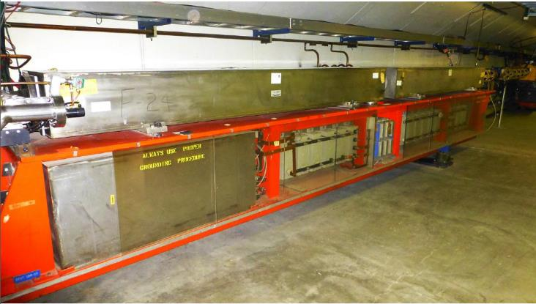
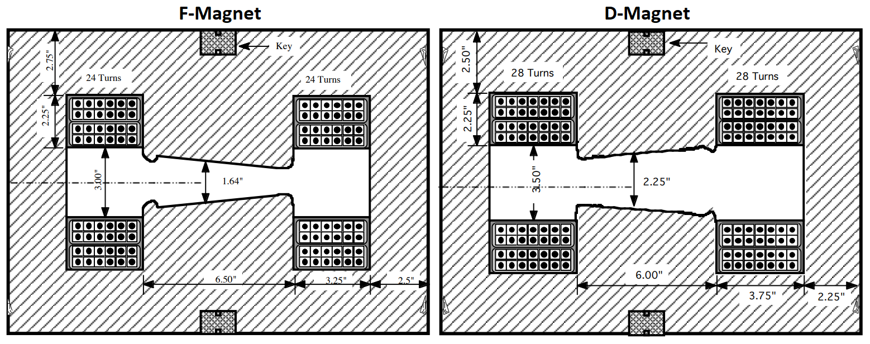
Booster Overview
The Booster is about 474 meters in circumference.
A 10-ft wide by 8-ft high tunnel enclosure below grade contains the accelerator.
48 magnet girders, 25-ft. long, support two combined function magnets, 10-ft. long each.
D Magnet
F Magnet
Choke

Slide 7
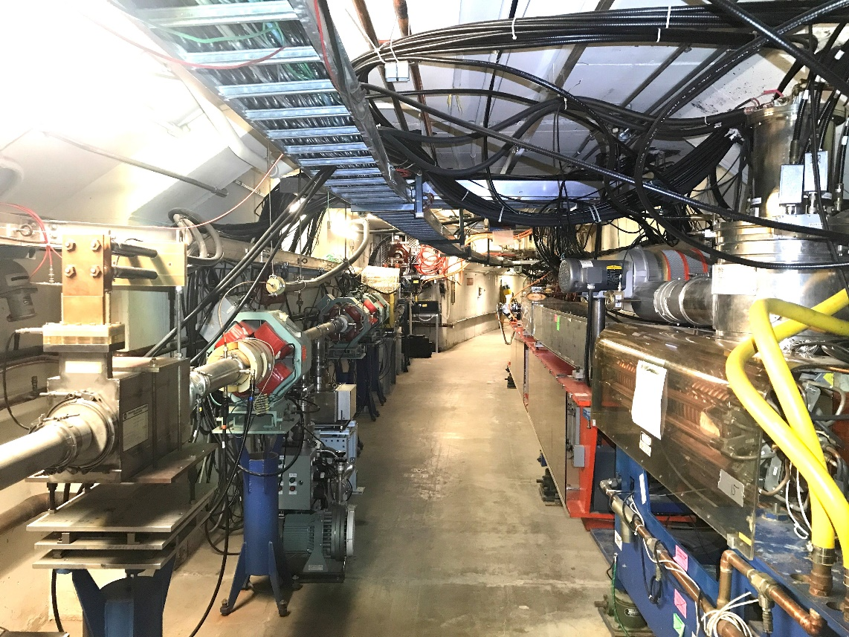
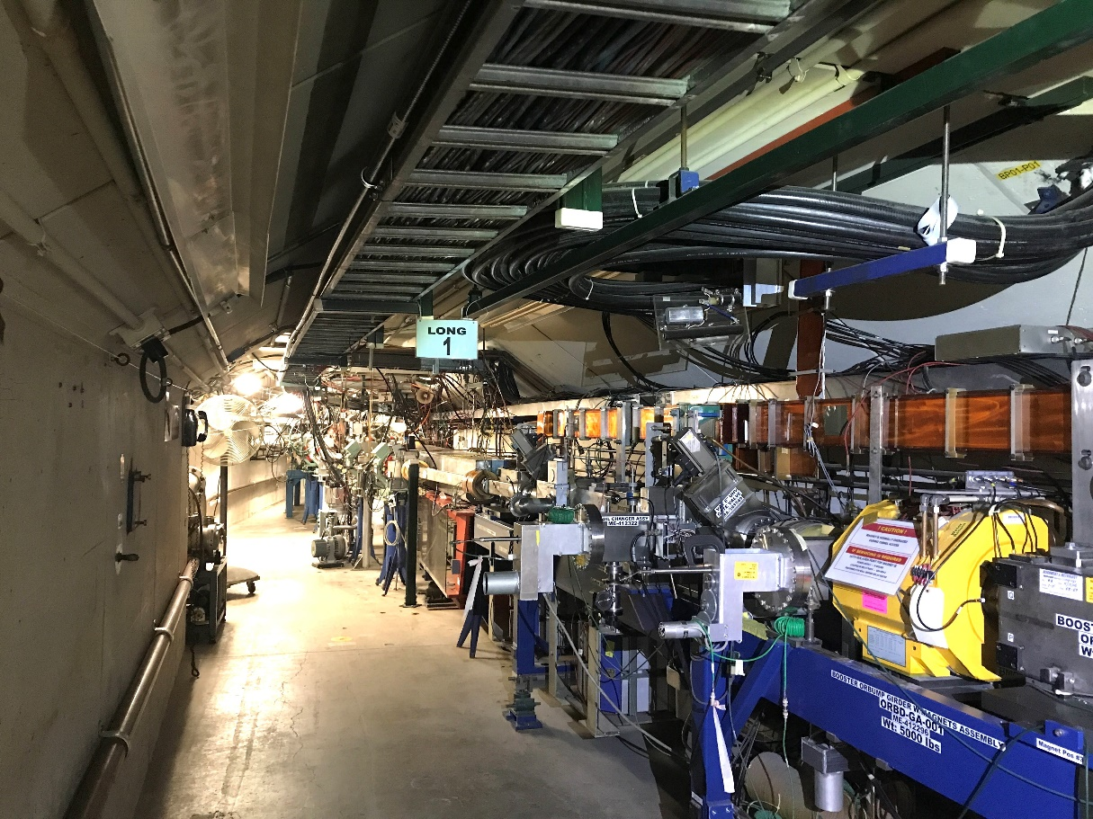
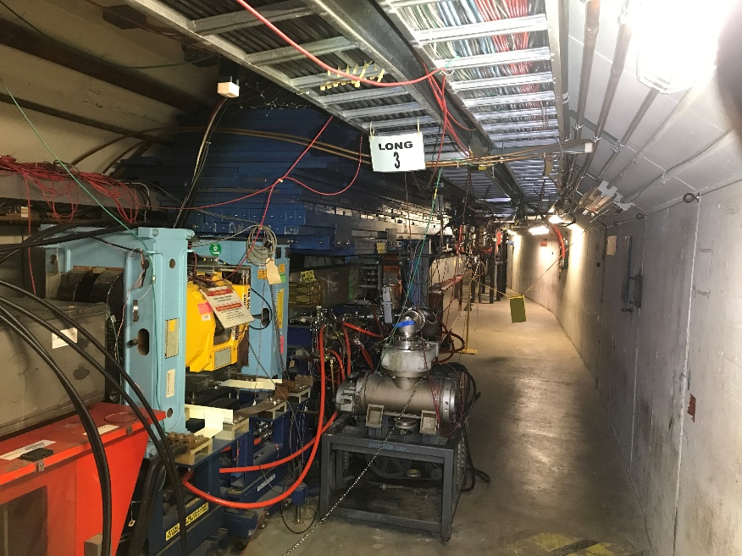
Booster Overview
Booster 400 MeV Booster Ring
Booster Injection Girder
H⁻ beam is injected from Linac in a multi-turn fashion via the 400 MeV line where it is converted into a proton beam at the injection region.
Beam is captured, accelerated and extracted to the Booster beam absorber or the 8 GeV Line sending beam towards downstream segments.
Booster Extraction

Slide 8
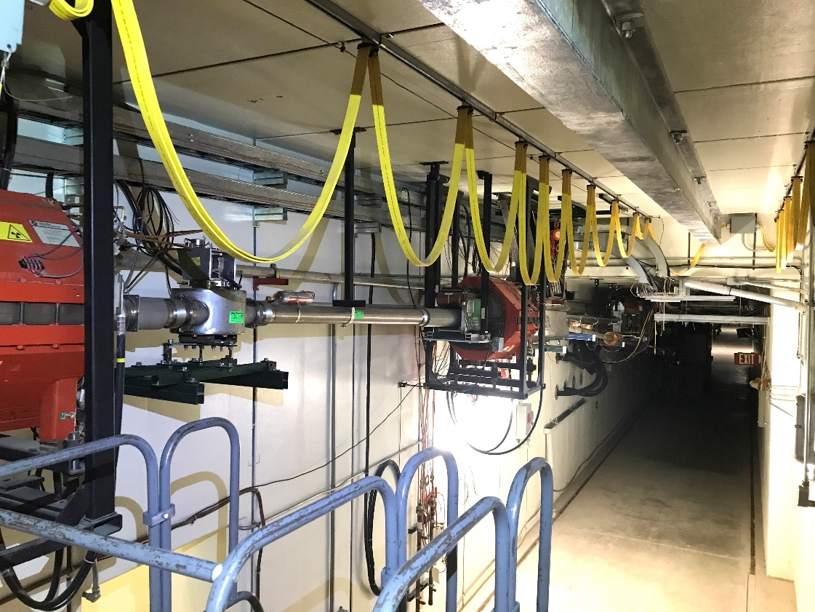
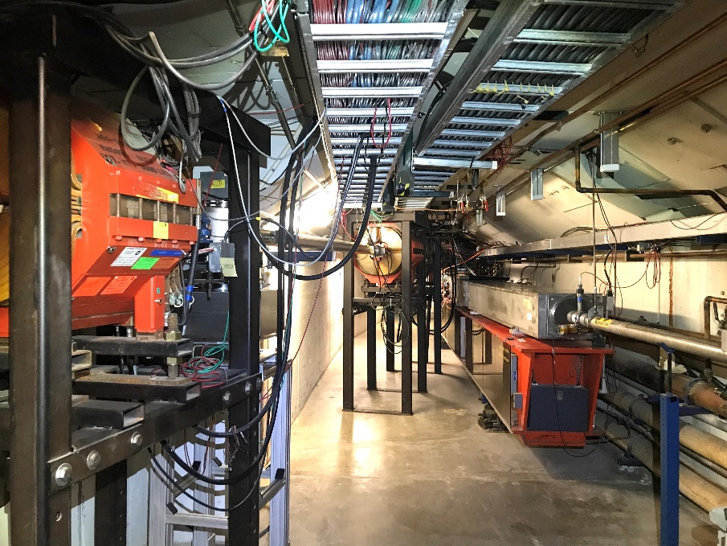
Booster Overview
There are two possible extraction areas for Booster beam at 8 GeV:
“Dump Mode” ⇨ Booster Beam Absorber
“MI Mode” ⇨ 8 GeV Line (all downstream segments) Separate segments are discussed in SAD Section 1
Booster MI8 (8GeV) Line Booster Ring
Booster 8 GeV Line section to Booster Absorber or 8 GeV Line Downstream Segment.

Slide 9
Outline
Booster Overview
Hazard Inventory
Non-Accelerator Specific Hazards
Accelerator Specific Hazards
Maximum Credible Incident (MCI) Discussion
Summary of Credited Controls

Slide 10
Hazard Inventory for Booster
Accelerator specific hazards are purple
Hazards not discussed today are evaluated via the common Risk Matrix tables
Covered in SAD Section I, Chapter 4
Hazards evaluated via risk assessment methodology per DOE-HDBK-1163-2020
Likelihood (L):
Anticipated (A), Unlikely (U), Extremely Unlikely (EU), Beyond Extremely Unlikely (BEU)
Consequence (C):
High (H), Moderate (M), Low (L), Negligible (N)
Risk (R):
I , II, III, IV (descending order of concern)

Slide 11
Summary of Baseline and Residual Risks – Booster
Risk Tables Description |  | Baseline Risk | Residual Risk
8.1 | Radiological – Onsite-1 Facility Worker | R: I | R: III, IV
8.2 | Radiological – Onsite-2 Co-located Worker | R: I | R: III, IV
8.3 | Radiological – MOI Offsite | R: I | R: IV
8.4 | Toxic Materials – Onsite 1 Facility Worker | R: NA* | R: NA*
8.5 | Toxic Materials – Onsite 2 Co-located Worker | R: * | R: *
8.6 | Toxic Materials – MOI Offsite | R: NA* | R: NA*
8.7 | Flammable & Combustible Materials – Onsite-1 Facility Worker | R: * | R: *
8.8 | Flammable & Combustible Materials – Onsite-2 Co-located worker | R: * | R: *
8.9 | Flammable & Combustible Materials – MOI Offsite | R: NA* | R: NA*
8.10 | Electrical Energy – Onsite-1 Facility Worker | R: * | R: *
8.11 | Electrical Energy – Onsite-2 Co-located Worker | R: * | R: *
8.12 | Electrical Energy – MOI Offsite | R: NA* | R: NA*
8.13 | Thermal Energy – Onsite-1 Facility Worker | R: * | R: *
8.14 | Thermal Energy – Onsite-2 Co-located Worker | R: * | R: *
8.15 | Thermal Energy – MOI Offsite | R: NA* | R: NA*
8.16 | Kinetic Energy – Onsite-1 Facility Worker | R: * | R: *
8.17 | Kinetic Energy – Onsite-2 Co-located Worker | R: * | R: *
8.18 | Kinetic Energy – MOI Offsite | R: NA* | R: NA*
8.19 | Potential Energy- Onsite-1 Facility Worker | R: * | R: *
8.20 | Potential Energy – Onsite-2 Co-located Worker | R: * | R: *
8.21 | Potential Energy – MOI Offsite | R: NA* | R: NA*
8.22 | Magnetic Fields – Onsite-1 Facility Worker | R: I | R: III
8.23 | Magnetic Fields – Onsite-2 Co-located Worker | R: NA* | R: NA*
8.24 | Magnetic Fields – MOI Offsite | R: NA* | R: NA*
8.25 | Other Hazards – Onsite-1 Facility Worker | R: * | R: *
8.26 | Other Hazards – Onsite-2 Co-located Worker | R: * | R: *
8.27 | Other Hazards – MOI Offsite | R: NA* | R: NA*
8.28 | Access & Egress – Onsite-1 Facility Worker | R: * | R: *
8.29 | Access & Egress – Onsite-2 Co-located Worker | R: * | R: *
8.30 | Access & Egress – MOI Offsite | R: NA* | R: NA*
8.31 | Environmental Hazards | R: * | R: *
* This hazard has been evaluated within the common Risk Matrix table included in SAD Section I Chapter 04 Safety Analysis. Work in the specified areas involving this hazard implements the controls specified in the common Risk Matrix table. No unique controls are in use.

Slide 12
Outline
Booster Overview
Hazard Inventory
Non-Accelerator Specific Hazards
Accelerator Specific Hazards
Maximum Credible Incident (MCI) Discussion
Summary of Credited Controls

Slide 13
Non-Accelerator Specific Hazards - Radiological
Residual Activation
High intensity beam delivery will produce activated materials inside the Booster enclosure.
The residual dose rate found in the Booster from initial entry surveys is historically less than 50 mrem/hr, exceptions include:
< 100 mrem at Injection, Collimation and Extraction HRA areas
Hazard applies to onsite facility workers and onsite co-located workers
Baseline Qualitative Risk (without controls) | Controls Preventive (P)/Mitigative (M) | Residual Qualitative Risk (with controls)
L: A C: H R: I | P – Employee Rad Worker training P – ALARA plan M – Shielding to reduce activation M – Proper dosimetry | L: EU C: L R: IV

Slide 14
Non-Accelerator Specific Hazards - Radiological
Radioactive Waste
Radioactive waste produced during Booster operations will be managed within the established Radiological Protection Program (RPP) as prescribed in the Fermilab Radiological Control Manual (FRCM)
Hazard applies to onsite facility workers and onsite co-located workers
Baseline Qualitative Risk (without controls) | Controls Preventive (P)/Mitigative (M) | Residual Qualitative Risk (with controls)
L: A C: H R: I | P – Postings P – Beam tuned to reduce beam loss M – Shielding to reduce generation of waste M – Material survey and release process | L: EU C: L R: IV

Slide 15
Non-Accelerator Specific Hazards - Radiological
Soil and Groundwater Interactions
Radionuclides are produced which may contaminate ground water
Can occur in areas of high chronic losses
Hazard applies to onsite facility workers and onsite co-located workers
Baseline Qualitative Risk (without controls) | Controls Preventive (P)/Mitigative (M) | Residual Qualitative Risk (with controls)
L: A C: H R: I | P – Beam Loss Monitoring M – Machine Protection System M – Engineered sump water discharge points M – Beamline Design M – Run Conditions | L: U C: N R: IV

Slide 16
Non-Accelerator Specific Hazards - Radiological
Contamination
Areas of contamination likelihood are marked and typically limited to HRA areas of the enclosure.
Low levels of Beryllium 7 have been detected.
Hazard applies to onsite facility workers and onsite co-located workers
Baseline Qualitative Risk (without controls) | Controls Preventive (P)/Mitigative (M) | Residual Qualitative Risk (with controls)
L: A C: H R: I | P – Radiological controls personnel survey and decontamination P – Postings placed in the event contamination is identified M – Shielding to reduce generation of waste M – Material survey and release process | L: EU C: L R: IV

Slide 17
Non-Accelerator Specific Hazards - Radiological
Non-Ionizing Radiation – Radio-Frequency (RF)
Potential Hazardous levels of RF electromagnetic energy are generated by the RF power sources in the Booster 400 MeV Line’s 805 MHz RF Cavity.
Hazard applies to onsite facility workers, onsite co-located worker
Baseline Qualitative Risk (without controls) | Controls Preventive (P)/Mitigative (M) | Residual Qualitative Risk (with controls)
L: A C: M R: II | P – RF Shielding P – ES&H periodic monitoring P – LOTO procedure P – Affected area postings | L: BEU C: M R: IV

Slide 18
Non-Accelerator Specific Hazards - Radiological
Non-Ionizing Radiation - Laser
There is a Class IV Nd:YAG (neodymium-doped yttrium aluminum garnet) laser in the downstream end of the 400 MeV line.
The laser is part of the Laser Profile Monitor (LPM).
This system is currently not in use.
Hazard applies to onsite facility workers and onsite co-located workers
Baseline Qualitative Risk (without controls) | Controls Preventive (P)/Mitigative (M) | Residual Qualitative Risk (with controls)
L: A C: H R: I | P – Class 1 (light tight) enclosures P – ORC and work planning processes P – Locked/Interlocked system P – LOTO procedure or other procedure approved by the laser safety officer (LSO) P – Affected areas are posted M – Use of PPE | L: BEU C: M R: IV

Slide 19
Non-Accelerator Specific Hazards - Electrical
Stored Energy Exposure
Pulsed Magnet systems have stored potential energy in the capacitors and Pulse Forming Networks (PFN).
Hazard applies to onsite facility workers and onsite co-located workers
Baseline Qualitative Risk (without controls) | Controls Preventive (P)/Mitigative (M) | Residual Qualitative Risk (with controls)
L: A C: M R: II | P – Stored capacitors with terminals grounded P – Procedures to for Loto of equipment. P – Electrical worker training | L: BEU C: M R: IV

Slide 20
Non-Accelerator Specific Hazards - Electrical
Low Voltage, High Current Exposure
Booster Pulsed systems and RF Bias Supplies operate with high current.
Hazard applies to onsite facility workers and onsite co-located workers
Baseline Qualitative Risk (without controls) | Controls Preventive (P)/Mitigative (M) | Residual Qualitative Risk (with controls)
L: U C: H R: I | P – Insulating guards/closed cabinets prevent incidental contact P – Electrical worker training P –M – Overcurrent protection | L: BEU C: M R: IV

Slide 21
Non-Accelerator Specific Hazards – Magnetic Fields
Fringe Fields
Powered and permanent magnets produce fringe fields that can be hazardous to people who have medical implants.
Hazard applies to onsite facility workers and onsite co-located workers.
Baseline Qualitative Risk (without controls) | Controls Preventive (P)/Mitigative (M) | Residual Qualitative Risk (with controls)
L: A C: H R: I | P – Work planning that warns about magnetic hazard P – Magnetic hazard warning part of hazard specification sheet P – Postings of magnetic field hazard at entry points | L: BEU C: H R: III

Slide 22
Outline
Booster Overview
Hazard Inventory
Non-Accelerator Specific Hazards
Accelerator Specific Hazards
Maximum Credible Incident (MCI) Discussion
Summary of Credited Controls

Slide 23
Accelerator Specific Hazards - Radiological
Prompt Ionizing Radiation – RF
805-MHz RF power sources for the accelerating cavity is also X-ray producing source.
Hazard applies to onsite facility workers, onsite co-located workers
Baseline Qualitative Risk (without controls) | Controls Preventive (P)/Mitigative (M) | Residual Qualitative Risk (with controls)
L: A C: M R: II | P – Proper operation of equipment P – System is disabled during Booster access M – Shielding M – ESH gallery radiation surveys | L: A C: N R: IV

Slide 24
Outline
Booster Overview
Hazard Inventory
Non-Accelerator Specific Hazards
Accelerator Specific Hazards
Maximum Credible Incident (MCI) Discussion
Summary of Credited Controls

Slide 25
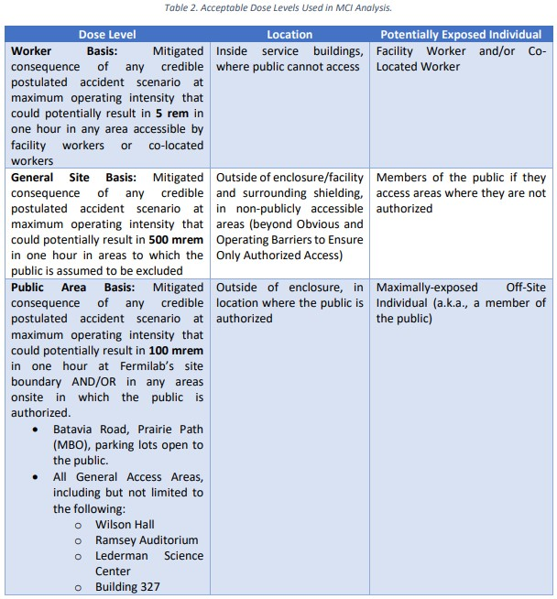
Maximum Credible Incident (MCI) – Radiological
The MCI focuses on exposure to an onsite worker, an onsite coworker, and the maximally exposed off-site individual (MOI)
The Booster is behind obvious and operating barriers.
The MCI reflects a theoretical accident scenarios for the Fermilab Booster. This would require several conditions to occur simultaneously, though unlikely, to create a higher-than-normal beam intensity and beam loss under those conditions.
Fermilab uses Credited Controls that flow down to the Accelerator Safety Envelope (ASE) to mitigate the consequences of an MCI to the following conditions:

Slide 26
Maximum Credible Incident (MCI) – Radiological (I)
The MCI for the Fermilab Booster looks at beam injected and not captured at 400 MeV as well as the theoretical maximum that can be captured. We also look at the maximum that could be accelerated and extracted at 8 GeV which is the highest dose possible and will be discussed.
MCI intensities are the theoretical maximum the Booster could produce and is a product of the following parameters:
35 mA beam from Linac
15 Hz repetition rate
Design Limit of Booster
60 µs beam pulse length
Multiturn maximum based on Injection bump magnet PFN
Assuming no shielding or other controls are present, this incident would result in a dose to any individual higher than 8 MRem at 8 GeV.

Slide 27
Maximum Credible Incident (MCI) – Radiological (II)
Based on MCI parameters, a potential beam operation at 15 Hz at 8 GeV would produce the greatest exposure.
At 8 GeV, an MCI intensity corresponds to:
3.8E17 protons per hour.
Intensity reduced (w.r.t. Linac/Injection) due to efficiency limitation and RF beam loading leading to Robinson Instabilities (→ 5.4E17 * 0.7 = 3.8E17).
The Booster Total Loss Monitor (TLM) system does not allow for one hour of continuous operation at MCI level losses.
It has a design trip limit that inhibits beam within 1 second allowing no more than 15 beam pulses circulating in Booster in case of an MCI event
The Booster MCI Justification document evaluates the consequences of an MCI beam loss event.
It uses shielding and simulation documentation along with characteristics of TLM active engineering credited controls.

Slide 28
Outline
Booster Overview
Hazard Inventory
Non-Accelerator Specific Hazards
Accelerator Specific Hazards
Maximum Credible Incident (MCI) Discussion
Summary of Credited Controls
Shielding Assessment Discussion

Slide 29
Credited Controls – Passive
Permanent Shielding
10.3 e.f.d. of shielding is credited with active engineering controls for Booster Ring.
13.5 e.f.d. minimum shielding is present in the Booster Ring
17.7 e.f.d. of shielding is credited for Booster 8 GeV Line portion
24.5 e.f.d. minimum shielding is present for Booster 8 GeV Line portion
Movable Shielding
Concrete block wall between Linac and the 400 MeV chute.
Concrete block wall separating the Booster enclosure from the Transfer Hall enclosure.
Labyrinth passage concrete blocks.
Penetration Shielding
The Booster enclosure has 172 penetrations that are filled with a combination of accelerator components and poly-beads to complete the necessary shielding.
Obvious and Operating Barriers to Ensure Only Authorized Access
To permit entry to only authorized individuals into the area where the General Site Basis applies surrounding the Booster of the Fermilab Main Accelerator, Obvious and Operating Barriers shall be established at the following locations to permit only authorized access:
Wilson Hall West,
Wilson Hall East,
Site 5

Slide 30
Credited Controls – Active Engineering (I)
Credited Control: Radiation Safety Interlock System (RSIS)
Inhibits beam by controlled redundant critical devices
Enforces the Search and Secure process
Interlocked doors are present at all access points into the Booster enclosure
Includes interlocked radiation detectors which protect individuals by disabling beam should prompt radiation from operations exceed specific dose rates
The ES&H Radiation Physics Engineering Dept. (RPE) ensures that all requirements for hardware and system testing are completed semi-annually with a four-month grace period
RPE also verifies the inventory of interlock keys and updates procedures for maintenance and testing of interlock systems
All RSIS are designed, installed and configuration managed in conformance with the requirements of the Fermilab Radiological Control Manual (FRCM)

Slide 31
Credited Controls – Active Engineering (II)
Interlocked Radiation Detectors
All interlocked detectors are calibrated on an annual basis
For areas that do not have adequate permanent shielding these detectors are used to protect an individual outside of the shielding boundary
ES&H RPE Interlock group also installs, tests & maintains all interlocked detectors

Slide 32
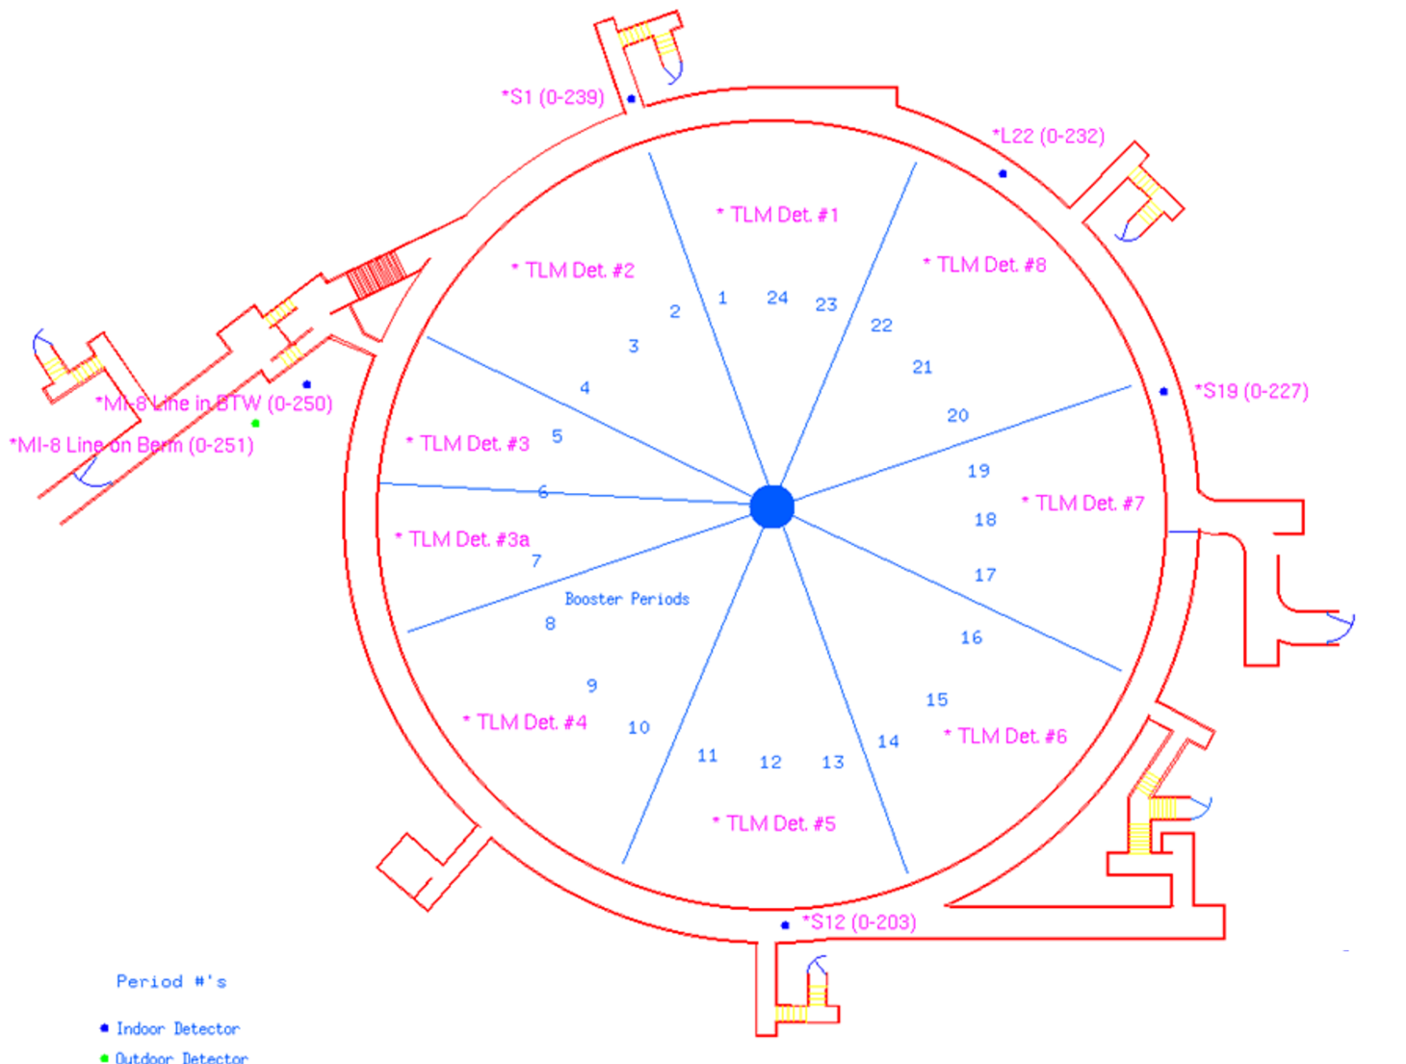
Credited Controls – Active Engineering (III)
TLM Det. #1
Type | Location | CC Limit (nC)
TLM | BSTR TLM1 Per 23, 24, 1 | 10,000
TLM | BSTR TLM2 Per 2, 3, 4 | 10,000
TLM | BSTR TLM3 Per 5, 6 | 10,000
TLM | BSTR TLM4 Per 8, 9, 10 | 10,000
TLM | BSTR TLM5 Per 11, 12, 13 | 10,000
TLM | BSTR TLM6 Per 14, 15, 16 | 10,000
TLM | BSTR TLM7 Per 17, 18, 19 | 10,000
TLM | BSTR TLM8 Per 20, 21, 22 | 10,000
TLM | BSTR TLM3a Per 6, 7 | 10,000
TLM Det. #2
TLM Det. #8
TLM Det. #3
TLM Det. #3a
TLM Det. #7
TLM Det. #4
TLM Det. #6
TLM Det. #5
Interlocked Radiation Detectors
The credited control trip limits for these interlocked radiation detectors are sufficient to protect against the MCI conditions
These are maximum values that turn off beam due to excessive fast beam loss.
Trip levels are set by the Radiation Physics Operations Department (RPO) to satisfy occupancy requirements per 10 CFR Part 835

Slide 33
Credited Controls - Administrative
Credited Control: Operation Authorization Document
Machine Beam Permit
Machine Run Condition
Beam will not be transported through Booster without approval of these documents
Credited Control: Staffing
To ensure accelerator operations are disabled and initiate an immediate response in the event of a determined ASE violation.
The following staffing shall be in place during applicable beam operation:
At least one member of the AD Operations Department who has achieved the rank of Operator II or higher shall be on duty and on site.
At least one member of the AD Operations Department shall be present in the Main Control Room (MCR).
Note: these requirements could be satisfied by a single person
Credited Control: Accelerator Operating Parameters
The MCI intensity of 3.8 E17 protons/hr shall not be exceeded at 8GeV

Slide 34
Questions

Slide 35
C.Y Tan

Slide 36
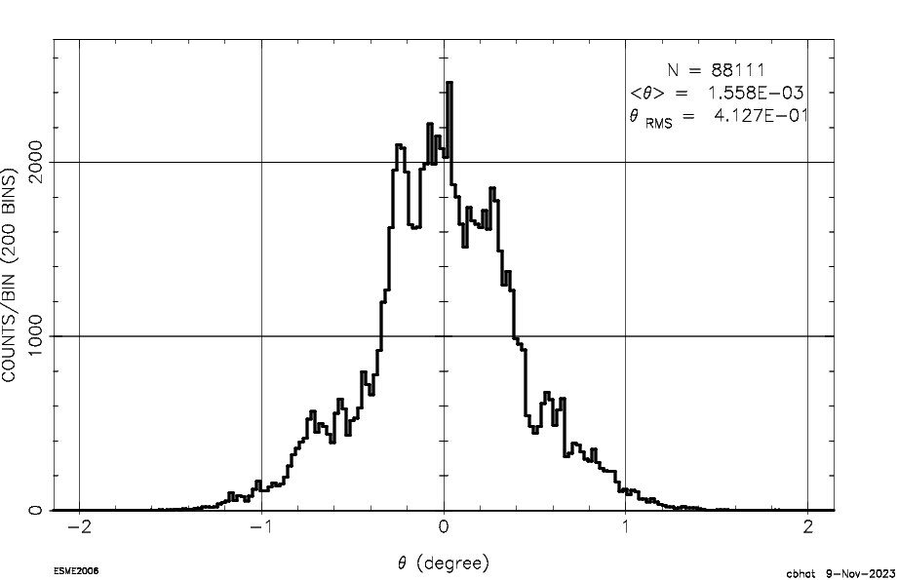
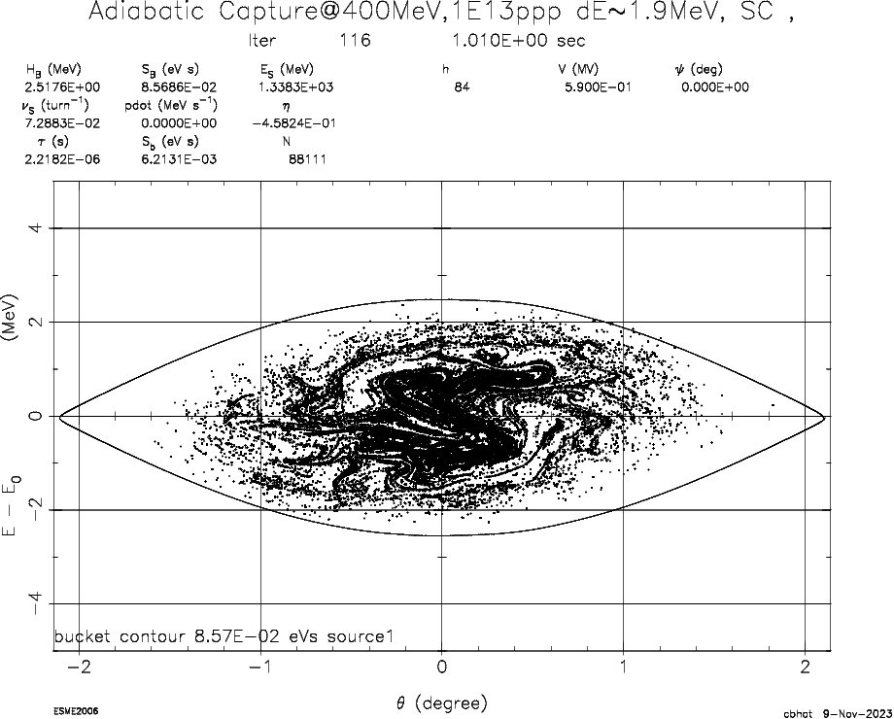
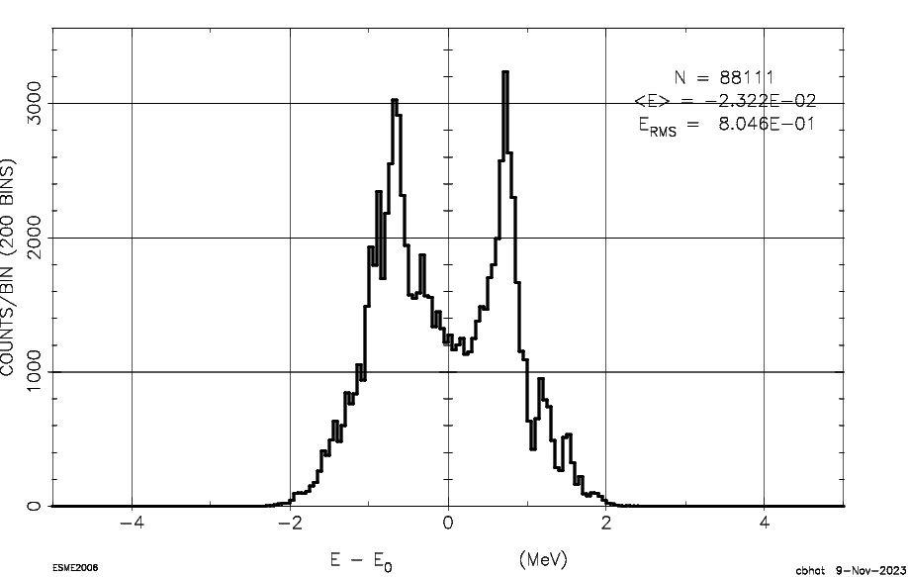
1E13 ppp in Booster
Line charge distribution of a single bunch
dE-dTheta-phase space
Energy Projection
C. Bhat

