Slide 1
Safety Assessment Document Updates for DOE O 420.2D
SAD Section III Chapter 08 - NuMI
Phil Schlabach
Accelerator Readiness Review
19-21 March 2024

Slide 2
Outline
NuMI Overview
Operating Modes
Hazard Inventory
Risk Table Summary
Non-Accelerator Specific Hazards
Accelerator Specific Hazards
Maximum Credible Incident (MCI) Discussion
Summary of Credited Controls

Slide 3
NuMI Overview
The Neutrinos at the Main Injector (NuMI) beam line begins with 120 GeV protons extracted from the Main Injector to a target station in the target hall where it collides, producing charged secondary particles (primarily pions and kaons) which are focused by a magnetic “horn” system and decay downstream producing the neutrino beam
The present primary consumer of NuMI beam is NuMI Off-axis ν_{e} Appearance (NOvA) experiment which has a near detector cavern in the MINOS tunnel and far detector in Ash River, MN
  for geographic reference I recall the nearest hardware store being in International Falls, MN which I’m sure you’ve visited many times
  There are and have been additional experiments in the MINOS cavern and other experiments in the short baseline program (SBN) which utilize(d) it as well (beam off axis to SBN detectors as well)
    The original experiment was the Main Injector Neutrino Oscillation Search (MINOS) for which the cavern was named
    It was joined by MINERvA (Main Injector Neutrino ExpeRiment to study v-A interactions)

Slide 4
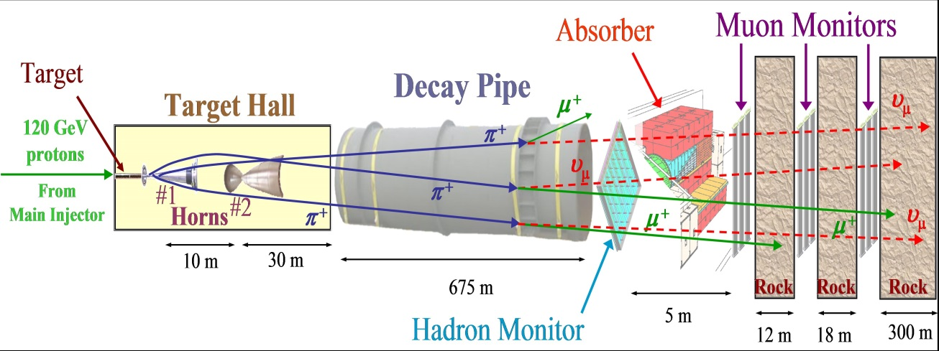
NuMI Overview
Extraction kicks MI beam up and toward the outer MI enclosure wall, flattens it out to transport out of the enclosure between the RR and MI beamlines, when it exits, it is bent downwards to dive through the water table and then back up to point at the target to aim the neutrino beam to the detector(s)
Features (see next slide)
  An underground lined Carrier Tunnel starting at the NuMI stub in the MI;
  An underground unlined Carrier Tunnel;
  Underground Pre-Target/Target enclosure;
  An underground Decay Tunnel;
  An underground Hadron Absorber Enclosure and Access Tunnel with Muon Alcoves
  Surface MI-65 and MINOS Service Buildings

Slide 5
NuMI Overview
The public is not invited to any area of the NuMI segment and are beyond Obvious and Operating Barriers

Slide 6
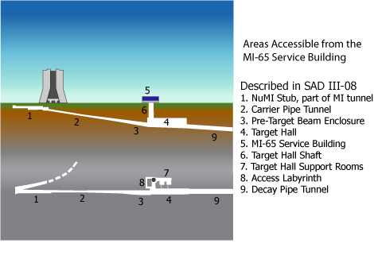
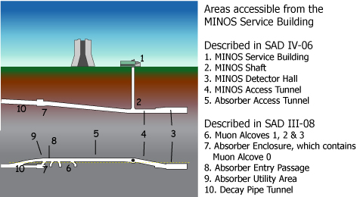
NuMI Overview
This SAD covers from the upstream end of the carrier pipe tunnel to the downstream end of the absorber including the radiation area outside and the muon alcoves
Stars locate the boundaries schematically (not to scale)

Slide 7
Operating Modes
There are two operating modes
  Normal operation as described
  Low intensity beam scans for alignment of downstream components with the target Hall shield door is not in place
    The beamlines are in a special configuration
    The shield door is not in place
    If the shield door is in place the scans are covered under normal operation

Slide 8
Hazard Inventory for NuMI
Accelerator specific hazards are purple
Hazards not discussed today are evaluated via the common Risk Matrix tables
  Covered in SAD Section I, Chapter 4
Hazards evaluated via risk assessment methodology per DOE-HDBK-1163-2020
  Likelihood (L):
    Anticipated (A), Unlikely (U), Extremely Unlikely (EU), Beyond Extremely Unlikely (BEU)
  Consequence (C):
    High (H), Moderate (M), Low (L), Negligible (N)
  Risk (R):
    I , II, III, IV (descending order of concern)

Slide 9
Risk Table Summary for NuMI

Slide 10
Non-Accelerator Specific Hazards - Radiological
Residual Activation
  The NuMI shielding assessment assesses residual activiation
    The residual dose rate in the primary beamline and downstream absorber are assessed as <100 milli-rem (mrem)/hr and 30 mrem/hr respectively; measured rates following normal continuous operation have typically been <15 mrem/hr
    Exceptions include target hall consumable components
      Target, horns 1 and 2 (6, 400, 33 rem/hr, estimated values for (30d, 1d) at operations of 700-kilowatt (kW) beam power)
      A typical changeout would involve remotely removing a component to the morgue for a years long cool off, followed by insertion in a cask for removal to on site radioactive storage for further years before transport
      Risk Matrix on next slide

Slide 11
Non-Accelerator Specific Hazards – Radiological
Residual Activation

Slide 12
Non-Accelerator Specific Hazards – Toxic Material
Beryllium
  The NuMI beamline contains a Be window through which beam passes from beamline vacuum to air in the Target Hall before colliding with the target
  These are engineered and used in such a way that the rupture of a window releases no beryllium into exposed areas
  The nature of the physical process sucks beryllium back into the vacuum pipe and it is captured in the short piece of vacuum tube that penetrates the target hall wall to the pre-target enclosure
  Processes and procedures are in place for replacement of the components comprising this assembly. They are disposed of in accordance with FRCM requirements

Slide 13
Accelerator Specific Hazards - Radiological
Prompt Ionizing Radiation – Beam Loss
  Ionizing radiation due to beam loss in the NuMI enclosures
  Analyzed maximum credible incident (MCI) to determine credited controls
    Accidental beam loss was analyzed for shielding but is not the MCI
    By intent, NuMI loses ~98% of the primary protons by hitting the target, this is not accidental, this scenario is the MCI
    Primary protons not interacting in the target are lost in the absorber as well as residual undecayed hadron debris from the target collision
  Risk Matrix on next slide

Slide 14
Accelerator Specific Hazards - Radiological

Slide 15
Accelerator Specific Hazards – Ground Water
Ground Water Activation
  The potential exists for activation of water within several meters of the tunnel wall
    Various systems allow us to minimize beam losses everywhere in NuMI
    Modeling of the hydrological system in the region of the beamline shows that NuMI acts as a perforated pipe with water flowing into it along the length of the beamline
    The water collected flows to the MINOS sump where it is pumped to a surface collection tank which is periodically sampled

Slide 16
Accelerator Specific Hazards – Radioactive Water
NuMI target, horns, decay pipe, and hadron absorber are cooled by water
Water in these cooling systems becomes activated with tritium and to a lesser extent beryllium-7
  Controls, interlocks and alarms designed for these systems prevent catastrophic losses as well as damage to the equipment
  Release of RAW the cooling systems causes no significant increase to the concentration of radionuclides in the drainage water
  Risk Matrix on next slide

Slide 17
Accelerator Specific Hazards – Radioactive Water

Slide 18
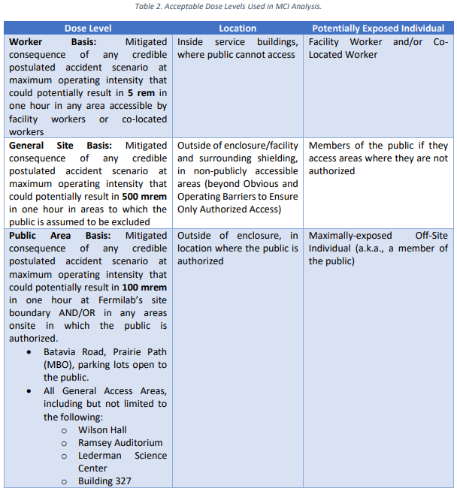
Maximum Credible Incident (MCI) – Radiological
The MCI focuses on exposure to an onsite worker and coworker
Incident bounds all postulated accident scenarios for NuMI
Fermilab uses Credited Controls that flow down to the Accelerator Safety Envelope (ASE) to mitigate the consequences of an MCI to the following conditions:

Slide 19
Maximum Credible Incident (MCI) – Radiological
Normal operation
  The MCI for the NuMI beamline is a beam with an intensity of 2.83e+17 protons/hour at an energy of 120 GeV incident on the target for one hour
  Assuming no shielding or other controls are present this incident would result in a dose to any individual far exceeding the limits in the last slide
  MCI intensity is the product of what the upstream machines can provide
Low intensity beam scan mode without the shield door present
  The MCI for the NuMI beamline is a beam with an intensity of 2.52e+15 protons/hour at an energy of 120 GeV incident on the target for one hour

Slide 20
Credited Controls
Permanent Shielding: Enclosure(s) overburden: 24 e.f.d.
Movable Shielding
  There are movable shielding components that must be removed for replacing the target/hons and must be in place for beam operation (e.g. target pile shield blocks, target hall shield door)
Penetration and Labyrinths
  Two survey risers which penetrate to the surface of the berm for use in alignment have removable shielding as well
Radiation Safety Interlock System (RSIS) which includes interlocked radiation detectors
Administrative Controls
  Operation Authorization Document
  Staffing
  Accelerator Operating Parameters
  Obvious and Operating Barriers
  Low intensity scans without the target hall shield door have additional administrative controls

Slide 21
Questions?

Slide 22
Backup Slide(s)

Slide 23
Non-Accelerator Specific Hazards - Radiological
Radioactive Waste
  Radioactive waste produced during NuMI operations will be managed within the established Radiological Protection Program (RPP) as prescribed in the Fermilab Radiological Control Manual (FRCM)
  Normal operation generates tritiated condensate from the NuMI dehumitifiers which is continuously pumped upstream into the MI65 service building for disposal
  Target and horns are consumable components and obviously rad waste after irradiation

Slide 24
Non-Accelerator Specific Hazards - Radiological
Contamination
  Although not typically encountered, contamination is possible in the primary beamline and is a consideration in work planning
  Contamination is common in the target pile and associated systems
    Shielding surrounding the target pile limits the spread of contamination
    Work is performed as per a radiological work permit specifying preventative measures
    Surveying and cleaning; mitigative measures, such as the material survey and release process, and the use of personal protective equipment reduce the spread of contamination

Slide 25
Non-Accelerator Specific Hazards –
Flammable & Combustible Materials
Flammable Materials
  Molecular hydrogen is produced in the target gas cooling system. It is diluted into a non-flammable ratio in air by venting into the large volume of the target hall and RAW water room
  Update to SAD wording

Slide 26
Non-Accelerator Specific Hazards - Electrical
Stored Energy Exposure
  Electrical hazards are present in the stripline connections between the power supply capacitor bank and the horns
  Similarly for the 60 kJules of stored energy in the power supply capacitor bank
  Access to the stripline is controlled by the NuMI radiation safety interlock system, the stripline is contained behind cages or the locked capacitor bank cabinet
  The power supply capacitor bank is designed, installed, operated, and maintained in accordance with FESHM requirements. Performing Lock out Tag out (LOTO) is required before performing maintenance on devices connected to hazardous energy sources. LOTO and grounding procedures are in place for work required
  These are a Non-Accelerator Specific Hazard (NASH) and described in Section I, Chapter 4

Slide 27
Non-Accelerator Specific Hazards - Electrical
Low Voltage, High Current Exposure:
  This hazard has been evaluated within the common Risk Matrix table included in SAD Section I Chapter 04 Safety Analysis. Work in NuMI involving this hazard implements the controls specified in the common Risk Matrix table. No unique controls are in use.

Slide 28
Non-Accelerator Specific Hazards –
Magnetic Fields
Fringe Fields
  The only magnetic fields present when personnel are present are corrector magnets. The electrical safety system prevents energizing of the large dipole and quadrupoles when interlocks are dropped. Access also requires the LOTO of the power to these magnets. No permanent magnets are present.

Slide 29
Non-Accelerator Specific Hazards – Potential Energy
Compressed gasses
  Compressed nitrogen and argon are used NuMI areas to facilitate operations
  Hazards evaluated within the common Risk Matrix table included in SAD Section I Chapter 04 Safety Analysis
Vacuum/Pressure Vessels/Piping
  Vacuum vessels are present in the NuMI areas in the form of beam pipes and other beamline components. Hazards evaluated within the common Risk Matrix table included in SAD Section I Chapter 04 Safety Analysis
  NuMI has air compressor tanks which are pressure vessels
    They follow the rules laid out in FESHM Chapter 5031 pointing to the ASME BPVC (Boiler and Pressure Vessel Code) Section VIII (Division 1 or Division 2) for compliance
    The tanks have a “U-Stamp” indicating compliance with code and a “Fermilab Silver Sticker” indicating an approved engineering note
No unique controls are in use

