Slide 1
Safety Assessment Document Updates for DOE O 420.2D
SAD Section IV Chapter 05 – NOvA Near Detector
Cindy Joe
Accelerator Readiness Review
March 19-21, 2024

Slide 2
Outline
NOvA Near Detector Overview
Hazard Inventory
Non-Accelerator Specific Hazards
Accelerator Specific Hazards
Maximum Credible Incident (MCI) Discussion
Summary of Credited Controls
Accelerator-specific hazards do not apply to this area.

Slide 3
Outline
NOvA Near Detector Overview
Hazard Inventory
Non-Accelerator Specific Hazards

Slide 4
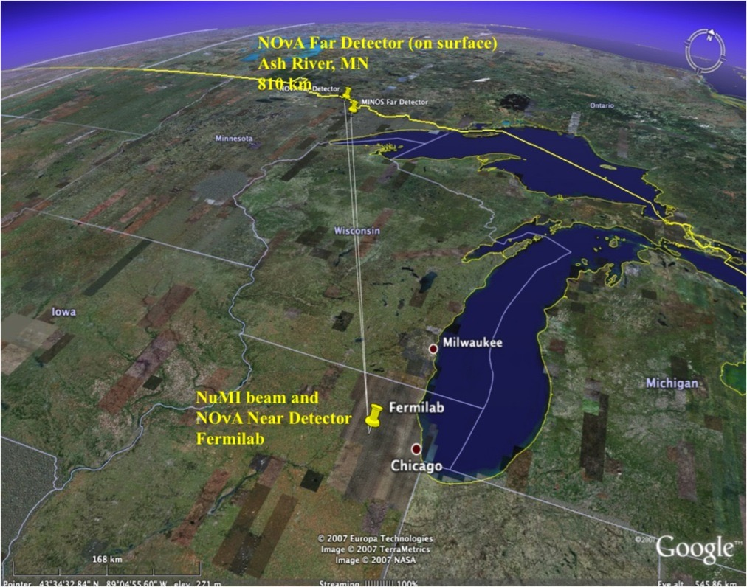
NOvA Near Detector Overview
The NOνA (NuMI Off-NuMI v_{e} Appearance) experiment uses a neutrino beam to study the strange properties of neutrinos, especially the transition of muon neutrinos into electron neutrinos. The neutrino beam interacts with the “Near Detector” located on the Fermilab site. There is also a “Far Detector” located in Ash River, Minnesota.
Due to the physical interaction properties of the neutrino beam no tunnel or other physical connection is needed between the Fermilab and the Far Detector. There is no detectable ionizing radiation due to the neutrino beam at either detector.

Slide 5
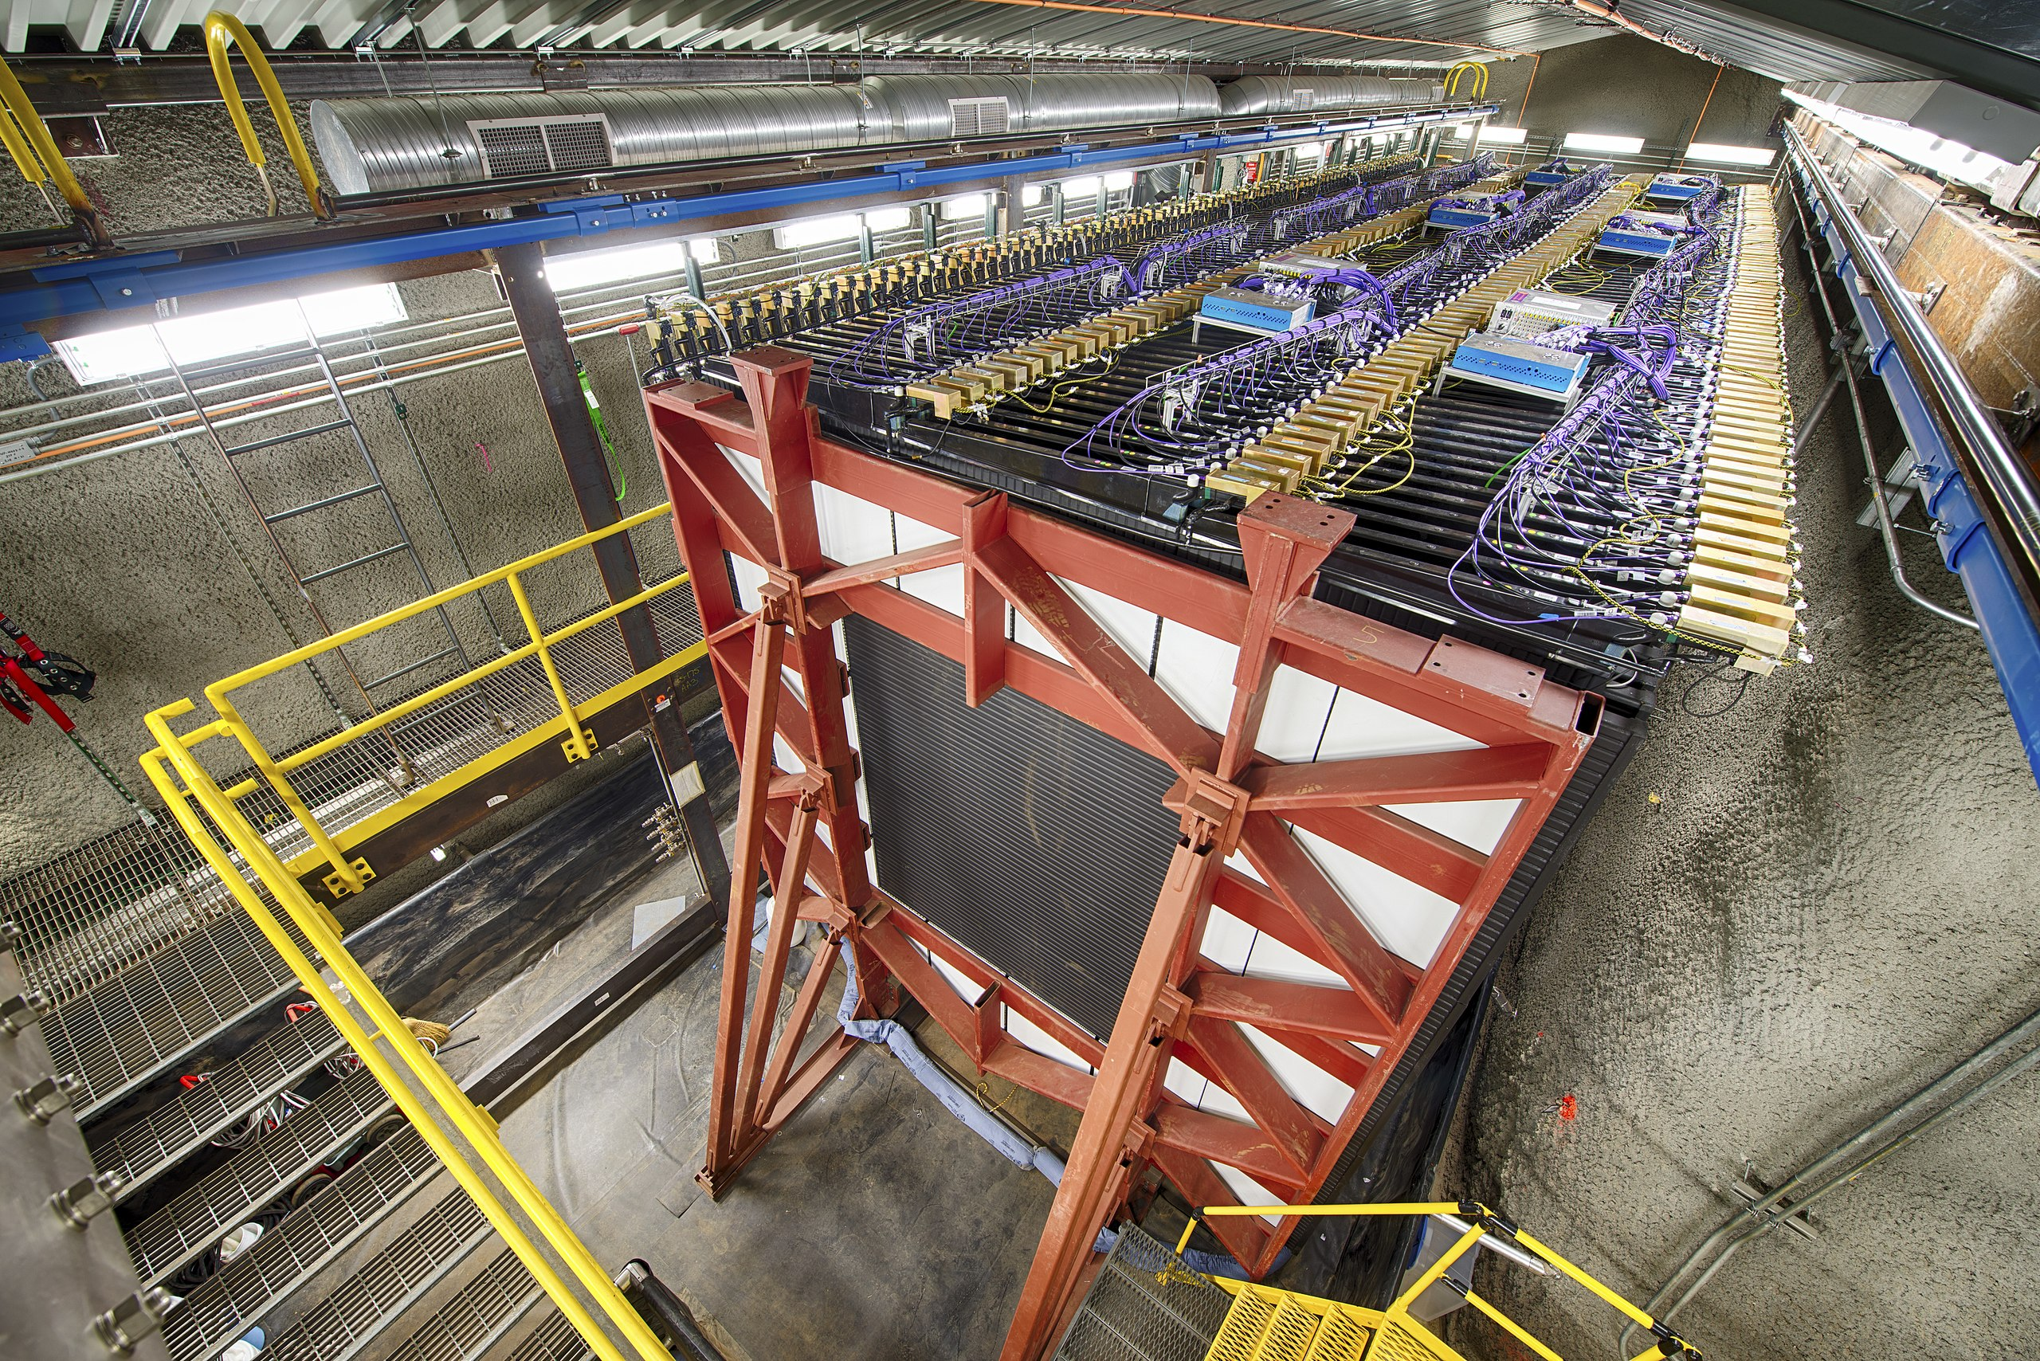
NOvA Near Detector Overview
The NOνA (NuMI Off-NuMI v_{e} Appearance) experiment uses a neutrino beam to study the strange properties of neutrinos, especially the transition of muon neutrinos into electron neutrinos. The neutrino beam interacts with the “Near Detector” located on the Fermilab site. There is also a “Far Detector” located in Ash River, Minnesota.
Due to the physical interaction properties of the neutrino beam no tunnel or other physical connection is needed between the Fermilab and the Far Detector. There is no detectable ionizing radiation due to the neutrino beam at either detector.

Slide 6
NOvA Near Detector Overview
The NOνA (NuMI Off-NuMI ve Appearance) experiment uses a neutrino beam to study the strange properties of neutrinos, especially the transition of muon neutrinos into electron neutrinos. The neutrino beam interacts with the “Near Detector” located on the Fermilab site. There is also a “Far Detector” located in Ash River, Minnesota.
Due to the physical interaction properties of the neutrino beam no tunnel or other physical connection is needed between the Fermilab and the Far Detector. There is no detectable ionizing radiation due to the neutrino beam at either detector.
Beam Direction

Slide 7
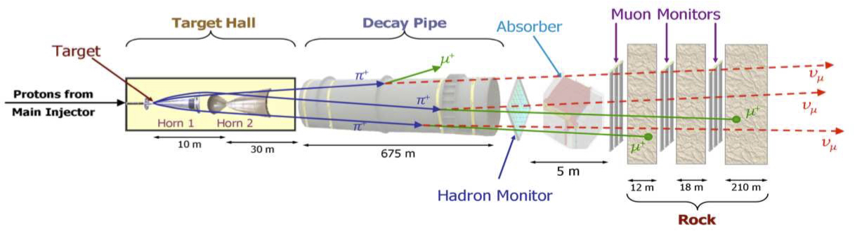
NOvA Near Detector Overview
The NOvA Near Detector is in the NuMI beamline. The NuMI beamline transports protons from Fermilab's Main Injector accelerator 1,000 feet down the beam line, where the protons interact with a graphite target to create muon neutrinos that interact with the Near Detector.

Slide 8
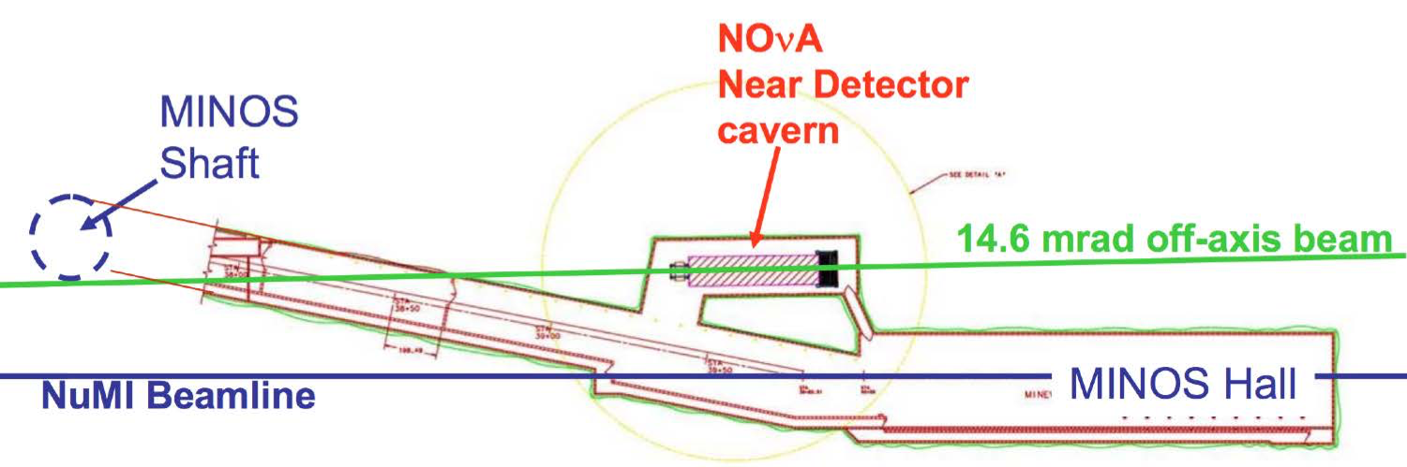
NOvA Near Detector Overview
The NOνA Near Detector resides approximately 350 feet underground in a cavern adjacent to the MINOS detector hall. The NOνA Near Detector cavern houses the NOνA Near Detector, which contains approximately 41,200 gallons of liquid scintillator oil, as well as supporting infrastructure.
Top view of inset section

Slide 9
Outline
NOvA Near Detector Overview
Hazard Inventory
Non-Accelerator Specific Hazards

Slide 10
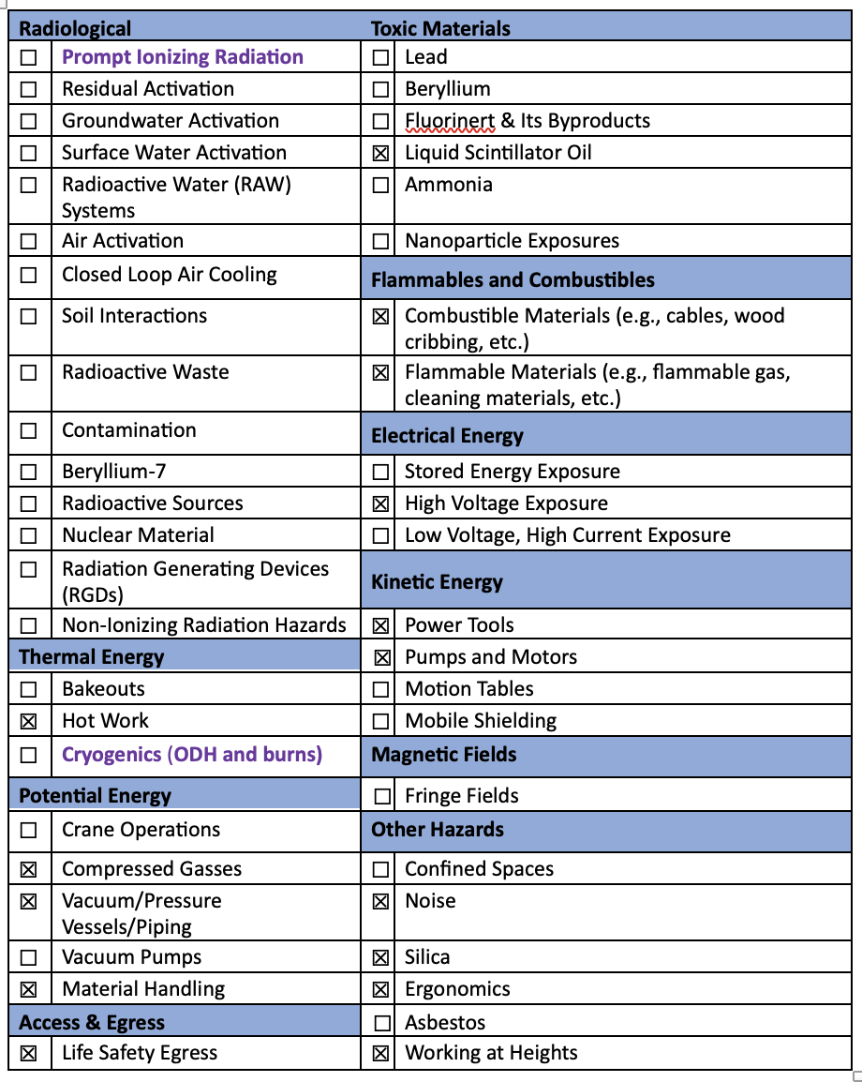
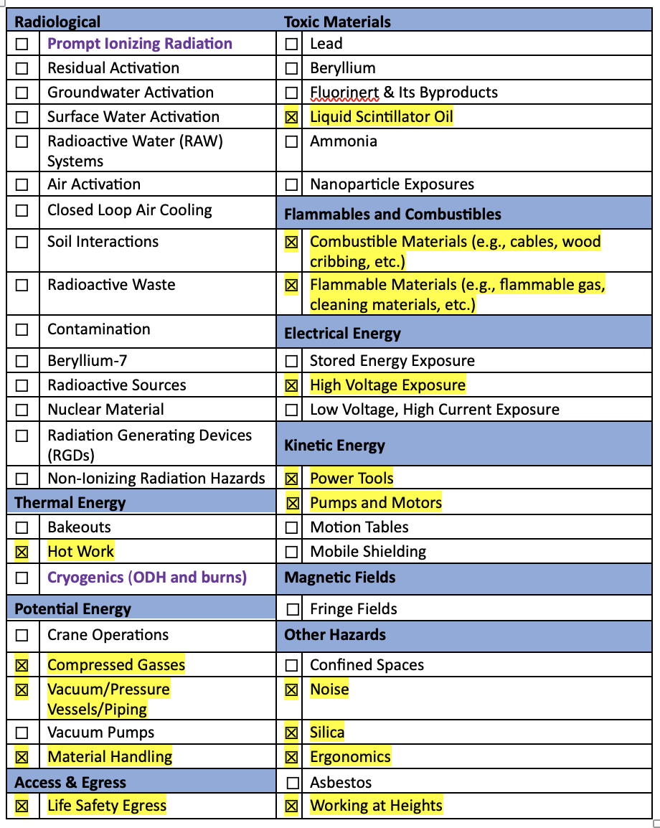
Hazard Inventory for NOvA Near Detector
Accelerator specific hazards are bold purple – None for NOvA Near Detector
Hazards not discussed today are evaluated via the common Risk Matrix tables
  Covered in SAD Section I, Chapter 4
Hazards evaluated via risk assessment methodology per DOE-HDBK-1163-2020
  Likelihood (L):
    Anticipated (A), Unlikely (U), Extremely Unlikely (EU), Beyond Extremely Unlikely (BEU)
  Consequence (C):
    High (H), Moderate (M), Low (L), Negligible (N)
  Risk (R):
    I , II, III, IV (descending order of concern)

Slide 11
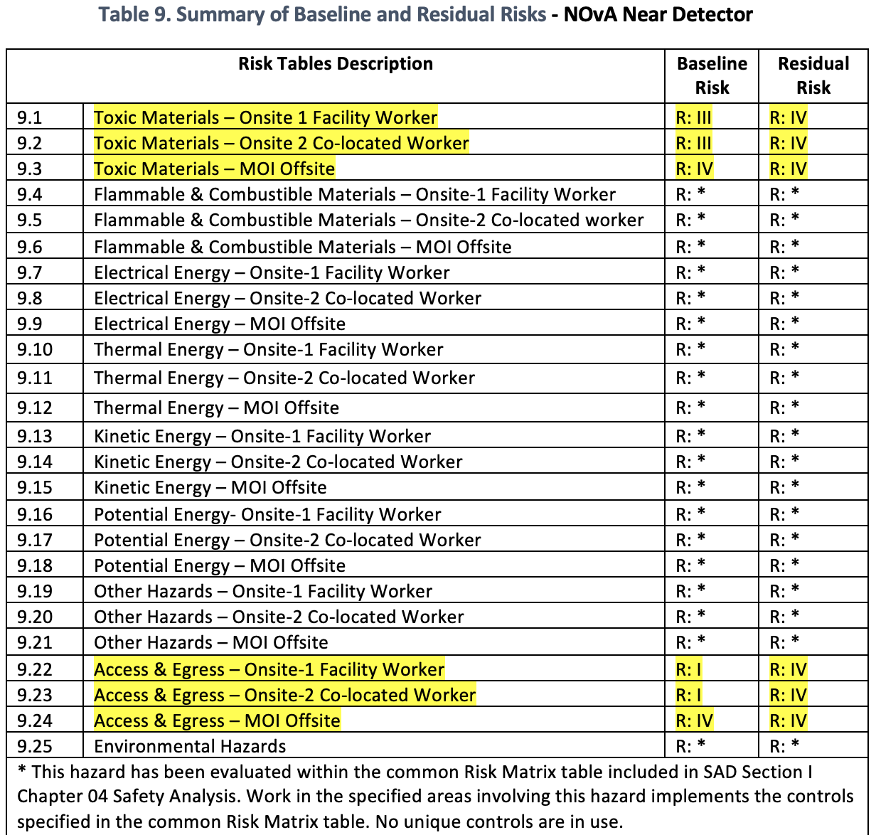
Risk Matrix Summary for NOvA Near Detector
Most of the risks for the NOvA Near Detector were determined to be adequately addressed using the common Risk Matrix tables.
However, some risks were addressed with unique controls which will be highlighted in subsequent slides.

Slide 12
Outline
NOvA Near Detector Overview
Hazard Inventory
Non-Accelerator Specific Hazards

Slide 13
Non-Accelerator Specific Hazards –
Life Safety Egress
Hazard: Inability to leave hazardous area in case of an emergency. In the MINOS Underground, this would be an ODH or fire alarm. In the MINOS Surface Building, this would be a fire alarm or tornado warning.
The NOvA Near Detector is located in the MINOS Underground Area, which is about 350 feet underground. Life safety egress is discussed further in the chapter on MINOS, SAD Chapter IV-06.
Briefly and in summary, the main access and egress to the MINOS Underground is via elevator. The MINOS Underground also contains positively pressured emergency escape passageways for life safety egress as well as a secondary emergency escape route which exits through the NuMI Target Hall at the MI-65 Service Building.

Slide 14
Non-Accelerator Specific Hazards –
Life Safety Egress
There is also an emergency diesel generator which supplies power for several functions including emergency exit lighting, elevator, ventilation, and crane power. There are multiple separate backup systems to the groundwater sump pump system, which continuously runs to prevent flooding.
Baseline Qualitative Risk (without controls) | Controls Preventive (P)/Mitigative (M) | Residual Qualitative Risk (with controls)
 | P- All MINOS Underground workers must take MINOS Underground Training. The most important part of this training concerns Life Safety Egress. P- In the case of a power outage, all Life Safety systems are powered by a large diesel generator: emergency lights, elevators, cranes (so the personnel basket to underground can be used), and air handling units (AHUs). M- First action on hearing an ODH or fire alarm underground is to exit to the Positive Pressure Emergency Passageway which should prevent smoke or toxic fumes from entering the area. M- Normally, workers should exit the underground via the main elevator. In the event the elevator is not working, the group should first call the emergency number X3131. If instructed to do so, the group should use the Secondary Escape Route explained in the MINOS Underground training and indicated with signs. The group may also be instructed to carry or use EEBDs. M- In the MINOS Surface Building, workers should go to the Assembly Area in the parking lot in the case of a fire alarm and go to the Tornado Shelter in the mechanical room in the case of a tornado warning.
L: A C: H R: I |  | L: EU C: N R: IV

Slide 15
Non-Accelerator Specific Hazards –
Liquid Scintillator
Hazard: NOvA’s liquid scintillator oil contains 5.35% pseudocumene. The pseudocumene is an eyes, skin and respiratory irritant, central nervous system depressant, and is toxic to marine life. Physical contact via handling or airborne exposure via outgassing oil
The NOνA Near Detector contains approximately 41,200 gallons of liquid scintillator oil. The scintillator distribution system design has minimal joints and connections to limit the potential for spills. The entire detector is installed inside of a pliable PVC membrane secondary containment. The NOνA Near Detector secondary containment has been reviewed and certified in the Fermilab Spill Prevention, Control and Countermeasure (SPCC) Plan, July 15, 2013, and is inspected regularly as prescribed.
A job-specific hazard analysis and procedure govern filling the detector and prescribe Personal Protective Equipment (PPE) to prevent worker contact with the liquid scintillator. The PVC modules, once filled, completely contain the pseudocumene, resulting in no further exposure. Emergency spill equipment, an eye wash and PPE are stationed near the detector in the event of a release. The secondary containment membrane has the capacity to contain 100% of the liquid scintillator oil and prevent a release to the environment.

Slide 16
Non-Accelerator Specific Hazards –
Liquid Scintillator
Baseline Qualitative Risk (without controls) | Controls Preventive (P)/Mitigative (M) | Residual Qualitative Risk (with controls)
L: A C: L R: III | P - A job-specific hazard analysis and procedure govern filling the detector and prescribe Personal Protective Equipment (PPE) to prevent worker contact with the liquid scintillator. P - The PVC modules, once filled, completely contain the pseudocumene, resulting in no further exposure. P - The entire detector is inside of a secondary containment membrane that has the capacity to contain 100% of the liquid scintillator oil and prevent a release to the environment. M - Emergency spill equipment, an eye wash and PPE are stationed near the detector in the event of a release. | L: BEU C: N R: IV

Slide 17
Questions?

Slide 18
Outline
NOvA Near Detector Overview
Hazard Inventory
Non-Accelerator Specific Hazards
Backup Slide(s)

Slide 19
Non-Accelerator Specific Hazards –
Life Safety Egress
Underground Evacuation video: https://mod.fnal.gov/mod/w3/Training/ESH/UndergroundEgress/index.htm

Slide 20
Non-Accelerator Specific Hazards –
Combustible Materials
Hazard: a potential facility fire (Reference: FESHM Chapter 2005 Operational Readiness Clearance & 6010 Fire Protection Program)
The Near Detector cavern underwent a fire hazard and life safety analysis using the International Building Code and NFPA 520 provisions as appropriate. Hughes Associates, Inc. completed this evaluation during March 19-2110. The liquid scintillator, as delivered to Fermilab, is a Class III B combustible liquid according to the flash point indicated by the MSDS, and presents a potential fire hazard during detector filling. The cellular structure of the detector significantly mitigates this hazard by containing the liquid scintillator within fire retardant cellular PVC extrusions.
A burn test performed on the rigid PVC extrusions and contained in the NOνA Rigid PVC Flammability Testing and other Fire related issues concluded that this design and the liquid scintillator’s high flash point of >202°F reduce the opportunity for ignition. Hazard mitigation includes restricting open flames or other sources of ignition present in any areas containing liquid scintillator via Fermilab Environment, Safety, and Health Manual (FESHM) Chapter 6020.2 - Welding, Burning, and Brazing chapter, an automatic water mist fire suppression system, a VESDA smoke detection, and FIRUS.
The large quantity of wavelength shifting fiber is a combustible, but does not constitute a fire hazard because it is completely enclosed inside the individual PVC cells.

Slide 21
Non-Accelerator Specific Hazards –
Combustible Materials
The installation of electronics, power supplies, and all other electrical components of the experiments performed in the Near Detector cavern are in accordance with the Particle Physics Division (PPD) Electrical Department guidelines and FESHM to ensure that they do not constitute a fire or shock hazard. All installations have been reviewed according to the ORC process.
Baseline Qualitative Risk (without controls) | Controls Preventive (P)/Mitigative (M) | Controls Preventive (P)/Mitigative (M) | Residual Qualitative Risk (with controls)
 | P: The use of Operational Readiness Clearance (ORC) and/or WPC process determine if additional combustibles will be introduced to the area P: Fire Safety and Life Safety Inspections are performed by the Fire Protection Group and the Fire Department P: Fire alarm systems ITM is performed at prescribed frequencies P: Prior to restart, a walkdown is conducted of the complex verifying transient combustibles are removed before operational activities commence P: Hot work program administered by the Fire Department P: Public is screened at Fermi site boundary, and Fermilab restricts public access to accelerator complex. | M: Smoke, heat, sprinklers, are monitored by a sitewide monitoring system with notification to the emergency dispatch center that is constantly staffed, 24/7, 365 days M: Fire detection and/or suppression is present M: Manual fire suppression services are provided, i.e., fire hydrants, throughout the complex M: Egress stairways are constructed as fire barriers M: On-site fire department trained in radiological environments M – Evacuation training/evacuation drills M: In the event of a fire, site security prohibits access to the public
L: A C: H R: I |  |  | L: BEU C: N R: IV
Baseline Qualitative Risk (without controls) | Controls Preventive (P)/Mitigative (M) | Controls Preventive (P)/Mitigative (M) | Residual Qualitative Risk (with controls)
 | P: The use of Operational Readiness Clearance (ORC) and/or WPC process determine if additional combustibles will be introduced to the area P: Fire Safety and Life Safety Inspections are performed by the Fire Protection Group and the Fire Department P: Fire alarm systems ITM is performed at prescribed frequencies P: Prior to restart, a walkdown is conducted of the complex verifying transient combustibles are removed before operational activities commence P: Hot work program administered by the Fire Department P: Public is screened at Fermi site boundary, and Fermilab restricts public access to accelerator complex. | M: Smoke, heat, sprinklers, are monitored by a sitewide monitoring system with notification to the emergency dispatch center that is constantly staffed, 24/7, 365 days M: Fire detection and/or suppression is present M: Manual fire suppression services are provided, i.e., fire hydrants, throughout the complex M: Egress stairways are constructed as fire barriers M: On-site fire department trained in radiological environments M – Evacuation training/evacuation drills M: In the event of a fire, site security prohibits access to the public
L: A C: H R: I |  |  | L: BEU C: N R: IV

Slide 22
Non-Accelerator Specific Hazards –
Flammable Materials
Hazard: a potential facility fire (Reference: FESHM Chapters 2005 Operational Readiness Clearance, 6010 Fire Protection Program, 6020.3 Flammable Gases, 6020.4, Combustible & Flammable Liquids)
Filling the cells with liquid scintillator oil presented a fire hazard due to static accumulation and discharge on the plumbing. This hazard was mitigated using plumbing that is conductive, grounded and bonded. Also, an anti-static additive was added to the scintillator in concentrations that increase conductivity to reduce the steady state electric current flow in the main distribution lines by a factor of ~100, reducing the charge delivered to the module by this factor. An additional risk from scintillator-initiated fire would stem from improper storage and disposal of oil-soaked rags. Spills are dealt with promptly, and fire-proof disposal receptacles are provided where needed. Appropriate interlocks and controls on the scintillator filling machines reduce the probability of spills during scintillator liquid transfer. If removal of the scintillator is required, similar provisions will mitigate these hazards.

Slide 23
Non-Accelerator Specific Hazards –
Flammable Materials
The installation of electronics, power supplies, and all other electrical components of the experiments performed in the Near Detector cavern are in accordance with the Particle Physics Division (PPD) Electrical Department guidelines and FESHM to ensure that they do not constitute a fire or shock hazard. All installations have been reviewed according to the ORC process.
Baseline Qualitative Risk (without controls) | Controls Preventive (P)/Mitigative (M) | Controls Preventive (P)/Mitigative (M) | Residual Qualitative Risk (with controls)
 | P: The use of Operational Readiness Clearance (ORC) and/or WPC process determine if additional combustibles will be introduced to the area P: Fire Safety and Life Safety Inspections are performed by the Fire Protection Group and the Fire Department P: Fire alarm systems ITM is performed at prescribed frequencies P: Prior to restart, a walkdown is conducted of the complex verifying transient combustibles are removed before operational activities commence P: Hot work program administered by the Fire Department P: Public is screened at Fermi site boundary, and Fermilab restricts public access to accelerator complex. | M: Smoke, heat, sprinklers, are monitored by a sitewide monitoring system with notification to the emergency dispatch center that is constantly staffed, 24/7, 365 days M: Fire detection and/or suppression is present M: Manual fire suppression services are provided, i.e., fire hydrants, throughout the complex M: Egress stairways are constructed as fire barriers M: On-site fire department trained in radiological environments M – Evacuation training/evacuation drills M: In the event of a fire, site security prohibits access to the public
L: A C: H R: I |  |  | L: BEU C: N R: IV

