Slide 1
Safety Assessment Document Updates for DOE O 420.2D
SAD Section III Chapter 10 – Muon Campus
Jerry Annala
Main Accelerator Readiness Review
Muon Campus
March 19-21, 2024

Slide 2
Outline
Muon Campus Overview
Hazard Inventory
Non-Accelerator Specific Hazards
Accelerator Specific Hazards
Maximum Credible Incident (MCI) Discussion
Summary of Credited Controls
Notes:
Outline of what I will cover starting with an overview of the Muon Campus.

Slide 3
Muon Campus Overview - History
Originally Antiproton Source for Tevatron Collider, completed in 1985
  Ceased operation in 2011 when Collider program ended
  Original shielding designed for secondary beam downstream of Target Station
Plans were already underway to repurpose facility for new experiments
  Mu2e Project received CD-0 in 2008, CD-1 in 2012
  g-2 Project received CD-0 in 2012, CD-1 in 2013
Beamlines were reconfigured for new uses
  Upstream beamlines simplified with dual-use M3 Line
  Accumulator Ring decommissioned and magnets used for new beamlines
  New external beamlines and tunnels built to transport beam to experiments
New experimental facilities were built
  MC-1 Building for g-2 and MC-2 Building for Mu2e
Commissioning of the Muon Campus began in early 2017
  Commissioning while the campus was still being constructed impacted the design of some enclosures
  g-2 Experiment ran 2017 – 2023 and has successfully concluded
  Upstream beam commissioning for Mu2e underway
Notes:
Originally constructed in the 80’s as the Antiproton Source for the Tevatron Collider.
Built to support 2 experiments – g-2 and Mu2e
Required new construction for experimental halls and beamlines from the existing accelerator
Use most of the Delivery Ring is used and decommissioned the Accumulator to use the magnets for the new beamlines.
We started commissioning parts of the Campus while building others – this influenced some of the enclosure boundaries.

Slide 4
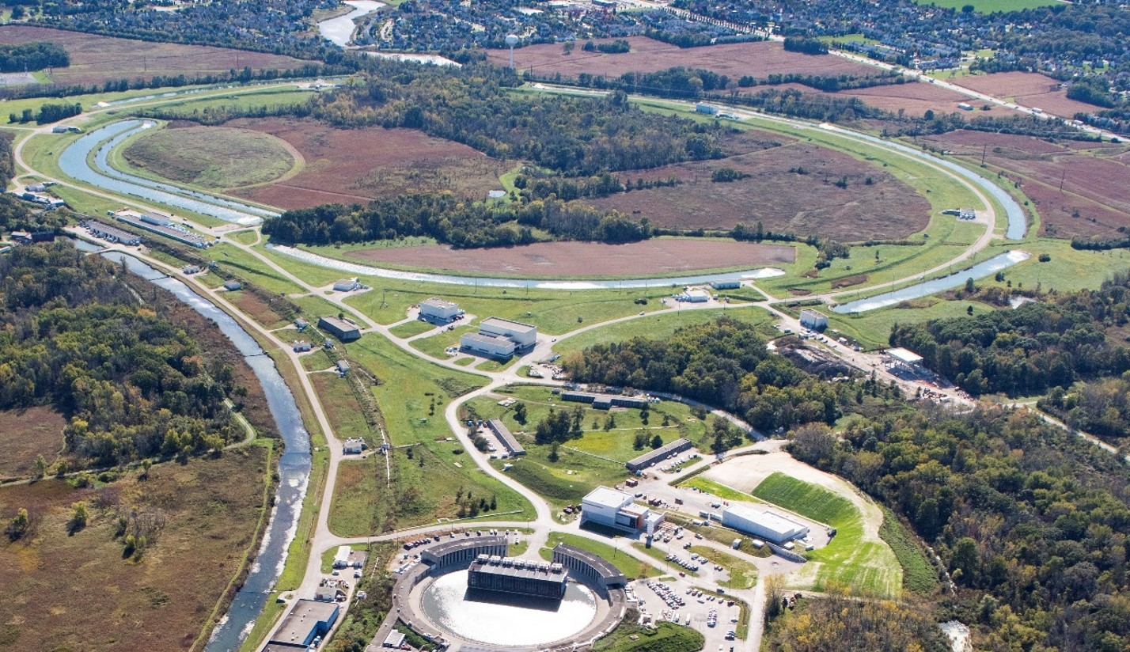
Muon Campus Overview - Layout
Recycler
P1, P2, M1
M2
(not in use)
AP0
Target Station
M3
Abort
Delivery Ring
AP50
AP30
AP10
M5
M4
Mu2e
(not in use)
MC-1
(g-2)
Notes:
Source of Protons is the Recycler fixed energy 8 GeV protons.
Muon Campus segment begins at the M1 beamline where it exits the Tevatron tunnel.
Muon Campus beamlines we will discuss are M1, M3, M2, Delivery Ring, abort line, M4 and M5 beamlines.

Slide 5
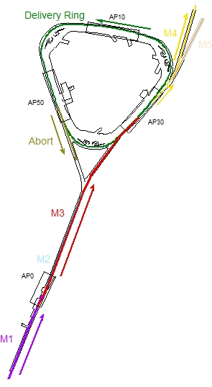
Muon Campus Overview - Modes of Operation
8 GeV beam sent from Recycler Ring in both modes of operation
  Beam in Recycler is rebunched to create shorter bunches (140 ns)
g-2 mode (no longer in operation)
  8 GeV protons to AP-0 Target Station, 3.1 GeV/c muons to MC-1
  Maximum 16 1E12 beam transfers every 1.4 seconds
Mu2e mode
  8 GeV protons bypass AP-0 and are transported to Delivery Ring
  Protons are resonantly extracted from DR and transported to MC-2
  Maximum 8 1E12 beam transfers every 1.4 seconds
g-2 operation
Mu2e operation
Notes:
g-2 mode directs protons onto AP0 target (used for Antiproton production) – secondary beam passes through M2, M3, DR (4 turns), Muons to M4, M5, g-2 storage ring. Protons go to DR abort.
Mu2e operations – Protons bypass Ap0 target, M3, DR, Resonant extraction, M4 to Mu2e. Left over protons to DR abort.

Slide 6
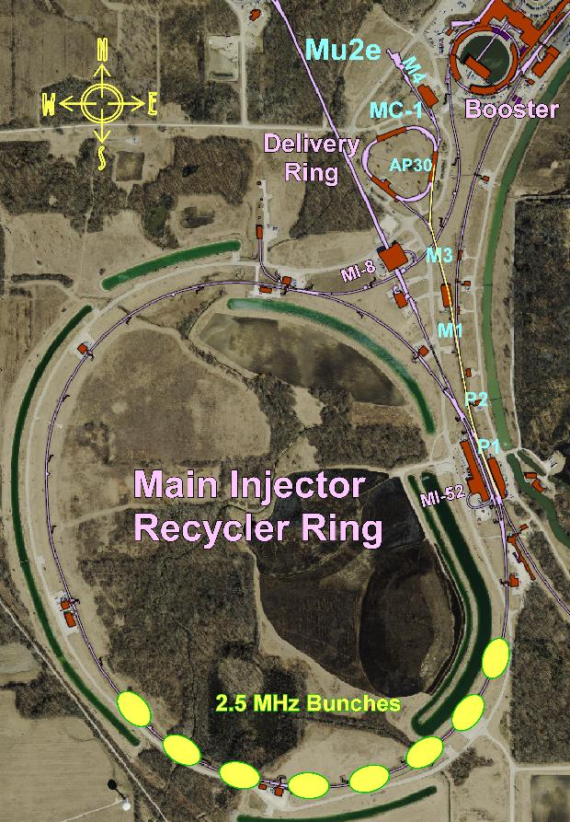
Muon Campus Overview - Recycler to Delivery Ring
Recycler energy is fixed at 8 GeV
Beam from Booster is re-bunched into 4 140 ns long bunches
  Two Booster injections to make 8 bunches
Beam is transferred to Delivery Ring every 48 ms (8 transfers every 1.4 s)
8 GeV beam passes through a series of beamlines to reach Delivery Ring
  P1 and P2 Lines in Tevatron Enclosure
  M1 line begins at F-17, passes through “sewer pipe” into PT/PV Encl.
  This buried pipe is the dividing line between the SY SAD and the Muon Campus SAD. The buried pipe is part of Muon Campus
  M3 Line bypasses AP-0 Target Station and connects to Delivery Ring
Less radiation shielding over M3 Line downstream of AP-0 Target Station
AP-0
Notes:
Beam for both modes come from 2 Booster batches with 8 bunches re-formed in the RR. Bunches are then transferred one at a time (g-2 transfers are faster).
Less shielding exist beyond the AP0 target because it was originally not designed for primary beam beyond the target. New enclosures are better shielded.

Slide 7
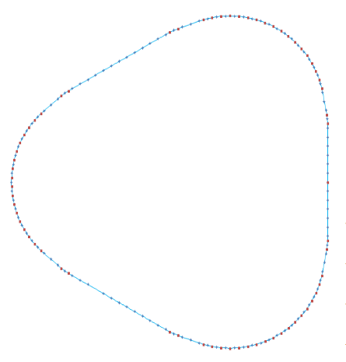
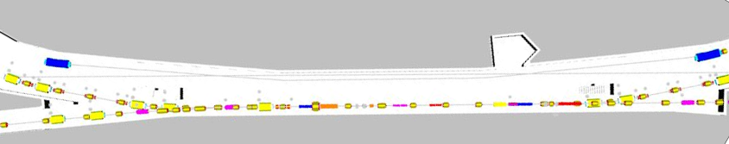
Muon Campus Overview – Delivery Ring and Abort
M4 – Resonantly extracted
protons to MC-2
Delivery Ring has 505 m circumference
  66 dipoles and 132 quadrupoles
  Three straight sections for injection, extraction or diagnostics
  Three arcs connect the straight sections
30 Straight Section has both injection and extraction
50 Straight Section has extraction to Abort Line
  Abort Line ends at steel absorber after about 50 m
  Old AP-2 Line
M3 – protons from RR
30 Straight Section
Abort Line
10 Straight Section
50 Straight Section
Injection
Extraction
30 Straight Section
M4 Line
M3 Line
Notes:
A look at the Delivery Ring to become familiar. Three straight sections under the service buildings, and arcs in between under earth berms. Both injection and extraction take place in the 30 straight section. The abort is from the 50 straight section and utilizes the old Antiproton injection line in the opposite direction.

Slide 8
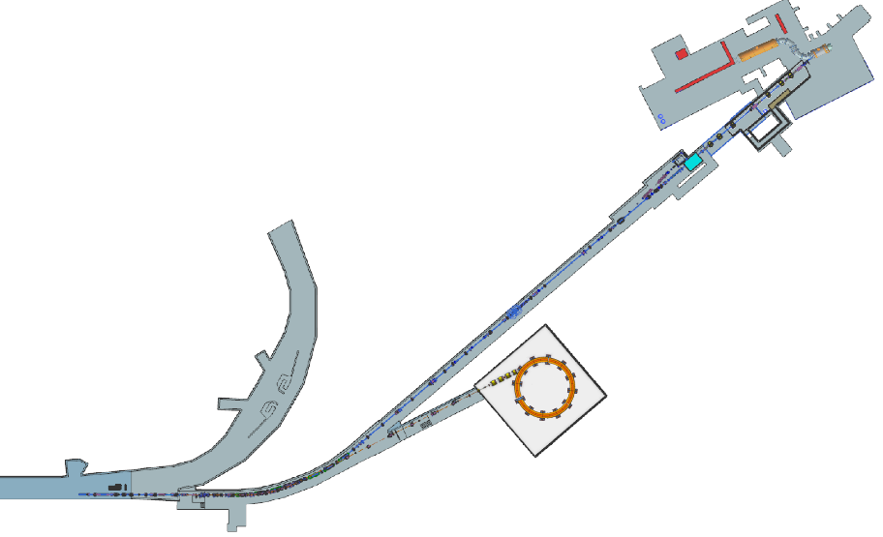
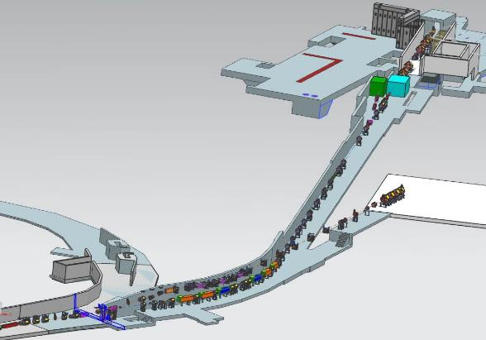
Muon Campus Overview - External Beamlines
M4 Line transports 8 GeV protons from Delivery Ring to Mu2e Experiment
  Resonantly extracted beam enters M4 Line in downstream 30 Straight Section
  245 m long, but has Diagnostic Absorber at 192 m for beam commissioning
  First 30 m of M4 Line also used to connect to M5 Line during g-2 operation
Mu2e Solenoids
In MC-2 Building
M4 Line
M4 Line
Delivery Ring
g-2 Storage Ring
In MC-1 Building
M5 Line
M5 Line
Shared section of M4
Notes:
Extraction for both experiments utilize the first part of the M4 line. There is a switch magnet early in the line where the Mu2e and g-2 beamlines separate.

Slide 9
Outline
Muon Campus Overview
Hazard Inventory
Non-Accelerator Specific Hazards
Accelerator Specific Hazards
Maximum Credible Incident (MCI) Discussion
Summary of Credited Controls

Slide 10
Hazard Inventory for Muon Campus
Accelerator specific hazards are purple
Hazards not discussed today are evaluated via the common Risk Matrix tables
  Covered in SAD Section I, Chapter 4
Hazards evaluated via risk assessment methodology per DOE-HDBK-1163-2020
  Likelihood (L):
    Anticipated (A), Unlikely (U), Extremely Unlikely (EU), Beyond Extremely Unlikely (BEU)
  Consequence (C):
    High (H), Moderate (M), Low (L), Negligible (N)
  Risk (R):
    I , II, III, IV (descending order of concern)
Notes:
Hazards are evaluated based on likelihood and severity of consequences. We implement preventative measures to decrease the likelihood, and mitigative measures to reduce the consequences until the risks are at an acceptable level.

Slide 11
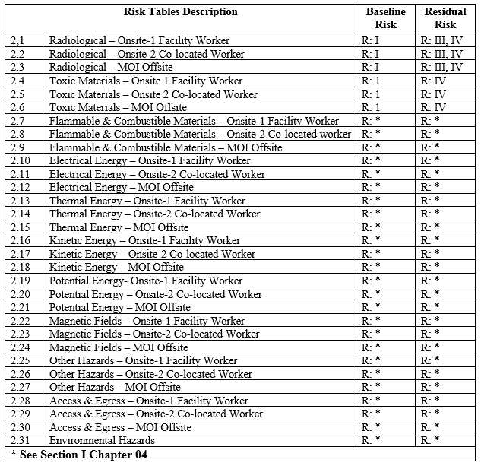
Risk Table Summary

Slide 12
Outline
Muon Campus Overview
Hazard Inventory
Non-Accelerator Specific Hazards
Accelerator Specific Hazards
Maximum Credible Incident (MCI) Discussion
Summary of Credited Controls

Slide 13
Non-Accelerator Specific Hazards - Radiological
Residual Activation
  Accelerator components can become activated from beam loss. Exposure to these activate components is possible.
  The residual dose rate found in the Muon Campus from initial entry surveys is historically less than 5 mrem/hr, exceptions include:
    <20 mrem/hr on either side of the AP0 target where the beam dimensions are large due to optics are set to maximize target yield
Baseline Qualitative Risk (without controls) | Controls Preventive (P)/Mitigative (M) | Residual Qualitative Risk (with controls)
L: A C: H R: I | P – Employee Rad Worker training P – ALARA plan M – Shielding to reduce activation M – Proper dosimetry | L: EU C: L R: IV
Notes:
Residual radiation obviously a hazard. Here we see two preventative measures and two mitigative to reduce the risk to a minimal level.

Slide 14
Non-Accelerator Specific Hazards - Radiological
Ground Water
  Scattered beam has potential to activate ground water at low levels calculated in the Shielding Assessments.
  Hazard applies to onsite facility workers, onsite co-located workers and
Baseline Qualitative Risk (without controls) | Controls Preventive (P)/Mitigative (M) | Residual Qualitative Risk (with controls)
L: A C: N R: IV | M – Radiation monitors turn off the beam if beam loss in the area exceeds limits determined in the Shielding Assessments | L: A C: N R: IV
Notes:
Ground water only an issue in certain locations (minimal especially now the g-2 is not active).

Slide 15
Non-Accelerator Specific Hazards - Radiological
Surface water
  Potential exposure to activated surface water due to beam loss leakage from beam enclosures located near surface water impoundment.
  Hazard applies to onsite facility workers and onsite co-located workers
Baseline Qualitative Risk (without controls) | Controls Preventive (P)/Mitigative (M) | Residual Qualitative Risk (with controls)
L: A C: N R: IV | P – Beam Loss Monitors in enclosures prevent excessive beam loss. M – Shielding to reduce surface water activation | L: U C: N R: IV

Slide 16
Non-Accelerator Specific Hazards - Radiological
Radioactive water (RAW) systems
  RAW water system is used to cool the Lithium Lens, Pulsed Magnet and the beam absorber in the AP0 target hall during g-2 operation.
Baseline Qualitative Risk (without controls) | Controls Preventive (P)/Mitigative (M) | Residual Qualitative Risk (with controls)
L: A C: M R: II | P – Locked cage containing the water equipment is controlled by the RSO who only grants access once radiation rates have dropped to safe levels P – Radiation training required to access the water cage M – Radiation Technician coverage required for water cage access M – Dosimetry is required by relevant RWP | L: EU C: N R: IV
Notes:
Raw water system at AP0 target station which is currently inactive.

Slide 17
Non-Accelerator Specific Hazards - Radiological
Air Activation
  Particle beams interacting with the target and immediate air volume can radioactivate the air which could then migrate to accessible areas.
Baseline Qualitative Risk (without controls) | Controls Preventive (P)/Mitigative (M) | Residual Qualitative Risk (with controls)
L: A C: H R: I | P – Interlock system prevents access to beam enclosures while beam is enabled. P – Enclosure and service building key possession is linked to necessary radiological and controlled access training. P – Activated Air monitor is installed in the AP0 service building. M – Air flow controlled to route air through HEPA filter and into decay path that provides time for activated air to decay before being released. | L: BEU C: M R: IV
Notes:
The largest risk of activated air is also from the inactive AP0 target station.

Slide 18
Non-Accelerator Specific Hazards - Radiological
Soil Interactions
  Scattered beam has the potential to activate soil at low levels calculated in the shielding assessment.
Baseline Qualitative Risk (without controls) | Controls Preventive (P)/Mitigative (M) | Residual Qualitative Risk (with controls)
L: A C: N R: IV | M – Sensing equipment (radiation detectors) shot off beam if anticipated levels are exceeded. | L: A C: N R: IV
Notes:
Radiation sensing equipment is used to keep risk of soil interactions limited to the area of the inactive target station.

Slide 19
Non-Accelerator Specific Hazards - Radiological
Radioactive Waste
  Radioactive waste produced during beam operations will be managed within the established Radiological Protection Program (RPP) as prescribed in the Fermilab Radiological Control Manual (FRCM)
Baseline Qualitative Risk (without controls) | Controls Preventive (P)/Mitigative (M) | Residual Qualitative Risk (with controls)
L: A C: H R: I | P – Radiological worker training P - Any item in a beam enclosure during beam-on condition is removed and surveyed by radiological workers and classified appropriately. P – Any item identified for disposal is surveyed and process by Radiological Control organization personnel in accordance with FRCM chapter 4. M – Labeling required by material survey and release process | L: BEU C: M R: IV
Notes:
Many preventative measures to reduce radioactive waste hazards.

Slide 20
Non-Accelerator Specific Hazards - Radiological
Contamination
  Activated dust or debris could be ingested by a worker or removed from radiation area unintentionally
Baseline Qualitative Risk (without controls) | Controls Preventive (P)/Mitigative (M) | Residual Qualitative Risk (with controls)
L: A C: H R: I | P – Radiation areas of areas before work. P – Contamination wipes taken regularly in areas of likely contamination P – RWP specifies PPE P – Training - frisking on exit | L: BEU C: H R: III
Notes:
Again, contamination is a risk where we implement many preventative measures.

Slide 21
Non-Accelerator Specific Hazards – Toxic Materials
Fluorinert and its byproducts
  Fluorinert is used as a dielectric in high voltage feedthroughs for HV devices.
  When heated or irradiated sufficiently, Fluorinert can produce HF and PFIB
  Fluorinert is evaluated in the standard risk matrix by implementing filtering of the toxic byproducts.
  In the Muon Campus, the beam intensity is low enough that filtering has not been implemented so the hazard is evaluated as shown here.
Baseline Qualitative Risk (without controls) | Controls Preventive (P)/Mitigative (M) | Residual Qualitative Risk (with controls)
L: A C: H R: I | P –Fluorinert and decomposition products are contained in a closed system. P – Maintenance Program identifies and implements appropriate controls to prevent exposure if system is breached. M – Fluorinert handling procedures exist for workers dealing with devices containing Fluorinert. M – Enclosure circulation and ventilation fans would disperse any released Fluorinert byproducts. | L: EU C: L R: IV
Notes:
Again, contamination is a risk where we implement many preventative measures.

Slide 22
Outline
Muon Campus Overview
Hazard Inventory
Non-Accelerator Specific Hazards
Accelerator Specific Hazards
Maximum Credible Incident (MCI) Discussion
Summary of Credited Controls

Slide 23
Accelerator Specific Hazards - Radiological
Prompt Ionizing Radiation – Beam Loss
  Ionizing radiation due to beam loss in the Muon Campus enclosures
  Analyzed maximum credible incident (MCI) to determine credited controls
  Hazard applies to onsite facility workers, onsite co-located workers.
Notes:
Prompt ionizing radiation is the only accelerator specific hazard to deal with in the Muon Campus. We will show the analysis of the Maximum Credible Incident (MCI) and how we mitigate this hazard under that (those) conditions.

Slide 24
Outline
Muon Campus Overview
Hazard Inventory
Non-Accelerator Specific Hazards
Accelerator Specific Hazards
Maximum Credible Incident (MCI) Discussion
Summary of Credited Controls

Slide 25
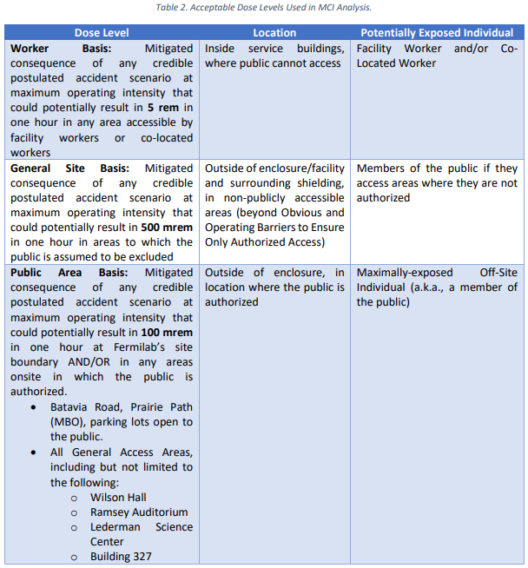
Maximum Credible Incident (MCI) - Radiological
Muon Campus includes locked buildings where public cannot access, and outdoor areas that are not accessible to the public.
The Muon Campus is entirely beyond the Obvious and Operating Barriers that prohibit public access.

Slide 26
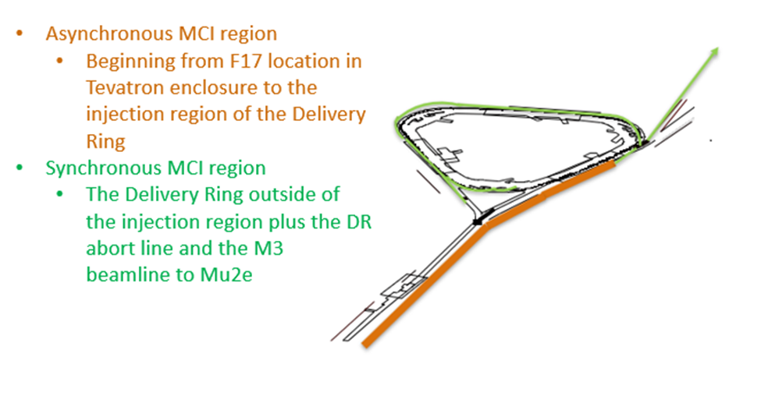
Regions separating MCI scenarios

Slide 27
Maximum Credible Incident (MCI) – Radiological
The MCI for the Muon Campus between the buried pipe at F17 and the injection region of the Delivery Ring is 3.78 e17 protons/hour at 8 GeV.
  This incident could result if the Booster was delivering its maximum beam intensity at 15 Hz to the Recycler. For the Muon Campus to receive this beam, at least one device in the Recycler would have to be malfunctioning in a way that steered beam on the first turn into the extraction channel of the Lambertson at approximately the same trajectory as beam meant for the Muon Campus.
  Assuming no shielding or other controls are present this incident would result in a dose to any individual higher than 1.2 e7 rem in an hour.
  In this scenario, beam that is not intended for the Muon Campus operation is delivered without participation of the normal transfer process. Since the pulse transfer devices are not triggered in this scenario, the beam would survive no further than the injection region under AP30 in the Delivery Ring. This scenario is identified as the asynchronous MCI.
  This scenario represents the maximum amount of beam that the upstream accelerators can physically transport.
Notes:
The Asynchronous MCI area is from the beginning of the MC at F17 to the injection region of the DR in AP30.
Maximum 15 Hz Booster beam with a mis-adjusted (malfunctioning) magnet(s) that just happen to steer the first turn in the Recycler onto the extraction trajectory at the extraction Lambertson. In this situation, all of the Booster beam would be steered toward the Muon Campus. The intensity in this scenario would be 1.05 e14 protons/hr. An accident at this intensity would result in a dose of 12 Mrem/hr without mitigations.

Slide 28
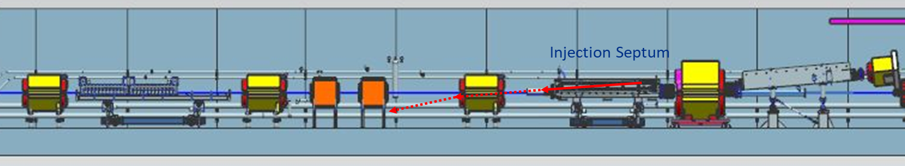
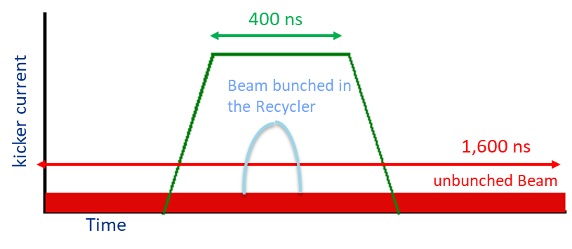
Asynchronous MCI beam trajectory and timing
If the beam does not arrive when the Injection Septum is pulsed (400 μsec), it continues downward through copper and steel into magnet body.
Bunches formed in Recycler are 140 nsec long and bunch trains from Booster are 1.6 μsec long. The kicker can only deflect the shorter bunches.
Timing required for injection
Notes:
This situation happens without being triggered by the beam transfer system from the RR, and would not involve the RF operations of the beam normally sent to the Muon Campus. The beam would arrive at a time where the injection septum and injection kicker were not activated. Beam would crash into the injection septum with a small among of surviving beam striking the steel of the next magnet.

Slide 29
Maximum Credible Incident (MCI) – Radiological
The MCI for the Muon Campus beyond the AP30 straight section is 5.4 e16 protons/hour at 8 GeV.
Assuming no shielding or other controls are present this incident would result in a dose to any individual higher than 1.8 e6 rem in an hour.
The MCI beyond the AP30 straight section is determined by the maximum repetition rate the Recycler RF system and the beam transfer systems can operate.
  The Recycler can prepare two Booster batches at a time for transfer to the Muon Campus.
  Injection of the two Booster batches takes 100 msec.
  The RF system requires 90 msec to form the bunches to be transferred.
  The beam transfer system requires 336 msec to transfer the 8 bunches prepared in the Recycler
  The total time required for transferring the 8 bunches of 1 e12 protons is 526 msec. Since the Booster repetition rate is 15 Hz, the cycle can only repeat every 8 Booster cycles or every .53 seconds.
Since this incident requires the injection system to be synchronized with the incoming beam, we will identify this as the synchronous MCI.
This scenario represents the maximum amount of beam that can physically be transported beyond the DR injection devices.
Notes:
In order for the beam to transport past AP30, the normal transfer process must happen. We could conceive that the process was sped up to this maximum rate. This would result in beam intensity in the Delivery Ring and M4 line of 1.54 e13 protons/sec which could result in an accident exposure of 1.8 Mrem/hr without any mitigation.

Slide 30
Outline
Muon Campus Overview
Hazard Inventory
Non-Accelerator Specific Hazards
Accelerator Specific Hazards
Maximum Credible Incident (MCI) Discussion
Summary of Credited Controls
Shielding Assessment Discussion

Slide 31
Credited Controls – Passive Engineering
Permanent Shielding
  Construction drawings and various topographical surveys of the berms have been used to determine the thickness of the permanent shielding in units of efd.
  20.3 efd of shielding is credited over the buried beam pipe between the Tevatron and Pre-Target enclosures.
  17.9 efd of shielding is credited where present in the asynchronous MCI areas
  15.1 efd of shielding is credited where present in the synchronous MCI areas
  4.0 efd of shielding is credited over the M5 beamline to the g-2 experiment hall
    Lesser amounts of shielding where credited active controls are implemented.
Notes:
Actual shielding determined from drawings made with input from metrology organization.
Shielding requirements in each area defined by geometry of beam line and MCI in the area.

Slide 32
Credited Controls – Passive Engineering
Movable Shielding
  A concrete block shield wall is constructed just upstream of the MC-1 experimental hall. This protects personnel in the hall from beam loss originating from the M4 beam line operation.
  A concrete block shield wall is constructed just upstream of the Mu2e Production Solenoid area. This protects personnel in the PS area from beam loss generated by operating with beam to the Diagnostic Absorber.
  There are seven magnet hatch openings in the Muon Campus that are filled with concrete shielding blocks for operation.
  The AP0 target hall is configured with many concrete shielding blocks and steel modules credited as shielding.
  23 survey site risers are filled with either sand or poly beads.
  An abandoned cryo penetration in AP30 is filled with poly beads.
  Cryo penetrations in stub rooms in the DR 20 and 40 sections contain 3 feet of sand for shielding.
  There are two beam stops and a fixed aperture mask that are used as credited movable shielding.
Clear and Obvious Barrier separates the general public from the Muon Campus.
Notes:
Two shield walls and the target vault make up most of the visible moveable shielding. There are also filled magnet hatches and penetrations that are captured in the credited moveable shielding inventory.

Slide 33
Credited Controls – Active Engineering
Credited Control: Radiation Safety Interlock System (RSIS)
  Inhibits beam by controlled redundant critical devices
  Enforces the search and secure process
  Interlocked doors are present at all access points into the Muon Campus enclosures.
  Includes interlocked radiation detectors which protect individuals by disabling beam should prompt radiation from operations exceed specific dose rates
  The ES&H Radiation Physics Engineering Dept. (RPE) ensures that all requirements for hardware and system testing are completed semi-annually with a four-month grace period
  RPE also verifies the inventory of interlock keys and updates procedures for maintenance and testing of interlock systems
  All RSIS are designed, installed and configuration managed in conformance with the requirements of the Fermilab Radiological Control Manual (FRCM)
Notes:
ES&H Radiation Physics Engineering Dept designs, implements, and maintains the elements of the RSIS system.

Slide 34
Credited Controls – Active Engineering
Interlocked Radiation Detectors
  All interlocked detectors are calibrated on an annual basis
  For areas that do not have adequate permanent shielding these detectors are used to protect an individual outside of the shielding
  ES&H RPE Interlock group also installs, tests & maintains all interlocked detectors

Slide 35
Credited Controls – Active Engineering
Interlocked Radiation Detectors
  Muon Campus does not have enough shielding for the MCI in many areas, so interlocked radiation detectors are required
  The credited control limits for these interlocked radiation detectors are sufficient to protect against the MCI
    We operate at levels below the MCI intensity.
  Limit levels are set by the Radiation Physics Operations Department (RPO) to satisfy occupancy requirements per 10 CFR Part 835
Detector Details
  Chipmunks are placed every 13 feet within the AP10, AP30, AP50 service buildings over the DR beamline.
    Chipmunk limit settings are all 500 mrem/hr or lower.
    Chipmunk a gate between beam line and MC-1 hall will be set to 250 mrem/hr or lower
  TLMs are located along the M3 line in the Transport and DR enclosures.
  TLMs are located throughout the DR arcs and along the abort line.
    TLM limit settings are all 10,000 nC/min or lower.
  Limit levels can be set lower than the values stated here and are determined by the Radiation Physics Operations Department (RPO) to satisfy occupancy requirements per 10 CFR Part 835.
Notes:
If detectors are required to satisfy the ASE, appropriate credited control limits are determined to satisfy the ASE limits. We operate at levels below the ASE and trips settings lower than the credited control level are set by the Radiation Physics Operations Department to satisfy requirements of the area postings. Credited Chipmunk and TLM locations and credited trip settings are noted here.

Slide 36
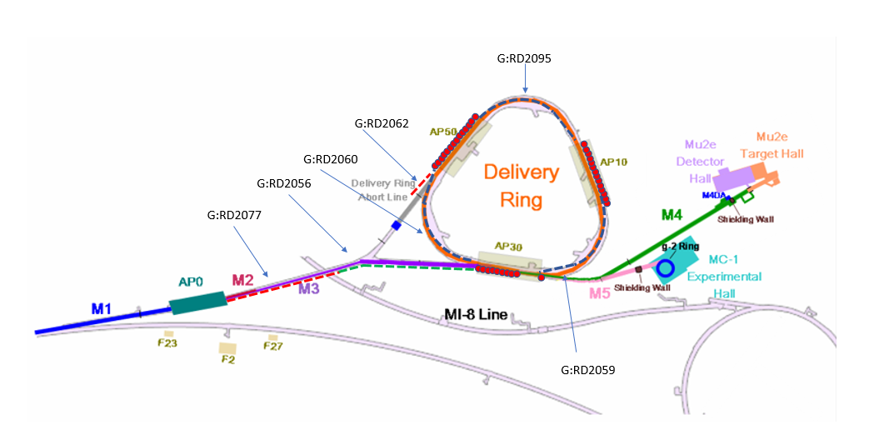

Credited radiation monitor locations
Chipmunks shown as red circles in service buildings
Notes:
Diagram shows the locations of the various credited radiation detectors

Slide 37
Credited Controls - Administrative
Credited Control: Operation Authorization Document
  Machine Beam Permit
  Machine Run Condition
  Beam will not be transported through the Muon Campus without approval of these documents
Credited Control: Staffing
  Ensures operations within bounding conditions specified in Operation Authorization Document
  The following staffing shall be in place during applicable beam operation:
    At least one member of the AD Operations Department who has achieved the rank of Operator II or higher shall be on duty and on site.
    At least one member of the AD Operations Department shall be present in the Main Control Room (MCR).
    These requirements can be satisfied by a single person.
Credited Control: Accelerator Operating Parameters
  The MCI intensity of 3.78 e17 protons/hr at 8 GeV shall not be exceeded anywhere in the Muon Campus.
  The intensity in the Delivery Ring outside of the 30 straight section, DR abort line and in the M4 beamline shall not exceed 5.54 e16 protons/hr at 8 GeV
  The intensity in the M5 beamline to g-2 shall not exceed 1.7 e13 particles/hr at an energy of 3.1 GeV
Notes:
Beam is not transported without signed beam permit and run conditions.
Staffing must be sufficient to operate beam in the Muon Campus
Credited controls must be in place to satisfy dose limits under the ASE intensities listed in the documentation.

Slide 38
Questions?

