Slide 1
Safety Assessment Document Updates for DOE O 420.2D
SAD Section III Chapter 12 – Switchyard
Michael K. Olander
Switchyard Accelerator Readiness Review
19-21 March 2024

Slide 2
Outline
Switchyard Overview
Hazard Inventory
Non-Accelerator Specific Hazards
Accelerator Specific Hazards
Maximum Credible Incident (MCI) Discussion
Summary of Credited Controls

Slide 3
Outline
Switchyard Overview
Hazard Inventory
Non-Accelerator Specific Hazards
Accelerator Specific Hazards
Maximum Credible Incident (MCI) Discussion
Summary of Credited Controls

Slide 4
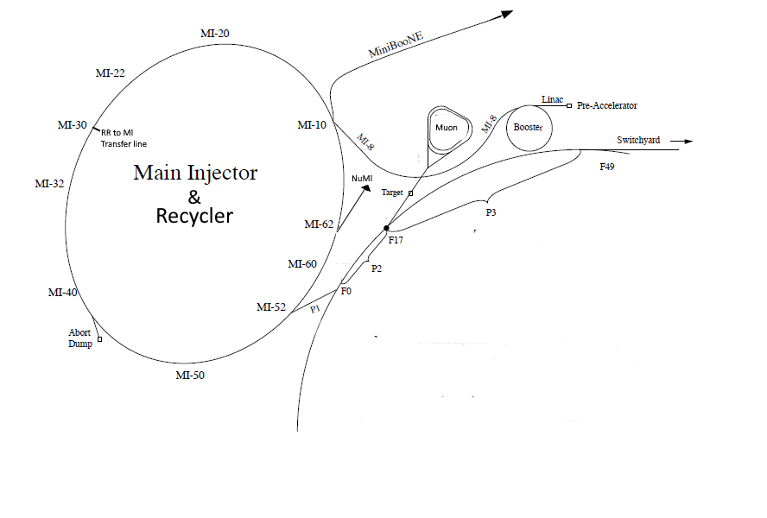
Switchyard Overview
One injection line from P1/P2
Three transfer lines
120 GeV beam to
Switchyard Dump
Meson Area
Neutrino Area

Slide 5
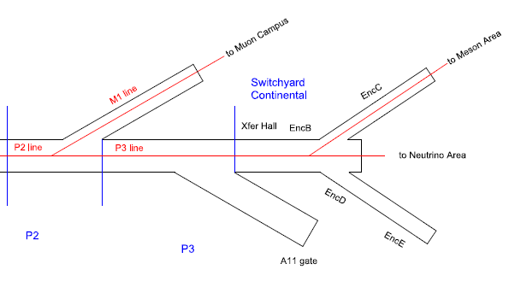
Switchyard Overview
120 GeV protons delivered from P1 & P2 Beamlines -> P3 -> Switchyard Continental

Slide 6
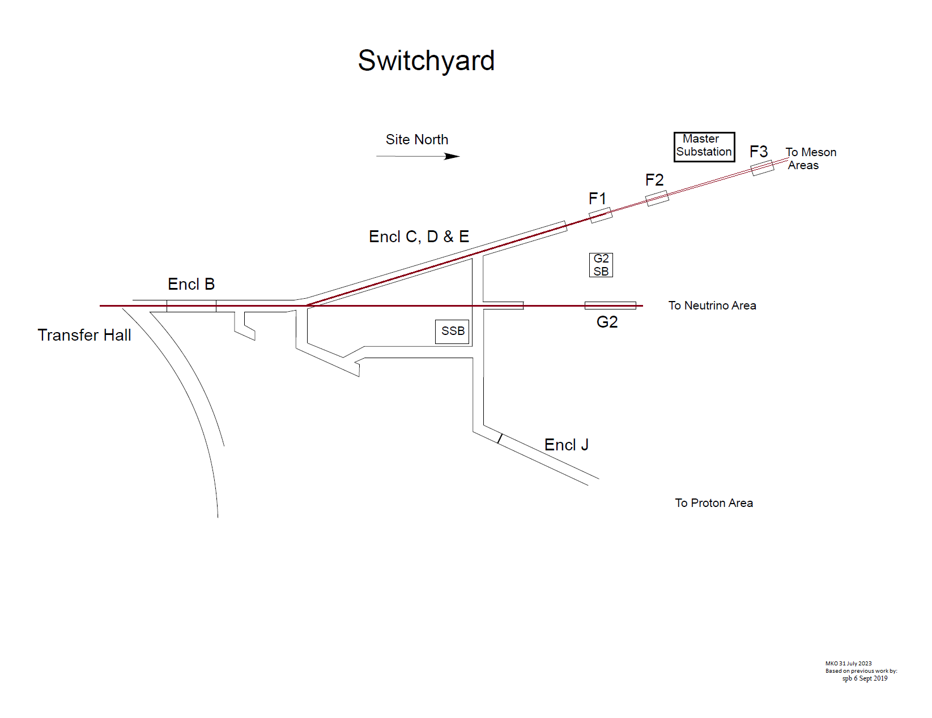
Switchyard Overview
Switchyard Continental sends beam to the Meson Area or Neutrino Area
Switchyard Continental is no longer capable of sending beam to the Proton Area.
The Proton Area is non-operational.
Switchyard Continental cannot send beam to the Tevatron; the transport components in Transfer Hall have been removed

Slide 7
Outline
Switchyard Overview
Hazard Inventory
Non-Accelerator Specific Hazards
Accelerator Specific Hazards
Maximum Credible Incident (MCI) Discussion
Summary of Credited Controls

Slide 8
Hazard Inventory for Switchyard
Radiological |  | Toxic Materials
☒ | Prompt Ionizing Radiation | ☒ | Lead
☒ | Residual Activation | ☐ | Beryllium
☒ | Groundwater Activation | ☐ | Fluorinert & Its Byproducts
☒ | Surface Water Activation | ☐ | Liquid Scintillator Oil
☒ | Radioactive Water (RAW) Systems | ☐ | Pseudocumene
☒ | Air Activation | ☐ | Ammonia
☐ | Closed Loop Air Cooling | ☐ | Nanoparticle Exposures
☒ | Soil Interactions | Flammables and Combustibles
☒ | Radioactive Waste | ☒ | Combustible Materials (e.g., cables, wood cribbing, etc.)
☒ | Contamination | ☒ | Flammable Materials (e.g., flammable gas, cleaning materials, etc.)
☒ | Beryllium-7 | Electrical Energy
☒ | Radioactive Sources | ☒ | Stored Energy Exposure
☐ | Nuclear Material | ☒ | High Voltage Exposure
☐ | Radiation Generating Devices (RGDs) | ☒ | Low Voltage, High Current Exposure
☐ | Non-Ionizing Radiation Hazards | Kinetic Energy
Thermal Energy |  | ☒ | Power Tools
☐ | Bakeouts | ☒ | Pumps and Motors
☒ | Hot Work | ☐ | Motion Tables
☐ | Cryogenics | ☐ | Mobile Shielding
Potential Energy |  | Magnetic Fields
☒ | Crane Operations | ☒ | Fringe Fields
☒ | Compressed Gasses | Other Hazards
☒ | Vacuum/Pressure Vessels/piping | ☒ | Confined Spaces
☒ | Vacuum Pumps | ☒ | Noise
☒ | Material Handling | ☐ | Silica
Access & Egress |  | ☒ | Ergonomics
☒ | Life Safety Egress | ☐ | Asbestos
Accelerator specific hazards are purple
Hazards not discussed today are evaluated via the common Risk Matrix tables
Covered in SAD Section I, Chapter 4
Hazards evaluated via risk assessment methodology per DOE-HDBK-1163-2020
Likelihood (L):
Anticipated (A), Unlikely (U), Extremely Unlikely (EU), Beyond Extremely Unlikely (BEU)
Consequence (C):
High (H), Moderate (M), Low (L), Negligible (N)
Risk (R):
I , II, III, IV (descending order of concern)

Slide 9
Risk Matrix Summary

Slide 10
Outline
Switchyard Overview
Hazard Inventory
Non-Accelerator Specific Hazards
Accelerator Specific Hazards
Maximum Credible Incident (MCI) Discussion
Summary of Credited Controls
Summary of Defense in Depth Controls

Slide 11
Non-Accelerator Specific Hazards - Radiological
Residual Activation
High intensity beam delivery can produce activated materials inside the Switchyard enclosures due to beam loss
Hazard applies to onsite facility workers and onsite co-located workers
Baseline Qualitative Risk (without controls) | Controls Preventive (P)/Mitigative (M) | Residual Qualitative Risk (with controls)
L: A C: H R: I | P – Radiological Work Permit P – Postings P – Training M – Run Conditions M – Local Component Shielding | L: BEU C: L R: IV

Slide 12
Non-Accelerator Specific Hazards - Radiological
Radioactive Water System
Applies to the Switchyard Dump
Passive water cooling
Hazard applies to onsite facility workers and onsite co-located workers
Baseline Qualitative Risk (without controls) | Controls Preventive (P)/Mitigative (M) | Residual Qualitative Risk (with controls)
L: A C: H R: I | P – Postings P – Radiological Work Permit P – Training M – Run Conditions | L: BEU C: M R: IV

Slide 13
Non-Accelerator Specific Hazards - Radiological
Air Activation
Air activation can occur at any area where high beam losses are present.
Hazard applies to onsite facility workers and onsite co-located workers
Baseline Qualitative Risk (without controls) | Controls Preventive (P)/Mitigative (M) | Residual Qualitative Risk (with controls)
L: A C: H R: I | M – Run Conditions M – Engineered Air Flow | L: A C: L R: III

Slide 14
Non-Accelerator Specific Hazards - Radiological
Soil Interactions
Radionuclides are produced which may contaminate ground water
Can occur in areas of high chronic losses when the beam passes through a berm pipe
Can occur around the Switchyard Dump
Hazard applies to onsite facility workers and onsite co-located workers
Baseline Qualitative Risk (without controls) | Controls Preventive (P)/Mitigative (M) | Residual Qualitative Risk (with controls)
L: A C: H R: I | P – Radiological Work Permit required for excavation M – Engineered Beam Dump M – Beamline Design M – Run Conditions | L: U C: N R: IV

Slide 15
Non-Accelerator Specific Hazards - Radiological
Radioactive Waste
Radioactive waste produced during Switchyard operations will be managed within the established Radiological Protection Program (RPP) as prescribed in the Fermilab Radiological Control Manual (FRCM)
Hazard applies to onsite facility workers and onsite co-located workers
Baseline Qualitative Risk (without controls) | Controls Preventive (P)/Mitigative (M) | Residual Qualitative Risk (with controls)
L: A C: H R: I | P – Locked Gates P – Key Control Program P – Postings M – Run Conditions M – Distance to Stored Material M – Material survey and release process | L:BEU C: N R: IV

Slide 16
Non-Accelerator Specific Hazards - Radiological
Contamination
Contamination is found in the Switchyard enclosures in areas where beam passes through an air gap, such as vacuum isolation at a septum.
Hazard applies to onsite facility workers and onsite co-located workers.
Baseline Qualitative Risk (without controls) | Controls Preventive (P)/Mitigative (M) | Residual Qualitative Risk (with controls)
L: A C: H R: I | P – Radiation Survey P – Posting M – Radiological Work Permit M – Training | L: EU C: L R: IV

Slide 17
Non-Accelerator Specific Hazards - Other
Confined Space
The F2-Manhole & F3-Manhole enclosures are confined spaces.
Hazard applies to onsite facility workers, onsite co-located workers, and MOI.
Baseline Qualitative Risk (without controls) | Controls Preventive (P)/Mitigative (M) | Residual Qualitative Risk (with controls)
Facility Worker & Co-located Worker L: A C: H R: I | P – Confined Space training informs workers of hazard and process for working in the confined space. P – Work practice procedure requires use of an attendant, outside of the enclosure. P – “Permit Required Access” and “Reclassification” require ES&H approval on every access. M – Mechanical ventilation active, when required. | L: BEU C: M R: IV
MOI L: BEU C: H R: III | P – Work practice procedure requires use of an attendant, outside of the enclosure. | L: BEU C: H R: III

Slide 18
Outline
Switchyard Overview
Hazard Inventory
Non-Accelerator Specific Hazards
Accelerator Specific Hazards
Maximum Credible Incident (MCI) Discussion
Summary of Credited Controls

Slide 19
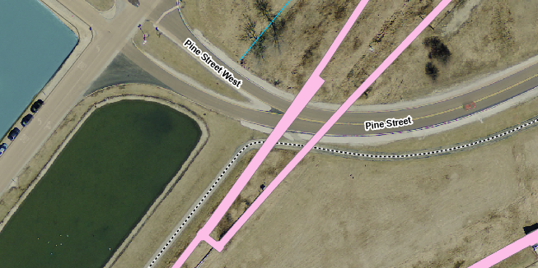
Accelerator Specific Hazards
The public is not invited into most areas of Switchyard. An example of an exception is where Pine Street crosses a section of Switchyard Continental. Additional signage in this area warns the public of the hazard.

Slide 20
Accelerator Specific Hazards - Radiological
Prompt Ionizing Radiation
Ionizing radiation due to beam loss in the Switchyard enclosure.
Analyzed maximum credible incident (MCI) to determine credited controls.
Hazard applies to onsite facility workers, onsite co-located workers.
Credited Controls are needed.

Slide 21
Outline
Switchyard Overview
Hazard Inventory
Non-Accelerator Specific Hazards
Accelerator Specific Hazards
Maximum Credible Incident (MCI) Discussion
Summary of Credited Controls

Slide 22
Maximum Credible Incident (MCI) – Radiological
The MCI focuses on exposure to an onsite worker, an onsite coworker and the maximally exposed off-site individual (MOI).
Fermilab uses Credited Controls that flow down to the Accelerator Safety Envelope (ASE) to mitigate the consequences of an MCI to the following conditions:

Slide 23
Maximum Credible Incident (MCI) – Radiological
Switchyard MCI derived from 120GeV P1/P2 MCI
One Credible Scenario:
For the P3 line and downstream, the MCI is 2.75E15 protons per hour

Slide 24
Outline
Switchyard Overview
Hazard Inventory
Non-Accelerator Specific Hazards
Accelerator Specific Hazards
Maximum Credible Incident (MCI) Discussion
Summary of Credited Controls

Slide 25
Credited Controls – Passive
Permanent Shielding
The required shielding will vary depending on whether the beam strikes a magnet, long pipe, or buried pipe. Where the permanent shielding is less than the required shielding, active engineered controls will be used.
Movable Shielding
The Switchyard area has moveable shielding placed in the equipment drop hatches adjacent to the SSB, at the downstream end of the G2 enclosure, and at the upstream end of the F1-Manhole enclosure. The shielding is administratively controlled by ES&H, using a procedure that outlines the conditions required to access the equipment drop hatch. The shielding is locked with two padlocks, one padlock cored to the enclosure entry key and one cored to configuration control series, utilized exclusively by members of ESH. The assigned RSO or designee will document the application and removal of the configuration control in a database established for this purpose.

Slide 26
Credited Controls – Passive
Penetration Shielding
The Switchyard enclosures have utility penetrations throughout the service buildings and are accounted for in the Safety Assessment Document.
Radiation Area Fencing
The following radiation area fences are credited:
The Radiation Fence surrounding the Master Substation
The Radiation Fence from the Master Substation to the fencing on the Meson Area Berm.
The Radiation Fence surrounding the G2 Service Building Cryogenic Penetrations

Slide 27
Credited Controls – Passive
Z-Range [Cell or ft] | Category | Credited Shielding [e.f.d.]
17880’ – 360’ | 4A | 13.9
360’ – 1520’ | 3C | 18.7
Transverse Station | Category | Credited Shielding [e.f.d.]
20390’ | 9A | 5.5
124’ | 9A | 5.5
273’ | 9A | 5.5
P3 to Switchyard Absorber Credited Shielding

Slide 28
Credited Controls – Passive
Z-Range [Cell or ft] | Category | Credited Shielding [e.f.d.]
1536’ – 1633’ | 3C | 18.7
1633’ – 1708’ | 3B | 13.8
1708’ – 1752’ | 3C | 18.7
1752’ – 2070’ | 3C | 18.7
2070’ – 2420’ | 3A | 16.3
2420’ – 3179’ | 3C | 18.7
One location with inadequate shielding, but protected with a passive Credited Control (fence):
Z-Range [Cell or ft] | Category | Credited Shielding [e.f.d.]
1520’ – 1536’ | 3C | 17.7
Neutrino Muon Credited Shielding

Slide 29
Credited Controls – Passive
Z-Range [Cell or ft] | Category | Credited Shielding [e.f.d.]
1237’ – 1335’ | 3A | 16.3
1335’ – 2308’ | 3C | 18.7
2308’ – 2350’ | 3A | 13.9
2350’ – 2370’ | 3C | 18.7
2370’ – 2413’ | 3A | 13.9
2413’ – 3005’ | 3C | 18.7
Two locations with inadequate shielding, but protected with a passive Credited Control (fence):
Z-Range [Cell or ft] | Category | Credited Shielding [e.f.d.]
3005’ – 3350’ | 3C | 15.5
3350’ – 3967’ | 3C | 14.5
Meson Primary Credited Shielding

Slide 30
Credited Controls – Passive
Cell or Z-Location | Location or Enclosure | Fill | Detector/Barrier
18569’ | F25 Cryo 48” | 48” filled with sand, 12” 8” 5” and 3” penetrations within unfilled | Chipmunk
19368’ | F35 Cryo 48” | 48” filled with sand, 12” 8” 5” and 3” penetrations within unfilled | Chipmunk
20121’ | F45 Cryo 48” | 48” filled with sand, 12” 8” 5” and 3” penetrations within unfilled | Chipmunk
0’ | A-0 Kicker Building Shortcut (South) | 3’ of Poly Rods with 10% packing factor in three 7” penetrations | Chipmunk
0’ | A-0 Kicker Building Shortcut (Middle) | 3’ of Poly Rods with 10% packing factor in three 7” penetrations | Chipmunk
0’ | A-0 Kicker Building Shortcut (North) | 3’ of Poly Rods with 10% packing factor in three 7” penetrations | Chipmunk
745’ | Enclosure B Cryo Penetration | Sand | TLM 1 (Enclosure B)
2333’ | Enclosure G2 Cryo Penetration #1 | The 8” header is filled with 24 ft. of sand. Polyethylene beads fill the annulus between 18” carrier and 8” header. Also, a 3 ft. thick sand shield, followed by a 3 ft. thick sand plug, exist at the end of the carrier pipe. | Fence
2337’ | Enclosure G2 Cryo Penetration #2 | The 8” header is approximately 50% full of piping and insulation. Polyethylene beads fill the annulus between 18” carrier and 8” header. Also, a 3 ft. thick sand shield, followed by a 3 ft. sand plug, exist at the end of the carrier pipe. | Fence

Slide 31
Credited Controls – Active Engineering
Credited Control: Radiation Safety Interlock System (RSIS)
Inhibits beam by controlled redundant critical devices
Enforces the search and secure process
Interlocked doors are present at all access points into the Switchyard enclosures
Includes interlocked radiation detectors which protect individuals by disabling beam should prompt radiation from operations cause exposure to exceed specific dose rates
Includes an interlocked repetition rate limiter which protect individuals by disabling beam if a magnet is energized longer than allowed in a fixed amount of time
The ES&H Radiation Physics Engineering Dept. (RPE) ensures that all requirements for hardware and system testing are completed semi-annually with a four-month grace period
RPE also verifies the inventory of interlock keys and updates procedures for maintenance and testing of interlock systems
All RSIS are designed, installed and configuration managed in conformance with the requirements of the Fermilab Radiological Control Manual (FRCM)

Slide 32
Credited Controls – Active Engineering
Interlocked Radiation Detectors
Detector Type | Location | Credited Control Limit
Chipmunk | A-0 Ramp | 490 mrem/hour
Chipmunk | Transfer Gallery North Addition | 24.5 mrem/hour
Chipmunk | Transfer Gallery North Addition | 24.5 mrem/hour
Chipmunk | F2 Refrigerator Building | 4810 mrem/hour
Chipmunk | F3 Refrigerator Building | 4940 mrem/hour
Chipmunk | F4 Refrigerator Building | 4950 mrem/hour
Chipmunk | A-0 Kicker Building (South) | 4900 mrem/hour
Chipmunk | A-0 Kicker Building (Middle) | 4900 mrem/hour
Chipmunk | A-0 Kicker Buiding (North) | 4900 mrem/hour
TLM | Enclosure B Cryo Penetration | 3400 nC/min

Slide 33
Credited Controls - Administrative
Credited Control: Operation Authorization Document
Machine Beam Permit
Machine Run Condition
Beam will not be transported through Switchyard without approval of these documents
Credited Control: Staffing
To ensure accelerator operations are disabled and initiate an immediate response in the event of a determined ASE violation.
The following staffing shall be in place during applicable beam operation:
At least one member of the AD Operations Department who has achieved the rank of Operator II or higher shall be on duty and on site.
At least one member of the AD Operations Department shall be present in the Main Control Room (MCR).
Note: these requirements could be satisfied by a single person
Credited Control: Accelerator Operating Parameters
For the P3 Beamlines and all segments downstream, beam shall not exceed 2.75E15 protons per hour at 120 GeV

Slide 34
Thank you for your attention

Slide 35
Credited Controls – Active Engineering
Power Supply Transductor & Shunt Current Monitors
Monitors S:VH94 power supply
Repetition Rate Limiter PLC at TG9

