Slide 1
Safety Assessment Document Updates for DOE O 420.2D
SAD Section IV Chapter 03 – Meson Switchyard 120 Experimental Areas
Evan Niner
Accelerator Readiness Review 1
19-21 March 2024

Slide 2
Outline
Meson Switchyard 120 Experimental Area Overview
Hazard Inventory
Non-Accelerator Specific Hazards
Accelerator Specific Hazards
Maximum Credible Incident (MCI) Discussion
Summary of Credited Controls

Slide 3
Outline
Meson Switchyard 120 Experimental Areas Overview
Hazard Inventory
Non-Accelerator Specific Hazards
Accelerator Specific Hazards
Maximum Credible Incident (MCI) Discussion
Summary of Credited Controls

Slide 4
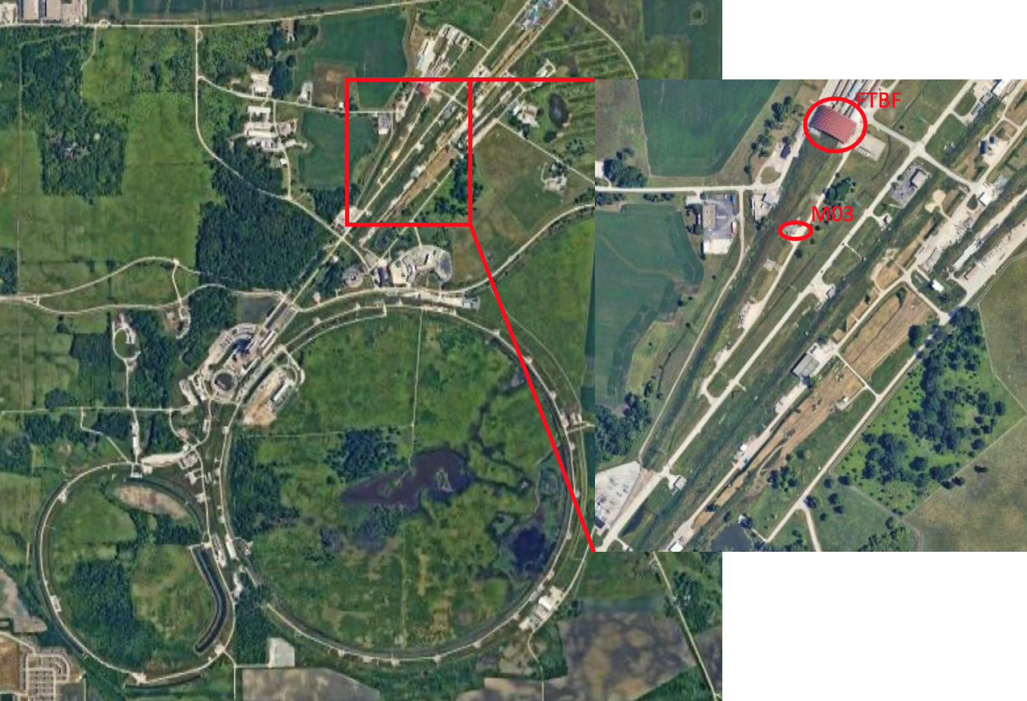
Meson Switchyard 120 Experimental Areas Overview
Beam from Meson Area segment (III-13)
Fermilab Test Beam Facility (FTBF)
MT6 Section 1, MT6 Section 2 of MTest beamline
MC7 Section 1, MC7 Section 2 of MCenter beamline
High rate tracking area located inside M03
Variety of short and medium term experiments rotating through the space

Slide 5
Meson Switchyard 120 Experimental Areas Overview
The Meson Switchyard 120 Experimental Areas are managed by the Particle Physics Directorate (PPD). The FTBF has a facility manager and dedicated scientific and technical support staff to schedule and coordinate experiment operations. Facility staff coordinate with the beamline physicist assigned from the External Beams Delivery Department in the Accelerator Directorate (AD) who maintains any AD owned systems, instrumentation, beamlines, and controls that are present in the experimental space.
Radiation safety has been carefully considered in the design of the Fermilab Meson Switchyard 120 Experimental Areas. All radiation hazards relating to beam operations safety are the responsibility of the Accelerator Directorate. The Accelerator Directorate, whose facilities includes all beamlines, their shielding, radiation, interlocks, beam surveys, monitors and impact of radiation on the environment, is addressed in SAD Section III Chapter 13 on the Meson Area.

Slide 6
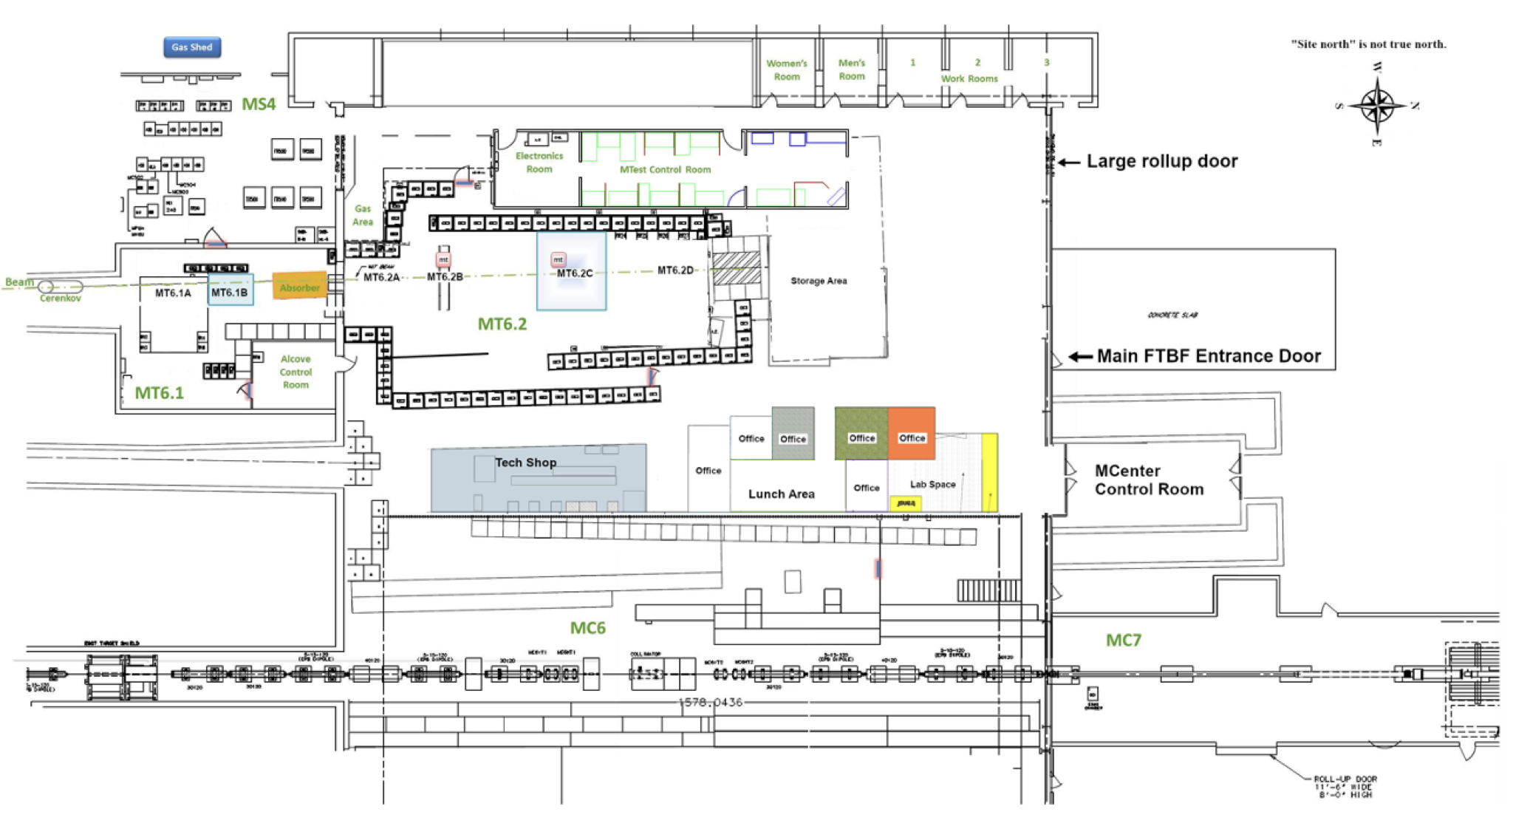
Meson Switchyard 120 Experimental Areas Overview
MTest: MT6 Section 1 and MT6 Section 2
“Diffracted Proton Mode” 120 Gev Protons
“High Energy Mode” 32 - 60 GeV secondary pion beam, as specified in shield assessment
“Low Energy Pion Mode” 1 - 30 GeV secondary pion beam, as specified in shield assessment
4.2 second spill once per 55 seconds with (O)10³ – (O)10⁶ particles per spill
Experiments may be simultaneously staged in MT6 Section 1 and 2

Slide 7
Meson Switchyard 120 Experimental Areas Overview
MCenter: MC7 Section 1 and MC7 Section 2
Secondary pion beam from 90 to 8 GeV, as specified in shield assessment
4.2 second spill once per 55 seconds with (O)10¹⁰ or lower particles per spill
Beam hits tertiary target at upstream end of MC7 Section 1 to produce lower energy particles in combination with analyzing magnet for momenta selection

Slide 8
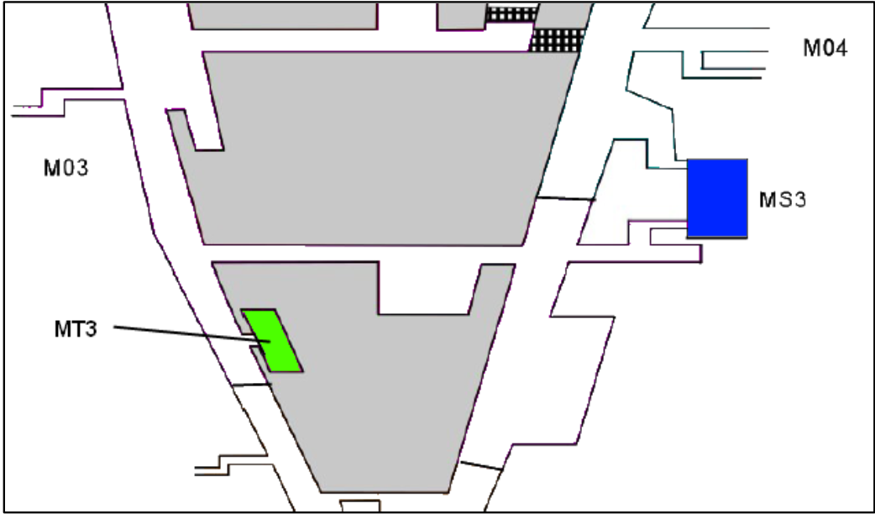
Meson Switchyard 120 Experimental Areas Overview
Location of M03 high rate tracking area in green
This is an air gap in the beam pipe with a motion table where an experiment may be placed
All credited controls and radiological hazards for this space are analyzed in III-13 for the Meson Area.

Slide 9
Outline
Meson Switchyard 120 Experimental Areas Overview
Hazard Inventory
Non-Accelerator Specific Hazards
Accelerator Specific Hazards
Maximum Credible Incident (MCI) Discussion
Summary of Credited Controls

Slide 10
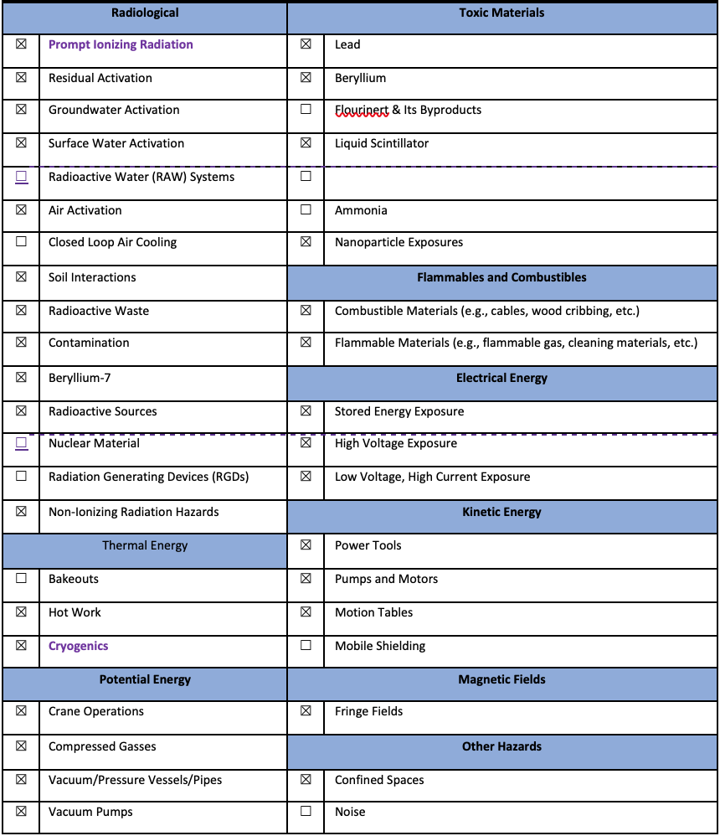
Hazard Inventory for Meson Switchyard 120 Experimental Areas
Accelerator specific hazards are purple
Hazards not discussed today are evaluated via the common Risk Matrix tables
Covered in SAD Section I, Chapter 4
Hazards evaluated via risk assessment methodology per DOE-HDBK-1163-2020
Likelihood (L):
Anticipated (A), Unlikely (U), Extremely Unlikely (EU), Beyond Extremely Unlikely (BEU)
Consequence (C):
High (H), Moderate (M), Low (L), Negligible (N)
Risk (R):
I , II, III, IV (descending order of concern)

Slide 11
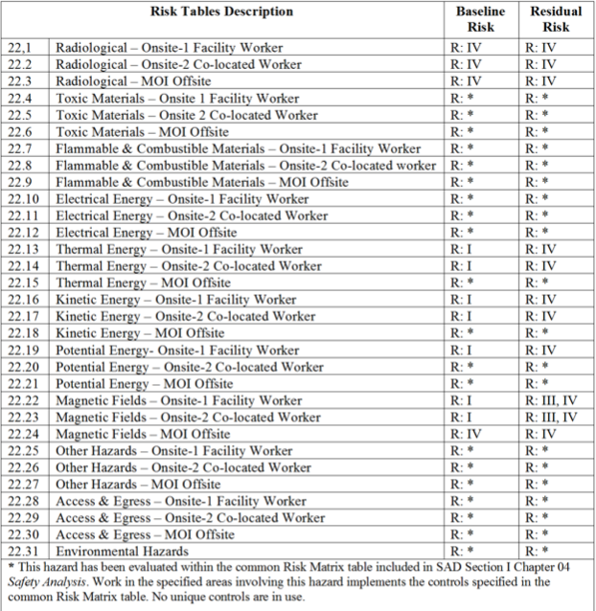
Hazard Inventory for Meson Switchyard 120 Experimental Areas
Accelerator specific hazards are purple
Hazards not discussed today are evaluated via the common Risk Matrix tables
Covered in SAD Section I, Chapter 4
Hazards evaluated via risk assessment methodology per DOE-HDBK-1163-2020
Likelihood (L):
Anticipated (A), Unlikely (U), Extremely Unlikely (EU), Beyond Extremely Unlikely (BEU)
Consequence (C):
High (H), Moderate (M), Low (L), Negligible (N)
Risk (R):
I , II, III, IV (descending order of concern)

Slide 12
Hazard Inventory for Meson Switchyard 120 Experimental Areas
This segment contains a large variety of experiments which rotate through on 1-4 week timescales (MTest) or longer (MCenter)
While many experiments share similarities, the hazards do vary, not all hazards are present at one time
Each planned experiments submits a Technical Scope of Work (TSW)
Describes the experiment and hazards months in advance of operations
Screened by FTBF staff and SMEs
Signed by division and directorate heads
Ensures proposed experiment falls under the SAD/ASE.
Upon arrival each installed experiment goes through an Operational Readiness Clearance (ORC)
Ensure safe operations and conformance with SAD/ASE before receiving beam
MCenter can see longer experiments (~1-3 year) which can require more significant changes to the beamline configuration or operations.
These changes follow the USI process to determine need for any shield assessment addendums, or updates to the SAD and ASE as necessary.

Slide 13
Outline
Meson Switchyard 120 Experimental Areas Overview
Hazard Inventory
Non-Accelerator Specific Hazards
Accelerator Specific Hazards
Maximum Credible Incident (MCI) Discussion
Summary of Credited Controls

Slide 14
Non-Accelerator Specific Hazards - Radiological
Residual Activation
MTest and MCenter have never seen an experiment component activate to the class 1 level
One piece of a lead calorimeter observed above background as class 0 since January 1, 2023.
Hazard applies to onsite facility workers and onsite co-located workers
Baseline Qualitative Risk (without controls) | Controls Preventive (P)/Mitigative (M) | Residual Qualitative Risk (with controls)
L: A C: N R: IV | P – Training P – RWP as relevant M – Survey and classification of items leaving enclosure by radiological worker M– Survey of items by Radiological Control personnel following FRCM chapter 4 for unrestricted release M – Run Conditions | L: EU C: N R: IV

Slide 15
Non-Accelerator Specific Hazards - Radiological
Radioactive Waste
Radioactive waste produced during Main Injector operations will be managed within the established Radiological Protection Program (RPP) as prescribed in the Fermilab Radiological Control Manual (FRCM)
Hazard applies to onsite facility workers and onsite co-located workers
Baseline Qualitative Risk (without controls) | Controls Preventive (P)/Mitigative (M) | Residual Qualitative Risk (with controls)
L: A C: N R: IV | P – Radiological worker training M – Any item in a beam enclosure during beam-on conditions is removed and surveyed by radiological workers and classified appropriately M – Any item identified for disposal is surveyed and processed by Radiological Control organization personnel in accordance with FRCM chapter 4 | L: U C: N R: IV

Slide 16
Non-Accelerator Specific Hazards - Radiological
Contamination
Contamination has not been seen on experimental equipment from beam exposure in MT6 Section 1&2, MC7 Section 1&2
Contaminated equipment could be brought to FTBF from another location (i.e. device irradiated in another beamline)
M03 high rate tracking area could see Be7 contamination from beam in air gap
Hazard applies to onsite facility workers and onsite co-located workers
Baseline Qualitative Risk (without controls) | Controls Preventive (P)/Mitigative (M) | Residual Qualitative Risk (with controls)
Item brought to FTBF L: A C: N R: IV Contamination at M03 L: A C: N R: IV | P – Radiological control prescreens items with contamination potential prior to acceptance. M – Radiological worker training M – RCT coverage and job specific RWP as determined by the RSO M – Contamination wipes to monitor space and equipment | L: U C: N R: IV L: A C: N R: IV

Slide 17
Non-Accelerator Specific Hazards - Radiological
Radioactive Sources
Various low activity sealed sources (Sr-90, Co-60, CS-137, Fe-55, Ru-106, etc.) used by experiments
Hazard applies to onsite facility workers and onsite co-located workers
Baseline Qualitative Risk (without controls) | Controls Preventive (P)/Mitigative (M) | Residual Qualitative Risk (with controls)
L: A C: N R: IV | P – All low activity sealed sources are kept in a lock box and registered through Radiological Control. P – Radiological and source training is required for source handling. | L: EU C: N R: IV

Slide 18
Non-Accelerator Specific Hazards – Toxic Materials
Liquid scintillator
Experiments may bring liquid scintillator which could include toxic additives such as pseudocumene or others
Hazard applies to onsite facility workers and onsite co-located workers
Baseline Qualitative Risk (without controls) | Controls Preventive (P)/Mitigative (M) | Residual Qualitative Risk (with controls)
L: A C: L R: III | P – TSW and ORC process for SME to screen hazard and establish appropriate protections and work planning for use P - A job-specific hazard analysis and procedure will prescribe Personal Protective Equipment (PPE) to prevent worker contact with the liquid scintillator. P - Detectors, once filled, will completely contain the scintillator, resulting in no further exposure. P - A secondary containment membrane that has the capacity to contain 100% of the liquid scintillator oil will prevent a release to the environment. M - Emergency spill equipment, an eye wash and PPE will be stationed near the detector in the event of a release. | L: BEU C: N R: IV

Slide 19
Non-Accelerator Specific Hazards – Kinetic Energy
Motion Tables
A variety of motion tables available for use in experimental areas for equipment staging
Hazard applies to onsite facility workers and onsite co-located workers
Baseline Qualitative Risk (without controls) | Controls Preventive (P)/Mitigative (M) | Residual Qualitative Risk (with controls)
L: A C: H R: I | P – Engineering notes/ORC procedure P – Safety stops P – Computer authorization for motion table controls P – Physical isolation of system (FTBF absorbers) M – Emergency stop as determined by SME M – Speed restrictions on motor | L: BEU C: L R: IV

Slide 20
Non-Accelerator Specific Hazards – Potential Energy
Compressed gases
A wide variety of gases are brought by experiments through the TSW/ORC process
Hazard applies to onsite facility workers and onsite co-located workers
Baseline Qualitative Risk (without controls) | Controls Preventive (P)/Mitigative (M) | Residual Qualitative Risk (with controls)
L: A C: H R: I | P – Engineering notes to evaluate ODH and piping P – TSW and/or ORC process P - Pressure Safety orientation training P - Compressed gas cylinder safety training P - All personnel have to be familiar with FESHM 5000 series and apply requirements. P - Gas cylinders are secured and capped when not in use. M - Personal Protective Equipment mitigates severity of injury | L: BEU C: M R: IV

Slide 21
Non-Accelerator Specific Hazards – Magnetic Fields
Fringe Fields
Permanent and electromagnets
Experiment may bring magnet through TSW/ORC process, analyzing magnets available in MC7
Hazard applies to onsite facility workers and onsite co-located workers
Baseline Qualitative Risk (without controls) | Controls Preventive (P)/Mitigative (M) | Residual Qualitative Risk (with controls)
Exposure to fringe fields beyond allowable limits (worker with ferromagnetic or electronic medical device(s)) L: A C: H R: I Exposure to fringe fields beyond allowable limits (worker without ferromagnetic or electronic medical device(s)) L: A C: L R: III Exposure to flying metallic objects L: A C: M R: II | P- Industrial hygiene conducts field surveys to establish safe field boundaries for workers. P- Access control points and individual components of concern (e.g., experiment permanent magnet) have postings to notify workers of magnetic hazard. P – Facility specific hazard awareness training alerting to fringe fields P- Industrial hygiene conducts field surveys to establish safe field boundaries for workers. P- Access control points and individual components of concern (e.g., experiment permanent magnet) have postings to notify workers of magnetic hazard. P – Facility specific hazard awareness training alerting to fringe fields P- Brass tools are used to prevent flying metallic objects from occurring, thereby preventing worker injury as prescribed by relevant magnet SOP P-Work Control procedure/SOP (ferromagnetic object control) requires that all ferromagnetic objects are removed prior to entry into a fringe field area (30G administrative limit). P-Work Control procedure/SOP requires worker training while in areas possessing fringe fields (300 G administrative limit). | L: BEU C: H R: III L: BEU C: L R: IV L: BEU C: M R: IV

Slide 22
Outline
Meson Switchyard 120 Experimental Areas Overview
Hazard Inventory
Non-Accelerator Specific Hazards
Accelerator Specific Hazards
Maximum Credible Incident (MCI) Discussion
Summary of Credited Controls

Slide 23
Accelerator Specific Hazards - Radiological
Prompt Ionizing Radiation – Beam Loss
Ionizing radiation due to beam loss in the Meson Switchyard 120 Experimental Area spaces
Analyzed maximum credible incident (MCI) to determine credited controls
Hazard applies to onsite facility workers, onsite co-located workers
Credited Controls are needed

Slide 24
Accelerator Specific Hazards - ODH
Cryogenics – ODH
MT6 Section 1, MT6 Section 2, MC7 Section 1, MC7 Section 2 are ODH 0 spaces
Cryogenic liquids brought by an experiment evaluated through TSW and ORC process to ensure compliance with posting and oxygen level above 19.5%
No credited controls required
M03 high rate tracking area falls under ODH program for the Meson Area (III-13), no additional credited controls required for experiment operations
Baseline Qualitative Risk (without controls) | Controls Preventive (P)/Mitigative (M) | Residual Qualitative Risk (with controls)
ODH L: A C: N R: IV Burns L: A C: H R: I | ODH P – TSW flags intended cryogenics for SME review prior to arrival P – SMEs produce engineering notes on piping and vessel system and ODH calculations. At present all amounts of cryogenic liquids in these spaces are ODH 0 or rejected P – ORC process has SMEs review installed system and documentation prior to operation Burns P – Cryogenic system designed and reviewed by qualified personnel P – WPC process provides instructions for use P - Protective clothing rules are enforced when working in areas with exposure to cryogenic liquids. P- Training required for all personnel handling cryogenics M – Onsite Emergency services are provided | ODH L: BEU C: N R: IV Burns L: BEU C:M R: IV

Slide 25
Outline
Meson Switchyard 120 Experimental Areas Overview
Hazard Inventory
Non-Accelerator Specific Hazards
Accelerator Specific Hazards
Maximum Credible Incident (MCI) Discussion
Summary of Credited Controls

Slide 26
Maximum Credible Incident (MCI) – Radiological
Although the experiments are installed in the Meson beamline areas, the experiments themselves do not affect the Maximum Credible Incident (MCI) as presented in Section III Chapter 13 for the Meson Area beamlines. The MCI for the experimental area is covered by the MCI analysis for the beamlines which pass through the experimental enclosures. The Meson area experiments do not require any additional credited controls.
New experiments for the Meson Switchyard 120 Experimental Areas are proposed through a Technical Scope of Work (TSW). If an experiment introduces new hazards or requires changes to beamline configuration or operations, the USI screening process would evaluate any necessary updates to shielding assessments, the SAD chapter, or ASE for III-13 or IV-03.

Slide 27
Outline
Meson Switchyard 120 Experimental Areas Overview
Hazard Inventory
Non-Accelerator Specific Hazards
Accelerator Specific Hazards
Maximum Credible Incident (MCI) Discussion
Summary of Credited Controls

Slide 28
Credited Controls – Radiological
All credited controls are presented in Section III Chapter 13 for the Meson Area beamlines including the experimental spaces. The experiments require no additional credited controls.

Slide 29
Summary
Meson Switchyard 120 Experimental Areas Overview
Hazard Inventory
Non-Accelerator Specific Hazards
Accelerator Specific Hazards
Maximum Credible Incident (MCI) Discussion
Summary of Credited Controls

Slide 30
Thank you for your attention

Slide 31
Outline
Meson Switchyard 120 Experimental Areas Overview
Hazard Inventory
Non-Accelerator Specific Hazards
Accelerator Specific Hazards
Maximum Credible Incident (MCI) Discussion
Summary of Credited Controls
Summary of Defense in Depth Controls
Backup Slide(s)

Slide 32
Meson Switchyard 120 Experimental Areas Overview
MT6 Section 1, MT6 Section 2, MC7 Section 1, and MC7 Section 2 enclosures have two access modes:
Controlled
Enclosures are secured for beam operations requiring keyed entry and radiological worker and controlled access training
Open
Interlocks may be dropped without radiological survey to put enclosure into an open state
FTBF building surrounding enclosures is a posted controlled area with keycard entry
Facility hazard awareness training and GERT required to enter building and enclosures in this state
Radiological worker training required to remove impacted items from beam enclosures
Radiological Control organization personnel required to survey impacted items for release from FTBF building
M03 high rate tracking area following RWPs and access procedures for Meson area.

