Slide 1
Safety Assessment Document Updates for DOE O 420.2D
SAD Section III Chapter 14 – Neutrino Area
Sue McGimpsey
Neutrino Area Accelerator Readiness Review
20 March 2024

Slide 2
Outline
Switchyard Overview
Neutrino Area Overview
Neutrino Muon Beam Line Overview
Hazard Inventory for Neutrino Area
Risk Table Summary
Non-Accelerator Specific Hazards
Accelerator Specific Hazards
Maximum Credible Incident (MCI) Discussion
Summary of Credited Controls

Slide 3
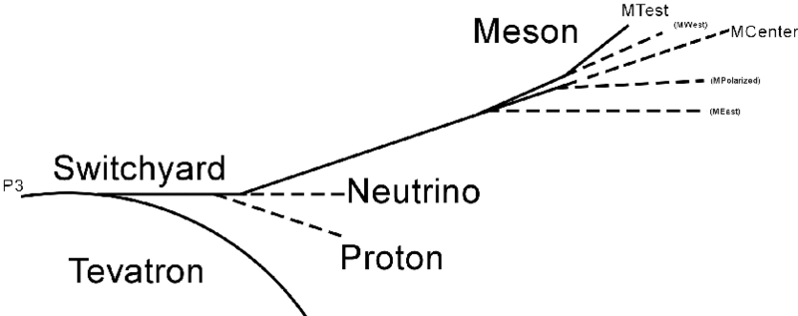
Switchyard Fixed Target Overview

Slide 4
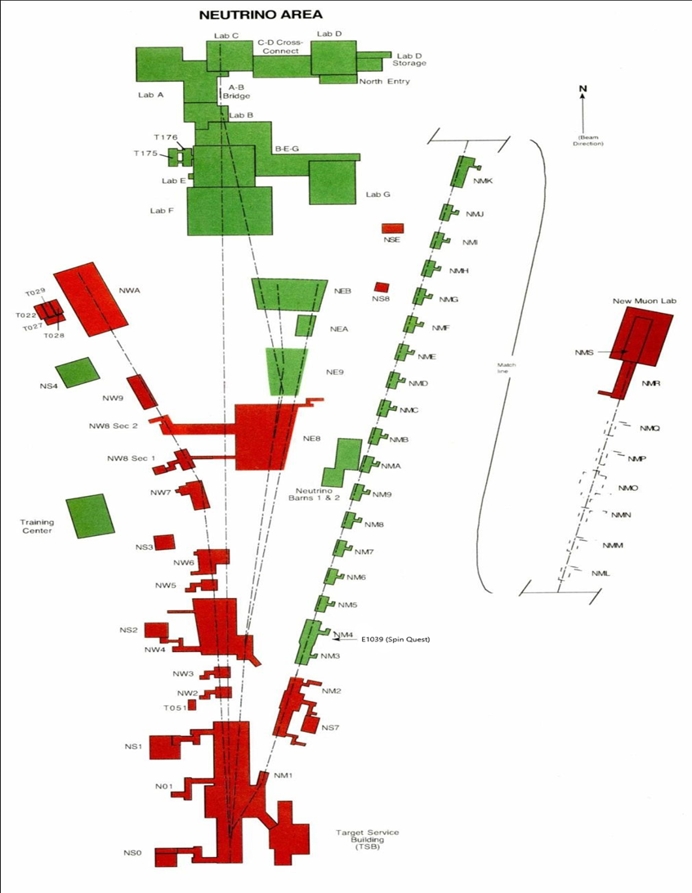
Neutrino Muon Beam Line
To Switchyard

Slide 5
Neutrino Muon Beam Line Overview
Only beam line in the Neutrino Area that is operational.
Switchyard receives a pulse of 120 GeV beam from the Main Injector during a “slow spill” every 55 seconds.
From Switchyard enclosure C beam can be sent to the Meson Area, Neutrino Area or the SY absorber.
When V100 is energized, beam is bent vertically up and away from the SY absorber and into the NM beam line.
The Neutrino Muon beam then travels through the G1 stub, G2, N01/NM1, NM2, NM3 and NM4 enclosures
The experimental area resides in NM4

Slide 6
Hazard Inventory for Neutrino Muon Beam Line
Accelerator specific hazards are purple
Hazards not discussed today are evaluated via the common Risk Matrix tables
  Covered in SAD Section I, Chapter 4
Hazards evaluated via risk assessment methodology per DOE-HDBK-1163-2020
  Likelihood (L):
    Anticipated (A), Unlikely (U), Extremely Unlikely (EU), Beyond Extremely Unlikely (BEU)
  Consequence (C):
    High (H), Moderate (M), Low (L), Negligible (N)
  Risk (R):
    I , II, III, IV (descending order of concern)

Slide 7
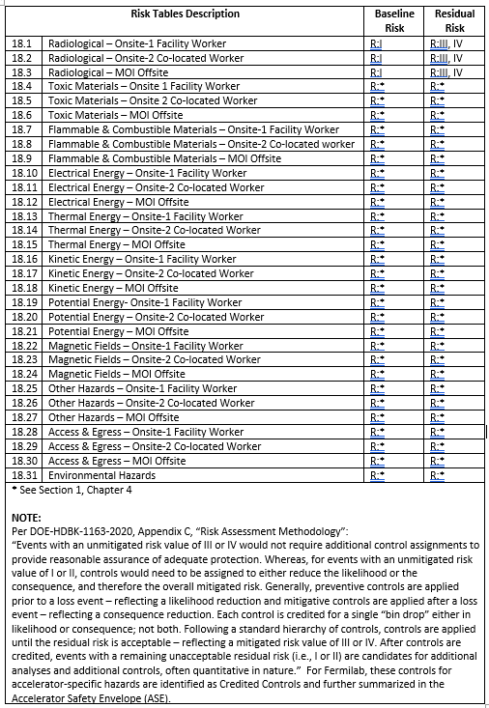
Risk Table Summary for Neutrino Muon Beam Line

Slide 8
Non-Accelerator Specific Hazards - Radiological
Residual Activation
  High intensity beam delivery can produce activated materials inside the Neutrino Muon beam enclosure due to beam loss
  The residual dose rate found in the Main Injector from initial entry surveys is historically less than 10 mrem/hr
  Hazard applies to onsite facility workers and onsite co-located workers
Baseline Qualitative Risk (without controls) | Controls Preventive (P)/Mitigative (M) | Residual Qualitative Risk (with controls)
L: A C: H R: I | P – Radiological Work Permit P – Radiological Posting P – Use of an LSM; Beam Loss Monitoring P – Radiological Training M – Radiological Posting and Decay Time Requirements M – Radiological Shielding M – Run Conditions | L: BEU C: N R: IV

Slide 9
Non-Accelerator Specific Hazards - Radiological
Ground/surface Water Activation
  High intensity beam delivery can interact with soil and leach into ground water
  Cooling water systems such as low conductivity water interact with activated beam line components
  The radioisotopes of concern for leaching are tritium and Na-22
  Hazard applies to onsite facility workers and onsite co-located workers
Baseline Qualitative Risk (without controls) | Controls Preventive (P)/Mitigative (M) | Residual Qualitative Risk (with controls)
L: A C: H R: I | P – Sump/Water Monitoring Systems P – Sump Pumps P – Beam Loss Monitoring M – Machine Protection System M – Run Conditions | L: BEU C: L R: IV

Slide 10
Non-Accelerator Specific Hazards - Radiological
Radioactive Water (RAW) system
  The primary beam absorber (FMAG) is cooled with water which becomes activated.
  The system is self contained and part of the RSIS
  Hazard applies to onsite facility workers and onsite co-located workers
Baseline Qualitative Risk (without controls) | Controls Preventive (P)/Mitigative (M) | Residual Qualitative Risk (with controls)
L: A C: H R: I | P – Interlocked Gates P – Interlocked Key P – Key Control Program P – Radiological Postings P – Radiological Training M – Engineered Containment | L: BEU C: M R: IV

Slide 11
Non-Accelerator Specific Hazards - Radiological
Soil Interactions
  Radionuclides are produced which may contaminate ground water
  Can occur in areas of high chronic losses
  Hazard applies to onsite facility workers and onsite co-located workers
Baseline Qualitative Risk (without controls) | Controls Preventive (P)/Mitigative (M) | Residual Qualitative Risk (with controls)
L: A C: N R: IV | P – Beam Loss Monitoring M – Engineered Beam Dump M – Beamline Design M – Run Conditions | L: U C: N R: IV

Slide 12
Non-Accelerator Specific Hazards - Radiological
Radioactive Waste
  Radioactive waste produced during Neutrino Muon operations will be managed within the established Radiological Protection Program (RPP) as prescribed in the Fermilab Radiological Control Manual (FRCM)
  Hazard applies to onsite facility workers and onsite co-located workers
Baseline Qualitative Risk (without controls) | Controls Preventive (P)/Mitigative (M) | Residual Qualitative Risk (with controls)
L: A C: H R: I | P – Locked Gates P – Key Control Program P – Postings M – Run Conditions M – Distance to Stored Material | L:BEU C: L R: IV

Slide 13
Non-Accelerator Specific Hazards - Radiological
Air Activation
  Air activation can occur at any area in the accelerator where beam losses occur
  The radioisotopes of concern are C-11, O-15, N-13 and Ar-41
  Hazard applies to onsite facility workers and onsite co-located workers
Baseline Qualitative Risk (without controls) | Controls Preventive (P)/Mitigative (M) | Residual Qualitative Risk (with controls)
L: A C: H R: I | P – Air Monitoring P - RSIS P– Beam loss Monitoring M – Engineered Flow and Cool Off Times M – Run Conditions | L: BEU C: L R: IV

Slide 14
Non-Accelerator Specific Hazards - Radiological
Contamination
  Contamination can be found in the Neutrino Muon enclosures in areas where beam loss has occurred
  Hazard applies to onsite facility workers and onsite co-located workers
Baseline Qualitative Risk (without controls) | Controls Preventive (P)/Mitigative (M) | Residual Qualitative Risk (with controls)
L: A C: H R: I | P – Locked Gates P – Key Control Program P – Radiological Posting M – Radiological Work Permit M – Training M – Run Condition | L: BEU C: N R: IV

Slide 15
Non-Accelerator Specific Hazards - Radiological
Radioactive Sources
  Not encountered throughout the beam line
  Could be needed as part of an experimental set-up
  Hazard applies to onsite facility workers and onsite co-located workers
Baseline Qualitative Risk (without controls) | Controls Preventive (P)/Mitigative (M) | Residual Qualitative Risk (with controls)
L: A C: H R: I | P – Radiological Posting P – Radiological Training P – Kept in locked cabinet when not in use M- Kept is storge when not in the field M – Shielded containers | L: BEU C: L R: IV

Slide 16
Accelerator Specific Hazards - Radiological
Prompt Ionizing Radiation – Beam Loss
  Ionizing radiation due to beam loss in the NM enclosure
  Analyzed maximum credible incident (MCI) to determine credited controls
  Hazard applies to onsite facility workers, onsite co-located workers

Slide 17
Maximum Credible Incident (MCI) - Radiological
The MCI would be one where the SY maximum credible intensity is lost and continuously incident on a magnet, beam pipe or buried beam pipe
Highest radiation losses are generated by accidents at locations with reduced passive shielding
This NM MCI beam intensity is the same as the SY MCI beam intensity
This has been determined to be 2.75E15 protons/hr or 4.2E13 protons/pulse
120 GeV beam energy
55s cycle time

Slide 18
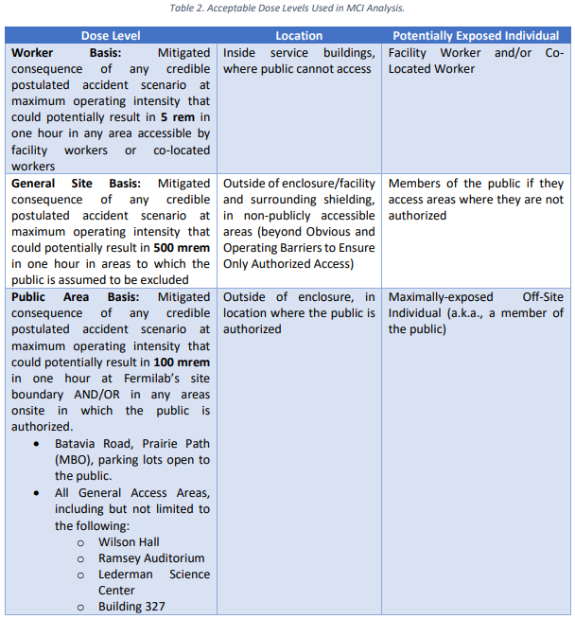
Acceptable Dose Levels Used In MCI Analysis

Slide 19
Credited Controls – Passive
Locked fence that surrounds the entire Neutrino Muon Berm
  N01/NM1 to NM4
Permanent shielding
  Varying amounts of permanent shielding is present within the fenced area.
  Two locations at the SW corner of the NM4 experimental hall and the NM3 berm (just upstream of NM4) could exceed the 5000 mrem/hr dose limit with the MCI.
  In these areas the existing shielding is a credited control along with active controls.

Slide 20
Credited Controls - Passive
The fence on the West side of the berm is 143 feet away from NM4 and is the closest accessible location. Keeping the berm dose rate to less than 5000 mrem/hr, 1/r would reduce this dose at the fence line to 35 mrem in one hour. Although this is conservative since the Neutrino Center berm is present between NM4 and the fence.

Slide 21
Longitudinal Permanent Shielding
Longitudinal Range | Location | Fixed Shielding (efd) | Movable Shielding (efd) | Current Shielding (efd) | Required (efd)
3179-3216 | NM1 | 19.6 |  | 19.6 | 13.9
3216-3620 | Beam Pipe | 22.0 |  | 22.0 | 16.3
3620-3829 | NM2 | 18.0 |  | 18.0 | 13.9
3829-3929 | NM2 | 15.5 |  | 15.5 | 13.9
3929-4060 | NM2 | 17.5 |  | 17.5 | 13.9
4060-4113 | Beam Pipe | 30.8 |  | 30.8 | 16.3
4113-4230 | NM3 | 21.0 |  | 21.0 | 13.9
4230-4334 | NM3 | 21.3 |  | 21.3 | 11.4
4334-4348 | NM3 | 12.5 |  | 12.5 | 11.4
4348-4360 | NM3 | 11.3 |  | 11.3 | 11.4

Slide 22
Longitudinal Permanent Shielding, Cont’d
Longitudinal Range | Location | Fixed Shielding (efd) | Movable Shielding (efd) | Current Shielding (efd) | Required (efd)
4353-4357 | NM3 collimator | 11.4 | 6.1 | 17.5 | 13.9
4357-4360 | NM3 | 11.4 |  | 11.4 | 11.4
4360-4368 | Target Cave |  | 11.7 | 11.7 | 13.9
4368-4373 | Target Wall |  | 29.9 | 29.9 | 16.3
4373-4374 | Pre-FMAG |  | 31.4 | 31.4 | 16.3
4374-4378 | FMAG US |  | 31.0 | 31.0 | 16.3
4378-4381 | FMAG US |  | 28.8 | 28.8 | 16.3
4382-4388 | FMAG DS |  | 26.0 | 26.0 | 16.3
4388-4389 | FMAG DS |  | 22.4 | 22.4 | 16.3
4389-4390 | FMAG DS |  | 28.5 | 28.5 | 16.3
4390-4391 | Post-FMAG |  | 3.5 | 3.5 | 3.0
4391-4392 | Post-FMAG |  | 8.9 | 8.9 | 3.0
4392-4394 | Post-FMAG |  | 3.5 | 3.5 | 3.0
4394-4454 | NM4 |  | 0.0 | 0.0 | 3.0
4454-4490 | NM4 |  | 7.1 | 7.1 | 3.0
4490-4503 | NM4 |  | 8.9 | 8.9 | 3.0

Slide 23
Transverse Permanent Shielding
Transverse Station (ft) | Location | Fixed Shielding (efd) | Movable Shielding (efd) | Current Shielding (efd) | Required (efd)
NC13176 | N01 | 26.6 |  | 26.6 | 16.3
NC13208 | N01 | 21.8 |  | 21.8 | 16.3
NM23673 | NM2 | 19.0 |  | 19.0 | 16.3
NM23827 | NM2 | 19.5 |  | 19.5 | 16.3
NM23882 | NM2 | 19.0 |  | 19.0 | 16.3
NM24009 | NM2 | 25.5 |  | 25.5 | 16.3
NM24028 | NM2 | 17.9 |  | 17.9 | 16.3
NM24100 | Beam Pipe | 31.4 |  | 31.4 | 18.7
NM34120 | NM3 | 18.4 |  | 18.4 | 16.3
NM34125 | NM3 | 21.7 |  | 21.7 | 16.3
NM34150 | NM3 | 21.7 |  | 21.7 | 13.9
NM34168 | NM3 | 21.2 |  | 21.2 | 13.9
NM34245 | NM3 | 21.3 |  | 21.3 | 13.9

Slide 24
Transverse Permanent Shielding, Cont’d
Transverse Station (ft) | Location | Fixed Shielding (efd) | Movable Shielding (efd) | Current Shielding (efd) | Required (efd)
4354-W | NM3 Collimator | 11.4 | 6.1 | 17.5 | 16.3
4354-E | NM3 Collimator | 11.4 | 6.1 | 17.5 | 16.3
4357-W | NM3 | 16.9 | 0.0 | 16.9 | 13.8
4357-E | NM3 | 16.9 | 0.0 | 16.9 | 13.8
4360-W | Target Cave |  | 4.0 | 4.0 | 13.9
4360-E(dn) | Target Cave |  | 19.8 | 19.8 | 13.9
4360-E(up) | Target Cave |  | 5.0 | 5.0 | 13.9
4361-W | Target Cave |  | 8.4 | 8.4 | 13.9
4361-E(dn) | Target Cave |  | 23.6 | 23.6 | 13.9
4361-E(up) | Target Cave |  | 11.4 | 11.4 | 13.9
4364-W | Cryo Line |  | 11.0 | 11.0 | 13.9
4364-E(dn) | Cryo Line |  | 23.6 | 23.6 | 13.9
4364-E(up) | Cryo Line |  | 11.4 | 11.4 | 13.9
4367-W | Target Cave |  | 6.7 | 6.7 | 13.9
4367-E(dn) | Target Cave |  | 32.6 | 32.6 | 13.9
4367-E(up) | Target Cave |  | 11.4 | 11.4 | 13.9
4368-W | Target Cave |  | 18.5 | 18.5 | 13.9
4368-E(dn) | Target Cave |  | 33.5 | 33.5 | 13.9
4368-E(up) | Target Cave |  | 20.3 | 20.3 | 13,9
4370-W | Target Wall |  | 22.9 | 22.9 | 13.9
4370-E(dn) | Target Wall |  | 32.8 | 32.8 | 13.9

Slide 25
Transverse Permanent Shielding, Cont’d
Transverse Station (ft) | Location | Fixed Shielding (efd) | Movable Shielding (efd) | Current Shielding (efd) | Required (efd)
4370-E(up) | Target Wall |  | 20.5 | 20.5 | 13.9
4373-W | Pre-FMAG |  | 25.9 | 25.9 | 16.3
4373-E(dn) | Pre-FMAG |  | 29.4 | 29.4 | 16.3
4373-E(up) | Pre-FMAG |  | 24.3 | 24.3 | 16.3
4376-W | FMAG Face |  | 31.0 | 31.0 | 16.3
4376-E(dn) | FMAG Face |  | 37.4 | 37.4 | 16.3
4376-E(up) | FMAG Face |  | 31.0 | 31.0 | 16.3
4378-W | FMAG |  | 28.8 | 28.8 | 16.3
4378-E(dn) | FMAG |  | 39.9 | 39.9 | 16.3
4378-E(up) | FMAG |  | 28.8 | 28.8 | 16.3
4380-W | FMAG |  | 26.0 | 26.0 | 16.3
4380-E(dn) | FMAG |  | 39.9 | 39.9 | 16.3
4380-E(up) | FMAG |  | 26.0 | 26.0 | 16.3
4382-W | FMAG |  | 26.0 | 26.0 | 16.3
4382-E(dn) | FMAG |  | 33.9 | 33.9 | 16.3
4382-E(up) | FMAG |  | 26.0 | 26.0 | 16.3
4388-W | FMAG |  | 22.4 | 22.4 | 16.3
4388-E(dn) | FMAG |  | 37.7 | 37.7 | 16.3
4388-E(up) | FMAG |  | 22.4 | 22.4 | 16.3
4389-W | FMAG |  | 26.1 | 26.1 | 16.3
4389-E(dn) | FMAG |  | 37.0 | 37.0 | 16.3
4389-E(up) | FMAG |  | 26.1 | 26.1 | 16.3
4390-W | Post-FMAG |  | 2.5 | 2.5 | 3.0
4390-E(dn) | Post-FMAG |  | 16.9 | 16.9 | 3.0
4390-E(up) | Post-FMAG |  | 2.2 | 2.2 | 3.0
4392-W | Post-FMAG |  | 10.4 | 10.4 | 3.0
4392-E(dn) | Post-FMAG |  | 24.6 | 24.6 | 3.0
4392-E(up) | Post-FMAG |  | 10.1 | 10.1 | 3.0
4394-W | Post-FMAG |  | 2.2 | 2.2 | 3.0
4394-E(dn) | Post-FMAG |  | 16.9 | 16.9 | 3.0
4394-E(up) | Post-FMAG |  | 2.2 | 2.2 | 3.0
4411-E(dn) | Post-FMAG |  | 12.4 | 12.4 | 3.0
4411-E(up) | Post-FMAG |  | 0.0 | 0.0 | 3.0
4411-W | Post-FMAG |  | 0.0 | 0.0 | 3.0
4482-E(dn) | Post-FMAG |  | 16.4 | 16.4 | 3.0
4482-E(up) | Post-FMAG |  | 6.6 | 6.6 | 3.0
4482-W | Post-FMAG |  | 6.6 | 6.6 | 3.0
4502-E(dn) | Post-FMAG |  | 14.8 | 14.8 | 3.0
4502-E(up) | Post-FMAG |  | 7.7 | 7.7 | 3.0
4502-W | Post-FMAG |  | 7.7 | 7.7 | 3.0

Slide 26
Credited Controls – Passive
Movable and penetration Shielding
  The “Target Station” which includes the area around the target cave and primary beam absorber (FMAG) is surrounded by steel and concrete

Slide 27
Credited Controls – Active Engineering
Radiation Safety Interlock System (RSIS)
  Inhibits beam by controlled redundant critical devices
  Enforces the search and secure process
  Interlocked doors are present at all access points into the Main Injector enclosure
  The ES&H Radiation Physics Engineering Dept. (RPE) ensures that all requirements for hardware and system testing are completed semi-annually with a four-month grace period
  RPE also verifies the inventory of interlock keys and updates procedures for maintenance and testing of interlock systems
  All RSIS are designed, installed and configuration managed in conformance with the requirements of the Fermilab Radiological Control Manual (FRCM)

Slide 28
Credited Controls – Active Engineering
Interlocked Radiation Detectors
  All interlocked detectors are part of standard RSIS used throughout Fermilab and are calibrated on an annual basis
  For areas that do not have the required amount of permanent shielding these detectors can be used to provide the same level of protection to an individual outside of the shielding

Slide 29
Credited Controls – Active Engineering
Credited Control Device | Longitudinal and Transverse Location Protected | Location | Credited Control Limit (mrem/hour)
Chipmunk (3-161) | 4348 – 4368 (Long.) | NM3 Berm | < 5000
Chipmunk (3-162) | 4360 – 4367 (Trans.) | SW Corner of NM4 Exp. Hall. | < 5000

Slide 30
Credited Controls - Administrative
Credited Control: Operation Authorization Document
  Machine Beam Permit
  Machine Run Condition
  Beam will not be transported through the Neutrino Muon beam line without approval of these documents
Credited Control: Staffing
  To ensure accelerator operations are disabled and initiate an immediate
  response in the event of a determined ASE violation.
  The following staffing shall be in place during applicable beam operation:
    At least one member of the AD Operations Department who has achieved the rank of Operator II or higher shall be on duty and on site.
    At least one member of the AD Operations Department shall be present in the Main Control Room (MCR).
    Note: these requirements could be satisfied by a single person
Credited Control: Accelerator Operating Parameters
  The MCI intensity of 2.75E15 protons/hr shall not be exceeded

Slide 31
Thank you for your attention

