Slide 1
Safety Assessment Document Updates for DOE O 420.2D
SAD Section IV Chapter 09 – Neutrino Switchyard 120 Experimental Areas
Evan Niner
Accelerator Readiness Review 1
19-21 March 2024

Slide 2
Outline
Neutrino Switchyard 120 Experimental Area Overview
Hazard Inventory
Non-Accelerator Specific Hazards
Accelerator Specific Hazards
Maximum Credible Incident (MCI) Discussion
Summary of Credited Controls

Slide 3
Outline
Neutrino Switchyard 120 Experimental Areas Overview
Hazard Inventory
Non-Accelerator Specific Hazards
Accelerator Specific Hazards
Maximum Credible Incident (MCI) Discussion
Summary of Credited Controls

Slide 4
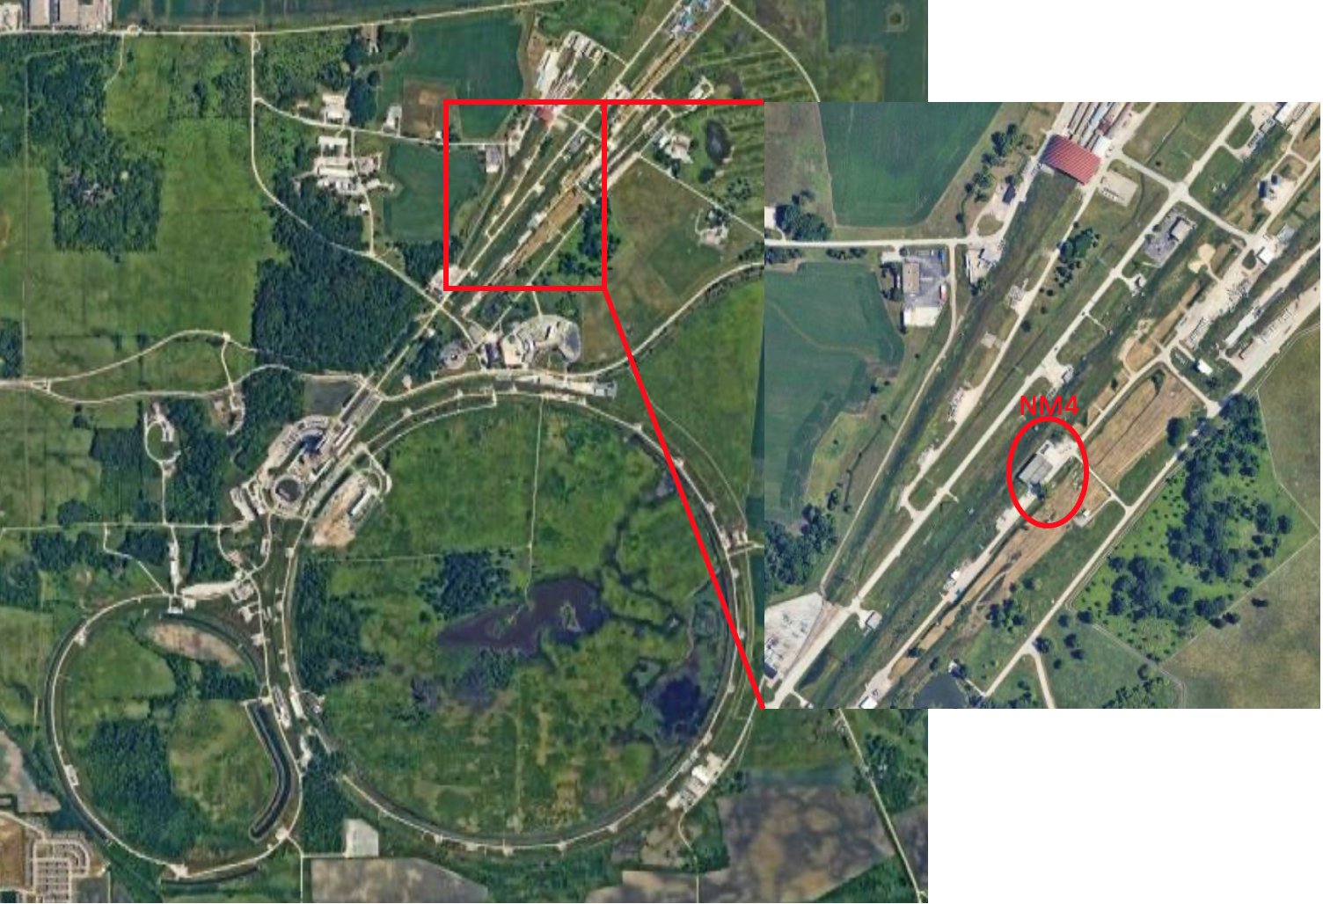
Neutrino Switchyard 120 Experimental Areas Overview
NM4 beam enclosure and service building
120 GeV proton beam from Neutrino beamline (III-14)
4.2 second slow spill extracted once every 55 seconds from Main Injector (same extraction as to Meson Experimental Area)
Currently occupied by E1039 SpinQuest experiment
Many systems repurposed from previous SeaQuest experiment last operated in 2017
Introduction of cryogenics platform and solid ammonia target
Ready to begin beam operations following ARR

Slide 5
Neutrino Switchyard 120 Experimental Areas Overview
The Neutrino Switchyard 120 Experimental Areas are managed by the Particle Physics Directorate (PPD). The SpinQuest experiment has an assigned Experiment Liaison Officer (ELO) to manage the NM4 facility and provide assistance and oversight to the experiment including coordination of lab resources. The ELO coordinates with the beamline physicist assigned from the External Beams Delivery Department in the Accelerator Directorate (AD) who maintains any AD owned systems, instrumentation, beamlines, and controls that are present in the experimental space.
Radiation safety has been carefully considered in the design of the Fermilab Neutrino Switchyard 120 Experimental Areas. All radiation hazards relating to beam operations safety are the responsibility of the Accelerator Directorate. The Accelerator Directorate, whose facilities includes all beamlines, their shielding, radiation, interlocks, beam surveys, monitors and impact of radiation on the environment, is addressed in SAD Section III Chapter 14 on the Neutrino Area.

Slide 6
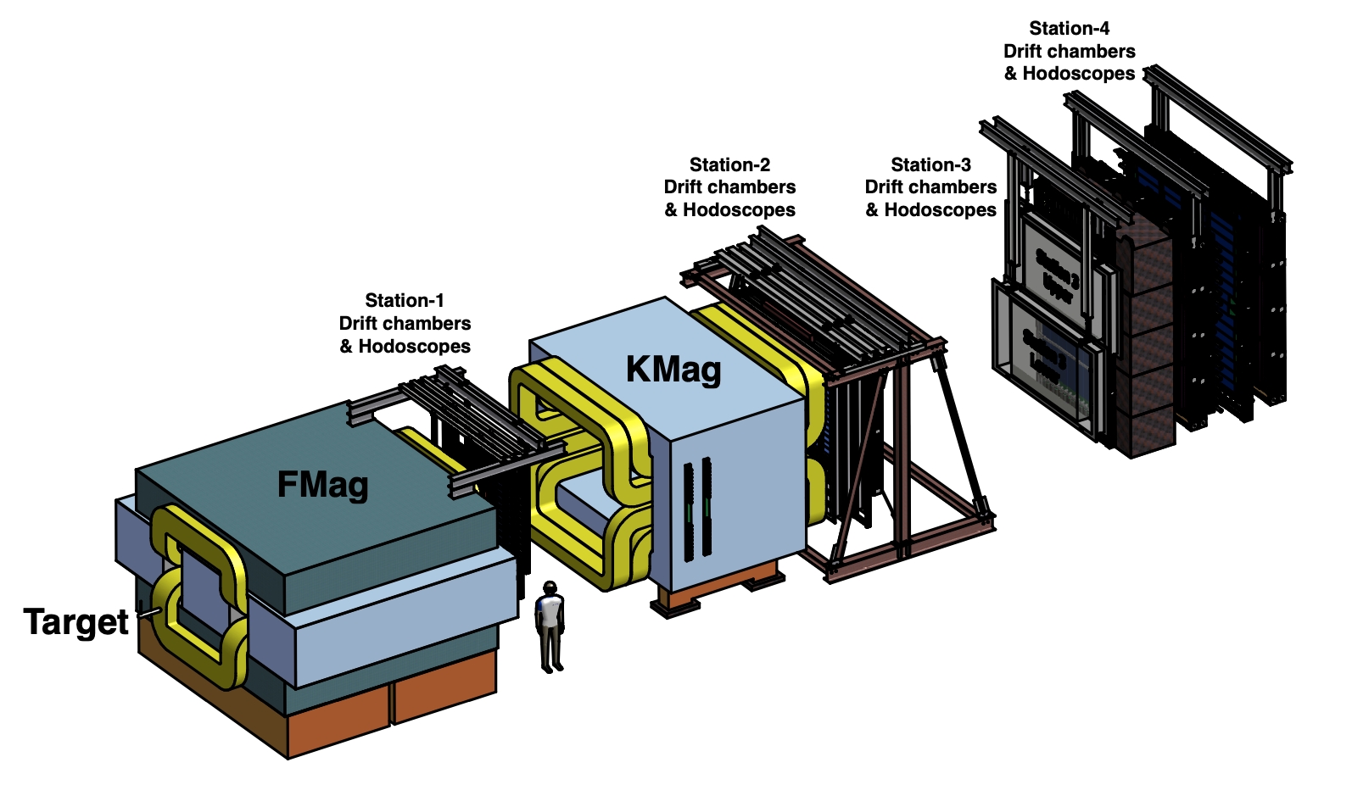
Neutrino Switchyard 120 Experimental Areas Overview - SpinQuest
SpinQuest Spectrometer
Repurposed from SeaQuest, lower level (below ground) of NM4 enclosure
Beam going left to right
FMag is a closed aperture solid iron magnet to focus muons downstream and absorb beam protons which do not interact with the target
KMag is a large open aperture magnet to measure muon momenta

Slide 7
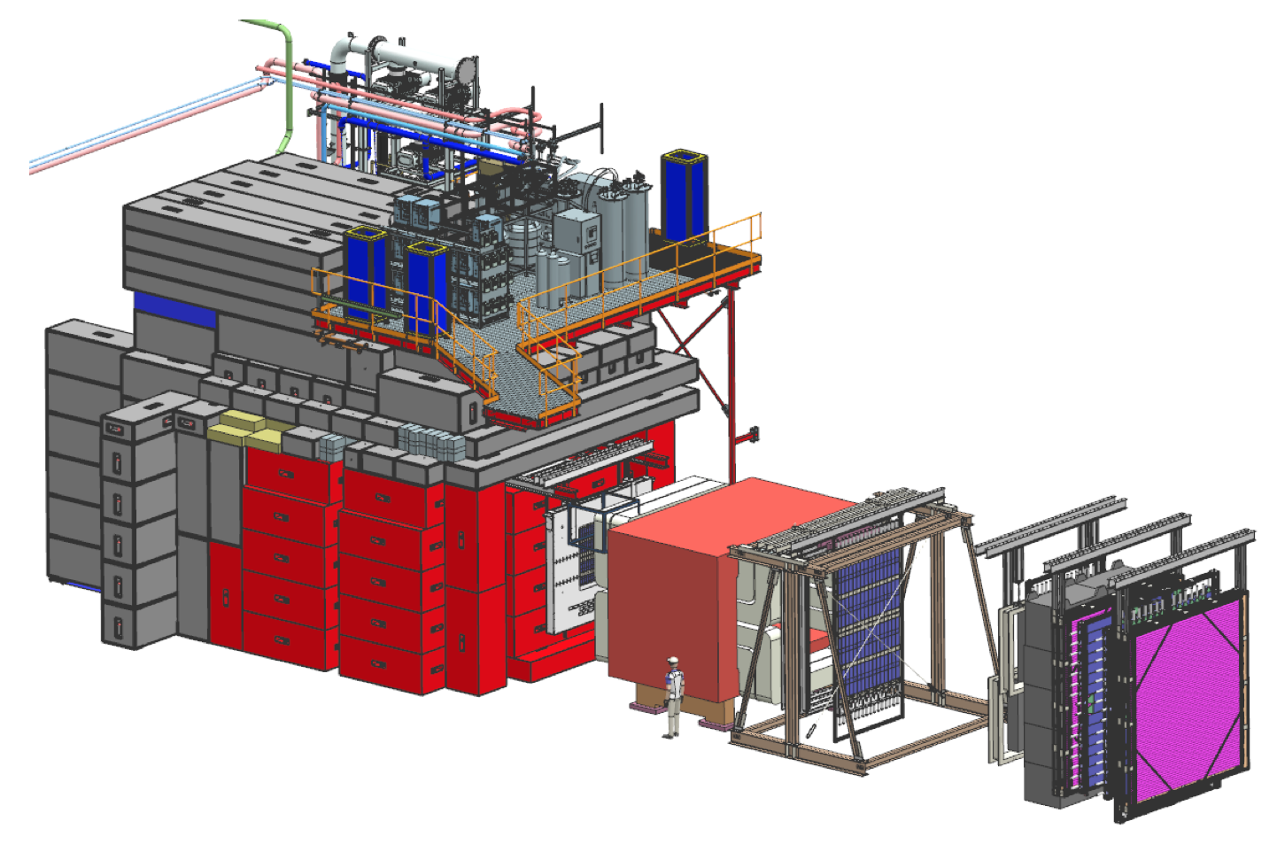
Neutrino Switchyard 120 Experimental Areas Overview - SpinQuest
Cryogenics platform
New cryogenics plant installed on second (ground) level of NM4 enclosure to capture gaseous helium and reliquify
The red shielding blocks are surrounding FMag and existing from SeaQuest. The grey shielding blocks are new to SpinQuest

Slide 8
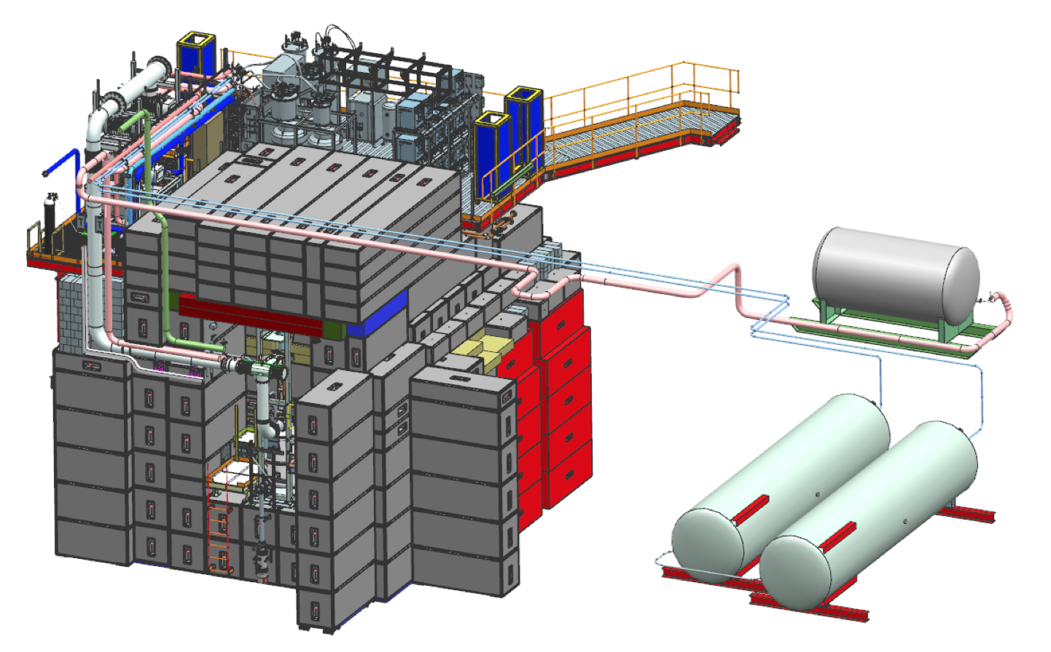
Neutrino Switchyard 120 Experimental Areas Overview - SpinQuest
Target cave systems
Cryostat cooled with liquid helium and insulated with liquid nitrogen and high vacuum
Superconducting magnet, 1K evaporation fridge, NMR and microwave system, and solid-state polarized ammonia target
Due to shielding target cave accessed via ladder from upstream NM3 enclosure
Also shown are external liquid nitrogen dewar and gaseous helium tanks connected to cryo platform
Guard rails installed in target cave not shown in this illustration

Slide 9
Neutrino Switchyard 120 Experimental Areas Overview - SpinQuest
SpinQuest experiment status
*40 Engineering notes related to cryogenic systems reviewed and approved
Cryogenics plant is operational and producing liquid helium
*61 ORCs for all each of the detector subsystems reviewed and approved
Experiment subsystems are operational and being commissioned without beam
Final full-system beam ORC 2164 walkthrough complete on 2/15/24
ORC covers operation of all experiment systems in the beam including the presence of ammonia and HDPE targets in the beam path. Procedures governing changing out an irradiated ammonia target and storage/shipment to be covered in additional ORC addendum.
*42 standard operating procedures for cryogenics plant, experiment systems, ammonia reviewed and approved
10 grams of ammonia currently onsite for handling practice and no-beam commissioning activities (more on next slides)
*See backup slides for lists

Slide 10
Neutrino Switchyard 120 Experimental Areas Overview - SpinQuest Systems
Polarized NH3/ND3 Target
Quantum Technology (QT) Liquefiers System
University of Virginia Microwave System
Liverpool NMR System
Oerlikon stacked Root pumps
Evaporation Refrigerator
Superconducting Magnet
Target Lifter or Target Actuator
Slow Control & Magnet power supply Rack
Spectrometer
Drift chambers
Scintillator hodoscopes
Fiber hodoscopes
Proportional tubes
Cerenkov beam monitor
Data acquisition and trigger
Beam dump (FMag) and analysis (KMag) magnets
*More detail on each system in backup slides

Slide 11
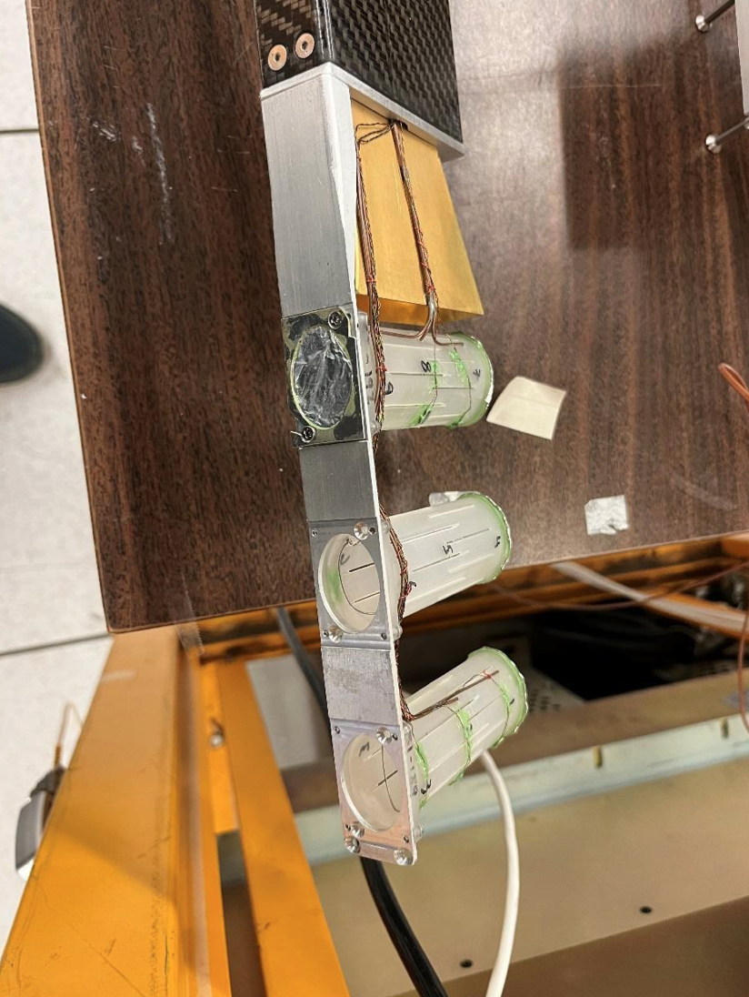
Neutrino Switchyard 120 Experimental Areas Overview - Ammonia
Ammonia handling
SpinQuest makes use of beads of polarized solid ammonia as target material
Beads are loaded into target insert stick in NM4 hall
Target insert then transported to NM3 target cave and lowered into cryostat
All work done keeping ammonia submersed in liquid nitrogen
Ammonia will sublimate above -77C
remove it from liquid nitrogen for less then 20 seconds at a time
At most 28.9 grams of ammonia in the target insert during operations
Ammonia target loses is polarization properties after some exposure to beam resulting in the need to change targets ~weekly when running beam
Exhausted targets stored and ultimately shipped back to University of Virginia for additional studies

Slide 12
Neutrino Switchyard 120 Experimental Areas Overview - Ammonia
SpinQuest has been working with ESH team of SMEs in a weekly meeting led by Barb Hill for nearly a year to create, review and approve procedures for handling the ammonia and other aspects of operations
Several months of practice now filling the target insert and loading the insert into the cave using plastic (HDPE) beads
Ammonia handles differently and the plastic beads cannot be used for all commissioning or physics measurements
Procedures for working with the ammonia filling the target insert and loading the insert in the cave have been approved in addition to shipping material to Fermilab and storing 10 grams of material in NM4. FSO provided final review.
10 grams of material shipped to FNAL 12/13/23
Training courses for SpinQuest target team
SpinQuest Ammonia Target Handling [FN000761/RR/01]
SpinQuest Ammonia Target Handling On the Job Training [FN000762/OJ/01]
SpinQuest target team has been practicing the first step in the procedure handling ammonia in the back of NM4 prior to filling the target insert or loading the insert into the cryostat.
Oversight from ESH and Industrial Hygiene for initial practice and air sampling
Daily training log recording who is performing each task and lessons learned to adjust procedures
SpinQuest is taking this very slowly one step at a time

Slide 13
Neutrino Switchyard 120 Experimental Areas Overview – Ammonia next steps
Next commissioning steps
First polarization of plastic (HDPE) beads on 1/21/24
Emergency response drill with Fire Department for ammonia sublimation in NM3 target cave took place on 2/26/24 and 2/29/24
On 3/19 10 gram sample on hand was moved into the target cryostat for initial commissioning for the first time (operating super conducting magnet, mircrowave, NMR systems for polarization studies) without beam, and will later scale up to 28.9 grams
After ARR and ASE rev 15: Run beam down Neutrino Muon line and to HDPE target with all systems operating
After ARR, ASE rev 15, and ORC addendum on irradiated ammonia handling: Install ammonia target with beam
Remaining ammonia procedure work for ORC addendum:
Finalize procedure for a longer term storage solution for larger quantities of ammonia both before and after irradiation
Explosion proof shed outside NM4. Shed installed and procedure drafted and under review
Finalize shipping procedure after beam exposure
Roles and responsibilities are defined and with anticipated target activation, can ship weekly with no long hold of material. Procedure drafted and under review.
Modify procedure to load target insert in/out of cryostat to include RCT coverage in beam conditions in progress
Continue to work with ESH to adjust and improve procedures as SpinQuest learns from experience
SpinQuest is ready for beam operations

Slide 14
Outline
Neutrino Switchyard 120 Experimental Areas Overview
Hazard Inventory
Non-Accelerator Specific Hazards
Accelerator Specific Hazards
Maximum Credible Incident (MCI) Discussion
Summary of Credited Controls

Slide 15
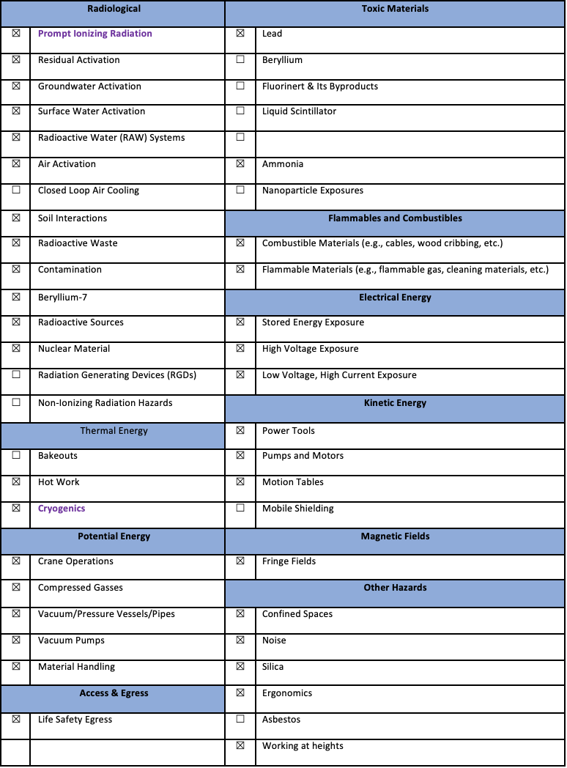
Hazard Inventory for Neutrino Switchyard 120 Experimental Areas
Accelerator specific hazards are purple
Hazards not discussed today are evaluated via the common Risk Matrix tables
Covered in SAD Section I, Chapter 4
Hazards evaluated via risk assessment methodology per DOE-HDBK-1163-2020
Likelihood (L):
Anticipated (A), Unlikely (U), Extremely Unlikely (EU), Beyond Extremely Unlikely (BEU)
Consequence (C):
High (H), Moderate (M), Low (L), Negligible (N)
Risk (R):
I , II, III, IV (descending order of concern)

Slide 16
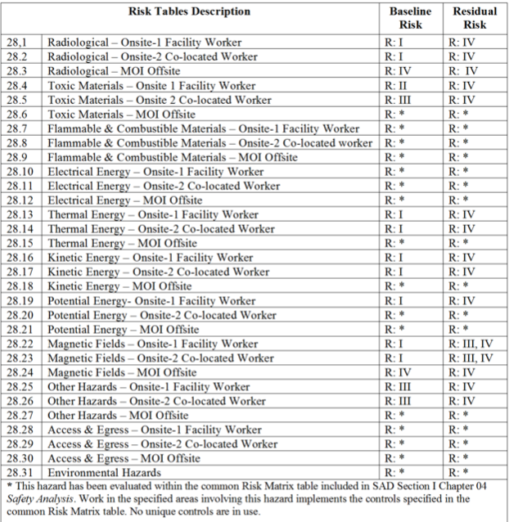
Hazard Inventory for Neutrino Switchyard 120 Experimental Areas
Accelerator specific hazards are purple
Hazards not discussed today are evaluated via the common Risk Matrix tables
Covered in SAD Section I, Chapter 4
Hazards evaluated via risk assessment methodology per DOE-HDBK-1163-2020
Likelihood (L):
Anticipated (A), Unlikely (U), Extremely Unlikely (EU), Beyond Extremely Unlikely (BEU)
Consequence (C):
High (H), Moderate (M), Low (L), Negligible (N)
Risk (R):
I , II, III, IV (descending order of concern)

Slide 17
Outline
Neutrino Switchyard 120 Experimental Areas Overview
Hazard Inventory
Non-Accelerator Specific Hazards
Accelerator Specific Hazards
Maximum Credible Incident (MCI) Discussion
Summary of Credited Controls

Slide 18
Non-Accelerator Specific Hazards - Radiological
Residual Activation
SpinQuest target station and front face of absorber magnet will activate
Ammonia target changeouts involve RCT coverage to survey materials, take contamination wipes, and provide oversight
Hazard applies to onsite facility workers and onsite co-located workers
Baseline Qualitative Risk (without controls) | Controls Preventive (P)/Mitigative (M) | Residual Qualitative Risk (with controls)
L: A C: H R: I | P – General and/or job specific RWP P – Use of LSM P – Radiological training P – Keyed entry M – Signage and decay time requirements | L: BEU C: M R: IV

Slide 19
Non-Accelerator Specific Hazards - Radiological
RAW
RAW water system in service of FMag and a water system in NM4 in service of the SpinQuest microwave system
Hazard applies to onsite facility workers and onsite co-located workers
Baseline Qualitative Risk (without controls) | Controls Preventive (P)/Mitigative (M) | Residual Qualitative Risk (with controls)
L: A C: L R: III | P – Interlocked doors P – Key control P – Radiological training M – Design of water system | L: BEU C: N R: IV

Slide 20
Non-Accelerator Specific Hazards - Radiological
Air Activation
Air activation from scattered beam off target
In SeaQuest operations 120 minute cool-off
Hazard applies to onsite facility workers and onsite co-located workers
Baseline Qualitative Risk (without controls) | Controls Preventive (P)/Mitigative (M) | Residual Qualitative Risk (with controls)
L: A C: H R: I | P – Interlock system preventing access to beam enclosure while beam is present. P – Air monitoring system P – Beam loss monitoring system P – Cool-off time M – Ventilation system design M – Run conditions | L: BEU C: L R: IV

Slide 21
Non-Accelerator Specific Hazards - Radiological
Radioactive Waste
Radioactive waste produced during Main Injector operations will be managed within the established Radiological Protection Program (RPP) as prescribed in the Fermilab Radiological Control Manual (FRCM)
Hazard applies to onsite facility workers and onsite co-located workers
Baseline Qualitative Risk (without controls) | Controls Preventive (P)/Mitigative (M) | Residual Qualitative Risk (with controls)
L: A C: L R: III | P – Radiological worker training P – Locked doors P - Key control program M – Any item in a beam enclosure during beam-on conditions is removed and surveyed by radiological workers and classified appropriately M – Any item identified for disposal is surveyed and processed by Radiological Control organization personnel in accordance with FRCM chapter 4 | L: BEU C: N R: IV

Slide 22
Non-Accelerator Specific Hazards - Radiological
Contamination
Contamination possible in the SpinQuest target cave area with beam going through air gap
Hazard applies to onsite facility workers and onsite co-located workers
Baseline Qualitative Risk (without controls) | Controls Preventive (P)/Mitigative (M) | Residual Qualitative Risk (with controls)
L: A C: H R: I | P – Locked gates P – Key control program P – Radiological training M – RCT coverage and/or job specific RWP M – Monitoring via contamination wipes | L:EU C: L R: IV

Slide 23
Non-Accelerator Specific Hazards – Toxic Materials
Ammonia
At most 28.9 grams of solid ammonia used as target material presents a toxicity hazard should its temperature rise above its melting point of -77°C
NM3 Target Cave
An active ventilation system in NM3 target cave comprising a 1,800 CFM curtain fan blowing air into the target cave and a 5,000 SCFM explosion proof, ducted fan draws any ammonia away from the target cave and dilutes the gas in the NM3 enclosure
Automatic activation of the ventilation system, warning lights and sounding of an audio alarm, occurs should either of two sensors located in the target cave detect ammonia concentrations above 25 ppm
FIRUS alarm
Key control to ensure only trained personnel present during a target changeout
Ventilation system locked ON during target changeouts
Hazard applies to onsite facility workers and onsite co-located workers
Baseline Qualitative Risk (without controls) | Controls Preventive (P)/Mitigative (M) | Residual Qualitative Risk (with controls)
NM3 Target Cave L: A C: M R: II | NM3 Target Cave P: Standard Operating Procedures for handling P: Training M: PPE (dermal) M: Engineering control (Room ventilation) M: Ammonia kept in solid form in cryogens | NM3 Target Cave L: EU C: N R: IV

Slide 24
Non-Accelerator Specific Hazards – Toxic Materials
Ammonia
NM4 handling areas
An area in the back of NM4 setup for loading and unloading ammonia from the target insert next to the enclosure air intake
Trained individuals following SOPs
For irradiated material additional coverage from RCTs and HCTT for shipment
Hazard applies to onsite facility workers and onsite co-located workers
Baseline Qualitative Risk (without controls) | Controls Preventive (P)/Mitigative (M) | Residual Qualitative Risk (with controls)
NM4 handling areas L: A C: M R: II | NM4 handling areas P: Standard Operating Procedures for handling P: Training M: PPE (dermal) M: Room ventilation M: Ammonia kept in solid form in cryogens | NM4 handling areas L: EU C: N R: IV

Slide 25
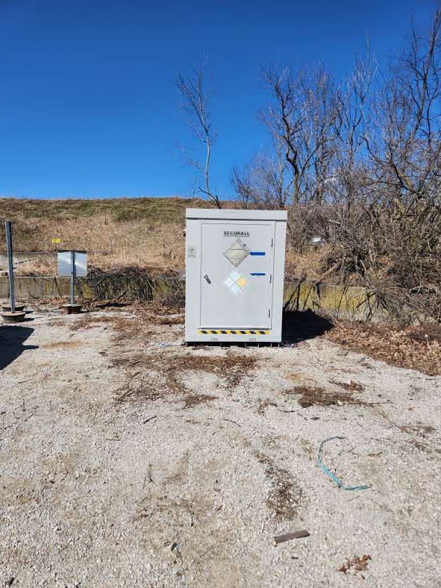
Non-Accelerator Specific Hazards – Toxic Materials
Ammonia
External storage shed
Explosion-proof storage shed located outside NM4 hall, storing up to 196 grams of ammonia (both fresh and irradiated material awaiting shipment)
Vents in shed allow air sampling before entry
Standard operating procedure (being drafted)
Hazard applies to onsite facility workers and onsite co-located workers
Baseline Qualitative Risk (without controls) | Controls Preventive (P)/Mitigative (M) | Residual Qualitative Risk (with controls)
External storage shed L: A C: M R: II | External Storage shed P: Standard Operating Procedures for handling P: Training M: PPE (dermal) M: Air sampling before entry M: Room ventilation M: Ammonia kept in solid form in cryogens | External storage shed L: EU C: N R: IV

Slide 26
Non-Accelerator Specific Hazards – Toxic Materials
Ammonia
Transportation
Involves Shipping and Receiving, Dispatch, and Hazard Control Technology Team (HCTT)
Fresh ammonia received from University of Virginia and shipped back
SOPs for receiving ammonia at FNAL (in use) and shipping irradiated ammonia back (drafting)
Transportation in a dry shipper with an absorbent material soaked in LN2 to sustain proper temperature for 18 days
Anticipate weeks shipments of irradiated material offsite as soon as a target is changed out
Hazard applies to onsite facility workers and onsite co-located workers
Baseline Qualitative Risk (without controls) | Controls Preventive (P)/Mitigative (M) | Residual Qualitative Risk (with controls)
Transportation L: A C: L R: III | Transportation P: Standard Operating Procedures for transportation before and after beam exposure P: Training M: Certified packaging, labeling, and tamper proof seals M: Ammonia kept in solid form in cryogens | Transportation L: EU C: N R: IV

Slide 27
Non-Accelerator Specific Hazards – Potential Energy
Compressed gases
SpinQuest uses nitrogen, helium, and argon/CO2 gas sources
Hazard applies to onsite facility workers and onsite co-located workers
Baseline Qualitative Risk (without controls) | Controls Preventive (P)/Mitigative (M) | Residual Qualitative Risk (with controls)
L: A C: H R: I | P – Engineering notes to evaluate ODH for gases brought to facility. New or modified piping/manifolds similarly evaluated. P – NM4 is an engineered ODH 0 space with monitoring/alarms/ventilation discussed further under cryogenic liquid hazards P: All personnel handling compressed gasses have to take Pressure Safety orientation training. P: All personnel handling compressed gasses have to take compressed gas cylinder safety training P: All personnel have to be familiar with FESHM 5000 series and apply requirements. P: Gas cylinders are secured and capped when not in use. M: Personal Protective Equipment mitigates severity of injury. | L: BEU C: M R: IV

Slide 28
Non-Accelerator Specific Hazards – Magnetic Fields
Fringe Fields
KMag, FMag, target system magnet
In supervised access power supplies are config controlled off for KMag and FMag
Hazard applies to onsite facility workers and onsite co-located workers
Baseline Qualitative Risk (without controls) | Controls Preventive (P)/Mitigative (M) | Residual Qualitative Risk (with controls)
Exposure to fringe fields beyond allowable limits (worker with ferromagnetic or electronic medical device(s)) L: A C: H R: I Exposure to fringe fields beyond allowable limits (worker without ferromagnetic or electronic medical device(s)) L: A C: L R: III Exposure to flying metallic objects L: A C: M R: II | P- Industrial hygiene conducts field surveys to establish safe field boundaries for workers. P- Access control points and individual components of concern (e.g., experiment permanent magnet) have postings to notify workers of magnetic hazard. P – Facility specific hazard awareness training alerting to fringe fields P- Industrial hygiene conducts field surveys to establish safe field boundaries for workers. P- Access control points and individual components of concern (e.g., experiment permanent magnet) have postings to notify workers of magnetic hazard. P – Facility specific hazard awareness training alerting to fringe fields P- Brass tools are used to prevent flying metallic objects from occurring, thereby preventing worker injury as prescribed by relevant magnet SOP P-Work Control procedure/SOP (ferromagnetic object control) requires that all ferromagnetic objects are removed prior to entry into a fringe field area (30G administrative limit). P-Work Control procedure/SOP requires worker training while in areas possessing fringe fields (300 G administrative limit). | L: BEU C: H R: III L: BEU C: L R: IV L: BEU C: M R: IV

Slide 29
Non-Accelerator Specific Hazards – Other
Noise
Localized spots in the NM3 target cave and NM4 cryoplatform with noise above 85 dB when some pieces of equipment such as fans and compressors are operational
Hazard applies to onsite facility workers and onsite co-located workers
Baseline Qualitative Risk (without controls) | Controls Preventive (P)/Mitigative (M) | Residual Qualitative Risk (with controls)
L: A C: L R: III | M – IH surveys and follow up w/ workers- administrative controls M – Hearing conservation program | L: A C: N R: IV

Slide 30
Outline
Neutrino Switchyard 120 Experimental Areas Overview
Hazard Inventory
Non-Accelerator Specific Hazards
Accelerator Specific Hazards
Maximum Credible Incident (MCI) Discussion
Summary of Credited Controls

Slide 31
Accelerator Specific Hazards - Radiological
Prompt Ionizing Radiation – Beam Loss
Ionizing radiation due to beam loss in the Neutrino Switchyard 120 Experimental Area spaces
Analyzed maximum credible incident (MCI) to determine credited controls
Hazard applies to onsite facility workers, onsite co-located workers
Credited Controls are needed

Slide 32
Accelerator Specific Hazards - ODH
Cryogenics
NM4 cryogenics plant takes in liquid nitrogen and gaseous helium from external sources to produce liquid helium
Liquid nitrogen from external dewar and liquid helium circulated from cryoplant into NM3 target cave cryostat for ammonia cooling and superconducting magnet operations
NM3 target cave air ventilation system described with ammonia hazard. NM4 around cryo platform area has two 20,000 CFM fans for air mixing
Both spaces are engineered ODH 0 areas
Oxygen sensors and alarms present to trigger ventilation system in both the NM3 target cave and NM4 independently
Credited Controls Required

Slide 33
Outline
Neutrino Switchyard 120 Experimental Areas Overview
Hazard Inventory
Non-Accelerator Specific Hazards
Accelerator Specific Hazards
Maximum Credible Incident (MCI) Discussion
Summary of Credited Controls

Slide 34
Maximum Credible Incident (MCI) – Radiological
Although the experiments are installed in the Neutrino beamline areas, the experiments themselves do not affect the Maximum Credible Incident (MCI) as presented in Section III Chapter 14 for the Neutrino Area beamlines. The MCI for the experimental area is covered by the MCI analysis for the beamlines which pass through the experimental enclosures. The Neutrino area experiments do not require any additional credited controls.
New experiments for the Neutrino Switchyard 120 Experimental Areas are proposed through a Technical Scope of Work (TSW). If an experiment introduces new hazards or requires changes to beamline configuration or operations the USI screening process would evaluate any necessary changes to shielding assessments, the SAD chapter, or ASE for III-14 or IV-09.

Slide 35
Outline
Neutrino Switchyard 120 Experimental Areas Overview
Hazard Inventory
Non-Accelerator Specific Hazards
Accelerator Specific Hazards
Maximum Credible Incident (MCI) Discussion
Summary of Credited Controls

Slide 36
Credited Controls – Radiological
All radiological credited controls are described in the Neutrino Area SAD chapter III-14 for the entire beamline including the experimental area.

Slide 37
Credited Controls – Active Engineering
ODH Safety System
NM4 (Cryo platform)
During personnel access into NM4, the following components of the Oxygen Deficiency Hazard (ODH) Safety System shall be in place, with no known loss of safety function, during personnel access into applicable areas:
Two (2) area/fixed oxygen monitors (one high, one low)
One (1) horn and one (1) strobe.
NM3 (Target Cave)
During personnel access into NM3, the following components of the Oxygen Deficiency Hazard (ODH) Safety System shall be in place, with no known loss of safety function, during personnel access into applicable areas:
Two (2) area/fixed oxygen monitors (one high, one low)
One (1) horn and one (1) strobe.

Slide 38
Summary
Neutrino Switchyard 120 Experimental Areas Overview
Hazard Inventory
Non-Accelerator Specific Hazards
Accelerator Specific Hazards
Maximum Credible Incident (MCI) Discussion
Summary of Credited Controls

Slide 39
Thank you for your attention

Slide 40
Outline
Neutrino Switchyard 120 Experimental Areas Overview
Hazard Inventory
Non-Accelerator Specific Hazards
Accelerator Specific Hazards
Maximum Credible Incident (MCI) Discussion
Summary of Credited Controls
Backup Slide(s)

Slide 41
SpinQuest Engineering Notes
EN03917 | (FNAL) LN2 outdoor dewar
EN04120-B | (FNAL) LN2 supply and vent lines Rev-B
EN04121 | (FNAL) QT-QT cool down line
EN04140 | (FNAL) gHe supply/return buffer tank to liquefaction plant
EN04630 | (FNAL) LCW cooling water system for cryo-plant & roots.
EN04678 | (QT) LHe dewar A, (250 liter)
EN04679 | (QT) LHe dewar B, (250 liter)
EN04748 | (QT) He purifier catalina cylinders (DOT cylinders)
EN04749 | (FNAL) Pneumatic air supply (supports QT system)
EN04752 | (FNAL) Pneumatic system receiver tank pressure vessel note
EN04753-A | (FNAL) gHe outdoor buffer tank (RD-1047) Rev-A
EN04755-A | (FNAL) gHe outdoor buffer tank (RD-1048) Rev-A
EN04772 | (QT) He recovery compressor
EN04773-A | (QT) He purifier dewar, Rev-A
EN04777 | (QT) LHe transfer line
EN04787 | (UVa) Target LN2 volume
EN04847-A | (FNAL) NM3 & Target Cave ODH Analysis Rev-A
EN04867 | (QT) Helium Liquefier, Low pressure gas
EN04894 | (FNAL) Beam pipe vacuum windows
EN04911-A | (QT) Purifier manifold, Rev-A
EN04935 | (QT) Dewar Pressure control line
EN05027 | (FNAL) NM4 ODH Analysis
EN05273-A | (UVa) Magnet Helium volume, Rev-A
EN05275 | (FNAL)Target Cave ODH system controls
EN05332 | (UVa) Target magnet gHe return line (Quench Line)
ED0016616 | (FNAL) Target cave ammonia spill mitigation
EN06273 | (UVa) Target Phase Separator vessel
EN06375 | (UVa) UVa Refrigerator Piping
EN07072 | (FNAL) E1039 NM4 ODH controls
EN07073 | (FNAL) E1039 NM4 ODH Calculations
EN07152 | (FNAL) Helium safety vent line
EN07172 | (UVa) Target fridge vessel
EN07252 | (UVa) Helium "U" tube
EN07455 | (UVa) Liquid Nitrogen delivery to target cryostat (in target cave)
EN07475 | (UVa) N2 vent pipe in target cave
EN09055 | (UVa) Cryofab portable dewar stinger & xfer line
EN09748 | (FNAL) Ammonia spill in NM4 (calculations)
EN10247 | (UVa) short gHe transfer line
ED0028948-B | (FNAL) Target insert jib crane and pulley, Rev B
EN11467 | (FNAL) Microwave water cooling system
EN06573 | KMAG LCW regulator
EN08675 | NS2 regulators in deionization loop
ED0013882 | (QT) Liquefaction System "What If" (V&I list)
ED0013883 | (QT/FNAL) Overall QT engineering document (from QT notes)
ED0030446 | NS2 cooling tower sprayers

Slide 42
SpinQuest ORCs – Target/cryogenic systems
1834 | E1039 Microwave Test Stand
1837 | E1039 Target Lifter System
1837.01 | E1039 Target Lifter Addendum (re-installation)
1847 | E1039 Roots Vacuum
1847.03 | E1039 addendum to ORC-1847 for gHe recovery piping
1853 | E1039 Magnet Power Supply Rack
1854 | E1039 NMR system part 1 (custom electronics)
1857 | E1039 Liquefaction Electrical System
1857.01 | E1039 Liquefaction Electrical System
1865 | E1039 Target Lifter Control System
1866 | E1039 Target Lifter ADC System
1867 | E1039 AC power dist for slow controls rack
1877 | E1039 Target lifter monitor
1888 | E1039 NMR system part 2 (commercial components)
1888.01 | E1039 NMR addendum
1895 | E1039 Slow controls rack for the SpinQuest experiment
1933 | E1039 NMR rack quiet AC power
1934 | E1039 Microwave motor controlling system (exp. Hall)
1938 | E1039 Helium Liquefaction plant
1941 | E1039 ODH & Hazardous Gas Controls
1954 | Spinquest (E1039) Fridge valve controlling system
1968 | E1039 Microwave test setup at counting hall
1969 | E1039 Microwave setup in Hall
1969.01 | E1039 Microwave setup in Hall (reinstall)
1970 | E1039 Annealing system at Hall (slow controls rack)
1970.01 | E1039 Annealing system (Roots gate valve control box)
1982 | E1039 Magnet Power supply rack update
1982.01 | E1039 Helium level addendum to ORC-1982
1983 | E1039 Update Roots vacuum
1984 | E1039 VME based NMR system (LANL)
1984.01 | E1039 VME based NMR system Addendum (LANL)
2002 | E1039 LN2 delivery and gN2 vent piping
2008 | E1039 Liquid Helium transfer and cooldown piping
2046 | E1039 NM4 ODH Controls
2049 | E1039 Target Magnet (electronics)
2050 | E1039 Target Fridge (electronics)
2053 | E1039 Target cave Helium, nitrogen piping
2056 | Target Magnet (cooldown cryogenics/mechanical)
2056.01 | Target magnet (Fridge addendum)
2071 | Target Magnet Powerup
2137 | E1039 Target Gate Valve bypass valve control box
2162 | Polarized target insert (electronics & microwave)
2167 | 2nd Microwave control box (for test stand)
2171 | Heat Tape for target cryostat
2186 | NMR Test Stand
2199 | Outdoor gHe tank pressure/temp sensors & readout
2201 | Magnet gHe flow controller bypass control electronics
2209 | Temperature sensors for cryo-compressor water system
2213 | UVa NMR 3 channel box (test stand)

Slide 43
SpinQuest ORCs - Spectrometer
1521 | Dark Photon Hodoscope
1522 | Proportional Tube Test Stand
1529 | Tiawan TDC (& test stand)
1530 | Chamber electronics
1550 | Hodoscopes
1574 | Chambers (St 3)
1594 | Trigger Supervisor
1628 | Chambers (St0, St 2)
1673 | Dark Photon Hodoscope
1673.01 | ACPower for DP Hodoscope Readout
2074 | Proportional Tubes
2089 | KMAG/FMAG Operation

Slide 44
Procedures – Part 1
Procedure | Docdb ID
Cryogenics on the cryoplatform
QT Purifier LN2 fill | 10337
Warm Purifier LN2 fill | 10528
QT Liquefier Dewar level cleaning and Dewar cleaning | 10401
Dewar evacuation | 10178
UVA-QT Purifier Helium Space Cleaning Procedure | 10404
UVA-QT Purifier LN2 Space Cleaning Procedure | 10407
Helium boiloff capture procedure | 10282
LHe transfer using commercial LHe Dewar in the cave | 9670
Stinging/Unstinging QT transfer line to/from QT Dewars | 10624
Observation of a LHe jet through QT transfer line | 10395
Liquid helium transfer between QT dewars A and B | 10543
Liquid helium transfer between commercial dewar and QT dewars A/B | 10546
Liquid helium transfer from commercial dewar to target magnet w/ UVa xfer line | 10547
Liquid helium transfer between QT dewars A and B w/ UVa xfer line | 10550
Liquid helium transfer from commercial dewar to QT dewars A/B w/ UVa xfer line | 10553
QT System Non-Cryogenics
QT system startup and shutdown | 10364
HR3 Compressor Oil, Oil filter replacement | 10320
In-cave Cryogenics
Magnet LHe fill | 9670
Magnet shield LN2 fill | 10337
Fridge LHe fill | 10375
Magnet cooldown | 9651
LOTO procedure for fast magnet cooldown | 10571
Magnet operations | 10062
Magnet fill from commercial LHe Dewar | 10056

Slide 45
Procedures – Part 2
Procedure | Docdb ID
Procedures related to gases
Pumping and purging (generic) | 10184
Leak checking (generic) | 10188
Outside gHe tank refill | 10198
Manually vented He Gas Storage Tank to the Atmosphere | 10285
Load gHe bottle into the system | 10525
Cleaning outside gHe tank using the UVA-QT purifier | 10523
Turning ON/OFF procedures
UVA-NMR system shutdown,startup,tuning, data-taking | 10367
Target Slow Control System turn on/off | 10369
Annealing System turning on/off | 10372
Microwave system powering up, Operation, and shutting down | 10387
Target lifter system powering up and shutting down procedure | 10381
HDPE Target Material Handling Related (Include Cryogenics)
Handling Target material CH2/CD2 (HDPE) | 10411
Filling the portable handheld dewar | 10358
Target material dewar filling from the portable handheld dewar | 10427
Target insert loading/unloading procedure (magnet cryostat) | 10355
Target material shipping procedure | 10498
NH3/ND3 Target Material Handling (Include Cryogenics)
Handling Target material NH3/ND3 | 10360
SpinQuest Target Pre-Irradiation Target Material storage 10g | 10696

Slide 46
SpinQuest Systems
SpinQuest Experiment has two liquefiers, producing ~4L of liquid helium per hour (each dewar). Each dewar has five cold heads which are connected to five compressors.
E1039 Liquefaction Electrical System (ORC-ID# 1857, 1857.01)
E1039 Helium Liquefaction Plant (ORC-ID# 1938), E1039 ODH & Hazardous Gas Controls (ORC-ID# 1941)
E1039 LN2 delivery and gN2 vent piping (ORC-ID# 2002)
E1039 Liquid Helium transfer and cooldown piping (ORC-ID# 2008)
E1039 NM4 ODH Controls (ORC-ID# 2046)
E1039 Target cave Helium, nitrogen piping (ORC-ID# 2053)
Outdoor gHe tank pressure/temperature sensors & readout (ORC-ID# 2199)
Polarized NH3/ND3 Target
Quantum Technology (QT) Liquefiers System
University of Virginia Microwave System
Liverpool NMR System
Oerlikon stacked Root pumps
Evaporation Refrigerator
Superconducting Magnet
Target Lifter or Target Actuator
Slow Control & Magnet power supply Rack
Spectrometer
Drift chambers
Scintillator hodoscopes
Fiber hodoscopes
Proportional tubes
Cerenkov beam monitor
Data acquisition and trigger
Beam dump (FMag) and analysis (KMag) magnets

Slide 47
SpinQuest Systems
SpinQuest Experiment has a 140 GHz Microwave system that uses the radio frequency (RF) signal by Extended-Interaction Oscillator (EIO). It transfers spin polarization from electrons to nuclei using RF irradiation in an external magnetic field.
E1039 Microwave test Stand (ORC-ID# 1834)
E1039 Microwave motor controlling system (exp. hall) (ORC-ID# 1934)
E1039 Microwave setup in Hall (ORC-ID# 1969, 1969.01).
Polarized NH3/ND3 Target
Quantum Technology (QT) Liquefiers System
University of Virginia Microwave System
Liverpool NMR System
Oerlikon stacked Root pumps
Evaporation Refrigerator
Superconducting Magnet
Target Lifter or Target Actuator
Slow Control & Magnet power supply Rack
Spectrometer
Drift chambers
Scintillator hodoscopes
Fiber hodoscopes
Proportional tubes
Cerenkov beam monitor
Data acquisition and trigger
Beam dump (FMag) and analysis (KMag) magnets

Slide 48
SpinQuest Systems
SpinQuest Experiment uses a specialized constant current phase sensitive Q-meter based NMR (Nuclear Magnetic Resonance) system. There are two different systems used, one is UVa constructed, and one is LANL constructed, however both are a version of the original Liverpool design. An RF field at the Larmor frequency of the proton (213 MHz) or deuteron (32.7 MHz) at 5 T is used to measure both absorption and dispersion with the non-destructive continuous wave NMR system.
There are three NMR channels per target cup with one Q-meter connected to each NMR coil with inductance Lc and resistance rc that is embedded in the target material. The RF field is produced at the NMR coils inside the target cup and sweeps across the frequency domain.
E1039 NMR System Part 1 (ORC-ID# 1854)
E1039 NMR System Part 2 (ORC-ID# 1888, 1888.01)
E1039 NMR rack quiet AC power (ORC-ID# 1933)
E1039 VME based NMR system (LANL) (ORC-ID# 1984, 1984.01)
UVa NMR 3 channel box (ORC-ID# 2213).
Polarized NH3/ND3 Target
Quantum Technology (QT) Liquefiers System
University of Virginia Microwave System
Liverpool NMR System
Oerlikon stacked Root pumps
Evaporation Refrigerator
Superconducting Magnet
Target Lifter or Target Actuator
Slow Control & Magnet power supply Rack
Spectrometer
Drift chambers
Scintillator hodoscopes
Fiber hodoscopes
Proportional tubes
Cerenkov beam monitor
Data acquisition and trigger
Beam dump (FMag) and analysis (KMag) magnets

Slide 49
SpinQuest Systems
Oerlikon stacked Root pumps can provide the highest cooling power at 17,000 m3/hr for a 1K system. Root pumps are connected to the evaporation refrigerator to keep the nose cool at 1K for the target material.
E1039 Roots Vacuum (ORC-ID# 1847, 1847.03)
E1039 Update Roots vacuum (ORC-ID# 1983)
Polarized NH3/ND3 Target
Quantum Technology (QT) Liquefiers System
University of Virginia Microwave System
Liverpool NMR System
Oerlikon stacked Root pumps
Evaporation Refrigerator
Superconducting Magnet
Target Lifter or Target Actuator
Slow Control & Magnet power supply Rack
Spectrometer
Drift chambers
Scintillator hodoscopes
Fiber hodoscopes
Proportional tubes
Cerenkov beam monitor
Data acquisition and trigger
Beam dump (FMag) and analysis (KMag) magnets

Slide 50
SpinQuest Systems
The evaporation refrigerator consists of heat exchangers, separator tank, annealing plates and the nose. The heat exchangers help to exchange the temperature from 4.2 K to 1 K. Separator tank used to store a chunk of LHe that is used to keep the nose cool and filled with LHe which continuously pumping down from the Root pumps to keep the lowest temperature at 1 K at 0.12 torr. Whereas the annealing plates are used to heat the target material to restore the polarization.
SpinQuest (E1039) Fridge valve controlling system (ORC-ID# 1954)
E1039 Target fridge (ORC-ID# 2050)
Polarized target insert (ORC-ID# 2162)
Polarized NH3/ND3 Target
Quantum Technology (QT) Liquefiers System
University of Virginia Microwave System
Liverpool NMR System
Oerlikon stacked Root pumps
Evaporation Refrigerator
Superconducting Magnet
Target Lifter or Target Actuator
Slow Control & Magnet power supply Rack
Spectrometer
Drift chambers
Scintillator hodoscopes
Fiber hodoscopes
Proportional tubes
Cerenkov beam monitor
Data acquisition and trigger
Beam dump (FMag) and analysis (KMag) magnets

Slide 51
SpinQuest Systems
The superconducting magnet coils provide magnetic field (transverse to the beam) at 5T with the uniformity dB/B < 10-4. The magnet consists of NbTi (niobium Tin) coils impregnated in epoxy to prevent them from moving during when the magnet is energized.
E1039 Target Magnet (ORC-ID# 2049)
Target magnet and fridge cooldown (ORC-ID# 2056)
Target Magnet Power (ORC-ID# 2071)
Heat Tape for target cryostat (ORC-ID# 2171).
Polarized NH3/ND3 Target
Quantum Technology (QT) Liquefiers System
University of Virginia Microwave System
Liverpool NMR System
Oerlikon stacked Root pumps
Evaporation Refrigerator
Superconducting Magnet
Target Lifter or Target Actuator
Slow Control & Magnet power supply Rack
Spectrometer
Drift chambers
Scintillator hodoscopes
Fiber hodoscopes
Proportional tubes
Cerenkov beam monitor
Data acquisition and trigger
Beam dump (FMag) and analysis (KMag) magnets

Slide 52
SpinQuest Systems
The target lifter or target actuator is used to control the target insert which carries target material and inserted in the evaporation refrigerator to bring up and down during the annealing process to enhance the target polarization.
E1039 Target Lifter System (ORC-ID# 1837, 1837.01)
E1039 Target Lifter Control System (ORC-ID# 1865)
E1039 Target Lifter ADC System (ORC-ID# 1866)
E1039 Target Lifter monitor (ORC-ID# 1877)
Polarized NH3/ND3 Target
Quantum Technology (QT) Liquefiers System
University of Virginia Microwave System
Liverpool NMR System
Oerlikon stacked Root pumps
Evaporation Refrigerator
Superconducting Magnet
Target Lifter or Target Actuator
Slow Control & Magnet power supply Rack
Spectrometer
Drift chambers
Scintillator hodoscopes
Fiber hodoscopes
Proportional tubes
Cerenkov beam monitor
Data acquisition and trigger
Beam dump (FMag) and analysis (KMag) magnets

Slide 53
SpinQuest Systems
The slow control rack is holding the slow control devices for the NM3 (target cave) operations whereas the magnet power supply rack is holding the power supplies to ramp up or energize or de-energize the superconducting magnet during operations.
E1039 Magnet Power Supply Rack (ORC-ID# 1853)
E1039 AC power distribution for slow controls rack (ORC-ID# 1867)
E1039 Slow controls rack for the SpinQuest experiment (ORC- ID# 1895)
E1039 Annealing system at Hall (ORC-ID# 1970, 1970.01)
E1039 Magnet power supply rack (ORC-ID# 1982, 1982.01)
E1039 Target Gate Valve bypass valve control box (ORC-ID# 2137)
Temperature sensors for LCW Outlet of QT Compressor at SpinQuest (ORC- ID# 2205)
Magnet gHe flow controller bypass control electronics (ORC-ID# 2201)
Polarized NH3/ND3 Target
Quantum Technology (QT) Liquefiers System
University of Virginia Microwave System
Liverpool NMR System
Oerlikon stacked Root pumps
Evaporation Refrigerator
Superconducting Magnet
Target Lifter or Target Actuator
Slow Control & Magnet power supply Rack
Spectrometer
Drift chambers
Scintillator hodoscopes
Fiber hodoscopes
Proportional tubes
Cerenkov beam monitor
Data acquisition and trigger
Beam dump (FMag) and analysis (KMag) magnets

Slide 54
SpinQuest Systems
SpinQuest has three stations of drift chambers. The drift chambers use gas mixtures of either 80% Ar and 20% CO2, or 96% P08 and 4% CF4 as operation gas. Neither gas mixtures are flammable. The drift chambers are readout using FNAL-designed ASDQ cards coupled with level-shifter boards as the front-end electronics. The high voltage of the drift chambers is provided by Droege HV supplies provided by PREP.
ORC-1638 (Station-0 and Station-1 drift chambers)
ORC-1574 (Station-3 drift chambers)
ORC-1573 (front-end electronics)
Polarized NH3/ND3 Target
Quantum Technology (QT) Liquefiers System
University of Virginia Microwave System
Liverpool NMR System
Oerlikon stacked Root pumps
Evaporation Refrigerator
Superconducting Magnet
Target Lifter or Target Actuator
Slow Control & Magnet power supply Rack
Spectrometer
Drift chambers
Scintillator hodoscopes
Fiber hodoscopes
Proportional tubes
Cerenkov beam monitor
Data acquisition and trigger
Beam dump (FMag) and analysis (KMag) magnets

Slide 55
SpinQuest Systems
SpinQuest has 4 stations of scintillator hodoscopes. The scintillator hodoscopes use the LRS- 1440 systems from PREP as HV supply, and the readout is collected by LRS-4416 discriminator modules.
ORC-1550 (All scintillator hodoscopes)
Polarized NH3/ND3 Target
Quantum Technology (QT) Liquefiers System
University of Virginia Microwave System
Liverpool NMR System
Oerlikon stacked Root pumps
Evaporation Refrigerator
Superconducting Magnet
Target Lifter or Target Actuator
Slow Control & Magnet power supply Rack
Spectrometer
Drift chambers
Scintillator hodoscopes
Fiber hodoscopes
Proportional tubes
Cerenkov beam monitor
Data acquisition and trigger
Beam dump (FMag) and analysis (KMag) magnets

Slide 56
SpinQuest Systems
SpinQuest has two stations of fiber hodoscopes, which were added in the summer of 2017 (during SeaQuest time). Unlike Scintillator hodoscopes covered in previous section, the fiber hodoscopes use Silicon-based Photomultipliers (SiPM) to collect the light signal, thus no HV is needed. A custom-made power supply provides around 70V bias voltage to all SiPMs. The signal is amplified by custom-made preamp, then collected by LRS-4416 discriminator modules.
ORC-1673 (all fiber hodoscopes)
Polarized NH3/ND3 Target
Quantum Technology (QT) Liquefiers System
University of Virginia Microwave System
Liverpool NMR System
Oerlikon stacked Root pumps
Evaporation Refrigerator
Superconducting Magnet
Target Lifter or Target Actuator
Slow Control & Magnet power supply Rack
Spectrometer
Drift chambers
Scintillator hodoscopes
Fiber hodoscopes
Proportional tubes
Cerenkov beam monitor
Data acquisition and trigger
Beam dump (FMag) and analysis (KMag) magnets

Slide 57
SpinQuest Systems
SpinQuest has 4 planes of proportional tubes located downstream of the hadron absorber. The proportional tubes use the same gas mixture and HV supply as drift chambers. The signal is amplified by commercial N-277 amplifier cards.
ORC-2074 (proportional tubes)
Polarized NH3/ND3 Target
Quantum Technology (QT) Liquefiers System
University of Virginia Microwave System
Liverpool NMR System
Oerlikon stacked Root pumps
Evaporation Refrigerator
Superconducting Magnet
Target Lifter or Target Actuator
Slow Control & Magnet power supply Rack
Spectrometer
Drift chambers
Scintillator hodoscopes
Fiber hodoscopes
Proportional tubes
Cerenkov beam monitor
Data acquisition and trigger
Beam dump (FMag) and analysis (KMag) magnets

Slide 58
SpinQuest Systems
The Cerenkov beam monitor is installed in the beam pipe upstream of the target in NM3. It detects the Cerenkov light emitted by the beam proton as a means to measure the instantaneous beam intensity. The Cerenkov detector uses pure Ar gas, the Cerenkov light is amplified by a photomultiplier and the measured by a FNAL-made QIE module for digitization and data collection, which is located in NM4.
ORC-2239 (cerenkov beam monitor and its readout electronics)
Polarized NH3/ND3 Target
Quantum Technology (QT) Liquefiers System
University of Virginia Microwave System
Liverpool NMR System
Oerlikon stacked Root pumps
Evaporation Refrigerator
Superconducting Magnet
Target Lifter or Target Actuator
Slow Control & Magnet power supply Rack
Spectrometer
Drift chambers
Scintillator hodoscopes
Fiber hodoscopes
Proportional tubes
Cerenkov beam monitor
Data acquisition and trigger
Beam dump (FMag) and analysis (KMag) magnets

Slide 59
SpinQuest Systems
SpinQuest uses the CODA system developed by Jefferson Lab as the main DAQ system. The trigger is based on the fast-timing signal from the scintillator hodoscopes. The signal is duplicated and sent to NIM-based coincidence modules (provided by PREP), and FPGA-based coincidence boards (CAEN v1495 modules). The coincidence trigger is handled by Jlab-made trigger supervisor and trigger interface modules. The signals from the detectors are digitized by custom-made TDC boards. All the DAQ and trigger electronics (other than the NIM modules), are hosted in VME crates located in various locations in the experiment hall.
ORC-1529 (TDCs and Tigger Interface card)
ORC-1594 (Trigger supervisor card)
Polarized NH3/ND3 Target
Quantum Technology (QT) Liquefiers System
University of Virginia Microwave System
Liverpool NMR System
Oerlikon stacked Root pumps
Evaporation Refrigerator
Superconducting Magnet
Target Lifter or Target Actuator
Slow Control & Magnet power supply Rack
Spectrometer
Drift chambers
Scintillator hodoscopes
Fiber hodoscopes
Proportional tubes
Cerenkov beam monitor
Data acquisition and trigger
Beam dump (FMag) and analysis (KMag) magnets

Slide 60
SpinQuest Systems
In addition to the superconducting magnet inside the target (covered in the target section), we have two dipole magnets in the experiment hall. The upstream beam dump magnet, referred to as the FMag, is a closed-aperture magnet filled with iron. The magnetic field in the center is about 2T, the operating current is 2000A. The downstream analysis magnet, referred to as the KMag, is an open-aperture magnet. The magnetic field in the center is about 0.4T, the operating current is 1600A.
ORC-2089 (FMag and KMag operation)
Polarized NH3/ND3 Target
Quantum Technology (QT) Liquefiers System
University of Virginia Microwave System
Liverpool NMR System
Oerlikon stacked Root pumps
Evaporation Refrigerator
Superconducting Magnet
Target Lifter or Target Actuator
Slow Control & Magnet power supply Rack
Spectrometer
Drift chambers
Scintillator hodoscopes
Fiber hodoscopes
Proportional tubes
Cerenkov beam monitor
Data acquisition and trigger
Beam dump (FMag) and analysis (KMag) magnets

Slide 61
ODH Layout – NM3 Target Cave

Slide 62
ODH Layout – NM4

