Slide 1
Booster Neutrino Beam (BNB) Safety Assessment Document Updates for DOE O 420.2D
Jason D. Crnkovic
Accelerator Readiness Review
19-21 March 2024

Slide 2
Outline
BNB Overview
Hazards
Non-accelerator specific hazards - radiological
Accelerator Specific Hazards
Maximum Credible Incident
Credited Controls

Slide 3
Booster Neutrino Beam (BNB) Segment Overview
Begins with buried transport beam pipe at end of 8-GeV Line
Receives beam from 8-GeV Line
Operates with 8 GeV protons
8-GeV Line receives beam from Booster
Booster receives beam from Linac
Beam is directed through dipole & quadrupole magnets to target hall
On-target mode (use beryllium target, horn, & 25-meter or 50-meter absorber)
Off-target mode (use 25-meter or 50-meter absorber)
Utilizes components such as ion pumps & beam monitoring equipment
Currently used for Short Baseline Neutrino (SBN) Program
ICARUS
ANNIE
SBND

Slide 4
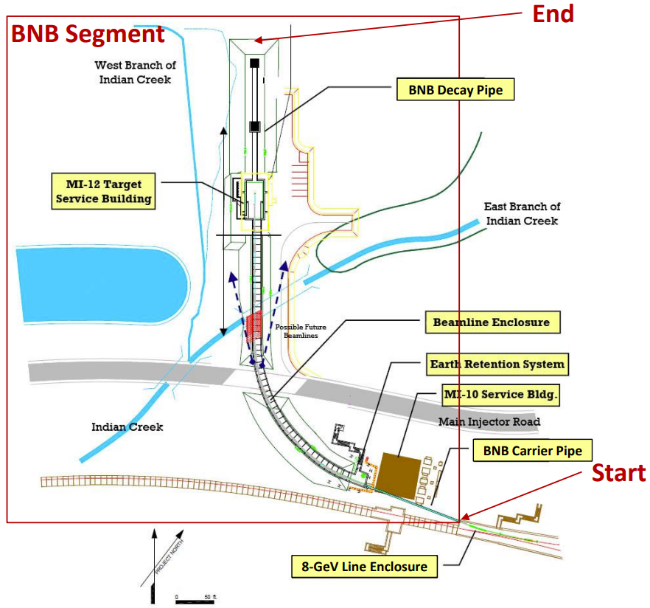
BNB Segment

Slide 5
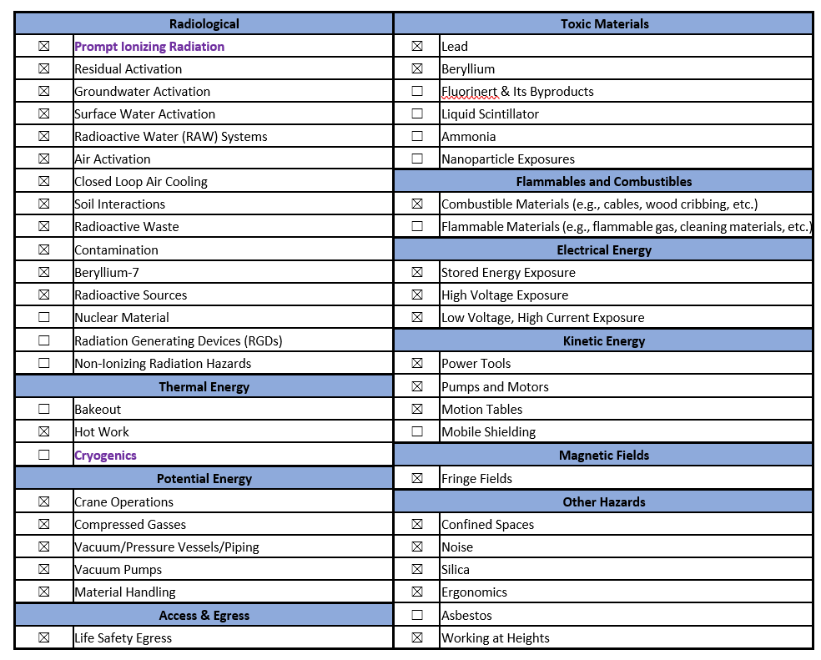
Hazard Inventory

Slide 6
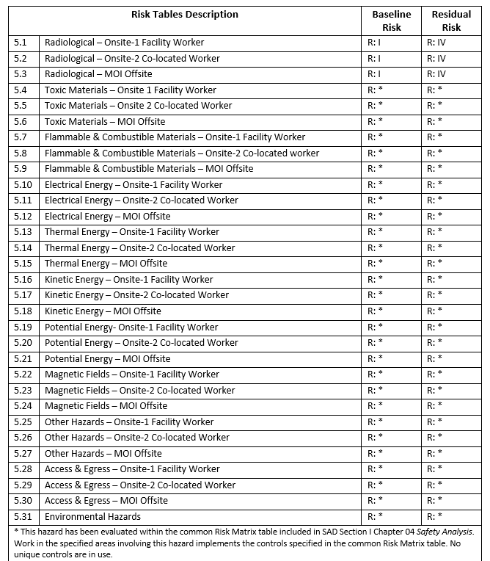
Hazard Inventory
Risk tables are used to evaluate hazards

Slide 7
Non-Accelerator Specific Hazards - Radiological
Residual Activation
Proton beam produces activated materials inside enclosures
Hazard applies to onsite facility workers & onsite co-located workers
Baseline Qualitative Risk (without controls) | Controls Preventive (P)/Mitigative (M) | Residual Qualitative Risk (with controls)
L: A C: H R: I | P – General and/or Job Specific RWP P – LSM P – Radiological Training M – Radiological Signage and Decay Time Requirements M – Target Pile Shielding | L: BEU C: L R: IV
Portable radiation detector

Slide 8
Non-Accelerator Specific Hazards - Radiological
Groundwater Activation
Protons can interact with soil and radioisotopes could leach into ground water
tritium & Na-22
Cooling water, e.g. low conductivity water (LCW), interacts with activated beam line components
Hazard applies to onsite facility workers & onsite co-located workers
Hazard | Baseline Qualitative Risk (without controls) | Controls Preventive (P)/Mitigative (M) | Residual Qualitative Risk (with controls)
Potential exposure due to construction activities, (e.g., earthmoving) Draining of groundwater captured in tanks | L: A C: N R: IV L: A C: N R: IV | P – Water Evaluation P – Water Capture M – Facility Designs P – Water Sampling M – RCTs Drain Tanks | L: EU C: N R: IV L: U C: N R: IV

Slide 9
Non-Accelerator Specific Hazards - Radiological
Surface Water Activation
Protons can interact with soil and radioisotopes could leach into ground water
tritium & Na-22
Cooling water, e.g. low conductivity water (LCW), interacts with activated beam line components
Hazard applies to onsite facility workers & onsite co-located workers
Hazard | Baseline Qualitative Risk (without controls) | Controls Preventive (P)/Mitigative (M) | Residual Qualitative Risk (with controls)
Potential exposure to activated surface water due to beam loss leakage from beam enclosures, located under the surface water impoundment. Potential exposure to activated surface water due to mixing surface water with a captured groundwater source. | L: A C: N R: IV L: A C: N R: IV | P – Beam Loss Monitoring M – Radiation Detectors M – Shielding P – Discharge Limit P – Monitoring Potential Sources M – Operations Pause M – Monitoring Surface Water | L: U C: N R: IV L: EU C: N R: IV

Slide 10
Non-Accelerator Specific Hazards - Radiological
Radioactive Water (RAW) Systems
Protons can interact with water
tritium
Cooling water, e.g. low conductivity water (LCW), interacts with activated beam line components
Humidity interacts with activated beam line components
Hazard applies to onsite facility workers & onsite co-located workers
Baseline Qualitative Risk (without controls) | Controls Preventive (P)/Mitigative (M) | Residual Qualitative Risk (with controls)
L: A C: H R: I | P – RAW Key Control System P – Secondary Containment P – General and/or Job Specific RWP P – LSM M – Run Condition M – RCT Or RSO Monitoring | L: BEU C: L R: IV
Portable radiation detector

Slide 11
Non-Accelerator Specific Hazards - Radiological
Air Activation
Protons can interact with air in enclosures
C-11, O-15, N-13 and Ar-41
Hazard applies to onsite facility workers and onsite co-located workers
Baseline Qualitative Risk (without controls) | Controls Preventive (P)/Mitigative (M) | Residual Qualitative Risk (with controls)
L: A C: H R: I | P – Active Air Monitoring P – LSM M – Air Dilution and Decay Time M – Run Condition M – Target Pile Shielding | L: EU C: N R: IV
Portable radiation detector

Slide 12
Non-Accelerator Specific Hazards - Radiological
Closed Loop Air Cooling
Protons can interact with air in enclosures
C-11, O-15, N-13 and Ar-41
Hazard applies to onsite facility workers and onsite co-located workers
Baseline Qualitative Risk (without controls) | Controls Preventive (P)/Mitigative (M) | Residual Qualitative Risk (with controls)
L: A C: H R: I | P – Active Air Monitoring P – LSM P – Air Containment M – Run Condition M – Target Pile Shielding | L: BEU C: L R: IV
Portable radiation detector

Slide 13
Non-Accelerator Specific Hazards - Radiological
Soil Interactions
Protons can interact with soil and radioisotopes could leach into ground water
tritium & Na-22
Hazard applies to onsite facility workers and onsite co-located workers
Baseline Qualitative Risk (without controls) | Controls Preventive (P)/Mitigative (M) | Residual Qualitative Risk (with controls)
L: A C: N R: IV | P – General and/or Job Specific RWP M – Beamline and Beam Dump Designs M – PPE M – Run Condition | L: U C: N R: IV

Slide 14
Non-Accelerator Specific Hazards - Radiological
Radioactive Waste
Radioactive waste produced during beam operations
Managed within established Radiological Protection Program (RPP) as prescribed in Fermilab Radiological Control Manual (FRCM)
Hazard applies to onsite facility workers and onsite co-located workers
Baseline Qualitative Risk (without controls) | Controls Preventive (P)/Mitigative (M) | Residual Qualitative Risk (with controls)
L: A C: H R: I | P – Fencing/Postings P – Locked Gates M – Run Condition M – Material survey and release process | L: BEU C: L R: IV

Slide 15
Non-Accelerator Specific Hazards - Radiological
Contamination
Protons can interact with fine particulates (dust) and liquids (e.g. oil)
Not typically encountered during normal maintenance
Hazard applies to onsite facility workers and onsite co-located workers
Baseline Qualitative Risk (without controls) | Controls Preventive (P)/Mitigative (M) | Residual Qualitative Risk (with controls)
L: A C: H R: I | P – Shielding for Activated Contamination P – Radiological Surveying and Cleaning P – General and/or Job Specific RWP P – LSM M – Material Survey and Release Process M – PPE | L: BEU C: L R: IV
Portable radiation detector

Slide 16
Non-Accelerator Specific Hazards - Radiological
⁷Be
Baseline qualitative risks due to this hazard were assessed and determined to be risk level IV (minimal concern) for workers, co-located workers, and the public.
No prevention or mitigation is required for this type of hazard, as Beryllium-7 is not hazardous in this pattern of facility use.
Target Air Cooling System (TAC) and target pile and MI12-B enclosure air exchange system provide defense-in-depth by considering ALARA in their design.
Each system incorporates a HEPA filter that will intercept Beryllium-7, and additional radiological controls are provided during a horn change to reduce the probability of exposure.
Baseline Qualitative Risk (without controls) | Controls Preventive (P)/Mitigative (M) | Residual Qualitative Risk (with controls)
L: A C: N R: IV | No prevention or mitigation is required. ⁷Be isn’t hazardous in this pattern of use by facility. | L: A C: N R: IV

Slide 17
Non-Accelerator Specific Hazards - Radiological
Radioactive Sources
Not typically used in the beam line
Hazard applies to onsite facility workers and onsite co-located workers
Baseline Qualitative Risk (without controls) | Controls Preventive (P)/Mitigative (M) | Residual Qualitative Risk (with controls)
L: A C: H R: I | P – Radiological Signage on or Near Source Cabinets P – Radiological Training P – Kept Under Lock-and-key M – Kept in Storage M – Shielded Containers | L: BEU C: L R: IV

Slide 18
Accelerator Specific Hazards
Prompt Ionizing Radiation
Significant radiation hazard during beam operations
Beam interacts with beam line & target materials
Includes protons, neutrons, pions, kaons, muons, photons, etc.
Credited Controls are needed!!!
Analyzed maximum credible incident to determine credited controls
Hazard applies to onsite facility workers, onsite co-located workers and a maximally exposed offsite individual

Slide 19
Maximum Credible Incident
Assumes full potential BNB intensity
Same as 8 GeV Line & Booster
Beam completely & continually lost for one hour
On a magnet or buried beam pipe
Highest radiation dose rates outside beam line areas at locations with reduced passive shielding
3.78E+17 protons/hr or 7E+12 protons/pulse
8 GeV proton energy
15 Hz cycle time

Slide 20
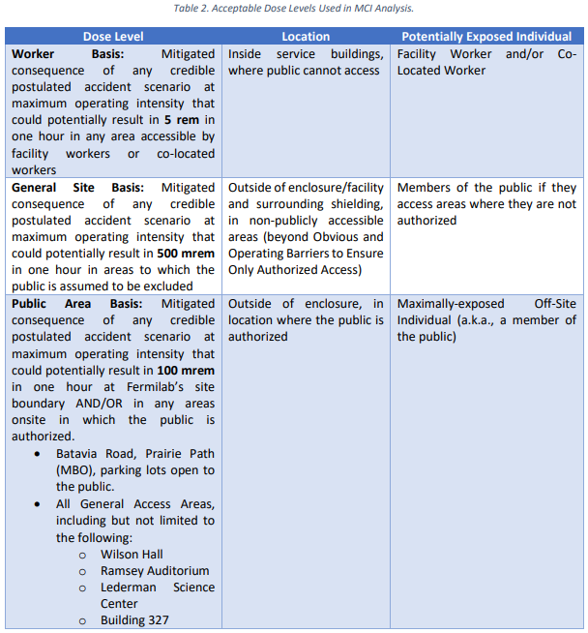
Maximum Credible Incident
Maximum Credible Incident (MCI) considers an onsite worker, onsite coworker, & maximally exposed off-site individual (MOI)
Fermilab uses Credited Controls that flow down to the Accelerator Safety Envelope (ASE) to mitigate the consequences of an MCI to the following conditions.
BNB segment is located behind a security access gate
Members of the public are not invited to this area.

Slide 21
Passive Engineering Credited Controls
Obvious and Operating Barriers to Ensure Only Authorized Access
To permit entry to only authorized individuals into the area where the General Site Basis applies surrounding the BNB segment of the Fermilab Main Accelerator, Obvious and Operating Barriers shall be established at the following locations to permit only authorized access:
Wilson Hall West, Wilson Hall East, Site 5
Penetration Shielding
Penetration shielding is managed by Radiation Physics Operations Dept.

Slide 22
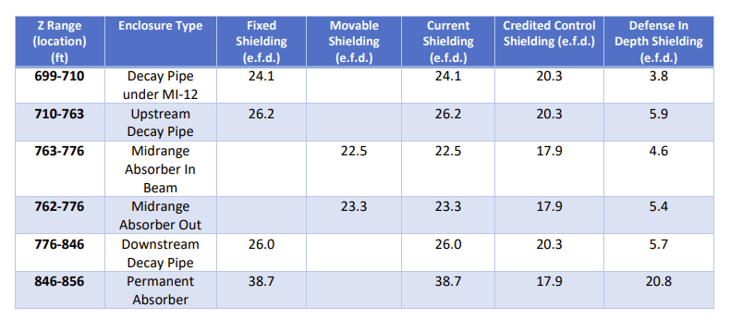
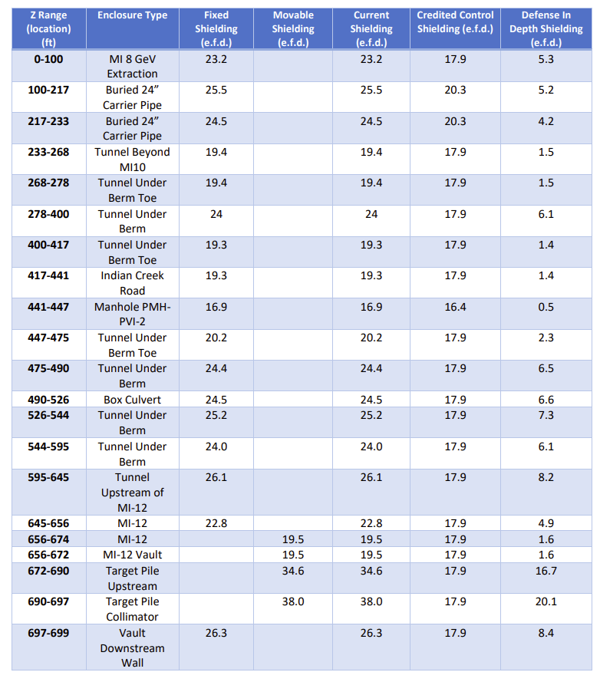
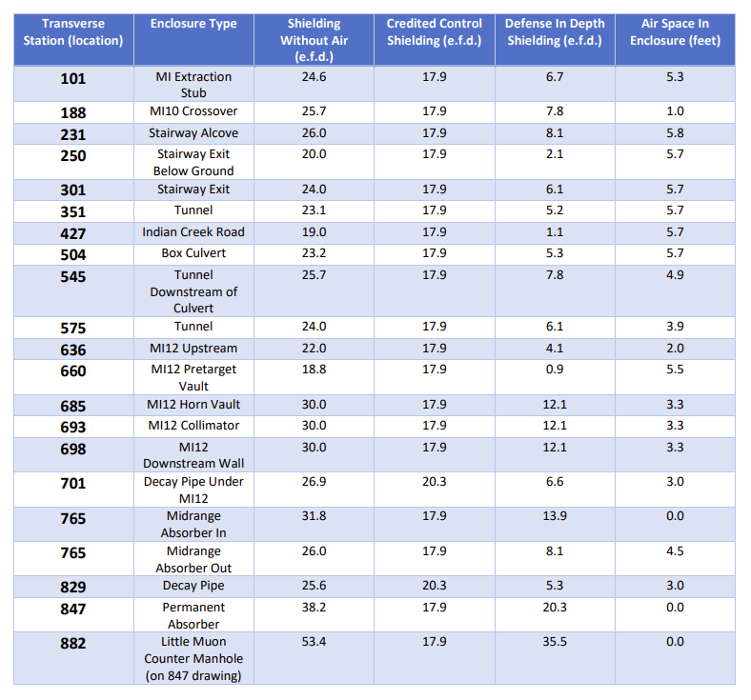
Passive Engineering Credited Controls
Permanent & Movable Shielding
Moveable shielding is managed by Radiation Physics Operations Dept. & utilizes a configuration management control system

Slide 23
Passive Engineering Credited Controls
Permanent & Movable Shielding
17.9 e.f.d. required for beam hitting a magnet in an enclosure
20.3 e.f.d. required for beam hitting a buried beam pipe
Requires a credited detector

Slide 24
Active Engineering Credited Controls
Radiation Safety Interlock System (RSIS)
Inhibits beam by controlled redundant critical devices
ES&H Radiation Physics Engineering Dept. (RPE) performs hardware & system testing on a semi-annual basis with a four-month grace period
RPE verifies inventory of interlock keys & updates procedures for maintenance, and testing interlock systems
RSISs are designed, installed, & configuration managed in conformance with the requirements of the Fermilab Radiological Control Manual (FRCM)

Slide 25
Active Engineering Credited Controls
Interlocked Radiation Detectors
Credited detectors feed into RSISs used throughout Fermilab
Calibrated on an annual basis
Areas without sufficient shielding use detectors to protect people
BNB uses one credited detector
On a berm by the Indian Creek Road manhole
Detectors are colloquially called chipmunks:
Fixed area monitoring radiation detector
Sealed ion chamber
Photon & neutron detection capabilities
Maintained & calibrated by the Fermilab ES&H Instrumentation Dept

Slide 26
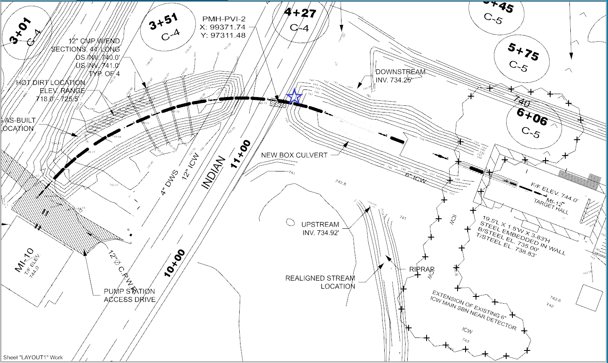
Active Engineering Credited Controls

Slide 27
Administrative Credited Controls
Operation Authorization Documents
Machine Beam Permit
Machine Run Condition
MCR Staffing
Monitor beam operations and detector trip levels to ensure they are below the ASE limit
To ensure accelerator operations are disabled and initiate an immediate response in the event of a determined ASE violation.
Turn accelerator components on & off as desired/needed
The following staffing shall be in place during applicable beam operation:
At least one member of the AD Operations Department who has achieved the rank of Operator II or higher shall be on duty and on site
At least one member of the AD Operations Department shall be present in the Main Control Room (MCR)
Note: these requirements could be satisfied by a single person
Accelerator Operating parameters
Beam intensity limit derived from MCI analysis

Slide 28
Summary
Hazards are evaluated with risk tables
Analyzed MCI scenario
Acceptable risk during MCI scenario created via credited controls
Passive engineering credited controls
Active engineering credited controls
Administrative credited controls
Non-accelerator-specific hazards also have an acceptable risk level

Slide 29
Backup

Slide 30
Defense in Depth Controls
Employ additional Defense in Depth controls to further reduce risk associated with radiation exposure
Training
e.g. Radiological Worker & Fermilab Controlled Access Trainings
Procedures
e.g, FESHM 2100 requires all departmental procedures to be reviewed and re-approved every twelve months
Passive shielding
Not all passive shielding at a particular location is taken as the credited control shielding

Slide 31
Hazard Inventory
Accelerator specific hazards are purple
Hazards not discussed today are evaluated via the common Risk Matrix tables
Covered in SAD Section I, Chapter 4
Hazards evaluated via risk assessment methodology per DOE-HDBK-1163-2020
Likelihood (L):
Anticipated (A), Unlikely (U), Extremely Unlikely (EU), Beyond Extremely Unlikely (BEU)
Consequence (C):
High (H), Moderate (M), Low (L), Negligible (N)
Risk (R):
I , II, III, IV (descending order of concern)

