Slide 1
Safety Assessment Document Updates for DOE O 420.2D
SAD Section IV Chapter 07 – Short Baseline Neutrino Experimental Areas
Catherine James
Accelerator Readiness Review
19 March 2024

Slide 2
Outline
SBN Experimental Areas Overview
Hazard Inventory
Non-Accelerator Specific Hazards
Accelerator Specific Hazards
Maximum Credible Incident
Summary of Credited Controls

Slide 3
Outline
SBN Experimental Areas Overview
Hazard Inventory
Non-Accelerator Specific Hazards
Accelerator Specific Hazards - NA
Maximum Credible Incident - NA
Summary of Credited Controls - NA

Slide 4
Outline
SBN Experimental Areas Overview
Hazard Inventory
Non-Accelerator Specific Hazards

Slide 5
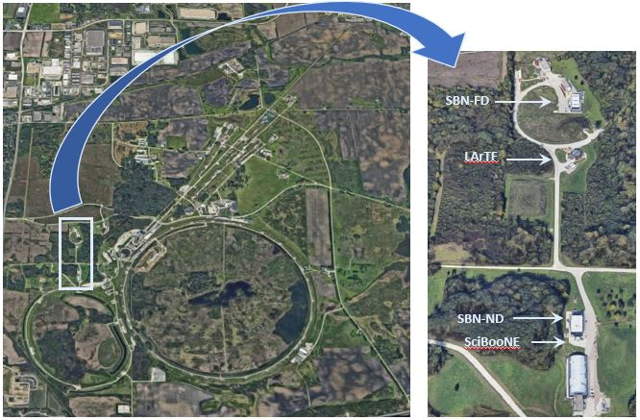
SBN Experimental Areas Overview
Four buildings within the Neutrino Campus
Positioned along the centerline of the Booster Neutrino Beam
Each building holds an experiment detector
The experiments measure properties of neutrinos, as part of the Fermilab Intensity Frontier scientific program

Slide 6
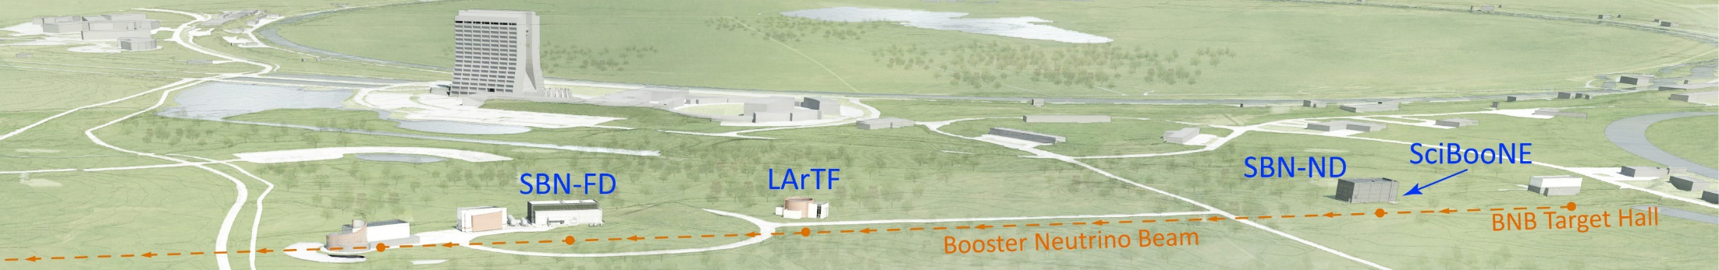
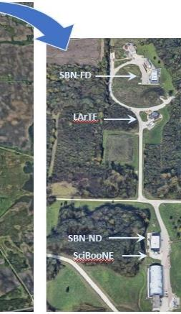
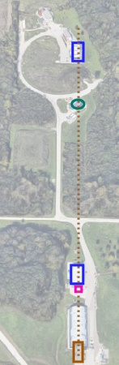
SBN Experimental Areas Overview
SciBooNE: ANNIE
  Accelerator Neutrino-Neutron Interaction Experiment
SBN-ND: SBND
  Short Baseline Near Detector
LArTF: MicroBooNE
  Micro Booster Neutrino Experiment
SBN-FD: ICARUS
  Imaging Cosmic And Rare Underground Signals

Slide 7
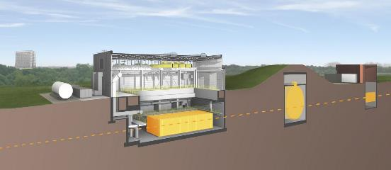
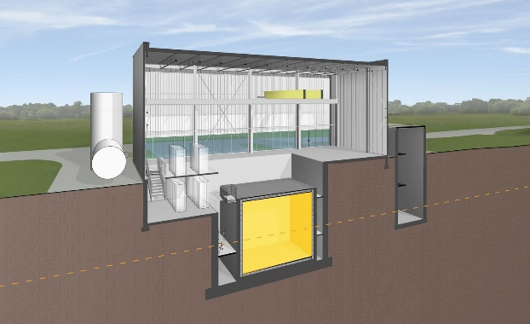
SBN Experiment Areas Overview
SBN-ND
SciBooNE
SBN-FD
LArTF
MiniBooNE
Each building has below-grade levels, 30-50 ft deep, so the detectors can be positioned on the centerline of the BNB which is ~20-ft below the surface
All buildings have restricted access, enforced by ID-card entry or by issued key. Access is restricted to personnel with valid ID and building-specific safety training.

Slide 8
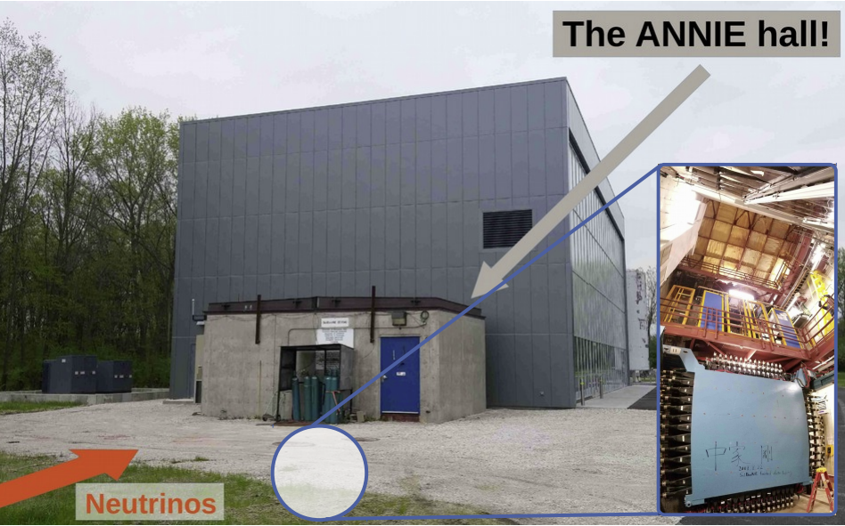
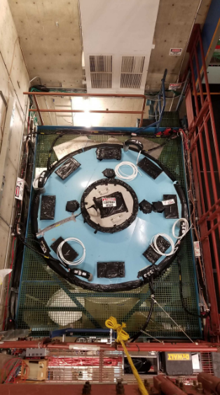
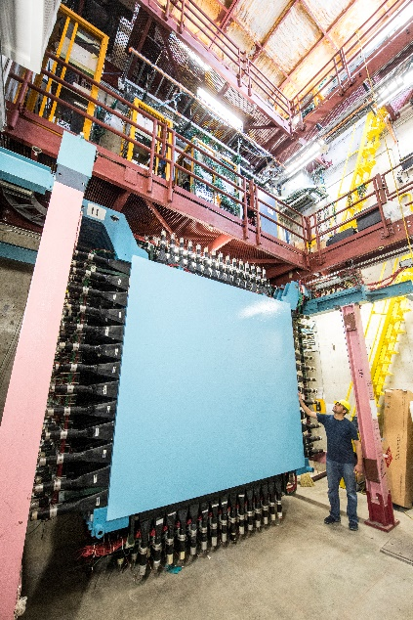
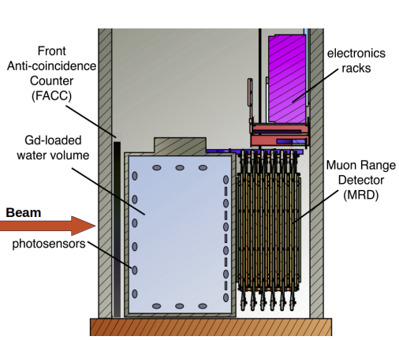
SBN Overview – ANNIE in SciBooNE
SciBooNE Building
The ANNIE detector consists of a water Cerenkov sub-detector coupled with a muon range sub-detector and a veto wall for rejection of background data. The water tank holds 26 tons of pure deionized water with a 0.2% concentration of gadolinium sulfate (Gd₂O₁₂S₃) in solution to enhance neutron detection. The muon range detector and veto wall use plastic scintillator. All the ANNIE sub-detectors employ photosensors to detect light from particles resulting from neutrino interactions with the detector materials.

Slide 9
SBN Overview – LArTPC Detectors
SBN-ND
SciBooNE
SBN-FD
LArTF
MiniBooNE
The other three SBN Areas buildings hold LArTPC detectors.
A Liquid Argon Time Projection Chamber (LArTPC) detector is fully immersed in a liquid argon volume contained within a cryostat. LArTPCs function by using liquified argon as both the target medium for the neutrinos and the detection medium for the particles resulting from the neutrino interactions. The particles from the interactions produce both light and ionization as they pass through the liquid argon, which is collected by photosensors and wire arrays.
An attached cryogenics system maintains temperature stability and purity of the liquid argon.

Slide 10
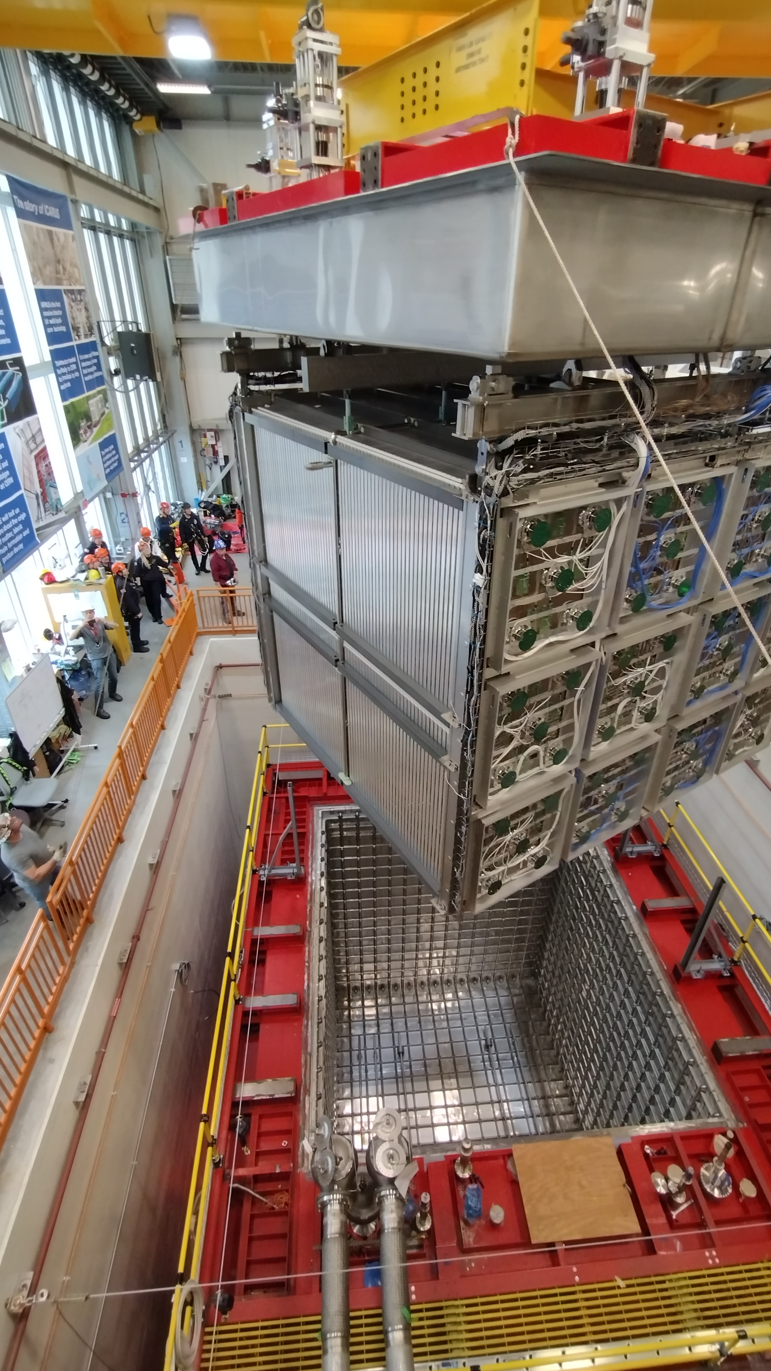
SBN Overview – SBND in SBN-ND
The Short Baseline Near Detector experiment is located in the SBN-ND building.
SBND is an LArTPC submerged in 260 tons of liquid argon, which is contained in a membrane cryostat similar to those utilized for DUNE.
Installation of the SBND detector and cryogenics system was completed at the end of CY 2023.
The cryostat was filled with liquid argon in February.
The Large Liquid Argon Safety panel approved normal operations of the cryogenics system on March 11.
Detector turn-on and commissioning will follow once stable LAr circulation is established.

Slide 11
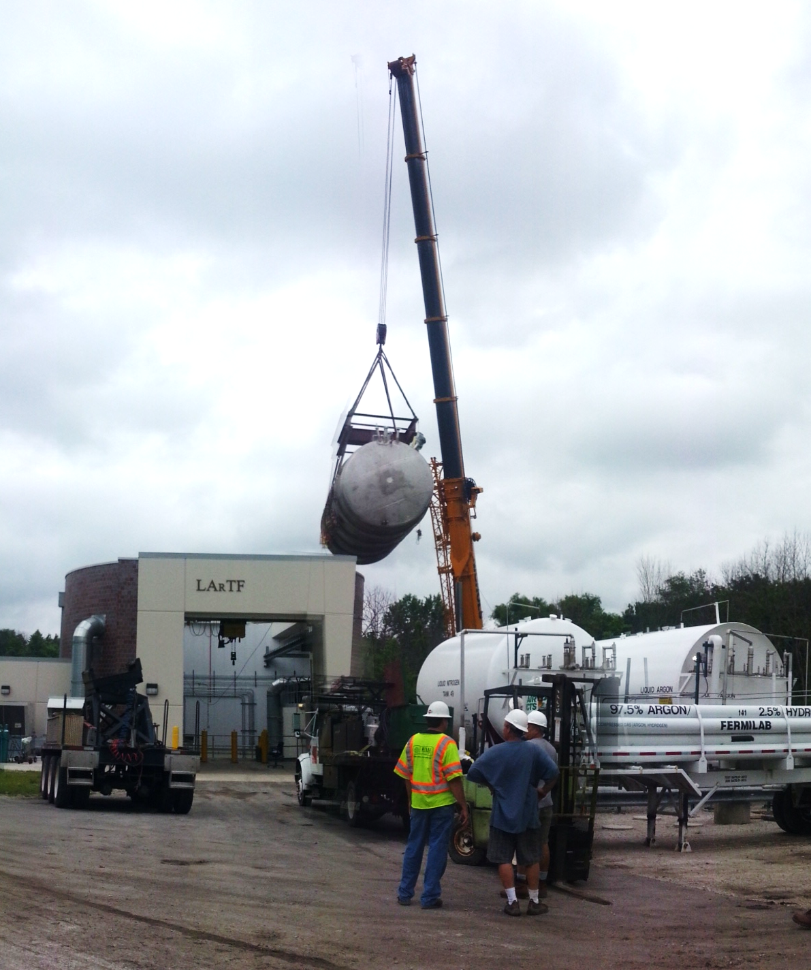
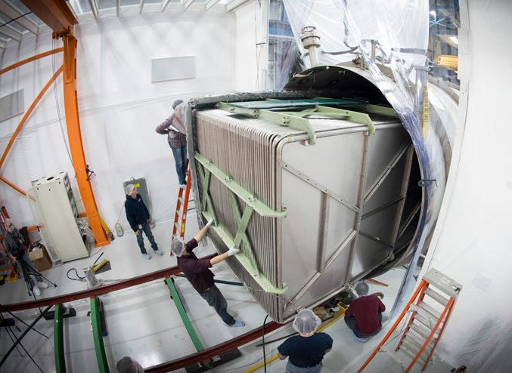
SBN Overview – MicroBooNE in LArTF
The MicroBooNE LArTPC detector held 170 tons of liquid argon in a steel cylinder-shape cryostat.
The experiment has completed data-taking. Liquid argon is no longer present at this location.
The collaboration is conducting post-operation tests on the detector hardware.

Slide 12
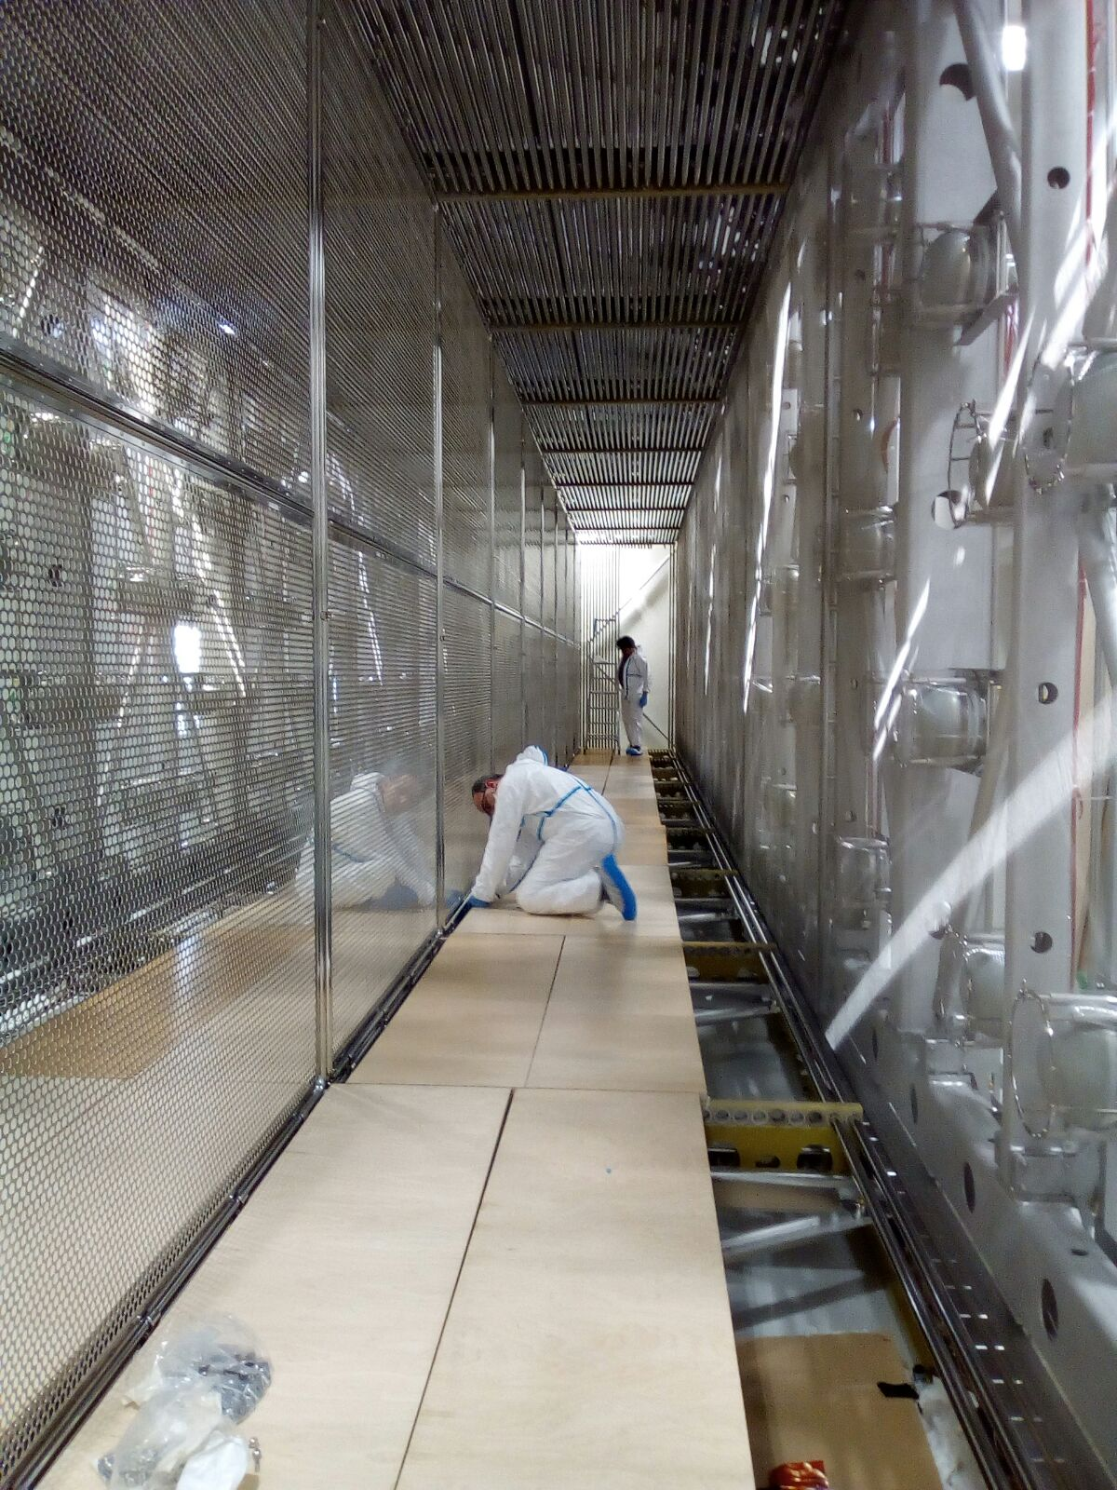
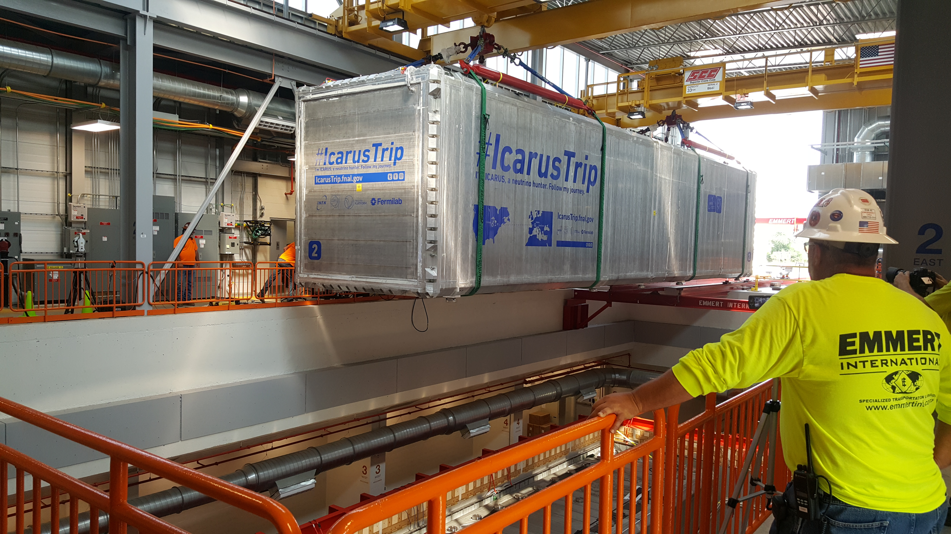
SBN Overview – ICARUS in SBN-FD
The ICARUS LArTPC detector is a pair of rectangular aluminum-walled cryostats each holding TPCs in a total of 760 tons of liquid argon.
ICARUS has been taking physics quality data since June 2022.

Slide 13
Outline
SBN Experimental Areas Overview
Hazard Inventory
Non-Accelerator Specific Hazards

Slide 14
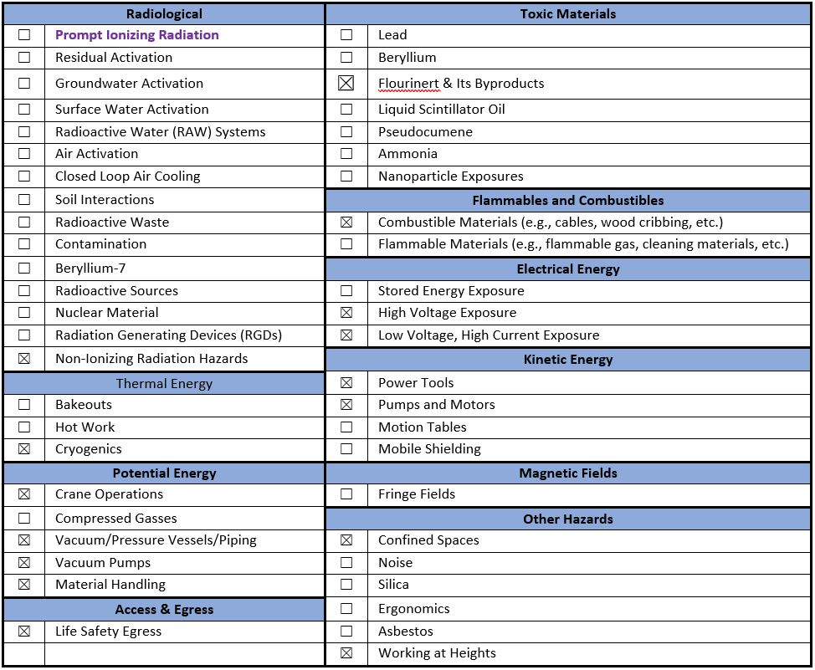
Hazard Inventory for SBN Experimental Areas
Accelerator specific hazards are bold-purple – None for SBN experimental areas
All SBN hazards are evaluated via the common Risk Matrix tables
  Covered in SAD Section I, Chapter 4

Slide 15
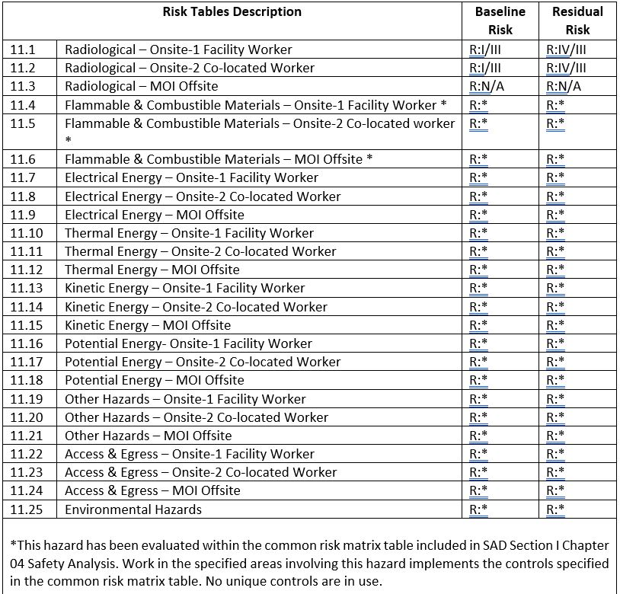
Risk Matrix Summary for SBN Experimental Areas
All but one SBN hazards are evaluated via the common Risk Matrix tables
  Covered in SAD Section I, Chapter 4
  Indicated by * for risk level
Hazards evaluated via risk assessment methodology per DOE-HDBK-1163-2020
  Likelihood (L):
    Anticipated (A), Unlikely (U), Extremely Unlikely (EU), Beyond Extremely Unlikely (BEU)
  Consequence (C):
    High (H), Moderate (M), Low (L), Negligible (N)
  Risk (R):
    I , II, III, IV (descending order of concern)

Slide 16
Outline
SBN Experimental Areas Overview
Hazard Inventory
Non-Accelerator Specific Hazards
  Highlight: non-ionizing radiation
  In backup: all others

Slide 17
Non-Accelerator Specific Hazards - Radiological
Non-Ionizing Radiation - Laser
  There are Class 4 Lasers installed in SBND
  There are Class 3R Lasers installed in ANNIE and ICARUS
  Hazard applies to onsite facility workers and onsite co-located workers
Baseline Qualitative Risk (without controls) | Controls Preventive (P)/Mitigative (M) | Residual Qualitative Risk (with controls)
Class 4 Laser L: A C: H R: I Class 3R Laser L: A C: L R: III | P – Class 1 (light tight) enclosures P – ORC and work planning processes P – Locked/Interlocked system P – LOTO procedure or other procedure approved by the laser safety officer (LSO) P – Affected areas are posted M – Use of PPE No analysis required | L: BEU C: M R: IV L: A C: L R: III

Slide 18
Questions?

Slide 19
Backup
Non-Accelerator Specific Hazards
  Highlight: non-ionizing radiation
  all other hazards

Slide 20
Non-Accelerator Specific Hazards – Cryogenics
Cryogenics - ODH
  Argon – non-toxic, heavier than air, slow vaporization from liquid
    Large volumes within cryostats are below grade;
    Below-grade spaces are ODH-1, ground-level spaces ODH-0;
    the below-grade spaces function as containment for leaked argon
      Building ventilation systems are designed to flush argon from below-grade spaces
  Hazard applies to onsite facility workers, onsite co-located workers
Baseline Qualitative Risk (without controls) | Controls Preventive (P)/Mitigative (M) | Residual Qualitative Risk (with controls)
L: A C: H R: I | P: Personnel must be trained and medically qualified to enter ODH spaces. P: Portable Oxygen Monitoring is provided for ODH spaces in accordance with the WPC P: Fire Safety and Life Safety Inspections are performed Fire Protection Group and the Fire Department. P: ODH alarm systems are tested and maintained M: ODH alarms are monitored by a sitewide monitoring system with notification to the emergency dispatch center that is constantly staffed, 24/7, 365 days. M: Area/fixed Oxygen Monitoring provided in areas where cryogenic liquids are stored M: Onsite Emergency services are provided. P: Cryogenic system designed and reviewed by qualified personnel | L: BEU C: N R: IV Reference: FESHM 4240 ODH, 5032 Cryogenics System Review

Slide 21
Non-Accelerator Specific Hazards –
Vacuum/Pressure Vessels/Piping
Vacuum Vessels/Piping – Hazard due to unexpected pressure release
  All the SBN cryogenics systems have vacuum vessels and piping.
  The SBND and ICARUS cryostats are low-pressure vessels
  Hazard applies to onsite facility workers, onsite co-located workers
Baseline Qualitative Risk (without controls) | Controls Preventive (P)/Mitigative (M) | Residual Qualitative Risk (with controls)
L: A C: H R: I | P: All involved personnel are required to take Pressure Safety orientation training FN000271 P: All vacuum/ pressure vessels have pressure safety devices that are tested and inspected every 5 years, tracked in Fermilab pressure vessel and pressure relief device database P: All vacuum/ pressure vessels go through the Operational Readiness Clearance and engineering note process with peer review and must meet applicable regulatory requirements M: Personal Protective Equipment mitigates severity of injury. | L: BEU C: M R: IV

Slide 22
Non-Accelerator Specific Hazards –
Vacuum Pumps
Vacuum Pumps – hazard due to interaction with existing vacuum
  All the SBN cryogenics systems have vacuum pumps
  Hazard applies to onsite facility workers, onsite co-located workers
Baseline Qualitative Risk (without controls) | Controls Preventive (P)/Mitigative (M) | Residual Qualitative Risk (with controls)
L: A C: H R: I | P: All involved personnel are required to be familiar with FESHM 5000 series and apply requirements P: All involved personnel are required to take Pressure Safety orientation training FN000271 P: Training for mechanical technicians FN000100 | L: BEU C: H R: III

Slide 23
Non-Accelerator Specific Hazards –
Crane Operations
Hazard – due to improper crane operations
  Overhead bridge cranes are in SBN-ND, LArTF, and SBN-FD
  Hazard applies to onsite facility workers, onsite co-located worker
Baseline Qualitative Risk (without controls) | Controls Preventive (P)/Mitigative (M) | Residual Qualitative Risk (with controls)
L: A C: H R: I | P: All overhead crane operators must take crane operator training FN000005/CR/OJ/EV P: Mobile Crane operators are trained and certified/licensed and take FN000360/CR. P: Qualified riggers are determined by their supervisor. P: All cranes are inspected on prescribed frequencies by an outside vendor M: Personal Protective Equipment mitigates the severity of injury by protecting the individual | L: BEU C: M R: IV

Slide 24
Non-Accelerator Specific Hazards –
Materials Handling
Hazard – injury due to moving/handling material
  Materials handling using forklifts can occur in all SBN Areas
  Frequent deliveries to buildings during construction phase; intermittent deliveries during experiment operations
  Hazard applies to onsite facility workers, onsite co-located worker
Baseline Qualitative Risk (without controls) | Controls Preventive (P)/Mitigative (M) | Residual Qualitative Risk (with controls)
L: A C: H R: I | P: All operators must complete Forklift Operator Training FN000014/CR/EV P: All operators are be familiar with FESHM 10000 series and apply requirements P: All PITs are inspected annually by an offsite vendor P: Backworks Safety training FN000335/CR P: Industrial Hygiene reviews ergonomics and maintains a database and FESHM 4120 M: Personal Protective Equipment mitigates severity of injury | L: BEU C: M R: IV

Slide 25
Non-Accelerator Specific Hazards –
Combustible Materials
Fire hazard - due to excessive combustible materials and/or inadequate housekeeping
  Combustible materials can accumulate up during construction phase
  Quantities of cabling are present in all experiments during operations
  Hazard applies to onsite facility workers, onsite co-located workers and a maximally exposed offsite individual (MOI)
*Does not apply to MOI
Baseline Qualitative Risk (without controls) | Controls Preventive (P)/Mitigative (M) | Controls Preventive (P)/Mitigative (M) | Residual Qualitative Risk (with controls)
 | P: The use of Operational Readiness Clearance (ORC) and/or WPC process determine if additional combustibles will be introduced to the area P: Fire Safety and Life Safety Inspections are performed by the Fire Protection Group and the Fire Department P: Fire alarm systems ITM is performed at prescribed frequencies P: Prior to restart, a walkdown is conducted of the complex verifying transient combustibles are removed before operational activities commence P: Hot work program administered by the Fire Department P: Public is screened at Fermi site boundary, and Fermilab restricts public access to accelerator complex. | M: Smoke, heat, sprinklers, are monitored by a sitewide monitoring system with notification to the emergency dispatch center that is constantly staffed, 24/7, 365 days M: Fire detection and/or suppression is present M: Manual fire suppression services are provided, i.e., fire hydrants, throughout the complex M: Egress stairways are constructed as fire barriers M: On-site fire department trained in radiological environments M – Evacuation training/evacuation drills M: In the event of a fire, site security prohibits access to the public
L: A C: H R: I |  |  | L: BEU C: N R: IV

Slide 26
Non-Accelerator Specific Hazards - Electrical
High Voltage – Shock Hazard, non-interlocked enclosure
  All the SBN Areas experiments utilize high voltage in their detectors
    Low-current, and using current-limited power supplies
    No exposed conductors
  Hazard applies to onsite facility workers and onsite co-located workers
Baseline Qualitative Risk (without controls) | Controls Preventive (P)/Mitigative (M) | Residual Qualitative Risk (with controls)
L: A C: H R: I | P: Equipment is enclosed (dead front panels), and tool use or lock removal is required to access P: Training for electrical workers including no energized manipulative work policy P: Hazard Analysis / LOTO Procedures / Standard Operating Procedures for work on electrical equipment M: Personnel protective equipment and training in proper use. M: Ground current monitors inhibit power supply operation when excessive ground current is detected. Intended for equipment protection but provides some shock mitigation | L: BEU C: L R: IV

Slide 27
Non-Accelerator Specific Hazards - Electrical
Low Voltage, High Current Exposure – fire hazard
  All the SBN Areas experiments utilize low voltage, high current systems in their detectors for electronics signal amplification and digitization
    No exposed conductors
    All detector electronics installations have electrical safety review as part of ORC
  Hazard applies to onsite facility workers and onsite co-located workers
Baseline Qualitative Risk (without controls) | Controls Preventive (P)/Mitigative (M) | Residual Qualitative Risk (with controls)
L: U C: H R: I | P: Equipment is enclosed preventing fire initiation. P: Overcurrent protection devices are designed into equipment. P: Ground current monitors inhibit power supply operation when excessive ground current is detected. M: Combustible controls mitigate potential fire initiation. M: Smoke detectors mitigate potential of personnel exposure to smoke inhalation. | L: BEU C: L R: IV

Slide 28
Non-Accelerator Specific Hazards –
Confined Spaces
Hazard - Limited egress
  The sump pits in all the SBN Area buildings are confined spaces
  The pit level in SBN-ND is treated as a confined space
  Hazard applies to onsite facility workers and onsite co-located workers
Baseline Qualitative Risk (without controls) | Controls Preventive (P)/Mitigative (M) | Residual Qualitative Risk (with controls)
L: A C: H R: I | P: Training P: Work practice procedure (attendant) P: Permit required; Permit and reclassification permit (ESH involvement) P: atmospheric monitoring M: mechanical ventilation when required M: PPE, harness, tripod, etc. when required | L: BEU C: H R: III

Slide 29
Non-Accelerator Specific Hazards –
Working at Heights
Hazard - Falls, dropped tools/material
  Frequently required during construction phase of SBN Areas experiments; infrequently required during experiment operations
    Work Planning processes applied
  Hazard applies to onsite facility workers and onsite co-located workers
Baseline Qualitative Risk (without controls) | Controls Preventive (P)/Mitigative (M) | Residual Qualitative Risk (with controls)
L: A C: H R: I | P: Fall protection program P: Training for scaffolding, ladders, mobile elevating work platforms P: Guard rails M: PPE-PFAS including approved anchor points, hard hats | L: EU C: M R: III

Slide 30
Non-Accelerator Specific Hazards –
Life Safety Egress
Hazard – blocked egress during emergency
  Safe egress was a primary design requirement for all SBN Areas buildings
    Emergency generators maintain ODH alarms and ventilation during power outage
  Hazard applies to onsite facility workers and onsite co-located workers
*Does not apply to MOI
Baseline Qualitative Risk (without controls) | Controls Preventive (P)/Mitigative (M) | Controls Preventive (P)/Mitigative (M) | Residual Qualitative Risk (with controls)
 | P: Alternate paths of egress are provided. P: Egress pathways are clearly marked P: Exit signs and emergency lighting is present P: Fire Safety and Life Safety Inspections are performed by Fire Protection Group and the Fire Department. P: Life safety systems testing is performed at prescribed frequencies | M: Life safety systems are monitored by a sitewide monitoring system with notification to the emergency dispatch center that is constantly staffed, 24/7, 365 days M: Fire detection and/or suppression is present M: Manual fire suppression services are provided, i.e., fire hydrants, throughout the complex M: Egress stairways are constructed as fire barriers
L: A C: H R: I |  |  | L: BEU C: N R: IV

