Slide 1
Safety Assessment Document Updates for DOE O 420.2D
SAD Section IV Chapter 04 – MiniBooNE Detector
Cindy Joe
Accelerator Readiness Review
March 19-21, 2024

Slide 2
Outline
MiniBooNE Detector Overview
Hazard Inventory
Non-Accelerator Specific Hazards
Accelerator Specific Hazards
Maximum Credible Incident (MCI) Discussion
Summary of Credited Controls
Accelerator-specific hazards do not apply to this area.

Slide 3
Outline
MiniBooNE Detector Overview
Hazard Inventory
Non-Accelerator Specific Hazards

Slide 4
MiniBooNE Detector Overview
BooNE (the Booster Neutrino Experiment) was designed to definitively explore the neutrino oscillation signal reported by the Los Alamos Liquid Scintillator Neutrino Detector (LSND) experiment. MiniBooNE represented the first phase for the BooNE collaboration and consisted of a 1 GeV neutrino beam and a single, 800-ton mineral oil detector (the MiniBooNE detector). The MiniBooNE detector is located 500 meters downstream of the neutrino source, and was optimized to search for the LSND signal.
The MiniBooNE detector took data from 2002 to 2019. The MiniBooNE Detector is currently not operating. However, the facility remains an active site.
A Fermilab Laboratory Directed Research and Development (LDRD) experiment, “Prototype of a Modern Modular Bubble Chamber with Light Nuclear Targets,” is actively planning to begin installation in the facility within the next year.

Slide 5
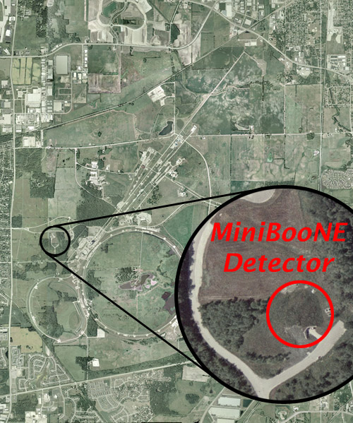
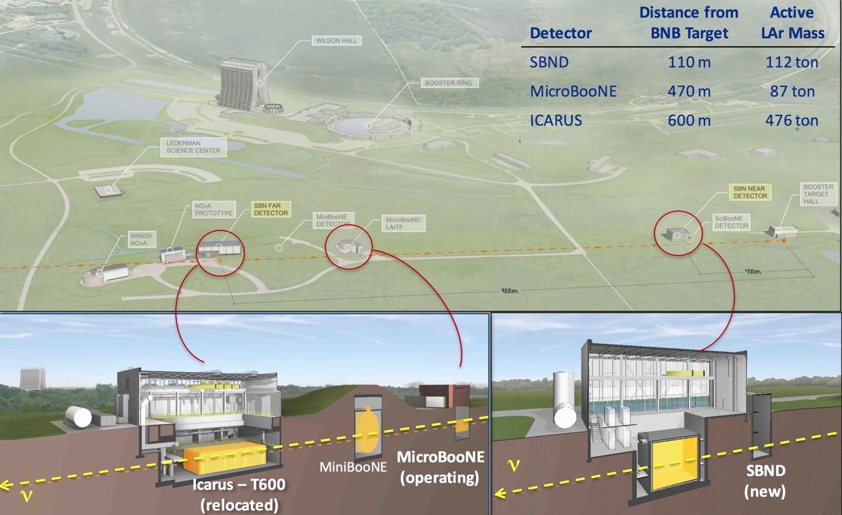
MiniBooNE Detector Overview
MiniBooNE is in the Booster Neutrino Beamline. It was the earliest experiment in this line.

Slide 6
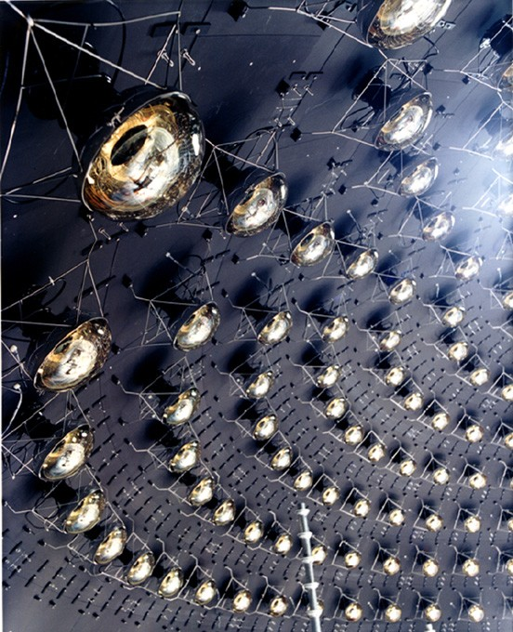
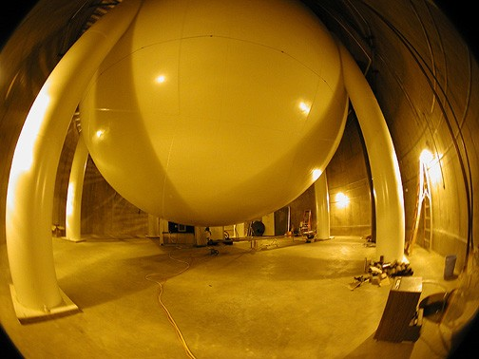
MiniBooNE Detector Overview

Slide 7
MiniBooNE Detector Overview
The MiniBooNE detector site consists of:
• The MiniBooNE detector vault: a cylindrical, concrete-lined excavation, 50 ft in diameter and 45 ft deep. This vault houses the detector tank and is equipped with access hatches for personnel and equipment.

Slide 8
MiniBooNE Detector Overview
• The detector tank: a 40-ft-diameter spherical tank located in the detector vault, instrumented with a little over 1500 photomultiplier tubes, and filled with 250,000 gallons of Marcol 7 (Fermilab MSDS 16080) mineral oil. A cover gas of nitrogen, which is fed from a 1000 L liquid nitrogen dewar, is introduced in the empty space at the top of the tank to provide protection from oxidation. Oxidation degrades the desirable properties of the mineral oil that are important to the experiment.

Slide 9
MiniBooNE Detector Overview
• The detector support enclosure: a 50-ft-diameter circular room located (at surface level) above the detector vault which houses electronics and oil handling equipment. The support enclosure includes power, fire protection, and air handling equipment, as well as a 2-ton trolley supporting a 1-ton hoist.

Slide 10
Outline
MiniBooNE Detector Overview
Hazard Inventory
Non-Accelerator Specific Hazards

Slide 11
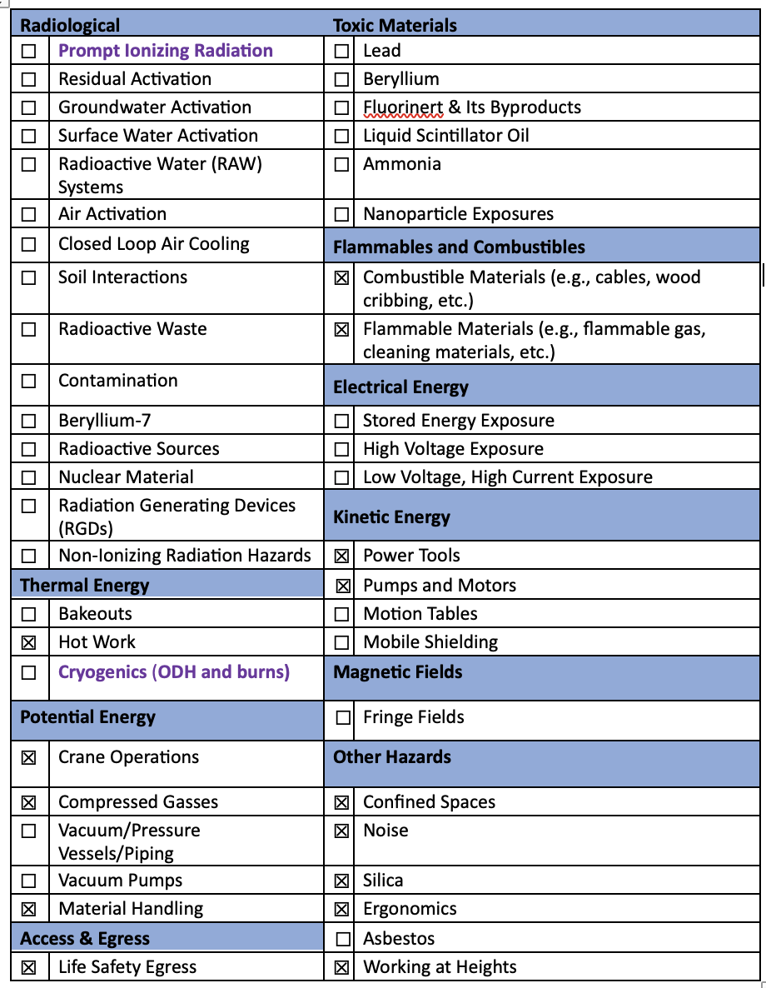
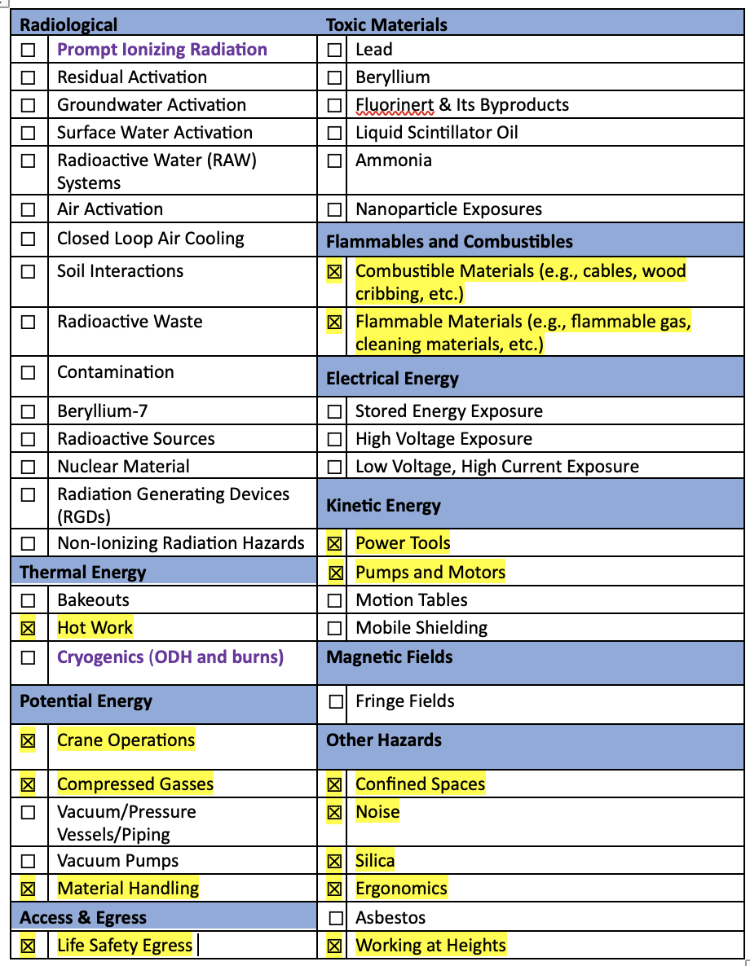
Hazard Inventory for MiniBooNE Detector
Accelerator specific hazards are bold purple – None for MiniBooNE Detector
Hazards not discussed today are evaluated via the common Risk Matrix tables
  Covered in SAD Section I, Chapter 4
Hazards evaluated via risk assessment methodology per DOE-HDBK-1163-2020
  Likelihood (L):
    Anticipated (A), Unlikely (U), Extremely Unlikely (EU), Beyond Extremely Unlikely (BEU)
  Consequence (C):
    High (H), Moderate (M), Low (L), Negligible (N)
  Risk (R):
    I , II, III, IV (descending order of concern)

Slide 12
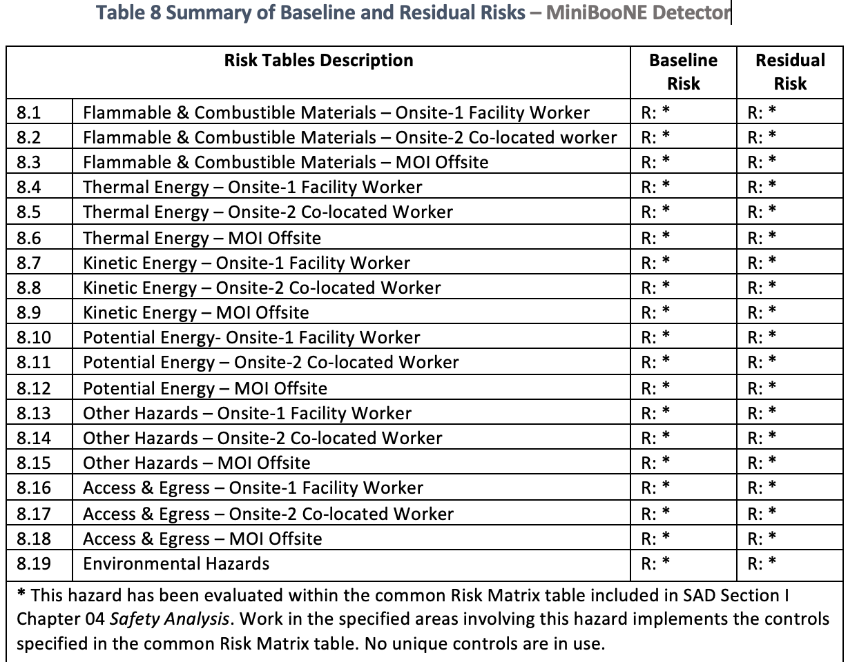
Risk Matrix Summary for MiniBooNE Detector
The risks for the MiniBooNE Detector were determined to be adequately addressed using the common Risk Matrix tables.

Slide 13
Questions?

Slide 14
Outline
MiniBooNE Detector Overview
Hazard Inventory
Non-Accelerator Specific Hazards
Backup Slide(s)

Slide 15
Non-Accelerator Specific Hazards –
Confined Spaces
FESHM defines a confined space as:
  1. Is large enough and so configured that an employee can bodily enter and perform assigned work; and
  2. has limited or restricted means for entry or exit; and
  3. is not designed for continuous employee occupancy.
The designation is determined by the presence of the oil, the space not meant for continuous occupancy, and the limited means of egress through hatches into the vault. Particle Physics Directorate facility management works with ES&H Directorate to maintain the space and provide equipment necessary for the permit-required entry. Entry into the vault must be approved by these groups. The requirements contained in FESHM will be adhered to for all entries into the vault.

Slide 16
Non-Accelerator Specific Hazards – Crane Operations
Hazard: personnel injury due to improper crane operations.
There is a two-ton trolley present in the MiniBooNE Service Building. It has a one-ton hoist mounted and allows the hoist position to be adjusted from the roll-up door at the entry of the building to the access hatch above the MiniBooNE detector. Its controls are kept locked when not in use. There is also a freestanding workstation crane with a capacity of 500 lbs positioned above an access point to the vault.
Baseline Qualitative Risk (without controls) | Controls Preventive (P)/Mitigative (M) | Residual Qualitative Risk (with controls)
L: A C: H R: I | P: All overhead crane operators must take crane operator training FN000005/CR/OJ/EV P: Mobile Crane operators are trained and certified/licensed and take FN000360/CR. P: Qualified riggers are determined by their supervisor. P: All cranes are inspected on prescribed frequencies by an outside vendor M: Personal Protective Equipment mitigates the severity of injury by protecting the individual | L: BEU C: M R: IV

Slide 17
Non-Accelerator Specific Hazards – Compressed Gasses
Hazard: Personnel injury due to unexpected release, or unsecure tanks
A 1000 L liquid nitrogen dewar supplies a cover gas to the empty space at the top of the tank to provide the oil protection from oxidation. This dewar is located outside the service building in a small protective fenced enclosure and refilled periodically as needed. There is no ODH hazard from its presence, and the secured location and protection minimize exposure.
Baseline Qualitative Risk (without controls) | Controls Preventive (P)/Mitigative (M) | Residual Qualitative Risk (with controls)
L: A C: H R: I | P: All personnel handling compressed gasses have to take Pressure Safety orientation training FN000271 P: All personnel handling compressed gasses have to take compressed gas cylinder safety training FN000213 P: All personnel must be familiar with FESHM 5000 series and apply requirements P: Gas cylinders are secured and capped when not in use M: Personal Protective Equipment mitigates severity of injury | L: BEU C: M R: IV

Slide 18
Non-Accelerator Specific Hazards –
Life Safety Egress
Hazard: A blocked egress would be of major life safety concern. (Reference: FESHM 6010)
The MiniBooNE Vault is classified as a permit-required confined space and therefore has additional restrictions and protections governing entry and exit. Personnel access is via a spiral stairway mounted on the vault wall. The entrance is covered by a hatch cover and is chained off with signs warning of the confined space. In the event of emergency, entrants would be extracted immediately.
Baseline Qualitative Risk (without controls) | Controls Preventive (P)/Mitigative (M) | Controls Preventive (P)/Mitigative (M) | Residual Qualitative Risk (with controls)
 | P: Alternate paths of egress are provided. P: Egress pathways are clearly marked P: Exit signs and emergency lighting is present P: Fire Safety and Life Safety Inspections are performed by Fire Protection Group and the Fire Department. P: Life safety systems testing is performed at prescribed frequencies | M: Life safety systems are monitored by a sitewide monitoring system with notification to the emergency dispatch center that is constantly staffed, 24/7, 365 days M: Fire detection and/or suppression is present M: Manual fire suppression services are provided, i.e., fire hydrants, throughout the complex M: Egress stairways are constructed as fire barriers
L: A C: H R: I |  |  | L: BEU C: N R: IV

Slide 19
Non-Accelerator Specific Hazards –
Combustible Materials
Hazard: a potential facility fire (Reference: FESHM Chapter 2005 Operational Readiness Clearance & 6010 Fire Protection Program)
The MiniBooNE detector contains approximately 250,000 gallons of mineral oil. The nitrogen environment, tank exterior deluge spray system (designed in accordance with Gage-Babcock & Associates analysis and the National Fire Protection Association Pamphlet No. 15 Entitled Water Spray Fixed Systems), VESDA, and FIRUS systems protect against fire risk. Electronics installations are reviewed through Fermilab’s ORC process.
A 9,500-liter stainless steel oil overflow tank located beneath the detector entrance hall provides an overflow capacity of 1% of the detector tank volume to allow for thermal expansion.

Slide 20
Non-Accelerator Specific Hazards –
Combustible Materials
Baseline Qualitative Risk (without controls) | Controls Preventive (P)/Mitigative (M) | Controls Preventive (P)/Mitigative (M) | Residual Qualitative Risk (with controls)
 | P: The use of Operational Readiness Clearance (ORC) and/or WPC process determine if additional combustibles will be introduced to the area P: Fire Safety and Life Safety Inspections are performed by the Fire Protection Group and the Fire Department P: Fire alarm systems ITM is performed at prescribed frequencies P: Prior to restart, a walkdown is conducted of the complex verifying transient combustibles are removed before operational activities commence P: Hot work program administered by the Fire Department P: Public is screened at Fermi site boundary, and Fermilab restricts public access to accelerator complex. | M: Smoke, heat, sprinklers, are monitored by a sitewide monitoring system with notification to the emergency dispatch center that is constantly staffed, 24/7, 365 days M: Fire detection and/or suppression is present M: Manual fire suppression services are provided, i.e., fire hydrants, throughout the complex M: Egress stairways are constructed as fire barriers M: On-site fire department trained in radiological environments M – Evacuation training/evacuation drills M: In the event of a fire, site security prohibits access to the public
L: A C: H R: I |  |  | L: BEU C: N R: IV

Slide 21
Non-Accelerator Specific Hazards –
Flammable Materials
Hazard: a potential facility fire (Reference: FESHM Chapters 2005 Operational Readiness Clearance, 6010 Fire Protection Program, 6020.3 Flammable Gases, 6020.4, Combustible & Flammable Liquids)
The MiniBooNE detector contains approximately 250,000 gallons of mineral oil. The nitrogen environment, tank exterior deluge spray system (designed in accordance with Gage-Babcock & Associates analysis and the National Fire Protection Association Pamphlet No. 15 Entitled Water Spray Fixed Systems), VESDA, and FIRUS systems protect against fire risk. Electronics installations are reviewed through Fermilab’s ORC process.
A 9,500-liter stainless steel oil overflow tank located beneath the detector entrance hall provides an overflow capacity of 1% of the detector tank volume to allow for thermal expansion.

Slide 22
Non-Accelerator Specific Hazards –
Flammable Materials
Baseline Qualitative Risk (without controls) | Controls Preventive (P)/Mitigative (M) | Controls Preventive (P)/Mitigative (M) | Residual Qualitative Risk (with controls)
 | P: The use of Operational Readiness Clearance (ORC) and/or WPC process determine if additional combustibles will be introduced to the area P: Fire Safety and Life Safety Inspections are performed by the Fire Protection Group and the Fire Department P: Fire alarm systems ITM is performed at prescribed frequencies P: Prior to restart, a walkdown is conducted of the complex verifying transient combustibles are removed before operational activities commence P: Hot work program administered by the Fire Department P: Public is screened at Fermi site boundary, and Fermilab restricts public access to accelerator complex. | M: Smoke, heat, sprinklers, are monitored by a sitewide monitoring system with notification to the emergency dispatch center that is constantly staffed, 24/7, 365 days M: Fire detection and/or suppression is present M: Manual fire suppression services are provided, i.e., fire hydrants, throughout the complex M: Egress stairways are constructed as fire barriers M: On-site fire department trained in radiological environments M – Evacuation training/evacuation drills M: In the event of a fire, site security prohibits access to the public
L: A C: H R: I |  |  | L: BEU C: N R: IV

Slide 23
Non-Accelerator Specific Hazards –
Confined Spaces
Hazard: limited egress (Reference: FESHM 4230)
The MiniBooNE vault is classified as a permit-required confined space. This is determined by the presence of the oil, the space not meant for continuous occupancy, and the limited means of egress through hatches into the vault. Entry into the vault must be approved.
Personnel access to and from the MiniBooNE vault is via a spiral stairway mounted on the vault wall. The entrance is covered by a hatch cover and is chained off with signs warning of the confined space. In the event of a catastrophic leak during an access to the vault, procedures for the confined space entry would be followed and all entrants extracted immediately.
Baseline Qualitative Risk (without controls) | Controls Preventive (P)/Mitigative (M) | Residual Qualitative Risk (with controls)
L: A C: H R: I | P: Training P: Work practice procedure (attendant) P: Permit required; Permit and reclassification permit (ESH involvement) P: atmospheric monitoring M: mechanical ventilation when required M: PPE, harness, tripod, etc. when required | L: BEU C: H R: III

