Slide 1
Safety Assessment Document Updates for DOE O 420.2D
SAD Section III Chapter 9 – P1 and P2 Beamlines
Accelerator Readiness Review
19-21 March 2024

Slide 2
Outline
P1 and P2 Beamlines Overview
Hazard Inventory
Non-Accelerator Specific Hazards
Accelerator Specific Hazards
Maximum Credible Incident (MCI) Discussion
Summary of Credited Controls

Slide 3
Outline
P1 and P2 Beamlines Overview
Hazard Inventory
Non-Accelerator Specific Hazards
Accelerator Specific Hazards
Maximum Credible Incident (MCI) Discussion
Summary of Credited Controls

Slide 4
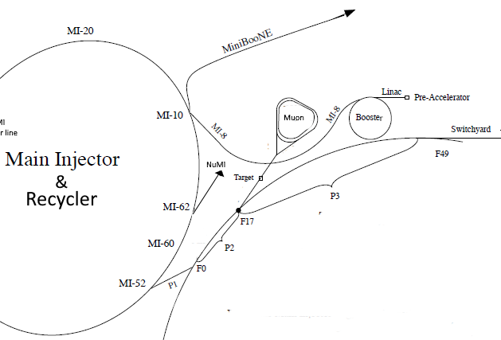
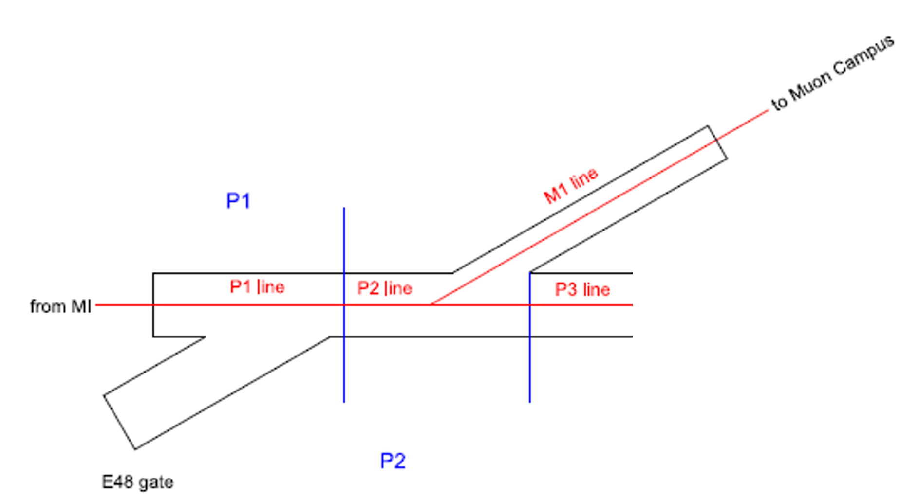
P1 and P2 Beamlines Overview
The P1 and P2 Beamlines transport
8 GeV beam from the Recycler to the Muon Campus (M1)
120 GeV beam from the Main Injector to Switchyard (P3)
Recycler and MI beam merge into the P1 line occurs in the Main Injector segment

Slide 5
Outline
P1 and P2 Beamlines Overview
Hazard Inventory
Non-Accelerator Specific Hazards
Accelerator Specific Hazards
Maximum Credible Incident (MCI) Discussion
Summary of Credited Controls

Slide 6
Hazard Inventory for P1 and P2 Beamlines
Radiological |  | Toxic Materials
☒ | Prompt Ionizing Radiation | ☒ | Lead
☒ | Residual Activation | ☐ | Beryllium
☒ | Groundwater Activation | ☐ | Fluorinert & Its Byproducts
☒ | Surface Water Activation | ☐ | Liquid Scintillator Oil
☐ | Radioactive Water (RAW) Systems | ☐ | Pseudocumene
☒ | Air Activation | ☐ | Ammonia
☐ | Closed Loop Air Cooling | ☐ | Nanoparticle Exposures
☒ | Soil Interactions | Flammables and Combustibles
☒ | Radioactive Waste | ☒ | Combustible Materials (e.g., cables, wood cribbing, etc.)
☒ | Contamination | ☒ | Flammable Materials (e.g., flammable gas, cleaning materials, etc.)
☒ | Beryllium-7 | Electrical Energy
☒ | Radioactive Sources | ☒ | Stored Energy Exposure
☐ | Nuclear Material | ☒ | High Voltage Exposure
☐ | Radiation Generating Devices (RGDs) | ☒ | Low Voltage, High Current Exposure
☐ | Non-Ionizing Radiation Hazards | Kinetic Energy
Thermal Energy |  | ☒ | Power Tools
☐ | Bakeouts | ☒ | Pumps and Motors
☒ | Hot Work | ☐ | Motion Tables
☐ | Cryogenics | ☐ | Mobile Shielding
Potential Energy |  | Magnetic Fields
☒ | Crane Operations | ☒ | Fringe Fields
☒ | Compressed Gasses | Other Hazards
☒ | Vacuum/Pressure Vessels/piping | ☒ | Confined Spaces
☒ | Vacuum Pumps | ☒ | Noise
☒ | Material Handling | ☒ | Silica
Access & Egress |  | ☒ | Ergonomics
☒ | Life Safety Egress | ☐ | Asbestos
Accelerator specific hazards are purple
Hazards not discussed today are evaluated via the common Risk Matrix tables
Covered in SAD Section I, Chapter 4
Hazards evaluated via risk assessment methodology per DOE-HDBK-1163-2020
Likelihood (L):
Anticipated (A), Unlikely (U), Extremely Unlikely (EU), Beyond Extremely Unlikely (BEU)
Consequence (C):
High (H), Moderate (M), Low (L), Negligible (N)
Risk (R):
I, II, III, IV (descending order of concern)

Slide 7
Risk Table summary

Slide 8
Outline
P1 and P2 Beamlines Overview
Hazard Inventory
Non-Accelerator Specific Hazards
Accelerator Specific Hazards
Maximum Credible Incident (MCI) Discussion
Summary of Credited Controls

Slide 9
Non-Accelerator Specific Hazards - Radiological
Residual Activation
High intensity beam delivery can produce activated materials inside the P1 and P2 Beamlines enclosures due to beam loss
Baseline Qualitative Risk (without controls) | Controls Preventive (P)/Mitigative (M) | Residual Qualitative Risk (with controls)
L: A C: H R: I | P – Radiological Work Permit P – Postings P – Training M – Run Conditions M – Local Component Shielding | L: BEU C: L R: IV

Slide 10
Non-Accelerator Specific Hazards - Radiological
Air Activation
Air activation can occur at any area where high beam losses are present.
Baseline Qualitative Risk (without controls) | Controls Preventive (P)/Mitigative (M) | Residual Qualitative Risk (with controls)
L: A C: H R: I | M – Run Conditions M – Engineered Air Flow | L: A C: L R: III

Slide 11
Non-Accelerator Specific Hazards - Radiological
Soil Interactions
Scattered beam has the potential to activate soil at low levels calculated in the shielding assessment.
Baseline Qualitative Risk (without controls) | Controls Preventive (P)/Mitigative (M) | Residual Qualitative Risk (with controls)
L: A C: N R: IV | P – RWP for excavation M – Beamline Design M – Run Conditions | L: U C: N R: IV
Notes:
Radiation sensing equipment is used to keep risk of soil interactions limited to the area of the inactive target station.

Slide 12
Non-Accelerator Specific Hazards - Radiological
Radioactive Waste
Radioactive waste produced during P1 and P2 Beamline operations will be managed within the established Radiological Protection Program (RPP) as prescribed in the Fermilab Radiological Control Manual (FRCM)
Baseline Qualitative Risk (without controls) | Controls Preventive (P)/Mitigative (M) | Residual Qualitative Risk (with controls)
L: A C: H R: I | P – Locked Gates P – Key Control Program P – Postings M – Run Conditions M – Distance to Stored Material M – Material survey and release process | L: BEU C: N R: IV

Slide 13
Non-Accelerator Specific Hazards - Radiological
Contamination
Contamination can be created when beam or beam loss strike dust or debris on or near the accelerator.
Baseline Qualitative Risk (without controls) | Controls Preventive (P)/Mitigative (M) | Residual Qualitative Risk (with controls)
L: A C: H R: I | P – Radiation Survey P – Posting M – Radiological Work Permit M – Training | L: EU C: L R: IV

Slide 14
Non-Accelerator Specific Hazards - Radiological
Radioactive sources
Radioactive Sources may be used in shutdown and maintenance activities
Baseline Qualitative Risk (without controls) | Controls Preventive (P)/Mitigative (M) | Residual Qualitative Risk (with controls)
L: A C: H R: I | P – Training P – Posting M – Storage Requirements M – “In-Use” Requirements | L: EU C: L R: IV

Slide 15
Outline
P1 and P2 Beamlines Overview
Hazard Inventory
Non-Accelerator Specific Hazards
Accelerator Specific Hazards
Maximum Credible Incident (MCI) Discussion
Summary of Credited Controls

Slide 16
Accelerator Specific Hazards - Radiological
Prompt Ionizing Radiation
Ionizing radiation due to beam loss in the P1 and P2 Beamlines
Analyzed maximum credible incident (MCI) to determine credited controls

Slide 17
Outline
P1 and P2 Beamlines Overview
Hazard Inventory
Non-Accelerator Specific Hazards
Accelerator Specific Hazards
Maximum Credible Incident (MCI) Discussion
Summary of Credited Controls

Slide 18
Maximum Credible Incident (MCI) – Radiological
8 GeV beam
The maximum-credible beam at 8 GeV would result from a large orbit distortion in the Recycler that could be caused by one or more correction elements being energized incorrectly. If the orbit was distorted such that the first turn of beam injected into the Recycler was steered into the extraction channel of the Lambertson at MI-52, all the beam getting to the Recycler could be sent to the P1 and P2 Beamlines.
3.78 E17 protons/h = 7 E12 protons/batch * 15 Hz
120 GeV beam
Maximum number of batches for SY120 at Booster MCI intensity, limited to 55s cycle time using Repetition Rate Limiter
2.75 E15 protons/h = 6 batches/cycle * 7 E12 protons/batch / 55 s
The 8 GeV MCI drives the shielding and radiation detector requirements

Slide 19
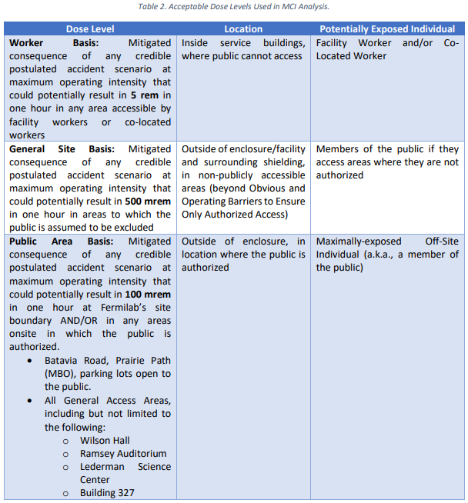
Maximum Credible Incident (MCI) – Radiological

Slide 20
Outline
P1 and P2 Beamlines Overview
Hazard Inventory
Non-Accelerator Specific Hazards
Accelerator Specific Hazards
Maximum Credible Incident (MCI) Discussion
Summary of Credited Controls

Slide 21
Credited Controls – Passive Engineering
Permanent Shielding
17.9 e.f.d. in all locations except in the 520-701 region (MI 8400-8475) where the loss is on a buried thick pipe, which requires 20.3 e.f.d.
Penetration Shielding
F13 10” diameter cryo penetration must be filled with at least 16.8 feet of sand
F13 6” diameter cryo penetration must be filled with at least 14.7 feet of sand
F15 48” diameter cryo penetration must be filled to the top of the berm with sand
No other penetrations are required to be filled
Obvious and Operating Barriers to Ensure Only Authorized Access
To permit entry to only authorized individuals into the area where the General Site Basis applies surrounding the P1 and P2 Beamlines segment of the Fermilab Main Accelerator, Obvious and Operating Barriers shall be established at the following locations to permit only authorized access:
Wilson Hall West, Wilson Hall East, Site 5

Slide 22
Credited Controls – Active Engineering
Credited Control: Radiation Safety Interlock System (RSIS)
Inhibits beam by controlled redundant critical devices
Enforces the search and secure process
Interlocked doors are present at all access points into the Switchyard enclosures
Includes interlocked radiation detectors which protect individuals by disabling beam should prompt radiation from operations cause exposure to exceed specific dose rates
Includes an interlocked repetition rate limiter which protect individuals by disabling beam if a magnet is energized longer than allowed in a fixed amount of time.
The ES&H Radiation Physics Engineering Dept. (RPE) ensures that all requirements for hardware and system testing are completed semi-annually with a four-month grace period
RPE also verifies the inventory of interlock keys and updates procedures for maintenance and testing of interlock systems
All RSIS are designed, installed and configuration managed in conformance with the requirements of the Fermilab Radiological Control Manual (FRCM)

Slide 23
Credited Controls – Active Engineering
Interlocked Radiation detectors
The P1 and P2 Beamlines do not have enough shielding for the MCI at the F15 Air Handler location, so interlocked radiation detectors are required
The credited control limits for these interlocked radiation detectors are sufficient to protect against the MCI
We operate at levels below the MCI intensity.
Limit levels are set by the Radiation Physics Operations Department (RPO) to satisfy occupancy requirements per 10 CFR Part 835
For 120-GeV beam, an interlocked repetition rate limiter prevents more than one MI extraction per 55s by disabling beam if a magnet is energized longer than allowed in a fixed amount of time
Detector Type | Location | Credited Control Limit
Chipmunk | F15 Air Handler | 440 mrem/hour

Slide 24
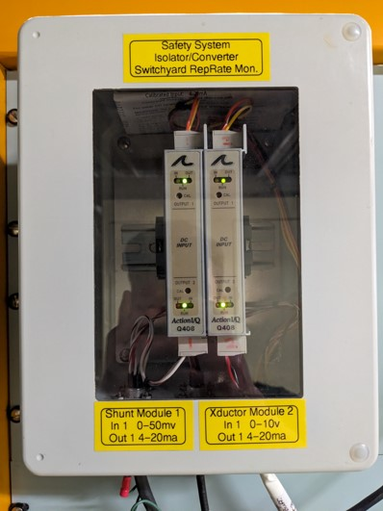
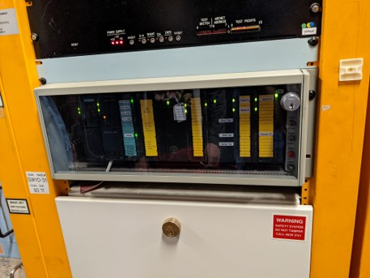
Repetition Rate Limiter

Slide 25
Credited Controls - Administrative
Credited Control: Operation Authorization Document
Machine Beam Permit
Machine Run Condition
Beam will not be transported through the P1 and P2 Beamlines without approval of these documents
Credited Control: Staffing
To ensure accelerator operations are disabled and initiate an immediate response in the event of a determined ASE violation
The following staffing shall be in place during applicable beam operation:
At least one member of the AD Operations Department who has achieved the rank of Operator II or higher shall be on duty and on site.
At least one member of the AD Operations Department shall be present in the Main Control Room (MCR).
Note: these requirements could be satisfied by a single person
Credited Control: Accelerator Operating Parameters
Beam shall not exceed 3.78 E17 protons per hour at 8 GeV beam energy
Beam shall not exceed 2.75 E15 protons per hour at 120 GeV beam energy

Slide 26
Questions?

