Slide 1
Accelerator Readiness Review (ARR) Plan and Schedule Overview
Maddie Schoell
DOE O 420.2D Phased Reviews: ARR #1 – Fermilab Main Accelerator
March 19-21, 2024

Slide 2
Outline
Safety Notes
Scope
Fermilab
General Phased ARR Review Plan
Current Document Status
Charge & Charge Questions
Schedule
Summary

Slide 3
Safety Notes
In the event of an emergency or alarm, we’ll go to the south (enclosed) stairs and go downstairs
For tornados: proceed to the basement/ground floor
For fire: proceed outside
Emergency phone number
From cell phone: 630-840-3131
From lab phone: x3131
Safety briefings and PPE will be provided to you for Site Visits today and tomorrow
As Business Visitors, you are required to be escorted by a Fermilab employee. We’ll guide you in the event of an emergency.

Slide 4
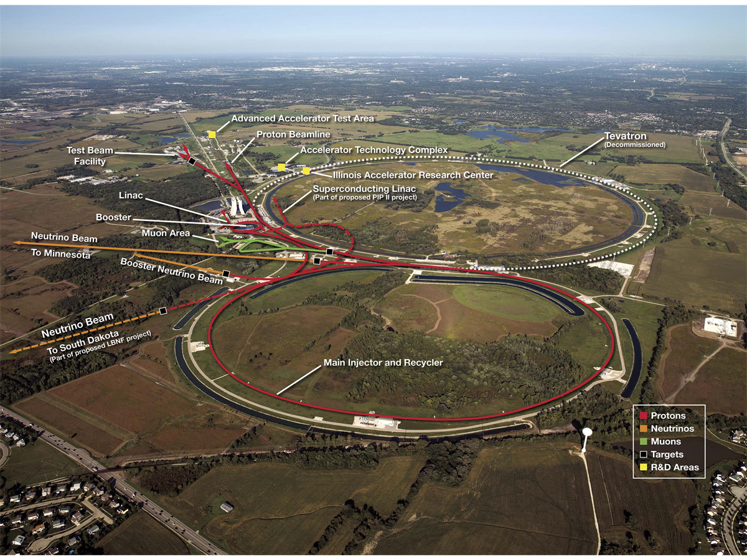
Scope – Fermilab
Fermilab Overview
6,800 acre site
High energy physics and particle beam physics research
Frontiers:
Energy
Intensity
Cosmic
Managed fully within DOE O 420.2D (no nuclear facilities)
Figure 1. Arial view of Fermilab

Slide 5
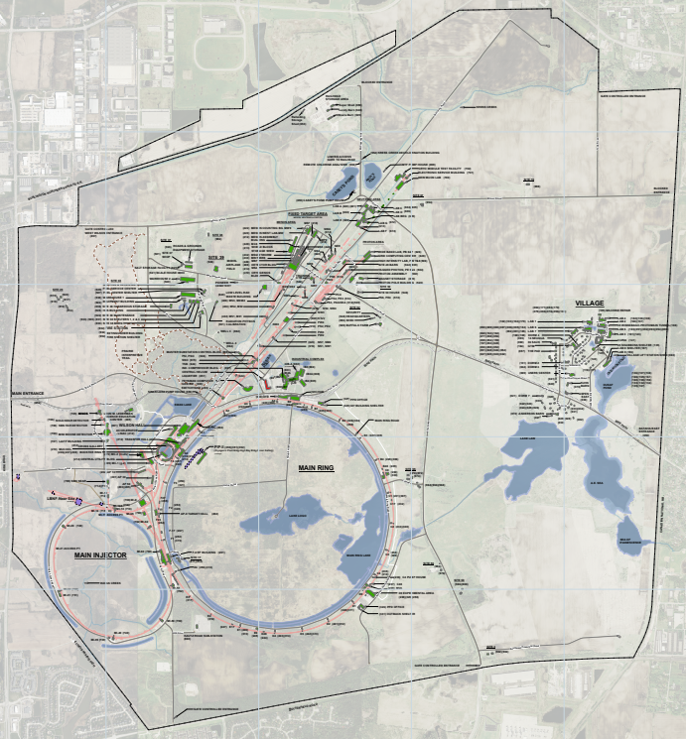
Scope – Accelerators at Fermilab
Fermilab Main Accelerator
FAST Accelerator
CMTS1
PIP2IT
VTS
3
4
2
5
1

Slide 6
Scope – General Phased ARR Review Plan
Fermilab has significantly updated accelerator safety documentation to:
Align with new requirements in DOE O 420.2D
Address comments and recommendations from
Fermilab Site Office
August 2023 Accelerator Readiness Review
September 2023 DOE 420.2D Assist Visit
Incorporating three cryomodule test stands as accelerators under DOE O 420.2D. Fermilab will go from two to five accelerators.

Slide 7
Scope – General Phased ARR Review Plan
*reviewed in previous review
*more on this in future review
General updates include
Fermilab SAD & ASE structure and layout update;
Updated methodology for non-accelerator specific hazards
Generated a common risk matrix table in the SAD
Updated methodology for analyzing Maximum Credible Incident (MCI) for prompt ionizing radiation accelerator-specific hazard
Identified Oxygen Deficiency Hazard (ODH) as an accelerator-specific hazard
Within applicable accelerator facilities (interlocked exclusion areas)
Incorporated new Credited Controls (ODH & radiation monitors)
Updated Unreviewed Safety Issue (USI) Program
New SAD Chapters and ASEs for new accelerators
IRR 1a
IRR 1a
IRR 1a
IRR 1c
Aug ARR & DOE Visit
IRR 1a
IRR 1a
IRR 3

Slide 8
Scope – General Phased ARR Review Plan
In order to sufficiently validate updates to documentation, Fermilab has been conducting a series of reviews from November 2023 through March 2024.
Conduct Internal Readiness Reviews (IRRs) specifically focused on SAD/ASE updates for each segment/accelerator
Fermilab Main Accelerator segments* will resume operations following the closure of IRR pre-start findings (including approval of SAD and ASE)
Conduct Full Scope Accelerator Readiness Reviews (ARRs) for each accelerator
*segments that are resuming previous operations will resume operations following closure of IRR pre-start findings. The Neutrino segment and the Neutrino SY120 Experimental Area underwent modifications since it’s last operation so will not resume following this IRR, instead it will resume following the ARR.

Slide 9
Scope – General Phased ARR Review Plan
We are currently in ARR #1
Figure 2. Phased ARR Review Plan Schedule, excerpt from Charge

Slide 10
Current Status
SAD Chapter | Technical Edits/Update Status | Review | Revision Inclusion | Approval Status
SAD Section I Chapters 1-10 Overview of Fermilab Facilities | Complete ☑ | IRR #1a ☑ | Included in SAD Rev. 22, updated in Rev. 24 & 25 | Director Approved ☑
SAD Section II Chapter 1 through Chapter 7 Support Facilities | Complete ☑ | IRR #1a ☑ | Included in SAD Rev. 22 | Director Approved ☑
SAD Section III Chapter 1 Linac | Complete ☑ | IRR #1a ☑ | Included in SAD Rev. 22, updated in Rev. 24 | Director Approved ☑ Operating ☑
SAD Section III Chapter 2 400 MeV Test Area (MTA) | Complete ☑ | IRR #1a ☑ | Included in SAD Rev. 22, updated in Rev. 24 & 25 | Director Approved ☑ Operating ☑
SAD Section III Chapter 3 [placeholder – PIP-II Linac] | n/a – placeholder |  | n/a – placeholder | n/a – placeholder
SAD Section III Chapter 4 Booster | Complete ☑ | IRR #1b ☑ | Included in Rev. 24 | Director Approved ☑ Operating ☑
SAD Section III Chapter 5 8 GeV Line | Complete ☑ | IRR #1b ☑ | Included in Rev. 24 | Director Approved ☑ Operating ☑
SAD Section III Chapter 6 Booster Neutrino Beam (BNB) | Complete ☑ | IRR #1b ☑ | Included in Rev. 24 | Director Approved ☑ Operating ☑
SAD Section III Chapter 7 Main Injector / Recycler | Complete ☑ | IRR #1b ☑ | Included in Rev. 24 | Director Approved ☑ Operating ☑
SAD Section III Chapter 8 Neutrinos from the Main Injector (NuMI) | Complete ☑ | IRR #1b ☑ | Included in Rev. 24 | Director Approved ☑ Operating ☑

Slide 11
Current Status
SAD Chapter | Technical Edits/Update Status | Review | Revision Inclusion | Approval Status
SAD Section III Chapter 9 – P1 and P2 Beamlines | Complete ☑ | IRR #1c ☑ | Included in Rev. 25 | Director Approved ☑ Operating ⃝ pending ASE Rev 15
SAD Section III Chapter 10 – Muon Campus | Complete ☑ | IRR #1c ☑ | Included in Rev. 25 | Director Approved ☑ Operating ⃝ pending ASE Rev 15
SAD Section III Chapter 11 – Tevatron | In progress ⃝ | TBD – will be reviewed following completion of operational facility reviews | Non-operational facility, will be included in future SAD Rev. | Director Approval ⃝
SAD Section III Chapter 12 – Switchyard | Complete ☑ | IRR #1c ☑ | Included in Rev. 25 | Director Approved ☑ Operating ⃝ pending ASE Rev 15
SAD Section III Chapter 13 – Meson | Complete ☑ | IRR #1c ☑ | Included in Rev. 25 | Director Approved ☑ Operating ⃝ pending ASE Rev 15
SAD Section III Chapter 14 – Neutrino | Complete ☑ | IRR #1c ☑ | Included in Rev. 25 | Director Approved ☑ Operating ⃝ pending ASE Rev 15
SAD Section III Chapter 15 – Proton | In progress ⃝ | TBD – will be reviewed following completion of operational facility reviews | Non-operational facility, will be included in future SAD Rev. | Director Approval ⃝

Slide 12
Current Status
SAD Chapter | Technical Edits/Update Status | Review | Revision Inclusion | Approval Status
SAD Section IV Chapter 1 – CDF Detector | In progress ⃝ | TBD – will be reviewed following completion of operational facility reviews | Non-operational facility, will be included in future SAD Rev. | Director Approval ⃝
SAD Section IV Chapter 2 – D Zero Detector | In progress ⃝ | TBD – will be reviewed following completion of operational facility reviews | Non-operational facility, will be included in future SAD Rev. | Director Approval ⃝
SAD Section IV Chapter 3 – Meson Switchyard 120 Experimental Areas | Complete ☑ | IRR #1c ☑ | Included in Rev. 25 | Director Approved ☑ Operating ⃝ pending ASE Rev 15
SAD Section IV Chapter 4 – MiniBooNE Detector | Complete ☑ | IRR #1b ☑ | Included in Rev. 24 | Director Approved ☑ Operating ☑
SAD Section IV Chapter 5 – NOvA Detector | Complete ☑ | IRR #1b ☑ | Included in Rev. 24 | Director Approved ☑ Operating ☑
SAD Section IV Chapter 6 – MINOS Hall Detectors | Complete ☑ | IRR #1b ☑ | Included in Rev. 24 | Director Approved ☑ Operating ☑
SAD Section IV Chapter 7 – Short Baseline Neutrino Experimental Areas | Complete ☑ | IRR #1b ☑ | Included in Rev. 24 | Director Approved ☑ Operating ☑

Slide 13
Current Status
SAD Chapter | Technical Edits/Update Status | Review | Revision Inclusion | Approval Status
SAD Section IV Chapter 8 – Muon g-2 Storage Ring | In progress ⃝ | TBD – will be reviewed following completion of operational facility reviews | Non-operational facility, will be included in future SAD Rev. | Director Approval ⃝
SAD Section IV Chapter 9 – Neutrino Switchyard 120 Experimental Areas | Complete ☑ | IRR #1c ☑ | Included in Rev. 25 | Director Approved ☑ Operating ⃝ pending ASE Rev 15
SAD Section V Chapter 1 – Fermilab Accelerator Science & Technology (IOTA/FAST) Electron Injector | In progress ⃝ | IRR #2 ⃝ | Will be included in future SAD Rev. | Director Approval ⃝
SAD Section VI Chapter 1 – [placeholder – Overview of Test Stand Accelerators at Fermilab] | n/a – placeholder | n/a – placeholder | n/a – placeholder | n/a – placeholder
SAD Section VI Chapter 2 – CMTS1 Accelerator | In progress ⃝ | IRR #3 ⃝ | Will be included in future SAD Rev. | Director Approval ⃝
SAD Section VI Chapter 3 – PIP2IT Accelerator | In progress ⃝ | IRR #3 ⃝ | Will be included in future SAD Rev. | Director Approval ⃝
SAD Section VI Chapter 4 – VTS Accelerator | In progress ⃝ | IRR #3 ⃝ | Will be included in future SAD Rev. | Director Approval ⃝

Slide 14
Current Status
SAD Chapter | Technical Edits/Update Status | Review | Revision Inclusion | Approval Status
SAD Appendix A VII-A.1 Accelerator Safety Envelope – Fermilab Main Accelerator | Sections 1-6: Complete ☑ | IRR #1a ☑ | Included in SAD Rev. 22, ASE A.1 Rev. 13 | Director Approved ☑ FSO Manager Approval ☑
 | Section 7: Linac ☑ MTA ☑ | IRR #1a ☑ | Included in SAD Rev. 22, ASE A.1 Rev. 13 | Director Approved ☑ FSO Manager Approval ☑
 | Section 7: Booster ☑ 8 GeV Line ☑ Booster Neutrino Beam (BNB) ☑ Main Injector ☑ Recycler ☑ Neutrinos from the Main Injector (NuMI) ☑ | IRR #1b ☑ | Included in SAD Rev. 24, ASE A.1 Rev. 14 | Director Approved ☑ FSO Manager Approval ☑
 | Section 7: P1 and P2 Beamlines☑ Muon Campus ☑ Switchyard ☑ Meson ☑ Neutrino ☑ | IRR #1c ☑ | Included in SAD Rev. 25, ASE A.1 Rev. 15 | Director Approved ☑ FSO Manager Approval ⃝ Submitted 3/15/2024

Slide 15
Current Status
SAD Chapter | Technical Edits/Update Status | Review | Revision Inclusion | Approval Status
SAD Appendix A VII-A.2 Accelerator Safety Envelope – FAST Accelerator | In progress ⃝ | IRR #2 ⃝ | Will be included in future SAD Rev., ASE A.2 Rev. 0 | Director Approval ⃝ FSO Manager Approval ⃝
SAD Appendix A VII-A.3 – Accelerator Safety Envelope – CMTS1 Accelerator | In progress ⃝ | IRR #3 ⃝ | Will be included in future SAD Rev., ASE A.3 Rev. 0 | Director Approval ⃝ FSO Manager Approval ⃝
SAD Appendix A VII-A.4 – Accelerator Safety Envelope – PIP2IT Accelerator | In progress ⃝ | IRR #3 ⃝ | Will be included in future SAD Rev., ASE A.4 Rev. 0 | Director Approval ⃝ FSO Manager Approval ⃝
SAD Appendix A VII-A.5 – Accelerator Safety Envelope – VTS Accelerator | In progress ⃝ | IRR #3 ⃝ | Will be included in future SAD Rev., ASE A.5 Rev. 0 | Director Approval ⃝ FSO Manager Approval ⃝
SAD Appendix B VII-B.1 Fermilab Shielding Policy | Complete ☑ | IRR #1a ☑ | Included in SAD Rev. 22 | Director Approved ☑
SAD Appendix B VII-B.2 Fermilab Unreviewed Safety Issue (USI) Process | Complete ☑ | IRR #1a ☑ | Included in SAD Rev. 22, updated in Rev. 23 | Director Approved ☑ FSO Manager Approval ☑
SAD Appendix C Non-Accelerator Specific Hazard (NASH) Risk Matrix Tables | Complete ☑ | IRR #1a ☑ | Included in SAD Rev. 22 | Director Approved ☑

Slide 16
Charge
ARR #1 Review Committee is asked to:
Verify that the people, processes, and equipment in place to support continued safe operations of the Fermilab Main Accelerator are in compliance with the requirements of DOE O 420.2D.
Please present findings, comments, noteworthy practices, and recommendations
Findings: statements of fact based on what you were presented
Comments: your opinion on the findings
Noteworthy practices: elements you believe the Lab does well
Opportunities for Improvement: elements you believe are compliant but could be improved
Recommendation: elements that must be addressed by the Lab to ensure compliance
For the Neutrino segment, please identify pre-start and post-start recommendations
For all other segments, all recommendations will be post-start (since we’re operational following IRRs)
Please also provide specific answers to the charge questions

Slide 17
Charge Questions
Do the updated Safety Assessment Document (SAD) Chapters and the Accelerator Safety Envelope (ASE) supporting Fermilab Main Accelerator Operations meet the requirements in DOE O 420.2D?
Is the methodology for determining necessary Credited Controls based on the Maximum Credible Incident (MCI) analysis appropriate, and is it clear in our updated documentation?
Have our documents demonstrated that we have sufficient Credited Controls identified to ensure potential dose to the public is at or below acceptable levels?
Are the necessary Credited Controls in place to support safe operations of the Fermilab Main Accelerator?

Slide 18
Charge Questions
Are the necessary program elements of DOE O 420.2D and the associated CRD in place?
Clearly defined roles and responsibilities for accelerator activities including those for training and procedures
A current listing/inventory of accelerators managed under this Order and exemptions or equivalencies to this Order
A Safety Assessment Document (SAD)
A DOE approved Accelerator Safety Envelope (ASE)
A DOE approved Unreviewed Safety Issue (USI) process
An Accelerator Readiness Review (ARR) process
A Contractor Assurance System that maintains an internal assessment process
A Configuration Management Program that addresses accelerator safety
Credited controls and appropriate administrative processes related to accelerator safety (e.g., training, procedures, etc.)

Slide 19
Charge Questions

Slide 20
Schedule
Tuesday – single session with full team
Welcome
ARR Plan and Schedule Overview
Accelerator Safety Program Overview
Fermilab Facility Overview and Description of Fermilab Main Accelerator
SAD/ASE Layout
Applicability and RGDs
Overview of NASH Analysis Methodology
Overview of MCI Analysis Methodology
Credited Controls
Configuration Management
ASE Violation Determination and Response
Operator Training Overview
Followed by tour of the Main Control Room (MCR)
Contractor Assurance System (CAS) Overview
Unreviewed Safety Issue (USI) Process Overview
Work Planning & Control (WPC) Overview
Shielding
Fencing
Obvious and Operating Barriers
Radiation Safety Interlock System (RSIS)
ODH Safety System
Operation Authorization Document
Staffing
Accelerator Operating Parameters

Slide 21
Schedule
Wednesday AM – two parallel sessions
Session A:
Linac
400 MeV Test Area (MTA)
Booster
8-GeV Line
Main Injector/Recycler
NuMI
NOvA Detector
MINOS Hall Detectors
Session B:
Booster Neutrino Beam (BNB)
MiniBooNE Detector
SBN Experimental Area
P1 and P2 Beamlines
Muon Campus
Switchyard
Meson
Meson Experimental Area
Wednesday PM – single session with full team
Neutrino
Neutrino Experimental – followed by tour of the enclosure and experimental hall
Interview/Discussion Time

Slide 22
Schedule
Thursday
Interview/Discussion Time
Executive Session Time
Closeout 1pm

Slide 23
Summary
Presentations will provide the review committee members with an overview of the program elements, segments and experimental areas, and provide evidence to answer the Charge questions
Field visits will be performed
Fermilab believes that this plan will support your evaluation of our implementation of accelerator safety programs for the Fermilab Main Accelerator, and confirm that they are compliant with DOE O 420.2D
We look forward to your observations and recommendations

Slide 24
Questions?

