Slide 1
Accelerator Safety Program Overview
Jessica Malo
DOE O 420.2D Phased Reviews:
ARR #2– Fermilab Accelerator Science & Technology (FAST) Accelerator
October 29-30, 2024

Slide 2
Outline
Fermilab Facility Overview
Safety Assessment Document (SAD) and Accelerator Safety Envelope (ASE) Layout
Applicability and Radiation Generating Devices (RGDs)
Overview of Non-Accelerator Specific Hazard (NASH) Analysis Methodology
Overview of Maximum Credible Incident (MCI) Analysis Methodology
Credited Controls
Configuration Management
ASE Violation Determination & Response

Slide 3
Fermilab Facility Overview and Safety Assessment Document (SAD) and Accelerator Safety Envelope (ASE) Layout

Slide 4
Outline
Fermilab SAD Structure
SAD Chapters
ASE Structure

Slide 5
Fermilab Safety Assessment Document (SAD) Structure
Fermilab has one modular Safety Assessment Document (SAD)
Section I – Overview of Fermilab Facilities
Section II – Support Facilities
Section III – Fermilab Main Accelerator (Accelerator Segments)
Section IV – Fermilab Main Accelerator (Experimental Areas & Detectors)
Section V – FAST Accelerator
Section VI – Test Stand Accelerators
Section VII – Appendices
VII-A – Accelerator Safety Envelopes
VII-B – Fermilab Accelerator Safety Policies & Programs
VII-B.1 Fermilab Shielding Policy
VII-B.2 Fermilab USI Process
VII-C – Non-Accelerator Specific Hazard (NASH) Risk Matrix Tables

Slide 6
Fermilab SAD Structure
Section I – Overview of Fermilab Facilities
Section II – Support Facilities
Section III – Fermilab Main Accelerator (Accelerator Segments)
Section IV – Fermilab Main Accelerator (Experimental Areas & Detectors)
Section V – FAST Accelerator
Section VI – Test Stand Accelerators
Section VII – Appendices
VII-A – Accelerator Safety Envelopes
VII-B – Fermilab Accelerator Safety Policies & Programs
VII-C – Non-Accelerator Specific Hazard (NASH) Risk Matrix Tables
I-01 Executive Summary
I-02 Introduction
I-03 Site, Facility Design Criteria and Operations
I-04 Safety Assessment
I-05 Accelerator Safety Envelope Basis
I-06 Environmental Monitoring
I-07 Quality Assurance
I-08 Post-Operations Planning
I-09 Acronyms
I-10 References

Slide 7
Fermilab SAD Structure
Section I – Overview of Fermilab Facilities
Section II – Support Facilities
Section III – Fermilab Main Accelerator (Accelerator Segments)
Section IV – Fermilab Main Accelerator (Experimental Areas & Detectors)
Section V – FAST Accelerator
Section VI – Test Stand Accelerators
Section VII – Appendices
VII-A – Accelerator Safety Envelopes
VII-B – Fermilab Accelerator Safety Policies & Programs
VII-C – Non-Accelerator Specific Hazard (NASH) Risk Matrix Tables
II-01 Railhead
II-02 Radiation Protection Calibration Facility (RPCF)
II-03 Radionuclide Analysis Facility (RAF)
II-04 Waste Handling Facilities
II-05 Technical Division Facilities
II-06 Shipping and Receiving Operations
II-07 Other Radioactive Material Storage Areas

Slide 8
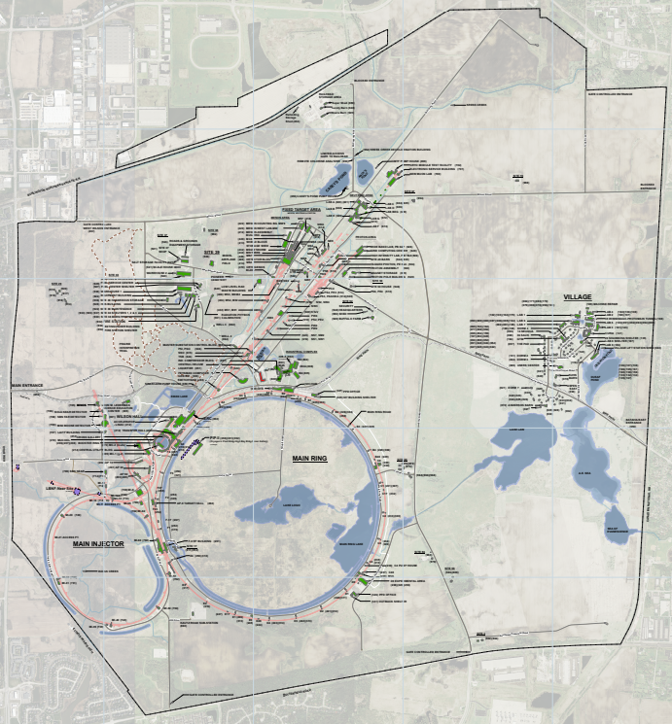
Support Facilities
Railhead
Radioactive Protection Calibration Facility (RPCF)
Radionuclide Analysis Facility (RAF)
Waste Handling Facilities
Applied Physics and Superconducting Facilities
Shipping & Receiving Operations
Other Radioactive Materials
1
7
7
3
7
4
7
6
2
7
5
7
4
7

Slide 9
Fermilab SAD Structure
Section I – Overview of Fermilab Facilities
Section II – Support Facilities
Section III – Fermilab Main Accelerator (Accelerator Segments)
Section IV – Fermilab Main Accelerator (Experimental Areas & Detectors)
Section V – FAST Accelerator
Section VI – Test Stand Accelerators
Section VII – Appendices
VII-A – Accelerator Safety Envelopes
VII-B – Fermilab Accelerator Safety Policies & Programs
VII-C – Non-Accelerator Specific Hazard (NASH) Risk Matrix Tables
III-01 Linac
III-02 400 MeV Test Area (MTA)
III-03 PIP-II Line *
III-04 Booster
III-05 8 GeV Line
III-06 Booster Neutrino Beam (BNB)
III-07 Main Injector / Recycler
III-08 NuMI
III-09 P1 and P2 Beamlines
III-10 Muon Campus
III-11 Tevatron
III-12 Switchyard
III-13 Meson
III-14 Neutrino
III-15 Proton
* placeholder

Slide 10
Fermilab SAD Structure
Section I – Overview of Fermilab Facilities
Section II – Support Facilities
Section III – Fermilab Main Accelerator (Accelerator Segments)
Section IV – Fermilab Main Accelerator (Experimental Areas & Detectors)
Section V – FAST Accelerator
Section VI – Test Stand Accelerators
Section VII – Appendices
VII-A – Accelerator Safety Envelopes
VII-B – Fermilab Accelerator Safety Policies & Programs
VII-C – Non-Accelerator Specific Hazard (NASH) Risk Matrix Tables
IV-01 CDF Detector
IV-02 DZero Detector
IV-03 Meson Switchyard 120 Experimental Areas
IV-04 MiniBooNE Detector
IV-05 NOvA Detector
IV-06 MINOS Hall Detectors
IV-07 SBN Experimental Areas
IV-08 Muon g-2 Storage Ring
IV-09 Neutrino Switchyard 120 Experimental Areas

Slide 11
Fermilab SAD Structure
Section I – Overview of Fermilab Facilities
Section II – Support Facilities
Section III – Fermilab Main Accelerator (Accelerator Segments)
Section IV – Fermilab Main Accelerator (Experimental Areas & Detectors)
Section V – FAST Accelerator
Section VI – Test Stand Accelerators
Section VII – Appendices
VII-A – Accelerator Safety Envelopes
VII-B – Fermilab Accelerator Safety Policies & Programs
VII-C – Non-Accelerator Specific Hazard (NASH) Risk Matrix Tables
V-01 Fermilab Accelerator Science & Technology (FAST) Accelerator

Slide 12
Fermilab SAD Structure
Section I – Overview of Fermilab Facilities
Section II – Support Facilities
Section III – Fermilab Main Accelerator (Accelerator Segments)
Section IV – Fermilab Main Accelerator (Experimental Areas & Detectors)
Section V – FAST Accelerator
Section VI – Test Stand Accelerators
Section VII – Appendices
VII-A – Accelerator Safety Envelopes
VII-B – Fermilab Accelerator Safety Policies & Programs
VII-C – Non-Accelerator Specific Hazard (NASH) Risk Matrix Tables
V-01 Fermilab Accelerator Science & Technology (IOTA/FAST) Electron Injector
VI-01 Overview of Test Stand Accelerators *
VI-02 Cryomodule Test Stand 1 (CMTS1)
VI-03 PIP-II IT
VI-04 Vertical Test Stand (VTS)
VI-05 Spoke Test Cryostat (STC)
* placeholder

Slide 13
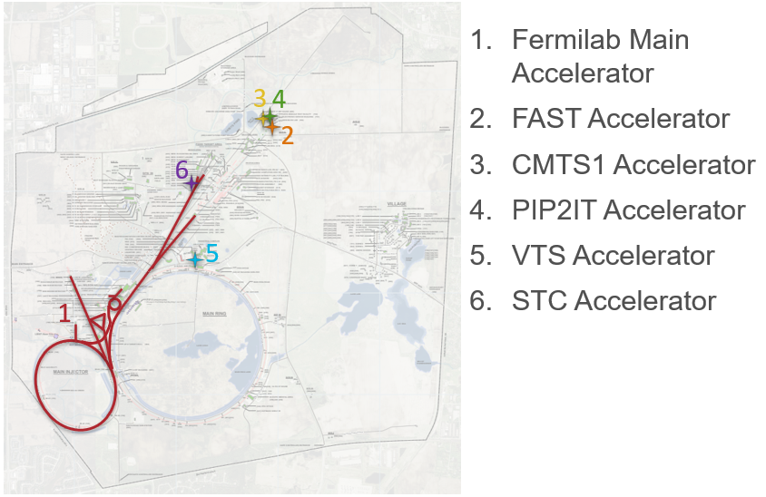
Accelerators at Fermilab
3
4
2
5
List of accelerators maintained by ESH Accelerator Safety Department in R.P. Form 47 (ESH DocDB 7481)

Slide 14
Fermilab SAD Structure
Section I – Overview of Fermilab Facilities
Section II – Support Facilities
Section III – Fermilab Main Accelerator (Accelerator Segments)
Section IV – Fermilab Main Accelerator (Experimental Areas & Detectors)
Section V – FAST Accelerator
Section VI – Test Stand Accelerators
Section VII – Appendices
VII-A – Accelerator Safety Envelopes
VII-B – Fermilab Accelerator Safety Policies & Programs
VII-C – Non-Accelerator Specific Hazard (NASH) Risk Matrix Tables
VII-A.01 ASE – Fermilab Main Accelerator
VII-A.02 ASE – FAST Accelerator
VII-A.03 ASE – CMTS1 Accelerator
VII-A.04 ASE – PIP-II IT Accelerator
VII-A.05 VTS Accelerator
VII-A.06 STC Accelerator

Slide 15
Fermilab SAD Structure
Section I – Overview of Fermilab Facilities
Section II – Support Facilities
Section III – Fermilab Main Accelerator (Accelerator Segments)
Section IV – Fermilab Main Accelerator (Experimental Areas & Detectors)
Section V – FAST Accelerator
Section VI – Test Stand Accelerators
Section VII – Appendices
VII-A – Accelerator Safety Envelopes
VII-B – Fermilab Accelerator Safety Policies & Programs
VII-C – Non-Accelerator Specific Hazard (NASH) Risk Matrix Tables
VII-B.01 Fermilab Shielding Policy
VII-B.01 Fermilab Unreviewed Safety Issue (USI) Process

Slide 16
Fermilab SAD Structure
Section I – Overview of Fermilab Facilities
Section II – Support Facilities
Section III – Fermilab Main Accelerator (Accelerator Segments)
Section IV – Fermilab Main Accelerator (Experimental Areas & Detectors)
Section V – FAST Accelerator
Section VI – Test Stand Accelerators
Section VII – Appendices
VII-A – Accelerator Safety Envelopes
VII-B – Fermilab Accelerator Safety Policies & Programs
VII-C – Non-Accelerator Specific Hazard (NASH) Risk Matrix Tables
VII-C – Non-Accelerator Specific Hazard (NASH) Risk Matrix Tables

Slide 17
Fermilab SAD Structure – SAD Chapters
SAD Chapters prepared by Machine/Area Owner, Department Head, or Primary Point of Contact
SAD Chapters reviewed by Line Organization Owner, ES&H Division Accelerator Safety Department Head and SAD Review Subcommittee Chair
Overall SAD approved by Lab Director
All Chapters have same Outline, consistency in formatting and creates ease for reader to find the same type of information across Chapters
Chapter nomenclature
II-1.2.1.1
SAD Section
Information section within the Chapter
Chapter within the SAD Section

Slide 18
Fermilab Accelerator Safety Envelopes (ASEs) Structure
Multiple Accelerator Safety Envelopes (ASEs)
One ASE for each accelerator
ASEs prepared by the ES&H Division Accelerator Safety Department Head and Accelerator Machine/Area Owner, Department Head, or Primary Point of Contact
ASEs Reviewed and Recommended for approval by the Directorate Associate Lab Director or Division Senior Director, the Accelerator Safety Department Head and SAD Review Subcommittee Chair
Final approval of the ASE granted by the Fermilab Director and the DOE Field Element Manager

Slide 19
Fermilab ASE Structure
ASE Outline
Section 1 Introduction and Scope
Section 2 Select Definitions and Acronyms
Section 3 Description of Credited Controls
Section 4 ASE Violation Determinations and Actions
Section 5 Configuration Management for Credited Controls
Section 6 Unreviewed Safety Issue (USI) Process
Section 7 Summary of Credited Controls for [all Segments of] the Accelerator
For the Fermilab Main Accelerator, this will be subdivided for each segment (i.e., Linac, MTA, etc.)

Slide 20
DOE O 420.2D Applicability and Radiation Generating Devices (RGDs)

Slide 21
RGD vs Accelerator
All RGDs as determined by DOE O 420.2C were run through the definitions of DOE O 420.2D to determine their new designation. The possibilities are:
Radiation Generating Device
Exempt / Equivalent Accelerator
Non-Exempt / Non-Equivalent Accelerator
Compliance with DOE O 420.2D and an ARR is required.

Slide 22
Radiation Generating Device vs Accelerator Determination
Is voltage or RF applied?
yes
Is ionizing radiation possible?
no
Device not under this program
no
yes
Device not under this program
Radiation Area possible?
Device is an RGD
no
yes
Device is an accelerator
yes
Equivalent Accelerator
≥10 MeV?
no
yes
May NOT have an equivalency

Slide 23
RGD vs Accelerator
Accelerator Requirements:
Follow DOE O 420.2D Requirements (FESHM 2010)
Have a SAD Chapter
Have an ASE
Conduct an ARR prior to commissioning and/or operations
Obtain FSO approval prior to commissioning and/or operations
Beam Permit/Running Condition (or equivalent) as Operation Authorization Document
May NOT have an equivalency
Accelerators:
Fermilab Main Accelerator
FAST
CMTS1
PIP2IT
VTS
STC
Notes:
FAST will be reviewed during IRR 2 and ARR 2 (TBD)
CMTS1, PIP2IT, VTS will be reviewed during IRR 3 and ARR 3 (March 26-28, and April 9-11)

Slide 24
Overview of Non-Accelerator Specific Hazard (NASH) Analysis Methodology

Slide 25
Outline
DOE-HDBK-1163-2020 as used at Fermilab for hazard analysis
Risk Assessment for each Accelerator
Hazard Mitigation for NASH Hazards

Slide 26
DOE-HDBK-1163-2020 as used at Fermilab
DOE-HDBK-1163-2020 Integration of Hazard Analyses
Community accepted process for performing risk assessments
Useful, comprehensive resource to support Hazard/Risk Assessment activities.
Handbook stresses a well-understood hierarchy of controls.
Engineered Controls (prevent/mitigate exposures)
Preventive preferred over mitigative
Passive controls preferred vs. active controls
Administrative controls and work practices
Preventive preferred over mitigative.
Note: PPE use based on activity-level HA

Slide 27
DOE-HDBK-1163-2020 as used at Fermilab
To guide conduct of Facility Level Hazard/Risk Assessments
Incorporated into all Safety Assessment Documents (SAD) Chapters to consistently evaluate non-accelerator specific hazards (NASH) and demonstrate that residual/mitigated risk is acceptable
Fermilab facility managers identified:
Radiological Hazards
Non-Accelerator Specific Hazards (NASHs)
Accelerator Specific Hazards include
Prompt ionizing radiation
Cryogenics (ODH) (within applicable accelerator facilities)
Notes:
ODH Credited Control will be discussed later in this talk, in pt 2 after the coffee break

Slide 28
Hazard Analysis - Receptors
NASH hazards and risks were evaluated for 3 different receptors:
Facility Worker (the worker actively performing the work)
Co-located Worker (the worker in the vicinity of the work, but not actively participating)
Members of public (due to Fermilab open campus, must involve the public onsite).

Slide 29
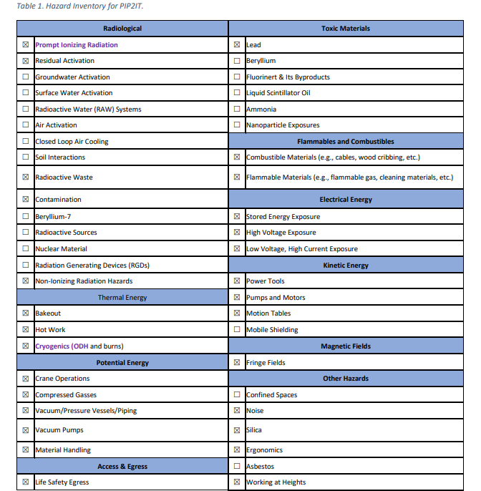
Hazard Analysis for Safety Assessment Document
Each Fermilab facility/experimental area went through a hazard identification process.
Hazards present at each accelerator were identified.
This list of identified hazards was reviewed against the common risk matrix table in Appendix C.
Hazards that were not fully addressed by the common Risk Matrix require description in the individual SAD Chapters.
Example Hazard Identification (HID) Table for PIP2IT.

Slide 30
Hazard Analysis for Safety Assessment Document
Once the Hazard identification table was filled in, an empty Risk Matrix was sent to the facility to fill in for each one of their respective hazards:
The hazard description: "Potential exposure to xyz" to worker (or to co-located worker, or to member of public).
What is the baseline qualitative risk?
What preventive and mitigative measures can we use to reduce risks caused by this exposure event?
What is the residual qualitative risk?
Hazard | Hazard Description | Baseline Qualitative Risk (without controls) | Preventative (P)/ Mitigative (M) | Residual Qualitative Risk (with controls)
Lead | Hazard: "Potential {worker, co-located worker, or public} exposure to XYZ." | L: A C: M R: II | P-preventive measure #1 M- mitigative measure #1 | L: U C: L R: III

Slide 31
DOE-HDBK-1163-2020 as used at Fermilab
Hazards are reviewed for baseline risk
A risk matrix is used to determine whether risks from the identified hazards are acceptable
Risk levels I and II require preventive and/or mitigative measures to demonstrate that risks are reduced to Levels III/IV
Facility hazards with baseline risk levels III or IV don't require additional evaluation, but some choose to identify measures they use to provide information to the risk assessment.
In situations where residual risk remains at I or II, additional, quantitative risk assessment is deemed necessary.
Each preventive measure reduces likelihood 1 bin.
Each mitigative measure reduces consequence 1 bin.
All NASH hazard risk levels have been reduced to acceptable levels.

Slide 32
Maximum Credible Incident (MCI) Analysis Methodology

Slide 33
Outline
Maximum Credible Incident (MCI) Methodology
Credited Controls Determined Through MCI
Defense-in-Depth Controls

Slide 34
Maximum Credible Incident (MCI) Methodology
Maximum Credible Incident (MCI) methodology detailed in SAD Section I Chapter 4
Maximum Credible Incident (MCI) is the worst-case accident due to prompt-ionizing radiation
Determined using:
Maximum operating parameters possible due to machine limitations
Maximum duration of an MCI event
Specifying amount of surrounding shielding (e.f.d.) around the enclosure that will be Credited Control
MCI is then analyzed to determine potential dose on the outside of enclosure or specified surrounding shielding
Potential dose compared to acceptable levels

Slide 35
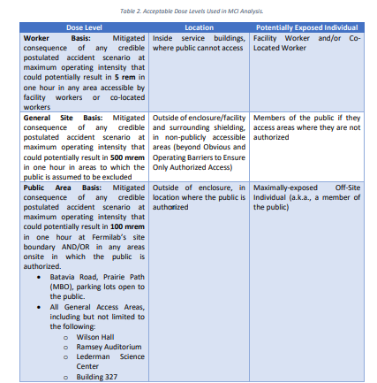
Maximum Credible Incident (MCI) Methodology

Slide 36
Maximum Credible Incident (MCI) Methodology
If potential dose below acceptable levels, specified surrounding shielding used in MCI analysis defined as Credited Control
No additional passive or active engineered Credited Controls needed
If potential dose above acceptable levels, then
additional passive and/or active engineered Credited Controls needed OR
active engineered Credited Controls can be established to lower the maximum operating performance and/or MCI event duration
In which case, MCI analysis is redone to ensure surrounding shielding is now sufficient

Slide 37
Credited Controls Determined Through MCI
Passive
Specified surrounding shielding used in MCI
Active Engineered
RSIS, Location and Credited Control (CC) Limit of radiation monitors in areas where identified specified shielding determined to be insufficient
Radiation monitors Trip Levels must be set at or below the CC Limit.
Administrative – Accelerator Operating Parameter
Accelerator operating parameter set to the maximum operating parameters used in MCI
Identified Credited Controls specified in the SAD and ASE.

Slide 38
Credited Controls

Slide 39
Credited Controls in use at the Fermilab Test Stand Accelerators:
Passive Credited Controls
Shielding
Active Engineered Credited Controls
Radiation Safety Interlock System (RSIS)
ODH Safety System
Administrative Credited Controls
Operation Authorization Document
Staffing
Accelerator Operating Parameters

Slide 40
Shielding
Shielding specified in the MCI analysis is the Credited Control
Shielding located between Exclusion Areas and occupied areas to keep personnel exposure to ionizing radiation within specified limits
Types of shielding include
Permanent shielding including labyrinths
Includes concrete structure (e.g., walls, floors, labyrinths) and soil
Movable shielding
Includes concrete blocks, stacked concrete, sand bags
Penetration shielding
Movable shielding located inside penetrations (e.g., sand bags, stacked concrete, poly beads/rods)

Slide 41
Radiation Safety Interlock System
RSIS establishes and maintains Exclusion Areas surrounding accelerator operating areas
Prior to accelerator operations, Search & Secure performed to establish the interlock system for the Exclusion Areas. Ensures no personnel remain within the Exclusion Areas prior to accelerator operations.
Hardware maintains the interlock system. Ensures no personnel inadvertently access the Exclusion Area during accelerator operations.
Includes radiation monitors with Trip Limits set at or below the CC Level specified in the MCI analysis.
Includes devices to limit intensity
Redundant design with fail-safe circuits. Failure initiates system shutdown resulting in safe condition.

Slide 42
Radiation Safety Interlock System
Required Calibration, Testing, Maintenance & Inspection Schedules
Operation of all access control interlock components shall be functionally tested at an interval no greater than 15 months.
Area radiation monitors shall be maintained calibrated on an interval no greater than 15 months.

Slide 43
ODH Safety System
ODH analysis analyzes worst case postulated accident scenarios, determines resulting ODH Classification and ODH Safety System requirements, based on quantitative risk assessment
ODH Safety Systems utilize various components (e.g., area oxygen monitors, vents, fans, lights/strobes, sirens, etc.)
ODH Safety System components that are required to detect and alert individuals of ODH within an interlocked and/or posted Exclusion Area are the Credited Controls. (e.g., oxygen monitors, lights/strobes, sirens)
Required Calibration, Testing, Maintenance, and Inspection Schedules
Operation of all ODH monitoring components shall be functionally tested at an interval no greater than 12 months.
Notes:
More components of the ODH Safety System required per FESHM 4240 (part of the DOE approved Worker Safety and Health Plan) than the minimum level of controls (i.e., the Credited Controls) needed to protect workers/public/environment

Slide 44
ODH Safety Systems
ODH Safety Systems currently exist and are very robust
Established via FESHM, which is part of the DOE approved Fermilab Worker Safety and Health Program
Cryo. Engineer review of system to determine ODH Classification (based on quantitative risk assessment)
Determines components required to maintain classification
Prescribes surveillance requirements
Prescribes actions to be taken in the event of component failure
Established response to ODH Alarms, includes Fire Department/Security, Cryo Coordinator/Facility Manager, and AD Main Control Room (as applicable)

Slide 45
ODH Safety Systems
FSO Comment Resolution form excerpt: “Since ODH is not a SIH (in accordance with DOE-HDBK-1163-2020) then this ASE must develop credited controls that will address the ODH concerns with applicable accelerator facilities.”
Response – ODH Safety System components that are required to detect and alert individuals of ODH within interlocked and/or posted Exclusion Area will be identified as Credited Controls and summarized in the ASE
Only ODH Safety Systems within Exclusion Areas (interlocked enclosures) are included. Similar systems in other areas are not included.
If multiple area oxygen monitors are in place, but not all of them are required to be operational to monitor and alert personnel to ODH, not all area oxygen monitors are considered Credited Controls
Notes:
Incorporating ODH Credited Controls per FSO rather than DOE O 420.2D
Enclosures may have multiple area oxygen monitors that are all required (e.g., one high and one low) and are all therefore Credited. However if there is ever an instance where there are duplicate/redundant monitors in the same spot, only one would need to be Credited. Currently, all monitors are Credited.

Slide 46
Operation Authorization Document
Approval document used to summarize the bounding conditions for safe operation of the accelerator,
Provides explicit approval for the operations of the accelerator.
The following information must be included:
Accelerator name
Issue date
Mode(s) of operation
Operating parameters
Essential devices
Exclusion Area(s)
Credited Controls

Slide 47
Staffing
Required to ensure operations within the bounding condition(s) specified in the Operation Authorization Document and
Required to ensure accelerator operations are disabled and initiate an immediate response in the event of a determined ASE violation.
Staffing requirements unique for each accelerator is defined within their respective SAD and ASE

Slide 48
Accelerator Operating Parameters
The bounding condition(s) for safe operation of the accelerator
For particle beam accelerators, this is the maximum intensity permitted for the accelerator
Maximum intensity permitted either due to physical characteristics of the machine or other engineered Credited Controls limiting intensity

Slide 49
Configuration Management

Slide 50
Configuration Management
Configuration Management methodology at Fermi applies an informal graded approach in that each Credited Control is analyzed uniquely to determine the appropriate level of rigor in labeling and other controls to ensure Configuration Management is maintained.
This is based on a number of factors such as likelihood of tampering/alteration, accessibility, and other factors.
All Credited Controls are surveilled according to the ASE, and this typically occurs following an extended maintenance shutdown prior to the next year of operation.

Slide 51
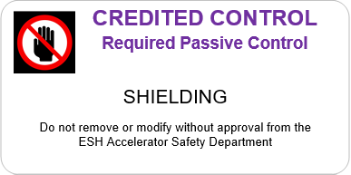
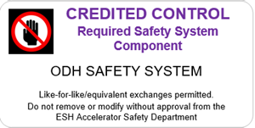
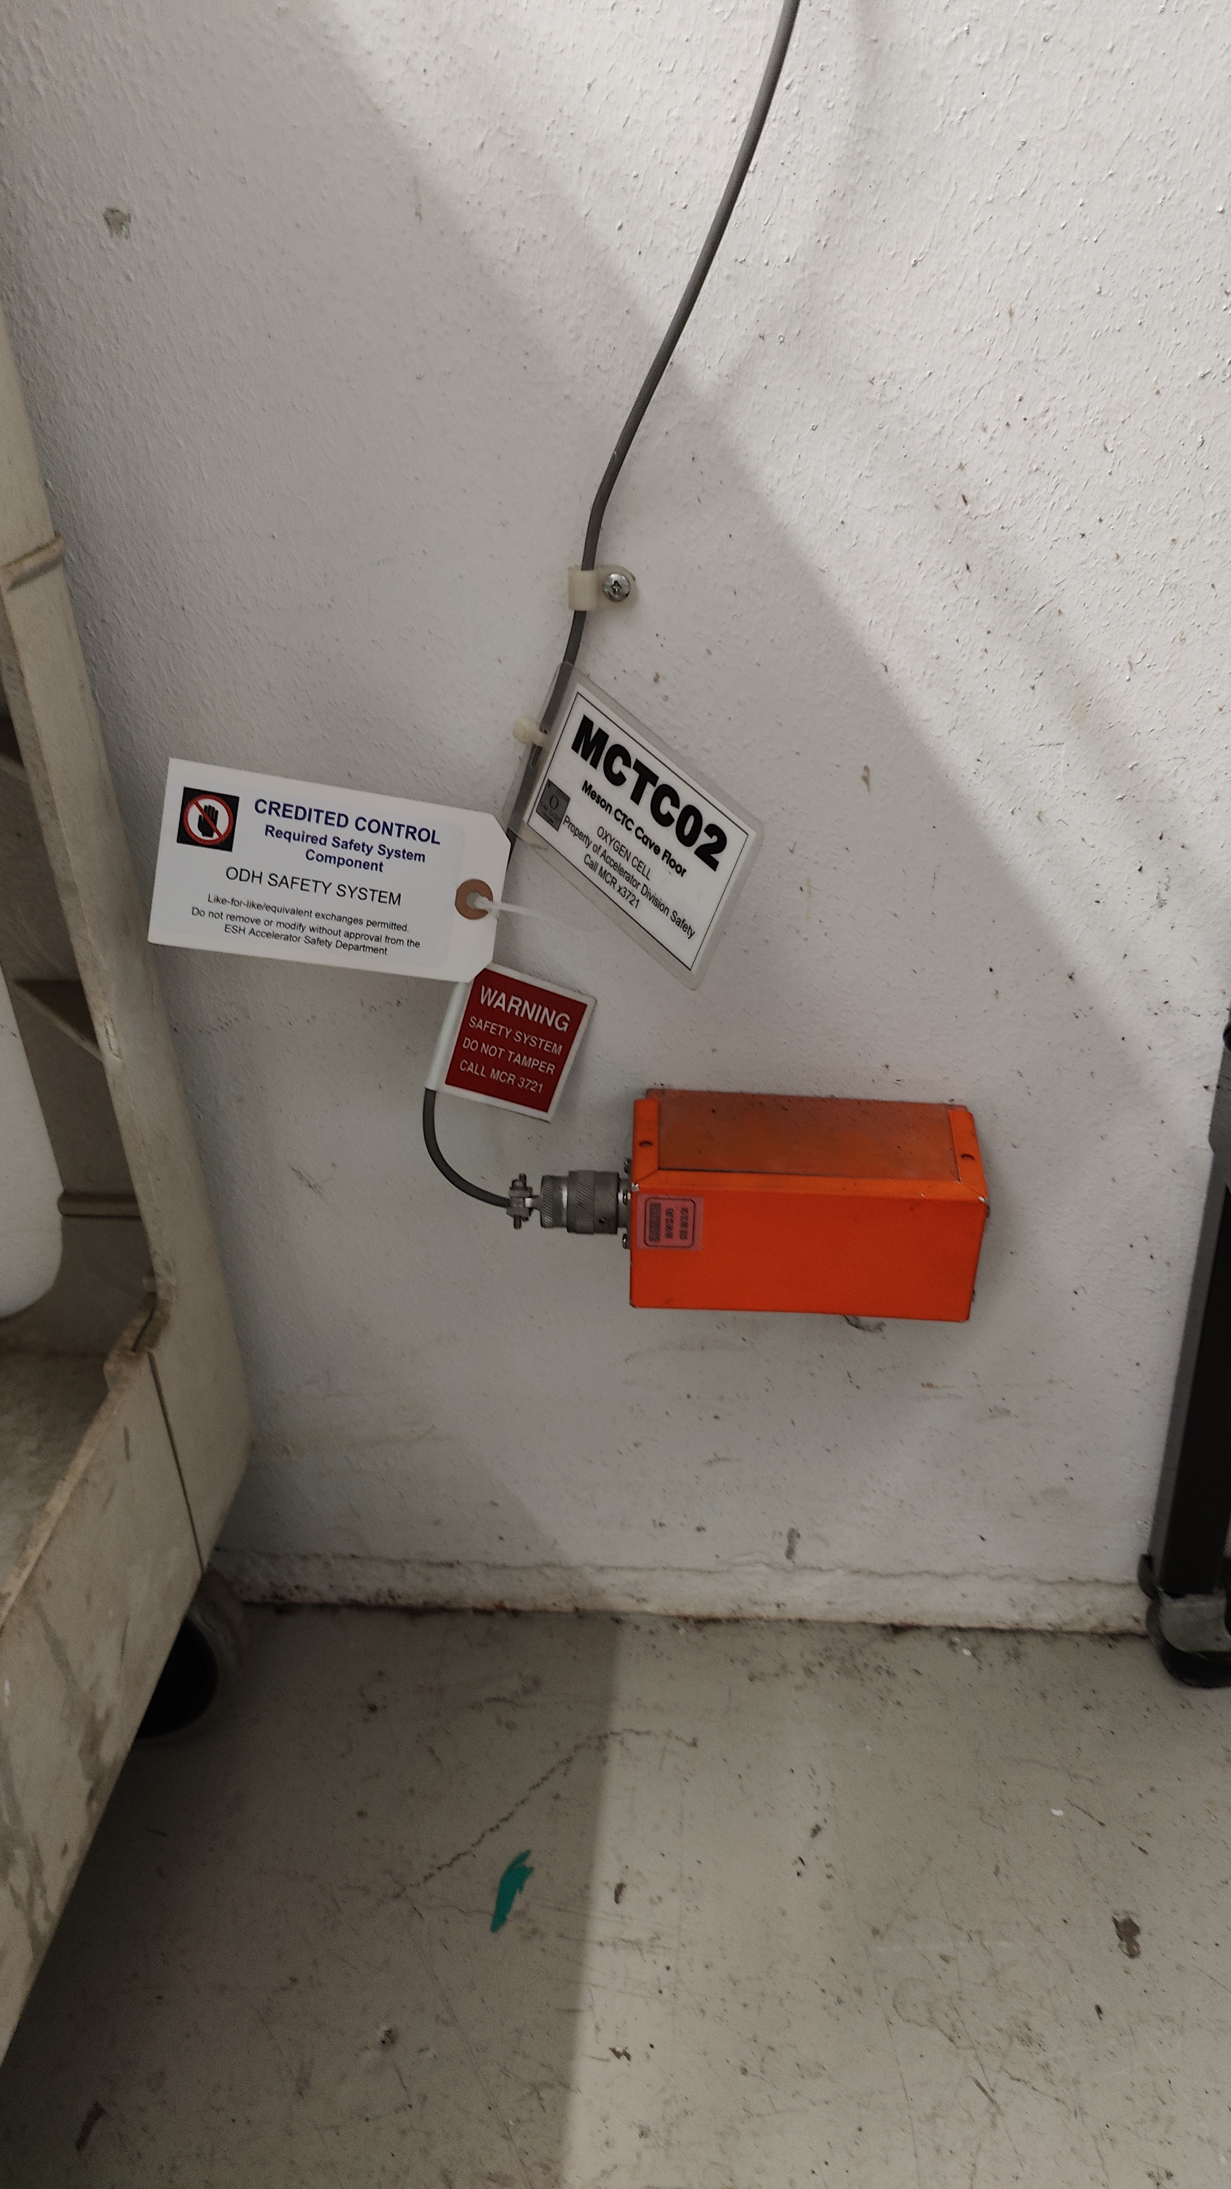
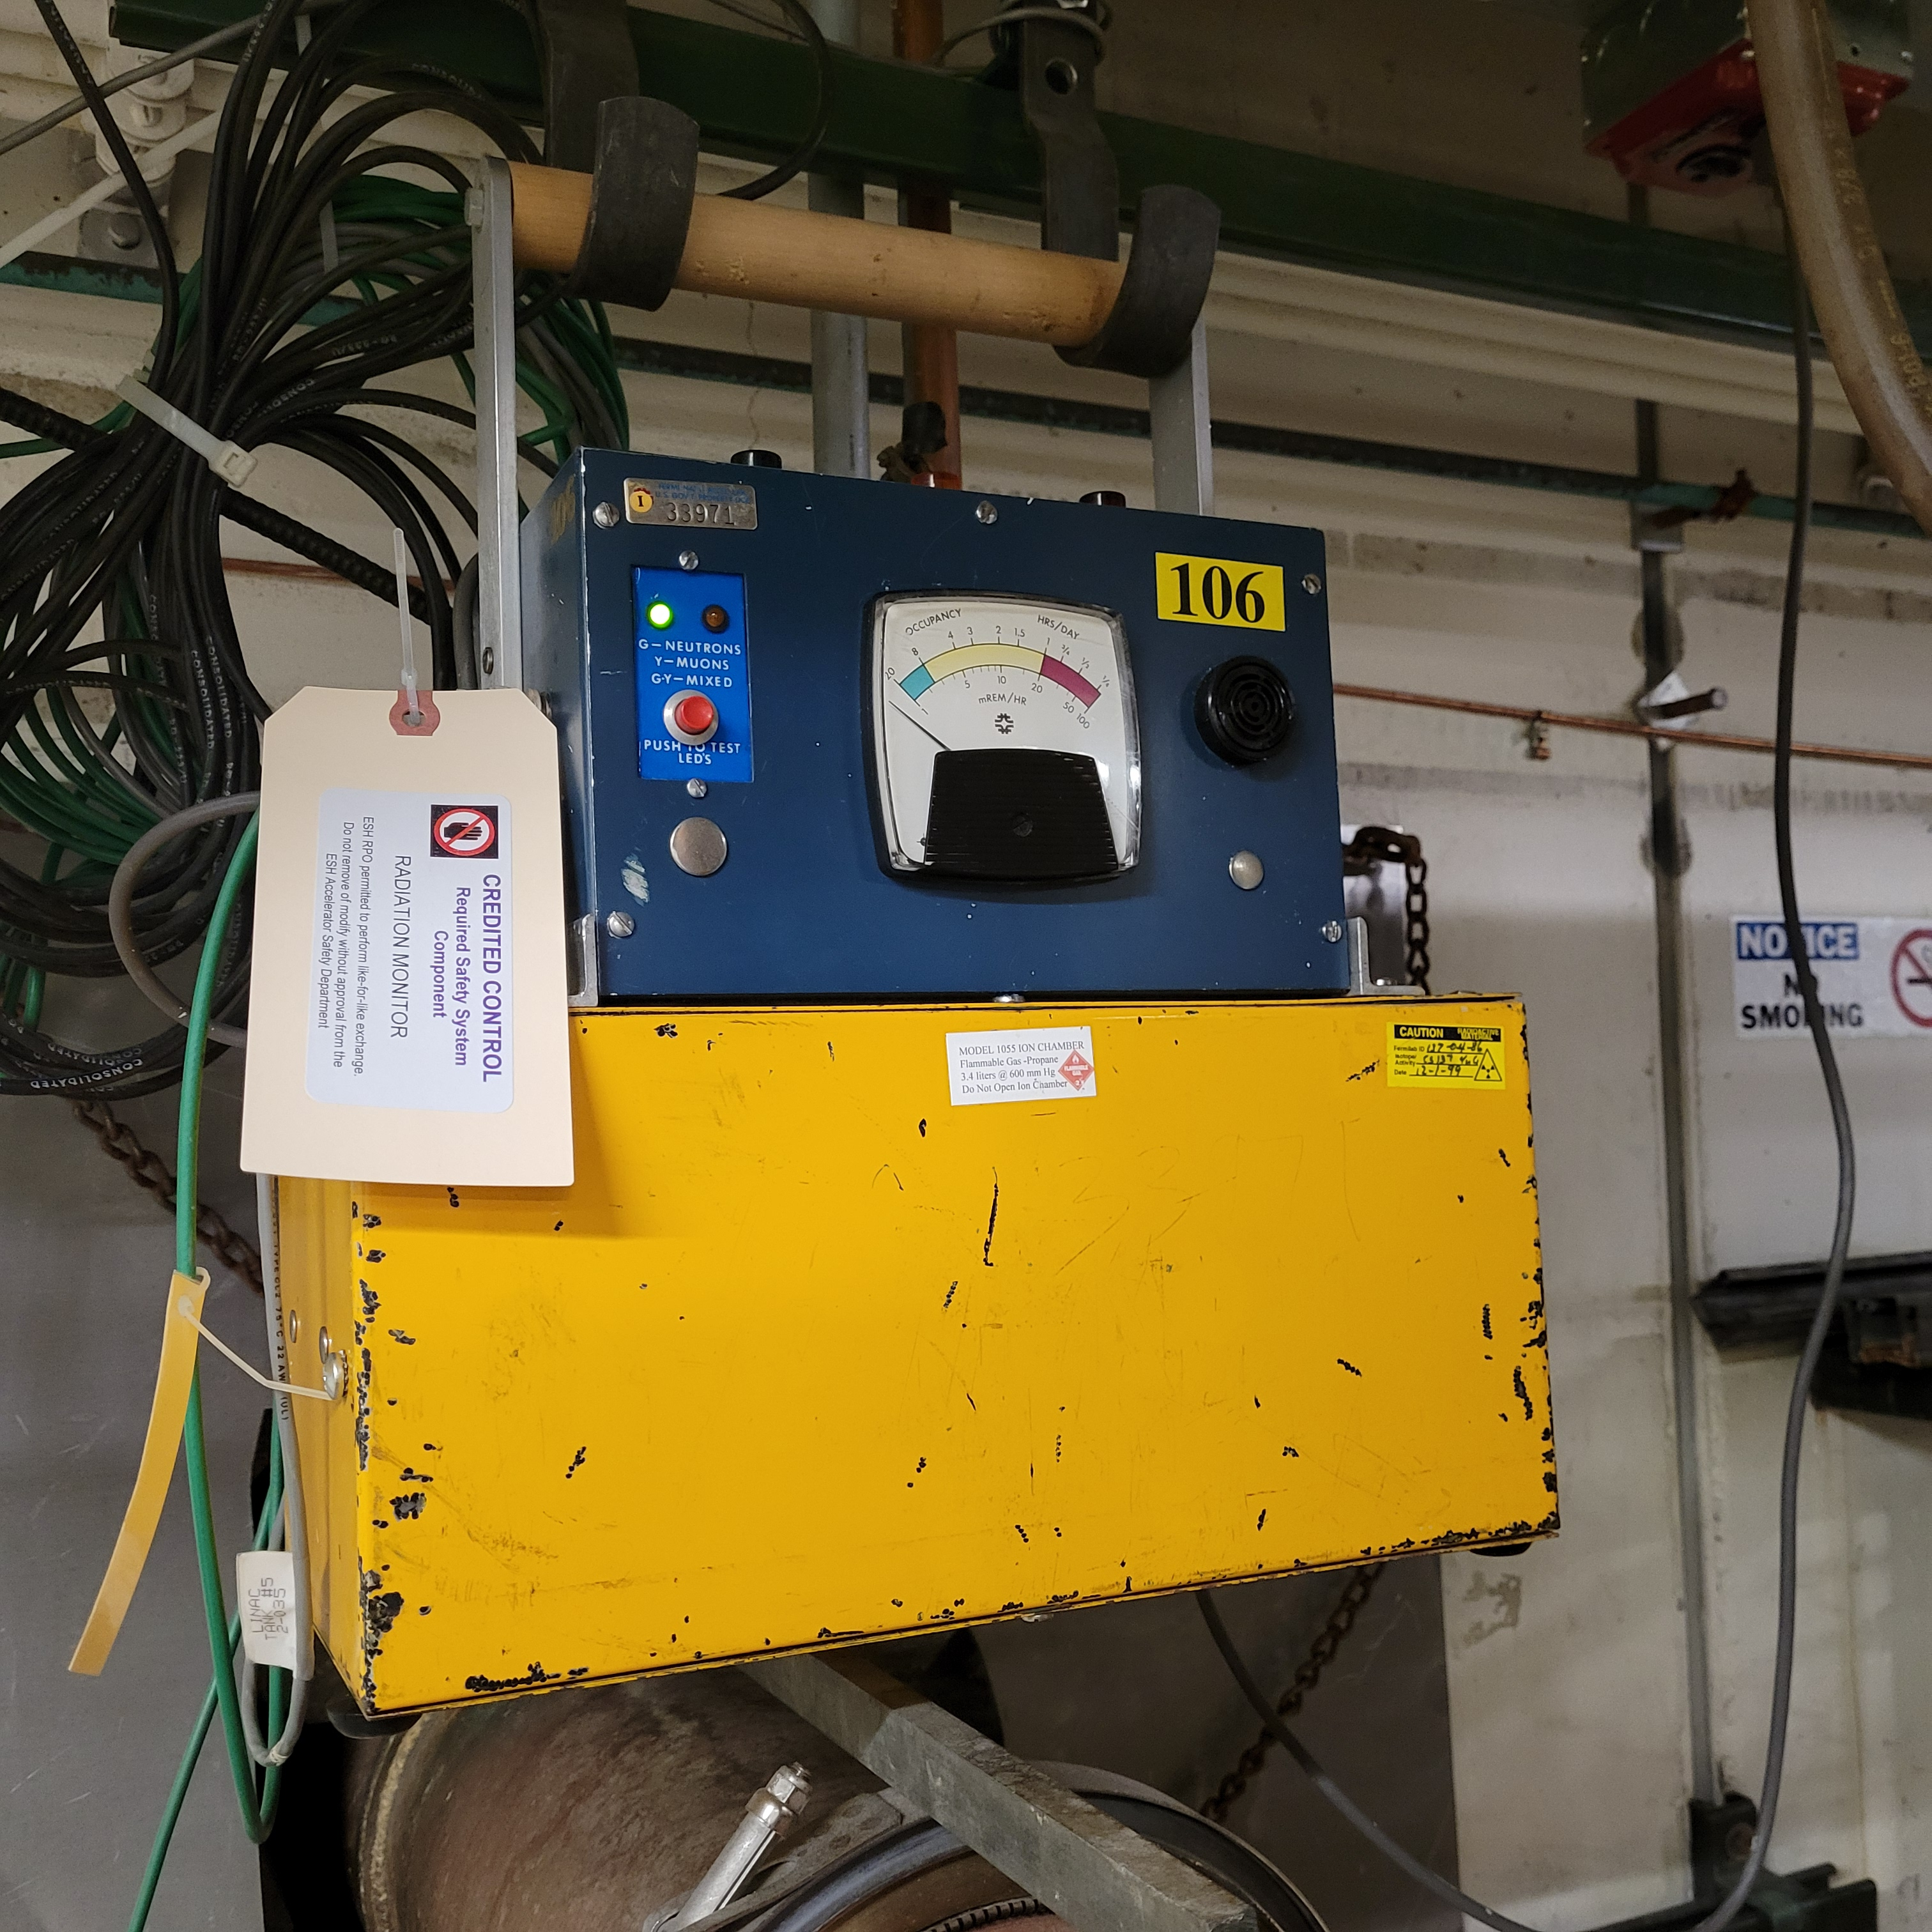
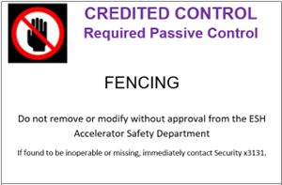
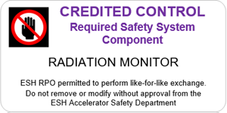
Configuration Management
Credited Control labels on:
Movable and Penetration Shielding
Radiation Monitors
ODH
ESH ASD maintains repository of labels for Machine Owners to apply and maintain appropriate labeling of their Credited Controls
STC O2 monitor, low
Radiation Monitor - Chipmunk

Slide 52
Configuration Management
Assigned RSO responsible for ensuring affected accelerator locked off in a safe state using RSO Configuration Control locks when prompt-ionizing radiation related Credited Controls are removed/affected
RSO confirms Credited Control is back in place prior to removing RSO Configuration Control lock.
RSOs utilize Configuration Control Log to track placing affected accelerator, in a Configuration Controlled off state
DSOs and Cryo SMEs managed Configuration Control for ODH-related Credited Controls
Ensure ODH Safety System in place per FESHM requirement and ODH analysis

Slide 53
ASE Violation Determination And Actions

Slide 54
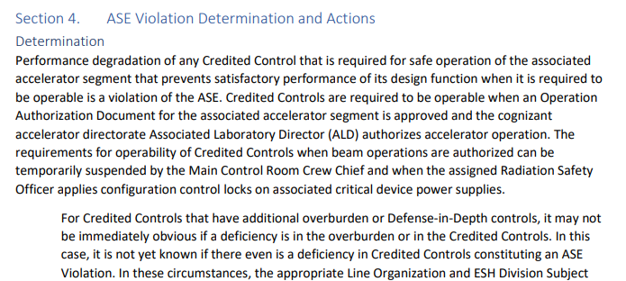
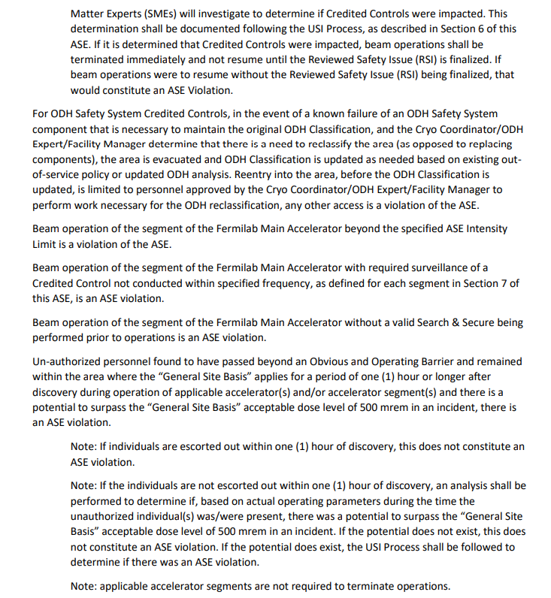
Accelerator Safety Envelope
ASE Section 4 specifically addressing “ASE Violation Determination and Actions” lists conditions which would be violation of the ASE
Accelerator operation with known loss of Credited Control and/or safety function of the CC
Accelerator operation beyond specified intensity limit
Accelerator operation with required surveillance of CC not conducted within specified frequency

Slide 55
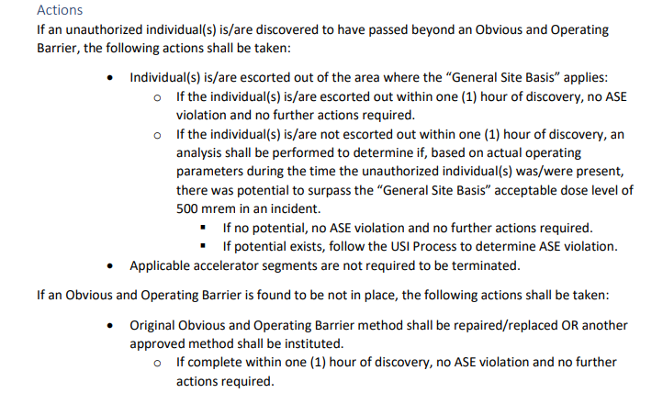
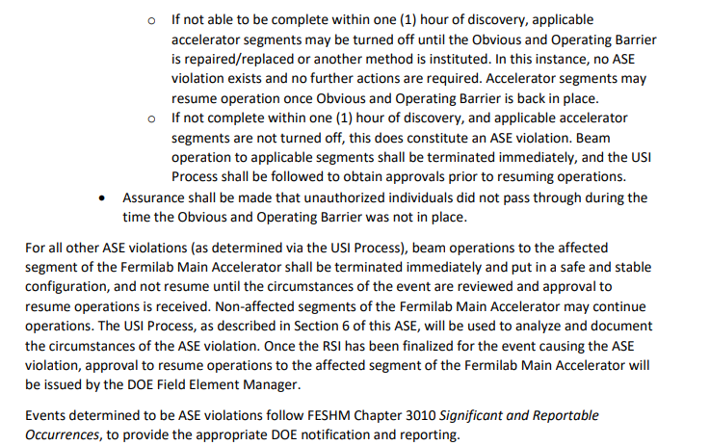
Accelerator Safety Envelope
ASE Section 4 also discusses actions to be taken in the event of an ASE Violation.
ASE Violations determined through the USI Process
Accelerator operations terminated immediately
Approval to resume operations will be issued by FSO Manager
After consultation with AD ALD, CSO and Lab Director

Slide 56
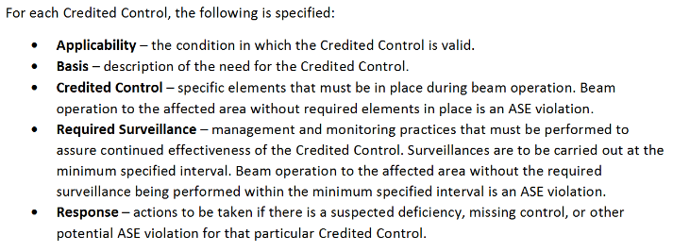
Accelerator Safety Envelope
ASE Section 3 includes description of information that will be specified for each Credited Control for each accelerator.
ASE Section 7 includes summary of all Credited Controls for each accelerator.
Each accelerator includes “Response” for potential ASE violations.

Slide 57
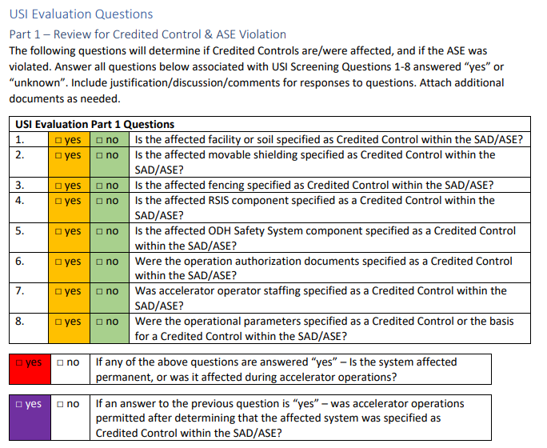
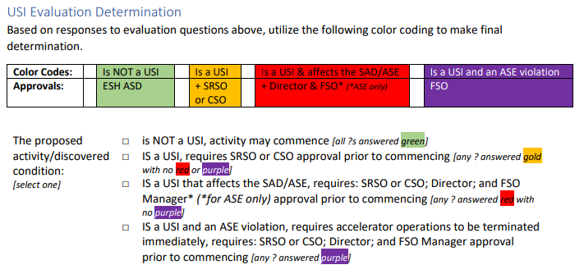
Unreviewed Safety Issue Program
USI Evaluation Form has specific questions to determine if proposed activity/discovered condition constitutes an ASE violation
Color-coded to ensure appropriate determination and necessary approvals

Slide 58
Unreviewed Safety Issue Program
USI Program specifies notification requirements for ASE violations
Machine Owner immediately notifies operators of violation, requests that accelerator operations to the affected accelerator, be suspended immediately and put in a safe and stable condition
ESH ASD Head immediately notifies SRSO, CSO, affected ALD, COO, CRO and Director of ASE violation
ESH ASD Head immediately notifies FSO Facility Representative and FSO Site Office Manager of the ASE Violation
More information on USI Process in USI Overview Presentation

Slide 59
Questions?

