Slide 1
Operations Department Training and Procedures
Kelli Rubrecht
DOE O 420.2D Phased Reviews: ARR #1 – Fermilab Main Accelerator
March 19-21, 2024

Slide 2
Outline
Operations Department Overview
Operator Training
Lab-wide Training
Op1 On-The-Job Training (OJT)
Tracking
Procedures
Types
Training and Tracking
Questions

Slide 3
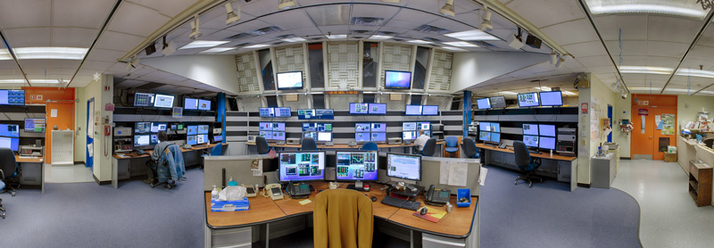
Operations Department Overview
Occupy Main Control Room (MCR) 24/7/365
5 Crews and 5 Crew Chiefs working rotating shifts
Crews range from 3 to 5 Operators (Op1’s and Op2’s)
Operations Specialists, Duty Assistant, Duty Admin, Department Head and Deputy Head
The Fermilab Main Control Room

Slide 4
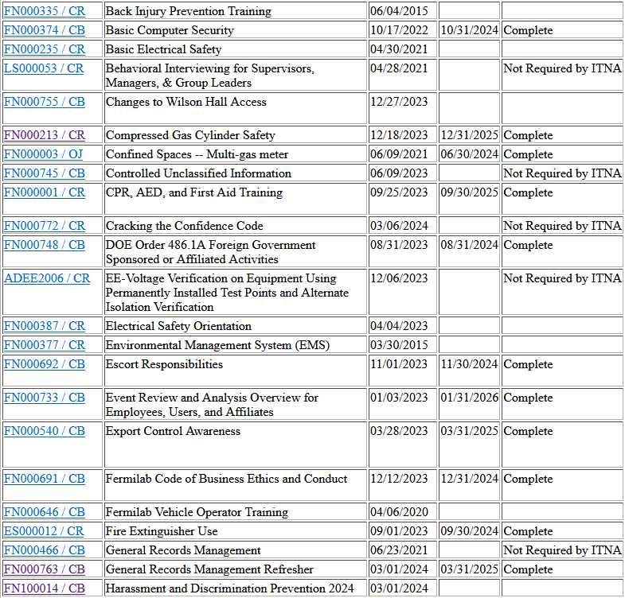
Operator Training – Lab-Wide
LOTO, Confined Space, CPR, NFPA 70E, Radiological Worker, Controlled Access, etc…
Retraining every 1-2 years as determined by the lab
Qualification Tests/Knowledge Checks
TRAIN Database to track and access lab-wide training
Sample Page from an employee’s lab-wide training tracked in TRAIN

Slide 5
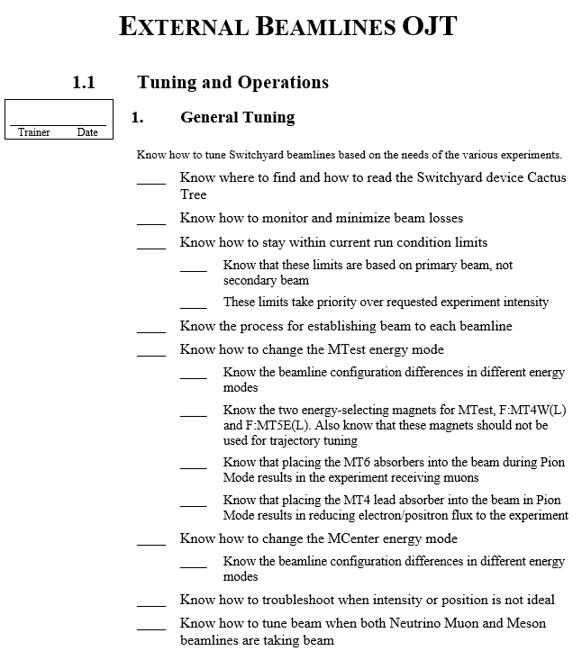
Operator Training – OJT
Introductory OJT
Written test before advancing
Proton Source, Main Injector/Recycler, External Beams, Muon Campus, Controls, and Safety OJTs
Specialists “Walkarounds” and written tests before completing the program
2-3 years on average to complete and go from Op1 to Op2
Sample page from External Beamlines OJT showing training topics, trainer signature requirement

Slide 6
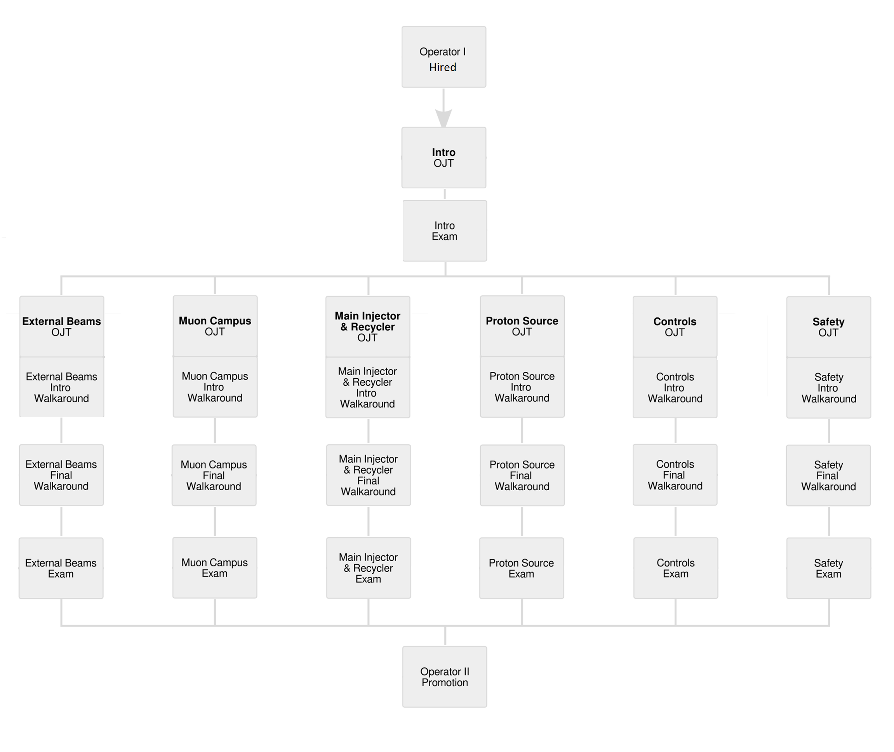
Operator Training – OJT
Op2 Promotion Requirements

Slide 7
Operator Training – Tracking
Lab-wide training tracked in TRAIN
Automatic email reminders ahead of expiration, most training offered online
Op1 OJT’s training tracked in Sharepoint spreadsheet
The bulk of an Op’s first few years, periodic check-ins throughout the year
Excerpt From Op2 Training Tracking Spreadsheet

Slide 8
Operator Training – Training Committee
Consists of Op2’s and higher
Write, update, and maintain OJT’s, written tests, other training material
Collaborate with Ops Specialists, support department and accelerator segment experts
Department Head/Deputy kept aware of Training Committee activities, gives final approval for training material

Slide 9
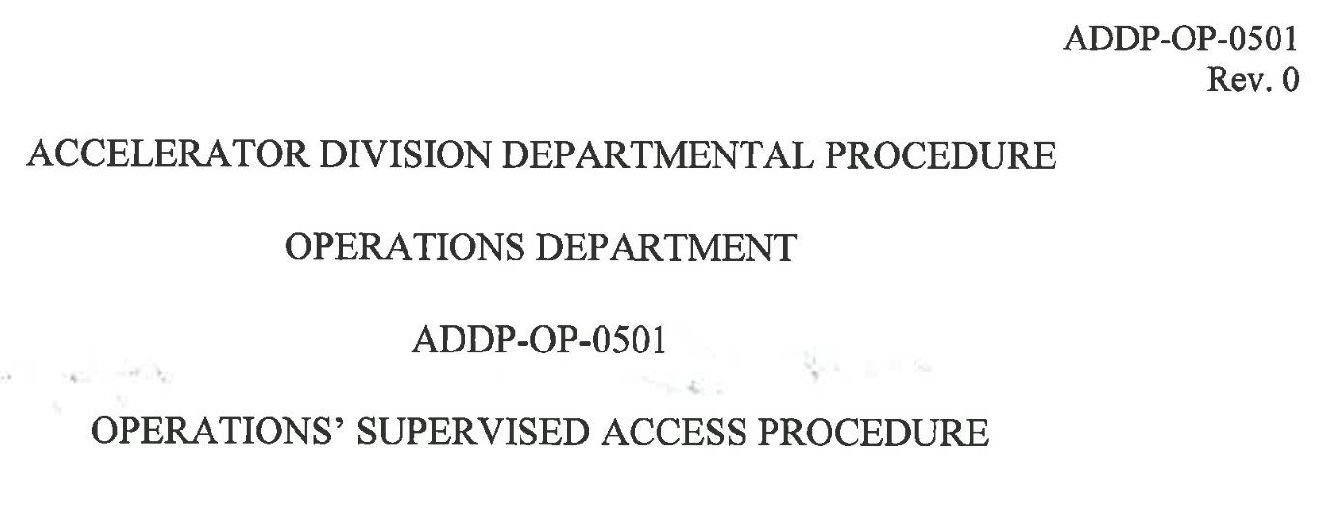
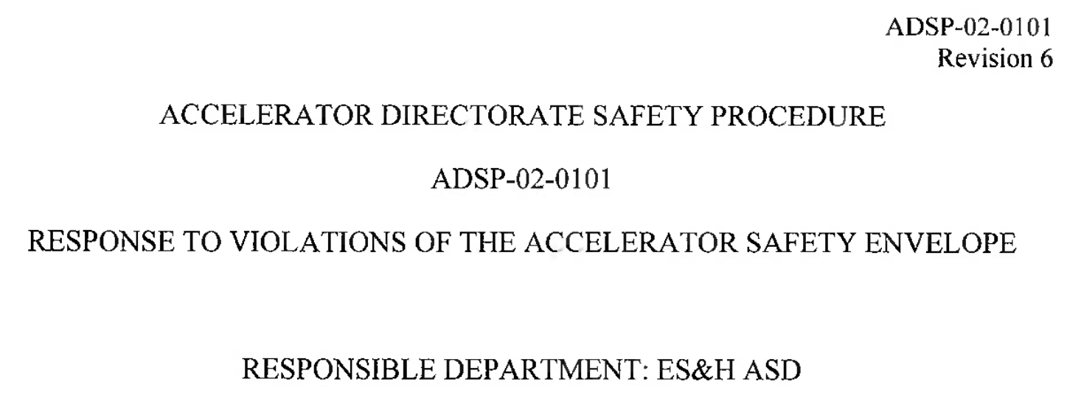
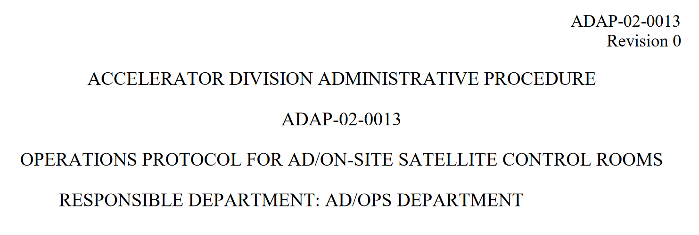
Operator Procedures
Directorate Procedures
ADAP’s, ADSP’s, PPD procedures
LOTO, control room interfacing, response to ASE violations, etc
Department Procedures (ADDP’s)
S&S, Emergency Response, Supervised Access
Proton Source, Power Electronics Systems
Tracked in Required Reading, moving to TRAIN
Excerpt from an ADDP
Excerpt from an ADSP
Excerpt from an ADAP

Slide 10
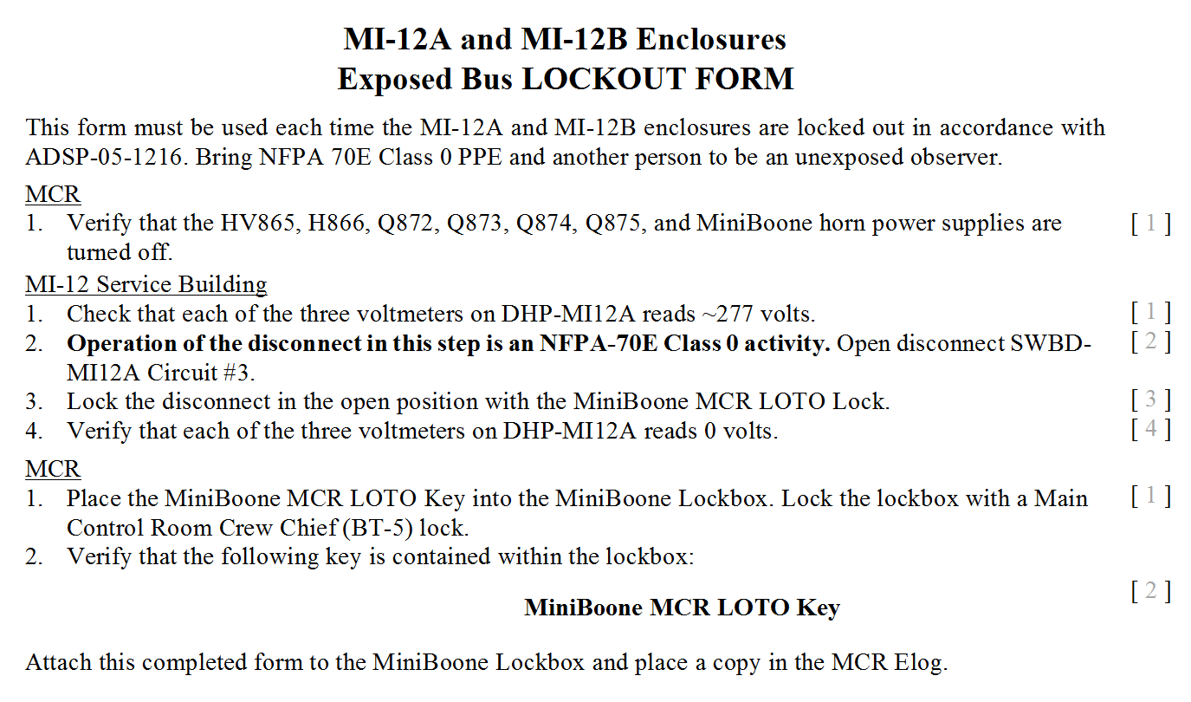
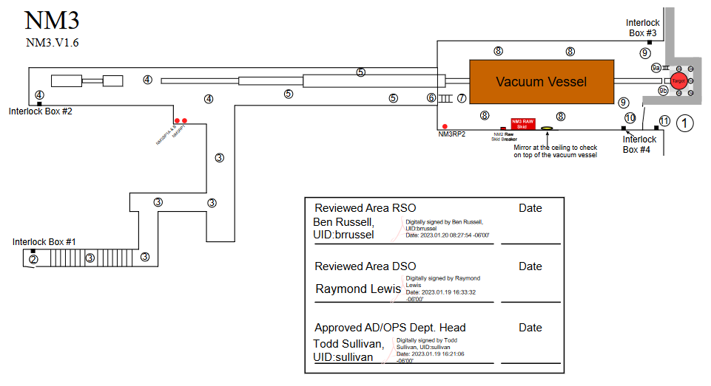
Operator Procedures – LOTO
Participate Lead Department Head signoff
Yearly re-certification per FESHM
Tracked in written binders in MCR
Example LOTO checklist
Operator Procedures – S&S
Participate Lead Department Head signoff
Tracked in written binders in MCR
Example S&S procedure

Slide 11
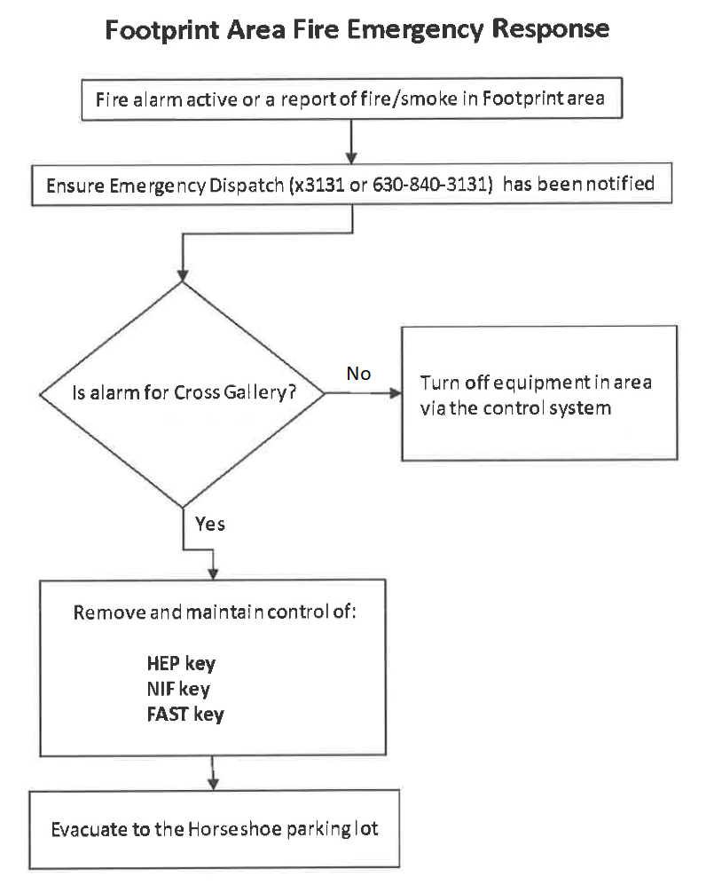
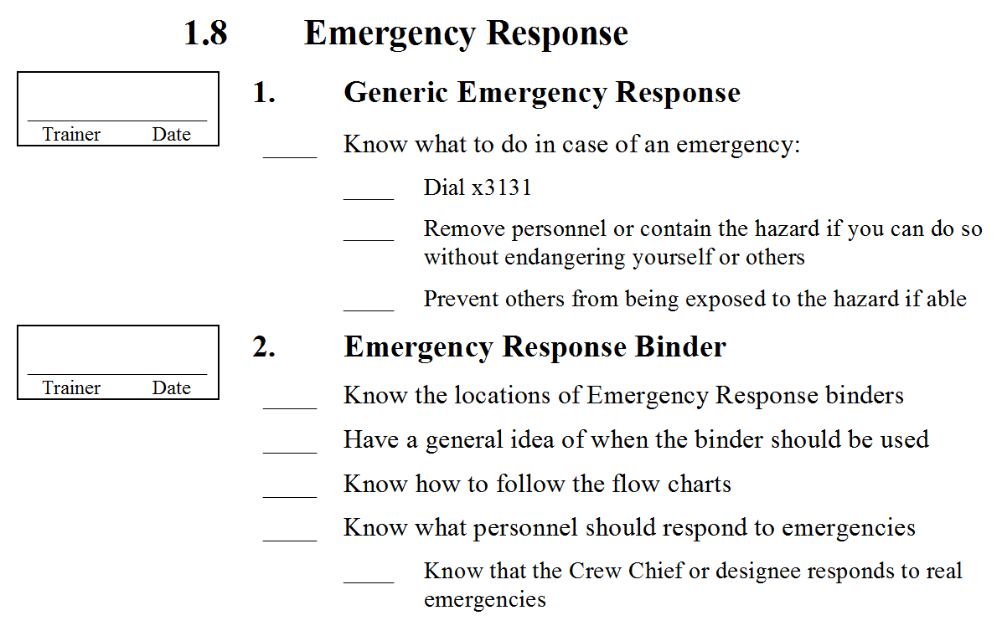
Operator Procedures – ERP’s
Main purpose is to assist the emergency responders as requested
Any evacuation of MCR results in beam-off
Like all Procedures, contents are reiterated in OJT’s
Example ERP flowchart
Excerpt from Safety OJT

Slide 12
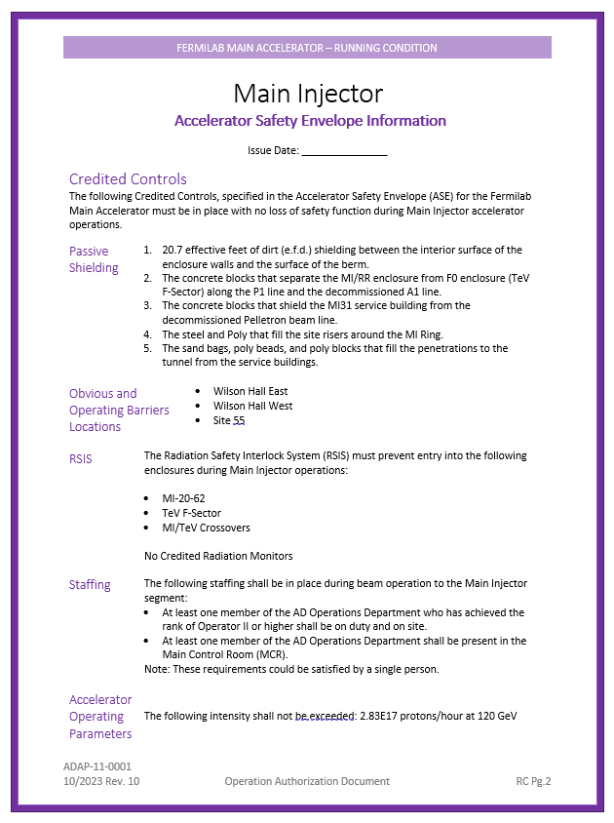
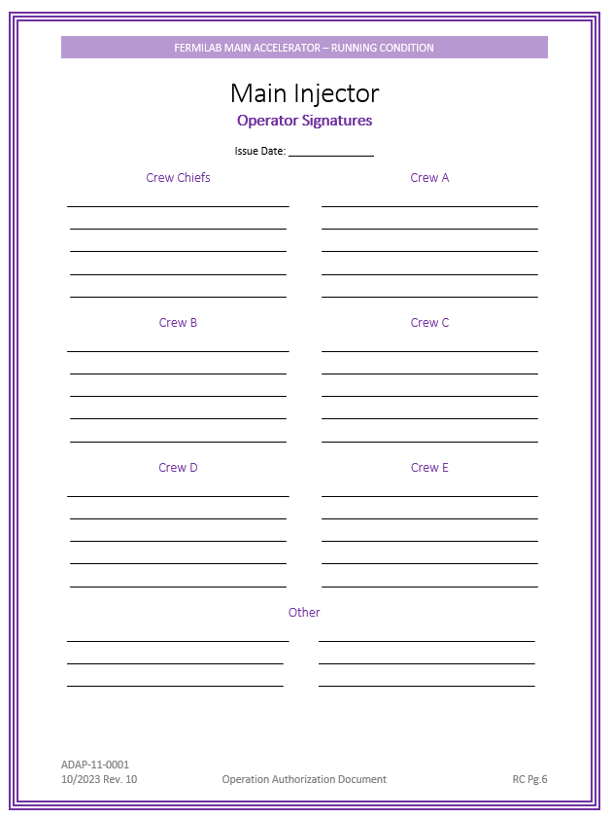
Beam Permits and Running Conditions
Signed Beam Permits and Running Conditions (Operation Authorization Documents) kept physically in MCR
Ops read and sign each document
Relays ASE requirements directly to the MCR
Excerpts from the Main Injector Running Conditions

Slide 13
Questions?

