Slide 1
Contractor Assurance System
Martha Michels, Director, Office of Contractor Assurance
DOE O 420.2D Phased Reviews: ARR #1 – Fermilab Main Accelerator
March 19-21, 2024

Slide 2
Outline
Overview of CAS at Fermilab and the organization
Crosswalk of the CRD program elements
CRD Program Element 2.c
Program elements must be periodically (interval not to exceed five years) reviewed and updated, as appropriate. The contractor must ensure the Contractor Assurance System includes processes to review the contractor accelerator safety program elements listed in this CRD.
CRD Program Element 2.g.(1)
As part of the ARR process, the contractor must demonstrate to the satisfaction of the DOE Field Element Manager that an appropriately comprehensive and independent ARR has been conducted, identified pre-start issues have been resolved, commissioning activities required for safe operations have been completed as appropriate, and the following processes are in place: … A Contractor Assurance System that maintains an internal assessment process.
Summary

Slide 3
Contractor Assurance System
CAS is a set of integrated processes, activities, and requirements systems that are used to provide reasonable assurance to ourselves and DOE that Lab management is executing the Lab's strategy, meeting contract requirements safely and efficiently, and effectively managing risk.
Contractor Assurance requirements are implemented via the Requirements Assurance Systems (RAS) and the Fermilab CAS Program Description (approved in November 2023).
ESH RAS and QA RAS describes the policies and processes to assure compliance with ESH and QA related requirements.

Slide 4
Quality Assurance Program
The Fermilab QA Program is a critical component of the Laboratory’s Contractor Assurance System.
Accelerator Division (AD) line management is responsible for ensuring compliance to the QA Program requirements in their areas of responsibility.
A member of the QA group is assigned as the QA Liaison for AD line management and their teams. They are responsible for providing awareness of QA requirements and supporting the integration of those requirements in the programs and processes.
The implementation of the QA Program in Accelerator Operations is done via procedures and training that ensure compliance to the SAD and other applicable requirements.
Independent and Management Assessments are identified to verify compliance and identify opportunities for improvement or best practices and submitted to the lab’s Integrated Assessment Plan (IAP).

Slide 5
OCA Organization
CAS elevated in the organization and resources provided.

Slide 6
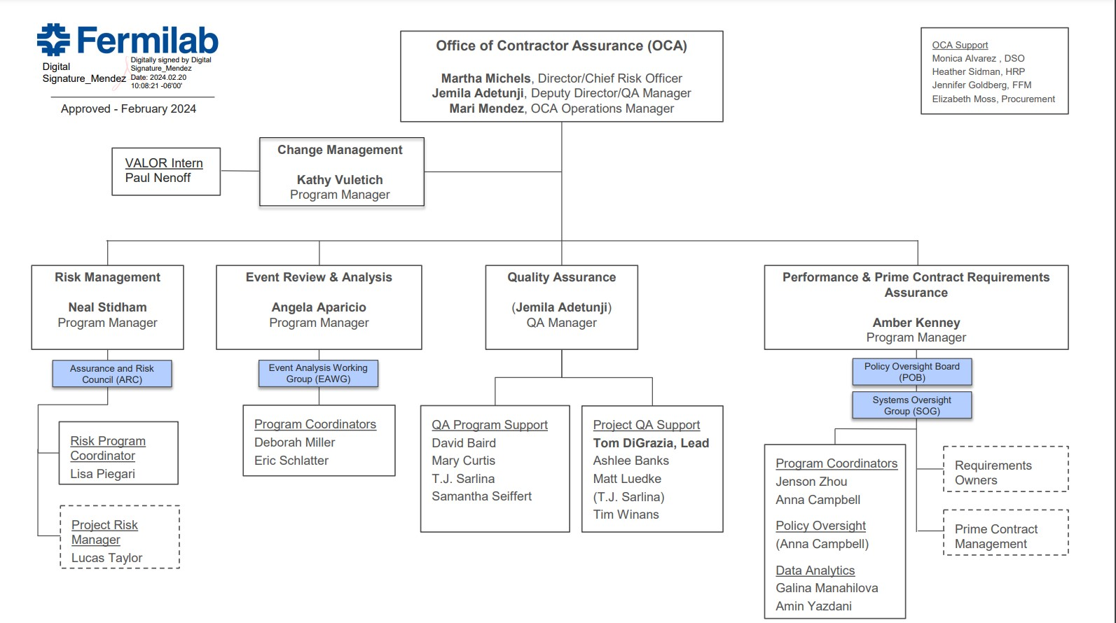
OCA Organization
QA sits within the OCA and the QA Manager is part of the leadership.

Slide 7
CRD Program Element 2.c
ESH RAS describes the policies and processes to assure compliance with ESH-related requirements.
Fermilab Environment, Safety and Health Manual (FESHM) chapters details specific processes and procedures to meet requirements. FESHM Chapter 2010, Planning and Review of Accelerator Facilities and Their Operations, details formal review procedures to assure compliance with DOE O 420.2.
A new section was added to FESHM 2010, ASO Compliance Assurance, describing the types of regular reviews to conduct on the accelerator safety program elements to meet this requirement The descriptions include frequency of reviews and review scope (e.g., process or system being reviewed). Scheduled reviews are formally tracked in the Assessment database.
Quality RAS describes policies and programs to assure compliance with Quality-related requirements.
The Fermilab Assessment Program provides the process and tools to support and manage assessments.

Slide 8
CRD Program Elements 2.g.(1)
As part of the ARR process, the contractor must demonstrate to the satisfaction of the DOE Field Element Manager that an appropriately comprehensive and independent ARR has been conducted, identified pre-start issues have been resolved, commissioning activities required for safe operations have been completed as appropriate, and the following processes are in place: … A Contractor Assurance System that maintains an internal assessment process;
ESH RAS Description
ARR listed as a type of assessment conducted that provides reasonable assurance that requirements are being met.
Quality RAS Description
Fermilab Assessment Program provides guidance on the assessment process and a database to capture key information. An annual Integrated Assessment Plan (IAP) is part of the program.
IAP aggregates proposed assessments from across the lab and tracks their progress.
Enterprise-IAP is a select subset of IAP assessments monitored regularly by the Systems Oversight Group.
scheduled ARRs are reflected on the E-IAP.
Issues Management database is the resource to manage issues and track responses through to resolution.
Further integrated ARRs in the program by including it as a Review category option under Review Category Groups External Reviews and Internal Laboratory Activities.

Slide 9
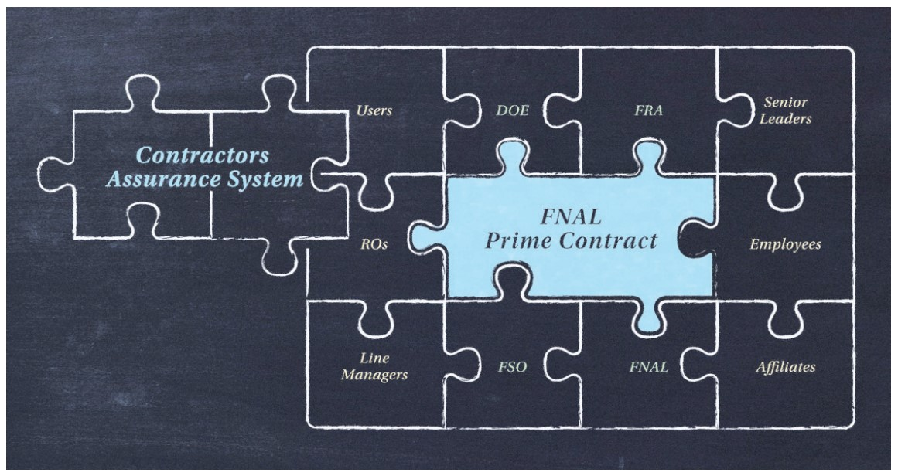
Summary
We have an approved, compliant Contractor Assurance System that we are continually improving.
We have an organization that leverages the skills across all the CAS elements, including QA.
The CAS requirements in DOE O420.2D are in place and strong.
Fermilab schedules management assessments to ensure program elements of DOE O 420.2D are being met (assessments tracked via the IAP and Issues Management processes).

Slide 10
Questions?

