Slide 1
Unreviewed Safety Issue (USI) Program
Jessica Malo
DOE O 420.2D Phased Reviews: ARR #1 – Fermilab Main Accelerator
March 19-21, 2024

Slide 2
Outline
USI Program Updates
USI Program Flowchart
USI Program Steps
Screening
Evaluation & Determination
Records
USI Program Review & Approvals
USI Program Status

Slide 3
USI Program Updates
Program updated to meet new requirements in DOE O 420.2D CRD §2.f.
Inclusion of step in the process to have issues become Reviewed Safety Issues (RSIs) upon the completion of appropriate USI review.
Incorporation of DOE Field Element Manager approval
Additional updates
Initial updated incorrectly allowed for use of Compensatory Measures via the USI process, which has since been removed (addressing several comments/recommendations)
Split the USI process into (1a) USI Screening Proposed Activity, (2a) USI Screening Discovered Condition, and (2) USI Evaluation phases. New Forms with questions for each phase.
Included a flowchart to outline the process

Slide 4
USI Program Flowchart

Slide 5
USI Program Overview
USI Program implemented for all Fermilab accelerators
Provides standard approach for reviewing USIs
USI Program required to “evaluate if accelerator specific hazards associated with a proposed activity or discovered condition are adequately addressed by the current SAD and approved ASE.”
Fermilab SAD evaluates accelerator specific hazards to ensure they are maintained at an acceptable level of risk (category III or IV).
If a proposed activity or discovered condition changes level of risk to an unacceptable level of risk (category I or II), that would constitute a condition not previously evaluated and/or addressed in the SAD.
Therefore, USI Process utilized when there is a reasonable chance that an issue could affect the risk of an accident from that evaluated in the SAD

Slide 6
USI Program Overview
Two types of categories, with examples:
Proposed Activities
New accelerators, segments, experimental areas
Modifications to existing accelerators, segments, experimental areas
Modifications to existing modes or parameters
Planned excavation near accelerator enclosure
Decommissioning activities
Discovered Conditions
Discovery of modification to accelerator, segment, experimental area with hazards beyond those evaluated in SAD or ASE
Discovery of modification to mode and/or parameter that have potential to introduce new accelerator specific hazard or increase consequence of previously evaluated hazard
Discovery of failed or missing Credited Control

Slide 7
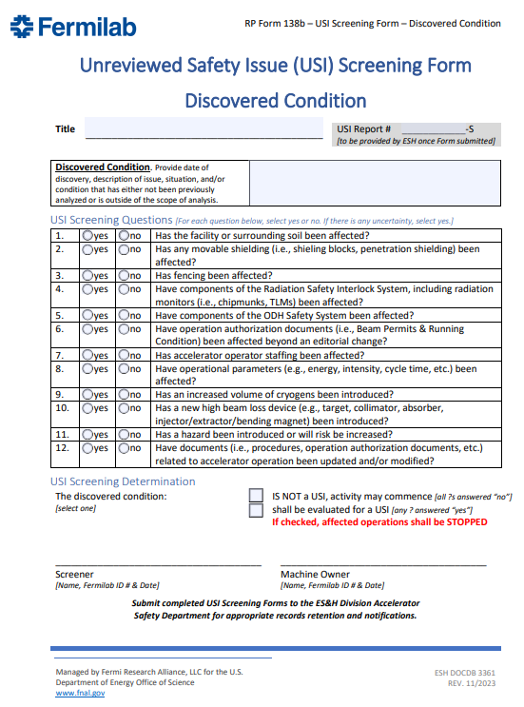
USI Program Steps
1. Screening
Performed by a Screener
Screeners – members of ESH Division, accelerator operations, accelerator Machine Owners and line management who has received USI Screening training
Uses USI Screening Form
Different forms for Proposed Activity and Discovered Condition
Answer series of questions to determine if proposed activity or discovered condition should be formally evaluated using USI Evaluation Process
Possible Outcomes: is not a USI, or shall be evaluated for a USI
If discovered condition determined to need USI Evaluation, affected accelerator operations is terminated
USI Screening Form signed by Screener and Machine Owner, submitted to ESH Accelerator Safety Dept for records retention

Slide 8
USI Program Steps
2. Evaluation & Determination
Completed by the Machine Owner and the ESH Accelerator Safety Department
USI Evaluation Form used as deemed necessary by USI Screening Form
Asks a series of more detailed questions related to question in the USI Screening Form
Determines if proposed activity is or is not a USI, and what levels of approvals are necessary for USIs
Color coded for ease of determination

Slide 9
USI Program Steps
2. Evaluation & Determination
Possible outcomes:
Not a USI
Is a USI
Is a USI that affects the SAD or ASE
Is a USI and ASE violation
Form includes space to identify actions for USIs

Slide 10
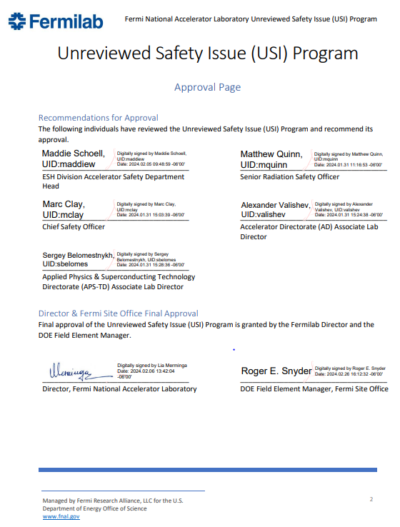
USI Program Steps
2. Evaluation & Determination
Approvals
All issues: Machine Owner and ESH Accelerator Safety Dept Head
All Issues Determined to be USIs: SRSO or CSO
All Issues that affect SAD: Director
All Issues that affect the ASE: Director and FSO Manager
All Issues found to have violated the ASE: FSO Manager
Submitted to ESH Accelerator Safety Department for records retention

Slide 11
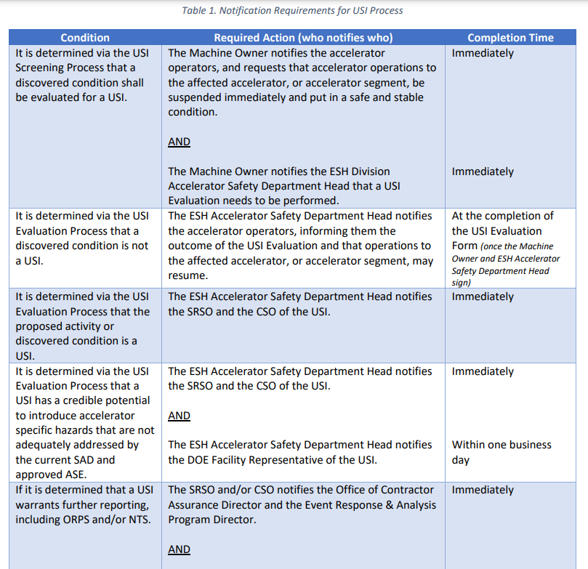
USI Program Steps
2. Evaluation & Determination
Notification occur throughout the Evaluation & Determination Step
Table 1 of USI Program dictates notification requirements, including:
Condition
Required Action (who notifies who)
May have multiple actions
Completion Time

Slide 12
USI Program Steps
3. Records
All completed USI Screening and USI Evaluation Forms are submitted to the ESH Division Accelerator Safety Department for records retention
Assigns USI report numbers
ESH Division shall maintain the completed forms and ensure records are retained for 75 years or the life of the facility
ESH Accelerator Safety Department submits electronic copies of all USI Evaluation Forms to the FSO Facility Representative

Slide 13
USI Program Review and Approvals
Recommendation for approval from Division Management who operate accelerators along with ESH Management.
ESH Division Accelerator Safety Dept. Head
Senior Radiation Safety Officer
Chief Safety Officer
Accelerator Directorate (AD) Associate Lab Director
Applied Physics & Superconducting Technology Directorate (APS-TD) Associate Lab Director
Final approval from
Fermilab Director
DOE Field Element Manager (Fermilab Site Office Manager)

Slide 14
USI Program Status
Completed an external peer review by one of the members of the August ARR, all comments and recommendations addressed (in the version available for this review)
Completed a pre-review with Fermilab Site Office, comments addressed (in the version available for this review)
Awaiting confirmation/acceptance of edits from FSO
USI Process Rev 0 approved 1/11/2024 with post-start recommendation
USI Process Rev 1 approved 2/26/2024
Currently in use, ~a dozen USIs screened/evaluated
Most completed/Reviewed Safety Issues (USIs)
Some in progress
OFIs identified and tracked (iTrack 63627)

