Slide 1
Accelerator Work Planning and Control
Jeremy Cantrell, Accelerator Directorate DSO and
Joel Fulgham ESH/RPO/ RSO Group Leader
DOE O 420.2D Phased Reviews: ARR #1 – Fermilab Main Accelerator
March 19-21, 2024

Slide 2
Outline
FESHM’s
AD Worklist (Work Tracking)
Radiation Safety Review
Work Planning and Control
  IMPACT- Integrated Management Planning and Control Tool

Slide 3
Fermilab Safety & Health Manuals (FESHM’s)
FESHM Chapter 2060 (Work Planning)
FESHM Chapter 7020 (Subcontractor other than Construction)

Slide 4
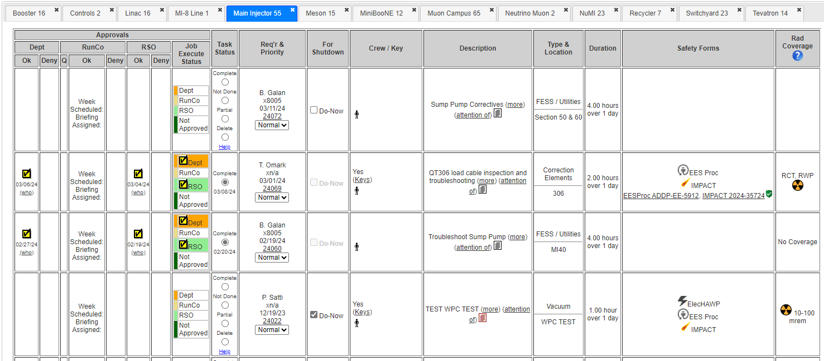
AD Worklist
Electronic Worklist
  Approve/Deny/Notify
Notes:
The Accelerator Directorate Worklist, is an AD centric process, which was used in the past to approve work and track where work was being performed within the AD complex.
This electronic worklist is still used by AD Operations and Machine Experts to Review and Approve work being performed in their areas, in conjunction with IMPACT which is used lab wide.

Slide 5
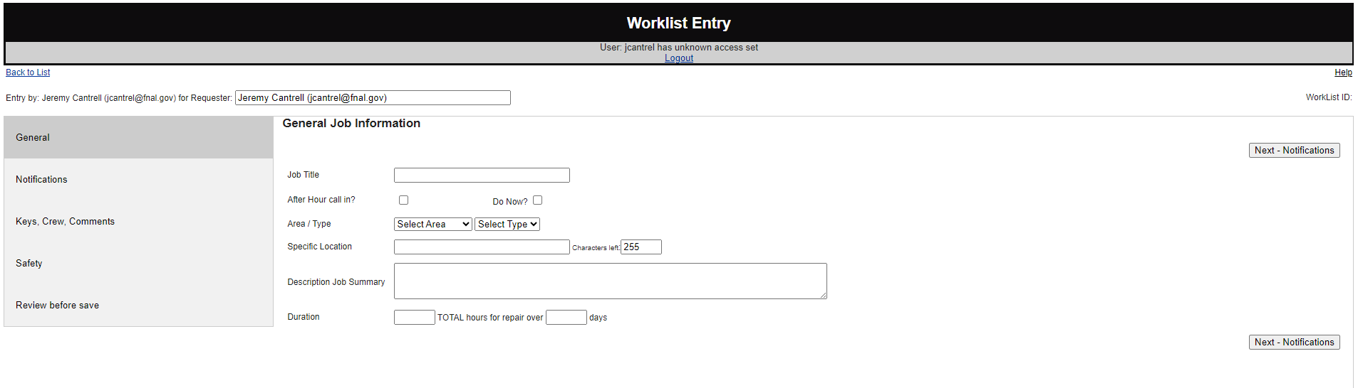
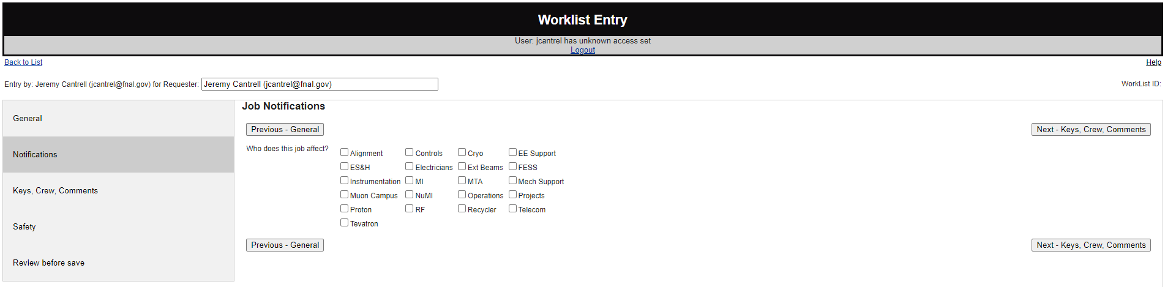
AD Worklist
Electronic Worklist Entry Form
Notes:
When someone wants to request to perform work in the AD complex, they start with the Worklist Entry Form.
On the first page the planner enters location, area, crew , and a job description.
On the Notification Page, the planner would click each radio button for the area that will be affected by this work.

Slide 6
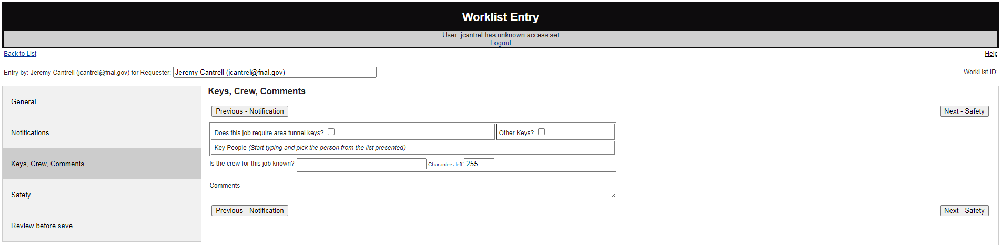
AD Worklist
Key Control
Notes:
The next two sections are Safety Sections for Key Control and a list of individuals entering the area.

Slide 7
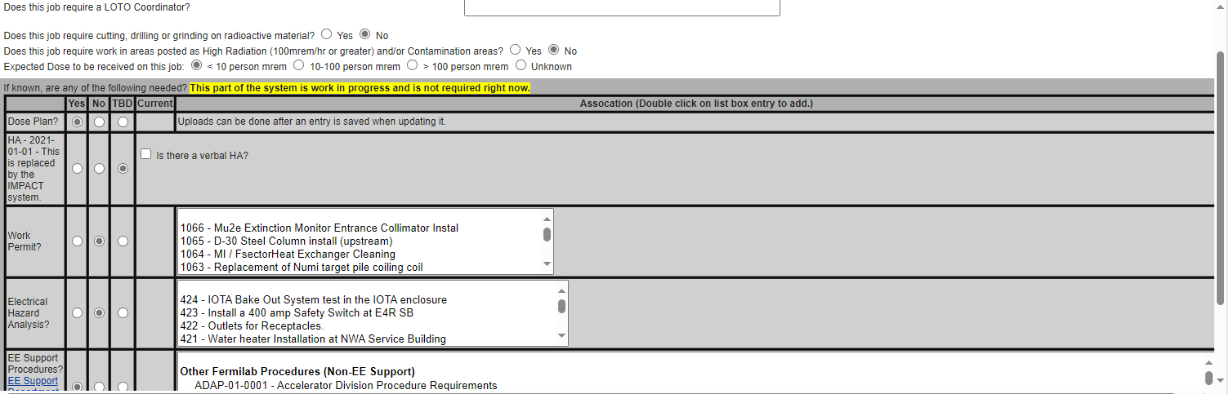
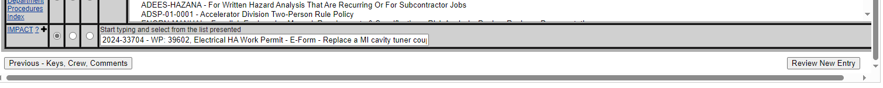
AD Worklist
General Hazard Review
Notes:
The next section is a General Hazard Review.
This section allows you to attach pertinent AD Procedures and link them to your IMPACT Work Packages.

Slide 8
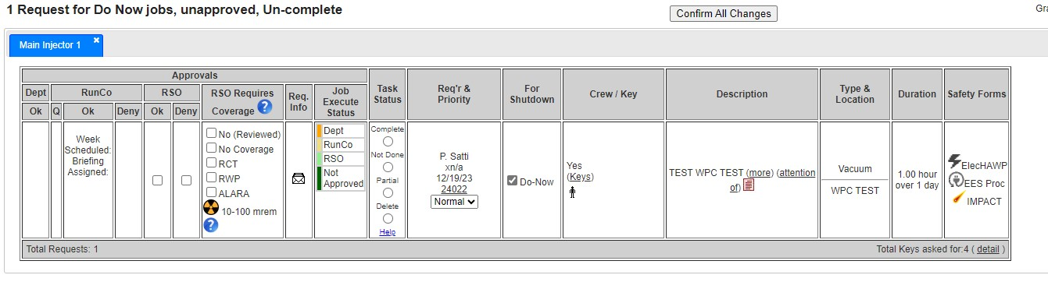
AD Worklist
Start of SME Reviews
Summary
Notes:
Once all the information is added and the request sent, notification and reviews start from all the affected areas you noted in the notifications section.

Slide 9
Work Planning
Radiation Safety Planning
  ALARA planner
JOB TITLE/NAME | Test test test test
Job-Specific RWP Number
IMPACT Number |  |  |  |  |  |  | Date:
AD Worklist Number
Other Worklist Number
Job Leader:
Assigned RCT:
Assigned RSO:
Instructions
filled out by job leader
may be filled out by job leader, RSO may update
only filled out by RSO
only filled out by RCT
Job Limits |  |  | Coverage Requirements
Job Estimate | 0 | mrem
Job Stop Limit | 0 | mrem
Individual Checkpoint | 100 | mrem
RSO Signature: |  |  |  |  | Date Finalized:

Slide 10
Work Planning
Radiation Safety Planning
  ALARA Assessment
    Task steps
    Details
Job Plan
Step | Action Item/Task | # of Exposed Workers | Estimated Time (min) | Detailed Work Location | Dose Rate (mR/hr) | Estimated Collective Dose (person-mrem) | Required PPE | Other Required Rad Controls | Actual Dose Received | Comments
1 |  |  |  |  |  | 0
2 |  |  |  |  |  | 0
3 |  |  |  |  |  | 0
4 |  |  |  |  |  | 0
5 |  |  |  |  |  | 0
6 |  |  |  |  |  | 0
7 |  |  |  |  |  | 0

Slide 11
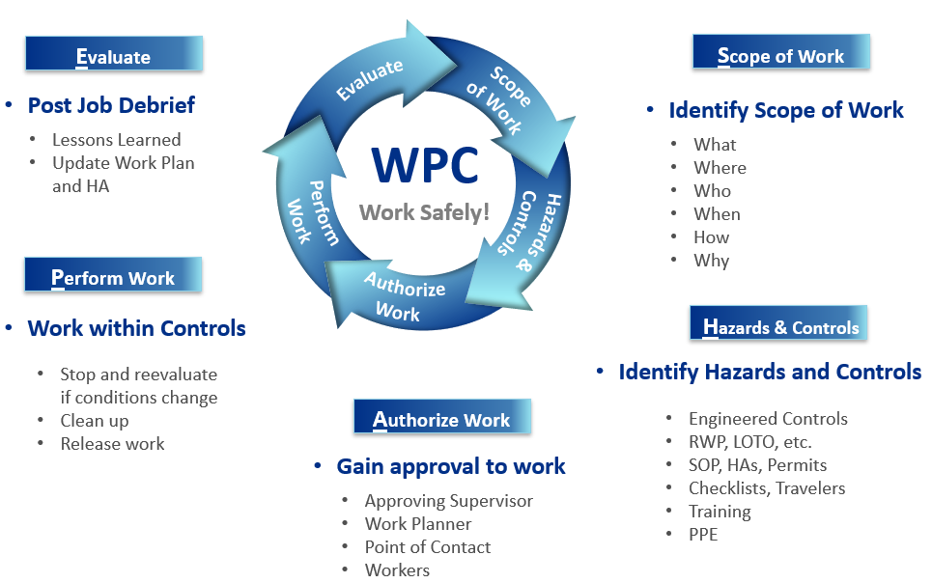
Work Planning & Control – S.H.A.P.E.

Slide 12
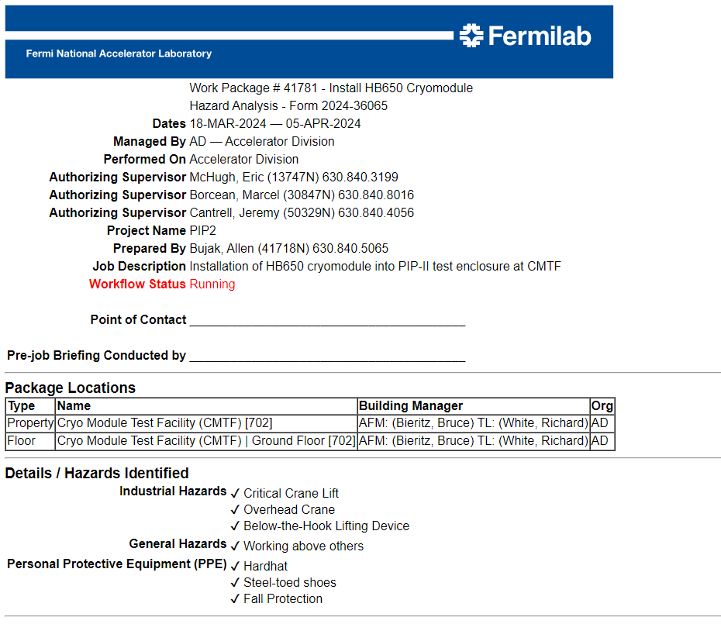
Scope of Work

Slide 13
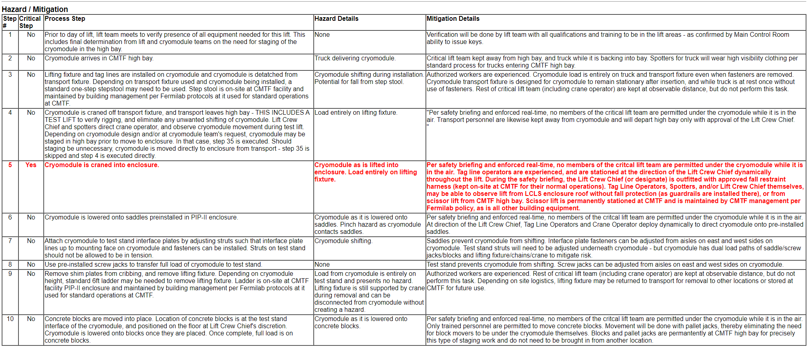
Hazards and Controls
SOP w/Hazards & Mitigations (Per FESHM 2060, Section 5.3)
SOP + IMPACT Hazard Assessment w/Mitigations for items not mitigated in the SOP
Hazard Assessment w/ Mitigations, if no SOP

Slide 14
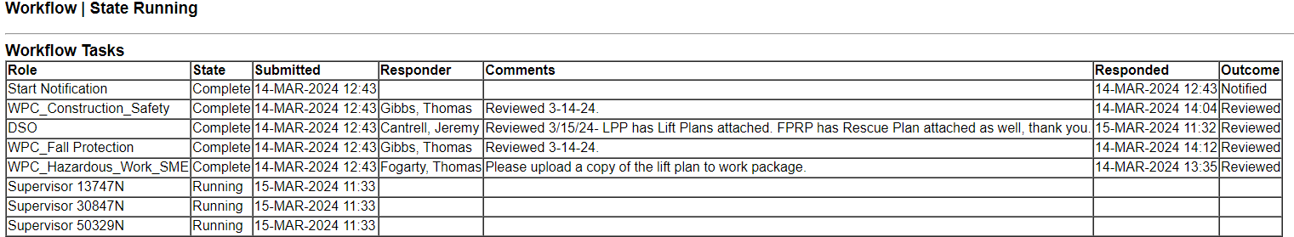
Authorize Work
Work Package
  Reviewed by SME’s
  Approved by Authorizing Supervisor

Slide 15
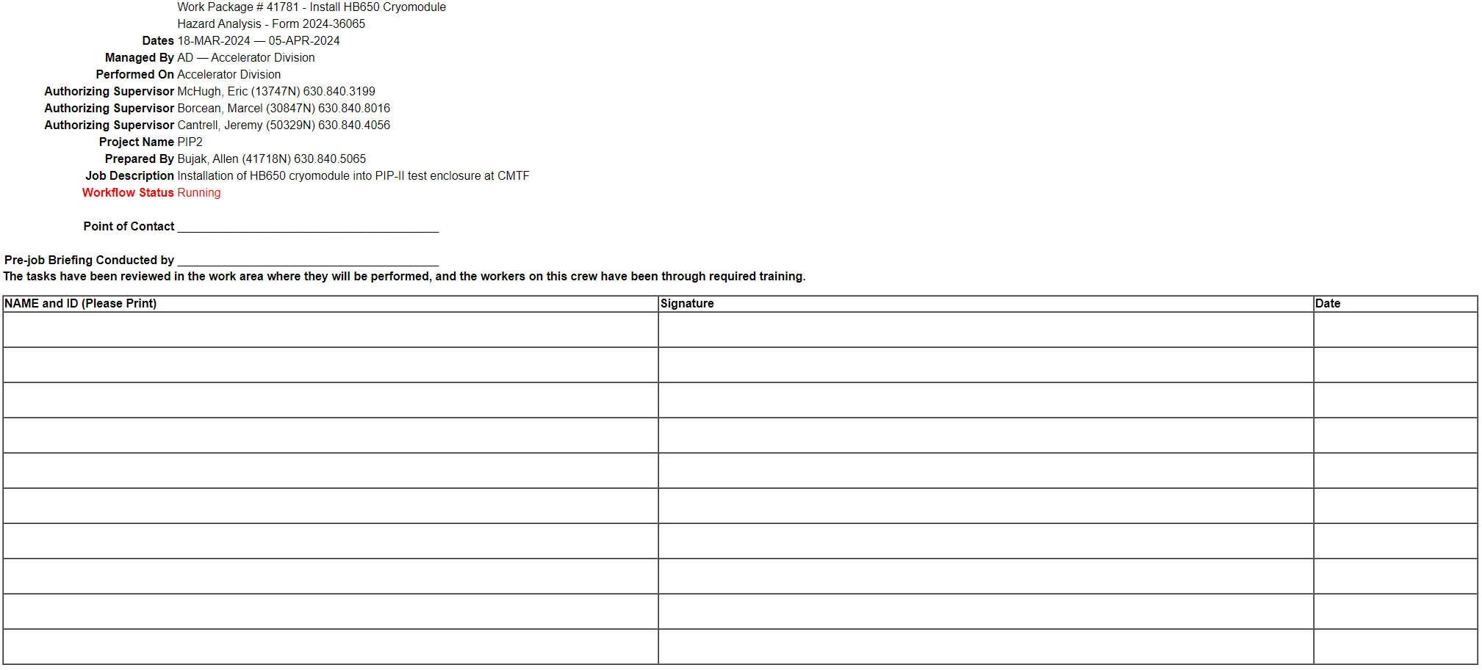
Pre-Job Brief
Pre-Job Brief
That pause to ensure every team member understands the work, and to identify and mitigate any changes since the work package was reviewed.

Slide 16
Summary
Work Tracking and Planning in the Accelerator Directorate complex is planned and reviewed by SMEs through:
  AD Electronic Worklist
    Used by AD, SpinQuest utilizes IMPACT.
  Radiation Safety Review
  ALARA planning
  IMPACT process

Slide 17
Questions?

