Slide 1
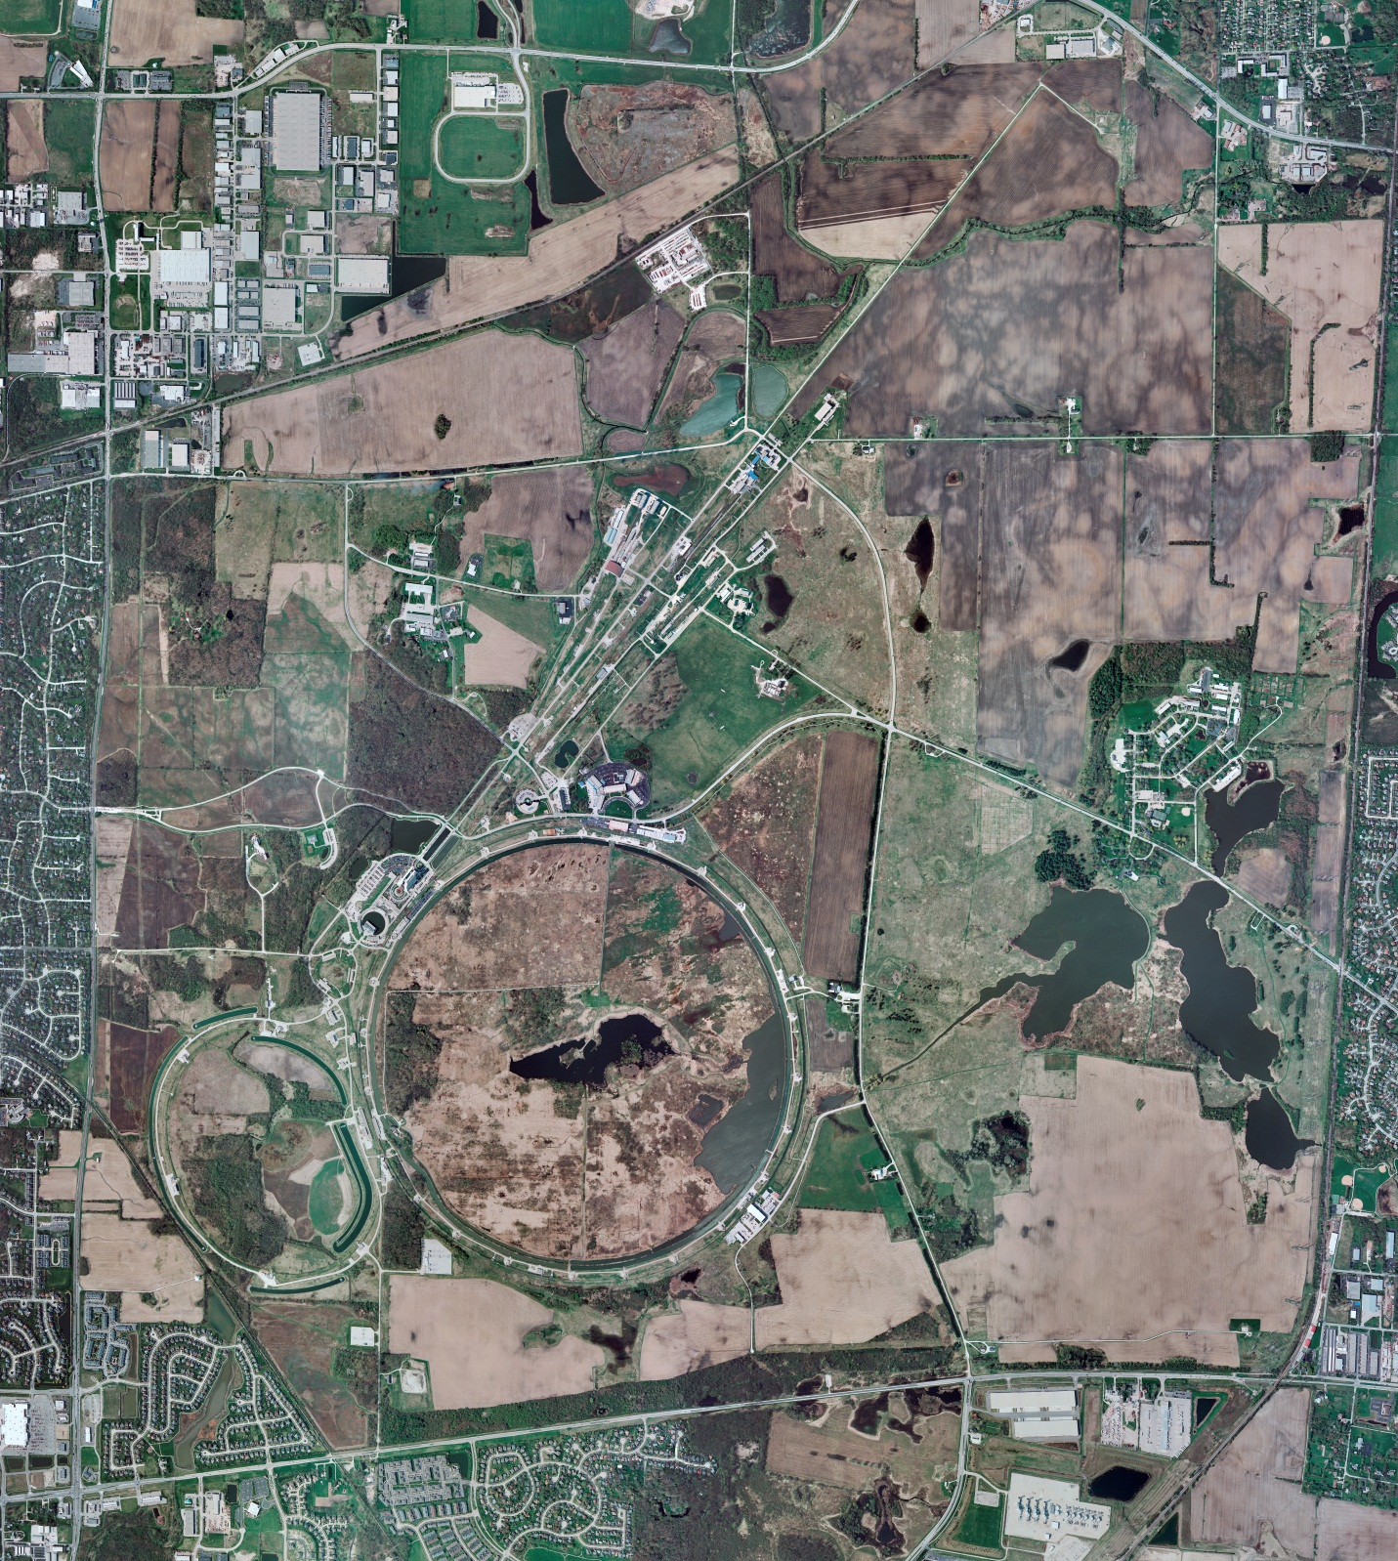
Helium Cryogenics
Status 2/2/2024 J.Makara
CMTF: SCP is shut down completely
CMTS: HECM28 at RT, LOTO’ed for its removal; HECM29 install late March
PIP2IT: SSR1 pCM at RT, LOTO’ed for its removal
North CM stand empty but HB650 installation mid March
MCTF: cryo system is cold with 3 comprs and 2 Fridges running
MDB/HTS: at RT
MDB/STC: .at RT but anticipate SSR2 cooldown soon
MDB Magnet: at RT
NML/FAST: Cryo system is shut down and isolated for extended shutdown period
CC1: at RT
CC2: at RT
CM: at RT
IB1: cryo system cold at 5 K and 2 K operations
Muon Campus: A0 comprs (3) online with MC-1 g-2 cryogenic system being warmed up to 80K but subseqeuently to RT in controlled manner
Misc:…High anxiety relating to Ln2 (and other cryogens) delivery to gated expt areas (ND, A0, MC1, etc), as communications not very clear

