Slide 1
Muon Campus Operation Report
Jim Morgan
Friday 09:00 Operations Meeting
February 2, 2024

Slide 2
Muon Campus status
Working on recommendations from SAD/ASE Review
ARR scheduled for later this month
ESS1 Electrostatic Septum at A0 Clean Room
Analysis of metal objects found in septum analyzed
Repairs, component replacement and cleaning in progress
TD finished with installing rad hard water lines on D30 quadrupoles
Q206 needed modifications to accommodate M4 Line vacuum pipe
Q205 (8Q24) will be swapped with spare that already has the rad hard water lines
Preparations for Electrostatic Septa installation
Will install new vacuum layout between Q202 and Q204 for electrostatic septa
Need to remove blocks from D40 Hatch for incoming and outgoing magnets
8Q24 with rad hardened water lines at AP-50, ready to be lowered into tunnel
Forklift and rad hard 8Q24 will be lowered into tunnel for installation
Existing 8Q24 and four NSA sextupoles that had water leaks go to TD
Investigating source of chronic D50 ceiling tunnel ceiling leak
ICW the remaining suspect, would eventually like it valved out to AP-50 as test
AP-0 Shield Blocks back in place, lens and pmag water systems dry
g-2 Ring powered down for the last time, warm-up begun
Study – M1-M3 Optics
Study – Alternative M5 optics
KPS5A PFL Repair
MC-1 Controlled Access
G-2 Trolley Run
Intentional Accelerator
Standby Period
<------------Week Days -------------------→

Slide 3
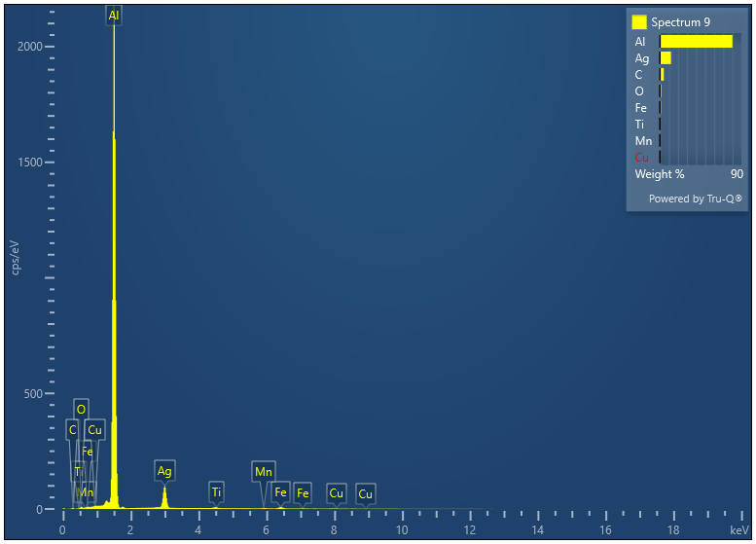
ESS1 disassembly and inspection
ESS1 frame and cathode were removed an inspected
Work began in early January
Metallic objects found on cathode stand-off and high voltage feedthrough
Discoloration also found on feedthrough
Several foils had discoloration, some dust on foil frame
Metal objects and dust analyzed, results below
Metallic objects thought to be galling from threads in aluminum frame
Previous theory was that objects came from Stainless Steel Conflat bolts
Element | Wt%
Al | 85.88
Ag | 13.39
Ti | 0.33
Cu | 0.18
Fe | 0.14
Total: | 100.00

Slide 4
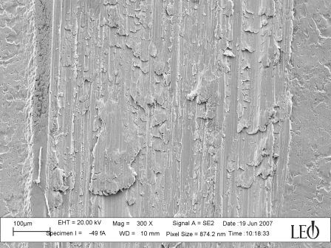
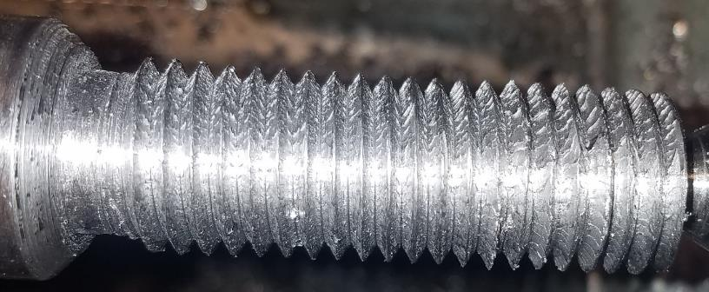
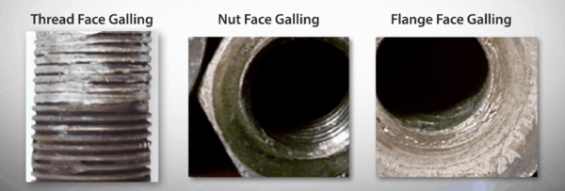
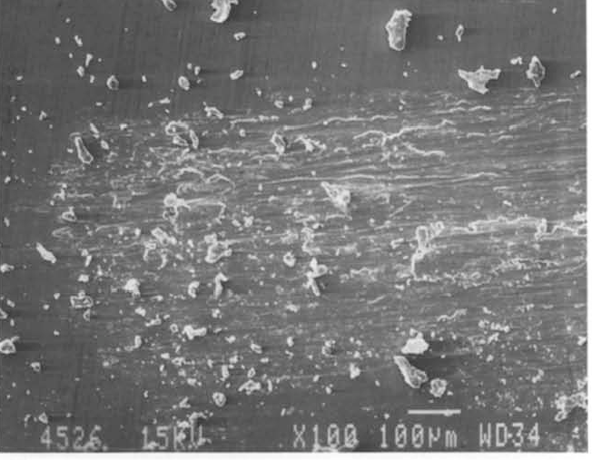
Examples of metal galling
Caused by adhesion of contacting surfaces
From Wikipedia entry on galling

Slide 5
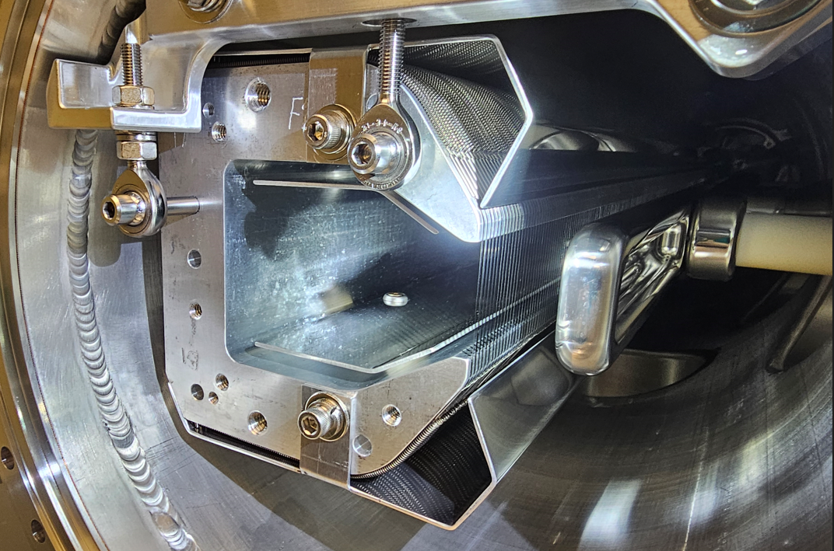
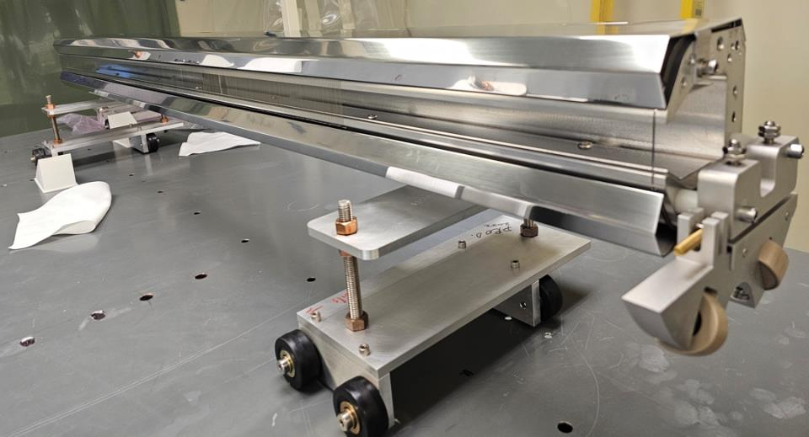
ESS1 end view

Slide 6
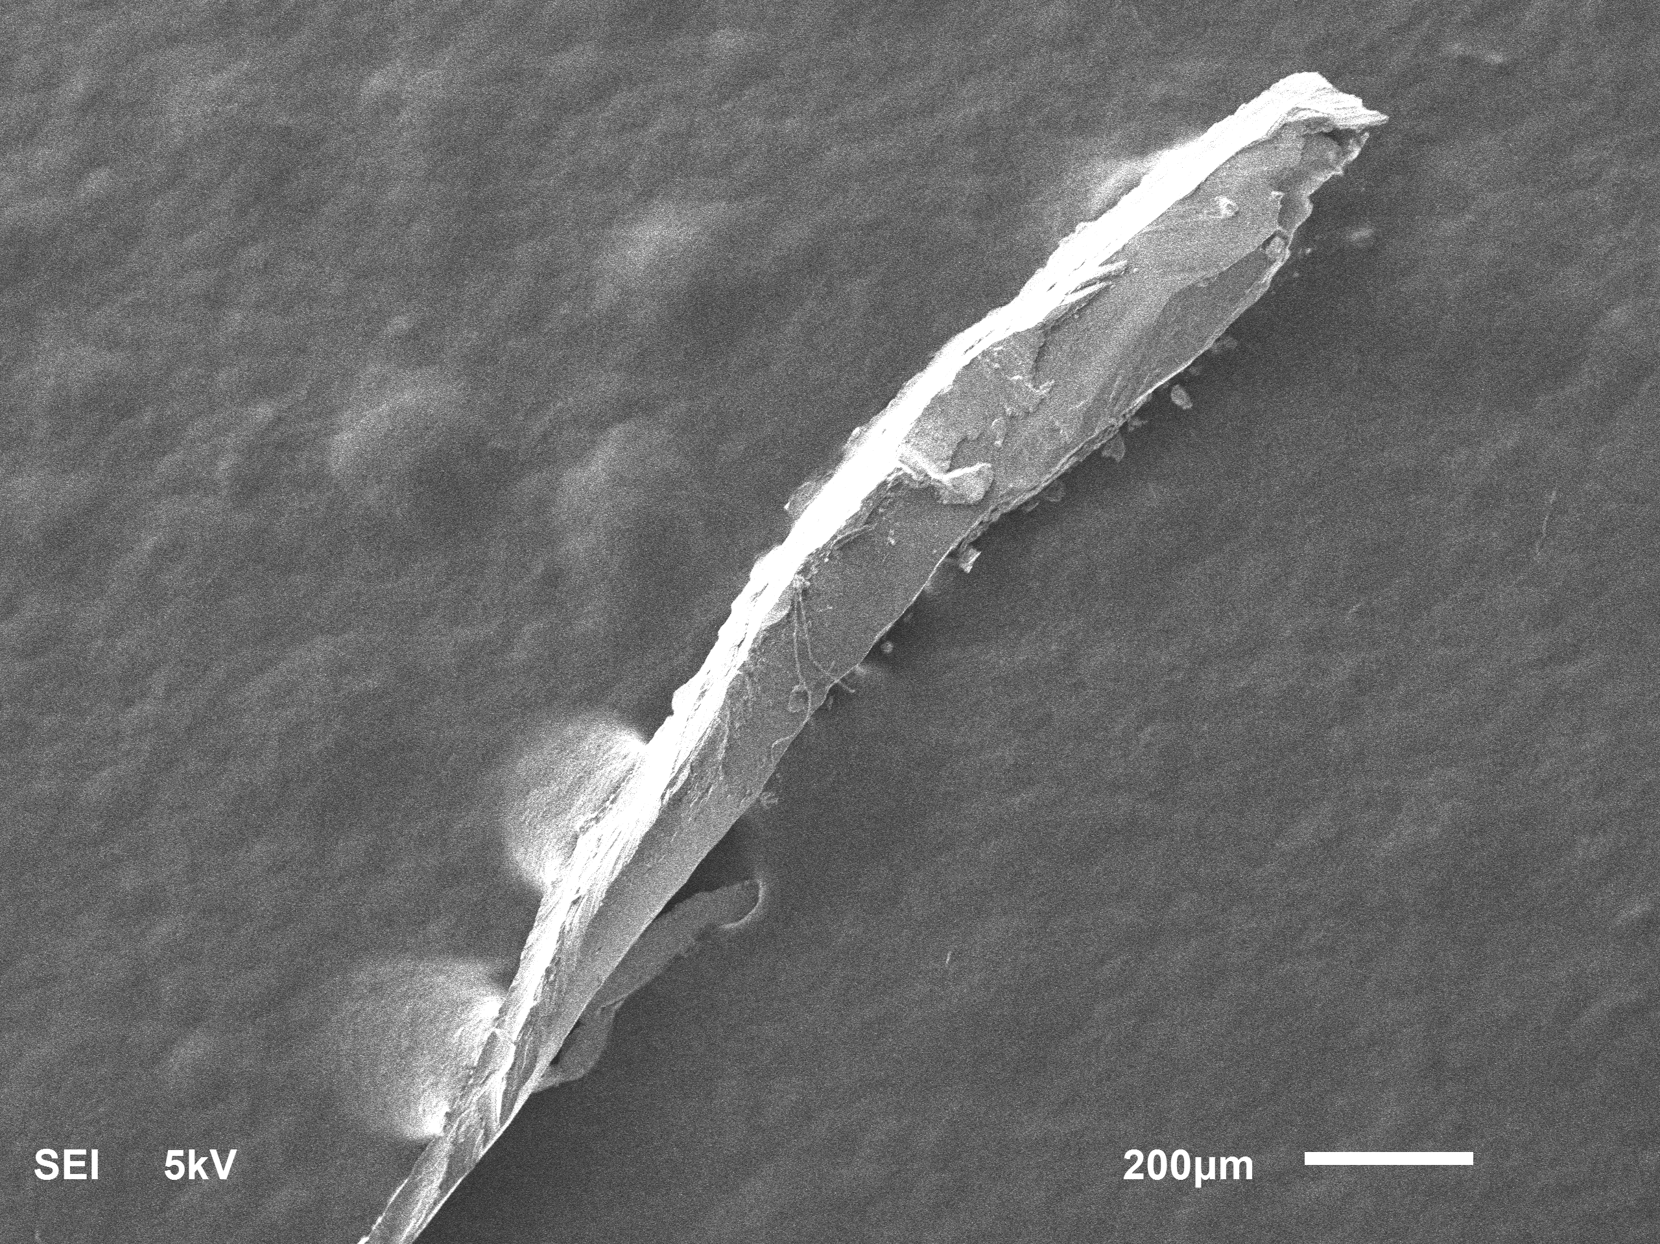
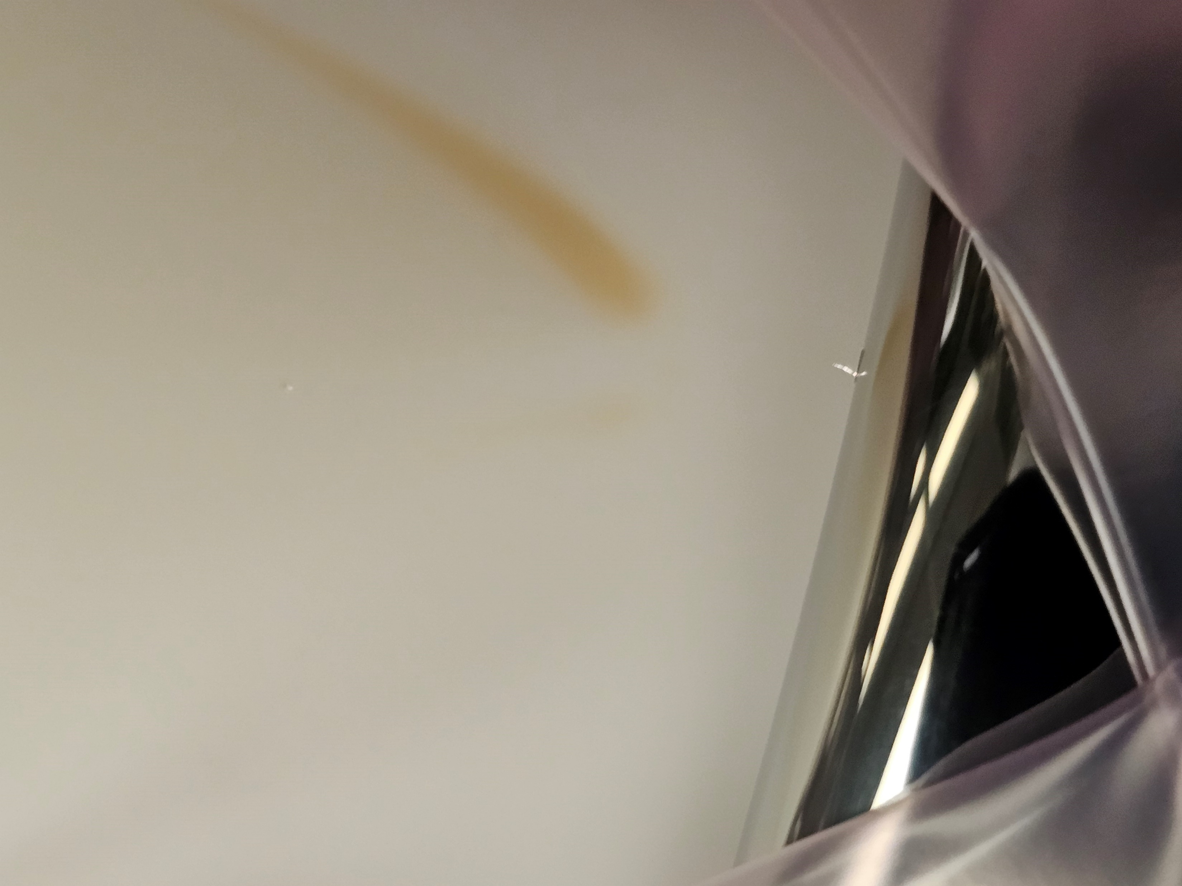
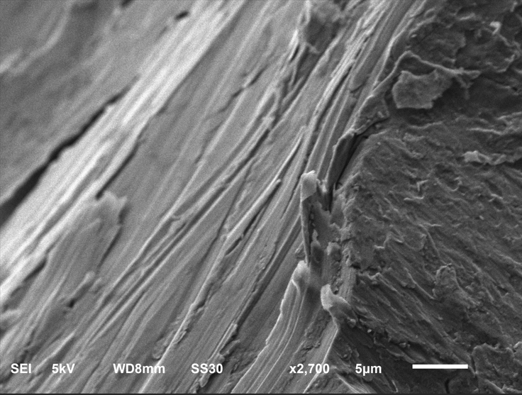
Mu2e ESS1, X-Ray scan of object on HV feedthrough

Slide 7
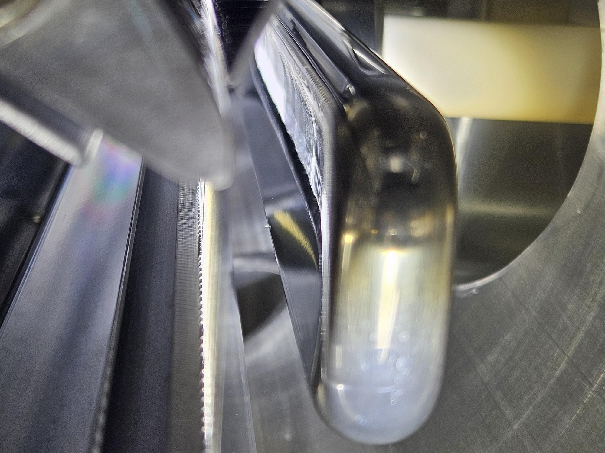
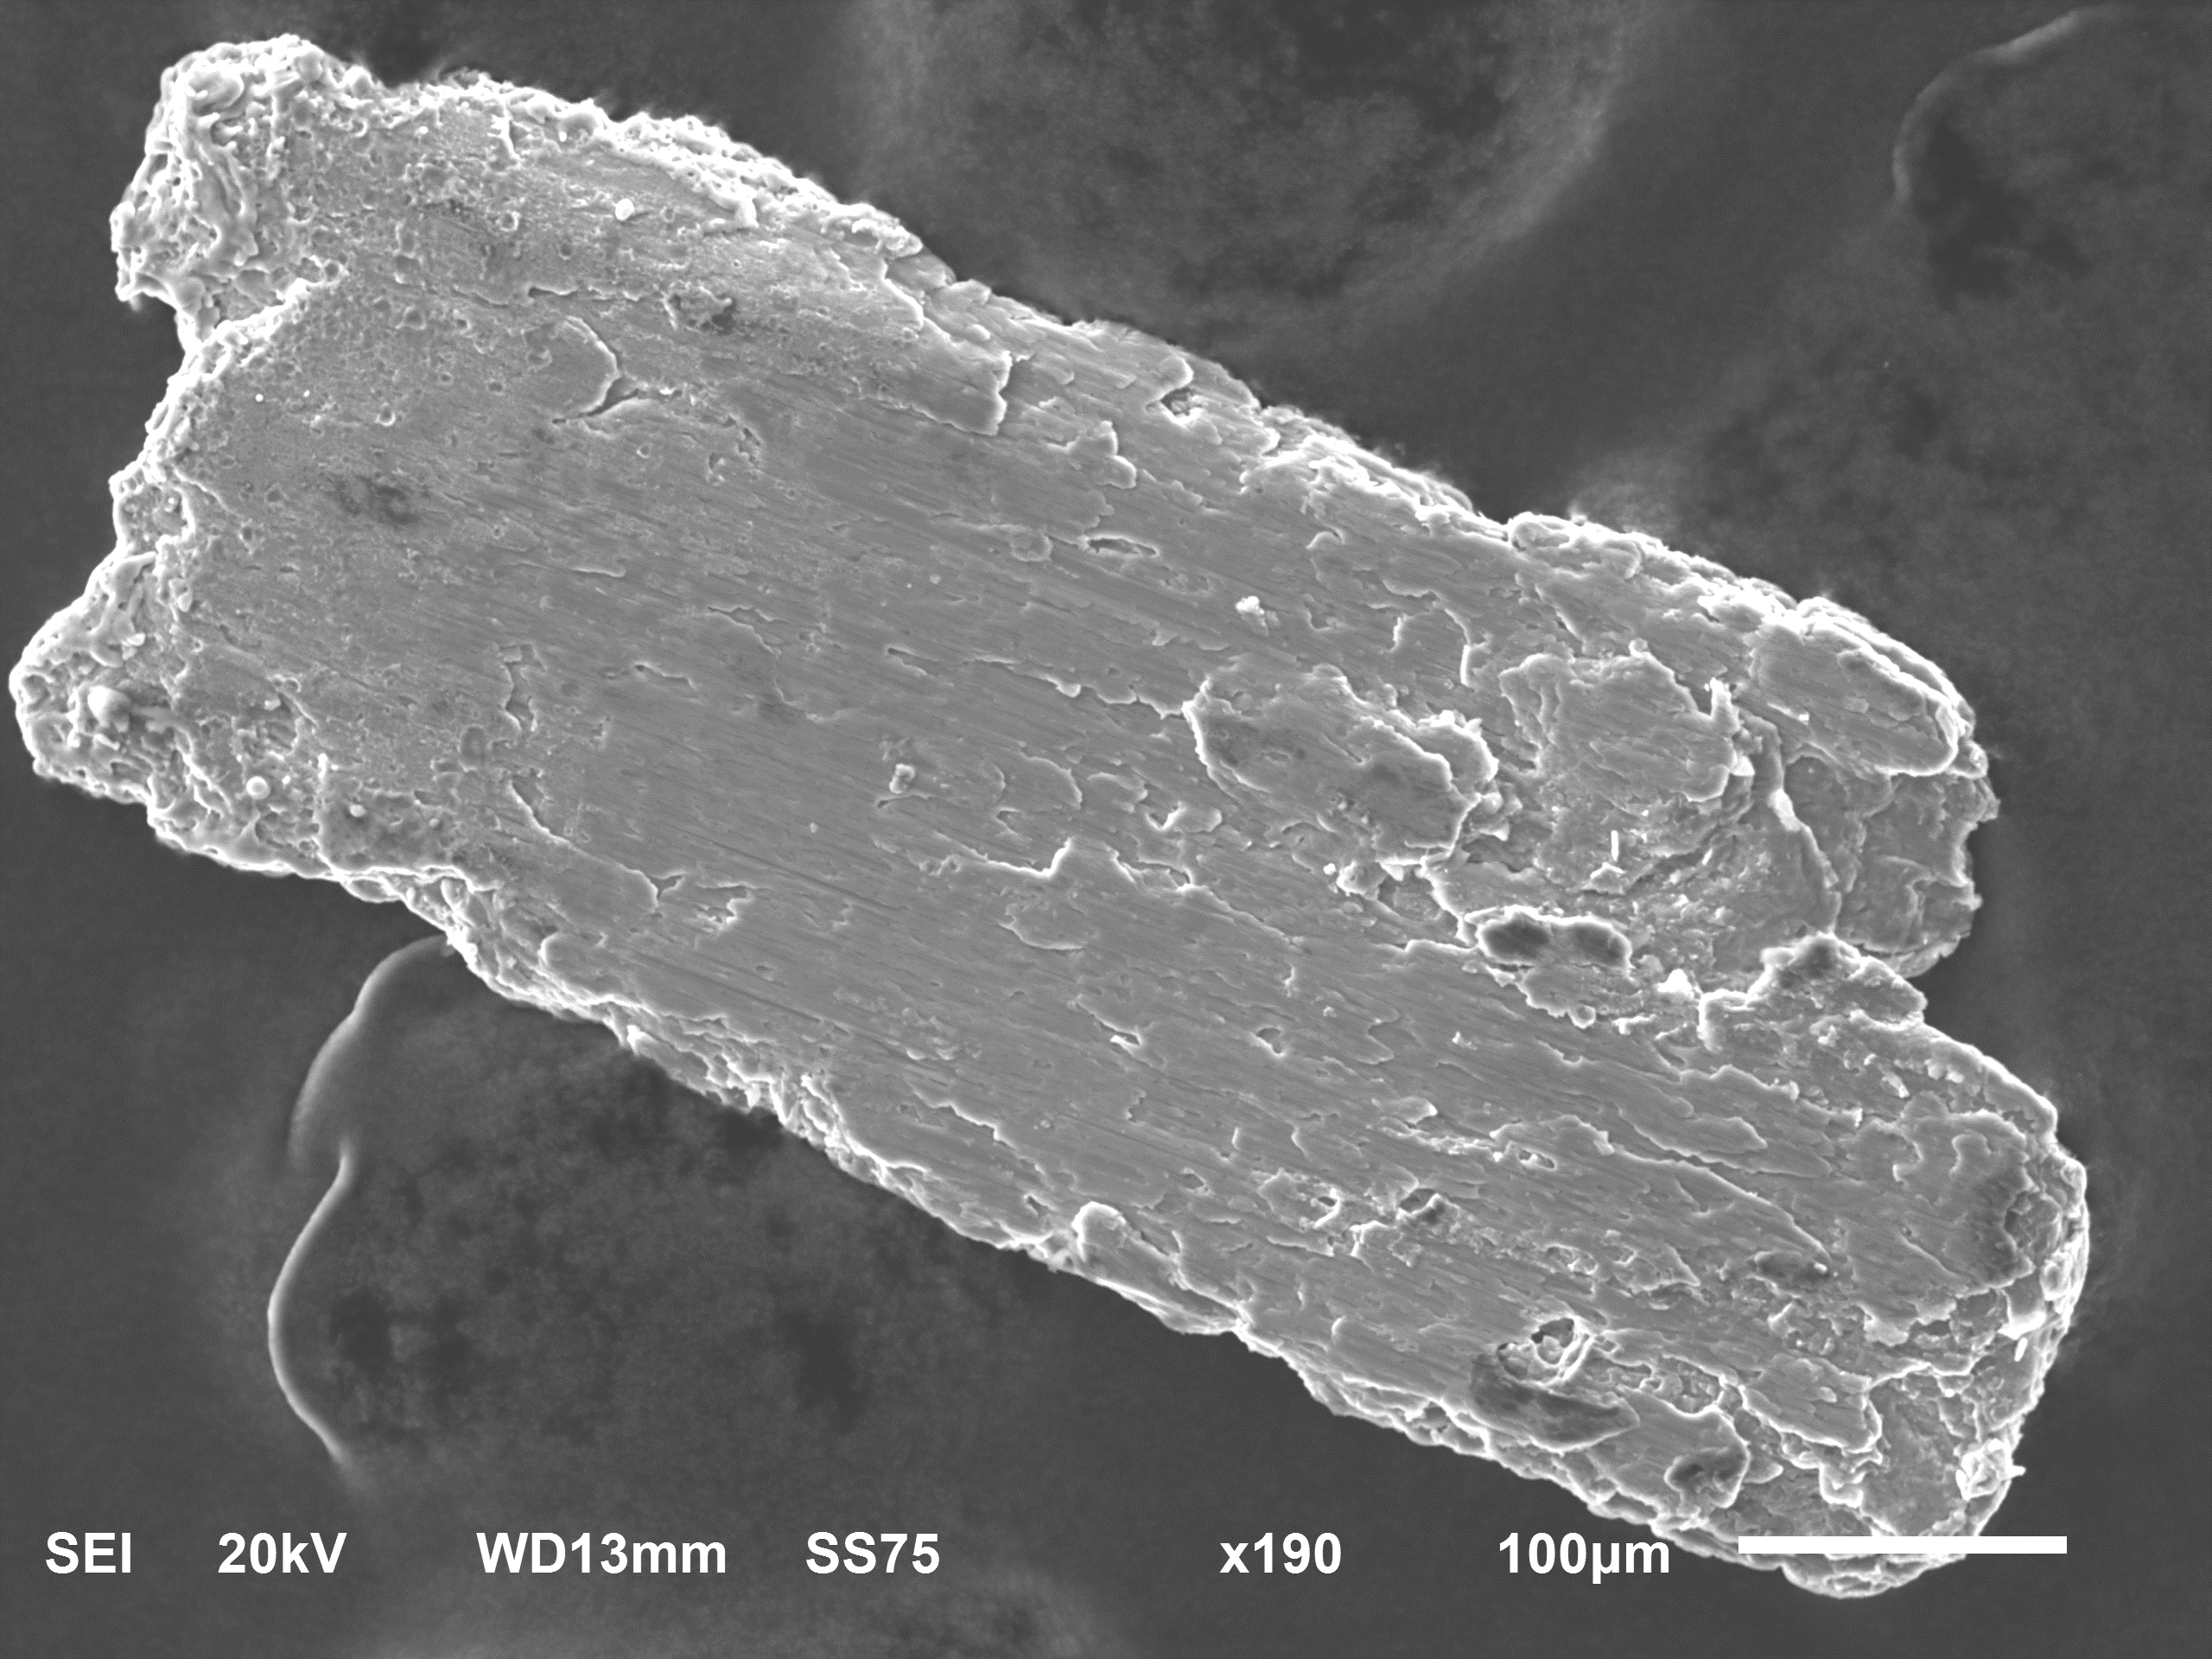
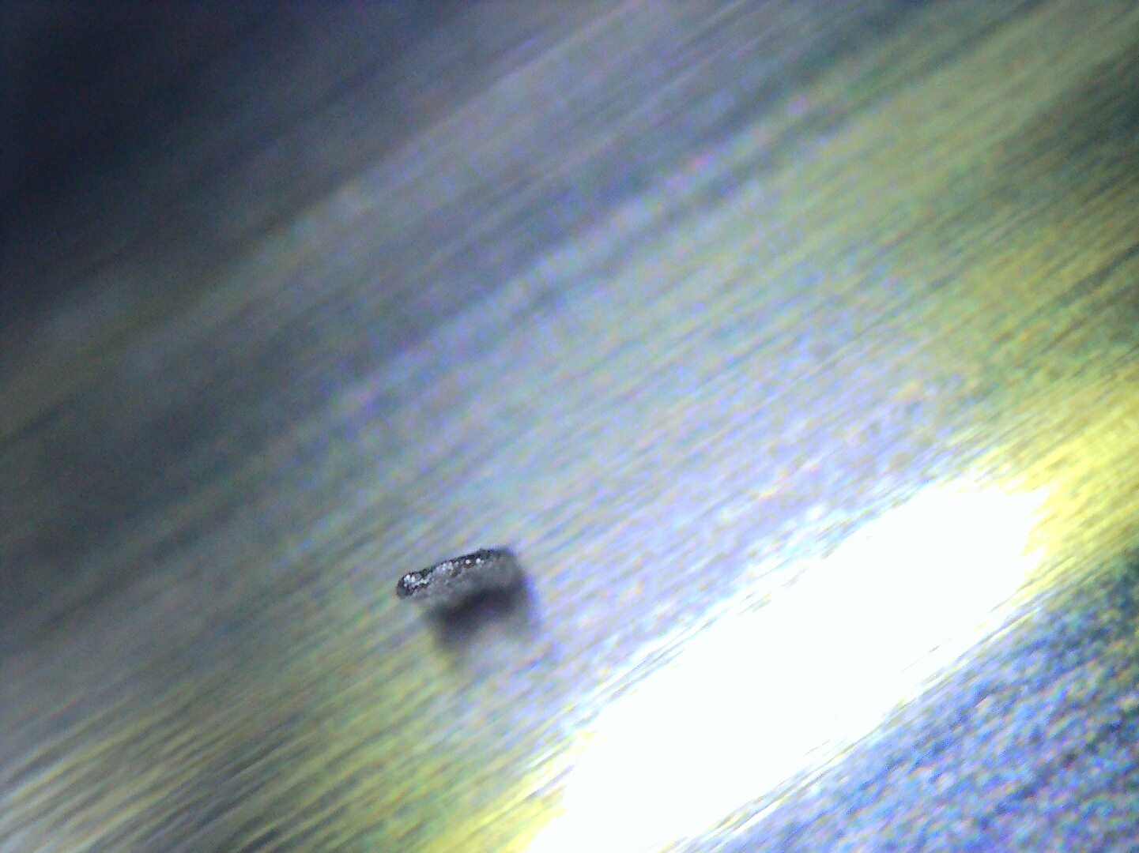
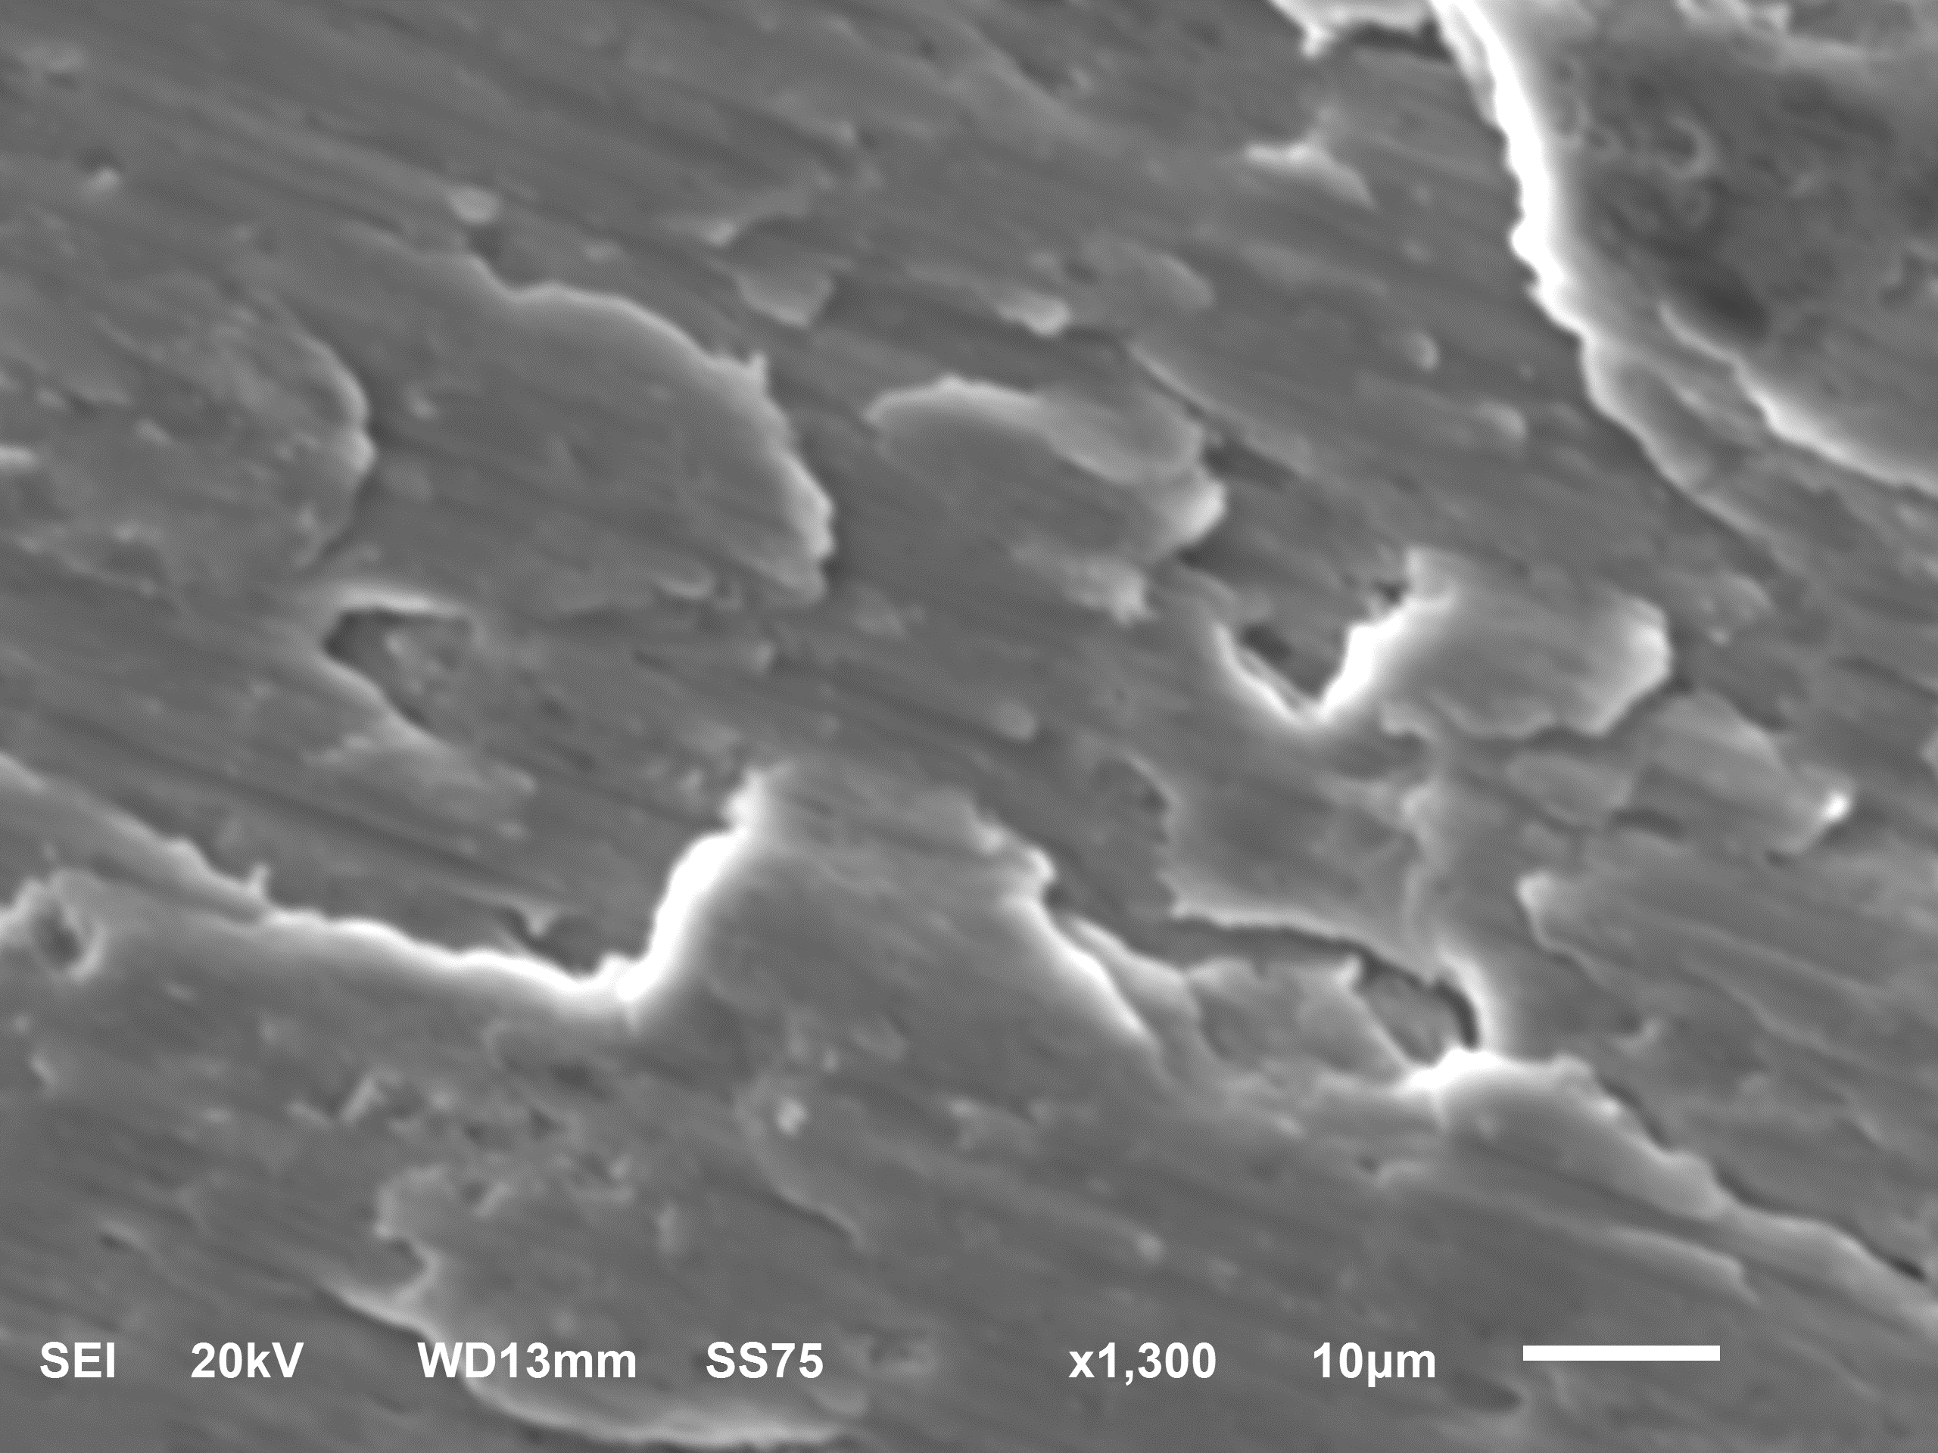
Mu2e ESS1, X-Ray scan of object on cathode

Slide 8
D30 installation plan
ESS1 component replacement and assembly will continue at the A0 Clean Room
Could optimistically be ready for tunnel installation at end of February
If delayed, vacuum spool will be installed in Delivery Ring
ARR Preparations
Scheduled for February 12 - 14
Q205 magnet swap and special vacuum pipe replacement
Waiting on parts to be machined
Opening of D40 Hatch has been delayed during the wait
Prepare for ESS1 installation
New compact vacuum pipe will be installed in Q203
ESS1 location will have vacuum spool installed if septum not ready soon enough

