Slide 1
9am Operations Meeting
Sue McGimpsey
MTA Update
2 February 2024

Slide 2
MTA STATUS
ELECTRICIAN WORK HAS BEEN COMPLETED!!!!!

Slide 3
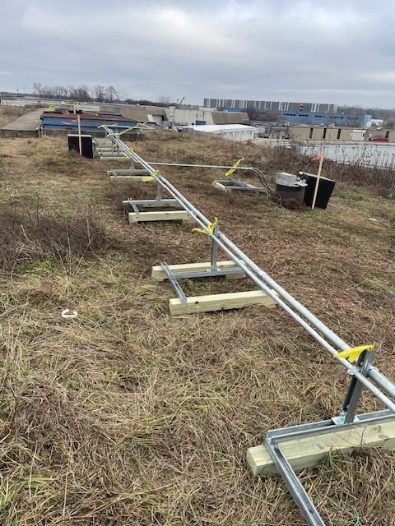
Chipmunk locations looking upstream

Slide 4
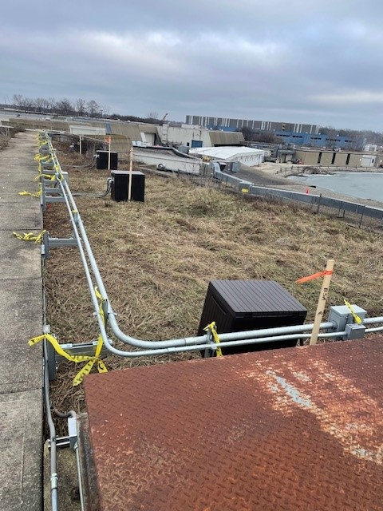
Chipmunk locations further upstream

Slide 5
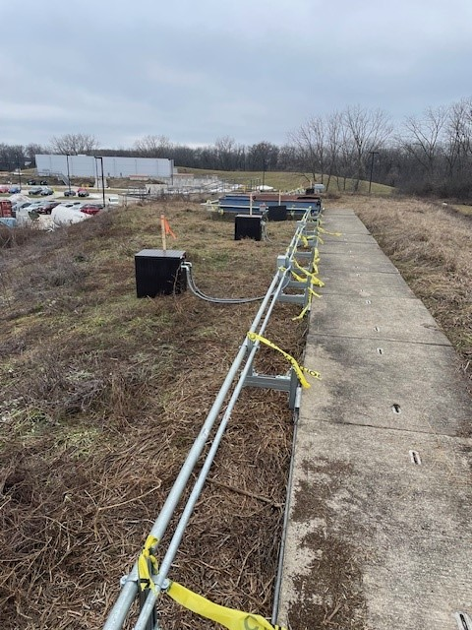
Chipmunk locations looking downstream

Slide 6
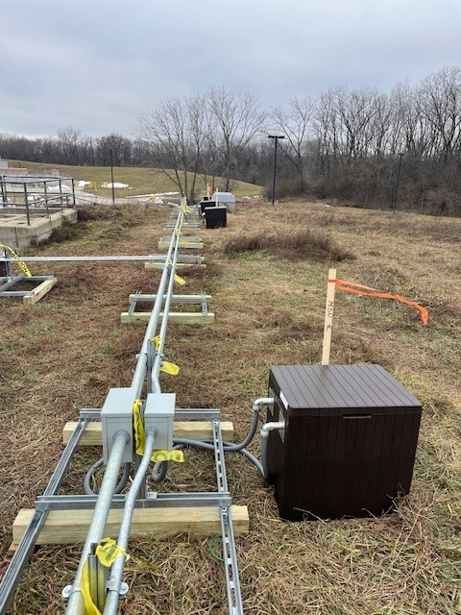

Slide 7
Things Still To-Do
Chipmunk installation in the houses and cable terminations – Rad Safety
Cable terminations – Interlocks (underway)
Rad Monitor and CDC testing – Interlocks
Get Remaining Signatures on SUSO sheet - Interlocks and Planning and Integration
Request Beam Sign Off/Obtain Approved RC and BP
Anticipating two weeks to beam – hopefully less!!
THANK YOU EVERYONE!!!!!!

Slide 8
THANK YOU PAUL!!!!!!

