Slide 1
Main Injector Reconfiguration (During Civil Construction)
Rework for LBNF Extraction Channel Installation

Slide 2
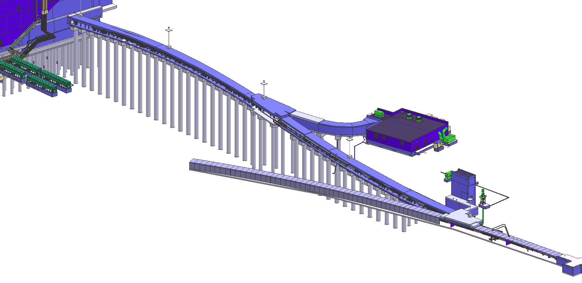
ISO View of Main Injector and Primary Beamline Enclosure
Target
Complex
(LBNF-20)
Primary
Beamline
Enclosure
Dipole
Magnets
Primary Beam Service Building
(LBNF-5)
Major
Vehicle
Access
Egress
Fermilab
Main Injector
Tunnel
Extraction
Enclosure
MI-10 Alcove

Slide 3
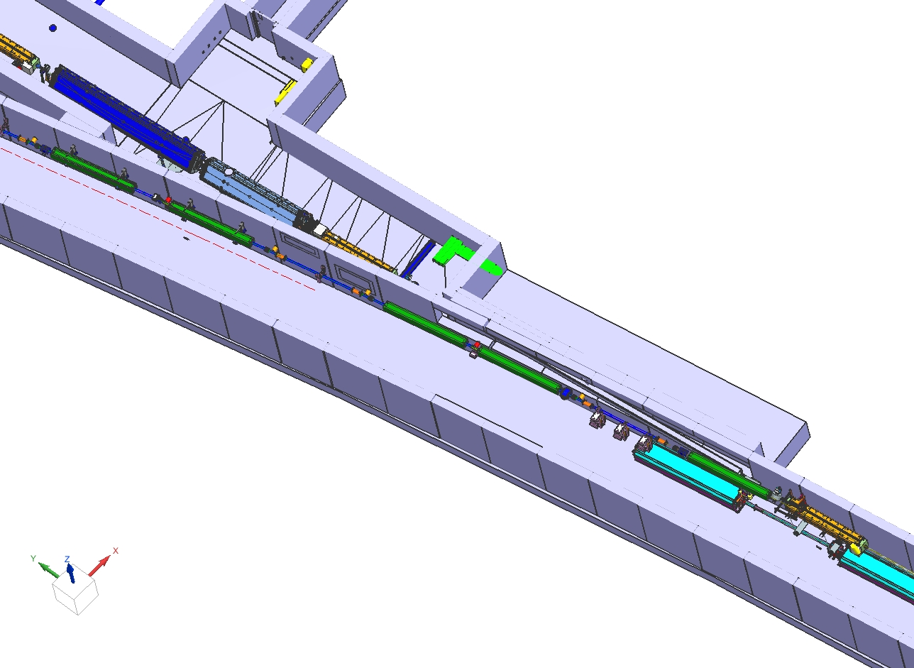
Main Injector Rework
Current Configuration
(pending Construction onset)
After Construction
Construction Barriers
Q-104
Q-104

Slide 4
Main Injector With Extraction Channel

Slide 5
Preparing The Main Injector Tunnel For Component Removal
What magnets are being removed:
MI from Q631- Q108 (8Q’s & 6 D’s)
RR from Q104- Q108 (8 magnets)
What devices are being relocated or removed (R):
MI 8 Gev Injection Lambertson (R)
MI Injection kickers (R)
SQA852 Quad (R)
LCW Headers and Secondary Manifolds
Main Injector Bus
Multiwire
IPMS
SEY experiment
Schedule:
Removal: Jan ‘27 –Mar ‘27
Civil Tie in: Mar’27 – May ‘28
Reinstall: May ‘28 – Dec ‘28
Cables:
Back Pull: ~215 cable ~ 32K ft
New installation: 400-500 cables ~200k ft
Cable tray will be left in place during construction work.

Slide 6
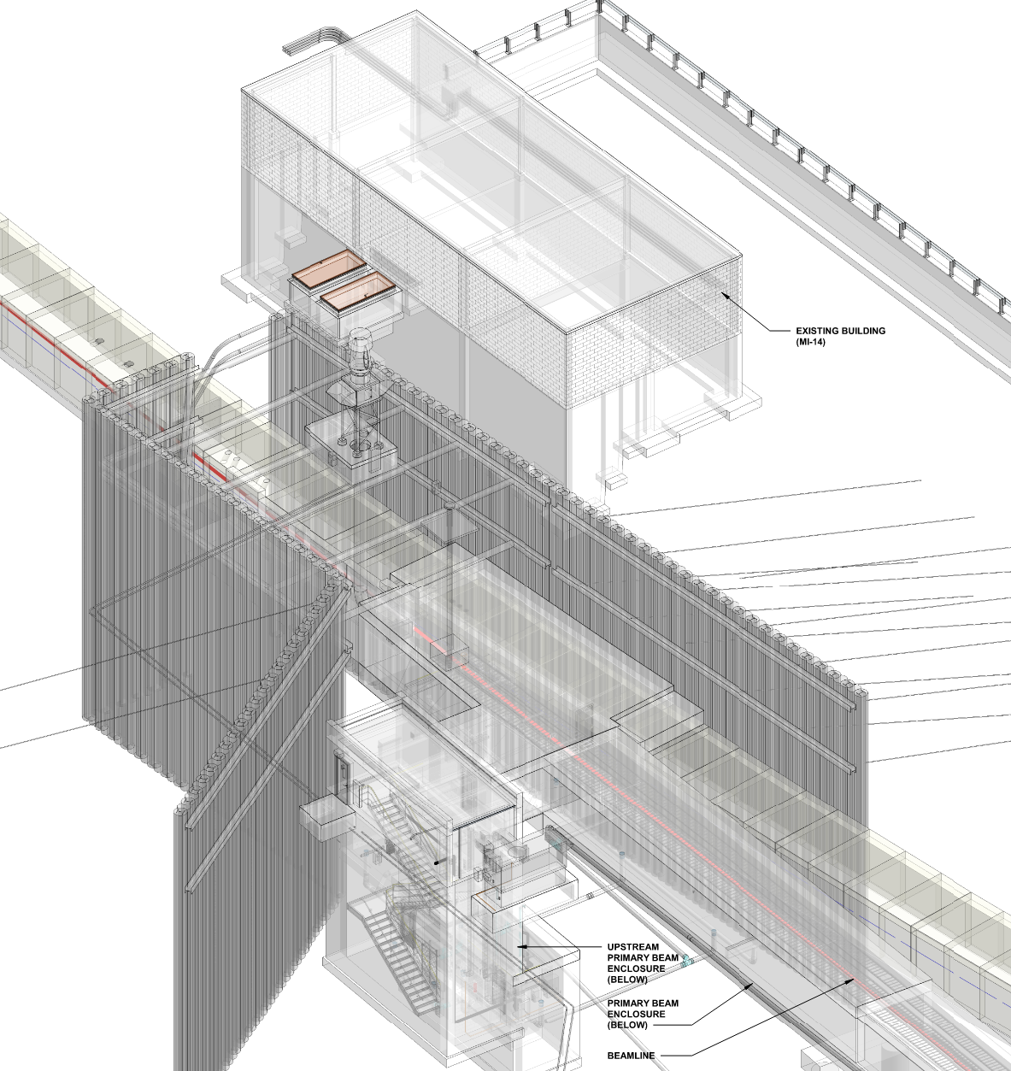
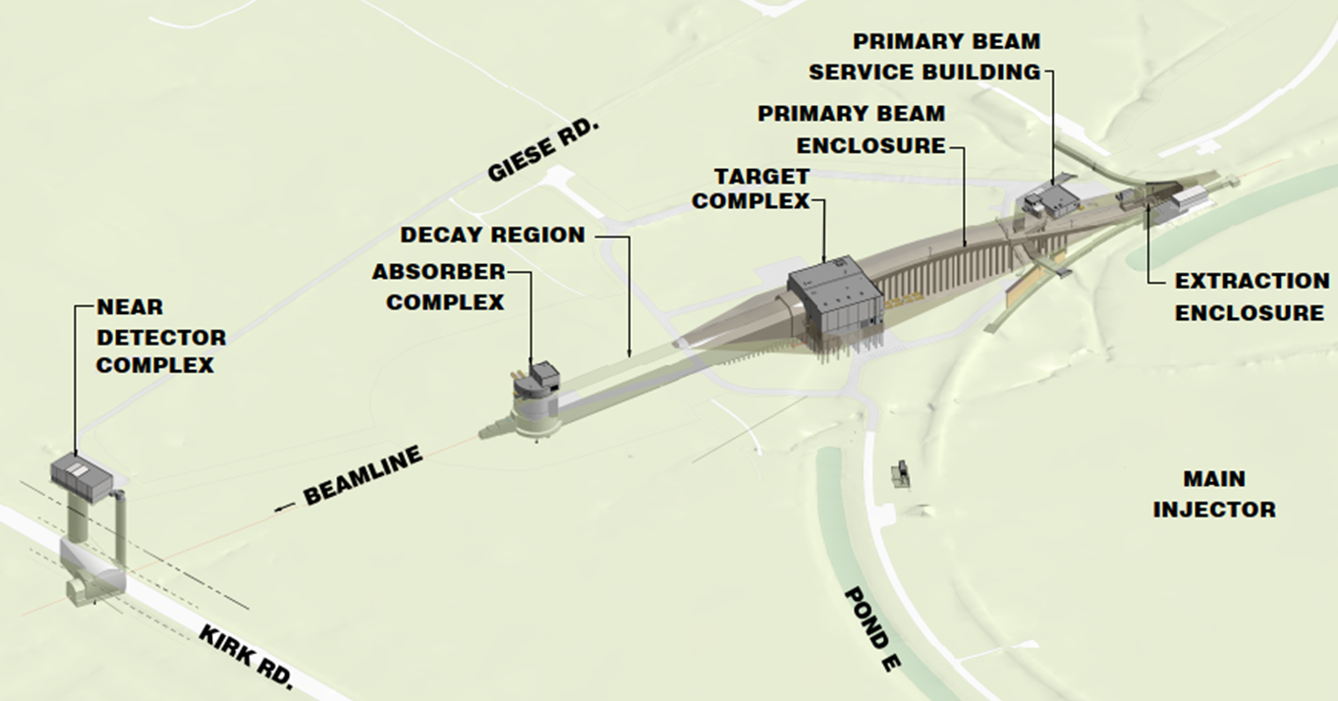
Main Injector/Extraction enclosure
MI Beam Direction

Slide 7
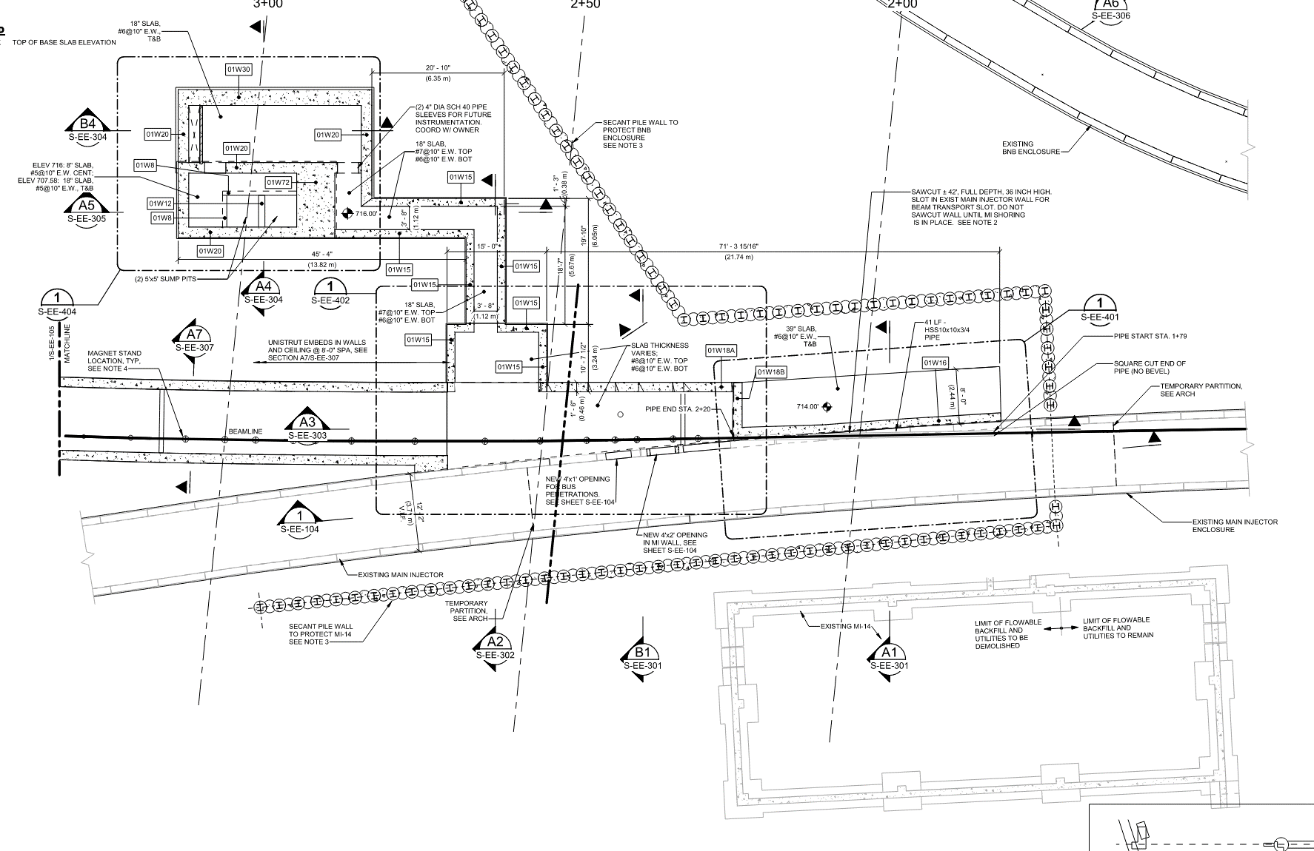

Slide 8
Elevation View Showing Beam Pipe Through MI Wall
1’x1’ Rectangular Pipe

Slide 9
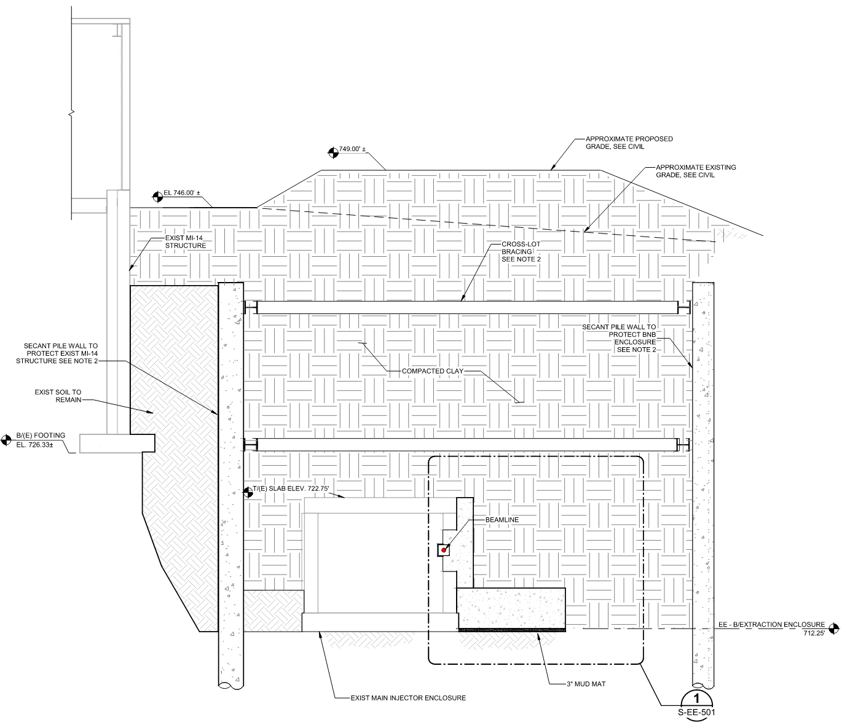
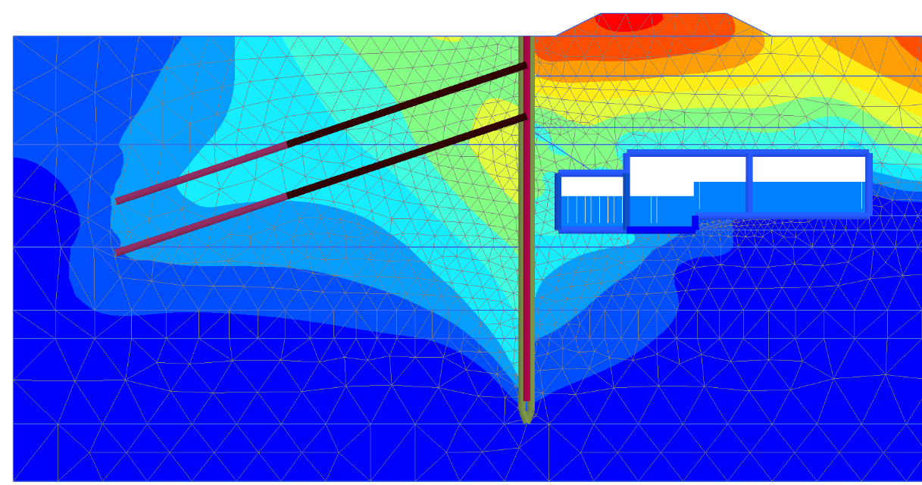
Geotechnical
Extraction Enclosure excavation and support of existing MI-14

