Slide 1
Accelerator Test Facilities for R&D
Erik Ramberg
Fermilab
26 February, 2013

Slide 2
The energy spectrum in particle physics
Energy Physics Detectors .
1 meV: ν masses & decay: STJ, MMC
1 eV: astrophysics photometry: TES, CCD, MKID
1 KeV: X-ray physics; dark matter: Pixel Arrays, Crystals
1 MeV: Solar/supernova ν : Water cerenkov, Liquid Scint.
1 GeV: ν osc., rare decays: LAr, Straw tubes
1 TeV: Colliders EW, SUSY: Silicon strips, calorimetry
1 PeV: Cosmic rays: Ground arrays, satellites
Particle species commonly encountered:
Photon, electron, proton, kaon, neutron, muon, neutrino, ‘phonon’, ‘quasi-particles’, nuclei, ions, etc.
As this shows, particle physics - more than any other field - has an immense range in energies and particle species to detect. Because of this, the field has had a rich tradition of detector innovation and development of small scale experiments leading to the design of large projects.
To support this wide research environment, there must be a corresponding set of test and research facilities.

Slide 3
Types of Facilities Required for Detector R&D and Small Experimental Activity
Test Beams
Electron, Photon, Proton, Neutrons, Ions
Irradiation
Gamma, Neutrons, Charged particles
Nuclear reactor test areas
Cryogenic test beds
Liquid Argon, Liquid Helium
High Magnetic Fields
Underground Lab Space
Low Background Counting
Laser interferometry
Metrology
Clean Rooms for Sensor Fabrication and low background studies
Thin Film Fabrication
Sputtering, Atomic Layer Deposition
Low Mass Mechanical Structures
Engineering and Technical Resources
Support for Simulation of detectors
Test Stand Equipment
Typically modular components, oscilloscopes, etc.
This talk gives a survey of the types of accelerator based test beds for detector research and small experimental activities that exist in the U.S.

Slide 4
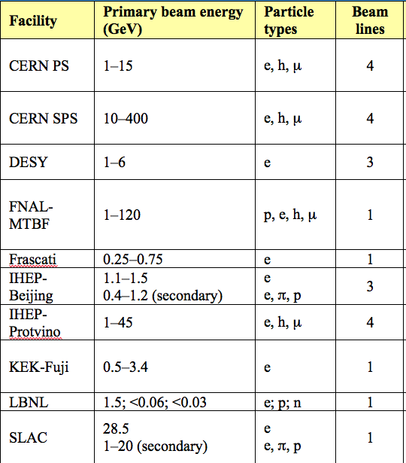
High Energy Charged Particle Test Beams
Test beam is a crucial part of detector testing
Only 2 high energy test beam facilities in U.S.
Experience says that both will be fully occupied

Slide 5
Fermilab Test Beam
MTest
Linac
MCenter
8GeV Line
Booster
Main Injector
SY120
P3 Line
Neutrino Line
P2 Line
Linac loads Booster with a ‘batch’ of up to 80 RF buckets of 19 nsec each
6 of these batches fills the Main Injector
MI accelerates beam to 120 GeV
During the slow spill of the Main Injector, protons are resonantly extracted over a 4 second flattop
One spill is allowed per minute
In the Switchyard (SY120), a septa magnet splits slow spill beam to Meson area or Neutrino area
The majority of the slow spill protons go to SeaQuest (~1E13) in the Neutrino area
The remainder (~ 2E11) can go to Meson
P1 Line
Tevatron

Slide 6
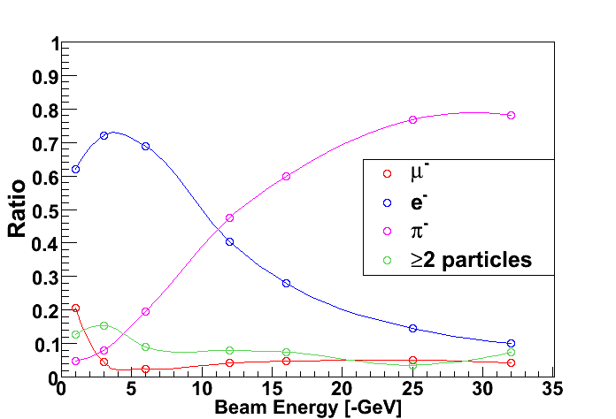
Beam and User Area Overview
Runs off of Main Injector 120 GeV proton primary beam. Primary targets in beamline provide for secondary undifferentiated beam from 1-66 GeV.
Rates are 10 Hz – 100,000 Hz
One 4 second spill per minute, 24 hours a day
Installing a high rate (1E11 Hz) area for tracking
Open to all groups who negotiate a Scope of Work with the various divisions within Fermilab

Slide 7
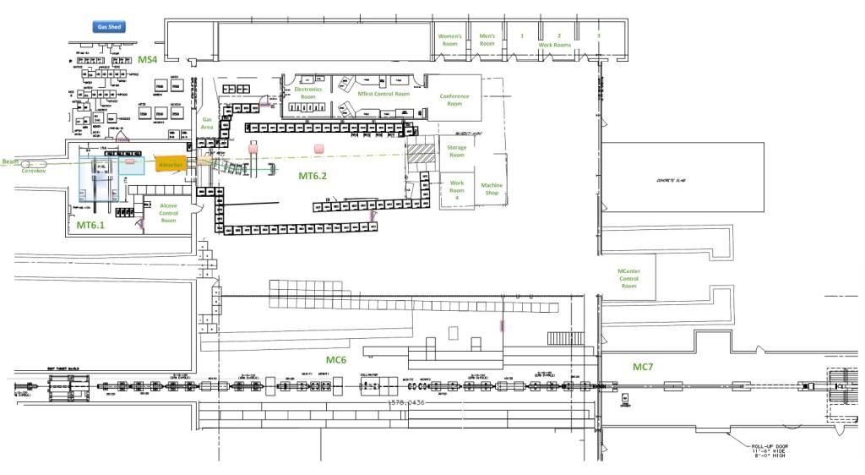
Tertiary spectrometer to be moved to MCenter
MTest and new MCenter Beam Layout as part of a unified Fermilab Test Beam Facility
User Area for MTest
Control room for MCenter
Installed cable route
Walkway to MC7
User Area for MCenter
Mcenter will be operational this calendar year

Slide 8
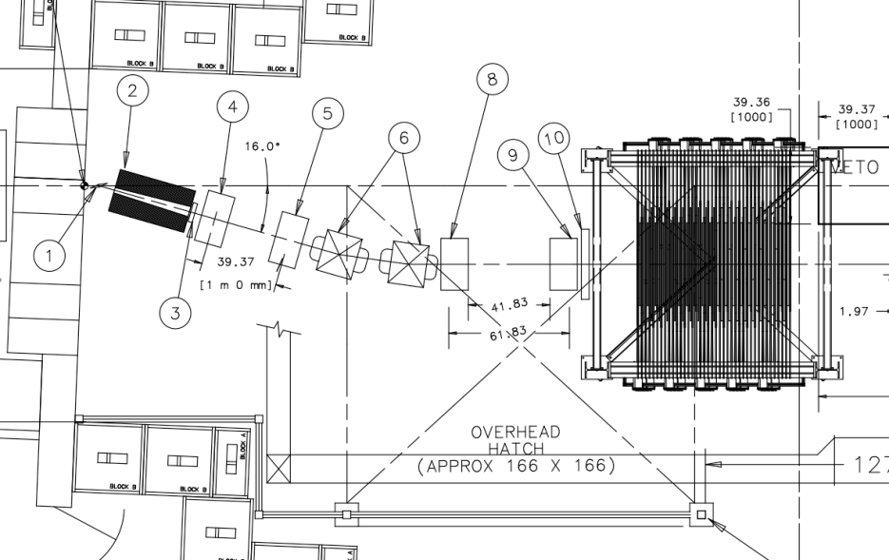
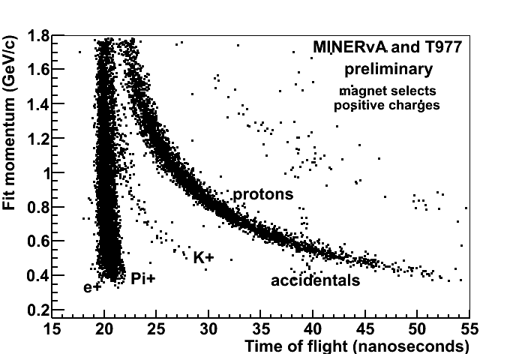
Accommodating Low Energy Users
The lowest energy we can realistically deliver with the secondary beam is ~1 GeV.
In 2008, T-977 MINERvA experiment requested pions with momentum as low as 200 MeV/c
To accommodate this request, Fermilab created a secondary target and tertiary beam spectrometer

Slide 9
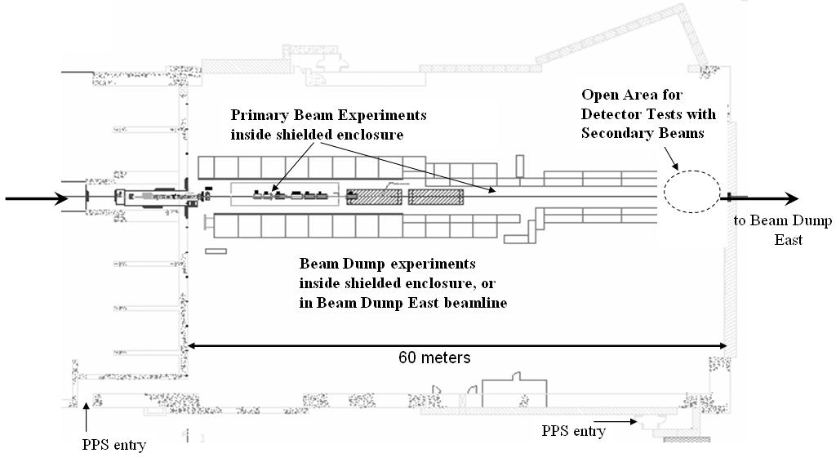
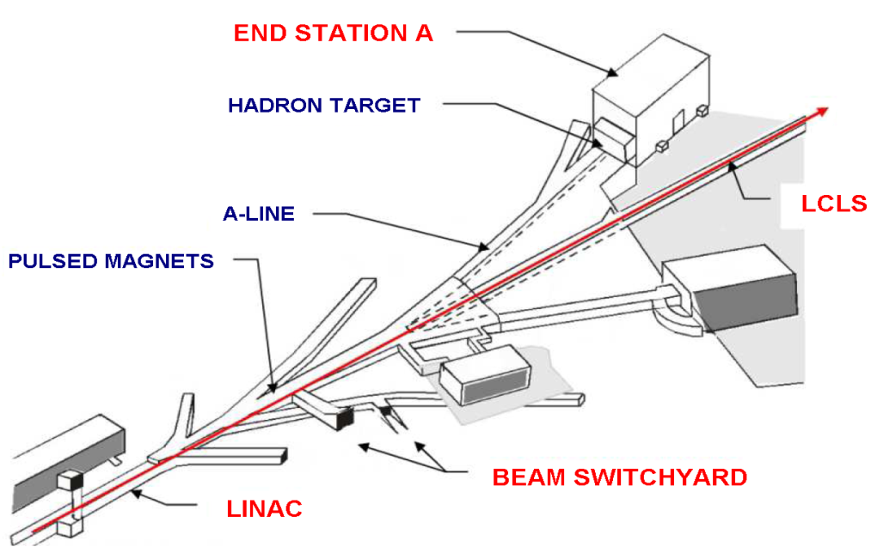
SLAC’s new ‘End Station Test Beam’
Use pulsed kicker magnets in the beam switchyard to send beam into ESA. Shares beam time with LCLS
Electron energies from 1-15 GeV
Rates from 1 particle/pulse to 0.25 nC at 5 Hz repetition
Plans for hadron production and possibly tagged photon
Excellent for machine interface testing as well as detector testing

Slide 10
ESTB parameters
Parameters | ESA
Energy | 15 GeV
Repetition Rate | 5 Hz
Charge per pulse | 0.35 nC
Energy spread, σ_{E} /E | 0.02%
Bunch length rms | 100 μm
Emittance rms (γε_{x},γε_{y}) | (4, 1) 10⁻⁶ m-rad
Spot size at waist (σ_{x,y}) | < 10 μm
Drift Space available for experimental apparatus | 60 m
Transverse space available for experimental apparatus | 5 x 5 m
0.25 nC

Slide 11
Received ESTB Beam Test Proposals
Peter Gorham, Hawaii U. | Askaryan Effect | Received
Howard Matis, LBNL | STAR upgrade | Received
Philippe Granier, SLAC | ATLAS detector | Received
Ray Frey, Oregon U. | LC detector | Received
Mike Hildreth, Notre Dame U. | ILC energy spectrometer | Received
Leo Greiner, LBNL | STAR Pixel Detector | Received
Bruce Schumm, UC Santa Cruz | ILC Radiation Damage | Received
J. Resta Lopez et al, U. Spain | CLIC collimator wakefield | Received
Mike Rooney | SuperB DCH | Intent
Elliott Bloom, SLAC | Fermi telescope | Intent
Mauro Pivi SLAC, ESTB Users Meeting August 2012, SLAC

Slide 12
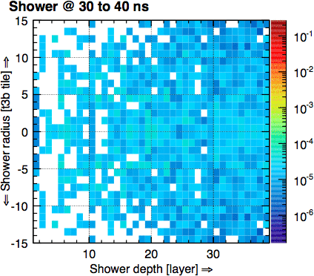
A Hadronic Shower in Real Time
Average 60 GeV pion shower in 4D:

Slide 13
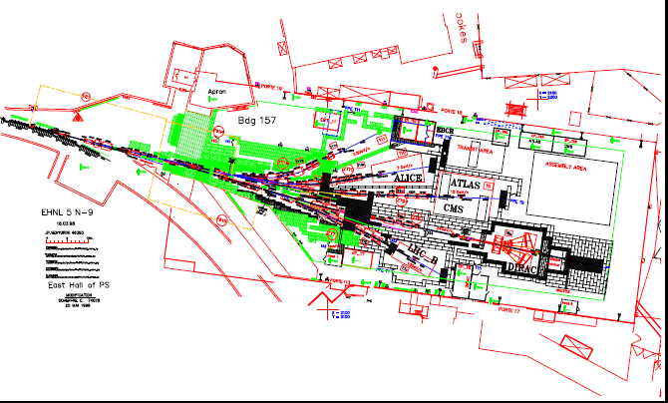
The Versatility of Test Beams at CERN
CERN
CERN East Area PS Test Beams

Slide 14
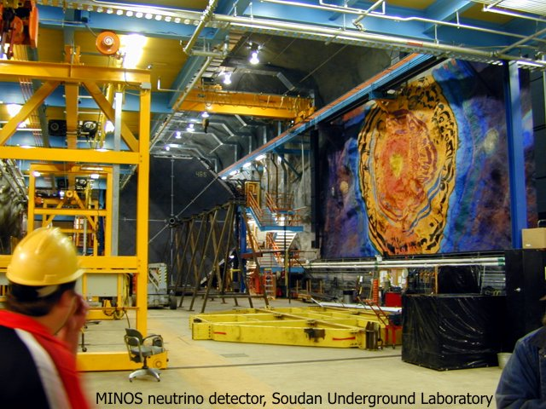
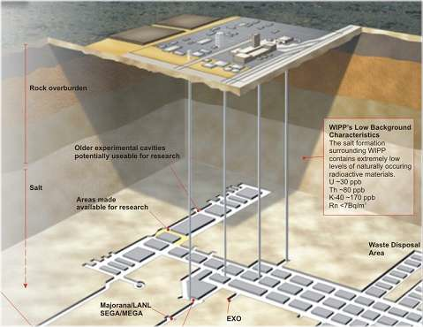
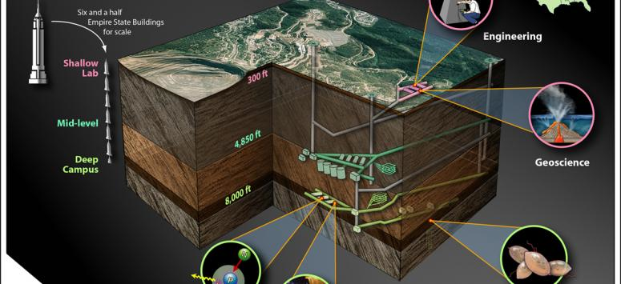
Underground labs
The only way to shield against cosmic ray induced backgrounds in test detectors is to locate them underground. There are a limited number of underground labs in the U.S. and only the NUMI tunnel at Fermilab has a beam going through it.
The NUMI beam is a good test bed for pulsed high energy neutrinos
WIPP
Soudan
Sanford
MINOS

Slide 15
High Intensity, Low Energy Facilities
It is quite common to perform irradiation survivability studies on detectors by placing them in a high intensity low energy proton or electron beam, or in mixed field areas, such as near a beam dump.
The HL-LHC detector upgrades demand an incredible rate and dose capability, that MUST be tested in high irradiation areas. Total doses will exceed 10¹⁶ particles per square cm in the vertex region
In addition, of course, high rate beams are vital for performing beam studies and can accommodate small experiments that test for rare interactions or symmetry violation processes

Slide 16
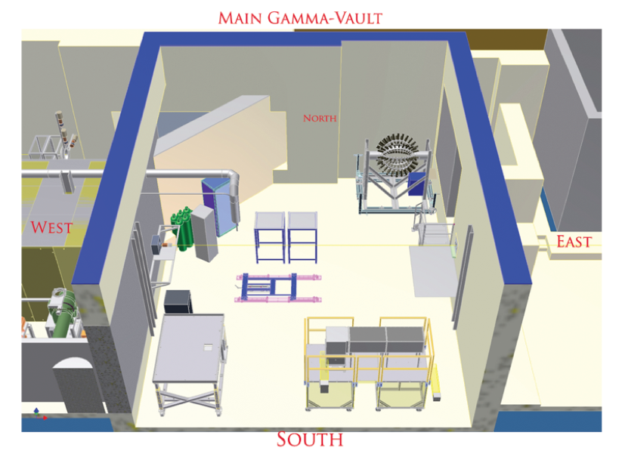
Moderate Intensity, Low Energy γ’s
HIGS (“High Intensity Gamma Source”
Triangle Universities
Compton Backscattered off of electrons in Duke Electron Storage Ring
Energies between 1‐100 MeV
Order of 5% energy spread
Fluxes on the order of 10⁸ per sec
Many other facilities provide reactor or source based irradiation capabilities:
e.g. U.Mass. Lowell Radiation Laboratory: 100 rad to 2 Mrad per hour

Slide 17
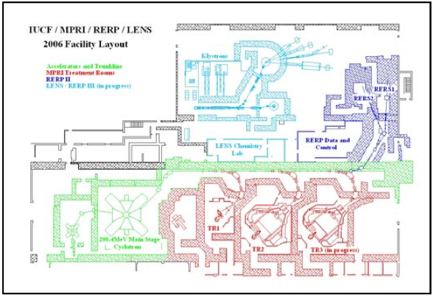
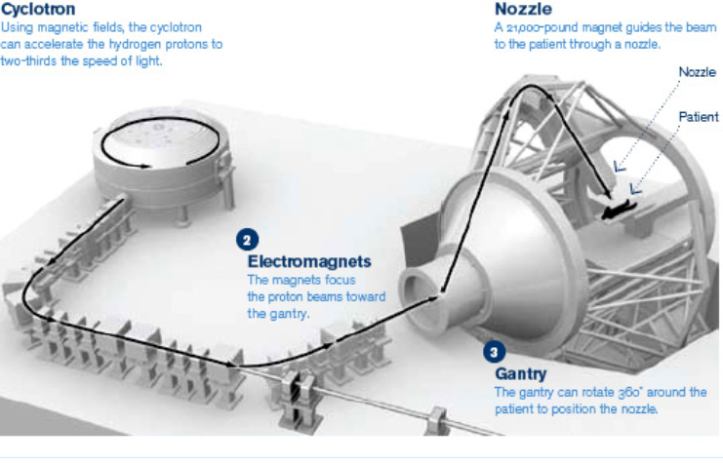
High Intensity, Low Energy Protons at University Cyclotrons and Medical Treatment Centers
Indiana University ISAT (“Integrated Science and Accelerator Technology”)
Proton Cyclotron 30-200 MeV
Flux 1E02 to 1E11 protons/cm2/sec
2-30 cm diameter beam
Loma Linda cyclotron allows for after hours experimental use. Beam is 230 Mev

Slide 18
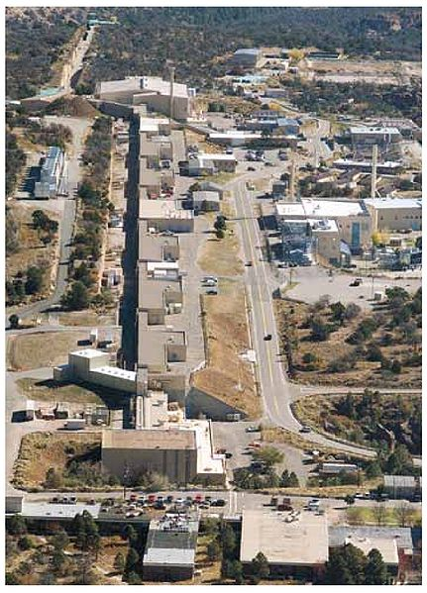
High Intensity, Low Energy Protons and Neutrons at Los Alamos
LANSCE=‘Los Alamos Neutron Science Center’
Has supported users for decades with several dedicated facilities:
Proton Radiography:
800 Mev protons
1 to 5E11 protons per pulse at 1 Hz
Lujan Neutron Scattering
Tungsten spallation with beam currents of 100 microamps
Cryogenic and high magnetic field capability
Source for ultra-cold neutrons

Slide 19
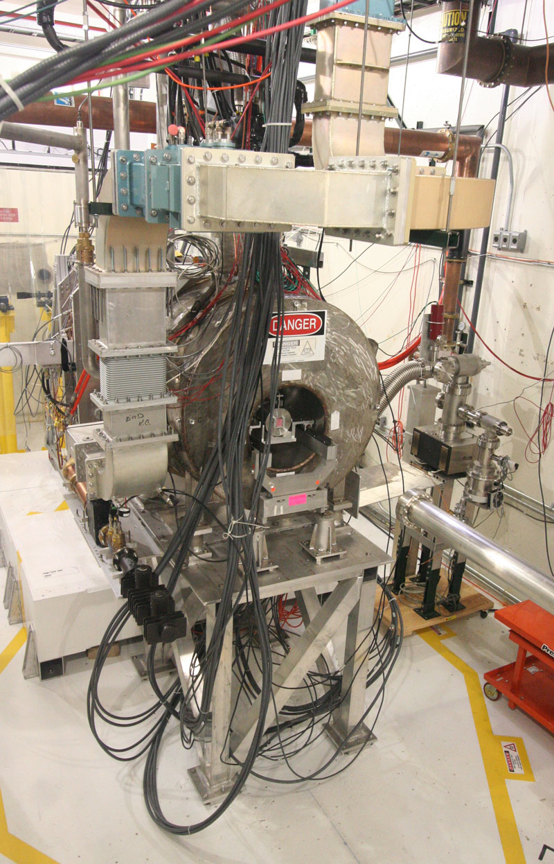
High Intensity Low Energy Protons at FNAL – ‘MTA’=MuCool Test Area
Purpose is to provide an experimental area for the MuCool project to test cavities inside high magnetic field, with intense beam.
400 MeV protons from Linac
1 Hz repetition rate with >1E12 beam available
No experiments beyond MuCool yet, but MOU’s are now considered

Slide 20
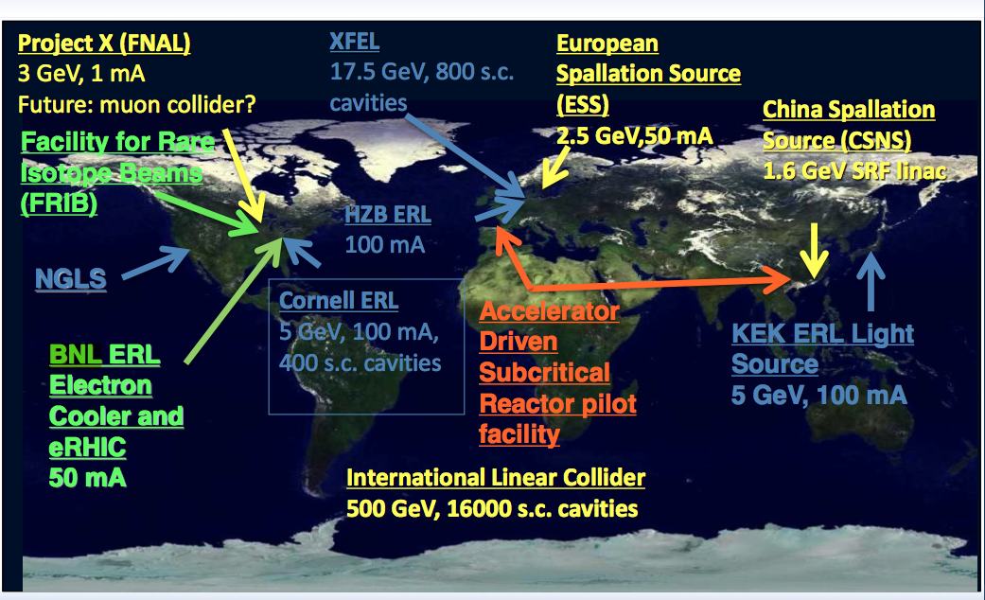
SCRF Cavities for Future Accelerators

Slide 21
JLAB’s Energy Recovery Linac (ERL) and FEL
Typical operation:
E = 130 MeV
135 pC pulses @ 75 MHz
The first high current ERL
provides a high intensity,
cost-effective platform
for HEP-related studies
Activities:
Search for Dark Matter
Cooling Ring Studies
Fixed Target Options

Slide 22
LIPPS Search for Dark Matter
JLAB search successfully excluded significant mixing regions in a modest 40 hour experimental run (note mass scale < 1E-3)
Notes:
22

Slide 23
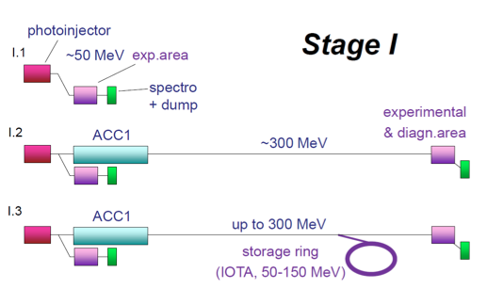
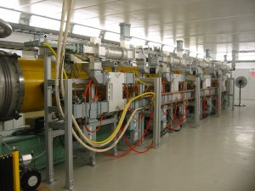
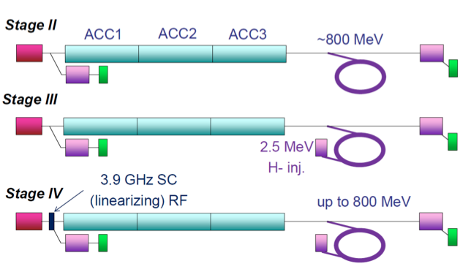
ASTA Proposal at FNAL
ASTA = ‘Advanced superconducting test accelerator’
Proposal to stage cryomodules together to steadily improve electron beam performance
SCRF ‘Cryomodule’

Slide 24
Experimental Program at ASTA
Electron Wave Function Size Measurements in IOTA Ring
LBNE Targetry Experiments
High strain rates induced by beam heating
Beam-induced thermomechanical shock of previously irradiated materials
Direct radiation damage of materials
A Tagged Photon Beam at ASTA for Detector R&D
Channeling radiation as a ultra-bright X-ray source
Compton Back scattered beam:
Measurement of Nuclear Processes Important to Astrophysics
R&D toward a next generation photo-fission source of isotopes

Slide 25
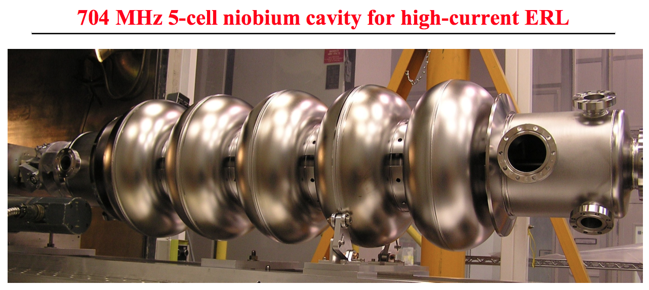
Brookhaven ERL Lab in Support of eRHIC

Slide 26
Workshop to Explore Physics Opportunities with
Intense, Polarized Electron Beams up to 300 MeV
March 14th-16th, 2013 at MIT
http://web.mit.edu/lns/PEB_Workshop/
Plenary Sessions
Dark photon physics Maxim Pospelov
Parity violation physics Yury Kolomensky
Precision nucleon structure Carl Carlson
Nuclear astrophysics Achim Schwenk Jlab FEL Accelerator Complex David Douglas
Mainz/MESA Kurt Aulenbacher
BNL ERL development Ilan Ben-Zvi
Polarized e-source development Matt Poelker
Precision electron polarimetry Eugene Chudakov
Parallel Sessions on dark photons, parity violation, precision nucleon structure, experiments with nuclei, and technology

Slide 27
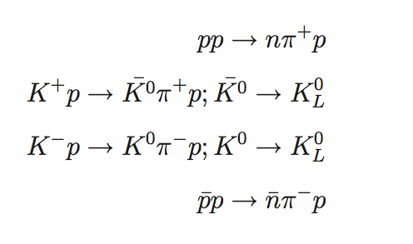
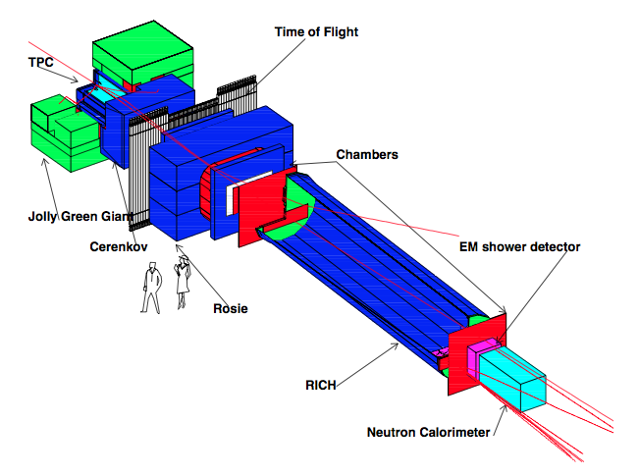
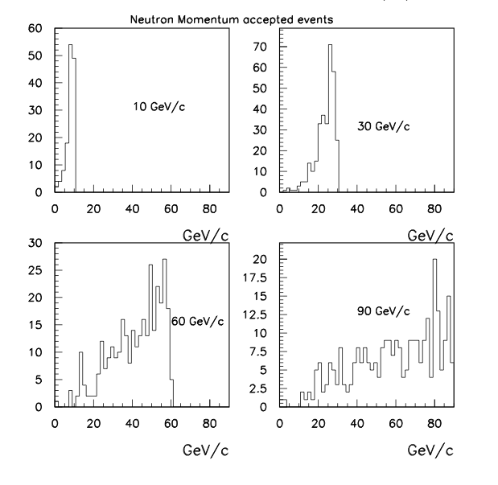
What are we missing?
How about a tagged high energy neutrals beam, for development of hadron calorimetry?
Neutron energy spectrum as a function of incoming proton energy
MIPP apparatus at Fermilab (still extant)

Slide 28
Summary
The field of particle physics involves a tremendous range of particle energies, intensities and species.
As demonstrated here, to develop and test detector technology and perform demonstration level experiments, it is important to match this variety with an appropriate set of beam facilities, open to users. These include:
High energy, low intensity hadron and electron beams
Tagged multi-species low energy beams, including photons
High intensity, low energy proton, electron and neutron beams
A set of already developed accelerator test-beds exist within the national laboratory system, and is being exploited.
New facilities will take performance to the next stage
Need to develop detector and experimental initiatives to match them

