Slide 1
Dielectric Laser Acceleration

Slide 2
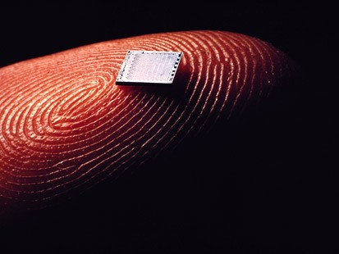
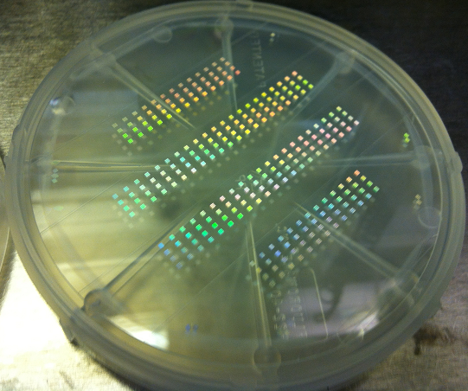
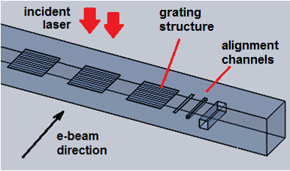
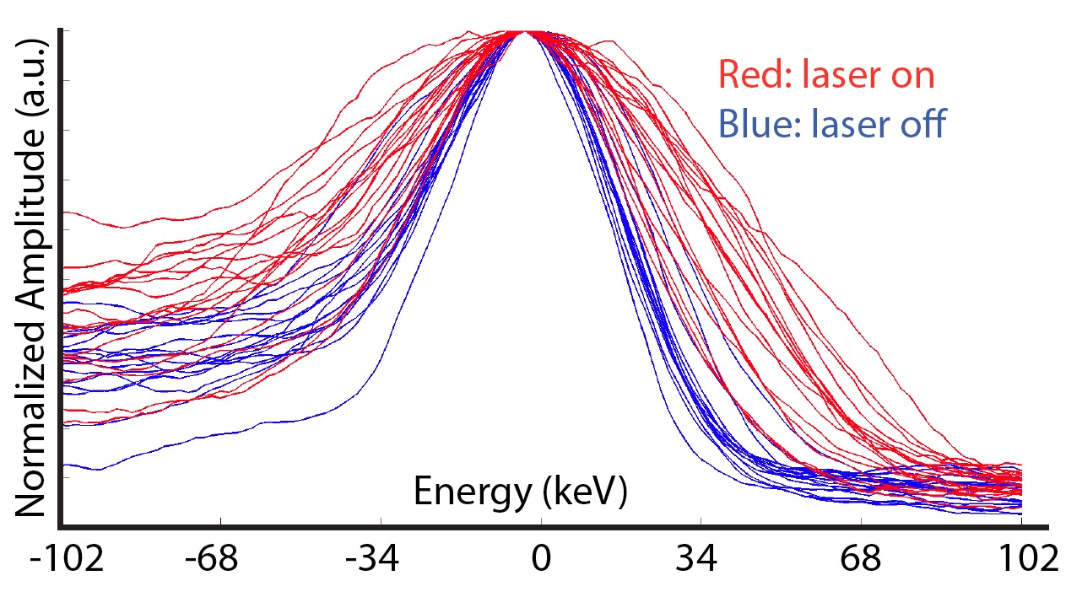
Dielectric Laser Acceleration (DLA)
"Accelerator-on-a-chip"
laser-driven microstructures
• lasers: high rep rates, strong field gradients, commercial support
• dielectrics: higher breakdown threshold → higher gradients
(>1 GV/m), leverage industrial fabrication processes
bonded silica phase reset accelerator prototypes fabricated at SLAC/Stanford
lower cost, more compact, higher gradient
Observed electron energy modulation from laser interaction (Dec. 2012)
gradient
Wafer is
diced into
individual
samples
for e-beam
tests.
Notes:
Traditional metal cavity accelerators can be scaled to higher frequencies, such as X-band to attempt to get higher gradient. But one is ultimately limited by machining tolerances, the proliferation of transverse wakefields, and the electric field breakdown limit of around 100 MV/m.
Continuing the trend to smaller structures into the optical and IR regime opens up the possibility of driving an accelerator using lasers, which can have peak field gradients of 0.5 GV/m and are more readily and cheaply available commercially than high-power microwave sources. Such structures could also be made of dielectric materials, which have damage thresholds in the GV/m range.
A few of the candidate structures that have been considered are shown here.

Slide 3
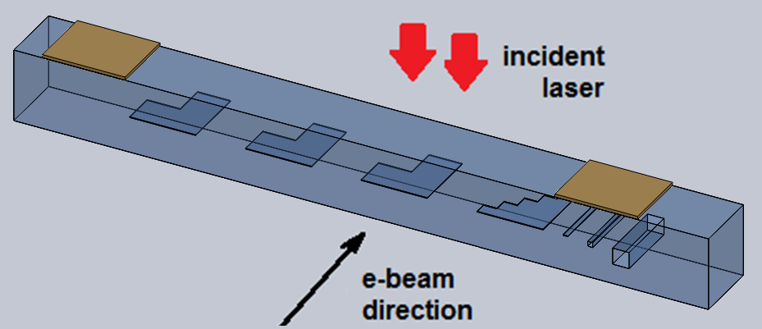
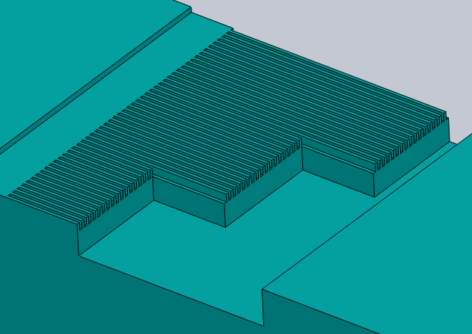
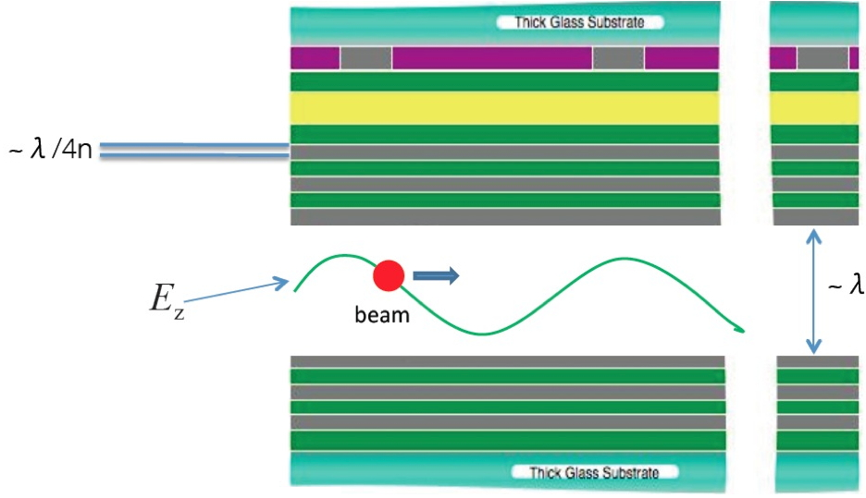
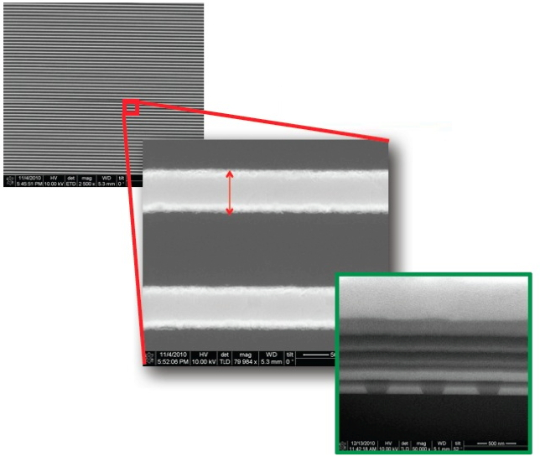
Recently Fabricated Prototypes
Enhanced Dual-Grating Silica Structures
SLAC/Stanford E163:
Multi-length gratings
1x 400nm gap
1x 800nm gap
1x1200nm gap
1x test structure
Symmetric process
Alignment channels
- IR reflectors (for laser alignment)
(one half shown only)
Multi-length
400 nm gap
Micro-Accelerator Platform
UCLA MAP (G.Travish)
- Initial prototypes recently completed and tested at SLAC.

Slide 4
DLA Results to Date
Fabrication of DLA Accelerators & SubComponents
• Fabrication of first demonstration-ready grating accelerator prototype (Aug 2011).
• Completed the first fully assembled 17-layer silicon woodpile accelerator (June 2012).
Simulation and Theory
• Simulation of high-efficiency (>95%) waveguide coupling technique (June 2012).
• Simulation of particle transport through many-period optical structures (Dec 2012).
• Design of novel DLA-based high-resolution beam position monitor (March 2012).
Benchtop and Electron Beam Testing
• Attosecond microbunching and net acceleration with ITR foil (2008).
• Detailed IR damage studies performed to identify robust materials (2009-2012).
• Demonstration of TM mode excitation in a photonic crystal accelerator (2011).
• First powered acceleration tests of completed DLA prototypes (2011-2012).
• First observation of acceleration in a DLA structure! (Dec 2012).

Slide 5
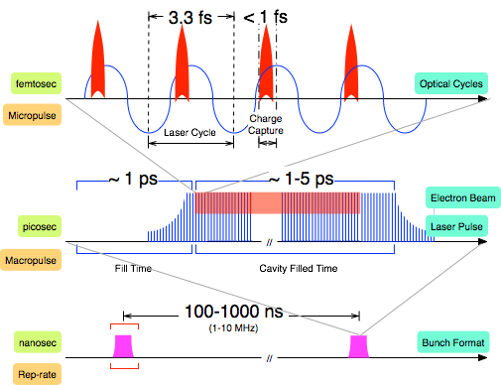
Optical structures naturally have sub-fs time scales and favor high repetition rate operation
Pulse Format

Slide 6
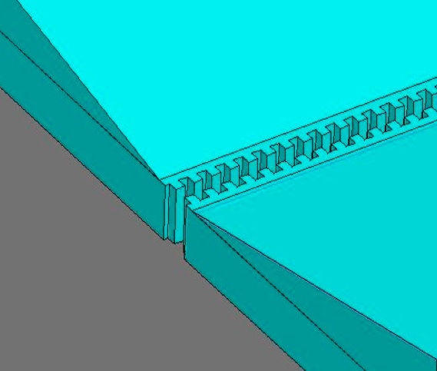
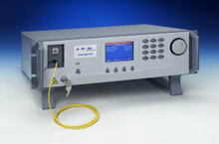
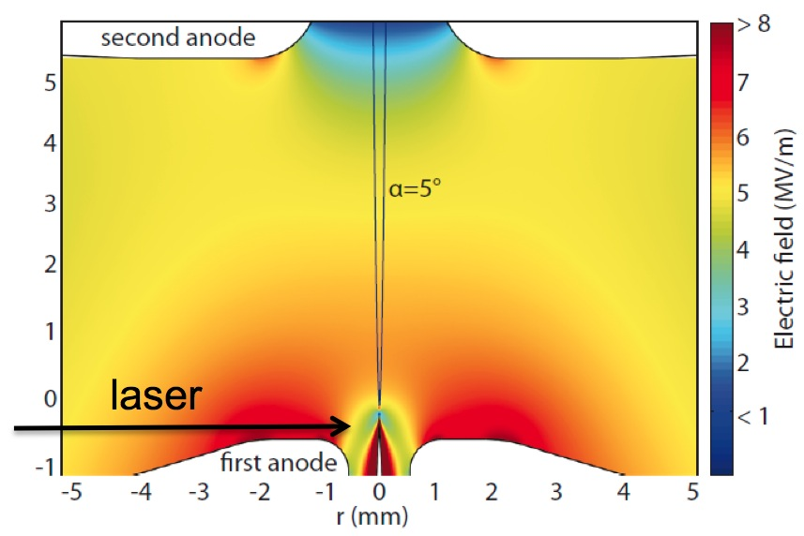
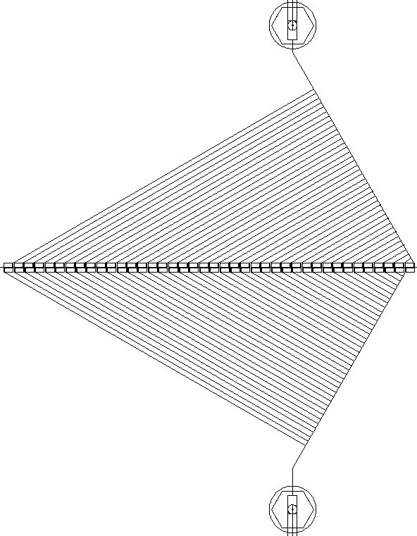
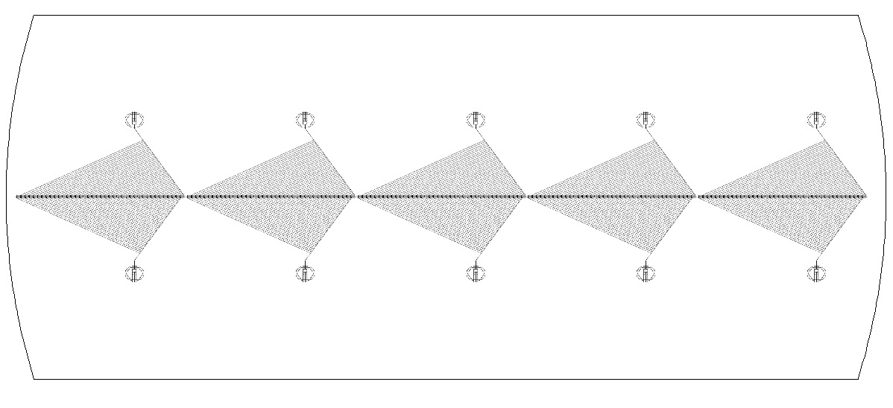
DLA Collider Concept
5 fiber lasers per
6'' wafer module
2 kW per laser
concept for 1 DLA accelerator structure (E. Peralta)
e-
Interaction Point
Thulium fiber laser λ=2 µm
1.5 TeV ⬄ 3.75 km ⬄ 62,000 lasers
needle emitter and
injector module
accelerator wafers
final focus and steering wafers
fiber laser feeds
Loop period=beam repetition rate
tungsten field emission
tip design (P. Hommelhoff)
Phase control
single 6'' accelerator wafer
5 modules per wafer
5 fiber feeds per wafer
40 stages per module
1 module = 40 mm long
1 stage = 750 µm long

Slide 7
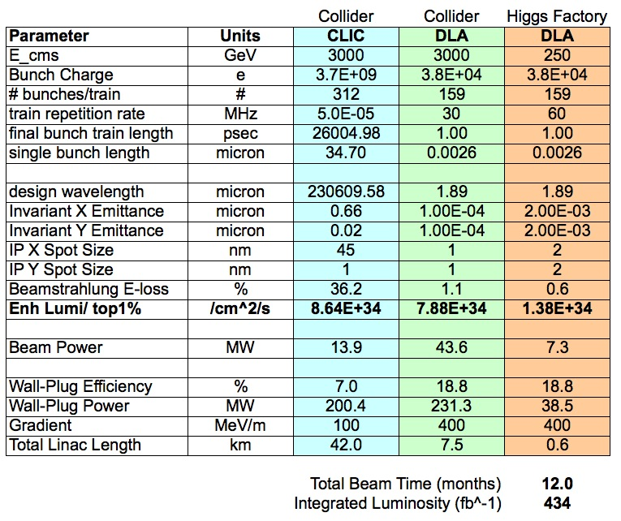
Strawman Parameter Table

Slide 8
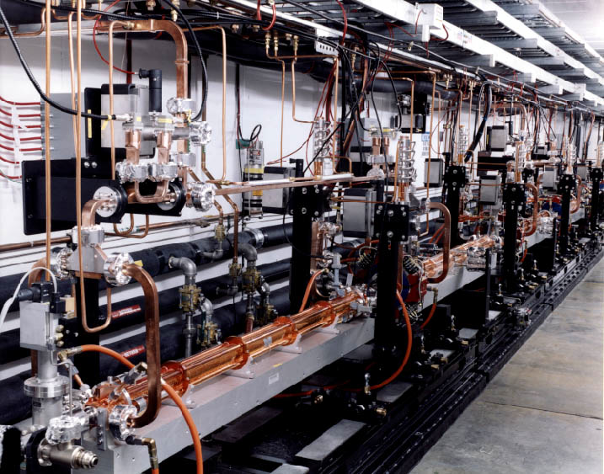
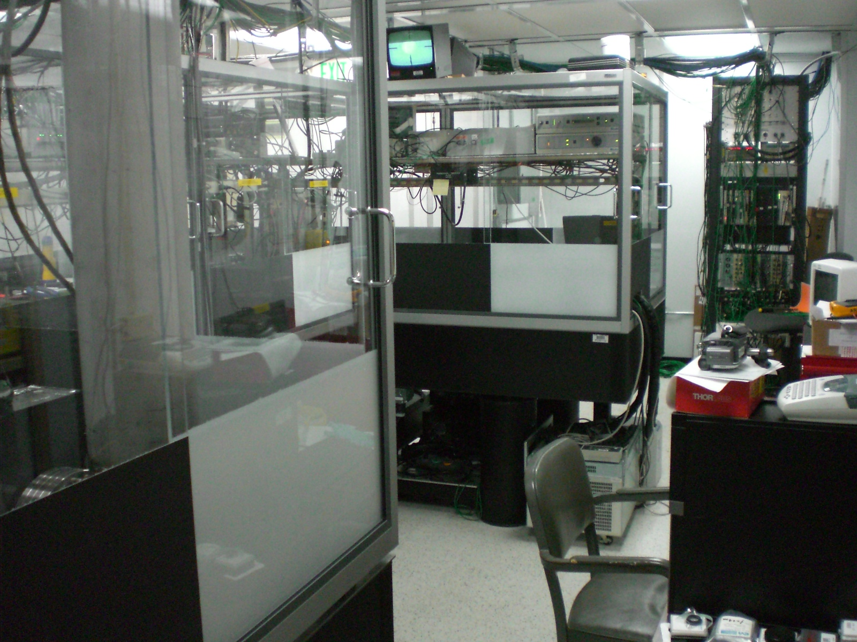
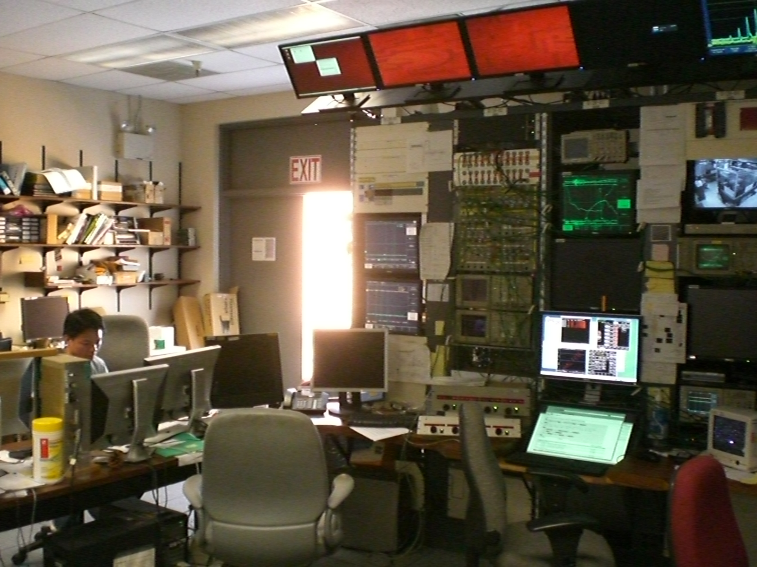
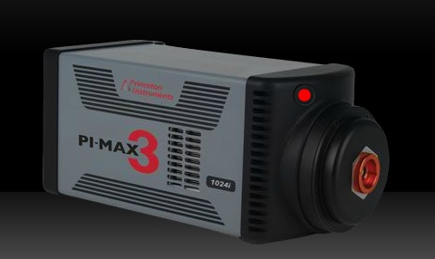
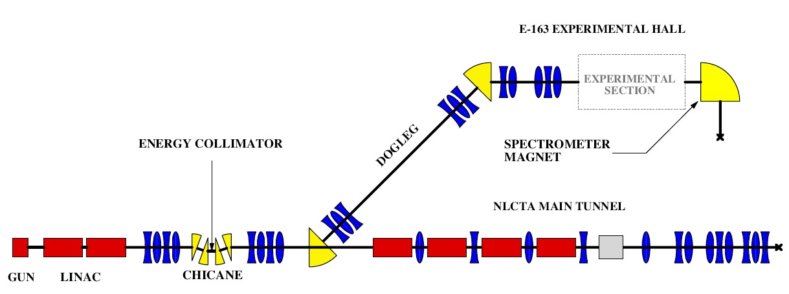
DLA Test Facility at SLAC
E163 @ NLCTA: A facility for testing laser-driven accelerator structures.
Beam energy = 60MeV; σ_{t} = 1ps; σ_{E} = 0.1%; 800nm Ti:Sapph laser
Ce:YAG
Class 10,000 Laser Room
Control Room
PI-MAX3
Intensified
CCD
NLCTA Beamline
~10 m

Slide 9
Future Test Facility Requirements
Traditional RF electron sources can be used for proof-of-principle experiments, but demonstrating future multi-stage devices will require new capabilities
e-Beam Requirements
nm-scale emittance
attosecond optical bunching
laser triggered, 1000 e-/bunch
1 MeV energy
Laser Requirements
1-2 um wavelength
Tuneable pulse length (100fs to 5ps)
1-50 MHz rep rates, modelocked
>1uJ pulse energy
Possible Approaches
• adapted TEM source
• needle-tip field emitter
+ low-beta pre-injector
• Thulium-doped fiber laser R&D
• Amplified Erbium-doped lasers
• proximity to nanofabrication facilities
• strong university participation & collaboration
• national lab accelerator expertise
Other Desirable
Features:

Slide 10
Unique testing needs for DLAs
Optical phase synchronization over km-scale lengths
nm-scale structure alignment over km-scale lengths
Laser pulse shaping to compensate for beam loading
Measurement of radiation damage to optical materials
Several m of test beam line for testing optical focusing schemes

Slide 11
5-Year Roadmap
Draft of funding profile for a multi-institution research program to develop a scalable DLA design on a 5-year time scale.

Slide 12
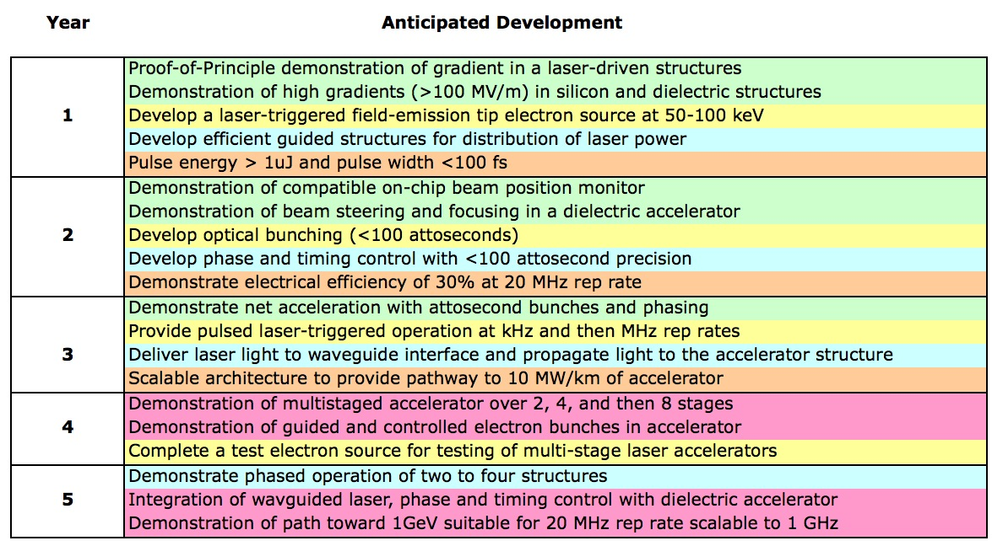
Roadmap Goals by Year

Slide 13
Risk Assessment
Issue | Risk | Time Scale to Solve
Pulsed e- sources with nm emittance | Medium | 5 years
Pulsed e+ sources with nm emittance | High | Unknown
Technology still in proof of principle stage | Medium | 1-2 years
Sub-micron co-alignment over 7 km | Medium | 5 years (see LIGO)
Developing near 100% efficient power distribution capability | Medium | 5-10 years
Availability of suitable laser sources | Low | 3 years
Combined technology demonstration (e.g. via a scaled-down test facility) | High | 5-10 years depending on funding & effort

