Slide 1
Linear Collider based on Short Pulse Two-Beam Accelerator Technology
Chunguang Jing
(HEP ANL/ Euclid Techlabs)
UC miniworkshop, Feb 25. 2013

Slide 2
Outline
Concept of Argonne Flexible Linear Collider
250GeV Higgs Factory
AWA---Test bed for short pulse high gradient technologies
Other

Slide 3
Argonne Flexible Linear Collider (based on AWA short pulse, high power, high gradient technologies)
Core of Concept:
Short rf pulse: tens of nanosecond
Modular TBA scheme: energy scalable easily
Flexible drive beam structure

Slide 4
1. Short rf pulse w/ a high efficiency
  TBA scheme in the main linac →fast rf rise time.
  Broad band TW accelerator→fast rf rise time.
  Large (~10%c) Vg → less filling time.
  high frequency and optimal beam loading → higher rf-to-beam efficiency.
e.g. rf-to-beam efficiency of a 26GHz Short Pulse Accelerator:
Competitive rf-beam efficiency for the short pulse TBA
T_{rf}=28ns
3ns
3ns
5.2A
120MeV/m
0.3m
13ns
T_{f}=9ns
316MW
25ns
T_{beam}=13ns=338rf cycles ,1bunch/2 rf periods, 0.4nC/bunch

Slide 5
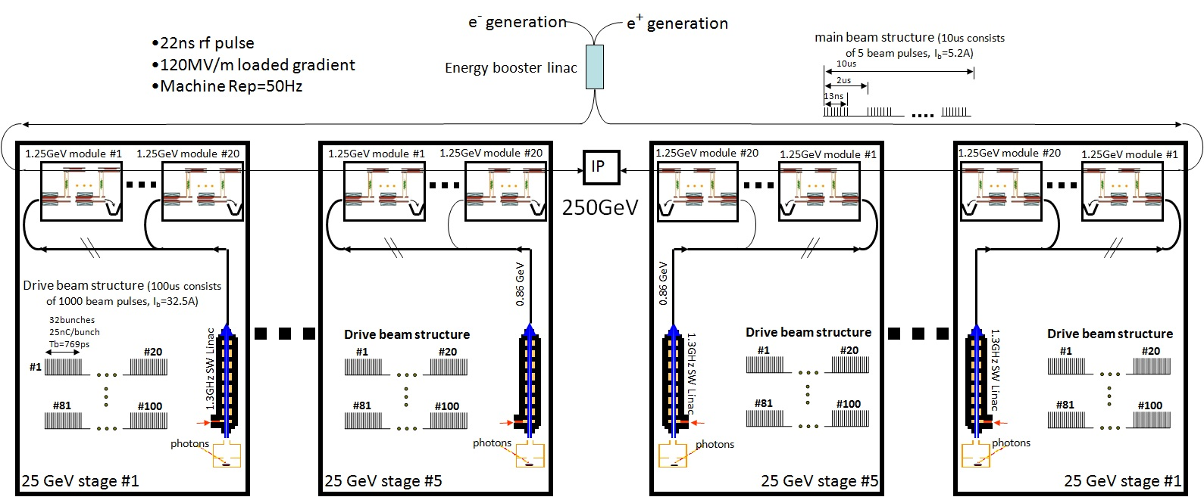
2. Modular TBA scheme
Layout of the ANL 26GHz 250GeV Flexible Linear Collider
Identical

Slide 6
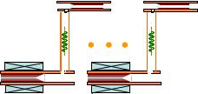

3. Flexible drive beam structure
1.25GeV module #1
1.25GeV module #20
main beam structure (10us consists of 5 beam pulses, I_{b}=5.2A)
10us
2us
13ns
860MeV
Drive beam structure (10us consists of 100 beam pulses, I_{b}=32.5A)
32bunches 25nC/bunch Tb=769ps
#20
#1
1.3GHz SW Linac
#81
#100
photons
25 GeV Stage

Slide 7
Design of the 250GeV K-band (26GHz) Dielectric Accelerator Based Linear Collider
Features:
Dielectric based TBA scheme
~20ns rf pulse, ~120MV/m loaded gradient
~4.2MW beam power, ~4.7% wall plug efficiency, <100MW grid power

Slide 8
ANL K-Band 250GeV Higgs Factory
4km
1.5km linac
1.5km linac

Slide 9
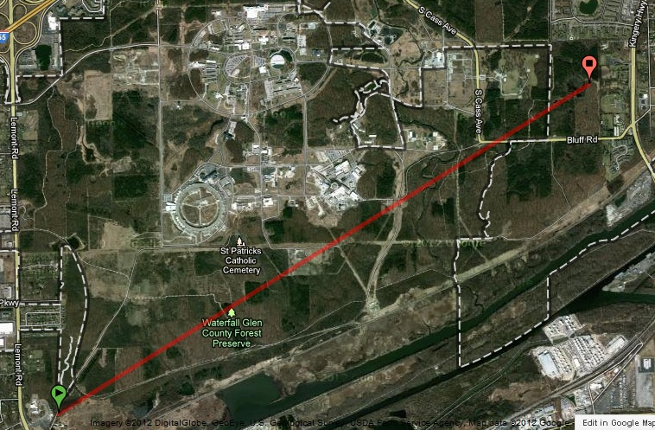
Let’s survey the Argonne campus
5.2km

Slide 10
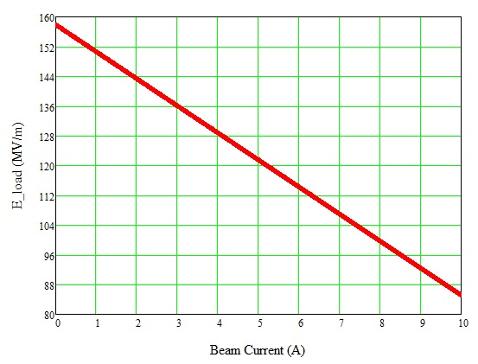
Some technical details:
1.25GeV module (15m) (35 DWPE & 35 DLA→ fill factor=70%)
1.25GeV module #1
1.25GeV module #20
333MW output/Dielectric PETS; 5% rf transportation loss; E_{load} =120MV/m (I_{b}=5.2A);
860MeV
Drive beam structure (10us consists of 100 beam pulses, I_{b}=32.5A)
Drive beam (860MeV) becomes 97MeV, main beam gain 1.25GeV
32bunches 25nC/bunch Tb=769ps
#20
#1
1.3GHz SW Linac
#81
#100
photons
25 GeV Stage

Slide 11
Power and efficiency flow chart (rough estimation)
Wall Plug
90.4MW
70.4MW
η_{AC-rf}=55%
Main beam injection, magnets, services, infrastructure, and detector
Power supplies to klystrons gallery
20MW*
38.7MW
* Scaled to CLIC design
Drive beam acceleration
η_{rf-drive}=89%
η_{total}=4.7%
34.4MW
Drive beam Dumps
DPETS
14.4MW
 | (125GeV,e⁻)
Ave. drive beam current | 20 mA
Ave. drive beam power | 17.2 MW
Ave. main beam current | 16.9 uA
Ave. main beam power | 2.11MW
η_{rf-tran}=95%
13.7MW
η_{rf-main}=30.8%
Main linac
4.22MW
Main beam

Slide 12
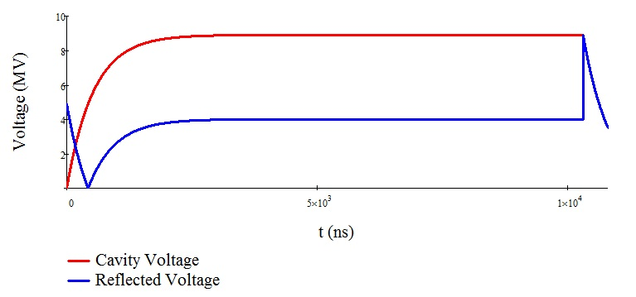
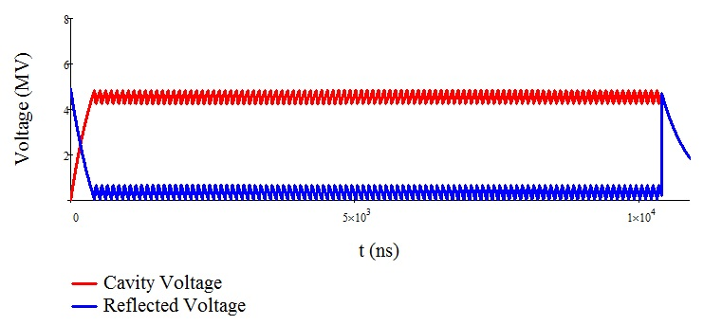
Drive beam accelerator
RF in
High β SW linac
To enhance RF power delivered to the beam
Low reflection (P_{R} min)
Low wall loss (P_{d} min)
High beam loading (P_{b}/P_{F} max)
Drive beam
β=10, Rs=12Mohm
drive bunch train
32.5A
80ns
Ave. energy gain = 4.8MeV/structure , powered by a 20MW 10us Klystron. ~180 KLs are needed to 860MeV drive beam, ~1800 KLs for total machine.
20ns
Beam off
Beam on

Slide 13
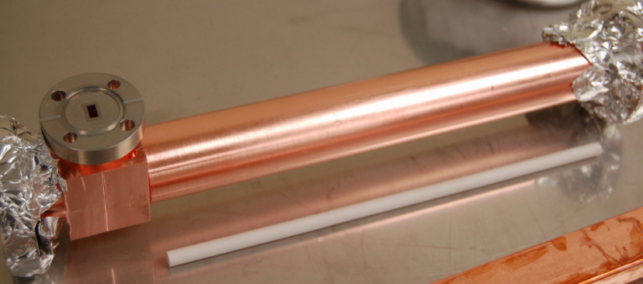
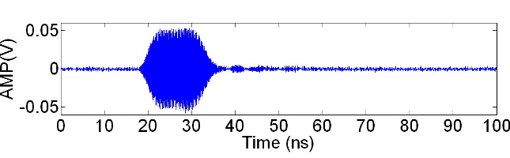
Dielectric Wakefield Power Extractor:
Parameters of 26GHz Dielectric Based Wakefield Power Extractor
Geometric and accelerating parameters | value
ID / OD of dielectric tube | 7 mm /9.068 mm
Dielectric constant | 6.64
Length of dielectric tubes | 300 mm
Vg | 0.254c
R/Q | 9788 Ω/m
Rf pulse rise time | 2.9 ns
BW_{_3dB} of the requested coupler | 120MHz
Steady power (25nC/bunch,σ_{z}=1mm) | 333 MW
RF pulse duration (32 bunches) | 22ns (flat top)
Peak Gradient | 84MV/m
Max Energy loss of the beam in the steady state | 21.8MeV

Slide 14
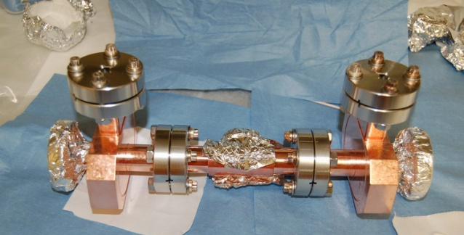
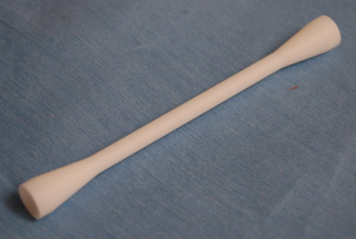
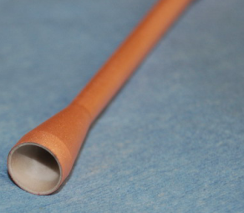
Dielectric Accelerator:
Parameters of 26GHz Dielectric Based Accelerator
Geometric and accelerating parameters | value
ID / OD of dielectric tube | 3 mm /5.025 mm
Dielectric constant | 9.7
Length of dielectric tubes | 300 mm
Vg | 11.13%c
T_{fill} | 9ns
R/Q | 21.98 kΩ/m
Q (loss tan=10^-4) | 2295
Shunt impedance | 50.44 MΩ/m
BW_{_3dB} of the requested coupler | 120 MHz
E_{acc} for 316MW input | 158 MV/m
E_{load} for 316MW input | 120 MV/m

Slide 15
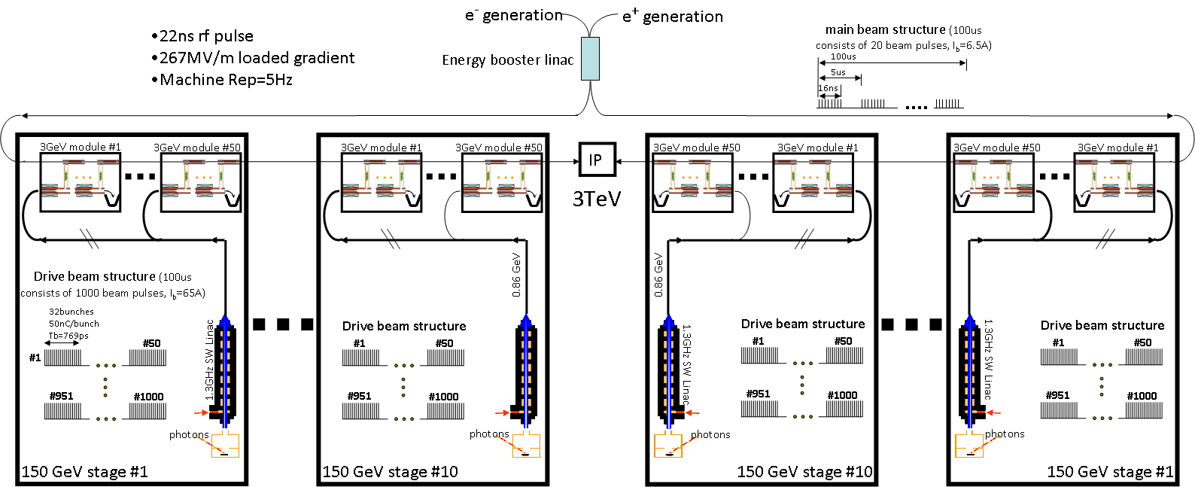
Using the same dielectric short pulse concept, energy of LC can be expandable from Multiple hundreds GeV to Multi-TeV.
Layout of the ANL 26GHz 3TeV Flexible Linear Collider

Slide 16
250GeV X-band Metallic Structure Based Linear Collider
Short rf pulse LC concept works well with dielectric accelerators, however, with sacrificing some parameters, it works with metallic structures as well.
Features:
Using matured X-band RF technologies
~50ns rf pulse, ~85MV/m loaded gradient, eliminating concerns of rf breakdown
~4.2MW beam power, ~3.4% wall plug efficiency, ~125MW grid power

Slide 17
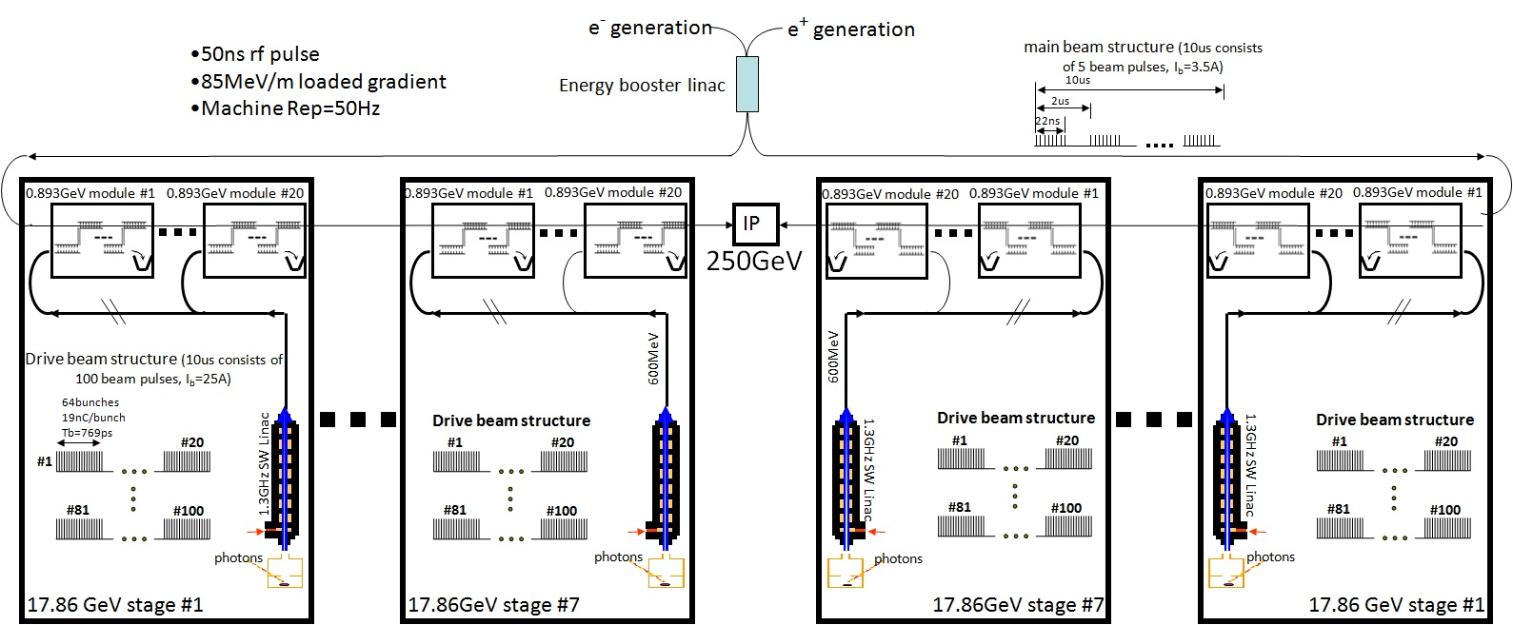
ANL X-band Metallic Accelerator Based 250GeV LC
5.2km
2.1km linac
2.1km linac

Slide 18
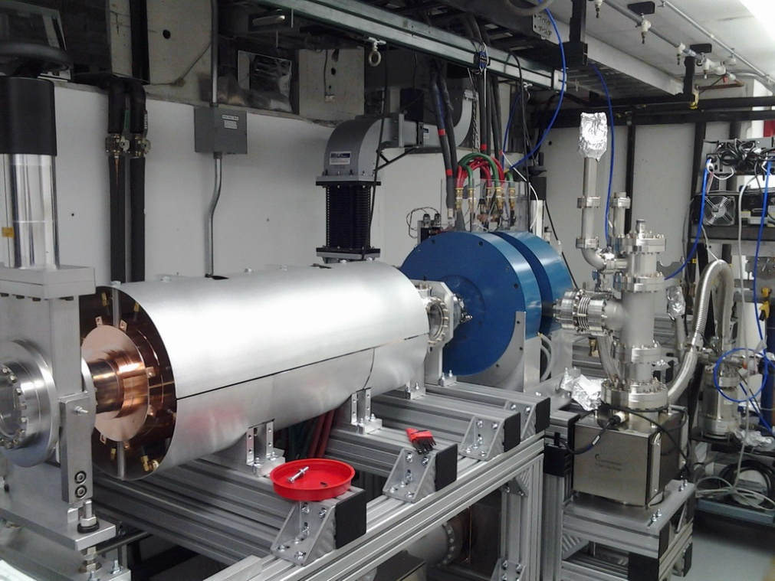
AWA Facility---Test Bed for short pulse TBA technology: 75 MeV Drive Beam+ 15MeV witness beam
Basic parameters for the drive beam:
1.3GHz Photogun w/ CsTe cathode
75 MeV, 1 – 100 nC (reached 150 nC)
1~2.5 mm bunch length (a bunch compressor is planned )
Normalized emittance < 200 mm mrad (at 100 nC)
Bunch train operation: 32 X 30nC or 10 X 100nC
Beam power: 3GW or 10GW
New drive gun w/ CsTe cathode
Experiments forecast in 5 years:
High power rf generation: 0.1~1GW, ~20ns duration, frequency covers cm to mm wave.
Two beam acceleration: >200MeV/m energy gain (short rf pulse, ~20ns).
Collinear wakefield acceleration: >300MeV/m energy gain.
Bunch shaping to improve efficiency for collinear wakefield acceleration

Slide 19
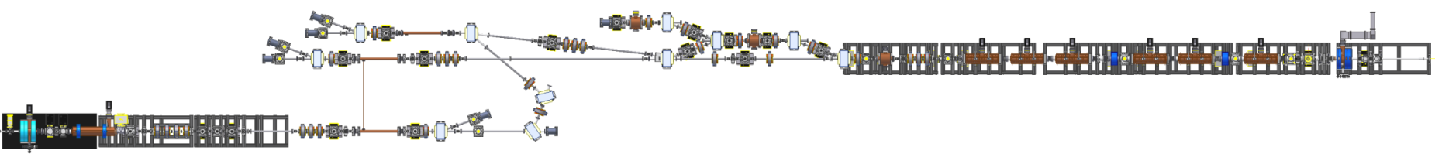
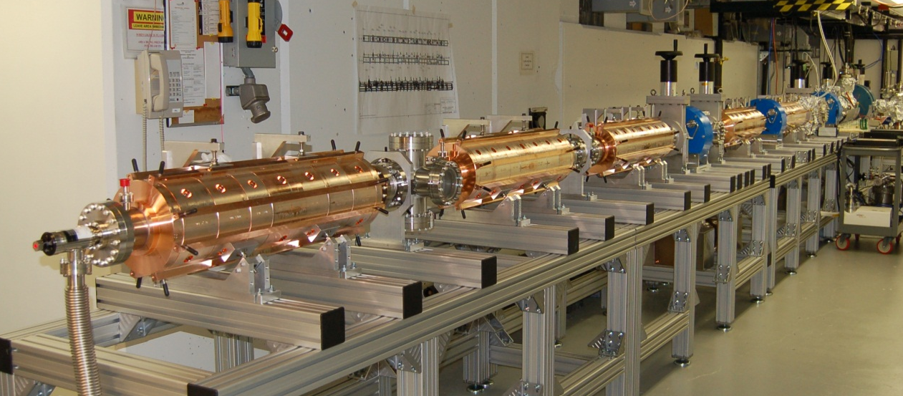
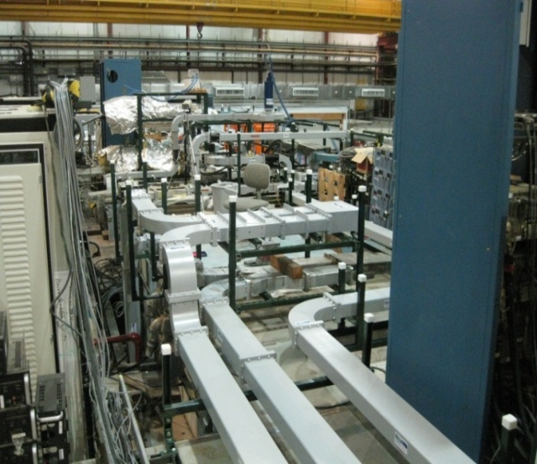
AWA Facility---Test Bed for short pulse TBA technology:
experimental area (TBA, Collinear, and bunch shaping)
75 MeV drive beam
15 MeV witness beam
Jan. 28, 2013

Slide 20
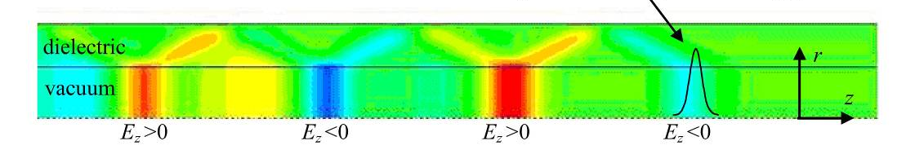
Collinear Dielectric Wakefield Accelerator to drive the future X-ray FEL

Slide 21
Motivation
Light source is an intrinsic requirement for current and future scientific research. Particularly, ultrashort x-ray pulses are a powerful tool for addressing grand challenges in science.
  e.g. LCLS came online in April 2010, but had received 314 proposals from 1,094 scientists in 25 countries to compete for a few opportunities.
One particular obstacle limiting construction of FEL light source facilities is the cost, particularly, linacs to provide high energy, high brightness beam.
  wanted: gradient >100MV/m, peak current >1KA, rep~1MHz, E~ a few GeV, etc.
In the past few years, the field of high gradient acceleration, aimed at the future high energy linear collider, achieved many impressive results.
  e.g. GV/m level in THz and 100MV/m in MW have been demonstrated in DWA structures.
Share the same key technologies to the dielectric collinear wakefield collider scheme, including transformer ratio enhancement, DWA structure development, staging, etc.

Slide 22
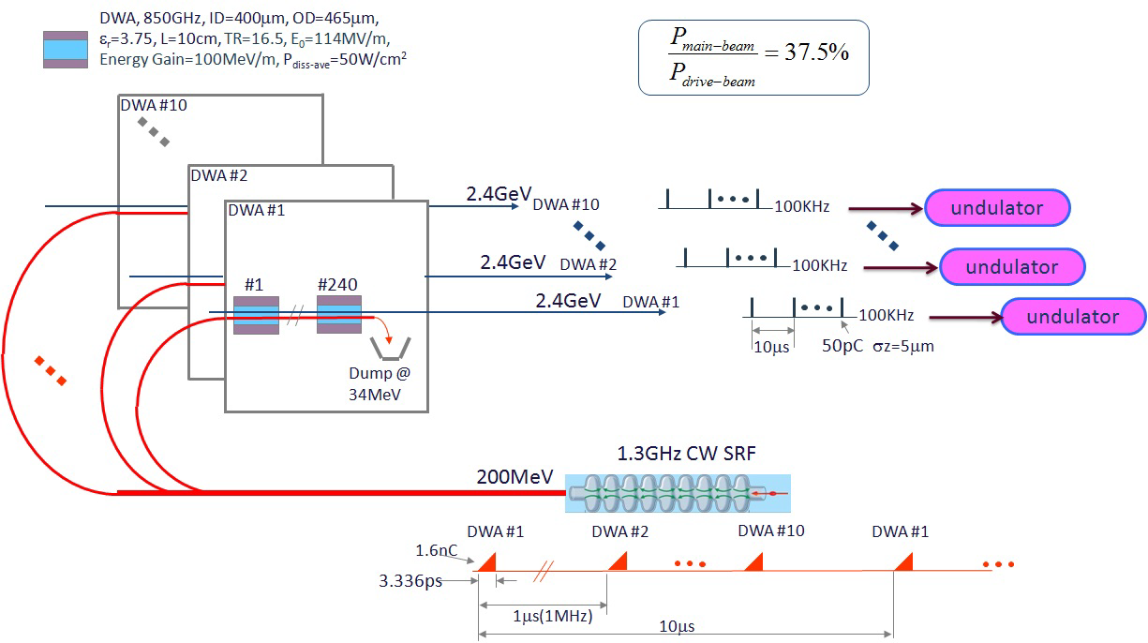
A Schematic of a FEL facility based on a 2.4 GeV DWA
Reduce construction and operational costs of a high bunch rep. rate FEL facility:
  accelerating gradient > 100 MV/m, -- peak current > 1KA,
  bunch rep. rate of the order of 1MHz, -- electron beam energy of a few GeV

Slide 23
Summary
  Multi-hundred GeV linear collider, the next HEP machine, can be built with short pulse, high power, high gradient technologies currently being developed at AWA. Other facilities, like Fermi ASTA, is also an idea test bed for advanced accelerator concepts, like dielectric wakefield acceleration.

