Slide 1
The U.S. Muon Accelerator Program
Mark Palmer
Frontier Facilities Meeting
University of Chicago
February 25, 2013

Slide 2
Program OveRVIEW

Slide 3
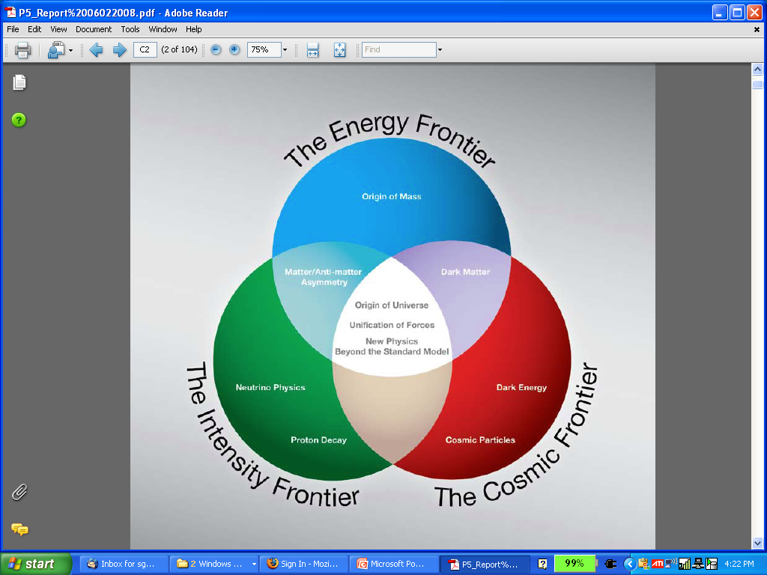
Why a Muon Accelerator Program?
  Muon accelerator R&D is focused on developing facilities that can address critical questions on two frontiers…
  The Intensity Frontier:
  with a Neutrino Factory producing well-characterized ν beams for precise, high sensitivity studies
  The Energy Frontier:
  with a Muon Collider capable of reaching the multi-TeV center-of-mass energies
The unique potential of a facility based on muon accelerators is physics reach that spans 2 frontiers

Slide 4
Muon Accelerator Physics Scope
Energy
Frontier
Intensity
Frontier

Slide 5
Muon Accelerators
Program Baselines

Slide 6
The Muon Accelerator Program Timeline
 | 2010 |  | ~2020 |  | ~2030
Muon Accelerator R&D Phase
Proton Driver Implementation (Project X @ FNAL)
Intensity Frontier
Energy Frontier
MAP Feasibility Assessment
Advanced Systems R&D
Muon Ionization Cooling Experiment (MICE)
Indicates a date when
an informed decision
should be possible
Proj X Ph I
Proj X Ph II
Proj X Ph III & IV
IDS-NF RDR
Proposed Muon Storage Ring Facility (νSTORM)
Evolution to Full Spec ν Factory
Collider Conceptual ➔ Technical Design
Collider Construction ➔
Physics Program
Notes:
Yellow diamonds indicate potential start of DOE CD process

Slide 7
MAP Goals
Within the 6-year time frame:
To deliver results that will permit the high-energy physics community to make an informed choice of the optimal path to a high-energy lepton collider
and/or a next-generation neutrino beam facility
As well as…
To explore the path towards a facility that can provide cutting edge performance at both the Intensity Frontier and the Energy Frontier
To validate the concepts that would enable the Fermilab accelerator complex to support these goals

Slide 8
Muon Collider

Slide 9
Muon Collider Concept
Muon Collider Block Diagram
Proton source:
For example PROJECT X at 4 MW, with 2±1 ns long bunches
Goal:
Produce a high intensity μ beam whose 6D phase space is reduced by a factor of ~10⁶-10⁷ from its value at the production target
Collider: √s = 3 TeV
Circumference 4.5km
L = 3×10³⁴ cm⁻²s⁻¹
μ/bunch = 2x10¹²
σ(p)/p = 0.1%
ε_{⊥N} = 25 μm, ε_{||N}=70 mm
β* = 5mm
Rep. Rate = 12 Hz

Slide 10
Muon Collider Parameters
3-4 MeV CoM
Energy Spread

Slide 11
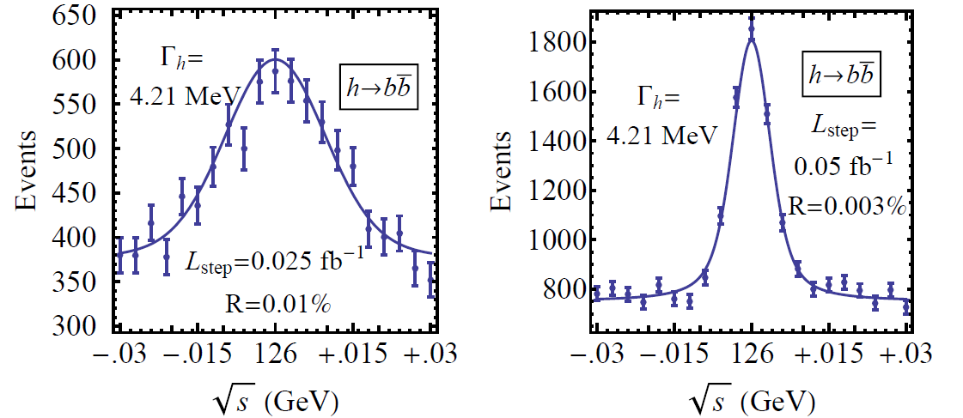
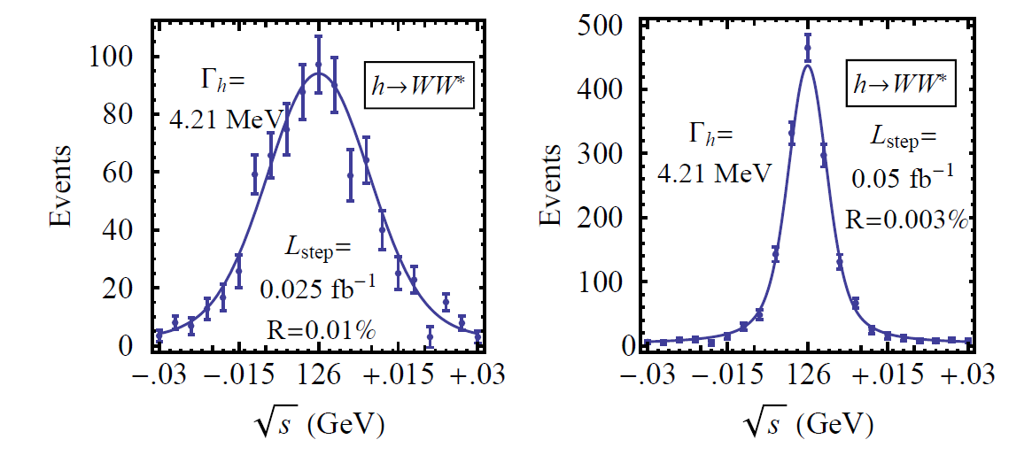
126 GeV Higgs Factory
s-channel coupling of Muons to HIGGS with high cross sections:
Muon Collider of with L = 10³² cm⁻²s⁻¹ @ 63 GeV/beam (50000 Higgs/year)
Competitive with e+/e- Linear Collider with L = 2. 10³⁴ cm⁻²s⁻¹ @ 126 GeV/beam
Sharp resonance: momentum spread ~ 4 × 10⁻⁵
Han and Liu
hep-ph 1210.7803
~30 T HTS Final
Cooling Solenoids
Reduced cooling:
ε_{⊥N} =0.3π⋅mm⋅rad,
ε_{||N} =1π⋅mm⋅rad
Major advantage for Physics of a μ⁺μ⁻ Higgs Factory: possibility of direct measurement of the Higgs boson width (Γ~4MeV FWHM expected)

Slide 12
Muon Collider - Neutrino Factory Comparison
NEUTRINO FACTORY
ν Factory Goal:
O(10²¹) μ/year
within the
accelerator
acceptance
Share same complex
MUON COLLIDER

Slide 13
Critical R&D AREAs

Slide 14
Overview of R&D Areas
Design Studies
  Proton Driver
  Front End
  Cooling
  Acceleration and Storage
  Collider
  Machine-Detector Interface
  Work closely with physics and detector efforts
Major System Demonstration
  The Muon Ionization Cooling Experiment – MICE
    Major U.S. effort to provide key hardware: RF Cavities and couplers, Spectrometer Solenoids, Coupling Coils
    Experimental and Operations Support
Technology R&D
  Normal Conducting RF
    Vacuum RF Cavities with reduced breakdown rates in high magnetic fields
    Cavity Materials
    RF Cavities filled with high pressure gas
  Superconducting RF
    Demonstrating good Q₀ performance with Niobium on Copper cavities
      Performance
      Fabrication techniques
  Magnets
    High field solenoids for cooling channel application
    10T dipole design (synergistic with LHC upgrade activities)
    Rapid cycling magnets for high energy hybrid synchrotron
    Shielded magnets for μ decay in rings
  Target and Absorbers
    Liquid jet targets capable
    Capture solenoid technology

Slide 15
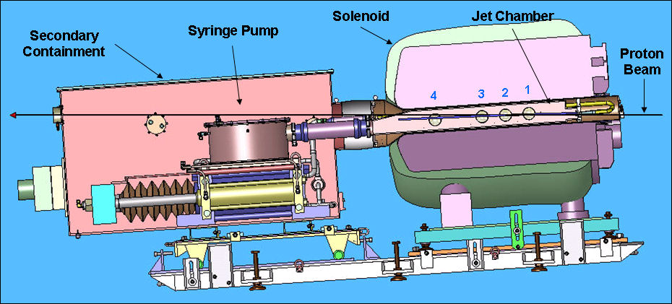
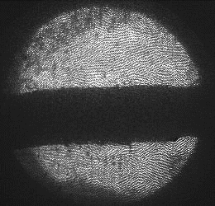
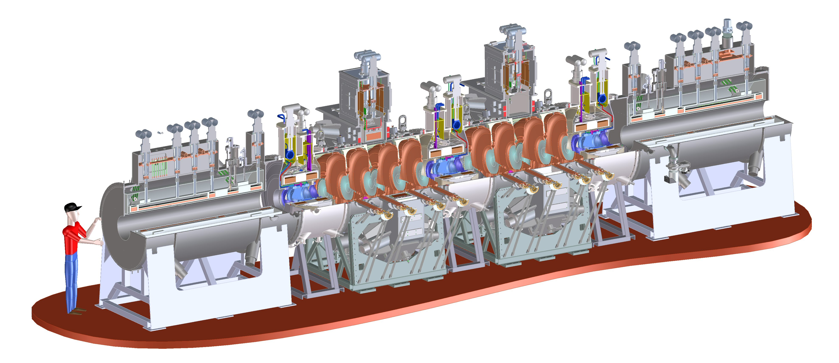
R&D Capabilities I (Completed, Current or Underway)
Target Technology:
MERIT Experiment
  Liquid Hg jet a 8MW
  with 70Hz rep. rate
Muon Ionization Cooling
Experiment (MICE)
  Cool beams produced
  with tertiary production
  mechanism
    dE/dx energy loss in materials
    RF to replace p_{long}
  Employs Guggenheim
  Cooling Channel
  Technology
1 cm
MICE
RF-Coupling
Coil (RFCC)
Units
Spectrometer
Solenoids

Slide 16
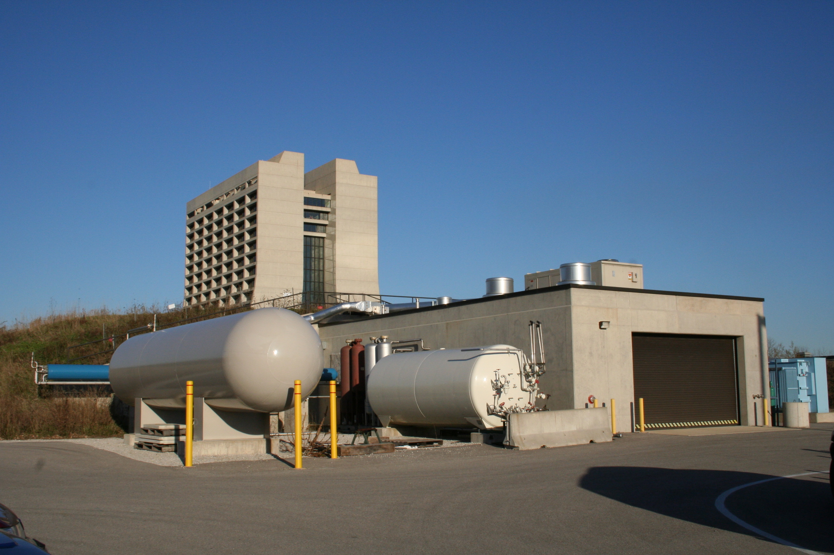
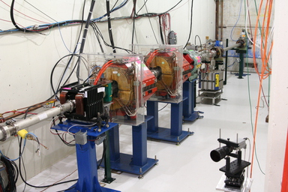
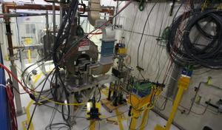
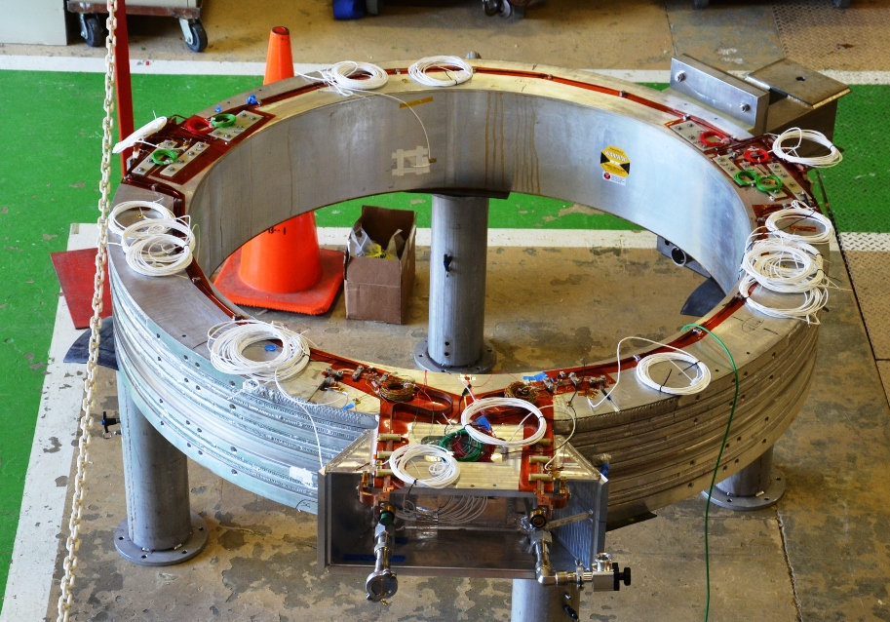
R&D Capabilities II (Completed, Current or Underway)
MuCool Test Area (MTA)
  RF power (12MW @ 805MHz,
  4.5MW @ 201MHz)
  Large-bore 5T superconducting solenoid
  Cryogenic plant
  400-MeV H- beamline
  Class-100 portable clean room
  Hydrogen safety infrastructure
  805- and 201-MHz cavities
  Radiation detectors
Solenoid Test Facility
  Utilizes Fermilab Central Helium Liquefier (CHL) Facility
  First MICE CC Coldmass ready for testing

Slide 17
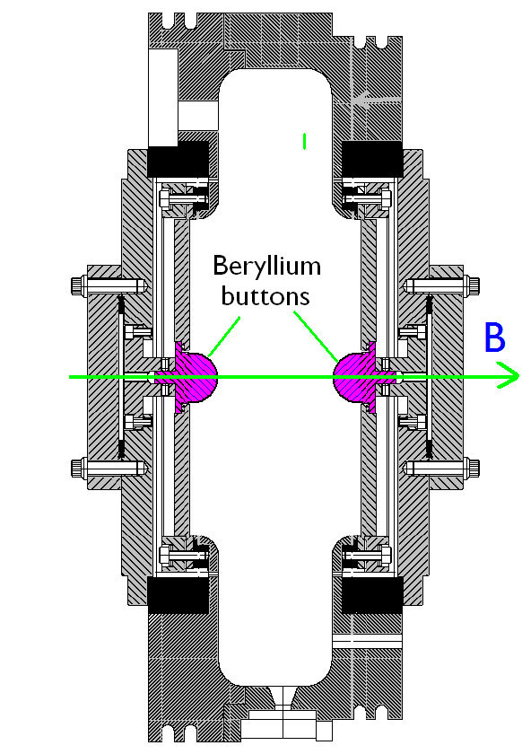
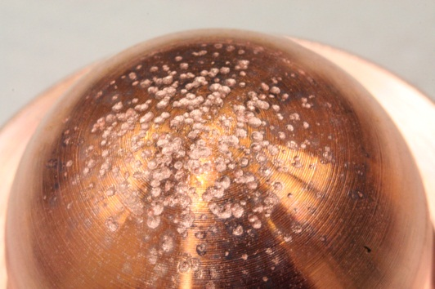
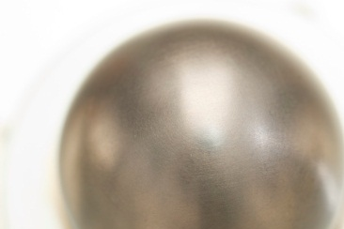
R&D Activities:
Cavity Materials
Breakdown tests with Be and Cu Buttons
Both reached ~31 MV/m
Cu button shows significant pitting
Be button shows minimal damage
a Materials choices offer the possibility of more robust operation in magnetic fields (increased operating lifetime)
Cu
Be

Slide 18
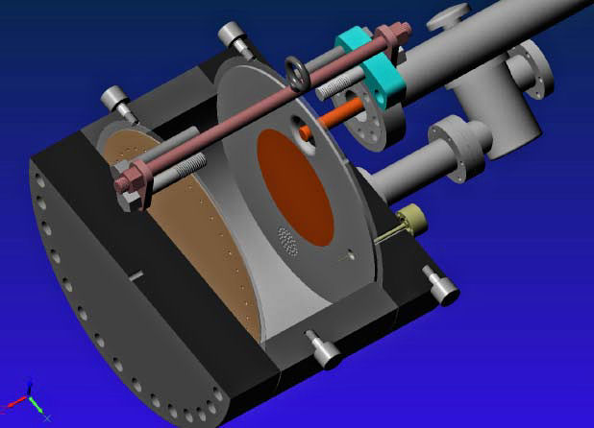
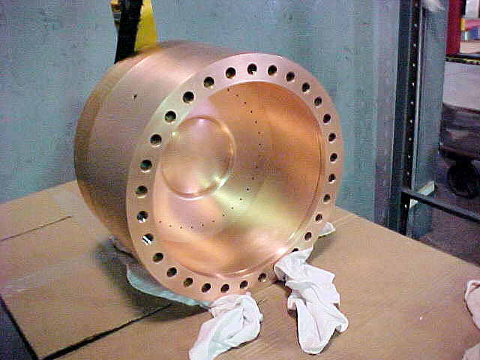
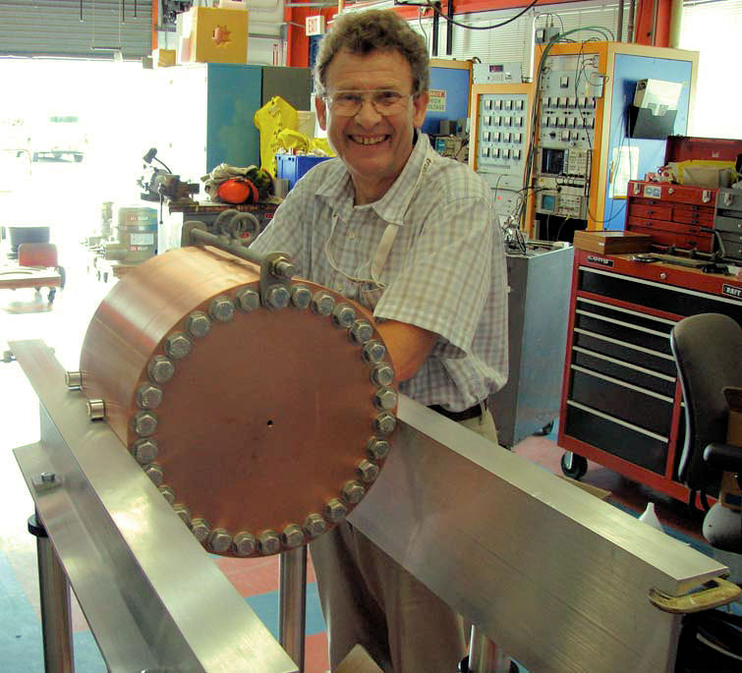
R&D Activities:
Vacuum RF
All-Seasons
Cavity
(designed for both
vacuum and high
pressure operation)
Vacuum Tests at B = 0 T & B = 3 T
  ~25 MV/m operating gradient in each configuration
Demonstrates possibility of successful operation of vacuum cavities in magnetic fields with careful design

Slide 19
R&D Activities:
High Pressure RF
Gas-filled cavity
  Can moderate dark current and breakdown currents in magnetic fields
  Can contribute to cooling
  Is loaded, however, by beam-induced plasma
Electronegative Species
  Dope primary gas
  Can moderate the loading effects of beam-induced plasma by scavenging the relatively mobile electrons
1% Dry Air (0.2 % O2) in GH2
Pure GH2
1% Dry Air
(0.2 % O2)
in GH2 at
B = 3 T
Beam on
~50× change in
RF dissipation
5/22/12
E₀ = 25 MV/m
19
E₀ = 25 MV/m

Slide 20
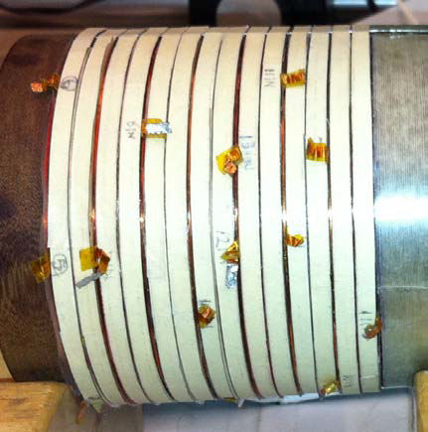
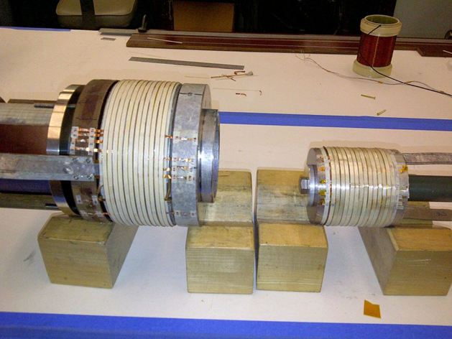
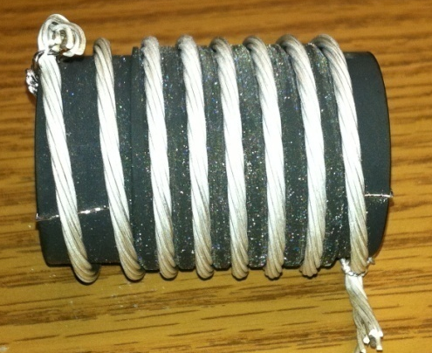
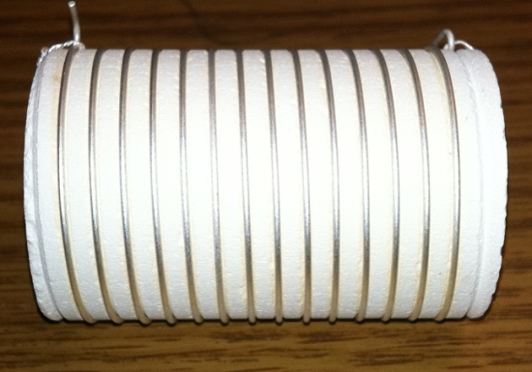
R&D Activities:
HTS High Field Magnets
Progress towards a demonstration
of a final stage cooling solenoid:
Demonstrated 15+ T (16+ T on coil)
  ~25 mm insert HTS solenoid
  BNL/PBL YBCO Design
  Highest field ever in HTS-only
  solenoid (by a factor of ~1.5)
Preparing for high field tests utilizing various outsert options (20+ T followed by 30+ T demonstrations)
BSCCO-2212 Cable -
Long piece-length obtained by hyperbaric fabrication process to reduce bubble formation
Multi-strand cable utilizing chemically compatible alloy and oxide layer to minimize cracks. Cable achieving full current density of single strand

Slide 21
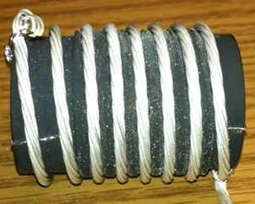
MAP Technology Highlights
Successful Operation of 805 MHz “All Seasons” Cavity in 3T Magnetic Field under Vacuum
MuCool Test Area/Muons Inc
World Record
HTS-only Coil
15T on-axis field
16T on coil
PBL/BNL
Demonstration of High Pressure RF Cavity in 3T Magnetic Field with Beam
Extrapolates to
μ-Collider Parameters
MuCool Test Area
Breakthrough in HTS Cable Performance with Cables Matching Strand Performance
FNAL-Tech Div
T. Shen-Early Career Award
The Path to a Viable
Muon Ionization
Cooling Channel
1% Dry Air (0.2% O2) in GH2
Pure GH2
1% Dry Air
(0.2 % O2)
in GH2 at
B = 3T
~50X reduction in
RF power dissipation
E₀ = 25 MV/m

Slide 22
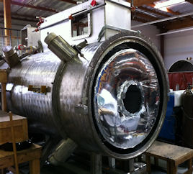
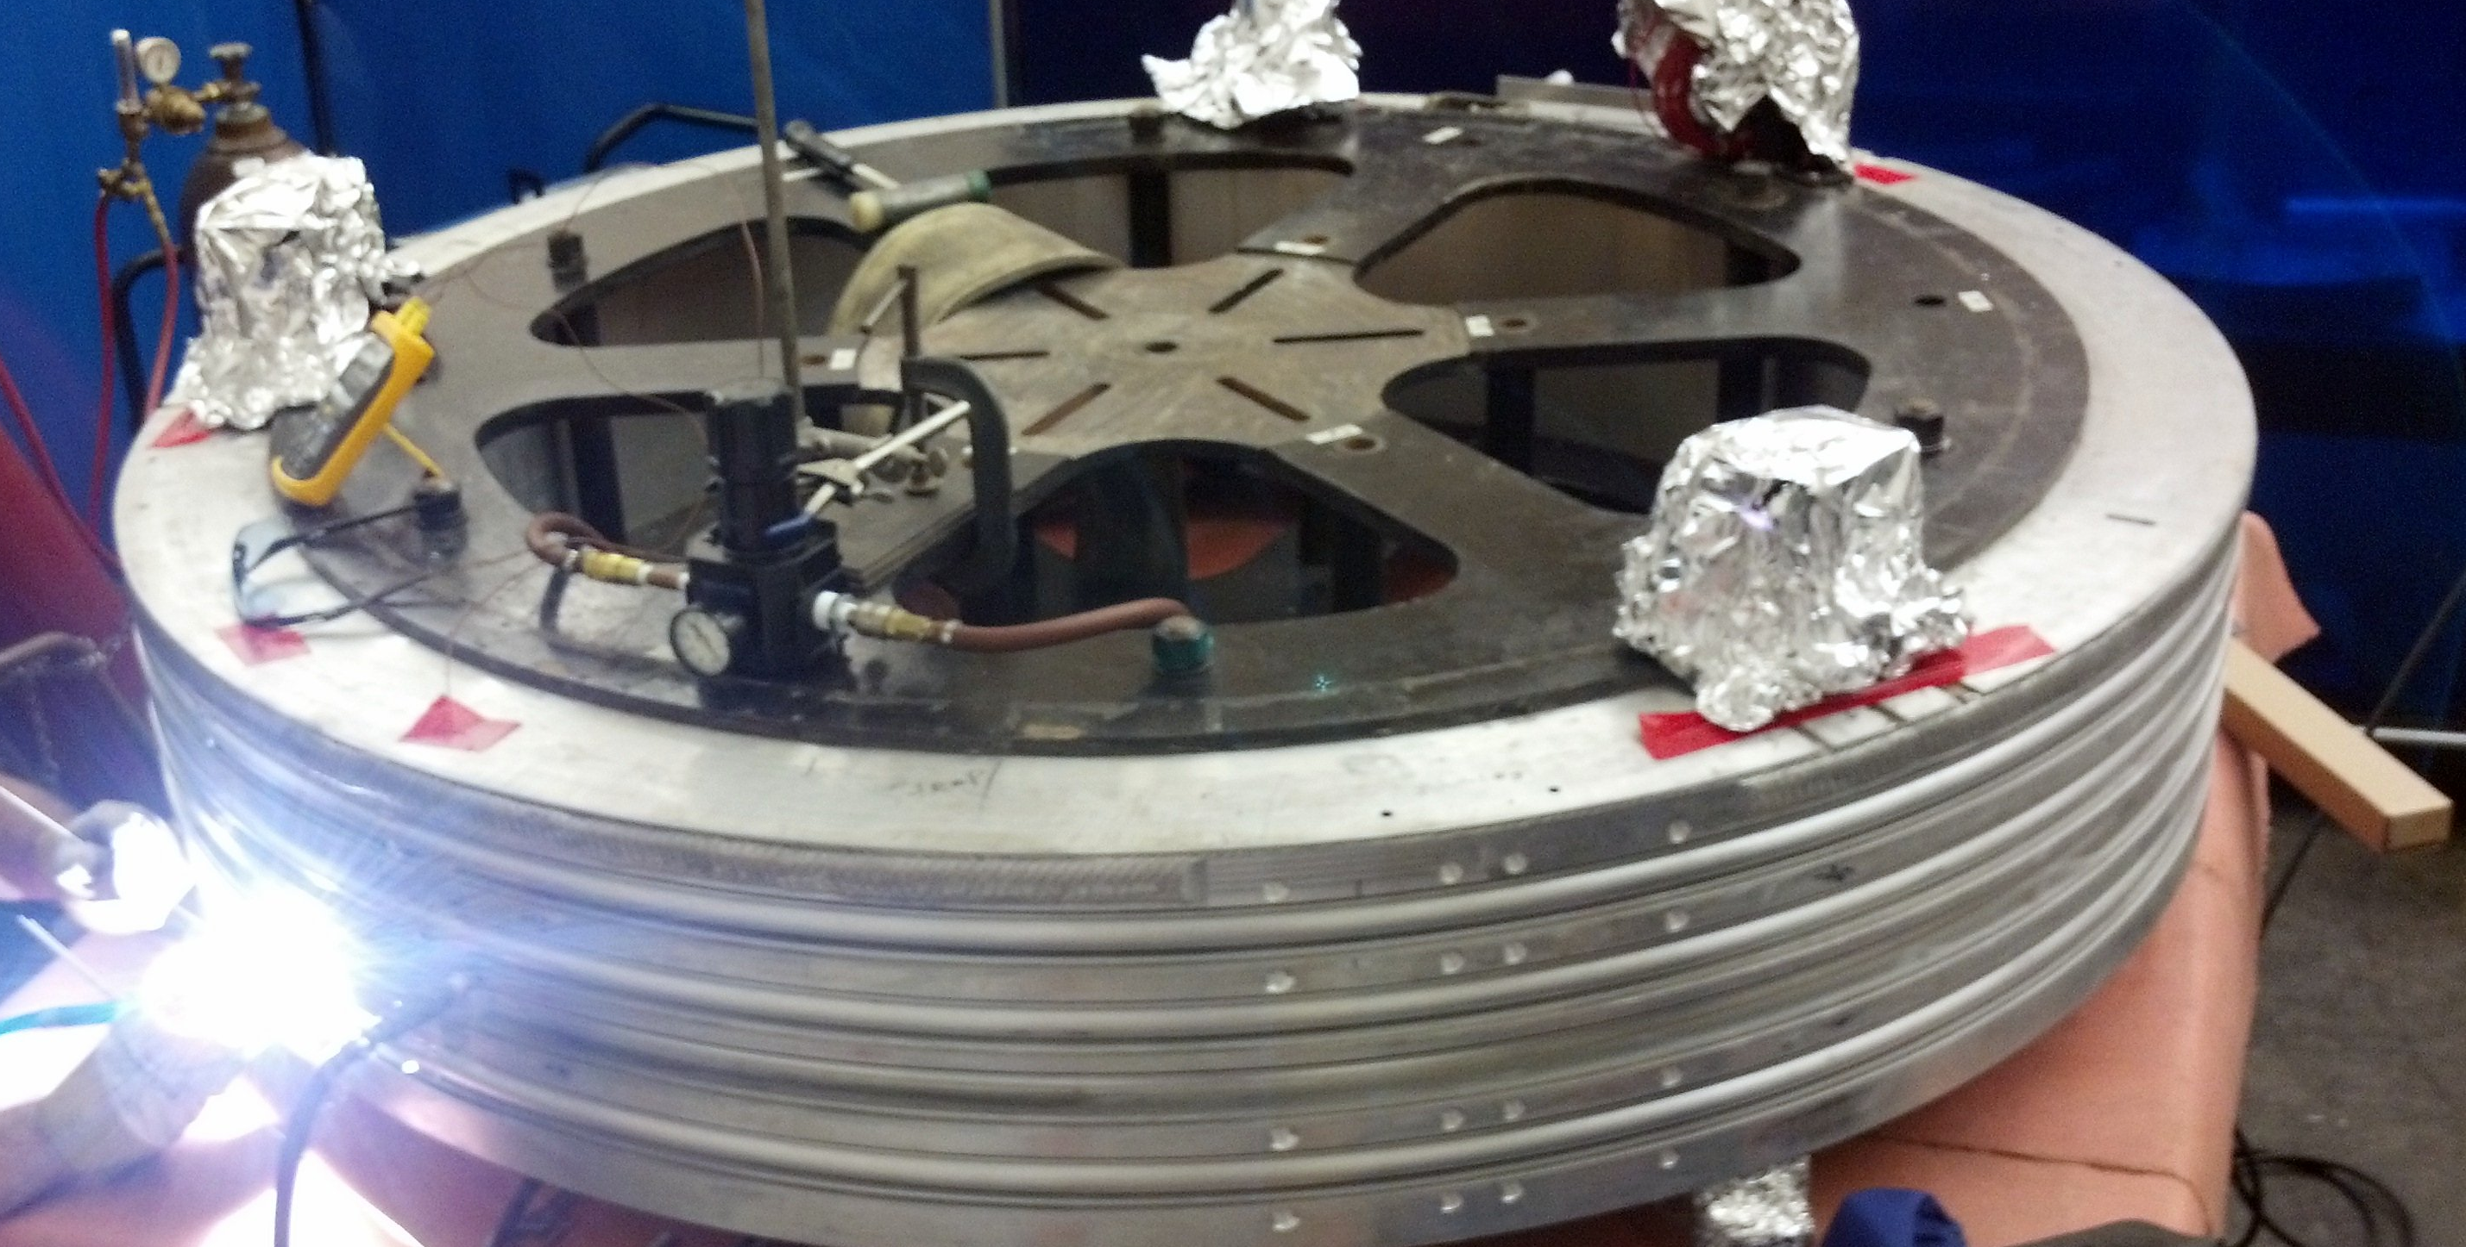
R&D Activities:
MICE Magnets
Spectrometer Solenoids @ LBNL
  1st SS
  Has reached 100% of target current
  2nd SS
  Assembly nearing completion with training and acceptance tests scheduled to begin immediately after 1st unit testing complete
Support MICE Step IV (2014-15)
Coupling Coils
First Coupling Coil cold mass delivered to FNAL from LBNL for testing in new Solenoid Test Facility
a Support MICE Step V/VI (2017-)

Slide 23
R&D Capabilities (Continuing and Future)
Continuing
  MTA (FNAL): RF cavity R&D
  MICE (RAL): ionization cooling demonstration
New possibilities
  νSTORM (Neutrinos from Stored Muons): Ring instrumentation, energy calibration methods, and R&D beams
  ASTA (FNAL): Novel cooling techniques: optical stochastic cooling, carbon-based crystal structures
  FACET II (SLAC): Potential studies with polarized muons

Slide 24

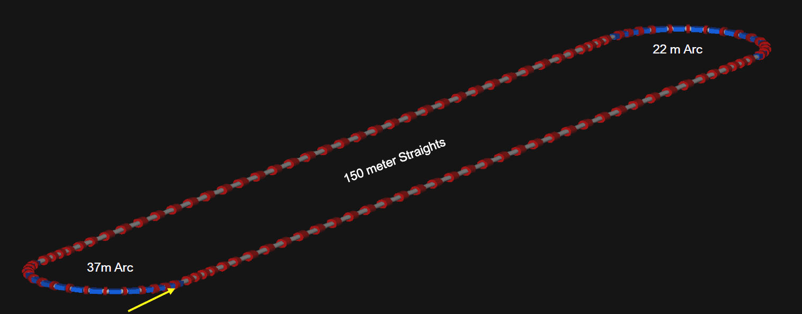
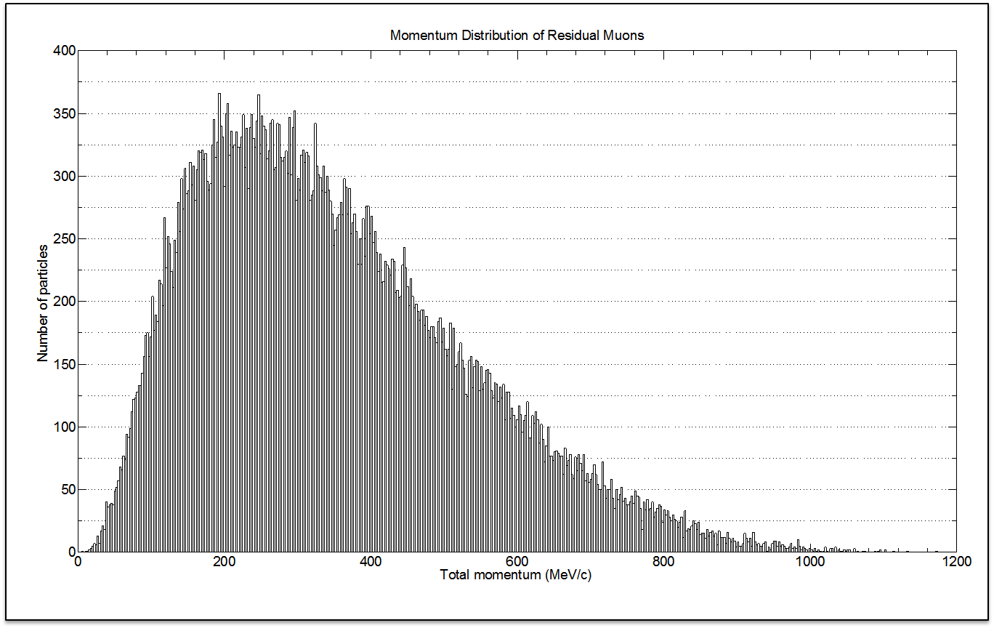
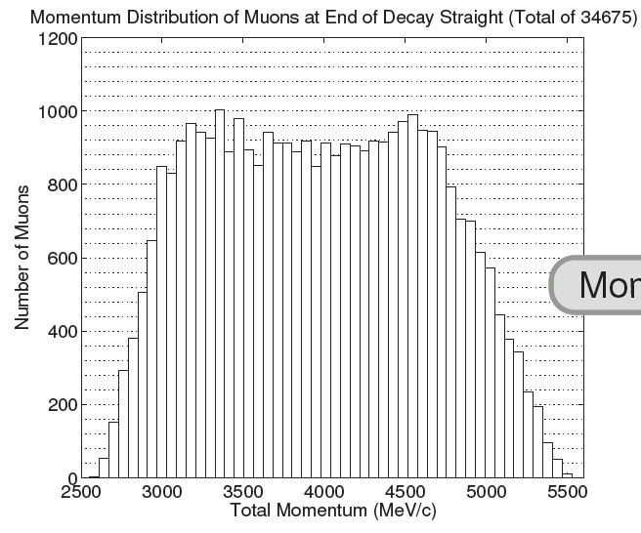
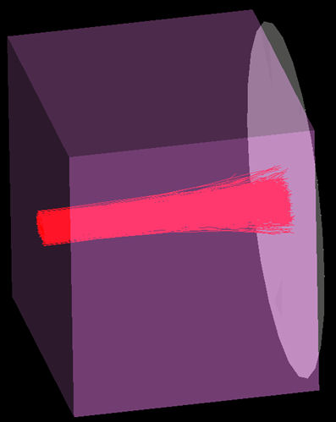
νSTORM – Physics + Critical Accelerator R&D
3.8 GeV/c ± 10% momentum acceptance,
circumference = 350 m
Provides important physics output
(ν cross sections and sterile ν search) as well as critical R&D leverage (ring instrumentation and a beam well-suited for advanced cooling R&D).
Source: 100kW horn-based target
At end of straight we have a lot of πs, but also a lot of μs with 4.5 < P(GeV/c) < 5.5
After 3.48m Fe, we have ≈ 10¹⁰ μ/pulse
in 100 < P(MeV/c) < 300

Slide 25
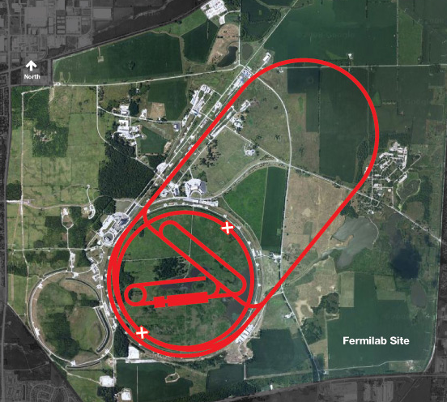
Conclusion
MAP is working towards a 6-year Feasibility Assessment to be delivered in 2018:
  Feasibility of key concepts needed for a Muon Collider and Neutrino Factory
  Provide the foundation for a facility that can support unsurpassed Intensity and Energy Frontier research
a A robust R&D program will enable an informed decision on the path forward for HEP
Muon Collider Concept
An effective muon accelerator R&D program will
rely on the availability of high capability test facilities

