Slide 1
CLIC 3TeV
http://cds.cern.ch/record/1132079/files/CERN-OPEN-2008-021.pdf

Slide 2
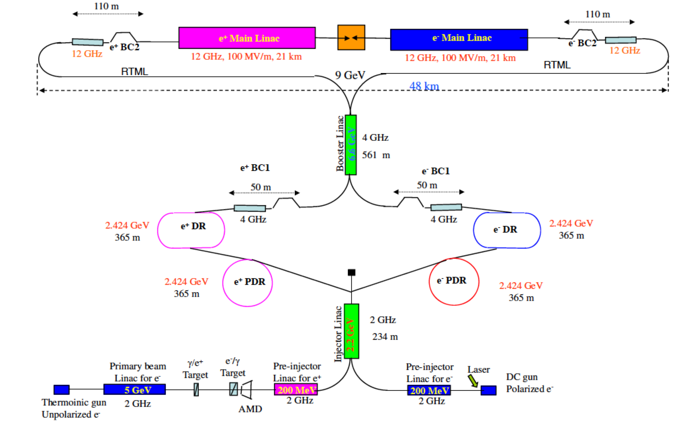

Slide 3
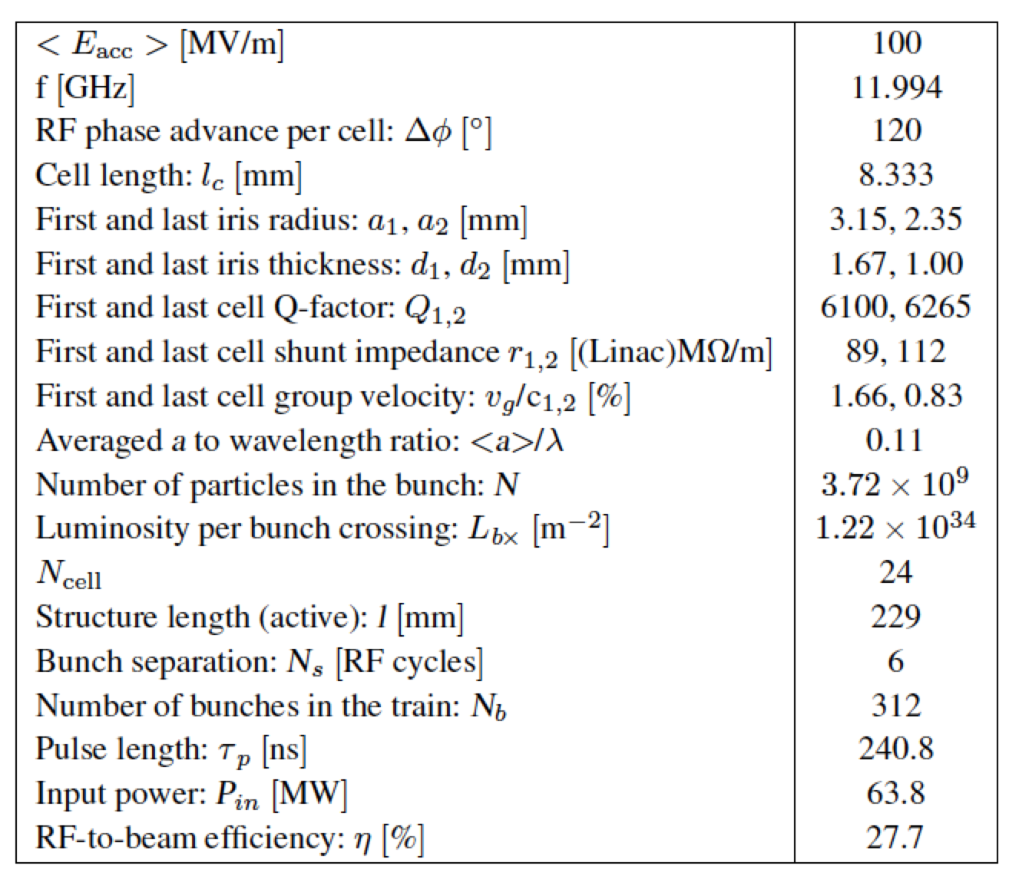

Slide 4
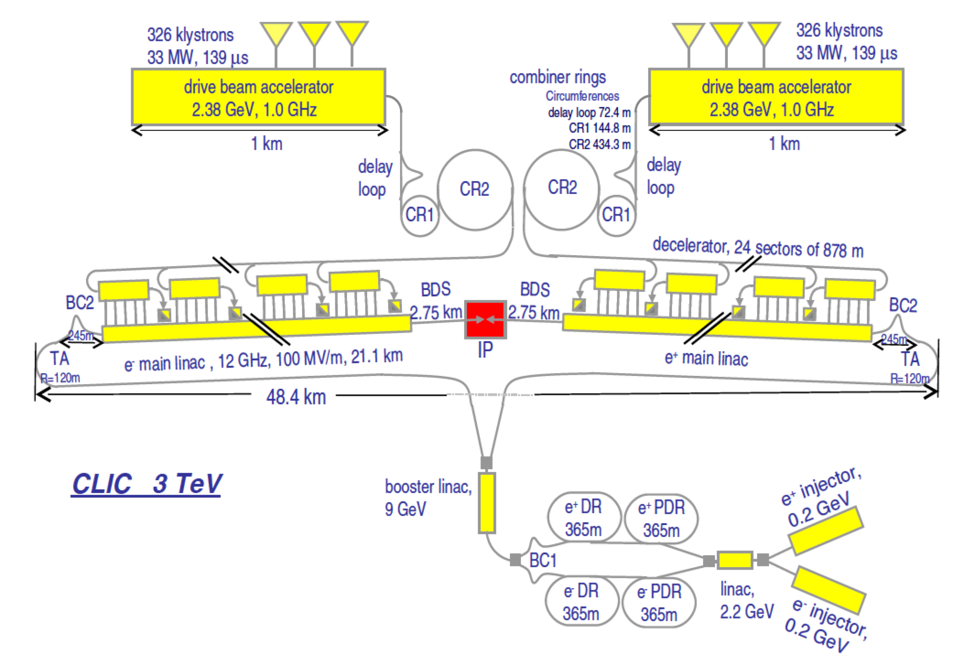

Slide 5
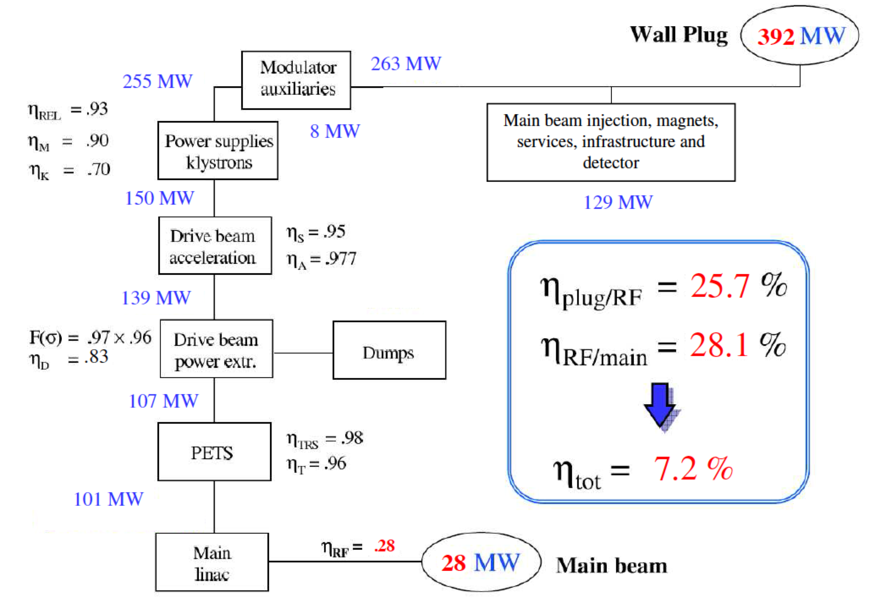

Slide 6
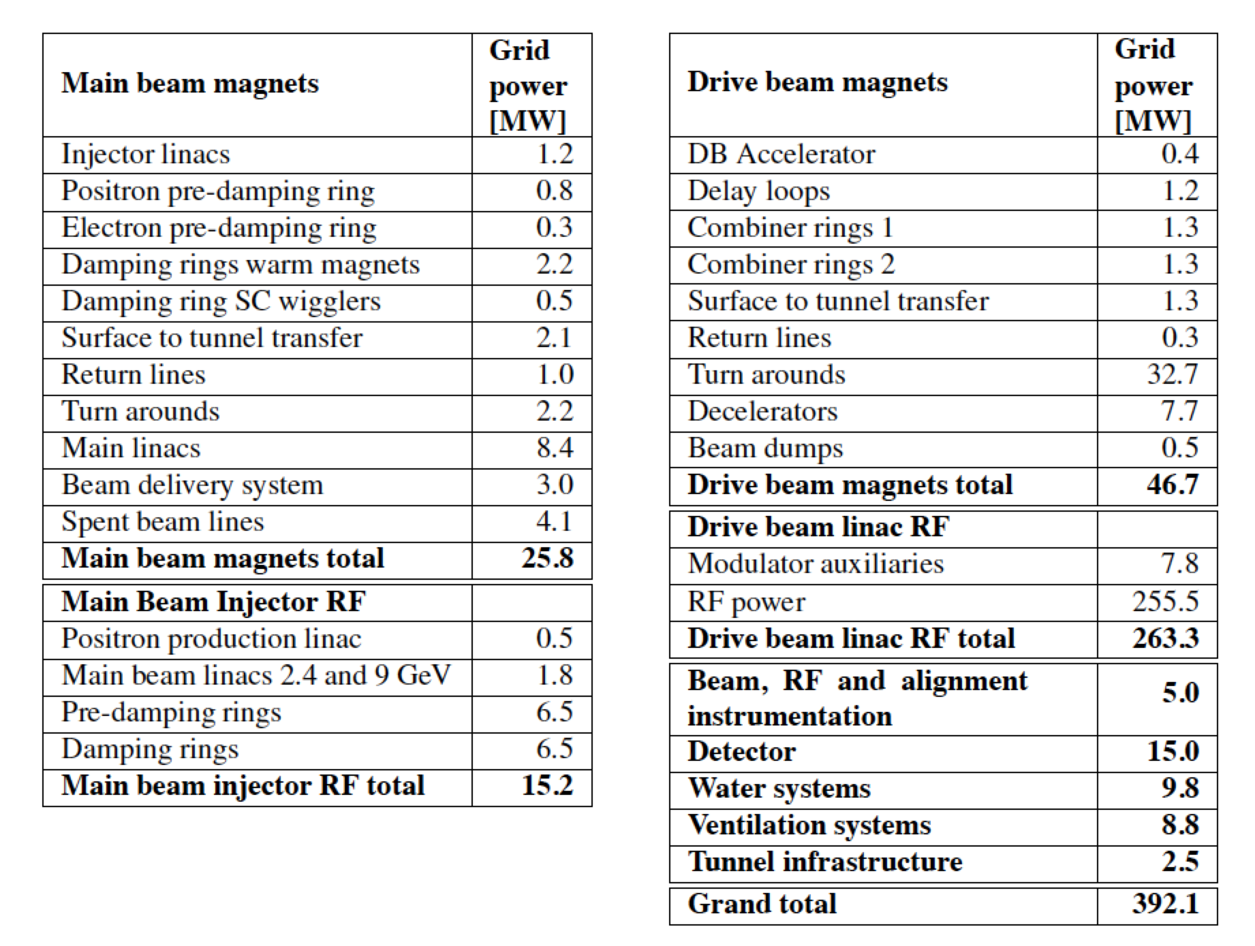

Slide 7
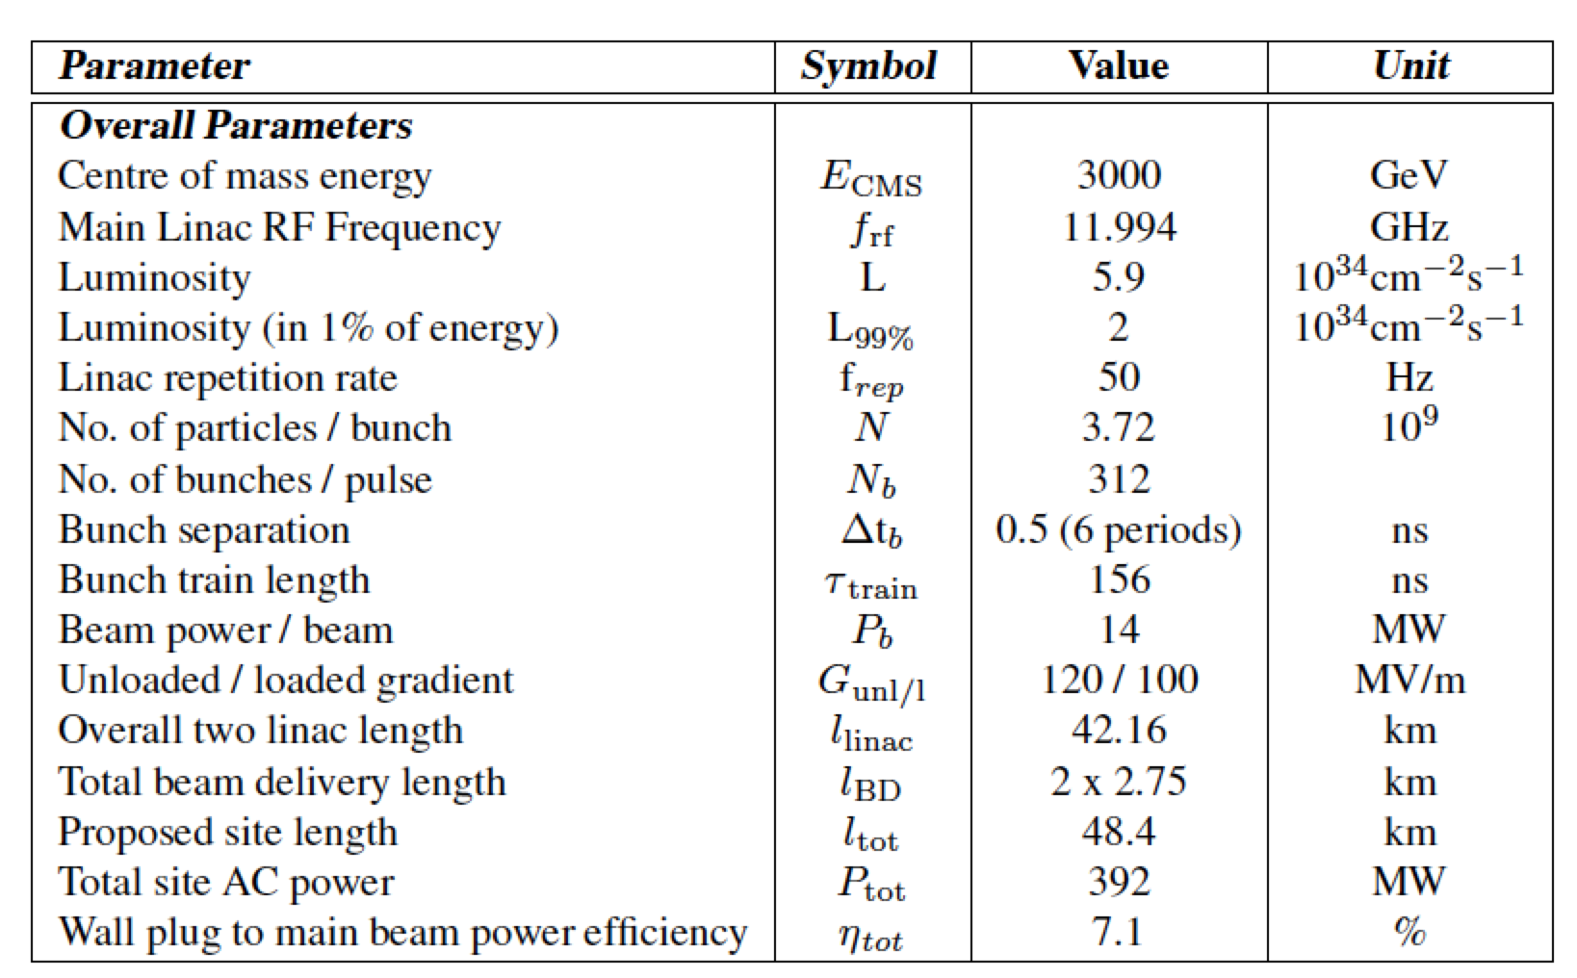

Slide 8
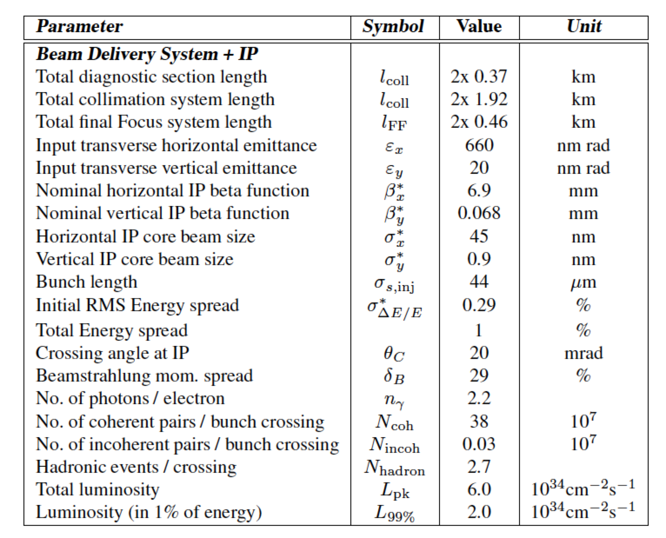

Slide 9
R&D subjects
RF components (SLAC: ASTA, FACET, ANL:AWA)
Positron source (SLAC:FACET II)
nm diagnostics
Drive beam system optimization
Damping rings
LINAC tuning

