Slide 1
Technologies and Tests for e+e- Circular Colliders: SuperKEKB and Tau-Charm
John Seeman
Snowmass: Accelerator Technologies Capabilities
February 25-26, 2013

Slide 2
Topics and Contributors
SuperKEKB Tsukuba
K. Oide, Y. Funakoshi, Y. Suetsugu, M. Kikuchi,
M. Sato, T. Suwada, U. Wienands, M. Sullivan, J. Fox
Super CT Novosibirsk
E. Levichev, P. Piminov, D. Shatilov, A. Bogomyagkov
Super Tau-Charm Tor Vergata-Frascati
M. Biagini, S. Tomassini, M. Giorgi, P. Raimondi
Discussion: US Roles, Test Beams, Technologies

Slide 3
Performance Achievements by PEP-II, KEKB, DAFNE, and BEPC-II
Two ring colliders with one IR work well.
Energy asymmetry ok.
Greater than 1000 bunches per beam can be used.
Bunch-by-bunch feedbacks effective with 4 nsec bunch spacings.
Multi-megawatt continuous RF systems manageable.
IP collisions with either head-on and crossing angles work.
Low detector backgrounds achievable with ampere beams.
Crab cavities, crab waist, and low emittance tuning can be done.
Beam instabilities (ECI, FII, IBS, resistive wall, …) mostly tamed.
High power (10kW/m) vacuum systems can be constructed.
Full energy injection
Top-up injection

Slide 4
SuperKEKB Tsukuba: Accelerator Layout
Funded and in construction.

Slide 5
SuperKEKB Tsukuba: Parameters

Slide 6
SuperKEKB Schedule

Slide 7
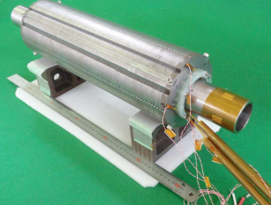
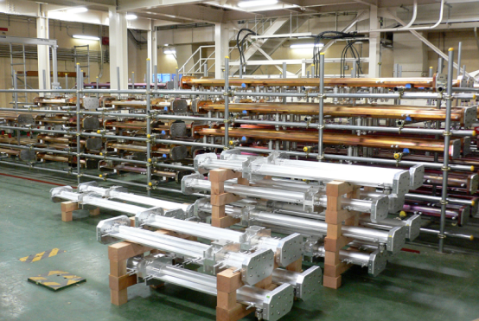
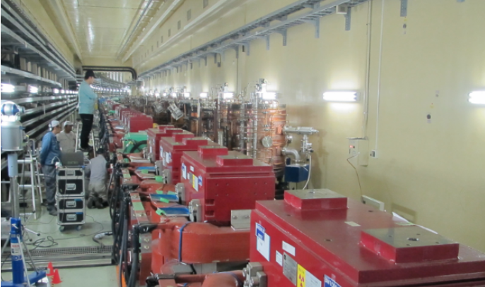
SuperKEKB Rings Components

Slide 8
Potential US-Japan and SLAC-SuperKEKB Collaboration Items

Slide 9
Super CT Novosibirsk: Overall Layout
CDR is completed. Seeking funding.

Slide 10
Super CT Novosibirsk: Ring Layout

Slide 11
Super CT Novosibirsk: Parameters

Slide 12
Super CT Novosibirsk: Main Collider Features

Slide 13
Super CT Novosibirsk: IR quadrupoles

Slide 14
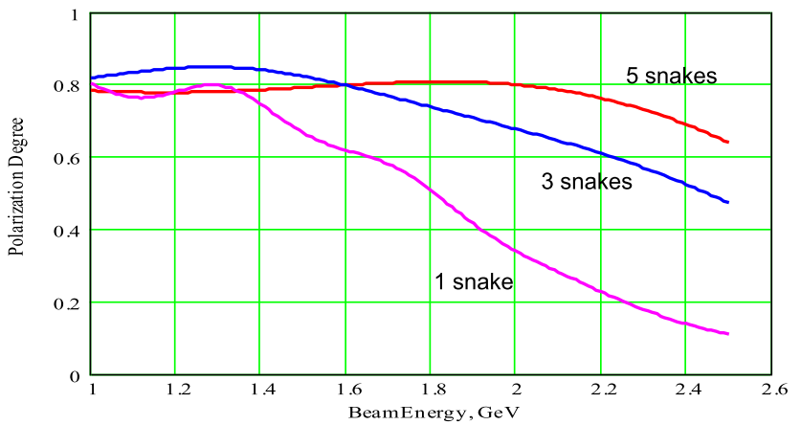
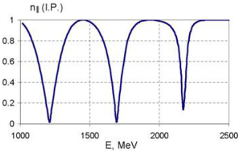
Super CT Novosibirsk: Polarization

Slide 15
Tau-Charm Factory at Tor Vergata-Frascati, Italy

Slide 16
Tor Vergata-Frascati Tau-Charm Factory Parameters

Slide 17
Tau-Charm Factory at Tor Vergata-Frascati, Italy

Slide 18
Tau-Charm Factory at Tor Vergata-Frascati, Italy
Status: Design is under revision to be
presented to the Italian Government later in the year.

Slide 19
Key Common Facility Features for these e+e- Colliders
Two rings with a single interaction point
Crossing angle at the IP with very flat beams (emittance ratio = ~300)
Need low detector backgrounds
Crab waist collisions
Wigglers to reduce damping times and emittances
Picometer-vertical and nanometer-horizontal emittances
Longitudinal polarized e- beams at the IP with spin rotators
Low emittance beam with beam-beam effects
Polarized beam with strong beam-beam effects
High currents:
Coherent Synchrotron Radiation (CSR)
Electron Cloud Instability ECI
Fast Ion Instability FII
Low impedance vacuum chambers
High power vacuum chambers

Slide 20
Interaction Point Design
Key issues: 300 micron scale βy*, large betas in IR quadrupoles, quadrupoles inside the detector, collision feedback, vacuum chamber design, magnet tolerances, alignment and jitter tolerances, crab cavities, crab waist,
US relevance: LHC, Muon collider, ILC, Higgs factory
Test accelerators/facilities: SuperKEKB, CESR-TA, PETRA-3, vibration stabilization facility
Technologies:
100+ Hz IP dither feedback on luminosity
Superconducting magnets
Permanent magnets
Power supply stability
Vibration control
Non-linear optics

Slide 21
Machine Detector Interface
Key issue: Synchrotron radiation backgrounds, lost particle backgrounds, SR heating of vacuum chambers, radiation damage/lifetime of detectors, sensor occupancy, luminosity measurement.
US relevance: LHC, Muon collider, ILC, Higgs factory
Test accelerators/facilities: SuperKEKB, LHC, lab tests of high power vacuum chambers, lab tests of detector lifetime
Technologies:
IP vacuum pumping
Advanced masking
Rapid luminosity feedback
Detector design

Slide 22
Low Emittances
Key issue: Component tolerances, vibration control, emittance measuring hardware, active feedbacks, field nonlinearities.
US relevance: ILC, Ultimate Storage Ring
Test accelerators/facilities: SuperKEKB, PETRA-3, CESR-TA, NSLS-II, lab tests of x-ray size monitors
Technologies:
300 to1 emittance tuning techniques
Coherent Synchrotron Radiation CSR simulations and
measurements
Fast Ion Instability FII simulations and measurements
Intra-Beam Scattering IBS simulations and measurements
Electron Cloud Instability ECI simulations and measurements
Effects of spin rotators.
Effects of beam-beam interaction

Slide 23
High Current Effects
Key issues: Beam stability, high power RF, high power vacuum components, AC wall efficiency, injector capabilities, I> 1 A.
US relevance: LHC, muon collider, muon storage ring, Project X, Ultimate Storage Ring
Test accelerators/facilities: SuperKEKB, CESR-TA
Technologies:
Better bunch feedbacks
ECI control
IBS mitigations
FII mitigations
More efficient klystrons
High power cavities
Longitudinal beam feedback

Slide 24
Longitudinally Polarized e- Beam at the Interaction Point
Key issue: Injected polarization, beam lifetime, polarization lifetime, spin rotators, polarization measurements, effect on IP optics, beam-beam effect on polarization.
US relevance: ILC
Test accelerators/facilities: SuperKEKB?, VLEPP-2000?
Technologies:
Siberian snakes
Solenoidal rotators
Beam-beam depolarization diagnostics
Spin manipulation in the Damping Ring and Linac.
e- polarized source

Slide 25
Example: Project Considerations (US-Japan or SLAC-SuperKEKB)
IP feedback on luminosity:
Fast dither x, y and y’ (100 Hz) position and angle
Lock in amplifiers for amplitude and phase
All planes at once
Single step or Newton algorithm
Linac beam position monitors (BPM):
Single passage for linac use
Multi-passage for ring use
Present hardware not reliable nor precise enough
Beam collimation:
Moveable jaws like PEP-II design
Low impedance
Multiple stages for effective spray elimination
Accelerator physics:
IP MDI, IP masking
CSR
Beam-beam effect
Commissioning
Bunch-by-bunch feedback:
Circuit design
Power amplifier analysis
Synchronization studies

