Slide 1
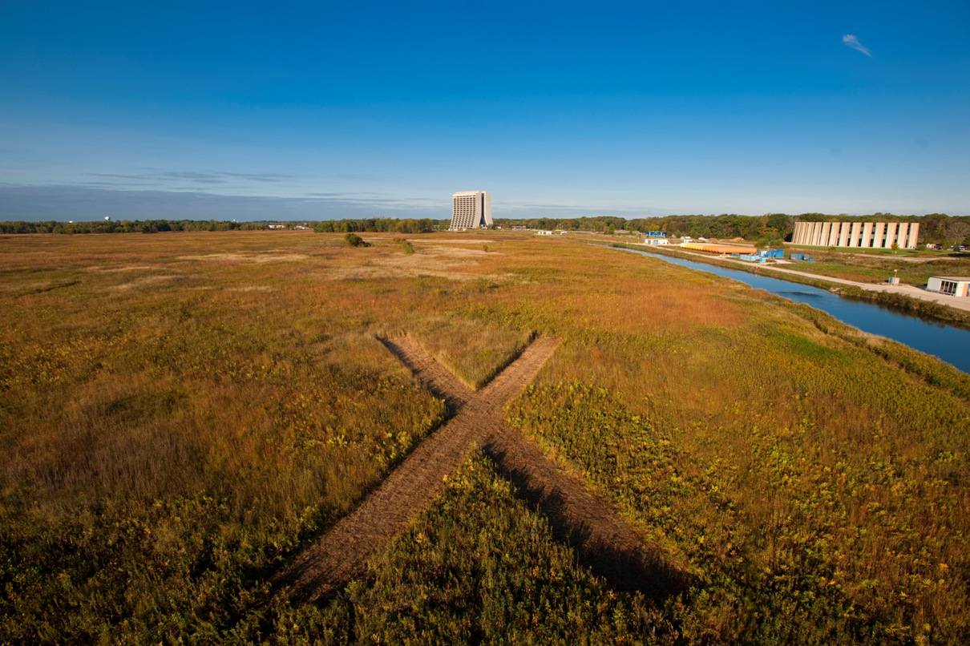
Project X Accelerator R&D
Sergei Nagaitsev
Snowmass Preparatory mini-Workshop on Frontier Capabilities: Accelerator Technology Test Beds and Test Beams.
February 25-26, 2013

Slide 2
Outline
Reference Design/Staging
R&D Program Goals
Test beds and test beams
Our websites: http://projectx.fnal.gov
http://projectx-docdb.fnal.gov

Slide 3
Reference Design
Siting
1 MW @ 1 GeV
3 MW @ 3 GeV
0.2 MW @ 8 GeV
>2 MW @ 60-120 GeV
6 MW TOTAL

Slide 4
Staging Plan
Stage 1
  1 GeV × 1 mA CW linac injecting into existing (upgraded) Booster
  Connection to Muon Campus
  New High Power Spallation Campus (1 GeV)
Stage 2
  Add 1-3 GeV × 1 mA CW linac, still injection into Booster
  20 Hz Booster upgrade
  New High Power Muon and Kaon Campus (3 GeV)
Stage 3 (Reference Design)
  Add 3-8 GeV × 1 mA @4.3% duty factor pulsed linac injecting into (upgraded) Recycler/MI
  Connection to Short Baseline Neutrino Campus
Stage 4 (Beyond the Reference Design)
  Current upgrade of CW and pulsed linac: 5 mA x 10% DF = 4 MW @ 8 GeV
  Main Injector/Recycler upgrades
  LBNE target upgrade
  Step toward a NF or MC

Slide 5
Reference Design Performance Goals
Linac
Particle Type H⁻
Beam Kinetic Energy 3.0 GeV
Average Beam Current 1 mA
Linac pulse rate CW
Beam Power to 1 GeV program 1000 kW
Beam Power to 3 GeV program 2870 kW
Pulsed Linac
Particle Type H⁻
Beam Kinetic Energy 8.0 GeV
Pulse rate 10 Hz
Pulse Width 4.3 msec
Cycles to Recycler/MI 6
Particles per cycle to Recycler/MI 2.7×10¹³
Beam Power 340 kW
Beam Power to 8 GeV program 170 kW
Main Injector/Recycler
Beam Kinetic Energy (maximum) 120 GeV
Cycle time 1.2 sec
Particles per cycle 1.5×10¹⁴
Beam Power at 120 GeV 2400 kW
simultaneous

Slide 6
Staged Physics Program
Project X Campaign
Program: | NOνA + Proton Improvement Plan | Stage-1: 1 GeV CW Linac driving Booster & Muon, n/edm programs | Stage-2: Upgrade to 3 GeV CW Linac | Stage-3: Project X RDR | Stage-4: Beyond RDR: 8 GeV power upgrade to 4MW
MI neutrinos | 470-700 kW** | 515-1200 kW** | 1200 kW | 2450 kW | 2450-4000 kW
8 GeV Neutrinos | 15 kW + 0-50 kW** | 0-42 kW* + 0-90 kW** | 0-84 kW* | 0-172 kW* | 3000 kW
8 GeV Muon program e.g, (g-2), Mu2e-1 | 20 kW | 0-20 kW* | 0-20 kW* | 0-172 kW* | 1000 kW
1-3 GeV Muon program, e.g. Mu2e-2 | ----- | 80 kW | 1000 kW | 1000 kW | 1000 kW
Kaon Program | 0-30 kW** (<30% df from MI) | 0-75 kW** (<45% df from MI) | 1100 kW | 1870 kW | 1870 kW
Nuclear edm ISOL program | none | 0-900 kW | 0-900 kW | 0-1000 kW | 0-1000 kW
Ultra-cold neutron program | none | 0-900 kW | 0-900 kW | 0-1000 kW | 0-1000 kW
Nuclear technology applications | none | 0-900 kW | 0-900 kW | 0-1000 kW | 0-1000 kW
# Programs: | 4 | 8 | 8 | 8 | 8
Total max power: | 735 kW | 2222 kW | 4284 kW | 6492 kW | 11870kW
* Operating point in range depends on MI energy for neutrinos.
** Operating point in range is depends on MI injector slow-spill duty factor (df) for kaon program.

Slide 7
R&D Program
Goal is to be prepared for a construction start in 2017
  Most likely, Stage 1
Goal of the R&D Program is to mitigate risk: technical/cost/schedule
Technical Risks
  Front End
    Unique capabilities of PX are enabled by the front end
    CW ion source through SSR1
  H- injection system
    Booster in Stage 1, 2; Recycler in Stage 3
  High Intensity Recycler/Main Injector operations
  High Power targets
Cost Risks
  Superconducting rf
    Cavities, cryomodules, rf sources – CW to long-pulse (~10% DF)
All of these elements are required at Stage 1

Slide 8
Linac Technology Map
LEBT
RFQ
MEBT
β=0.11
β=0.22
β=0.51
β=0.61
β=0.9
β=1.0
RT
CW
Pulsed
162.5 MHz
0.03-11 MeV
325 MHz
10-177 MeV
650 MHz
0.18-3 GeV
1.3 GHz
3-8 GeV
Section | Freq | Energy (MeV) | Cav/mag/CM | Type/Focusing
RFQ | 162.5 | 0.03-2.1
HWR (β_{G}=0.1) | 162.5 | 2.1-11 | 8/8/1 | HWR, solenoid
SSR1 (β_{G}=0.22) | 325 | 11-38 | 16/8/ 2 | SSR, solenoid
SSR2 (β_{G}=0.51) | 325 | 38-177 | 35/21/7 | SSR, solenoid
LB 650 (β_{G}=0.61) | 650 | 177-467 | 30/20/5 | 5-cell elliptical, doublet
HB 650 (β_{G}=0.9) | 650 | 467-1000 | 42/16/7 | 5-cell elliptical, doublet
HB 650 (β_{G}=0.9) | 650 | 1000-3000 | 120/30/15 | 5-cell elliptical, doublet
ILC 1.3 (β_{G}=1.0) | 1300 | 3000-8000 | 224 /28 /28 | 9-cell elliptical, quad
Notes:
I would suggest that you point out that Indian DAE labratories are already working on SSR1, 650 and ILC cavities.

Slide 9
Project X Risk Matrix
High Level Risks | Mitigation Program
MEBT Chopper Performance -Absorber -Extinction Level | PXIE
CW RFQ Performance | PXIE
High Power Beam thru HWR/SSR1 Performance | PXIE
Beam Performance Beam loss Halo formation | PXIE
Machine Protection System | PXIE
High power targetry (R&D) -Lifetime -Remote handling | Project X R&D Collaboration with PNNL, BNL, RAL, Oxford, CERN
Main Injector Performance -H- injection -Beam stability | Project X R&D Collaboration with BNL, SNS
Booster Performance | Project X R&D

Slide 10
Project X Risk Matrix
High Level Risks | Mitigation Program
Low-beta CW cavities and cryomodules (performance) | SRF Program Collaboration with ANL, India
650-MHz CW cavities and CMs (cost) | SRF Program Collaboration with JLab, India
1.3-GHz pulsed cavities and CMs (cost, performance) | ILC/SRF Program Collaboration with KEK, DESY
Long-pulse CM operation (performance) | ASTA

Slide 11
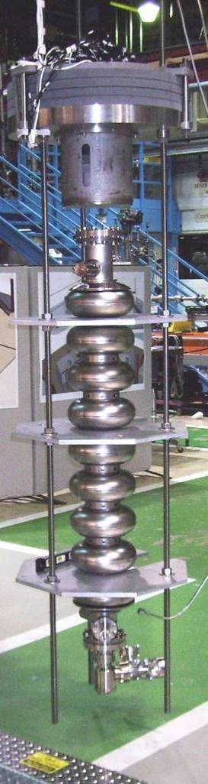
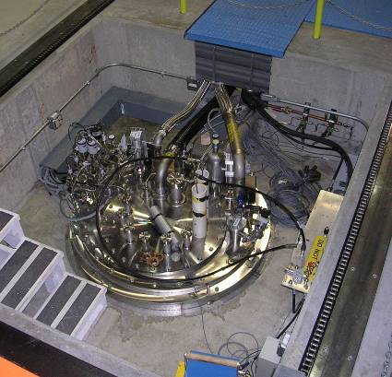
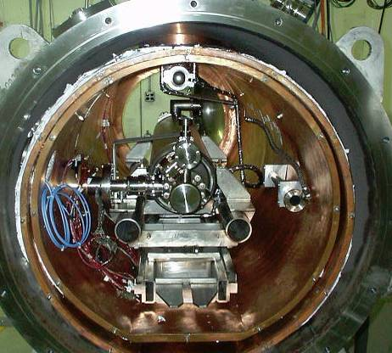
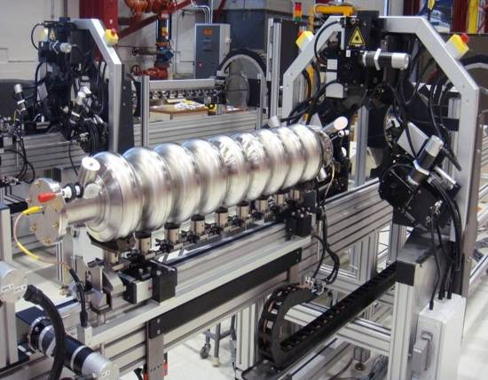
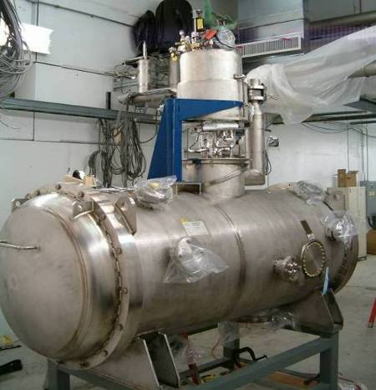
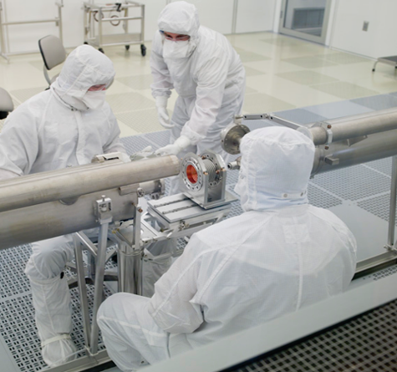
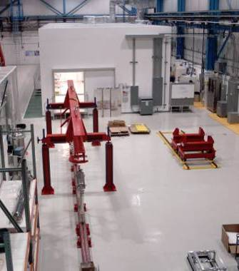
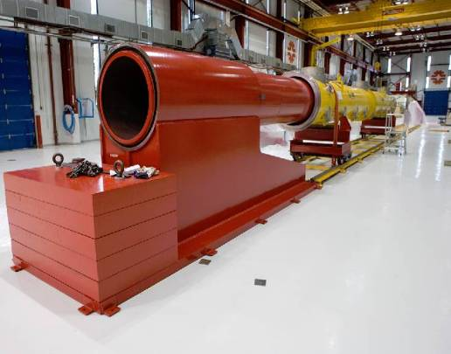
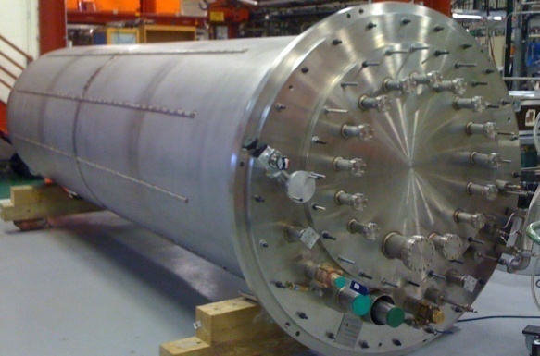
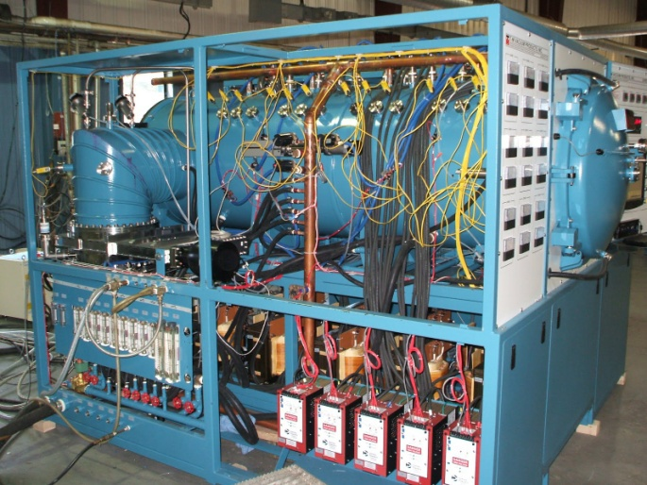
FNAL SRF infrastructure
Cavity tuning machine
VTS
HTS
VTS
String Assembly
MP9 Clean Room
VTS2 Dewar
Final Assembly
New Vacuum Oven

Slide 12
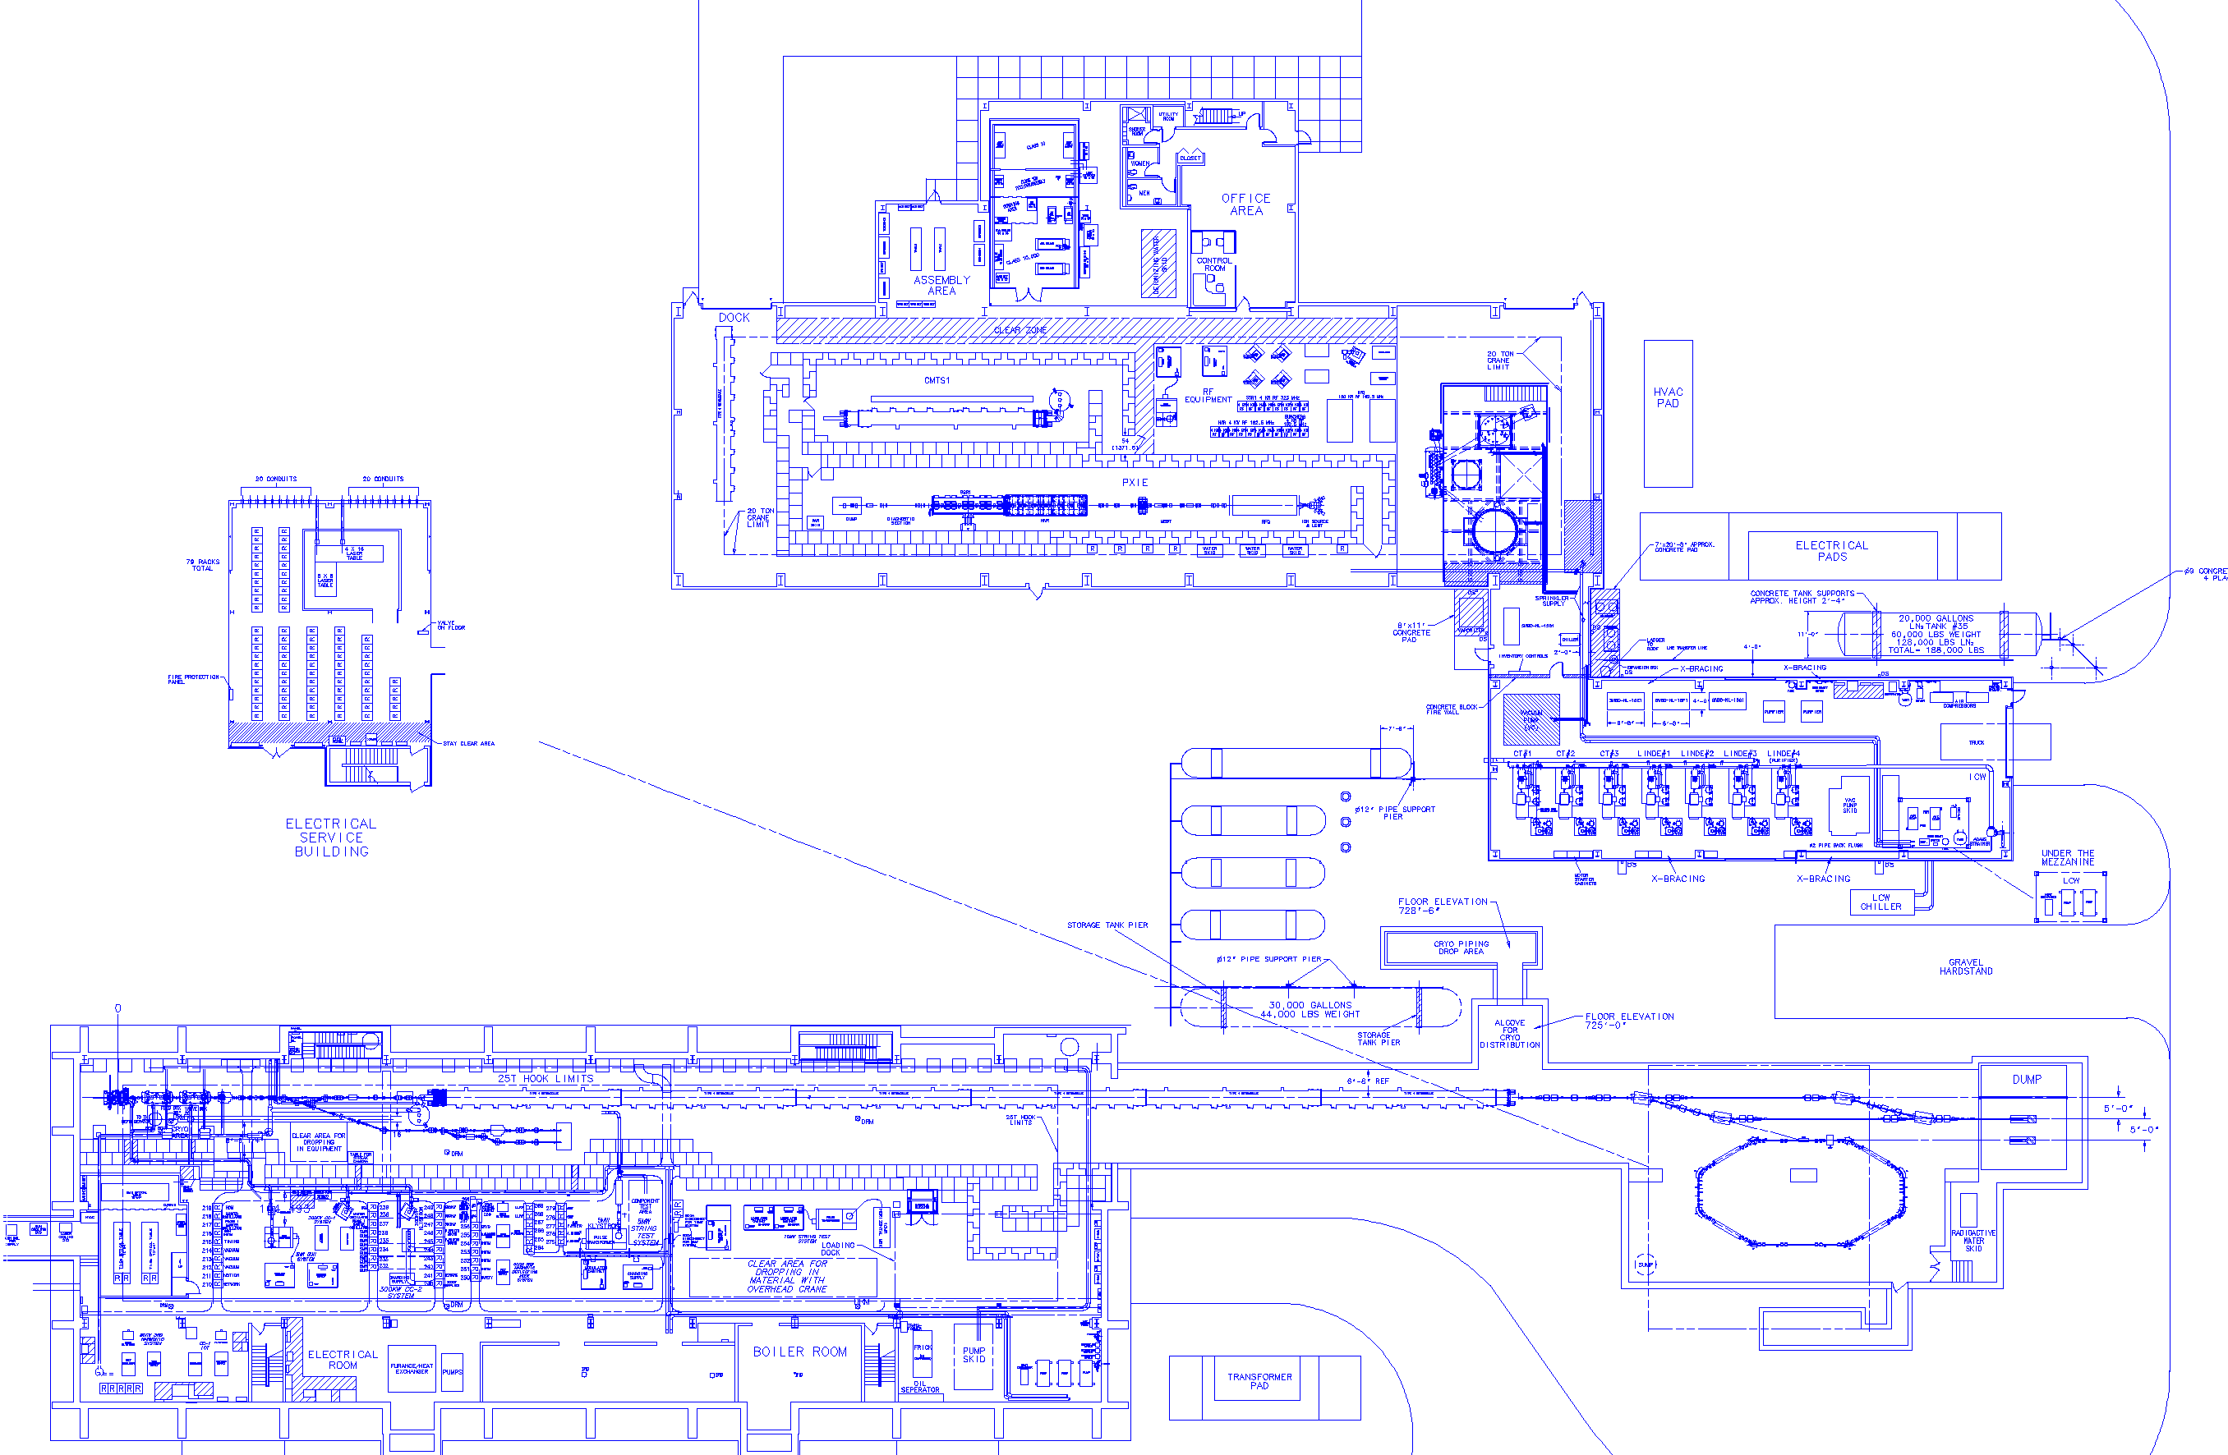
SRF Test Facility Complex
CMTF Main Bldg.
14,700 sq. ft. high bay
5,000 sq. ft. low bay
Cryomodule Test Facility
(CMTF)
Cryomodule
Test Stand 1
Cleanroom
Cryogenic
Cold Boxes
Compressor Bldg. 5,300 sq. ft. high bay
PXIE Accelerator
Pass Thru Line
Existing NML Building
Test Beam Lines
Proposed ASTA Accelerator (nominal 3 CM up to 6 CM)
IOTA Ring
Beam
Absorbers

Slide 13
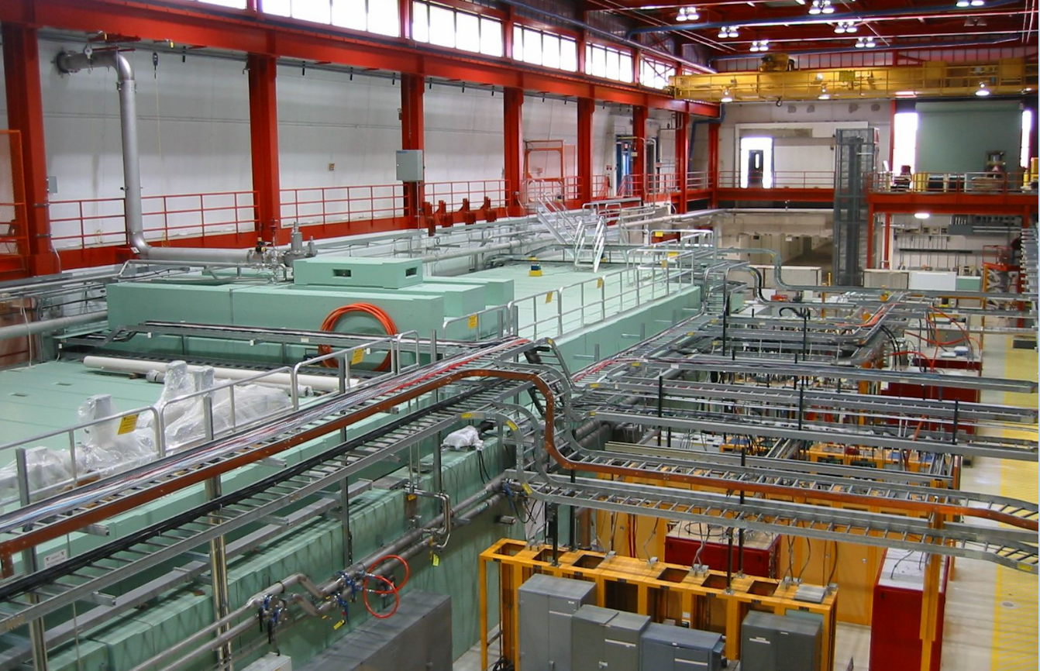
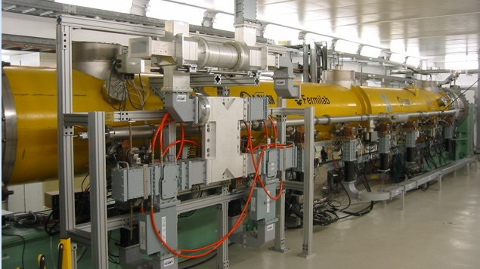
RF Unit Test Facility (home of ASTA)
1st Cryomodule tests complete

Slide 14
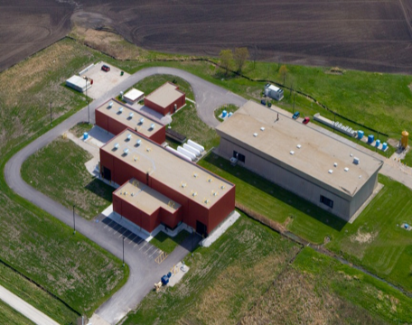
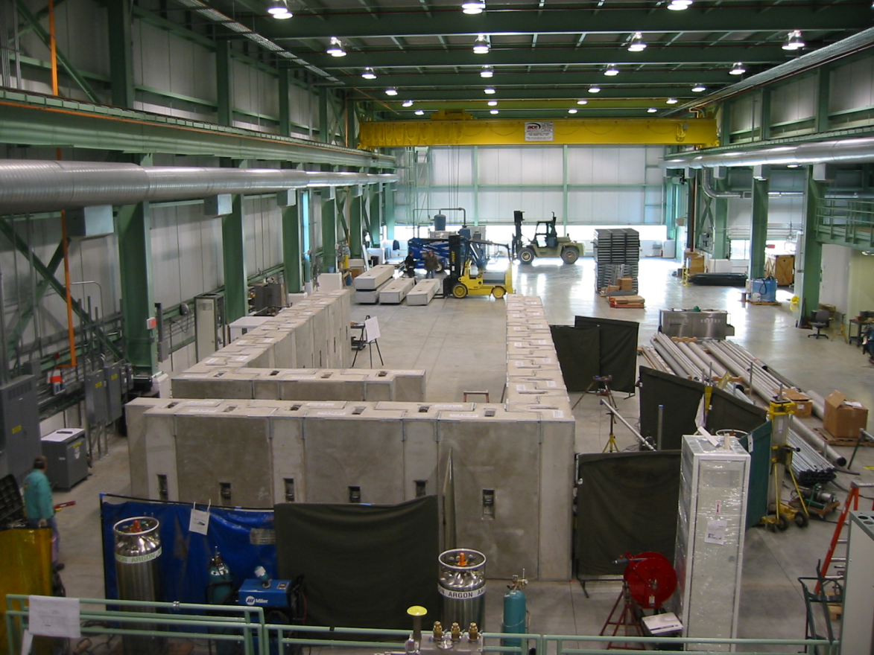
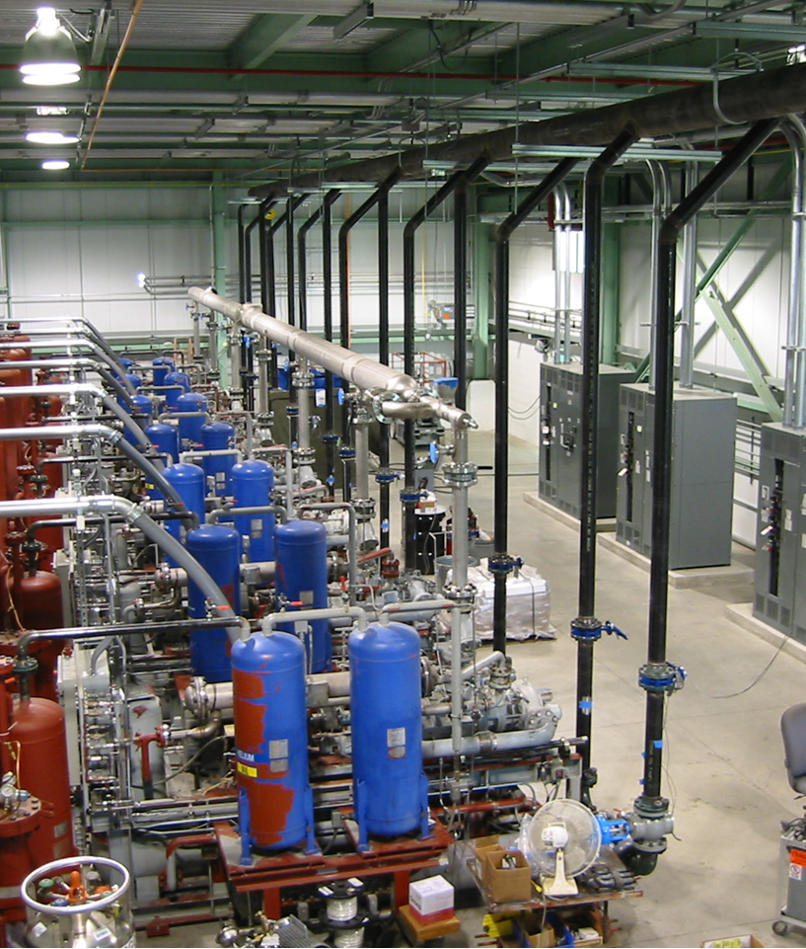
ASTA
PXIE

Slide 15
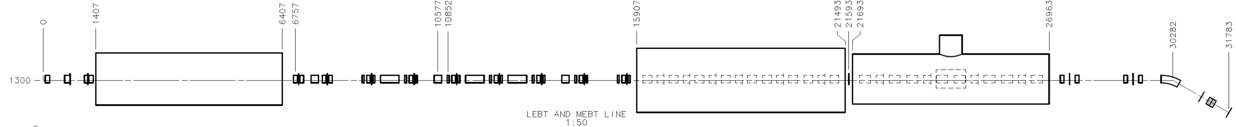
Project X Injector Experiment
(PXIE)
LEBT
RFQ
MEBT
HWR
SSR1
HEBT
40 m, ~25 MeV, 1 mA CW
PXIE is a comprehensive systems integration test program for the Front End
PXIE will address the address/measure the following:
  LEBT pre-chopping
  Vacuum management in the LEBT/RFQ region
  Validation of chopper performance
  Bunch extinction
  MEBT beam absorber
  MEBT vacuum management
  Operation of HWR in close proximity to 10 kW beam absorber
  Operation of SSR with beam
  Emittance preservation and beam halo formation through the front end

Slide 16
High Power Targets
Pre-conceptual target schemes studied at
  Spallation Targetry Forum (March 2012)
  Physics Study (June 2012)
  MuSR Forum (October 2012)
  Energy Station Workshop (January 2013)
Ultra-cold neutrons led by NCSU, ORNL, UTenn
  NCSU formally joined PX Collaboration in January 2013
Isotope production led by ANL
  Concept development of the 500kW isotope target based on rastered beam on a set of stacked thorium disks in a carbon fiber wool matrix
Energy Station led by PNNL
  Concept presented at PXES Workshop
MARS conceptual studies in progress for optimal target configuration for kaon, muon, and neutron production.
Neutrino target devgelopment led by FNAL (building on NOvA/LBNE)
Materials development under development by RaDIATE Collaboration
  FNAL, PNNL, BNL, RAL, Oxford, CERN

Slide 17
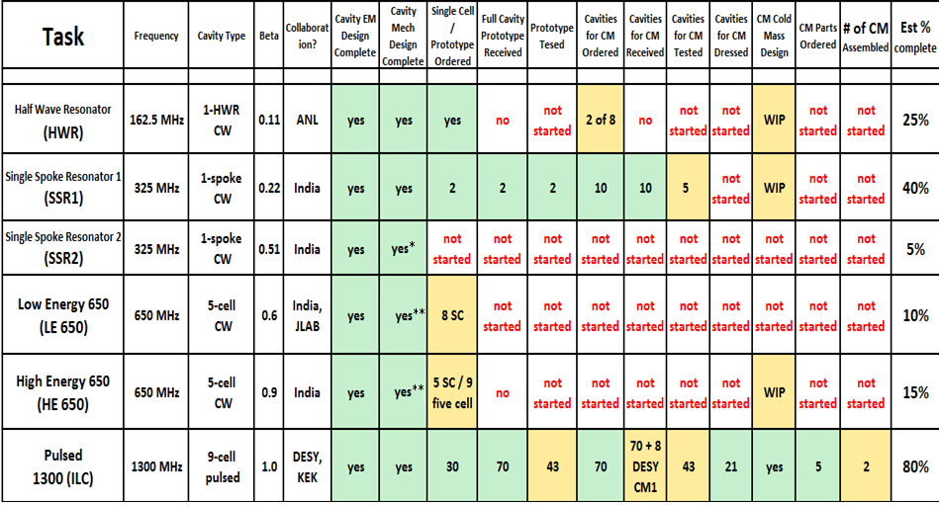
Project X Cavity and CM development
PXIE
Lots of cavity and cryomodule development remains to lower Project risks
* Concept mechanical design
** Blade tuner design; the end tuner design is under development

Slide 18
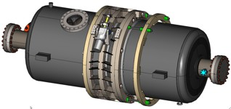
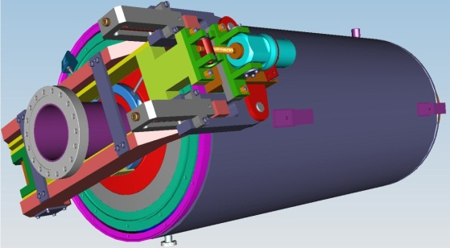
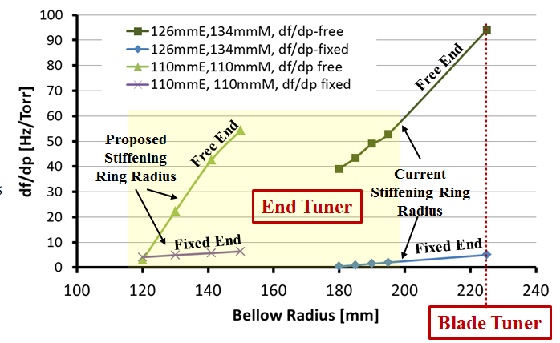
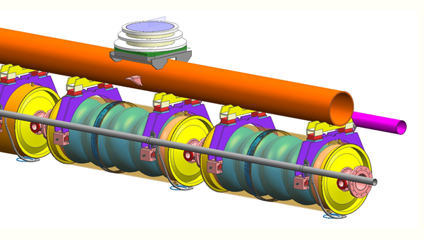
650 MHz CW Cavities and CMs are a design challenge
  Modification of cryomodule design developed for ILC
  …but must accommodate large (250 W) heat loads at 2 K
Lots of detailed engineering remains
⬅Blade Tuner
End Tuner ➔
Stiffening rings located to minimize dF/dP while maintaining tunability
Working on detailed CM engineering design and 3D models of 650 MHz CM
Collab with India

Slide 19
High-Q Program
CW Operation:
RF load:
  ILC: <5 W/CM (0.5 % duty cycle, E_{acc} = 35 MeV/m);
  Project X: ~200 W/CM (100% duty cycle, E_{acc} = 17 MeV/m).
For CW operation RF load and thus, Q₀ is an issue.
High Q₀ allows for lower capital (cryosystem) and operational costs (e.g. few MW reduction of power consumption).
High Q₀ allows for higher gradient at CW and, thus, allows for lower capital cost of the linac.
Increase of Q₀ by ~two times may save many tens of M$ for a billion-scale project.
High Q₀ is necessary!

Slide 20
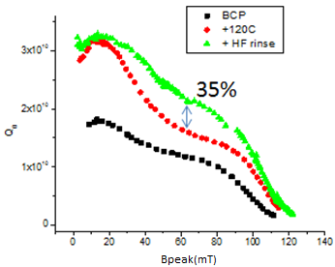
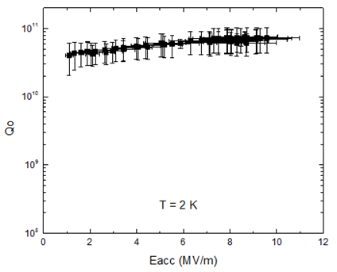
Different approaches to improve Q₀:
NbN: superconductor with higher T_{c} (~16K, compared to 9.2K for Nb);
Nitridization: simple and inexpensive modification to standard Nb treatments.
First result at FNAL: world record Q ~ 7.5e10 at 2K and 10MV/m for
a 1.3GHz single cell cavity; residual resistance <0.5 nOhm!
HF rinse:
Single HF rinse (5 min) followed by water rinse is beneficial for the medium field Q value – gains of up to 35% measured at 70 mT,
f=1.3 GHz (B_{peak}/E_{acc}=4.26 mT/MeV/m).
A. Grassellino, LINAC 2012
Romanenko,
TTC Meeting 2011

Slide 21
1.3 GHz for ILC and Project X
Goals: ILC SRF goals
    S0 >35 MV/m bare cavities
    S1 31.5 MV/m dressed cavities in a ILC Cryomodule
    S2 Beam test of full ILC RF unit (CM, klystron, modulator)
    Build and test ~ 1 CM/yr
  All of this will benefit the 3-8 GeV pulsed linac for Project X
Accomplishments:
  Excellent progress on gradient improvement
  ANL/FNAL EP facility: world class throughput & yield
  18 Dressed cavities, CM2 populated with 35 MV/m cavities, have >8 good cavities tested in VTS for CM3
  Parts for 4 more 1.3 GHz cryomodules ( ARRA funds)
  Cost reduction (e.g. tumbling vs. EP, & cavity repair)
Excellent progress on all of these
  CM1 tests complete, CM2 installation now

Slide 22
Basic Parameters of Project X Pulsed Linac
Pulsed Linac is based on ILC/XFEL technology:
Cryomodule: ILC type with SC quad in center of CM (8 cav+Quad /CM)
Focusing : FODO Lattice, each Quad has X/Y correctors and BPM
Cavity:
  Average Gradient 25 MV/m; gradient spread ± 10% (ACC7/FLASH)
  Q₀=1∙10¹⁰; Q_{L}=1 ∙ 10⁷ (Matched Q_{L}=2.5∙10⁷ => BW_{1/2} =26Hz - too small )
  Filling time = 3 (4) ms, flat-top = 4.4 ms
RF source:
  50 kW per cavity ; ~50% overhead (LLRF, detuning, losses)
  One RF source per one (two) cryomodules: Total: 28 (14) RF stations
  Power 0.4 (0.8) MW klystron per 1(2) CM
  Pulse length = 8.4 ms; Rep. rate = 10 Hz
H⁻ input beam parameters:
  Current = 1 mA; ( max 5 mA peak @ 162.5 MHz)
  Input Energy 3GeV; ε_{T}= 0.3 mm·mrad; σ_{E} = 0.5 MeV (init); Δt=2ps (rms)

Slide 23
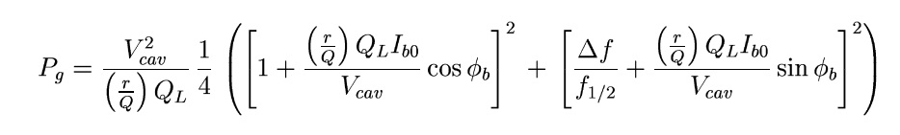
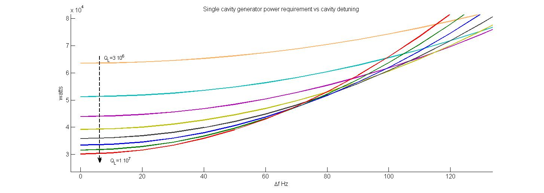
Cavity RF power vs. detuning
RF power
requirements
Specs for RF power/cavity
Power requirements for ~70 Hz detuning are similar for Q_{L} in range: 6∙10⁶ 1∙10⁷ )
Cavity detuning

Slide 24
R&D at NML, HTS and ASTA
Lorentz Force Detuning (LFD) compensation for long pulses:
  Detuning at 25 MV/m is > 600Hz, if not compensated
  Adaptive LFD compensation should provide <30 Hz freq. stability
  Studies at NML and HTS
LLRF: Only VS is regulated (flat), individual cavity gradients tilt (A & φ)
  Non constant beam energy gain along bunch train.
  Potential emittance growth, final energy spread and beam loss due to tilts in A & φ
Acceptable Gradient spread (± 10%)?
  Reduce gradient spread or minimize impact.
  Use optimum Q_{L} and power distribution for a given gradient spread.
Bringing up the LINAC
  How much gradient overhead is needed to go from I_{beam}=0 to 1 mA?
Studies at NML, HTS
Simulations & experimental studies at FLASH and ASTA

Slide 25
Summary
The Project X Reference Design represents a unique facility which will form the basis for a world leading Intensity Frontier program in the U.S. over many decades
  Platform for future development of a Neutrino Factory or Muon Collider
R&D program underway with very significant investment in both RT and SRF technologies and test facilities
  Front-end R&D: PXIE
  Cavity and cryomodule development, high-Q: SRF test facilities
  Long-pulse feed-forward and feed-back studies: ASTA
We could be ready to initiate construction ~FY2017

Slide 26
Backup Slides

Slide 27
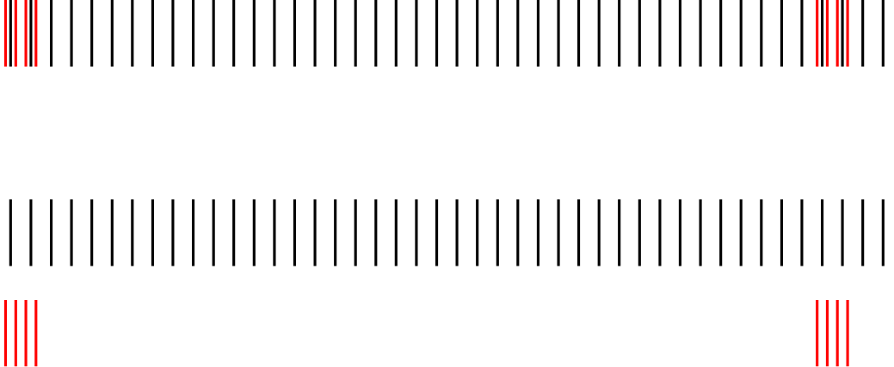
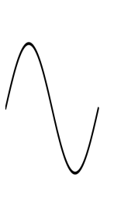
Stage 1 Bunch Patterns
3.6 mA peak current
1 mA
f₀/2
1 GeV
0.91 mA
0.09 mA
1 μsec

Slide 28
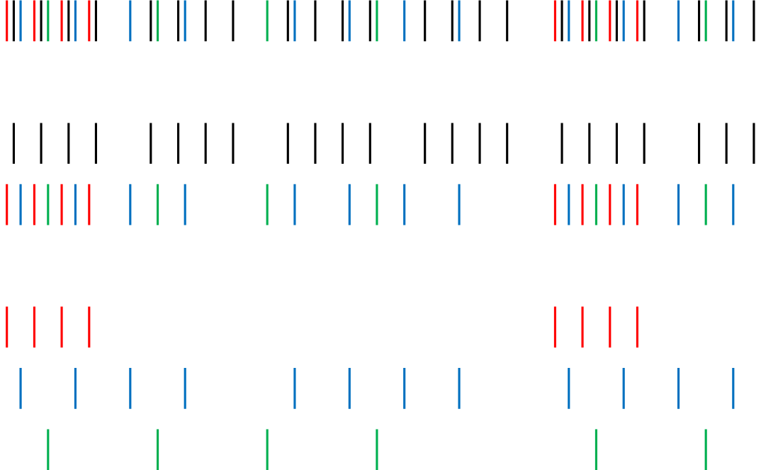

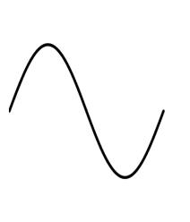
Stage 2 Bunch Patterns
5 mA peak current
2 mA
f₀/2
1 GeV
1 mA
1 mA
f₀/8
3 GeV
0.25 mA
0.5 mA
0.25 mA
0.5μsec

Slide 29
Stage 1
Scope
  1 GeV CW linac injecting into upgraded Booster
  Connection to Muon Campus
  Possible new EDM/Neutron campus (1 GeV)
Performance
  Main Injector: up to 1.2 MW at 120 GeV, 0.9 MW at 60 GeV
  Muon Campus: >80 kW to Mu2e @ 1GeV
  EDM/Neutron Campus: up to 900 kW @ 1 GeV
  8 GeV Program: up to 42 kW
Utilization of the existing complex
  Booster, Main Injector and Recycler (with PIP)
  LBNE target system
  Muon Campus
  400 MeV Linac retired – eliminates major reliability risk

Slide 30
Stage 2
Scope
  Upgrade 1 GeV linac to 2 mA, still injecting into Booster
  1-3 GeV CW linac
  20 Hz Booster upgrade
  3 GeV Campus
Performance
  Main Injector: up to 1.2 MW at 60-120 GeV
  3 GeV Campus: 3 MW
  EDM/Neutron Campus: 1 MW @ 1 GeV
  8 GeV program: up to 84 kW
Utilization of the existing complex
  Booster, Main Injector and Recycler (with PIP)
  LBNE target system

Slide 31
Stage 3
Scope
  3-8 GeV pulsed linac
  Main Injector Recycler upgrades
  Short baseline neutrino facility/experiment
Performance
  Main Injector: 2.4 MW at 60-120 GeV
  3 GeV Campus: 2.9 MW
  EDM/Neutron Campus: 1 MW @ 1 GeV
  8 GeV program: up to 170 kW
Utilization of the existing complex
  Main Injector and Recycler
  LBNE beamline/target
  8 GeV Booster retired – eliminates major reliability risk

Slide 32
Stage 4
Scope – beyond the Reference Design
  Current upgrade of CW and pulsed linac: 5 mA x 10% DF
  Main Injector/Recycler upgrades
  LBNE target upgrade
  Step toward a NF or MC
Performance
  Main Injector: 4 MW at 60-120 GeV
  3 GeV Campus: 2.7 MW
  EDM/Neutron Campus: 1 MW @t 1 GeV
  8 GeV program: 3-4 MW
    (Requires an accumulator ring for low duty factor)
Utilization of the existing complex
  Main Injector and Recycler
  LBNE beamline/target

