Slide 1
Higgs Factory R&D and Facilities
Weiren Chou (Fermilab)
With input from: Alain Blondel, Frank Zimmermann, Daniel Schulte (CERN)
Tanaji Sen (Fremilab)
Alex Chao (SLAC)
Kaoru Yokoya (KEK)
Jie Gao (IHEP)
Wei Gai (ANL)
Yuri Bylinski (TRIUMF)
Presentation at the Snowmass Preparation Mini-Workshop
25-26 February 2013, U. of Chicago

Slide 2
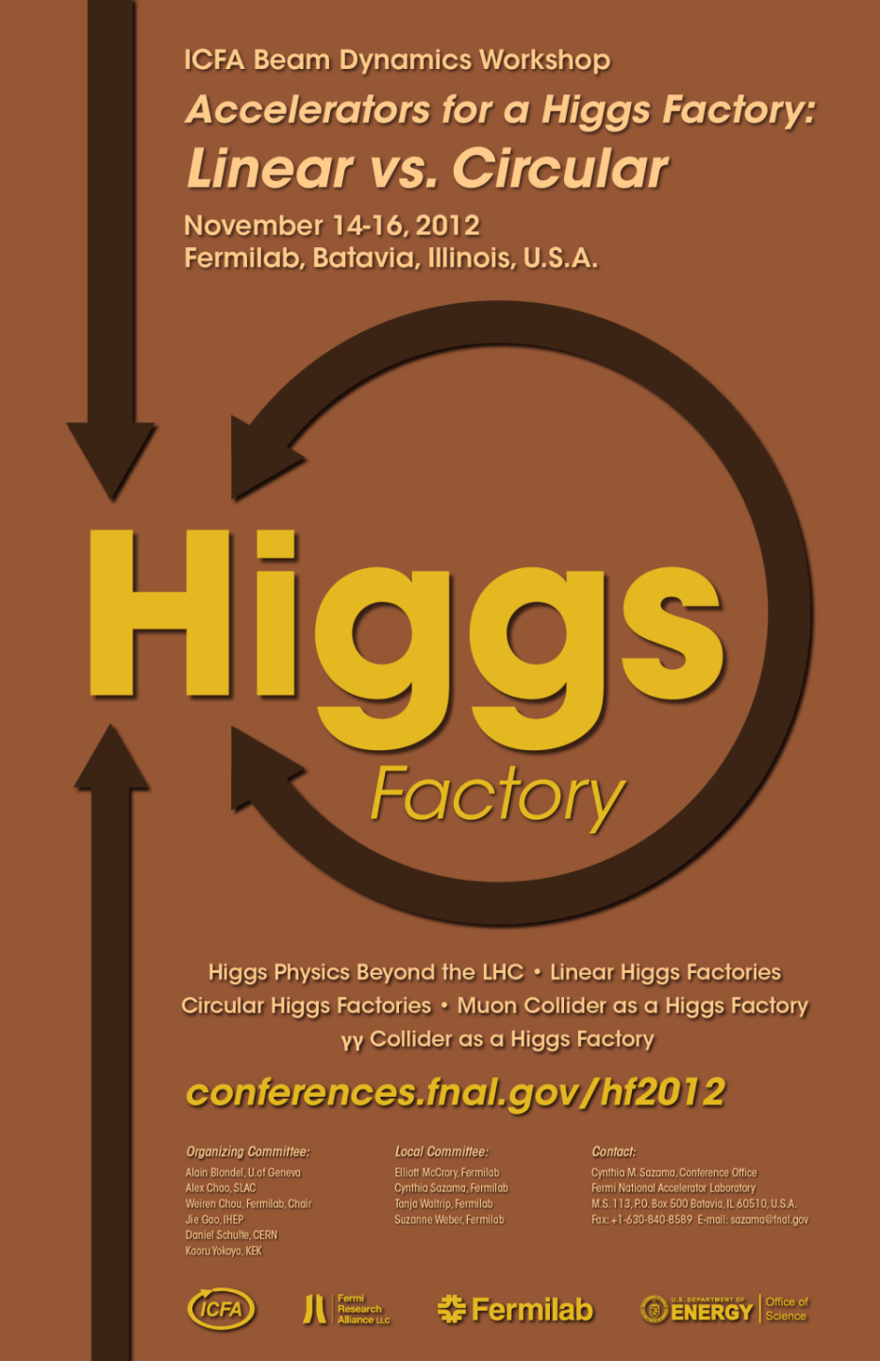

Slide 3
The World HEP Landscape Planning – a Circle?
2001 Snowmass
2004
After 4th of July 2012
Linear e+e-
  Cold (TESLA)
  Warm (NLC/JLC)
Circular e+e-
VLHC
Muon collider
Cold Linear e+e- (ILC)
Linear e+e-
  ILC
  CLIC
  X-band klystron based
Circular e+e-
  Fermilab site filler
  LEP3 and TLEP
  SuperTRISTAN
  China Higgs Factory (CHF)
  VLLC
Muon collider
Photon cillider
  ILC-based
  CLIC-based
  SAPPHiRE
  SLC-type
  ERL-based

Slide 4
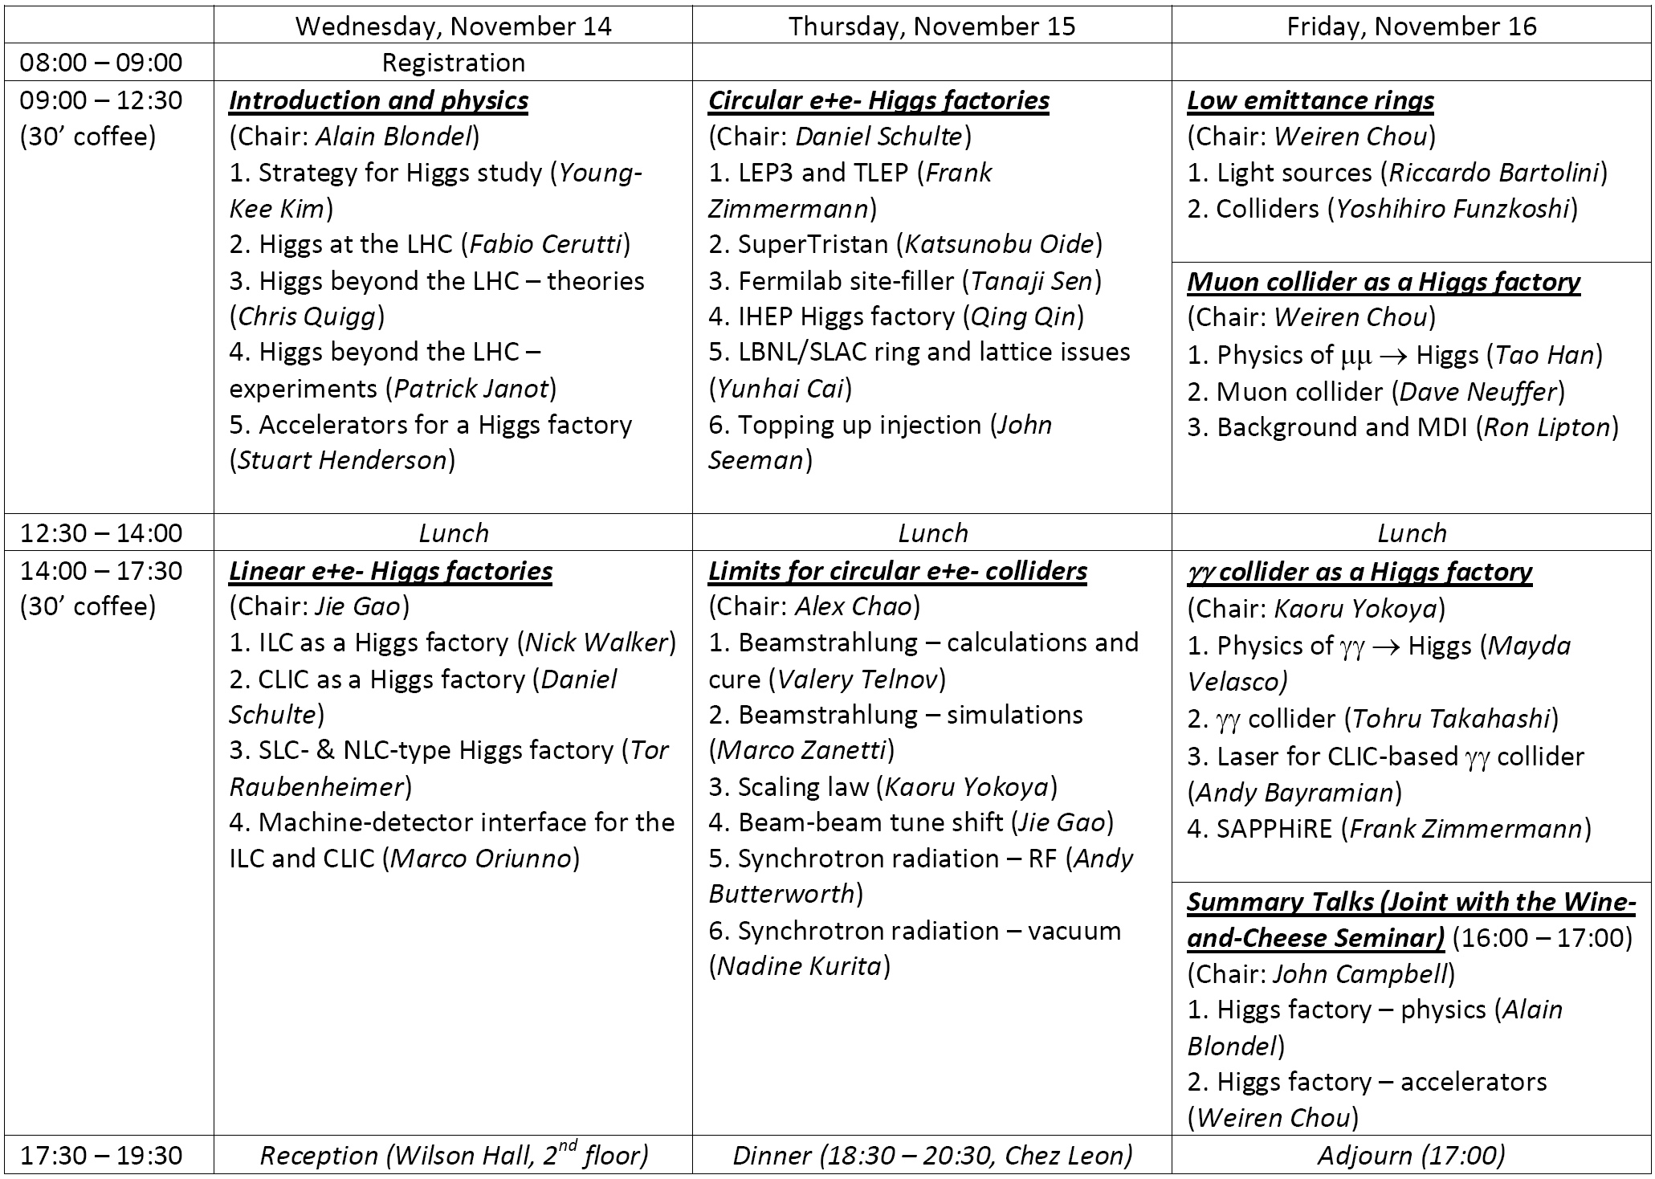

Slide 5
Purpose and Report
The purpose of the workshop was not to recommend any specific machine.
The purpose was to make technical comparison between these candidates:
  Physics reach
  Performance (energy, luminosity)
  Upgrade potential
  Technology maturity and readiness
  Technical challenges requiring further R&D
A parameter comparison table was compiled during the workshop.
A draft report was sent to all participants on January 18.
More than 100 e-mails were received with comments on the draft.
A revised final report was published on February 15.

Slide 6
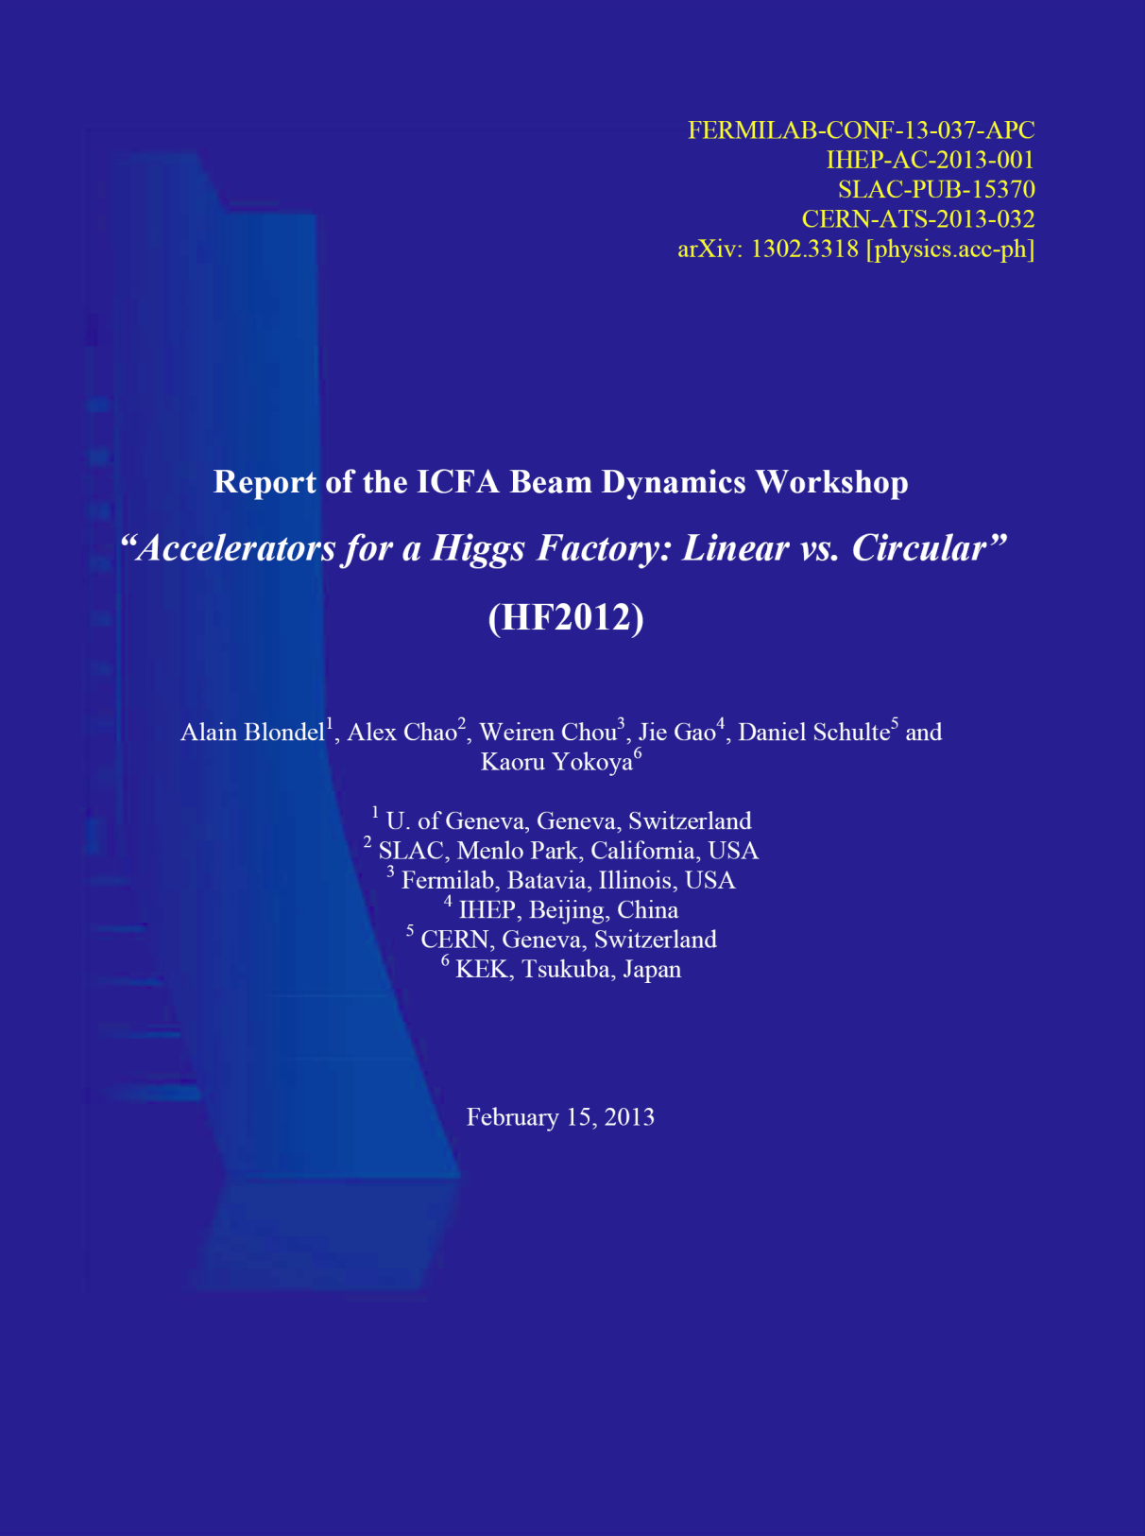

Slide 8
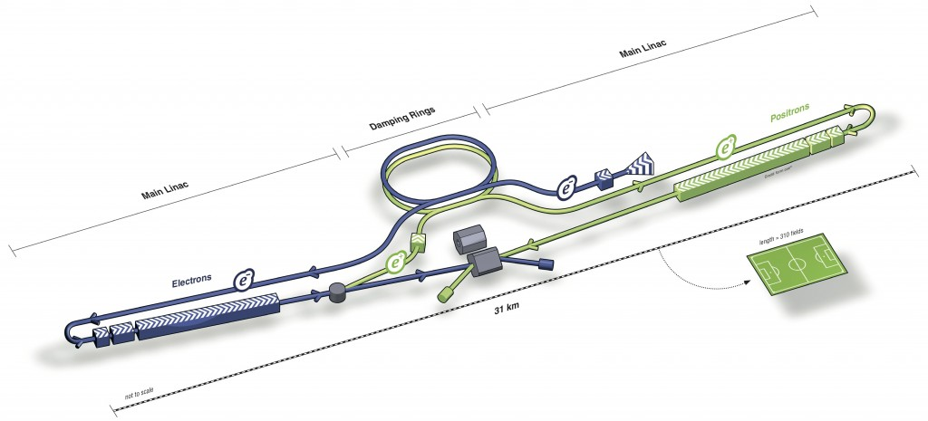
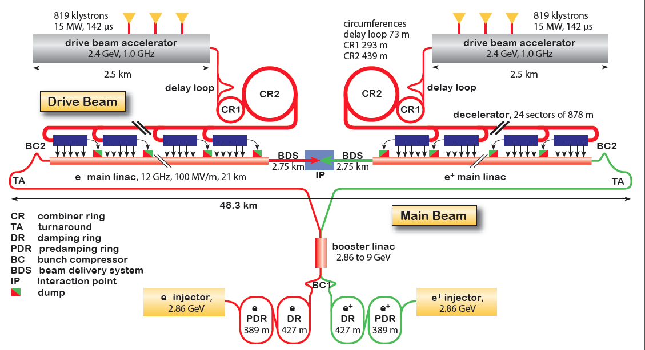
(1) Linear e⁺e⁻ Collider as a Higgs Factory
ILC
CLIC (also has a klystron version for low energy)

Slide 9
(1) Linear e⁺e⁻ Collider as a Higgs Factory (cont.)
Advantages:
  Extensive design and prototyping work have been done
  Key technologies are in hand after large investment for R&D.
  There exist well-organized international collaborations led respectively by the ILC GDE and CLIC Collaboration (now combined in the Linear Collider Collaboration)
  Important step towards high energy e+e- collisions
  Polarized beams (e- 80%, e+ 30%)
  A front runner (in terms of readiness)
Challenges:
  High cost
Specific issues:
  ILC
    FFS
    Positron source for a Higgs factory needs 10 Hz operation of the e- linac for e+ production, or the use of an unpolarized e+ beam as a backup scheme
  CLIC
    Accelerating structure
    Industrialization of major components
    From CDR to TDR

Slide 10
(1) Linear e⁺e⁻ Collider as a Higgs Factory (cont.)
In terms of readiness, the ILC is clearly a front runner. But even this candidate has its technical challenges for a Higgs factory. For example:
e+ production
Vertical beam size at IP

Slide 11
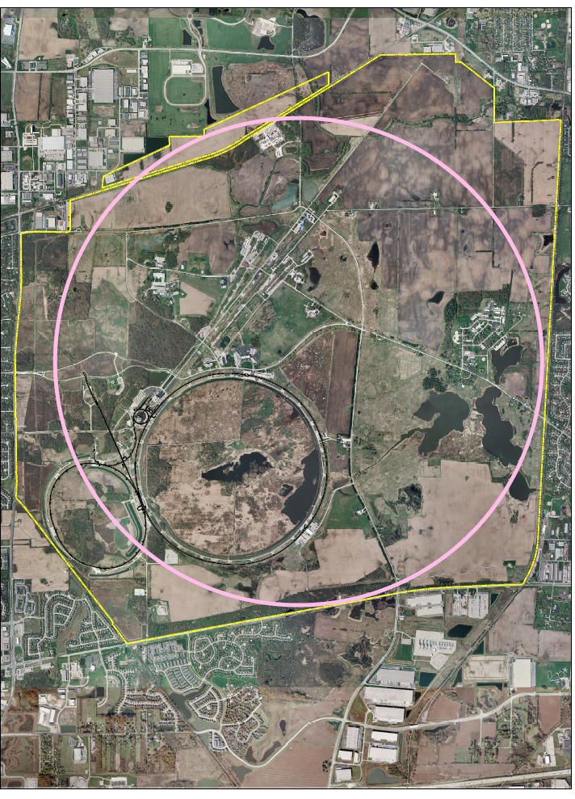
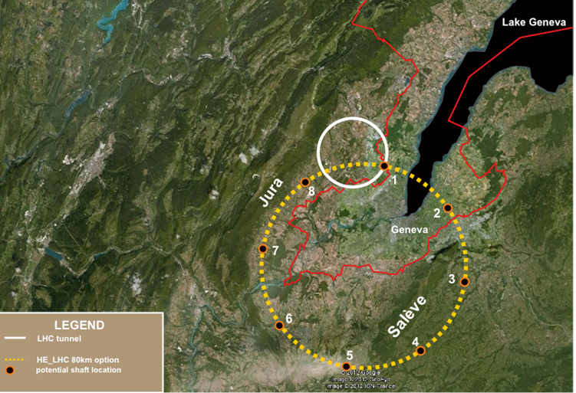
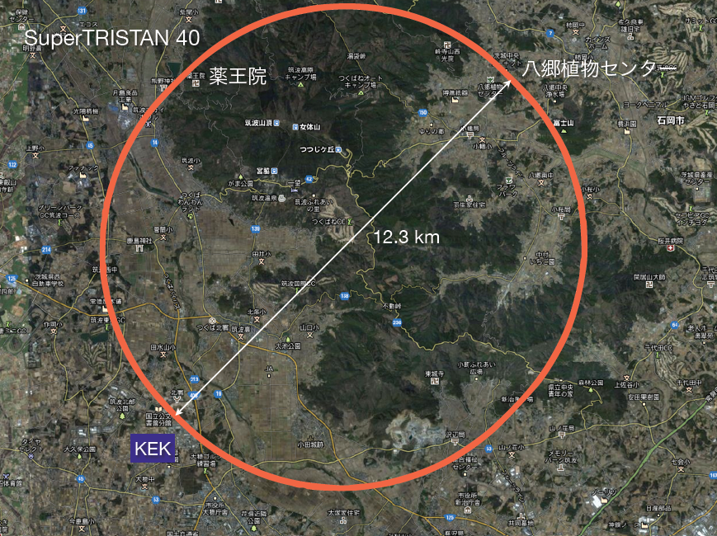
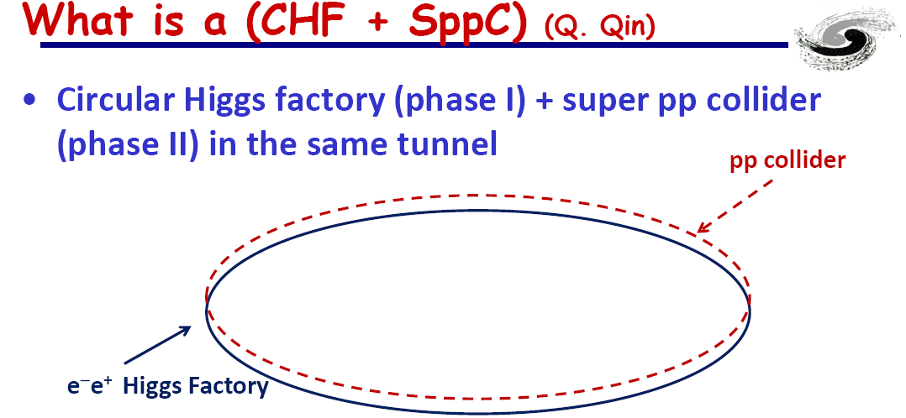
(2) Circular e⁺e⁻ Collider as a Higgs Factory
Fermilab Site-Filler
LEP3 and TLEP
SuperTRISTAN
China Higgs Factory

Slide 12
(2) Circular e⁺e⁻ Collider as a Higgs Factory (cont.)
Advantages:
  At 240 GeV and below, a higher luminosity than a linear collider when the ring size is sufficiently large
  Based on mature technology and rich experience
  Some designs can use existing tunnel and site
  More than one IP
  Tunnel of a large ring can be reused as a pp collider in the future
Challenges:
  Beamstrahlung limiting beam life time requires lattice with large momentum acceptance
  RF and vacuum problem from synchrotron radiation
  A lattice with low emittance
  Efficiency of converting wall power to synchrotron radiation power
  Limited energy reach
  No comprehensive study; design study report needed.

Slide 13
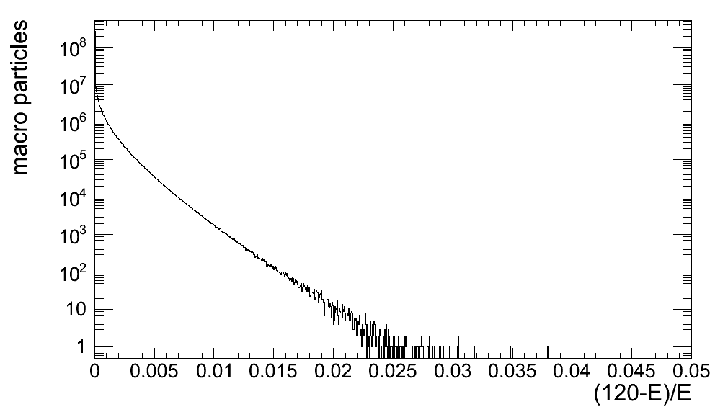
BS lifetime (M. Zanetti)
Simulate and track O(10⁸) macroparticles and check the energy spread spectrum
Lifetime computed from the fraction of particles beyond a given momentum acceptance (η)
Exponential dependence on η
TLEP-H
Lifetime>4h η=3%

Slide 14
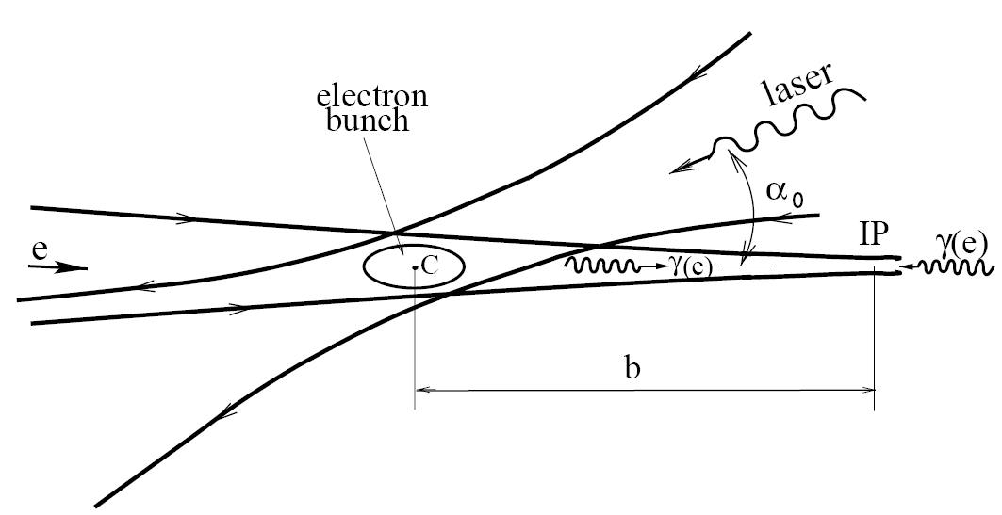
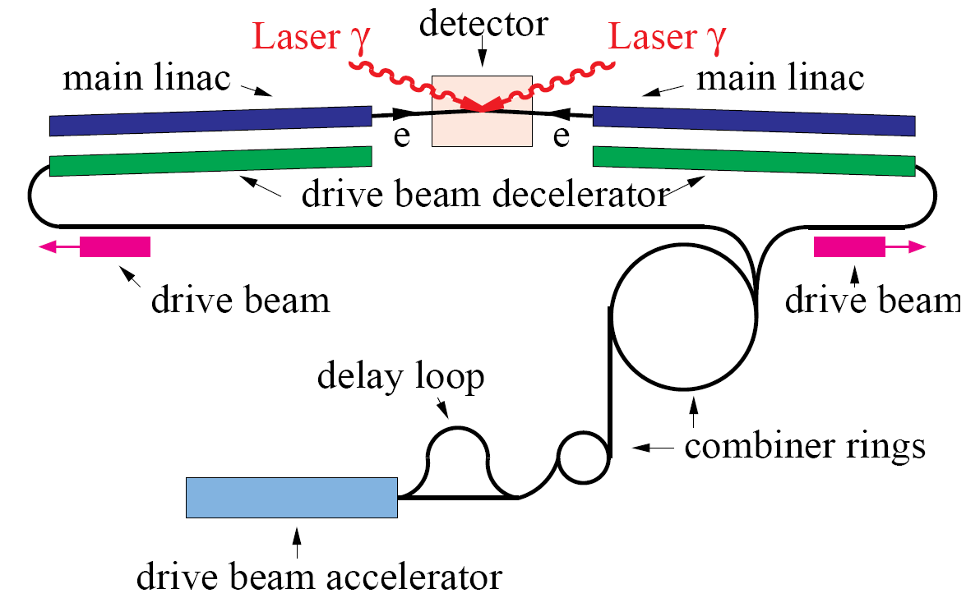
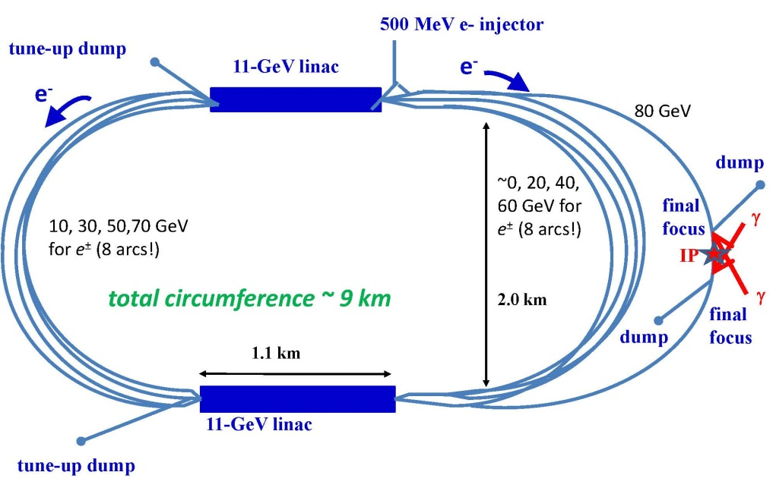
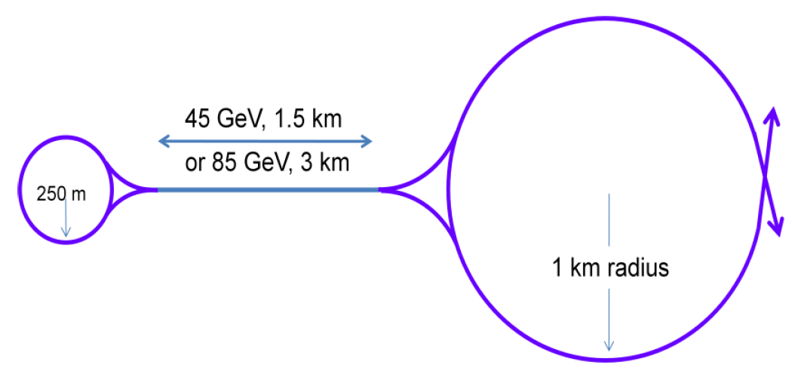
(3) Photon Collider as a Higgs Factory
CLIC-based
SAPPHiRE
SLC-type

Slide 15
(3) Photon Collider as a Higgs Factory (cont.)
Advantages:
  Allow access to CP property of the Higgs
  Lower beam energy (80 GeV per e- beam to generate 63 GeV γ beam)
  High polarization in the colliding γ beams
  No need for e+ beam
  160 GeV e- linac has a lower cost w.r.t. a 240 GeV linear e+e- collider
  Can be added on a linear e+e- collider
Challenges:
  Physics not as comprehensive as a 240 GeV e+e- collider would be.
  Background problem
  Complex IR design
  No comprehensive study.; design study report needed.
Specific issues:
  ILC-based
    Optical cavity
  CLIC-based
    Laser can piggy-back on the Livermore LIFE fusion project. (But the project schedule is unknown.)
  Recirculating linac-based:
    Polarized low emittance e- gun

Slide 16
ILC-based γγ Collider
1 ps
370 ns
980 μs (2640 pulses in a train)
200 ms (5 Hz)
Laser Requirements
Pulse width | Pulse energy | Pulse spacing | No. pulses in a train | Laser power in a train | Laser average power | Rep rate | Wavelength | Spot size | Crossing angle
1 ps | 10 J /Q | 370 ns | 2640 | 25 MW /Q | 150 kW /Q | 5 Hz | 1 μm | 120 nm x 2.3 nm | 25 mrad
Need an optical cavity with Q ~ 300

Slide 17
CLIC-based γγ Collider
1 ps
0.5 ns
177 ns (354 pulses in a train)
20 ms (50 Hz)
Laser Requirements
Pulse width | Pulse energy | Pulse spacing | No. pulses in a train | Laser power in a train | Laser average power | Rep rate | Wavelength | Spot size | Crossing angle
1 ps | 5 J | 0.5 ns | 354 (5 x 354 = 1770 J per train) | 10 GW | 88.5 kW | 50 Hz | 1 μm | 120 nm x 2.3 nm | 25 mrad

Slide 18
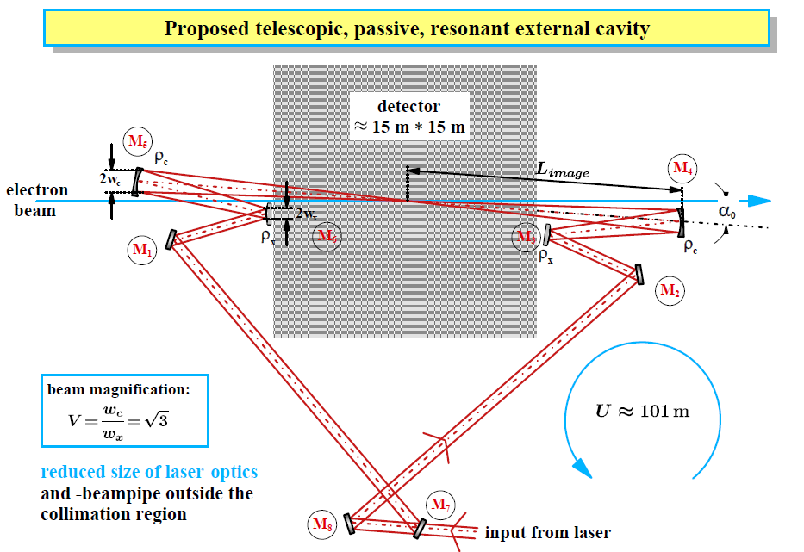
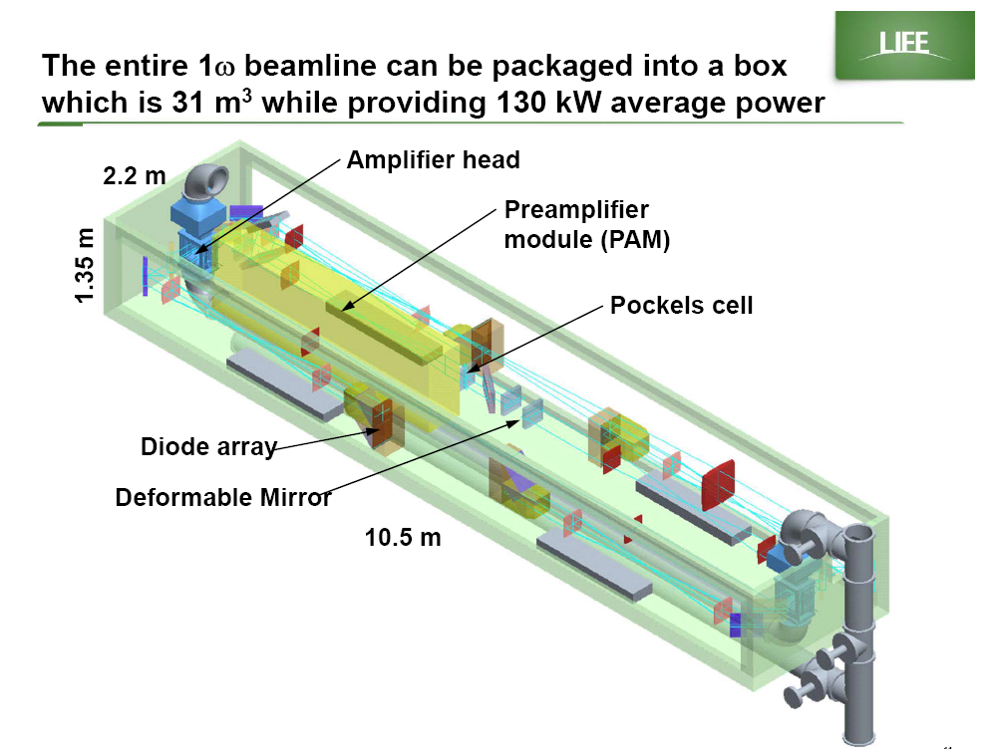
Laser for cold RF-based γγ collider – KEK optical cavity
Laser for warm RF-based γγ collider – Livermore fusion project LIFE laser box

Slide 19
(1) Linear e+e- Higgs Factory R&D and Facilities
Type | R&D | Goal | Facility
ILC | Optimization for 250 GeV E_{CM} | Cost effectiveness | LLC, XFEL
 | Final Focusing System | 37 nm vertical size | ATF2
 |  | Collision point stability | ATF2
 | High gradient 1.3 GHz 9-cell cavity | Eacc > 35 MV/m | DESY, IHEP, Jlab, KEK
 | Beamloading effect | 31.5 GeV/m with ILC beam | LLC, XFEL, ASTA
 | e+ production with 125 GeV e- beam • Longer undulator (from 150 m to 230 m) • 10 Hz e- linac • New undulator with shorter period (from 11.5 mm to 8-9 mm) | Yield rate > 1 | ANL, LLNL, KEK
CLIC | Power efficiency |  | CTF3
 | Optimization for 250 GeV E_{CM} | Cost effectiveness | CTF3
 | Accelerating structure | 100 MeV/m in a complete unit | CFT3
NLC-type X-band | New RF sources, better cavity design, new energy-efficient modulators | Cost effectiveness, energy efficiency | CTF3, SLAC, KEK

Slide 20
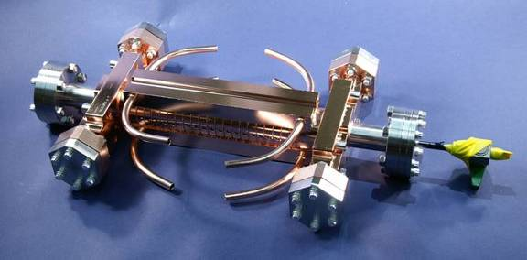
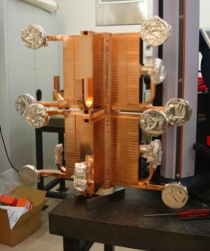
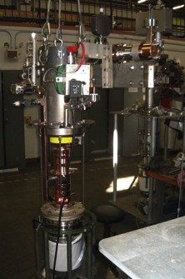
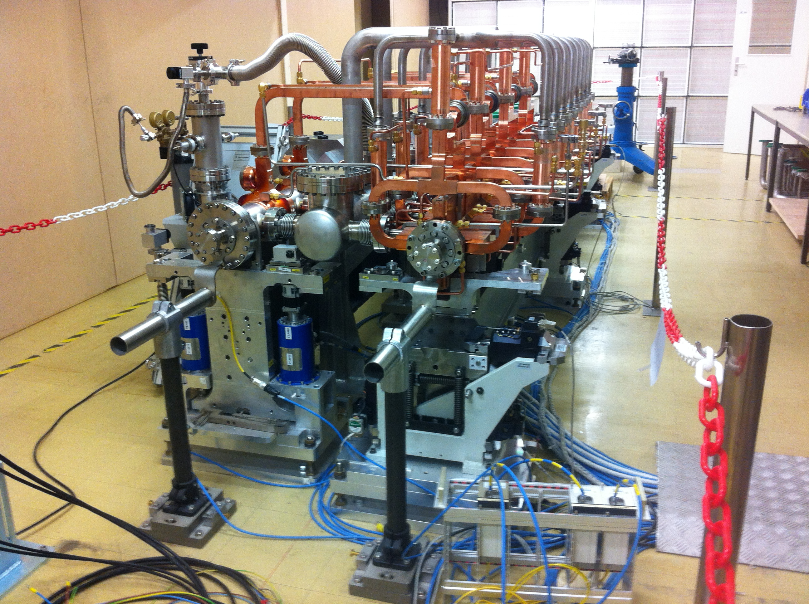
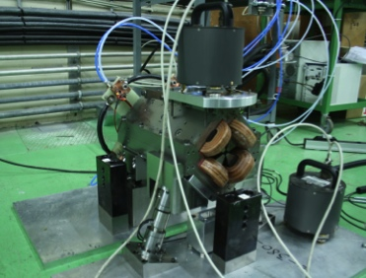
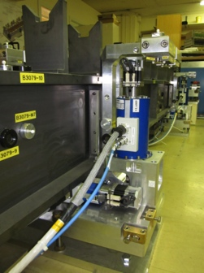
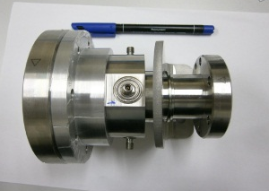
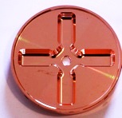
Project Implementation Plan 2012-16
Define the scope, strategy and cost of the project implementation
LHC data crucial – also at nominal energy
Costs, power, scheduling, site, etc
Define and keep an up-to-date optimized overall baseline design that can achieve the scope within a reasonable schedule, budget and risk.
Overall design and system optimisation, activities across all parts of the machine from sources to beam-dump, links to technical developments and system verification activities
Develop the technical design basis. i.e. move toward a technical design for crucial items of the machine – X-band as well as all other parts.
Priorities are the modulators/klystrons, module/structure development including significantly more testing facilities and alignment/stability
Identify and carry out system tests and programs to address the key performance and operation goals and mitigate risks associated to the project implementation.
Priorities are the measurements in: CTF3+, ATF, FACET and related to the CLIC Drive Beam Injector studies, addressing the issues of drive-beam stability, RF power generation and two beam acceleration, as well as beam delivery system studies.

Slide 21
(2) Circular e+e- Higgs Factory R&D and Facilities
Type | R&D | Goal | Facility
All | Forming a study group | To produce a design report | Fermilab, SLAC, CERN, SLS, ESRF, DAFNE, Diamond, SuperKEK-B, IHEP
 | Lattice design in the arc and IR | Large η (2-6%), small ε | Fermilab, SLAC, , CERN, IHEP, IOTA(?)
 | RF coupler, 1.3 GHz | 50 kW CW | ARIEL, IHEP
 | 650 MHz (700 MHz) | 200 kW CW | ASTA, SLAC, IHEP (CERN)
 | HOM damper |  | ASTA, SLAC, IHEP
 | Vacuum | Cooling | Fermilab, SLAC
 |  | Radio activation with MeV γ | ?
 | Wall plug efficiency | 50% | ILC, CLIC, Proj X, CERN
 | Radiation shielding |  | KEK-B
 | Beam-beam | Limit for multiple IPs | CERN
 | Top-up injector | Ramp speed | CESR (5 GeV/0.1 s) SRF?
 | Collective effects | Stabilities | Fermilab, SLAC, IHEP

Slide 22
(3) Photon Collider Higgs Factory R&D and Facilities
Type | R&D | Goal | Facility
All type | Forming a study group | To produce a design report | Fermilab, SLAC, CERN, KEK, Jlab
 | IR optics | A feasible design | Fermilab, SLAC, CERN, KEK, Jlab
 | Removal of spent electrons |  | ASTA
 | Inverse Compton Scattering |  | ASTA, SLAC, KEK
 | High average power laser |  | LLNL, LBNL, LANL, ELI, SPARC-X, FERMI, IRIDE
ILC-based | Optical cavity |  | SLAC, KEK
CLIC-based and SLC-type | 50 Hz high power laser |  | LLNL (LIFE), ELI
SAPPHiRE | FEL design |  | SLAC

Slide 23
Questions?

Slide 24
Parameter Table – Linear Higgs Factories

Slide 25
Parameter Table – Linear Higgs Factories (other parameters)

Slide 26
Parameter Table – Circular Higgs Factories

Slide 27
Parameter Table – Muon Collider as a Higgs Factory

Slide 28
Parameter Table – Photon Collider as a Higgs Factory

