Slide 1
JLab ERL Test Bed Opportunities for HEP Technology Development and Physics Experiments
George R. Neil
Associate Director, Jefferson Laboratory
February 2013
Snowmass Workshop
Chicago IL

Slide 2
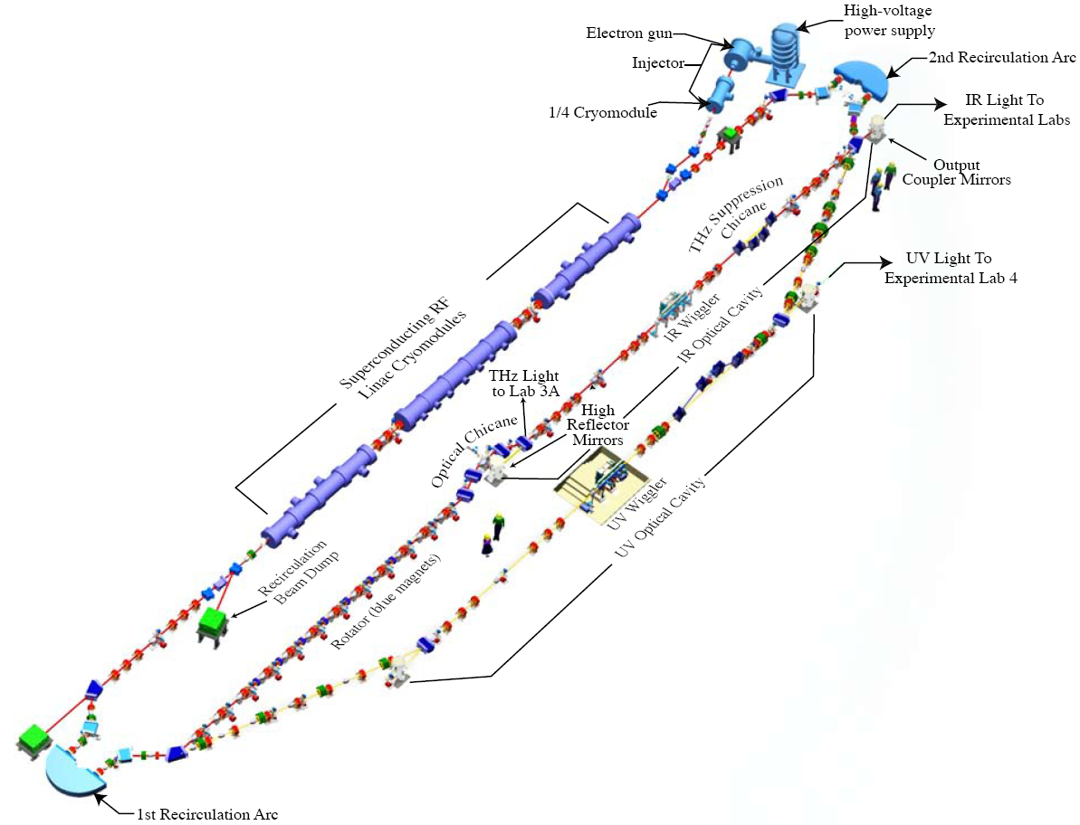
Existing JLab High Intensity ERL
Typical operation:
E = 130 MeV
135 pC pulses @ 75 MHz
The first high current ERL
provides a high intensity,
cost-effective platform
for HEP-related studies
Highlighted activities:
Search for Dark Matter
Cooling Ring Studies
Fixed Target Options

Slide 3
JLab FEL Accelerator Capabilities
 | Near Term Capability | Full Capability | Internal Target (Near Term)
 | external target | external target | internal target
E (MeV) | 80-320 | 80-610 | 80-165
P_{max} (kW) | 100 | 300 | 1650
I (mA) | 0.31-1.25 | 0.5/3.75 | 10
f_{bunch} (MHz) | 750/75 | 750/75 | 750/75
Q_{bunch} (pC) | 1.67-0.4/16.7-4 | 5-0.67/50-6.7 | 13.5/135
ε_{transverse} (mm-mrad) | ~1/~3 | ~2/~5 | ~3/~10
ε_{longitudinal} (keV-psec) | ~5/~15 | ~10/~25 | ~15/~50
Polarization | No | Up to 600 μA | No
 | 750 MHz drive laser; single F100 | 12 GeV RF drive; three F100s | 12 GeV RF drive; three F100s

Slide 4
Workshop to Explore Physics Opportunities with Intense, Polarized Electron Beams up to 300 MeV
March 14th -16th at MIT
http://web.mit.edu/lns/PEB_Workshop/
Plenary Session
Overview talk: dark photon physics Maxim Pospelov
Overview talk: parity violation physics Yury Kolomensky Overview talk: precision nucleon structure Carl Carlson
Overview talk: nuclear astrophysics Achim Schwenk
JLab FEL Accelerator Complex David Douglas
Mainz/MESA Kurt Aulenbacher
BNL ERL development Ilan Ben-­‐Zvi
Polarized e-­‐source development Matt Poelker
Precision electron polarimetry Eugene Chudakov
Report on JLab‐MIT test in July 2012 Chris Tschalär
Parallel Sessions on dark photons, parity violation, precision nucleon structure, experiments with nuclei, and technology

Slide 5
Workshop to Explore Physics Opportunities with Intense, Polarized Electron Beams up to 300 MeV
March 14th -16^{th,} MIT, Cambridge, MA
http://web.mit.edu/lns/PEB_Workshop/
Qweak report and Technology Application at Lower Energies Mark Pitt
Calculation of γZ box graph Wally Melnitchouk
Comparison of γZ Structure Function Models Benjamin Rislow
Future weak charge measurements including Moeller design Kent Paschke
Charge Symmetry breaking effects Gerald Miller
The P2@MESA experiment at Mainz Dominik Becker
Back angle measurements using P2 Sebastian Baunack
Particle physics motivation Bill Marciano
Nuclear physics aspects Bill Donnelly
Mainz/MAMI Harald Merkel
HPS at JLab Stepan Stepanyan
APEX at JLab Philip Schuster
DarkLight Experiment Ray Cowan
DarkLight beam background measurements Jim Boyce
Dark photon search at MESA Matthias Molitor
The TREK/E36 Experiment at J-­‐PARC Michael Kohl
Relat. Dark Matter Sarah Andreas
Invisible Decays Yonatan Kahn
Measurement of the charge radius of the proton Mehdi Meziane
MUSE@PSI: muon vs. electron Ron Gilman
MAMI initial state radiation expt Miha Mihovilovic
Polarizabilities expt Rory Miskimen

Slide 6
Workshop to Explore Physics Opportunities with Intense, Polarized Electron Beams up to 300 MeV
Polarizabilities theory nucleon Vladimir Pascalutsa)
Polarizabilities theory few body Harald Griesshammer
Overview talk on lattice QCD Will Detmold
Nuclear structure corrections to Lamb shift in muonic deuterium Mikhail Gorshteyn
Tests of chiral symmetry: theory Barry Holstein
Tests of chiral symmetry: experiment Aron Bernstein
160(γ,α)12C and 160(e,e’α)12C to access 12C(α,γ)16O Genya Tsentalovich
12C(α,γ)16O accessed using electrons and internal targets Narbe Kalantarians
160(γ,α)12C to access 12C(α,γ)16O Claudio Ugalde
Ideas for polarized electron scattering at the S-­‐DALINAC Joachim Enders
AT motivation and theory Andrei Afanasev
Potential AT measurements at Mainz David Balaguer Rios
AT and PREX, PREX-­‐II, CREX report Mark Dalton
Neutron skins and neutron stars Jorge Piekarewicz
Potential Rn and AT measurements at Mainz Concettina Sfienti
Test of nonlocality in quantum mechanics Jacek Ciborowski
Clean measurements of the nucleon axial-­‐vector
and magnetic free neutron form factors Alexandre Deur
High brightness Beam Diagnostics Ralph Fiorito)
Polarimeters at MAMI and MESA: Past and future Valery Tyukin
The polarimeter chain at MESA Kurt Aulenbacher
Polarimetry -­‐ Scaling with energy David Gaskell
Hydro Moeller development at Mainz Patricia Aguar-­‐Bartholomae
High Power Cryotargets and Modeling Silviu Covrig
Status of the MESA Injector Robert Heine
Report on Workshop on TPCs at high rate experiments

Slide 7
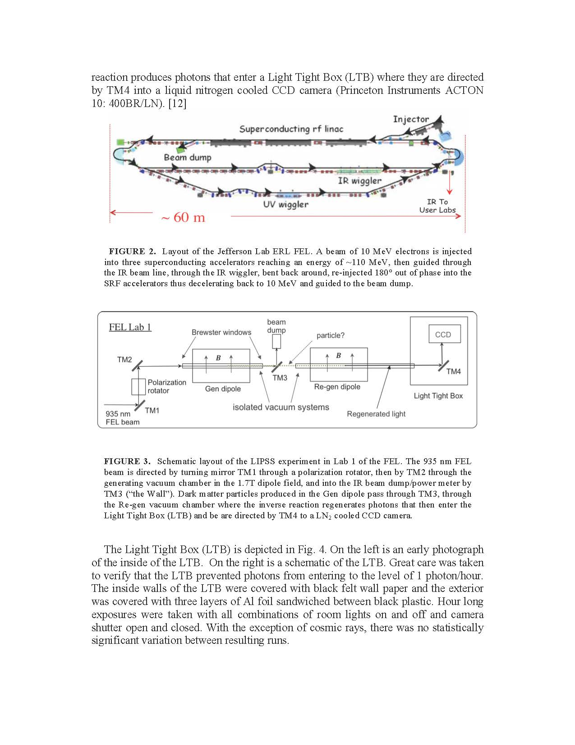
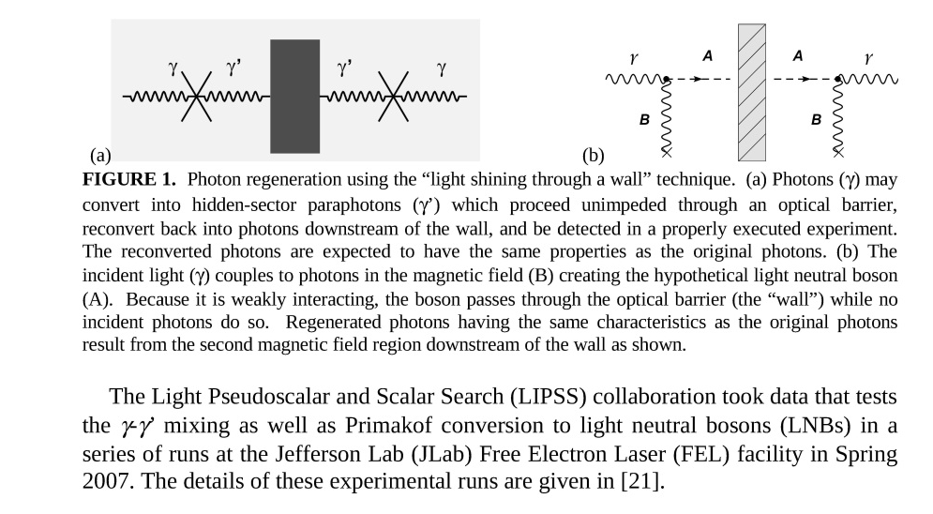
LIPPS Search for Dark Matter
Light from the JLAB FEL was used to search for Dark Matter
Courtesy J. Boyce
Notes:
7

Slide 8
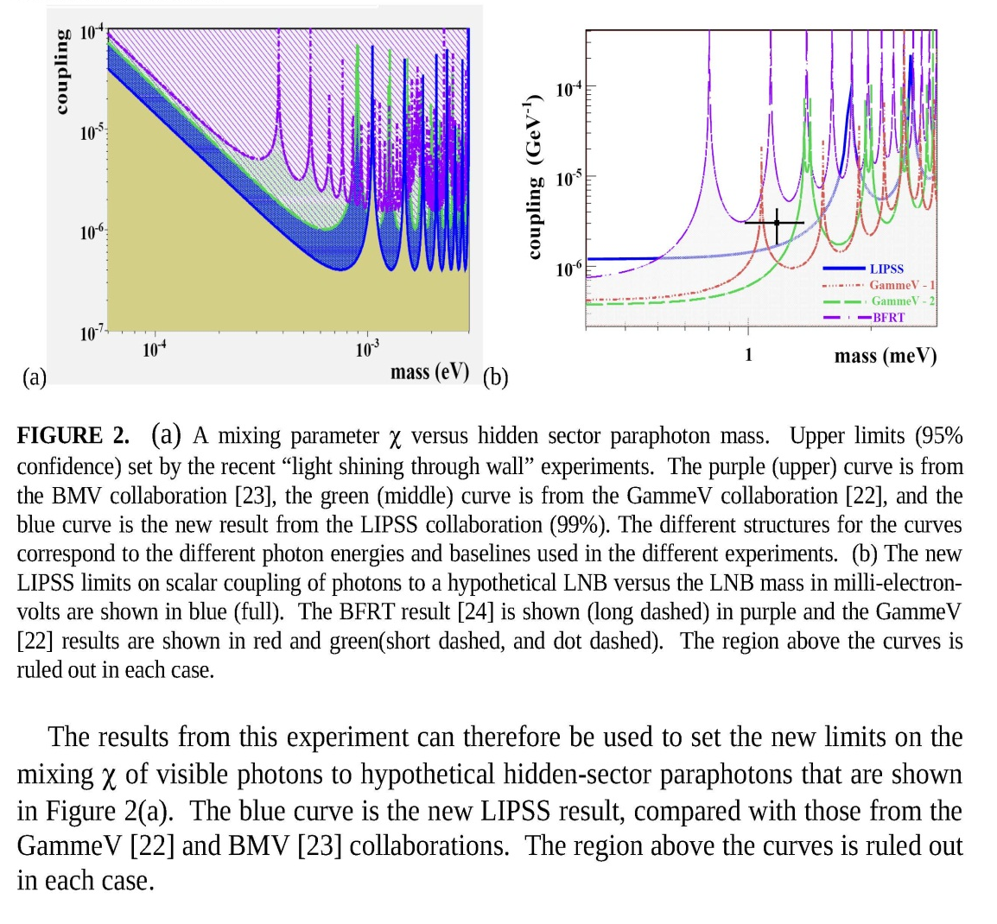
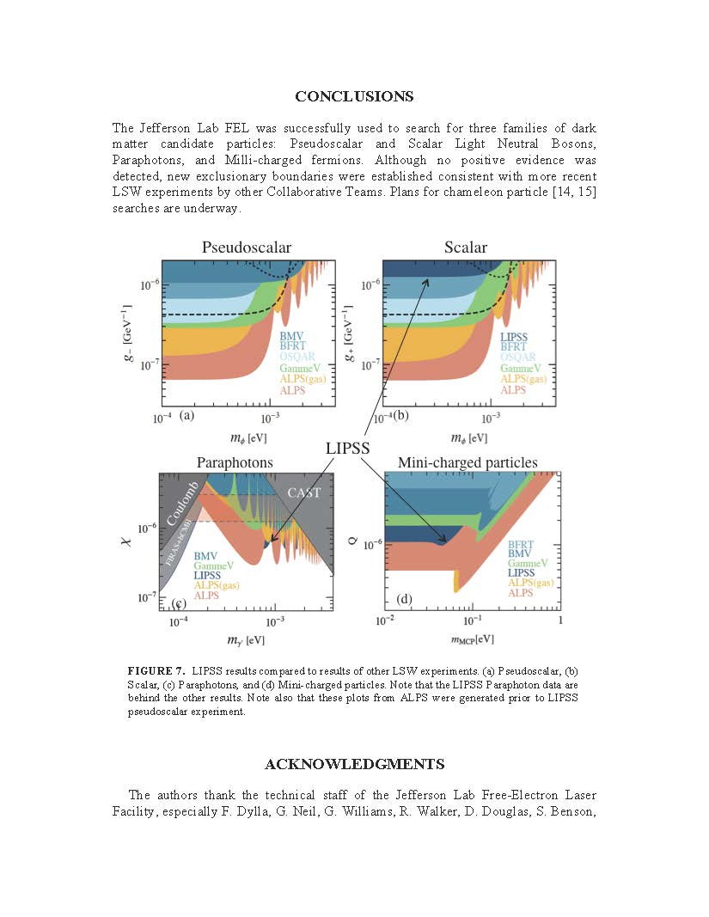
LIPPS Search for Dark Matter - Results
JLAB search successfully excluded significant mixing regions in a modest 40 hour experimental run
Courtesy J. Boyce
Notes:
8

Slide 9
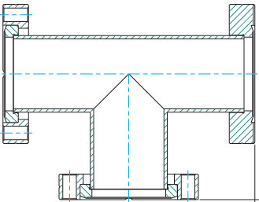
Proposed FEL Chameleon Search – set-up as follow-on to LIPPS
LTB
CCD
ND 10
Window
Window
Dipole
PUMP
Shutter S₁
Shutter S₂
Run Procedure:
Pump out system.
Close Shutter S2
Open Shutter S1
Send Laser (Green, or Red, or FEL) into chamber for time T_{L}
Close Shutter 1.
Open Shutter 2 after T_{D}
Open camera shutter.
Close camera shutter after Δt time.
Store camera image.
Repeat steps 2 – 9 for series of delay times T_{D}.
Repeat steps for series of decreasing ND values and T_{D} values.
S₂
_{closed}
S₂
_{open}
S₂
_{closed}
T_{D}
ΔT = image exposure
ΔT
T_{R} = image readout
(~6 seconds)
T_{L}
S₁
_{open}
S₁
_{closed}
T_{R}
The chamber is exposed to laser light when S₁ is open: T_{L}
The afterglow is recorded when S₂ is opened at a time T_{D} after S₁ is closed.
Courtesy J. Boyce

Slide 10
DarkLight Feasibility Test
Courtesy R. Milner (MIT)
DarkLight Collaboration
Notes:
10

Slide 11
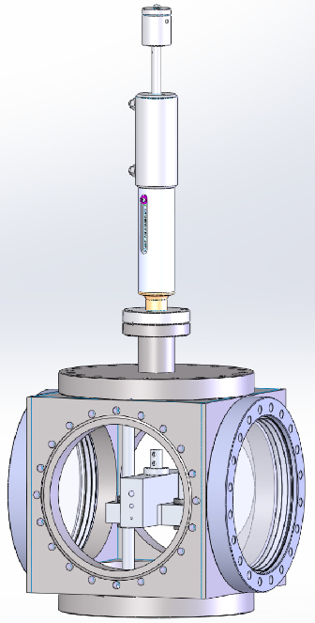
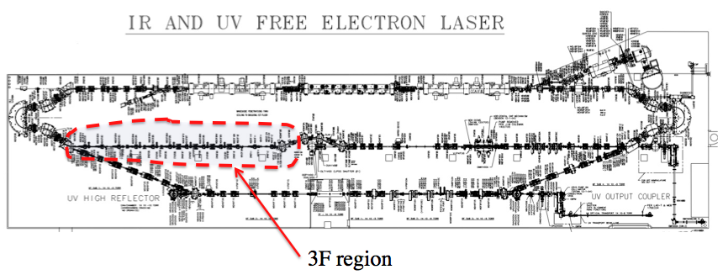
DarkLight Feasibility Test
Goal
Simulate high-power ERL operation with an internal gas-jet target controlling power deposition from beam loss and impedance/wake effects from both beam core and halo components through a 10 cm long small aperture (6, 4, or 2 mm diameter)
i.e., put > 400 kW through a coffee stirrer!
Target
Chamber
Stepper motor
Tube block
Designed and constructed by MIT-Bates R&E Center
in collaboration with JLab FEL staff
DarkLight Collaboration
Notes:
11

Slide 12
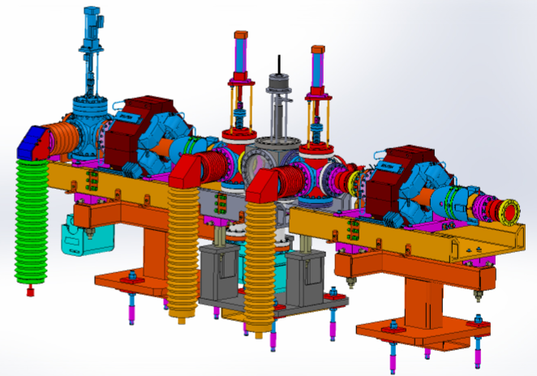
Darklight Experiment
Viewer1 inserted
Chamber
Viewer2
replaced
3F7 Quad
E-beam
3F6 Quad
Also radiation detectors for background determination
DarkLight Collaboration
Notes:
12

Slide 13
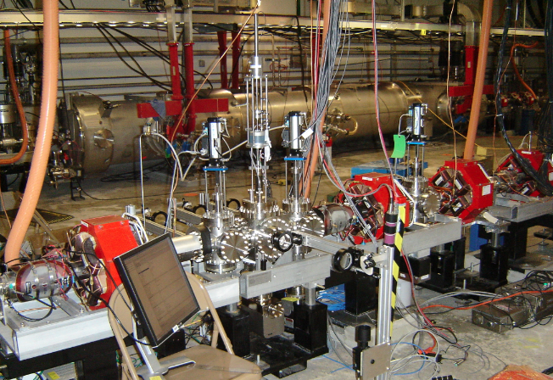
Cube and Diagnostics
DarkLight Collaboration

Slide 14
Achievements
  Established low beam loss in transmission of CW high power sub-100 micron beam at 100 MeV by independently controlling betatron match of primary beam and halo.
  Measured beam interception as low as 3.2 PPM in 2 mm aperture while running 450 kW of beam power (100 MeV, 60 pC, 75 MHz) significantly exceeding DarkLight requirements
  Measured background radiation to establish anticipated ratio of signal to background levels and detector shielding requirements
  Performed 8 hour stability run delivering 120 C though 2 mm aperture
  Performed halo imaging and profile measurements using new camera with 10⁵ dynamic range.
DarkLight Collaboration

Slide 15
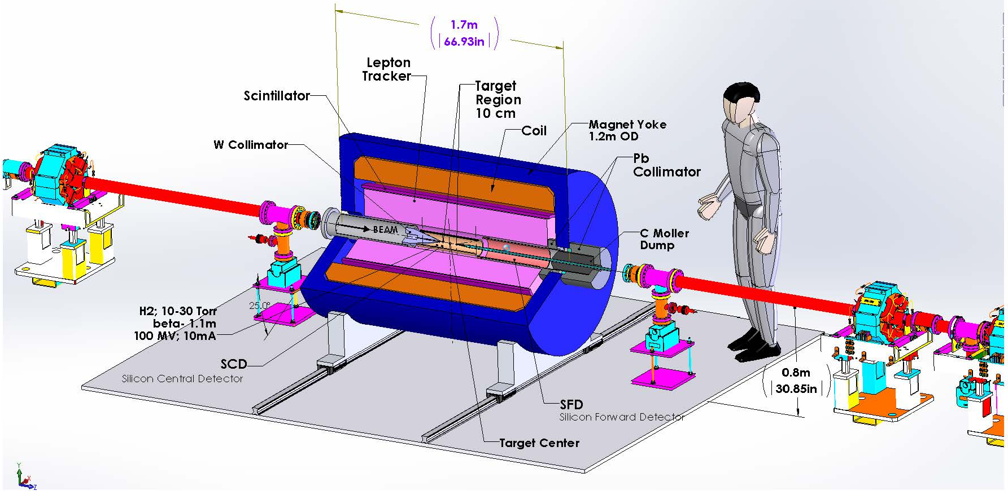
Experiment under detailed planning
Modest experiment cost ($5M) and operating cost compared to typical HEP studies
DarkLight Collaboration

Slide 16
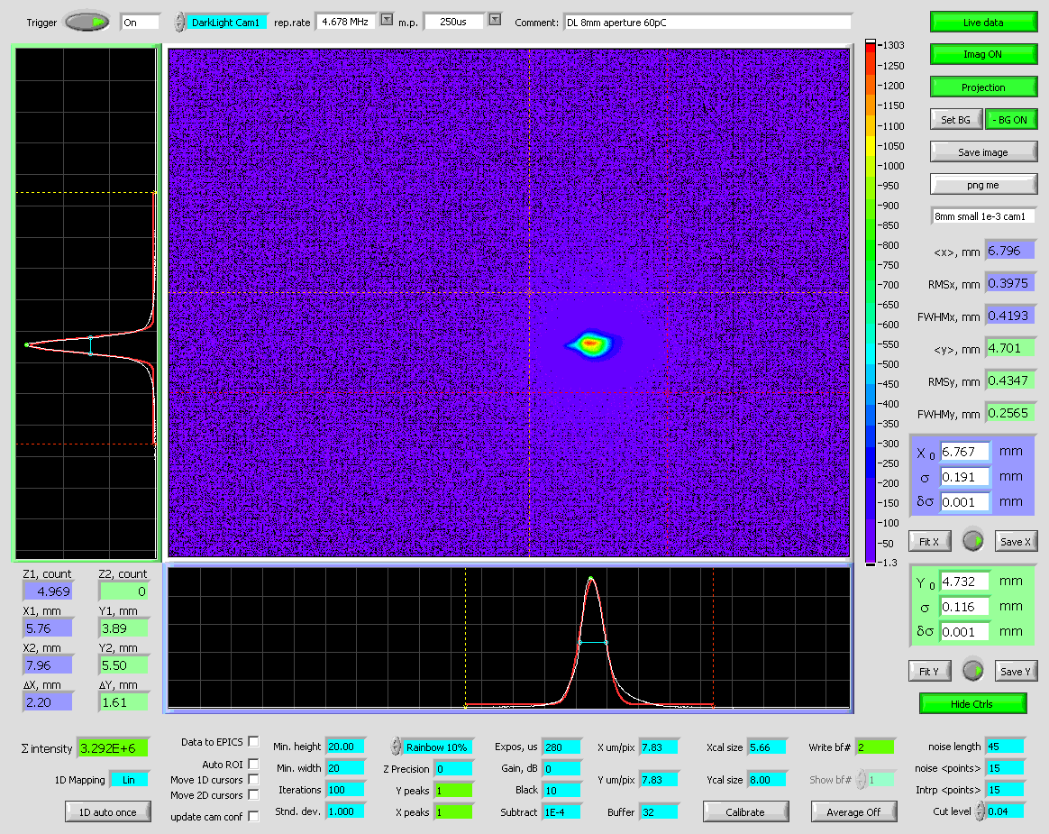
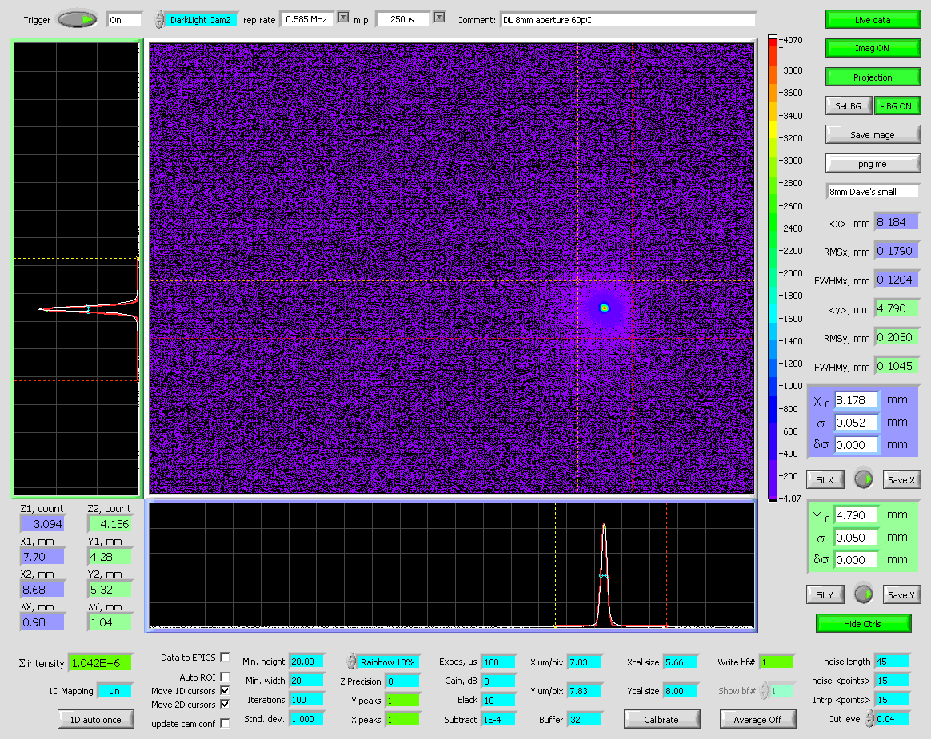
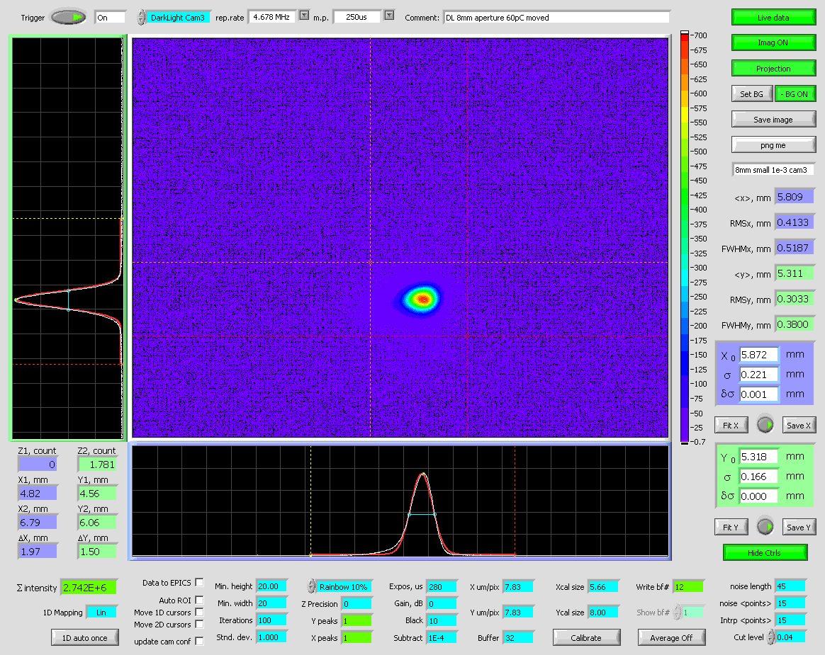
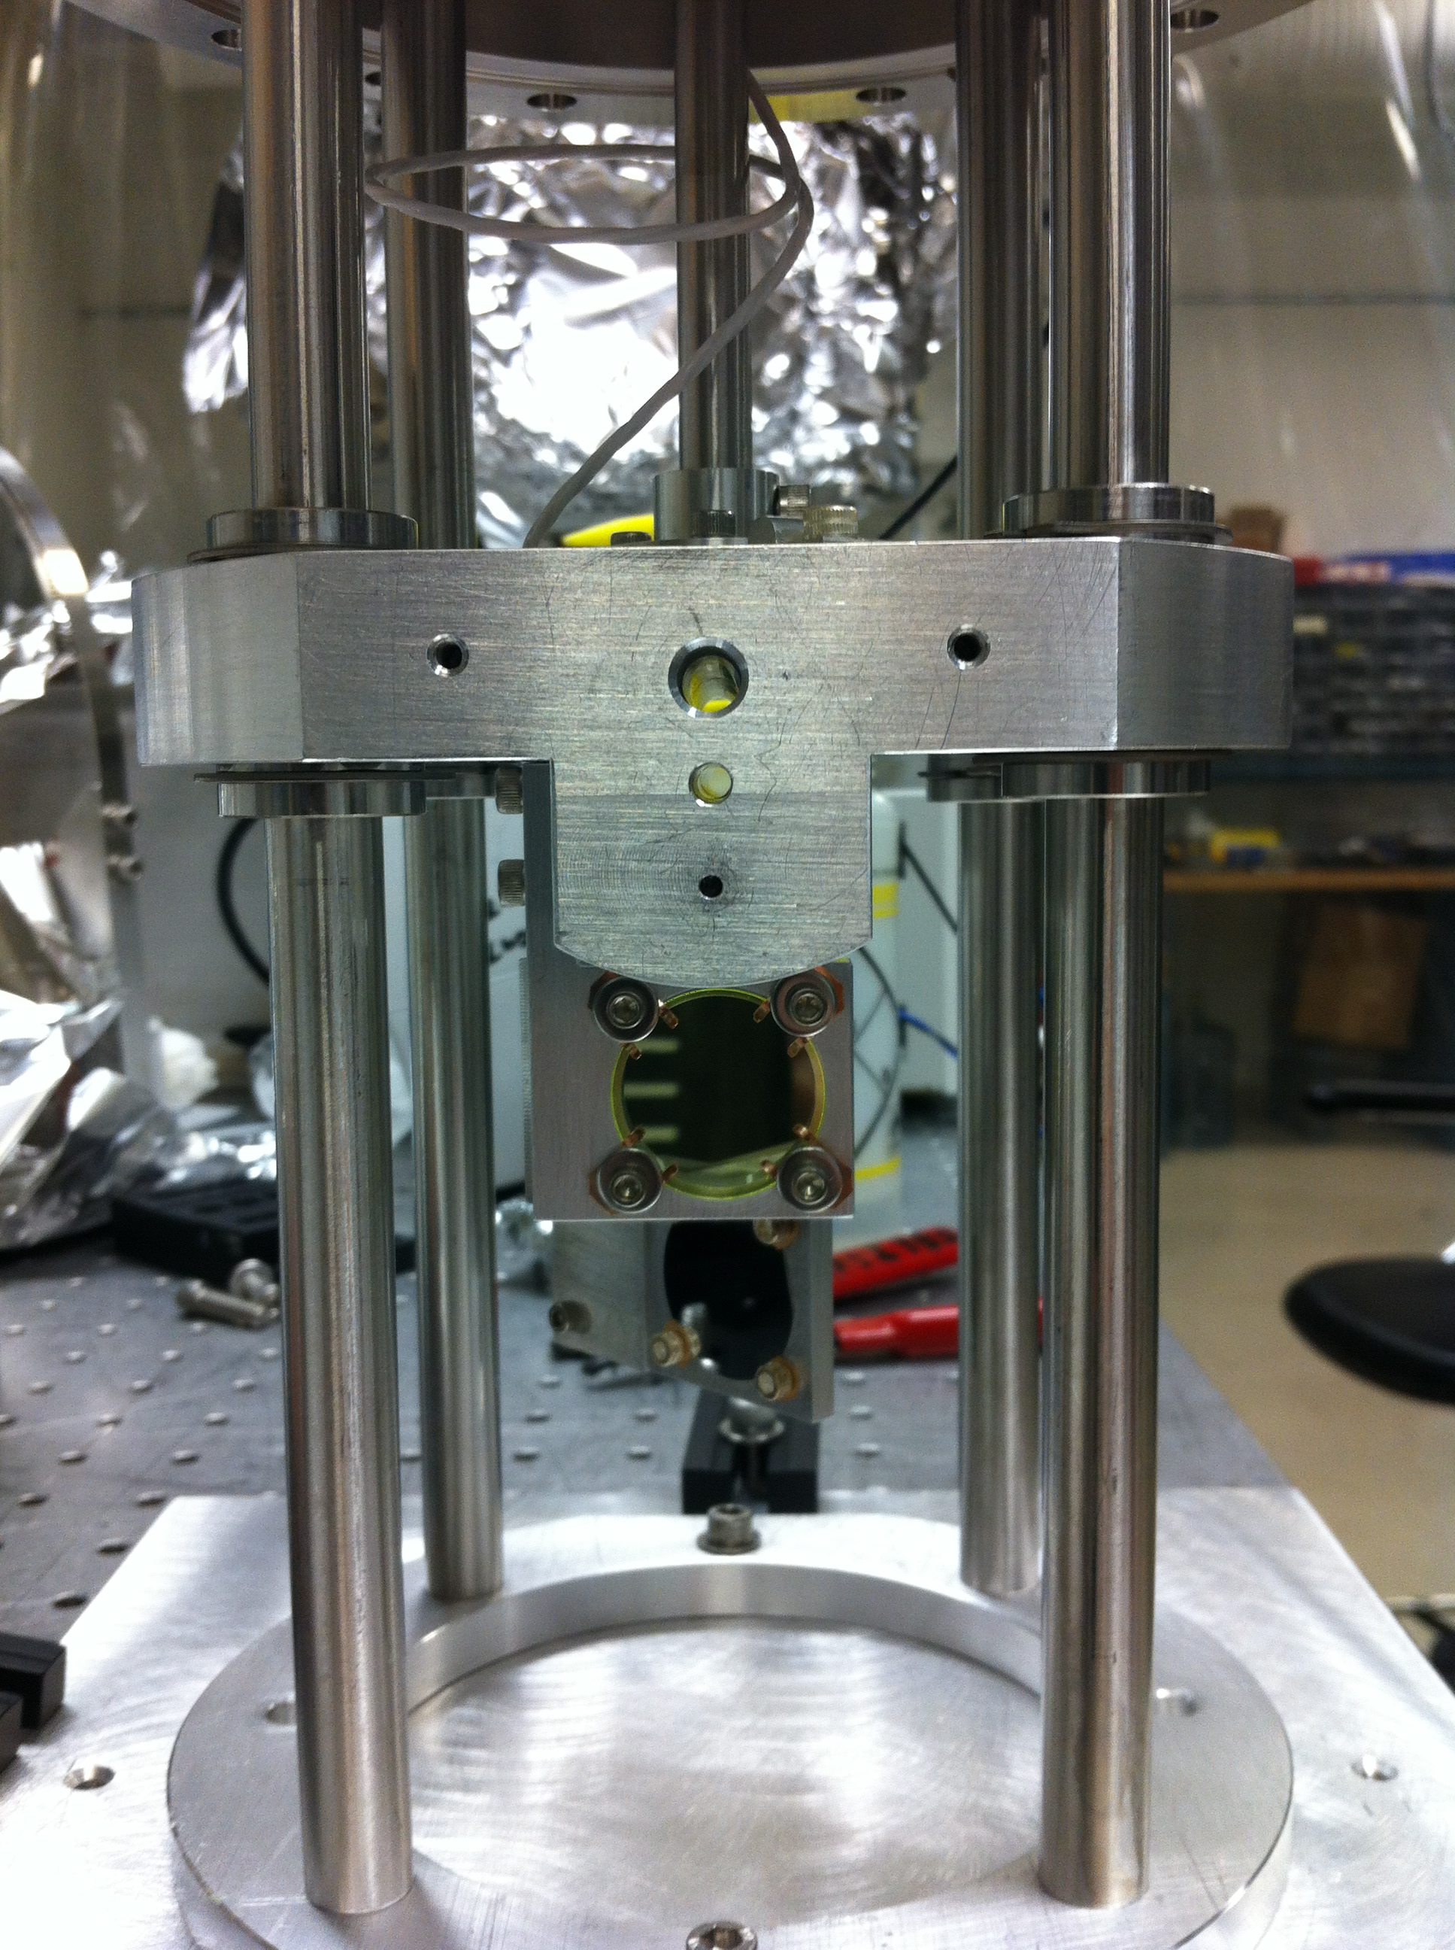
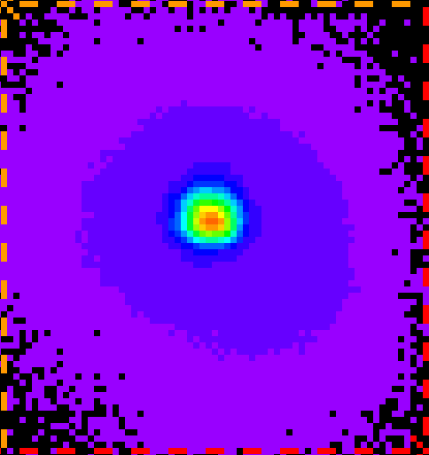
DarkLight transverse beam diagnostics
50 cm upstream
center
50 cm downstream
Area: 1 mm x 1 mm;
Best Gaussian: fit σ_{x}=50 μm; σ_{y}=52μm
10 μm diffraction limit on resolution
Separate measurement showed ability to image halo at 5 x 10⁻⁴ level
DarkLight Collaboration

Slide 17
High Dynamic Range Diagnostic Development is Essential
Four sorts of the unwanted beam (beam halo)
Fraction of the phase space distribution that is far away
from the core (due to the beam dynamics)
Low charge due to not well attenuated Cathode Laser (ERLs) – but real bunches that have proper timing for acceleration
Due to the Cathode Laser but not properly timed (scattered and reflected light)
Field emission: Gun (can be DC or RF), Accelerator itself (can be accelerated in both directions)
Evtushenko

Slide 18
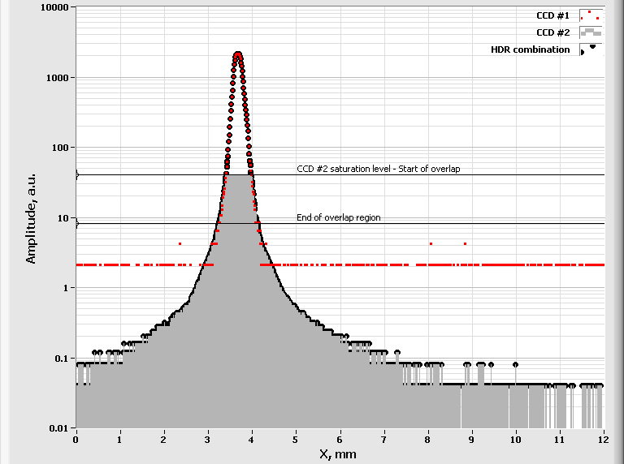
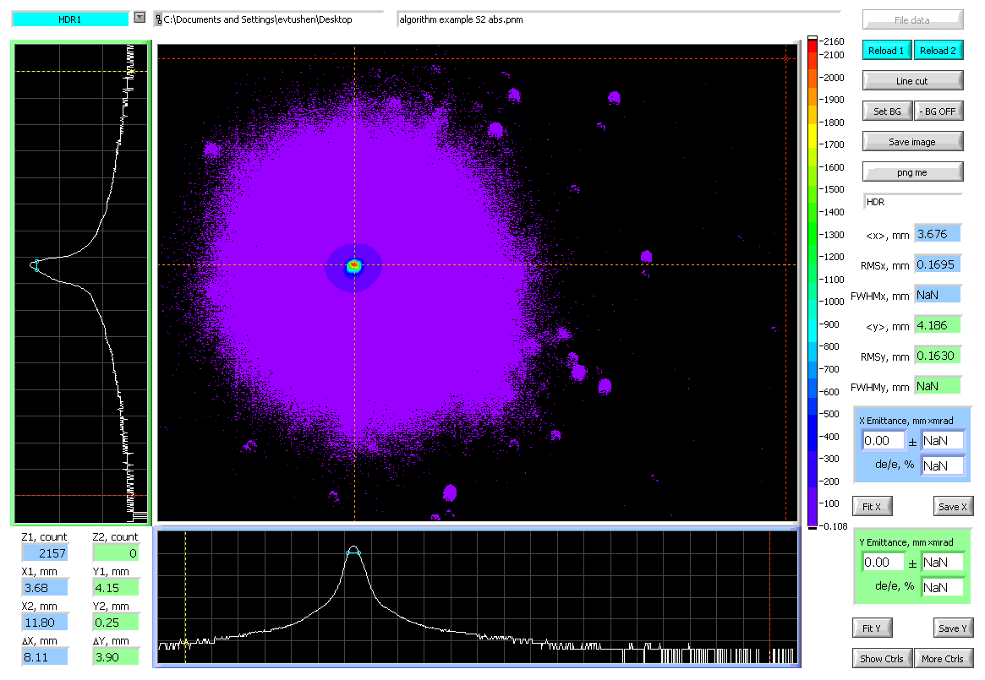
Combining algorithm; LDR image
Combining algorithm operates on lines of the images
The integration time is sufficient for normalization of two images
Averaging works as usual to improve SNR and DR (need stable beam)
Becomes non trivial to display LDR images
P. Evtushenko
funding by DOE BES under Young Investigator Program

Slide 19
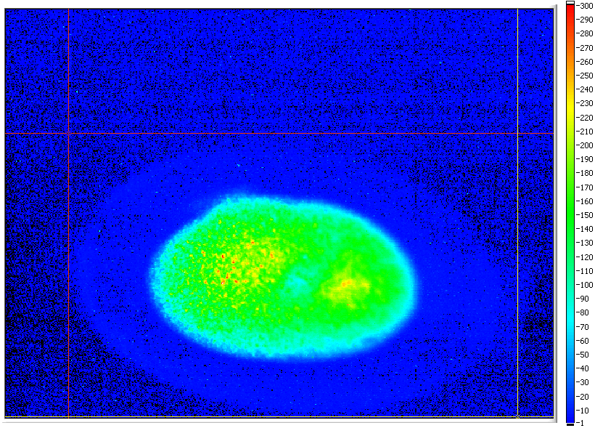
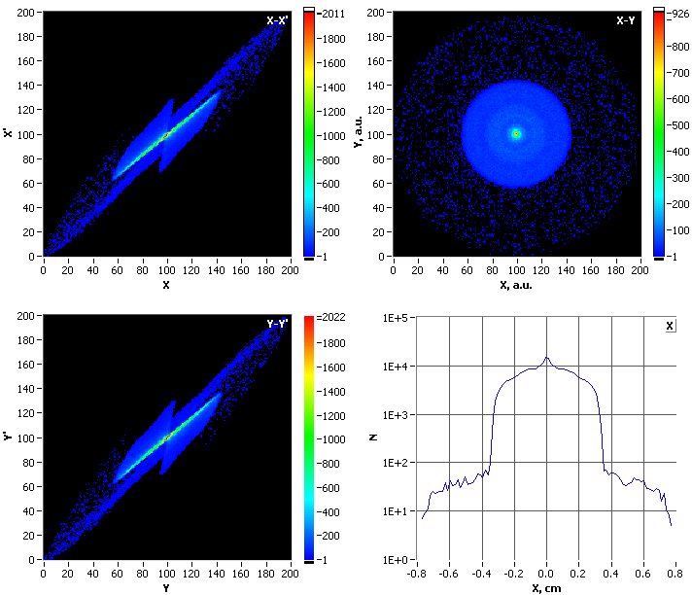
Measurements vs. Modeling at the level ~10³
Measured in JLab FEL injector,
local intensity difference of the
core and “halo” is about 300.
(500 would measure as well)
10-bit frame grabber & a CCD
with 57 dB dynamic range
PARMELA simulations of the same setup with 3E5 particles:
X and Y phase spaces, beam profile and its projection show
the halo around the core of about 3E-3.
Even in idealized system (simulation) non-linear beam
dynamics can lead to formation of halo.
Evtushenko

Slide 20
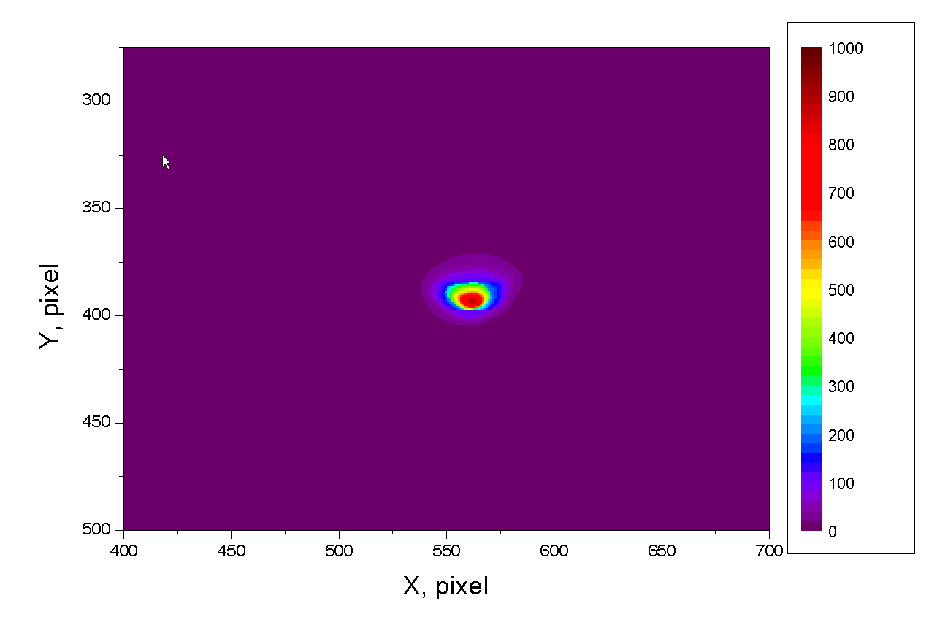
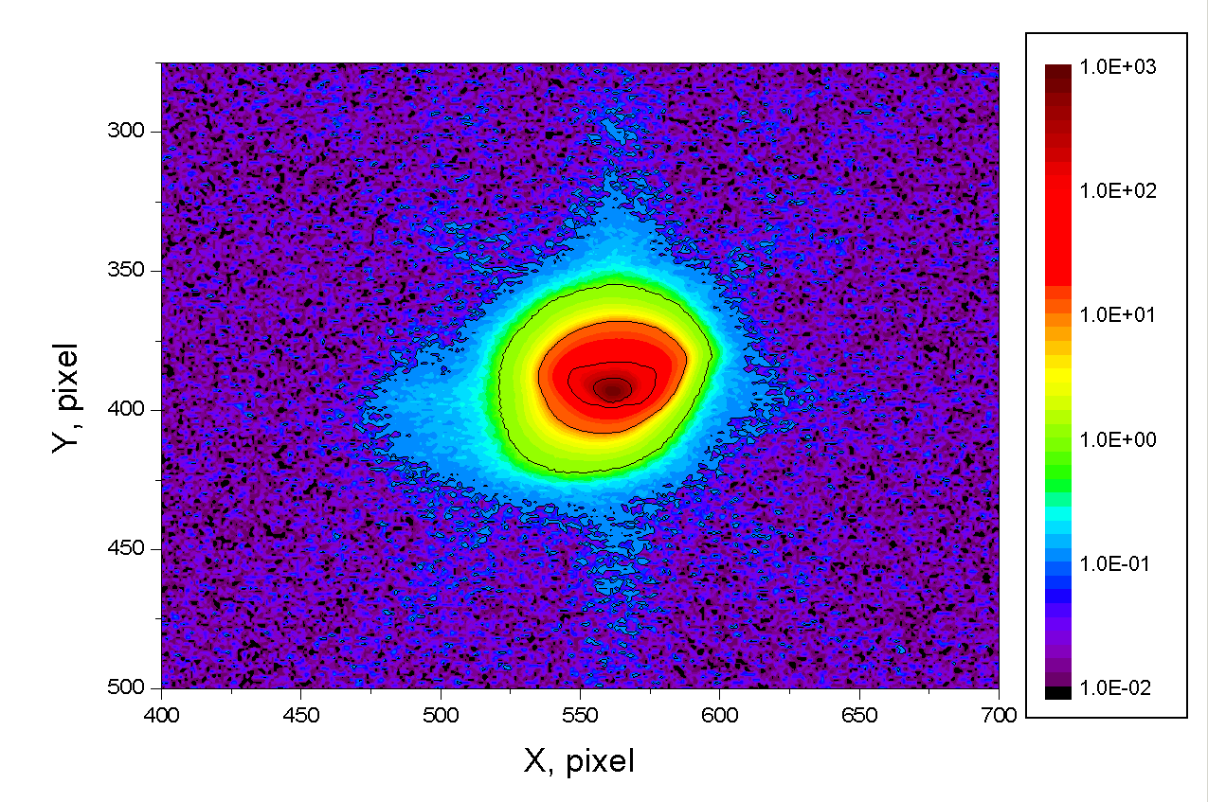
Linear vs. Log scale
The two pictures here show exactly the same data (beam profile - (x,y))
but in linear and log scale
Next step is to use such measurements for beam characterization, emittance and Twiss parameters measurements (add x’ and y’)
Ultimately we want to do tomographic measurements; for now just quad scan
For non-Gaussian beam RMS beam width is a tricky thing!
It depends on how much of tails of the distribution function f(x)
is taken in to account.
Evtushenko

Slide 21
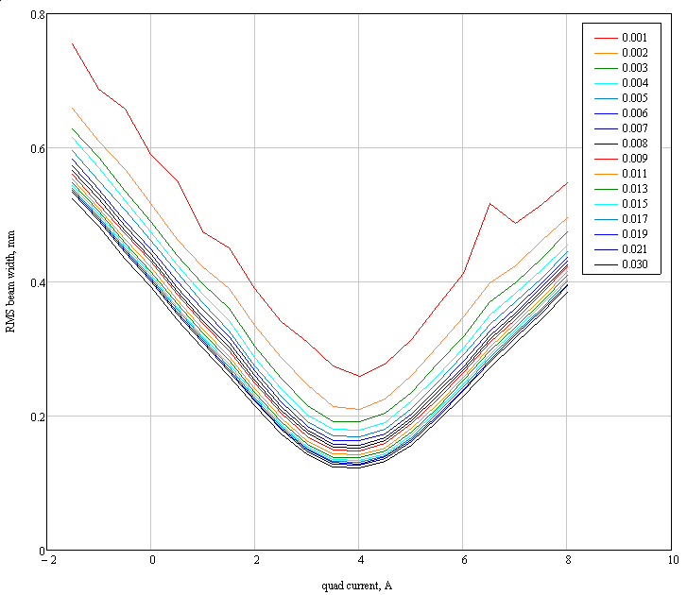
Quadrupole scan raw data
Level of interest
(LOI)
more tails included
less tails included
Evtushenko

Slide 22
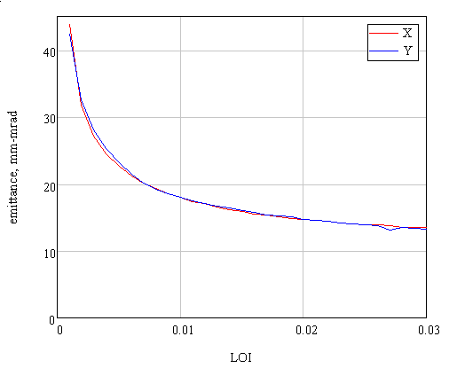
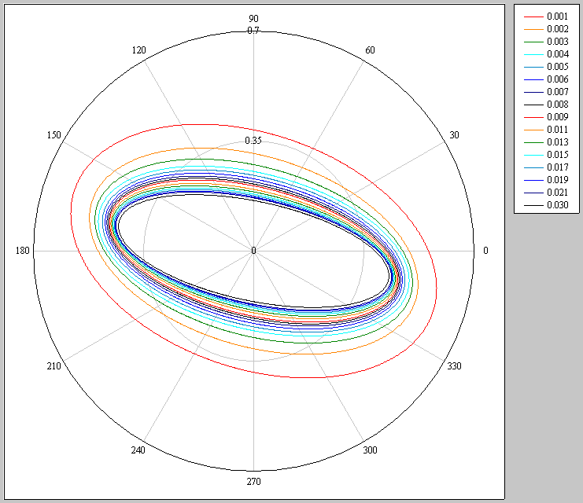
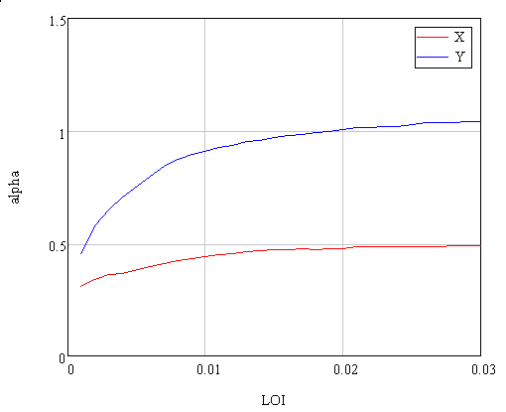
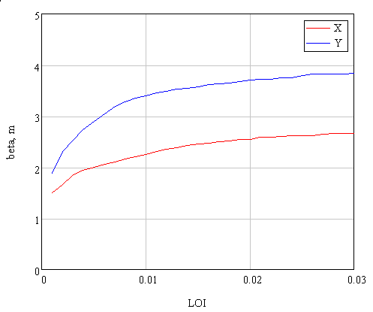
Emittance and Twiss parameters
RMS emittance
less tails included
more tails included
alpha function(s)
beta function(s)
Evtushenko

Slide 23
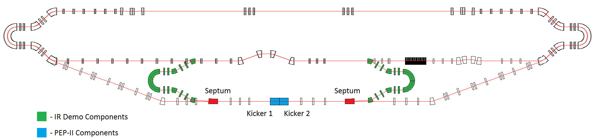
ERL Circulator Electron Cooler applications to high energy proton rings
solenoid
ion bunch
Design Choices
Energy Recovery Linac (ERL)
Compact circulator ring
to meet design challenges
Large RF power (up to 81 MW)
Long gun lifetime (average current 1.5 A)
Required technologies
High bunch charge magnetized gun
High current ERL (55 MeV, 15 to 150 mA)
Ultra fast kicker
electron bunch
Cooling section
Fast kicker
circulator ring
Fast kicker
energy recovery
injector
SRF Linac
dump
e-bunches circulates 10 -100 times ➔ reduction of current from an ERL by a same factor
Optimization
eliminating a long return path
could double the cooling rate
Proposal: A technology demonstration
using JLab FEL facility
30 m
Solenoid (20 m)
injector
SRF
dumper
Edward Nissen’s
Notes:
23

Slide 24
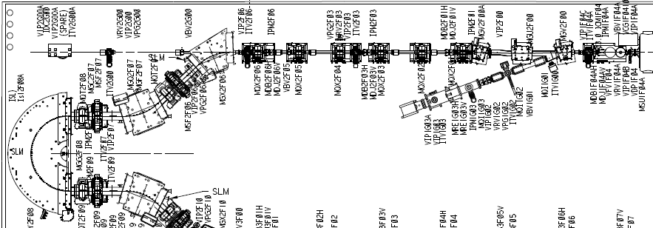
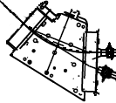
Fixed Target Dedicated
Facility Configuration
2-pass,
up to 600 MeV
no energy recovery
Extraction transport configured to exit at west end of building
    Delivers beam to open area
    Provides appropriate beam/lattice properties for tuning/control

Slide 25
