Slide 1
The CSU Advanced Beam laboratory (ABL)
Sandra Biedron

Slide 2
ABL: Two Primary Focus Area
Accelerator Science and Technology
Leads: Sandra Biedron and Stephen Milton
Lasers
Jorge Rocca, Menoni, Mario Marconi
Main Concept
Merge Accelerator Technologies with Laser Technologies to create new technologies with performance capabilities not possible with only one.

Slide 3
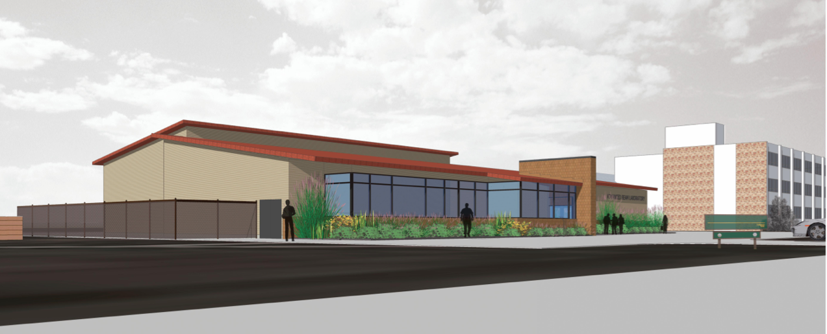
The Advanced Beam Laboratory
CSU Board of Governors approved construction and expenditure of the money needed to build of the new building.
CSU President has chosen to move forward with the construction and has developed a funding plan.

Slide 4
ABL Timeline
Accelerated Delivery
Made possible by an existing construction contract to build what is called Engineering II.
We are using the same Architect and General Contractor
Timeline (Abbreviated)
12 November 2012 – Fence off construction yard
19 November 2012 – Begin site preparation work
February 2013 – Walls go up
31 July 2013 – Building ready for move in

Slide 5
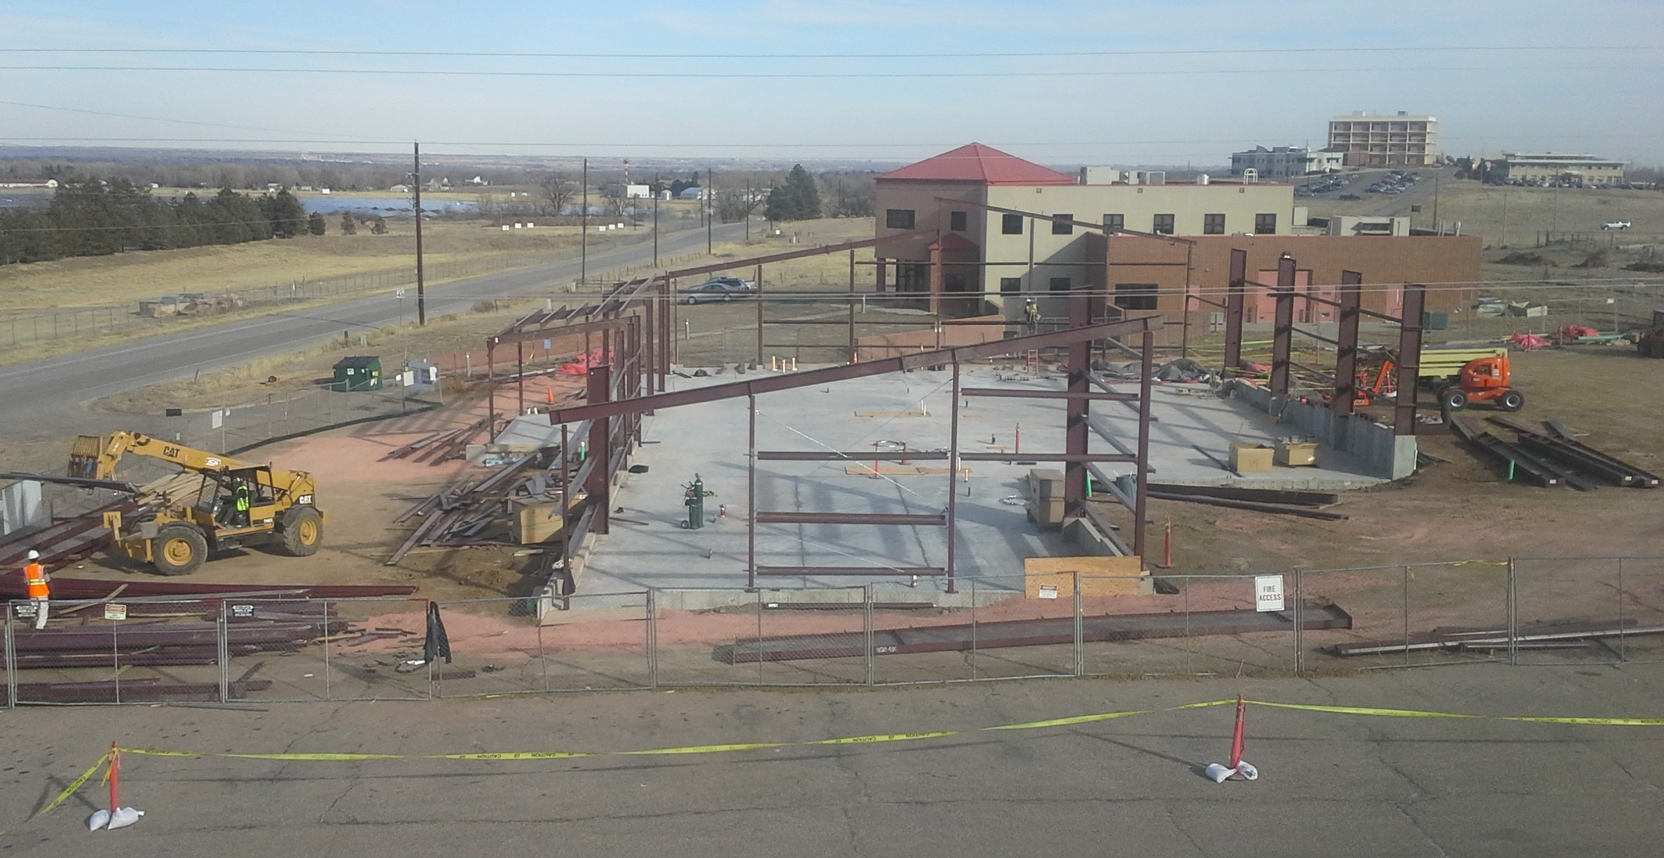
ABL: Current Status
Footings and Slab Complete
Iron work going up

Slide 6
ABL Basic Layout and Initial Capabilities
Laser Lab 1
Laser Lab 2
100-150 Terawatt Ti:Sapphire laser system. Wavelength: 0.8 micrometers, Energy before compression: 13 Joules. Repetition rate: up to 5 Hz. Plans to scale to 0.5 Petawatt
1 J, 5 picosecond, 100 Hz repetition rate diode-pumped laser (100 W average power)
Wavelength: 1.03 micrometers. Highest repetition rate diode-pumped chirped-pulse-amplification laser in the world. Can be scaled in repetition rate and pulse energy, future parameters depend on funding.
Accelerator Lab
Drive Laser Laboratory
6 MeV Photocathode Driven Electron Linac
L- Band (1.3 GHz)
Two Klystrons Available (One needed for PC Gun)
15 us pulse durations at 10 Hz
Up to 81.25 MHz pulse rates available
Accelerator Control Room

Slide 7
High energy femtosecond Ti:Sapphire laser (> 100 TW, up to 5 Hz repetition rate)
Profs. Jorge Rocca, Carmen Menoni

Slide 8
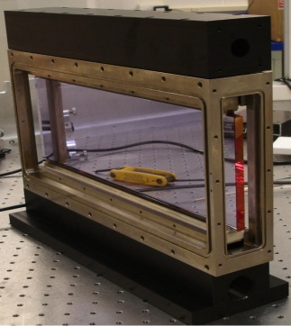
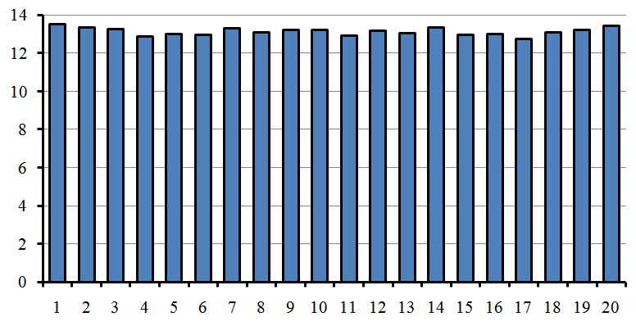
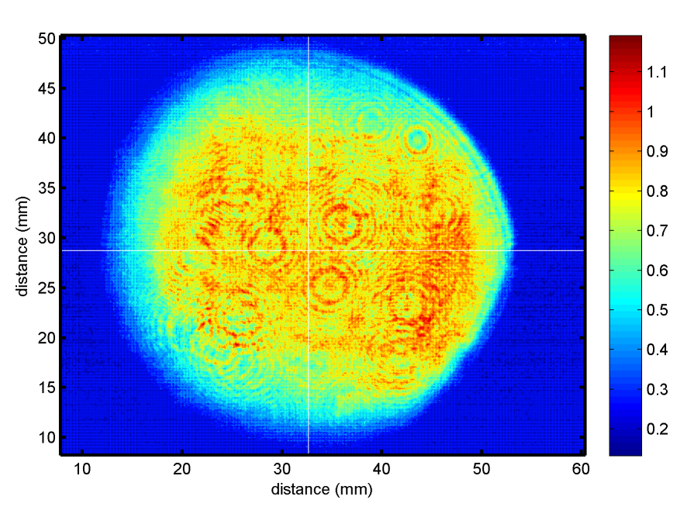
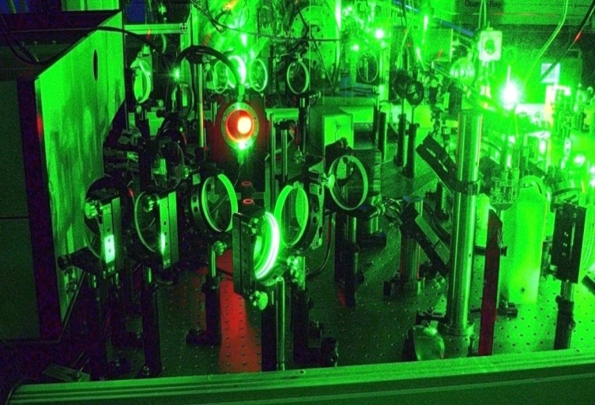
High repetition rate Titanium-Sapphire laser
Energy Pre-compression= 13 J
Std div. = 1.5 %

Slide 9
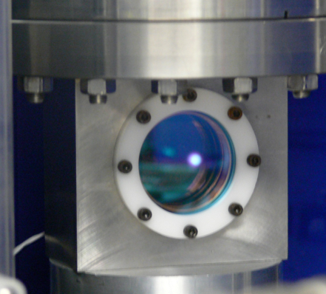
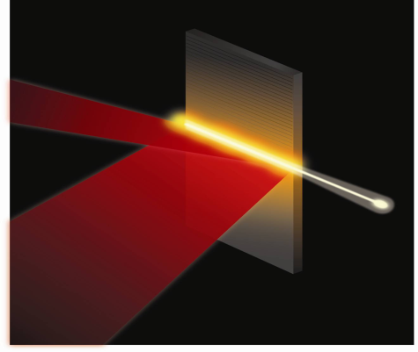
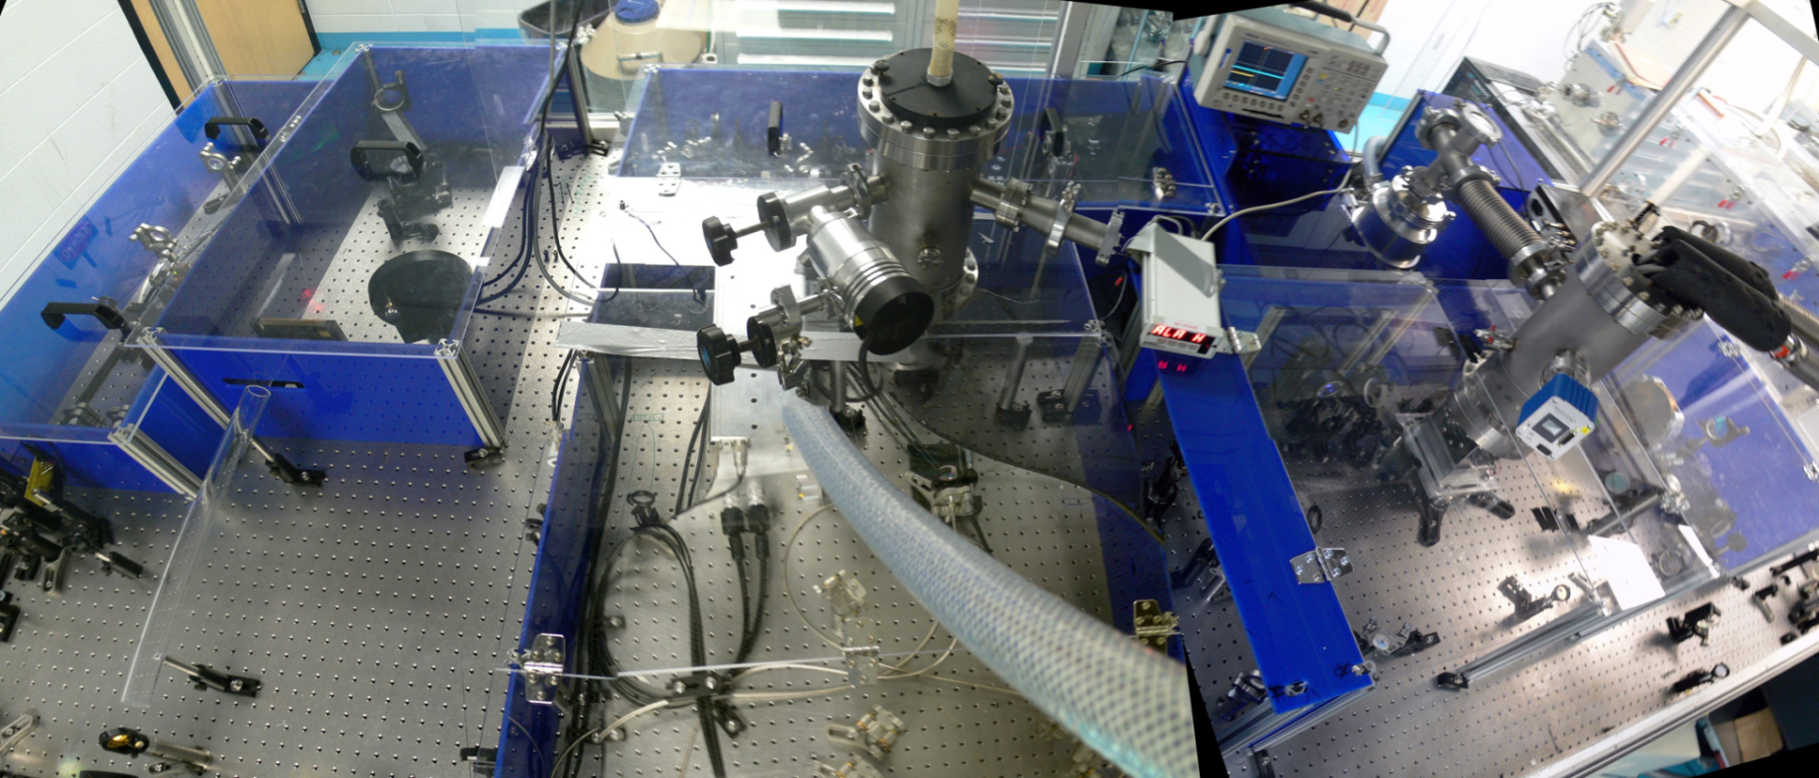
Unique high power diode-pumped solid state lasers pump table-top soft x-ray lasers at 100 Hz repetition rate
Laser Diode Drivers
Solid State Ultrashort Pulse High Power Laser
Soft X-Ray Plasma Amplifier
13.9 nm laser
e
Ag⁺¹⁹
B. Reagan et al., Optics Letters, 37, 3624, ( 2012)

Slide 10
Compact high power diode-pumped CPA laser generates 1 J , 5 ps, pulses at 100 Hz repetition rate
1 J, 5 ps, 100 Hz
B. Reagan et al., Optics Letters, 37, 3624, ( 2012)

Slide 11
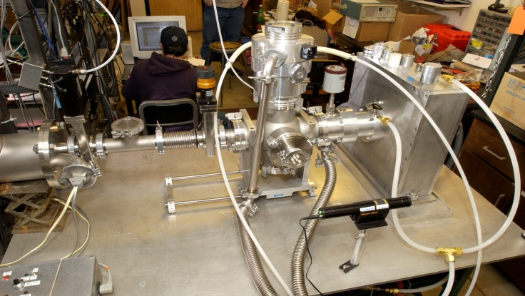
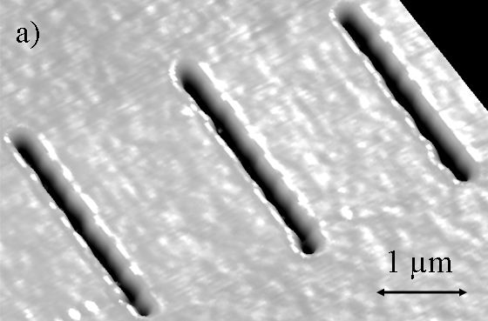
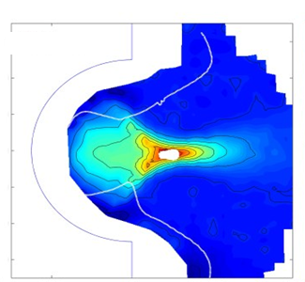
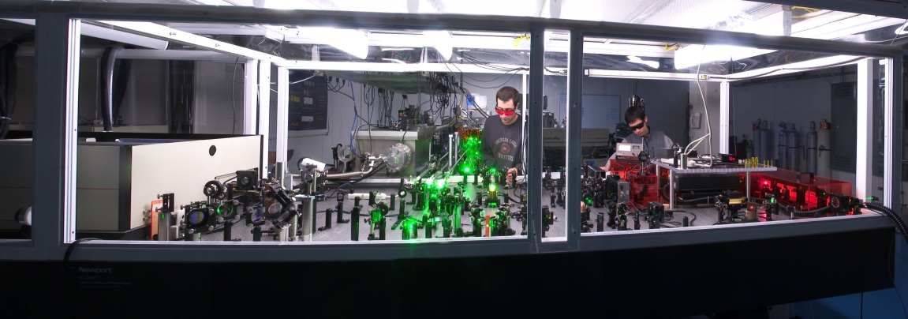
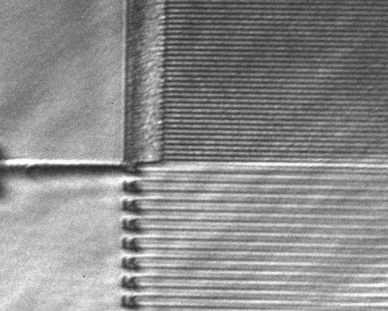
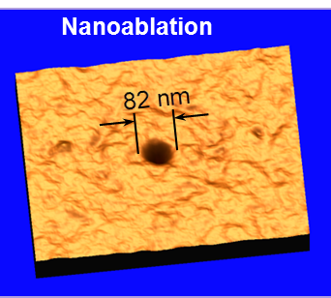
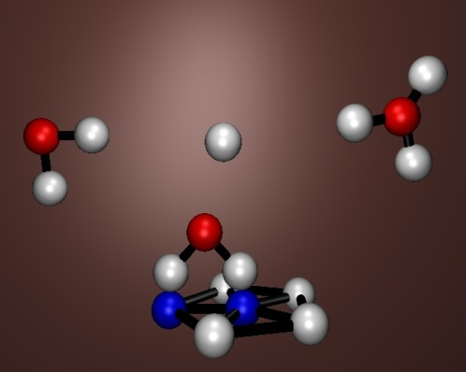
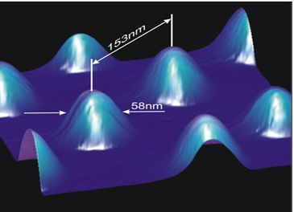
Compact plasma-based soft x-ray lasers for application (J.J. Rocca, C.S Menoni. M. Marconi)
Discharge Pumped SXRL λ=46.9 nm
Nanomachining
Plasma diagnostics
Microscopy
100 nm lines
Laser Pumped SXRL λ= 8.8– 32.6 nm
High pulse energy (µJ-mJ)
High monochromaticity (λ/Δλ < 10⁻⁴)
High peak spectral brightness
Microscopy
Interferometry
Chemical spectroscopies
Nanopatterning
82 nm holes
58 nm pillars

Slide 12
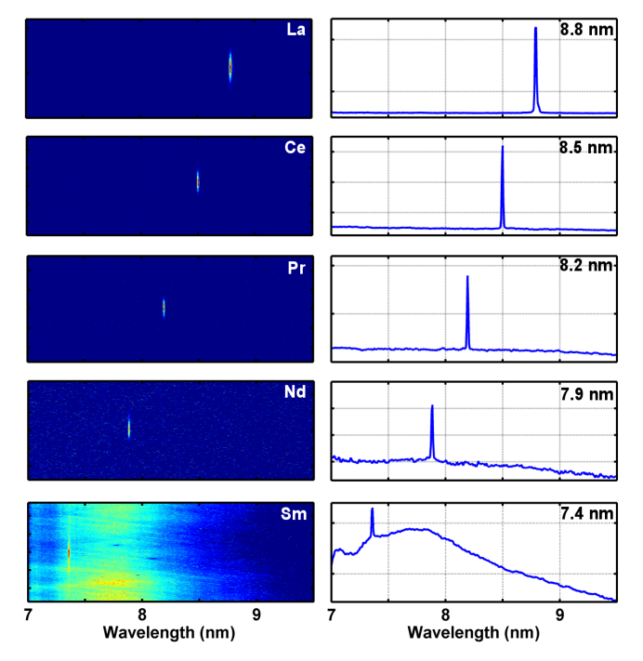
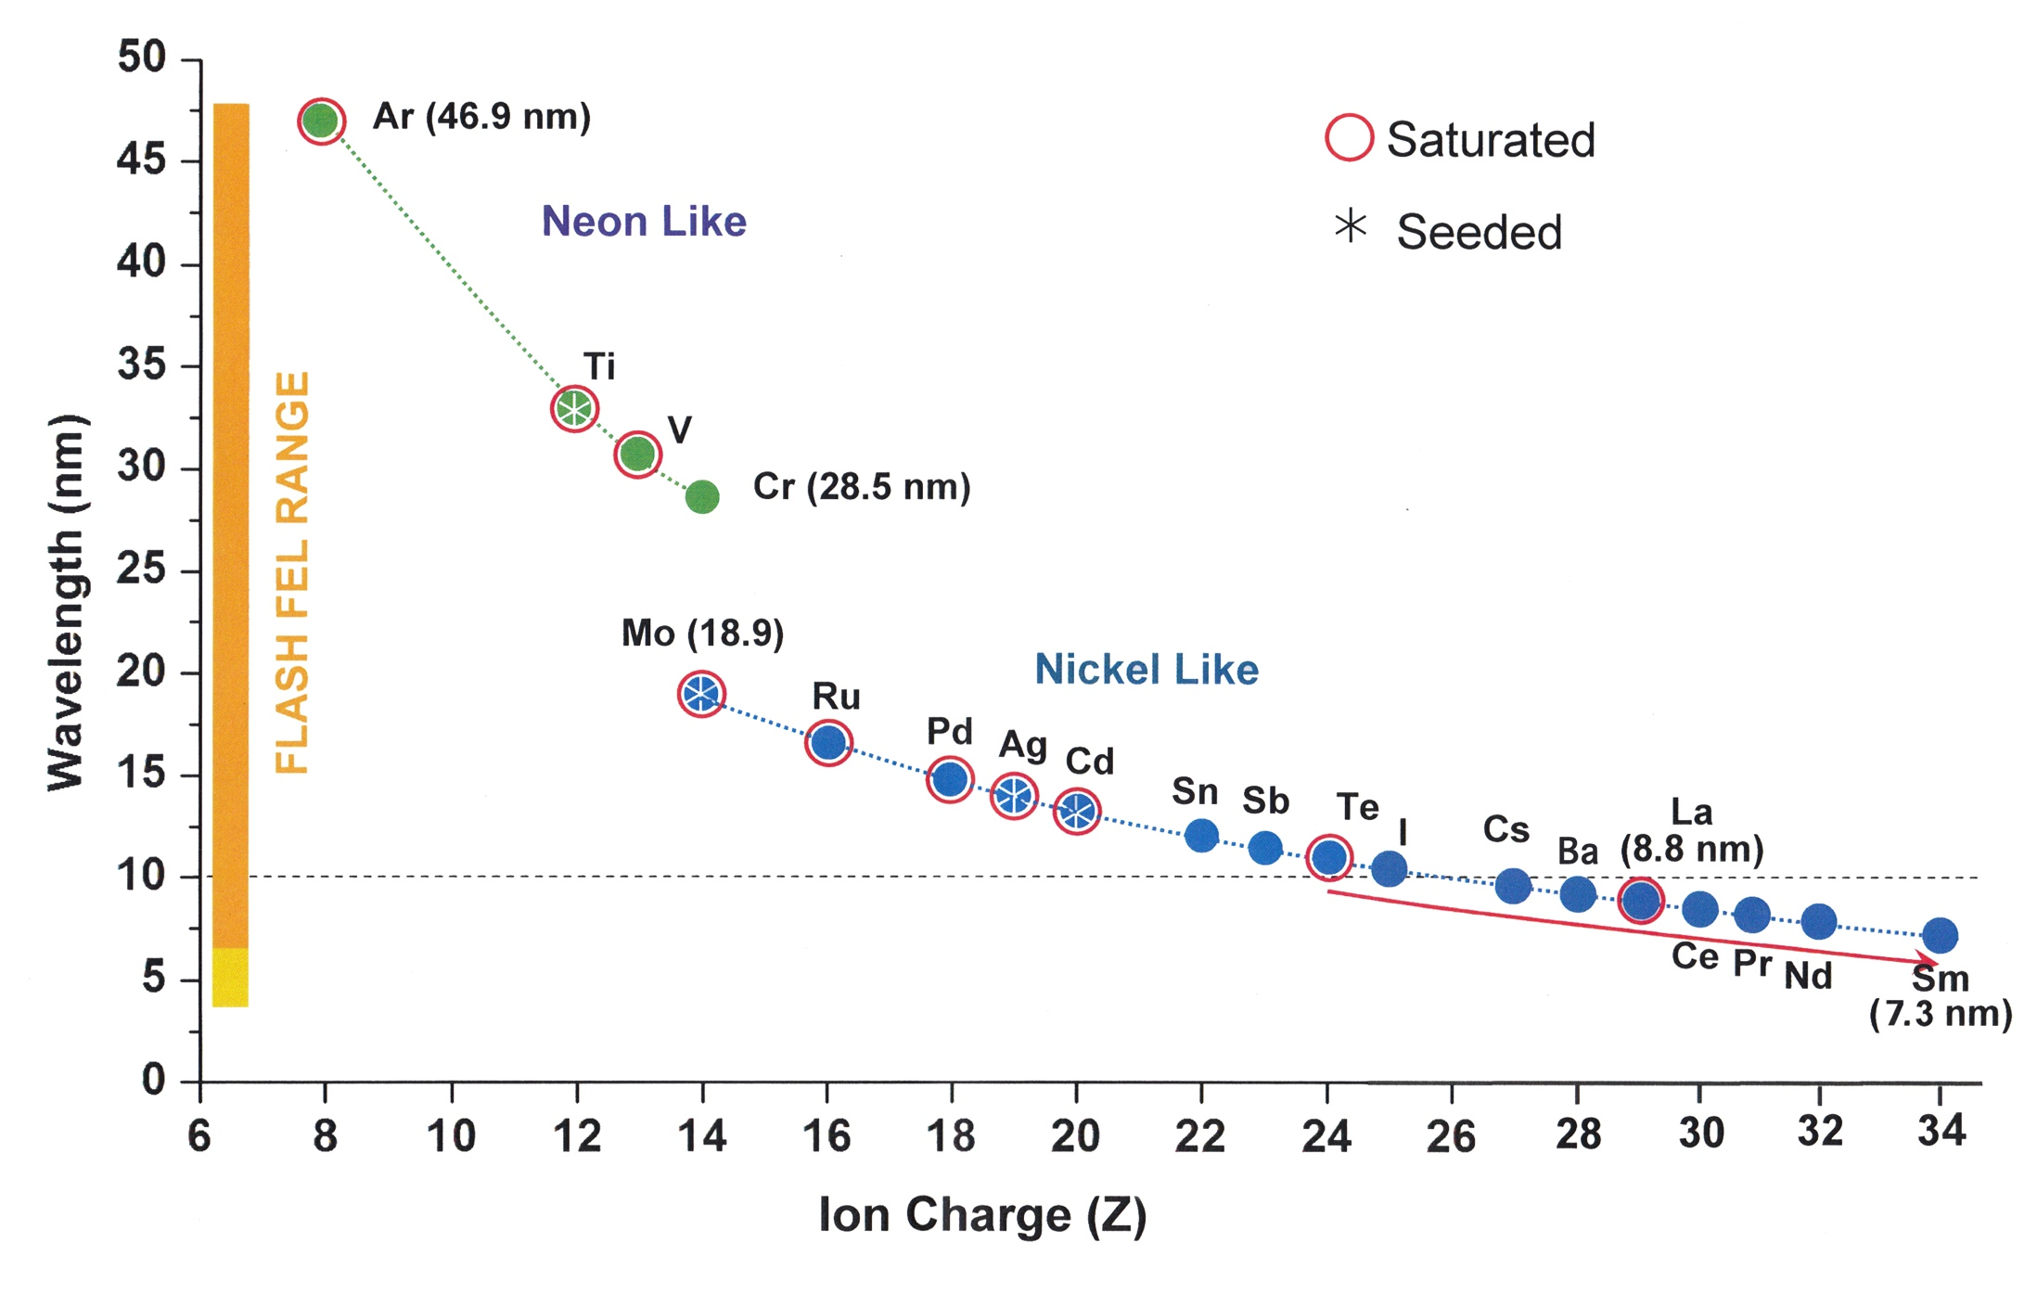
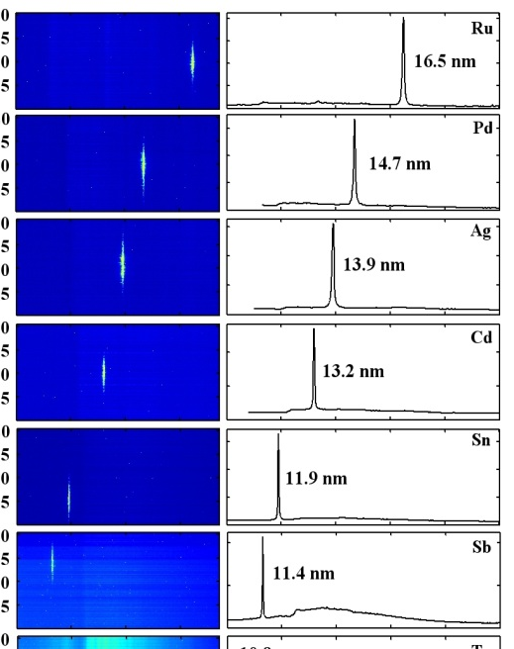
Gain-saturated table-top SXRLs cover 8.8 nm - 47 nm wavelength region
Saturated
Seeded
∗
Pr
D. Alessi et al. Phys. Rev X, 1, 021023, (2011)

Slide 13
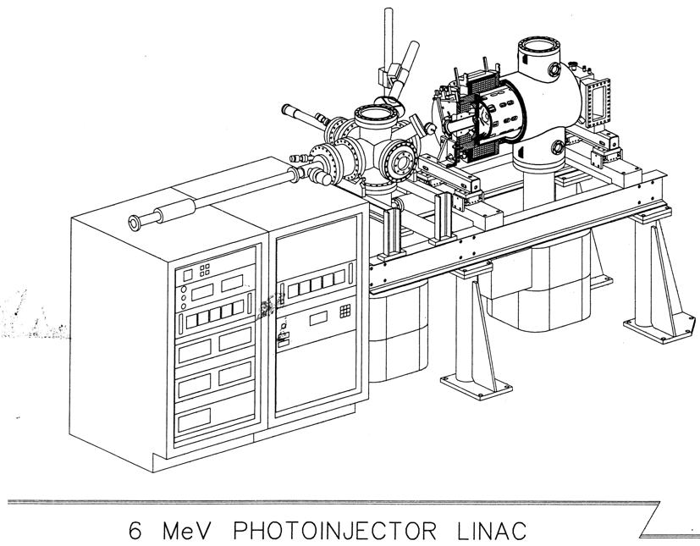
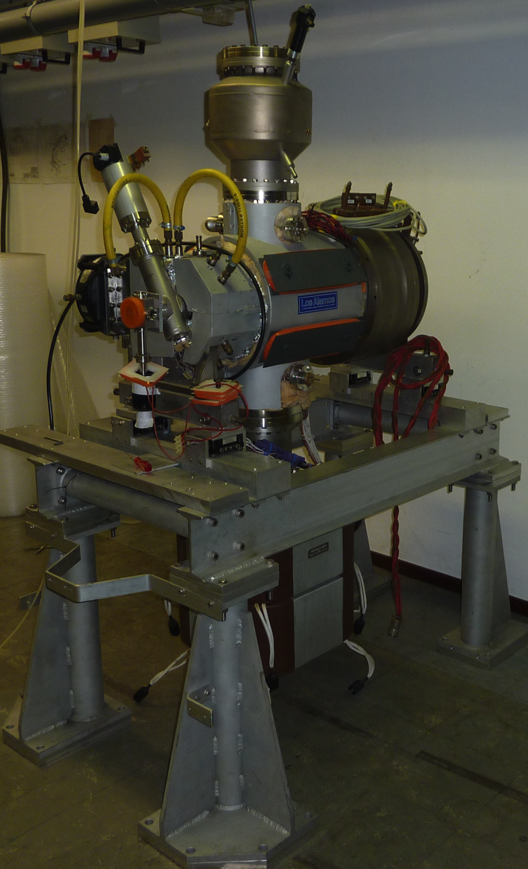
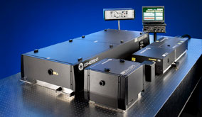
CSU Accelerator Laboratory
Donated by the Univ. of Twente
Donated by the Boeing Corp.

Slide 14
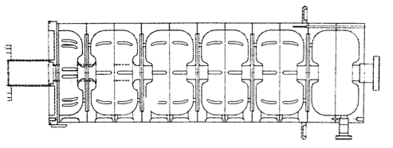
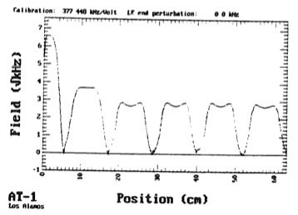
Linac Performance Parameters
Linac Characteristics
Energy | 6 MeV
Number of Cells | 5 ½
RF Frequency | 1.3 GHz
Shunt Impedance | 50 MΩ/m
Q-Value | 18,000
Axial Electric Field
Cell no. 1 | 26 MV/m
Cell No. 2 | 14.4 MV/m
Cell No. 3 – 6 | 10.6 MV/m
Solenoid Field Strength | 1,200 G

Slide 15
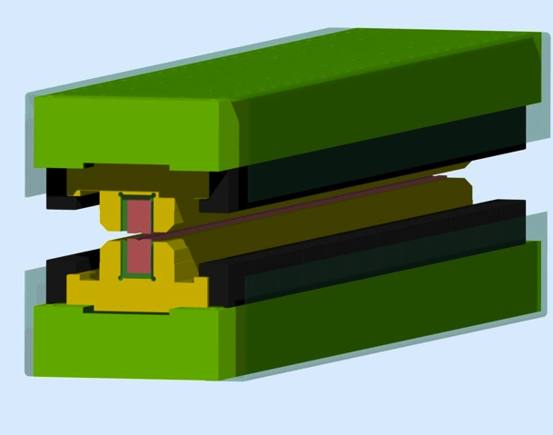
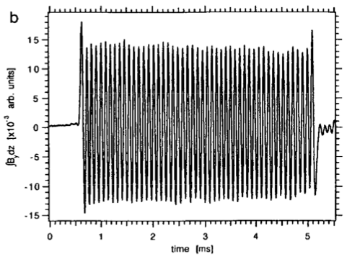
System Performance Parameters
Major System Parameters
Linac
Frequency | 1.3 GHz
Repetition Rate | 10 Hz
Mircopulse Rep. Rate | 81.25 MHz (max.)
Klystron
Type | TH 2022C (Thales)
Power | 20 MW
Modulator
Type | PFN
Pulse Duration | 15 μsec
Undulator
Type | Hybrid: NdFeB
K | 1 (at 8 mm gap)
Period | 25 mm
Periods | 50

Slide 16
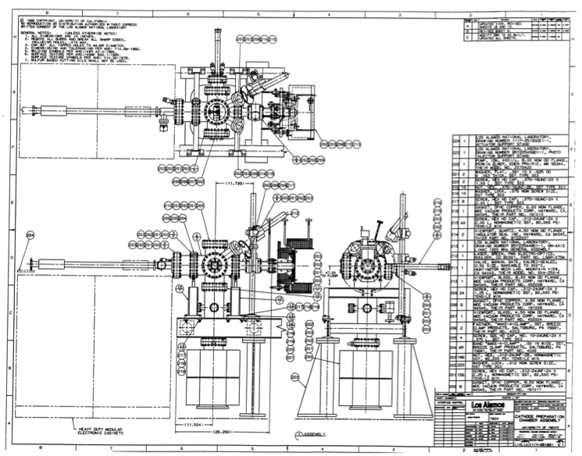
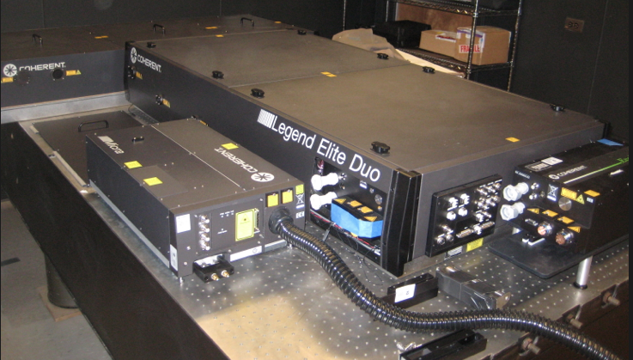
Cathode Preparation Chamber
A Variety of Cathodes Can be Used
Cathode preparation chamber
Used in the past
CeK₂Sb, K₃Sb, and Copper
The choice is dependent on what the experiment demanded

Slide 17
ABL Initial Capabilities/Explorations
Laser Laboratories: Initial and Historical Functions
Soft x-ray lasers (driven by the optical lasers in previous slide) Wavelength range: 8.8 nm to 47 nm. Picosecond pulse duration. Pulse energy = 2-10 microjoule. Average power: up to 0.15 mW (world highest average power table top soft x-ray lasers)
Side Note:
These soft x-ray lasers are made possible by the generation of very uniform, high density plasmas.
Ancillary Capabilities of Group
Laser design and fabrication
High power optics development and production
Nano patterning

Slide 18
ABL Initial Capabilities/Explorations
Accelerator Laboratories: Initial and Historical Functions
Compact, High-power THz FEL
Tunable between 200-800 microns
About 1 MW peak power from 900 MW available peak beam power (6 MeV, 150 A peak current)
Average: a few mW (81.25 MHz rep rate, 15 microsecond macropulse,25-ps micropulse)
Specialized beam diagnostics
Electro Optical Sampling System
System intended for tests at JLab FEL
If JLab not ready then we will test it at CSU
Laser/Plasma/e- Beam Interaction Studies
Continuation of an experiment started at University of Twente

Slide 19
A Smattering of Current Projects
Soft X-ray compact laser development
High-Power THz FEL
Neural Network Control of Accelerators
X-band Technologies
High Power Optics Development
Nanopatterning
High Density Plasma Theory, Simulation, and Production
Electro-Optical Sampling Diagnostic for High-Power Beams
Photocathode studies
Laser/Plasma/e- Beam interactions
Compact source design and development
Study of LSC/CSR and the Microbunching Instability
Medical Applications of Accelerator System
Two-Beam Systems
FEL Harmonic Control
Blue indicates areas potentially relevant to HEP programs

Slide 20
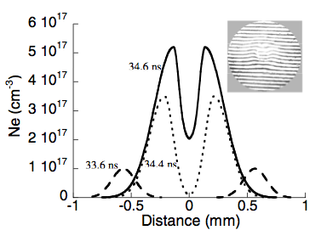
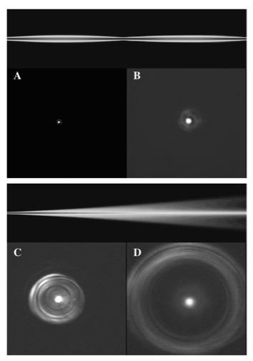
Other Intriguing Areas We Are Beginning to Pursue
Capillary Discharge
Near Field
Electron Density Profile
Far Field
The potential to use this technology for high-gradients is tremendous and CSU IS the world leader in this.

Slide 21
Summary
The CSU Advanced Beam Laboratory
The Coupling of
Accelerator Expertise and Existing Accelerator System
6 MeV photocathode linac system with state-of-the-art drive laser
Laser/Plasma Expertise and Existing Laser, Plasma and Ancillary Systems/Areas
Unique state-of-the-art laser systems
Plasma Sources
EUV/Soft x-ray Microscopy/Spectroscopy expertise
Multilayer Optics expertise
Will be used for
Basic beam (Laser, particle and combined beam) research and development
Purpose-Built Building
Ready for move in 31 July 2012

