Slide 1
High Gradient Research, High Power RF Research, and Applications
Sami G. Tantawi
June
18, 2012
V. Dolgashev ( Scientific Staff member)
J. Wang ( Scientific Staff member)
Lisa Laurent ( Scientific Staff member)
Jeff Neilson (Scientific Staff member)
Zenghai Li (Scientific Staff member)
Gordon Bowden (Engineering support)
Anahid Dian Yeremian ( Engineering support)
Jim Lewandowski ( Engineering support )
Andrew Haase (Engineering support )
David Martin (Engineering support )
Charles Yoneda (Engineering support )
Faya Wang ( Young Investigator Award)
Chao Chang (Post Doc)
Muhammad Shumail (Graduate student)
and national and International collaborators,

Slide 2
Outline
Update on the High Gradient Research
RF sources research
Apllications:
  RF undulator
  Electron Therapy machine devlopments

Slide 3
High Gradient Research Efforts
Basic Physics Research
    Geometrical Studies
      Standing wave accelerator structures
      Photonic band gap Structures
      Mixed E&H setup
    Material Studies
      Pulsed heating effects
      Hard materials
      Mixed materials
      Low temperature accelerators
Full Length Accelerator Structures
    Damped and un-damped CERN structures
    Distributed Coupling Standing Wave Accelerator Structures.
    Resonant Ring Structures
RF Sources Research
    Massively Parallel Multimoded Klystrons
    Novel RF sources
    Large signal Codes
    Coupled systems; sources and accelerator structures

Slide 4
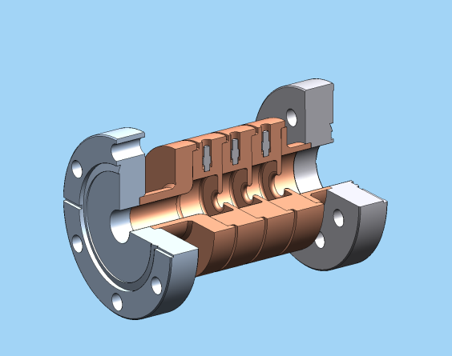
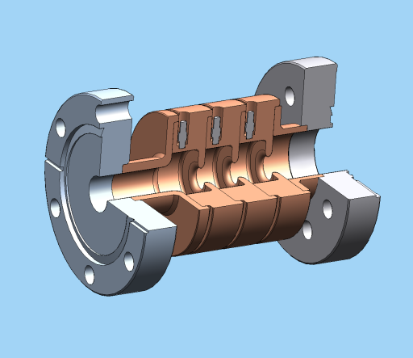
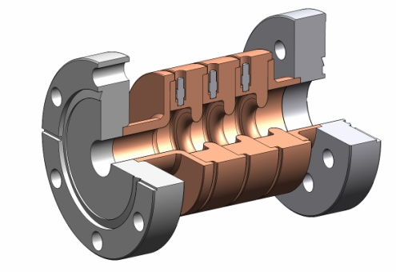
Geometrical Studies: Three Standing-Wave Structures of Different Geometries
1)1C-SW-A2.75-T2.0-Cu
2) 1C-SW-A3.75-T2.0-Cu
3) 1C-SW-A5.65-T4.6-Cu
3
2

Slide 5
Geometrical Studies:
Standing-wave structures with different iris diameters and shapes a/λ=0.215, a/λ=0.143, and a/λ=0.105
Geometric dependence of radio-frequency breakdown in normal conducting accelerating structures
Valery Dolgashev, Sami Tantawi, Yasuo Higashi, and Bruno Spataro
Appl. Phys. Lett. 97, 171501 (2010);
SLAC,KEK,
INFN
Breakdown Probability (1/pulse/meter)
Breakdown Probability (1/pulse/meter)
Breakdown Probability (1/pulse/meter)
Breakdown Probability (1/pulse/meter)

Slide 6
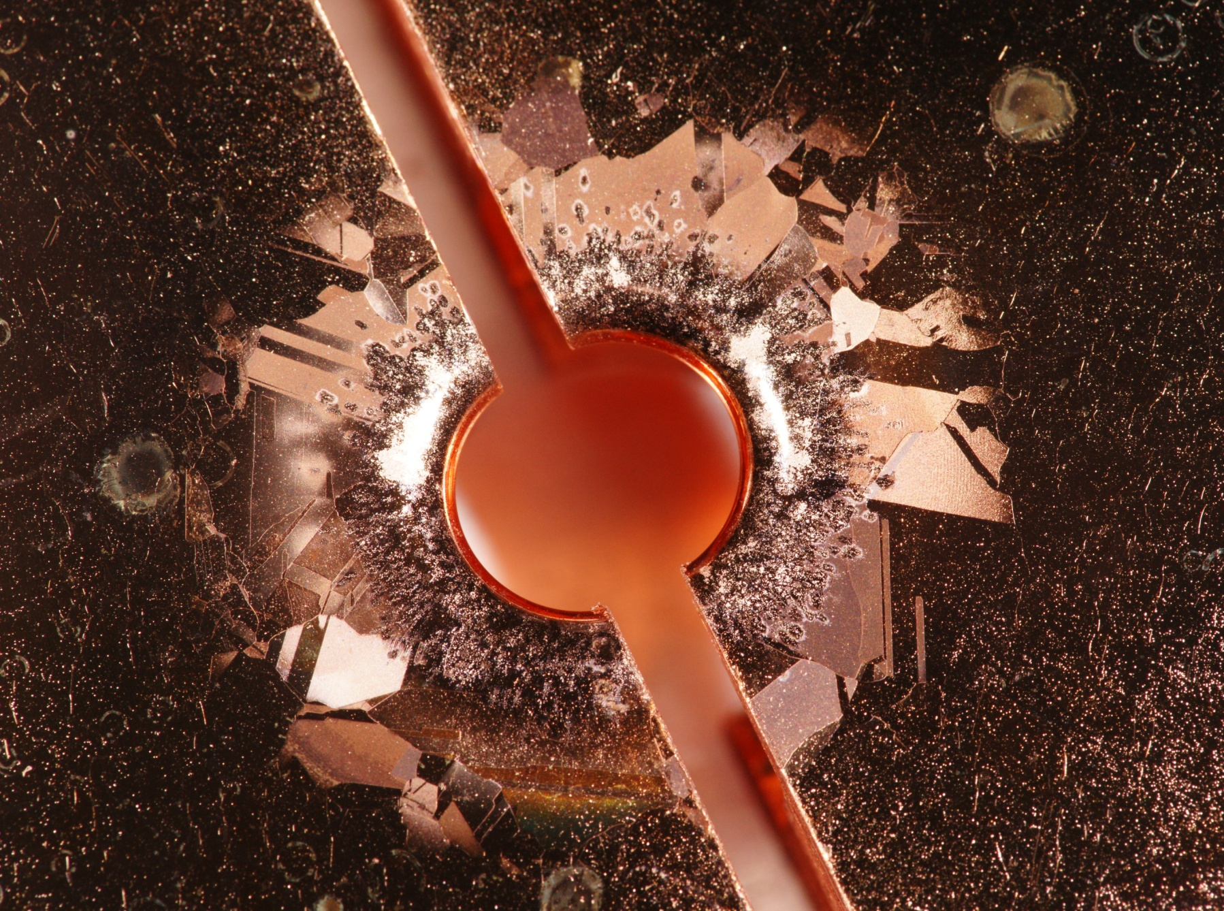
Typical breakdown and pulse heating
damage is standing-wave structure cell
SLAC-KEK-INFN

Slide 7
Breakdown Rate Correlation with Magnetic field had a Serious Consequences on the Research Efforts
SLAC, KEK,
INFN, CERN, MIT, Yale
  New geometry optimization for accelerator structure based on reduction of the magnetic surface field.
  A Dedicated study of surface magnetic fields and material: L. Laurent, S. Tantawi, V. Dolgashev, C. Nantista, Y. Higashi, M. Aicheler, S. Heikkinen and W. Wuench, Phys. Rev. ST – Accelerators and Beams, 14, 041001 (2011).
    Hard copper might open the door to extremely high gradient structures.
    Hard copper alloys such Cu Ag or Cu Cr could be of great interest to accelerator.
  Technology developments
    Mixed Materials structures could also result in very high gradients
    Methods for building structures based on alloys
  Basic Physics studies with Mixed E&H dual-mode cavities was initiated
  Low temperature operation could lead to very high gradient structure
    Conductivity increases ( not with big factor because of anomalous skin effect, enough to reduce cyclic stresses dramatically)
    The yield strength of copper improves
    A proof of principle experiment is about to begin at SLAC
  A new methodology for designing Photonic Band Gap (PBG) structures
  A way to understand the results of MUON cooling cavity operation under strong magnetic field

Slide 8
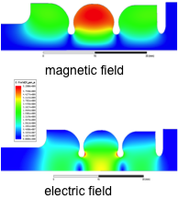
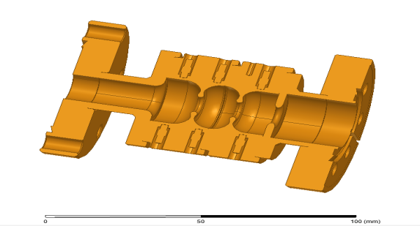
Geometry Test:
High shunt Impedance, Reduced Magnetic Field
Structure is designed through a specially written finite element code associated with a genetic optimization algorithm.
Optimized shape,
on axis coupled
Optimized shape,
on axis coupled
Elliptical iris,
side-coupled
Elliptical iris,
side-coupled
200 ns
Round iris,
on axis coupled
Elliptical iris,
on-axis coupled
Elliptical iris,
on-axis coupled
Optimized shape,
on axis coupled
600 ns
Elliptical iris,
on axis coupled
Elliptical iris,
side-coupled

Slide 9
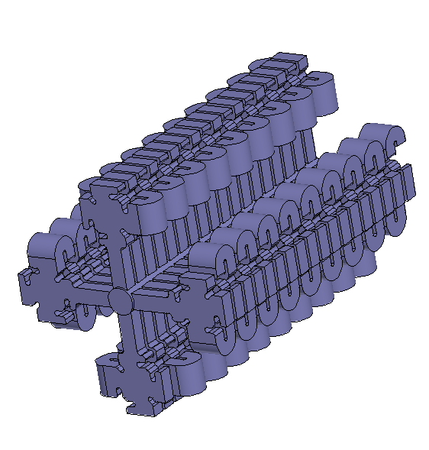
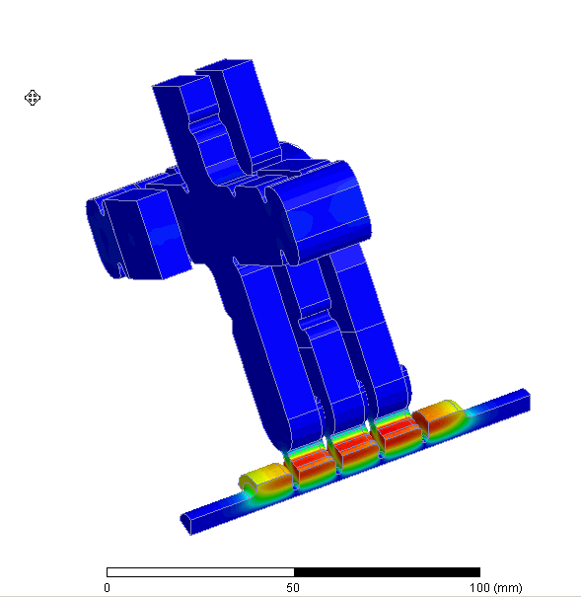
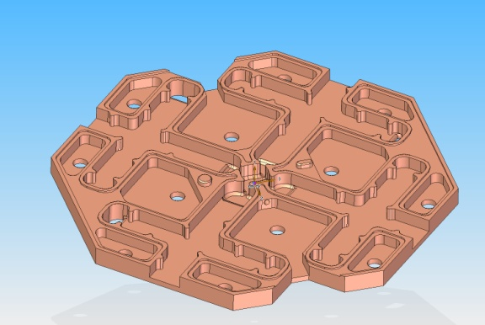
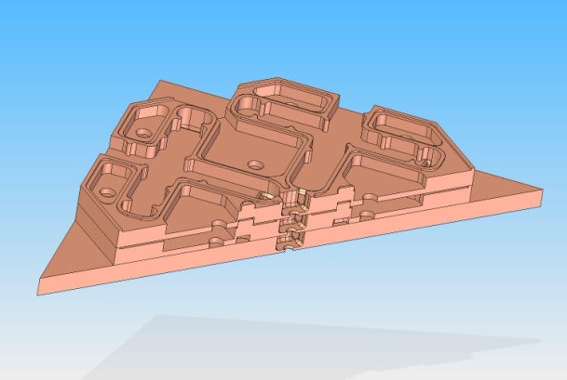
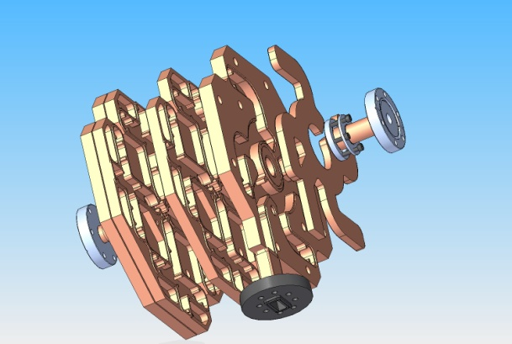
Distributed coupling accelerator structure
Optimizing the individual cell shape compromises the coupling between cells, hence, we needed to invent a method for distributed coupling:
A patent will be filled by Stanford university’s Office of Technology Licensing
The structure can be build using brazing and diffusion bonding processes because the directional coupler and the bends are manufactured on the same cell plate
This most suitable for normal conducting high repetition rate applications
There are interest from Some industrial firms to license this technology
SLAC, KEK
2
3
1
4

Slide 10
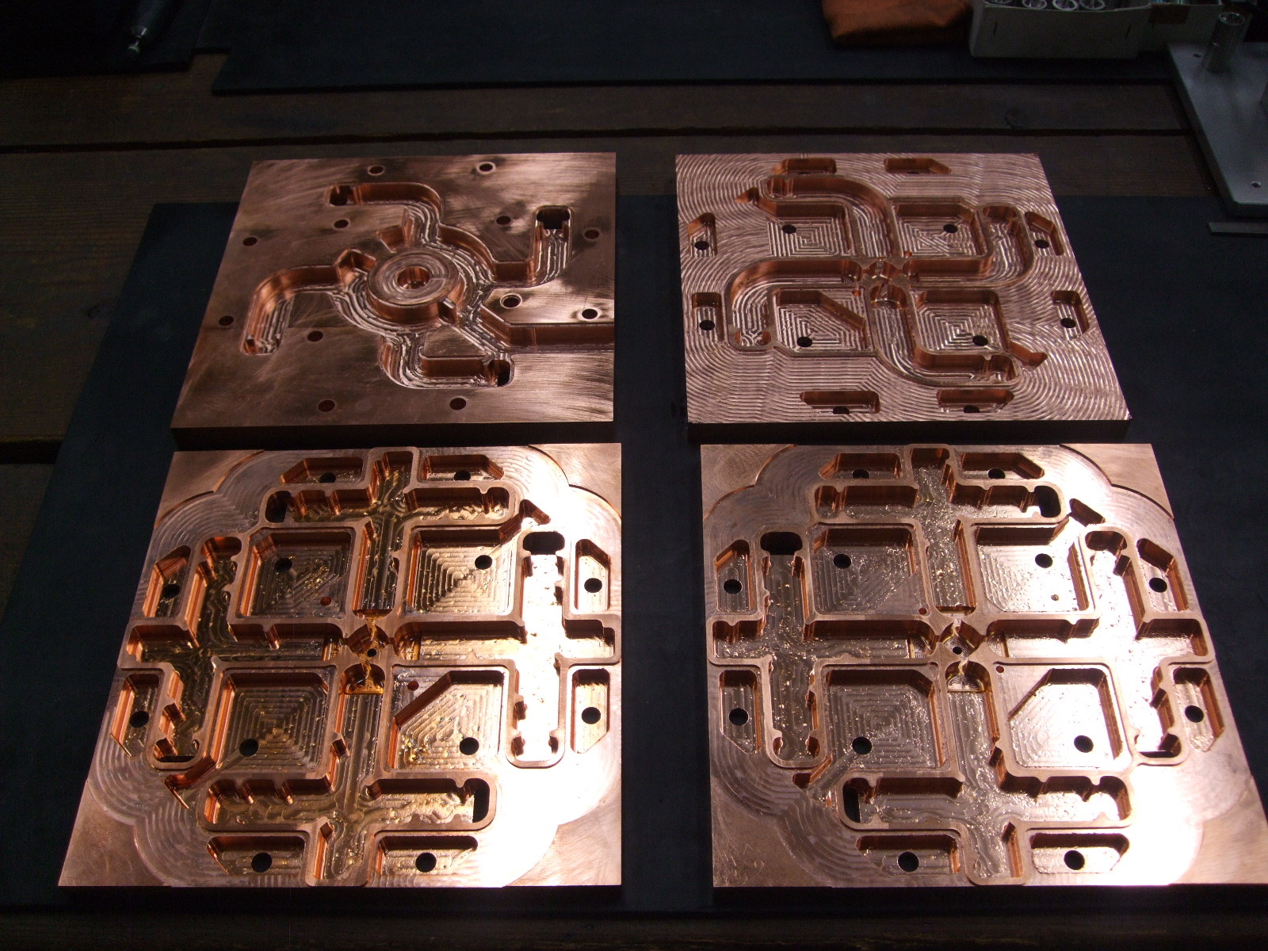
Manufacturing of Parallel fed Standing Wave structure
Yasuo Higashi, KEK

Slide 11
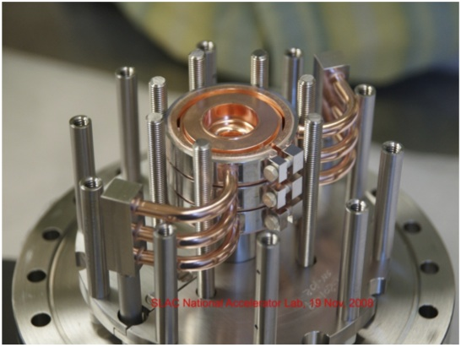
Comparison of Soft and Hard Copper Structures
We had to develop an apparatus for testing accelerator structure without brazing
The results shows a great improvement of possible gradients at very low breakdown rates, Lower than that required by a collider application
It is now possible to talk about reliable gradient higher than 150 MV/m
600 ns
Soft Copper
600 ns
Hard Copper
200 ns
200 ns

Slide 12
Breakdown data for three 1C-SW-A2.75-T2.0-structures
made of soft heat treated Cu, hard Cu and hard CuAg (initial and final performance),
150 ns shaped pulse
hard CuAg,
final
hard CuAg,
final
hard
CuAg
hard
CuAg
hard
Cu
soft Cu
soft Cu
soft Cu
soft Cu
hard
Cu
hard CuAg,
initial
hard CuAg,
initial
hard CuAg,
final
hard
CuAg
hard
CuAg
hard CuAg,
final
hard
Cu
soft Cu
soft Cu
soft Cu
soft Cu
hard
Cu
hard CuAg,
initial
hard CuAg,
initial
Gradient performance of “initial CuAg” is better then any other structure, pulse heating
dependence will need to be investigated

Slide 13
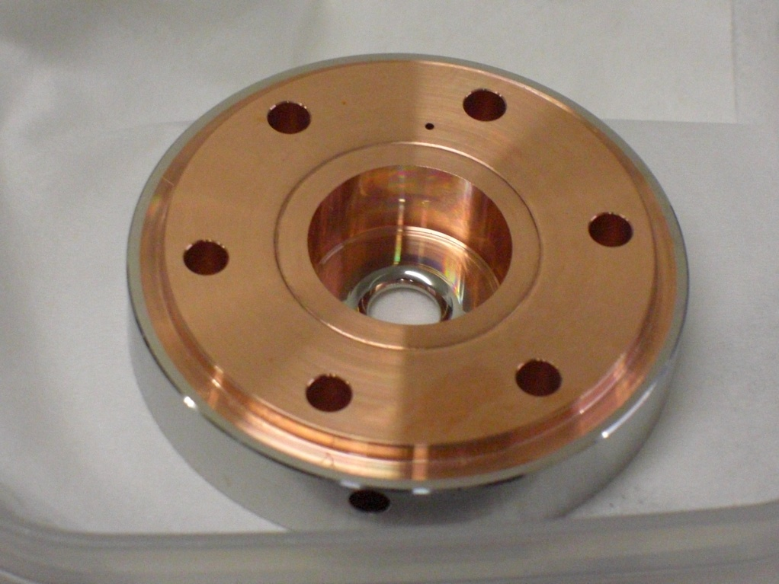
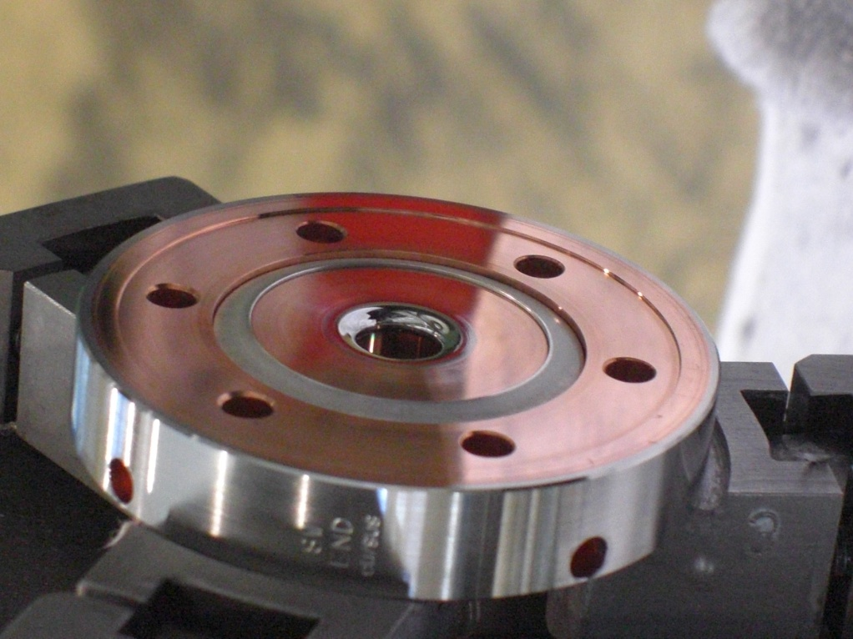
1C-SW-A3.75-T2.6-Clad-Cu/SUS, Cu/Mo
surface polished cell
Cu/Mo
Cu/SUS
Bulk surface skin
resistivity resistivity depth
(Ohm-m) (Ohm) (mm)
Cu 1.724x10E-8 0.034 0.505
SUS 304 6.4 x10E-7 0.208 3.07
Mo 5.7x 10E-8 0.062 0.918
Yasuo Higashi, KEK, September 2011

Slide 14
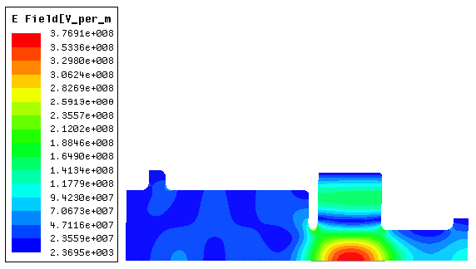
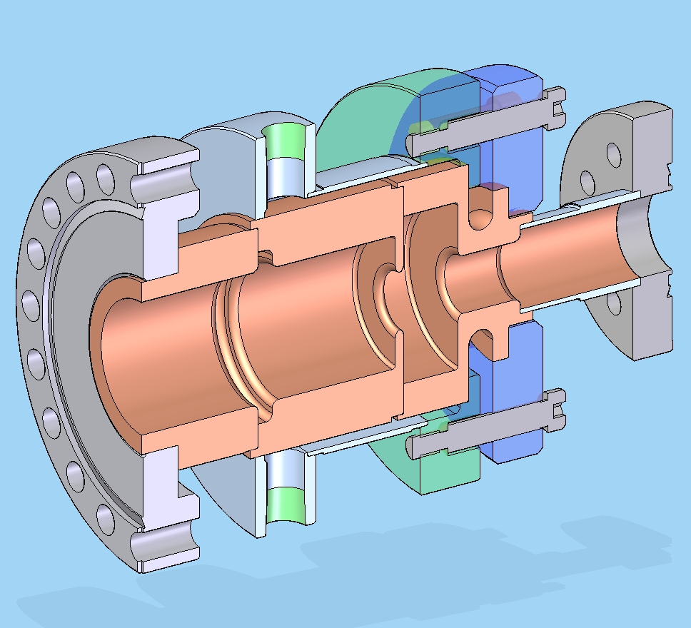
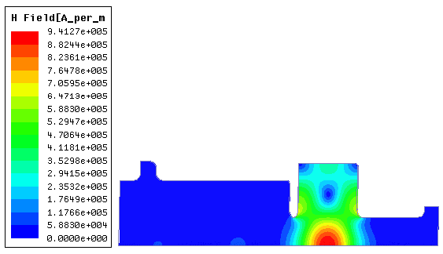
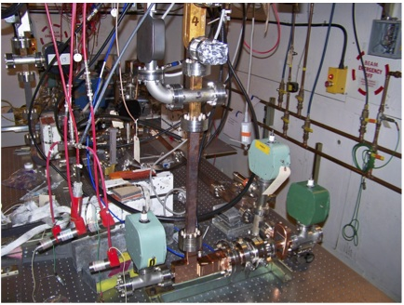
Dual mode Cavity for studying the relative effects of electric and magnetic fields
This experiment began two month ago and we are in the process of collecting statistics.
The experiment is very fixable because it allow us to change the electric and magnetic field timing, Ratio and phase
We are already seeing very interesting results that could have an impact on our understanding of the phenomena
Electric Field due to the TM₀₂₀ Mode
TM01 in
TE01 in
Magnetic Field due to the TE₀₁₁ Mode

Slide 15
Changing relative position of TM and TE modes
J. Lewandowski, 12 April 2012

Slide 16
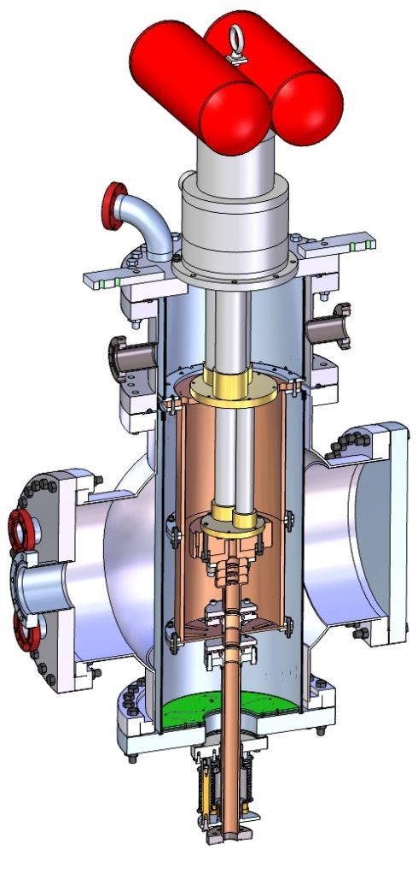
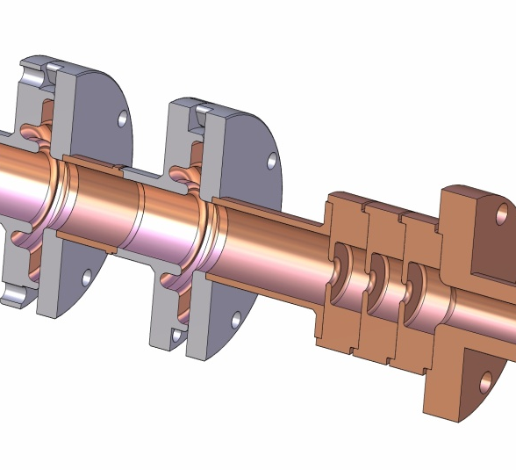
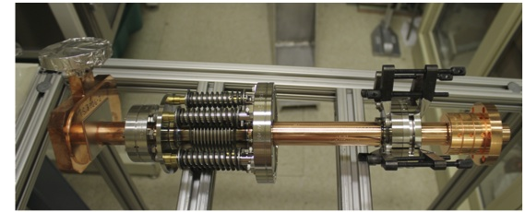
Cryogenic Testing of accelerator structures
We made detailed measurements for copper conductivity at 11.424 GHz. Because of the anomalous skin effect this data was not available.
Conductivity increases (by a factor of 17.6 at 25K), enough to reduce cyclic stresses.
The yield strength of copper improves.
The experiment is ready and will be executed in a month or so as soon as there is a time slot in ASTA
RF in

Slide 17
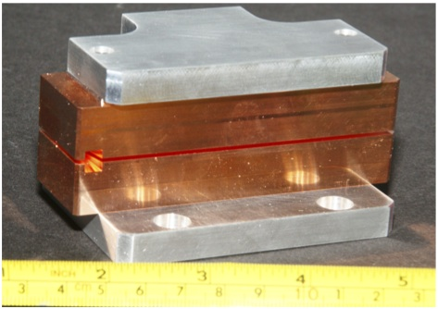
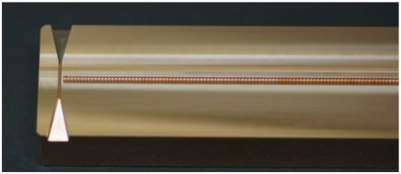
Future plans for the high gradient collaboration
The collaboration during the next 5 will address 4 fundamental research efforts:
  Continue basic physics research, materials research frequency scaling and theory efforts.
  Put the foundations for advanced research on efficient RF sources.
  Explore the spectrum from 90 GHz to THz
    Sources at MIT
    Developments of suitable sources at 90 GHz
    Developments of THz stand alone sources
    Utilize the FACET at SLAC and AWA at ANL
    Address the challenges of the Muon Accelerator Project (MAP)
mm-Wave structure to be tested at FACET

Slide 18
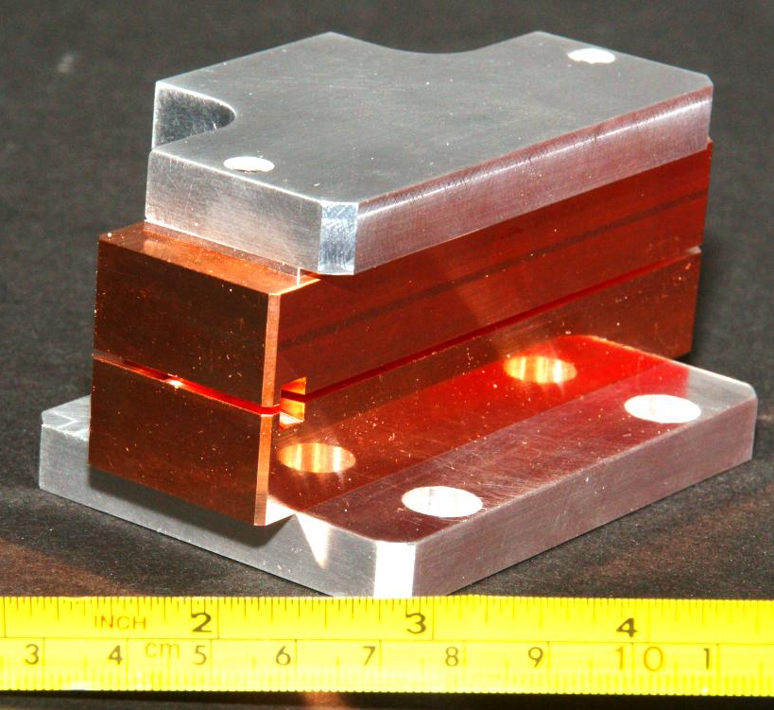
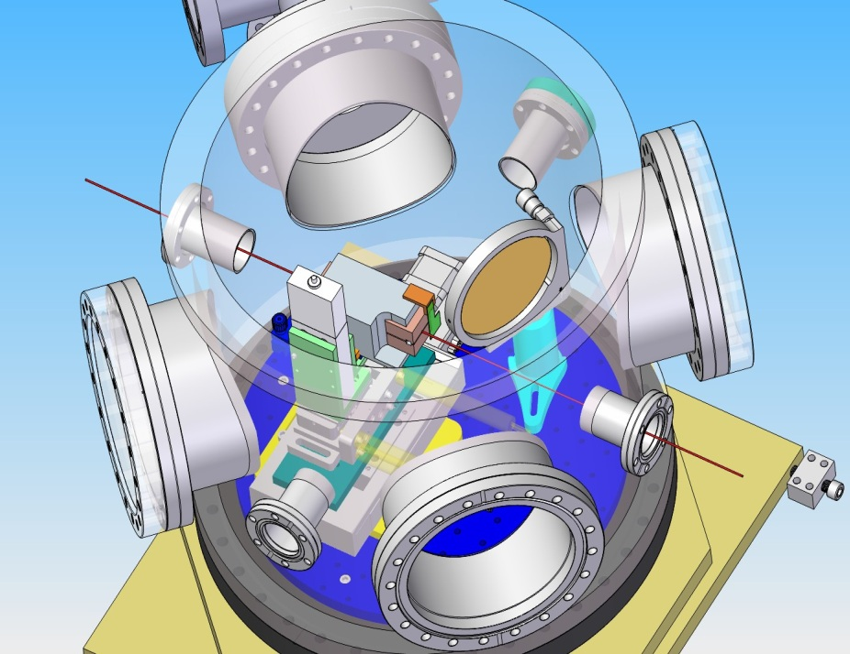
RF Breakdown Test of Metal Accelerating Structure at FACET
beam
structure
waveguide horn
connected to
100 GHz
detector
Assembled structure, beam gap set to 0.9mm
Structure in FACET vacuum chamber
1st iris – breakdown damage, peak surface fields
<1.3 GV/m
9th iris – no breakdown
damage, peak surface fields
> 0.64 GV/m, pulse length ~3ns
Autopsy of output part of the structure
Valery Dolgashev, Sami Tantawi, SLAC

Slide 19
Research on Advanced RF sources
  We need to put forward the foundations for advanced research on efficient RF sources. This is needed to utilize the availability of ultra-high gradient structures:
  New ideas from SLAC; provisional patent soon
  Research on advanced special purpose codes.
  Research on multi-beam overmoded devices.
  Advanced cathodes and modulation techniques.
  Research on coupled systems: accelerator structures and sources
    This is a new idea that will allow us to retrieve some of the energy in the cavity back to the RF source.
    New optimization for the total system resulting in over all efficiency enhancement
    Run the system in a high rep rate mode to eliminate the need for multibunch operation
    New optimization for a lepton colliders

Slide 20
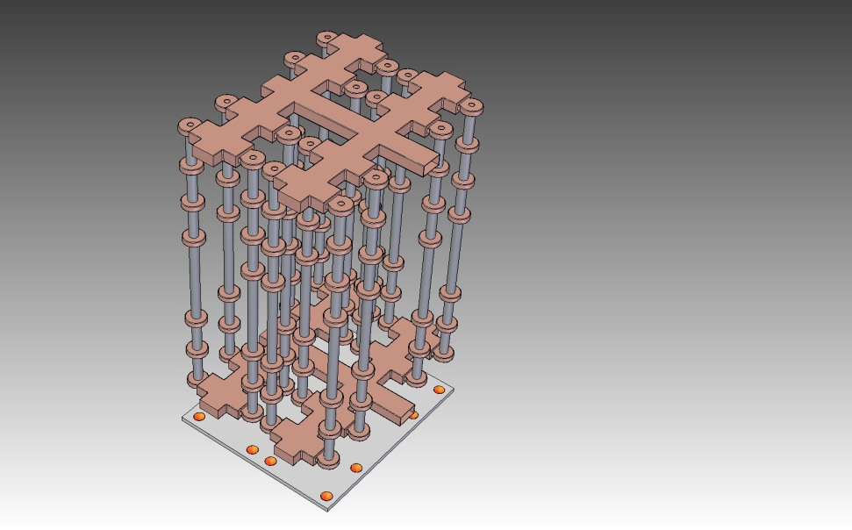
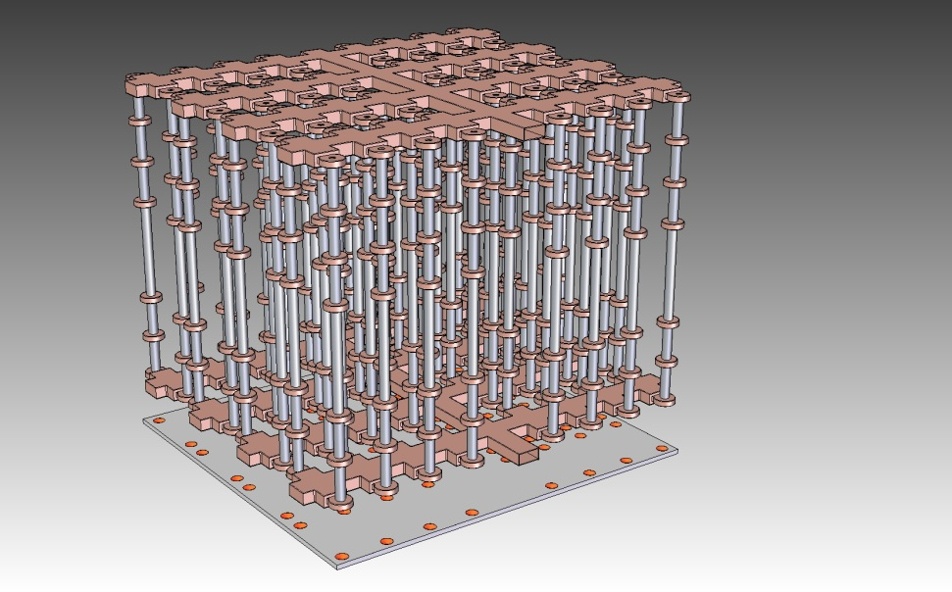
Multi-beam klystron devlopments
MBK 16
MBK64
Most possible compact configuration

Slide 21
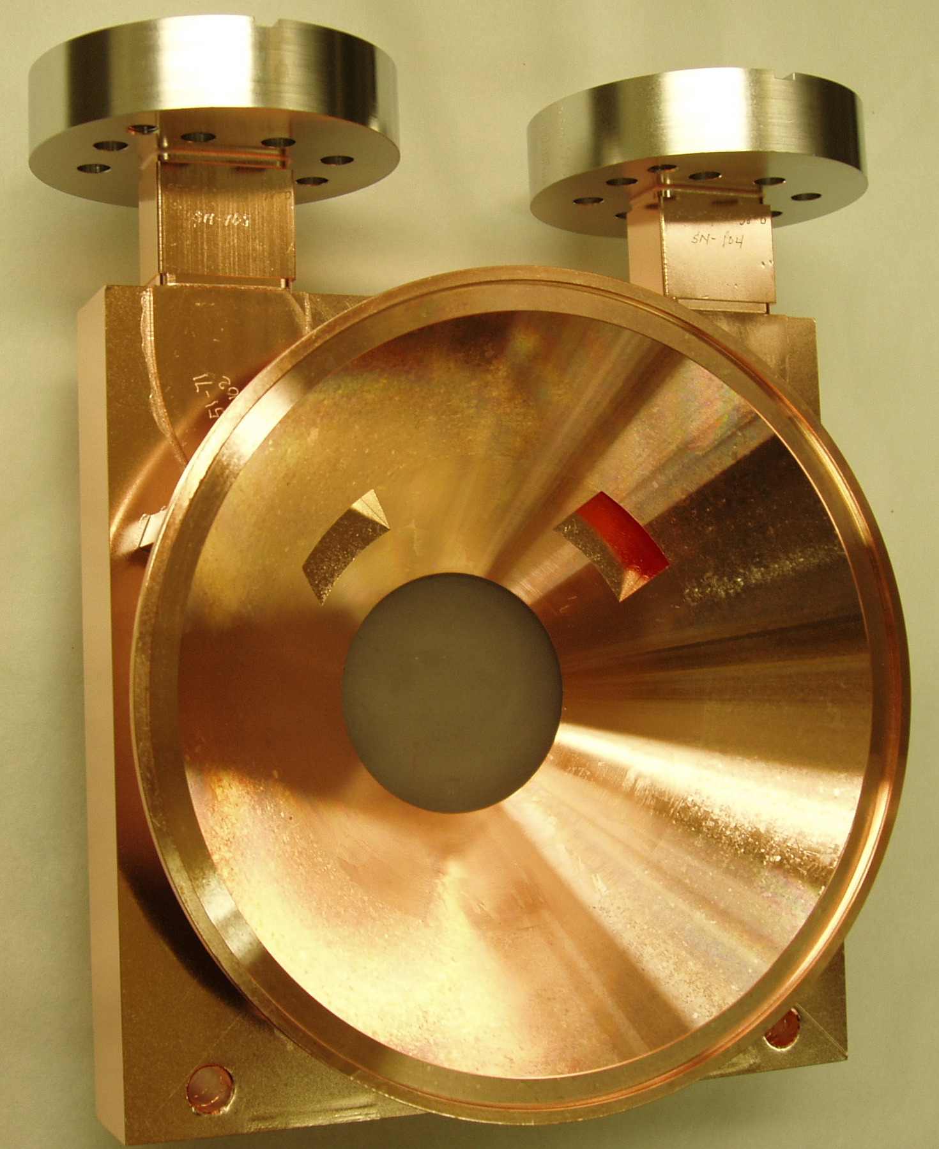
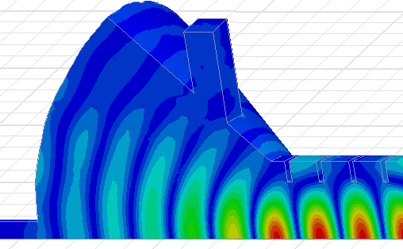
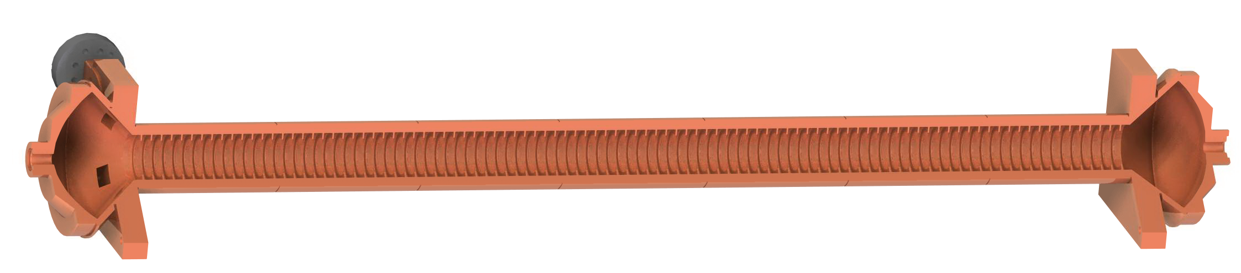
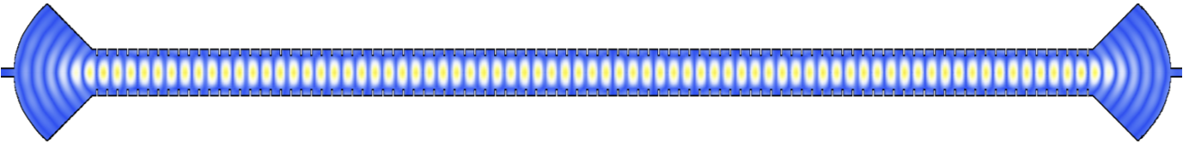
Undulator Coupler Design (RF undulator will have a great impact on polarized positron production for future colliders)
Two coupling ports 90º apart to excite two polarizations independently
Coupler Field Configuration
Undulator Mechanical Structure
Electric Field Distribution
Corrugation Period=0.4254 λ
Inner Radius=0.75 λ
Outer radius= 1.01293 λ
Corrugation Thickness= λ/16
Number of periods =98
λ=2.6242296 cm
Undulator Wavelength=1.39306 cm
Power required (for linearly polarized, K=1)=48.8 MW
Q0=94,000

Slide 22
Far Field @ 69 MeV
Electric field polarization vector

Slide 23
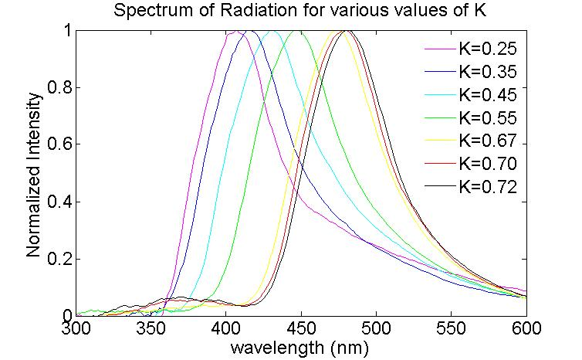
Spectrum shift as a function of K

Slide 24
Application of recent developments of High Gradient Technology to futures colliders
Optimized high gradient structures also have very high shunt impedance, which can be utilized to improve RF to beam efficiency.
New advances in RF source designs improve efficiency and reduce operating voltages:
  One can then design efficient modulators with short rise and fall times
  One can invention an RF unit that does not utilize pulse compression, much higher efficiency for the overall system
  Cost effective depressed collectors can be included in the design
  No electric magnets in the klystron system
  An overall system that can compete very well ( in terms of wall plug power) with superconducting alternatives could be envisioned, except that the former can be extended to much higher gradient.
  The cost of a warm machine vs cold one need to be studied based on the advances made for the warm technologies

Slide 25
Faculties and Resources
We need to keep RF testing of RF structure and component facilities allife (e.g. ASTA, NLCTA, the MIT 17 GHz facility, and the NRL 11.4 GHz facility)
These facilities need to be upgraded to work at higher frequencies from Ka-band to W-band
Research on advanced and transformational technologies for RF sources is essential for the realization and application of high gradient technologies
Progress on high gradient research required the collective resources of national and international laboratories and universities. The same apply for RF source technology and creating the appropriate collaborations under the umbrella of the DoE is a must for progress in this field.

Slide 26
Summary
The work being done is characterized by a strong national and international collaboration. This is the only way to gather the necessary resources to do this work.
With the understanding of geometrical effects and material requirments, we have demonstrated standing and traveling wave accelerator structures that work above 150 MV/m loaded gradient.
We started our collaborative research towards transformational RF source technology.
Our work is attracting attention from other disciplines such as BES light sources, medical linacs, novel medical treatment devices and medical proton therapy machines.
The effort reported here is just a representative sample of our effort

Slide 27
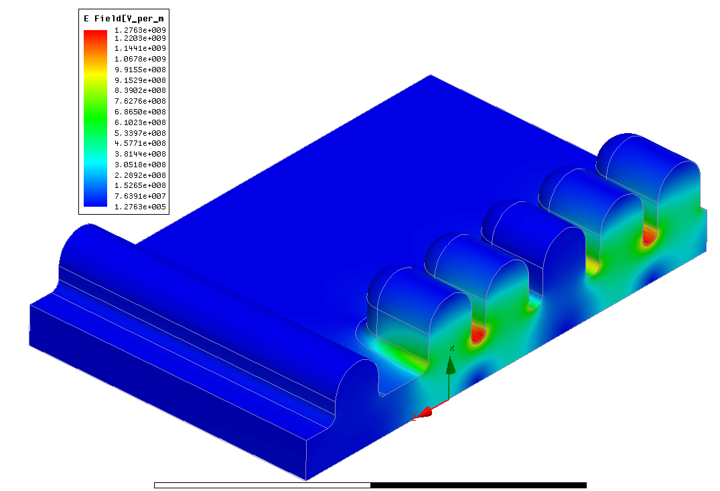
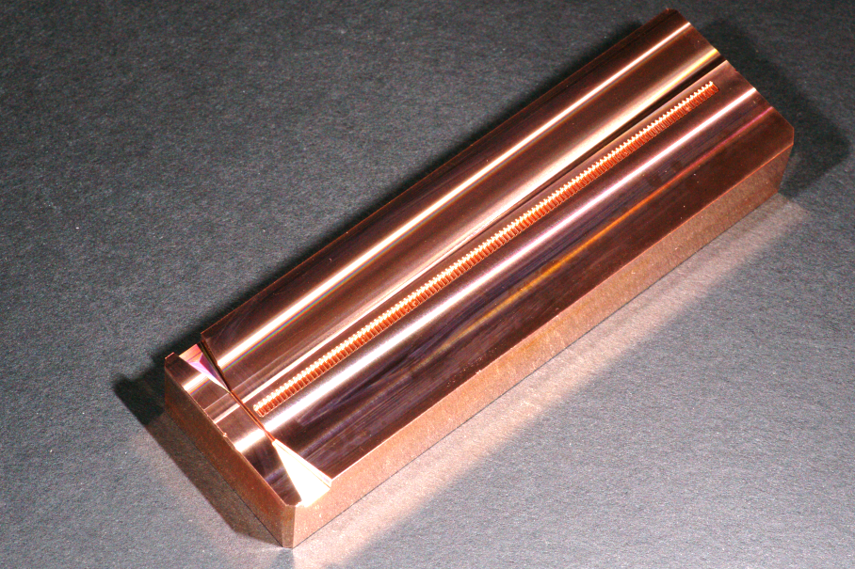
RF Breakdown Test of Metal Accelerating Structure at FACET
RF out
10 cm
electron
beam
output horn
0
2
4 mm
HFSS model of 1/4th of output part of accelerating
structure, beam gap 0.9 mm, frequency 116 GHz, excitation 1.6 nC, peak electric field ~1.3 GV/m
Accelerating structure
manufactured by Makino
Fill time [ns]
Parameters of accelerating structure with changing beam gap, excited by 1.6 nC bunch
Valery Dolgashev, Sami Tantawi, SLAC

Slide 28
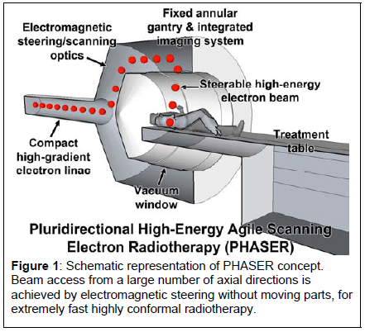
New concept for electron beam therapy

Slide 29
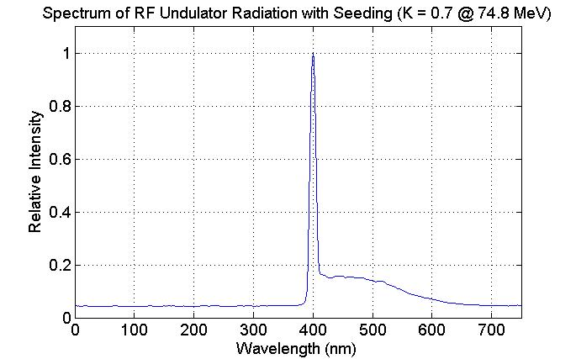
Date of measurements: July 18, 2012 ( The idea of these measurements was initated by Erik Hemsing)
On-axis coherent radiation due to 2nd harmonic of 800 nm seeding
Off-axis incoherent radiation

Slide 30
Measurements of the undulator K parameter

Slide 31
Spin offs and Opportunity that Came as a Direct Result of High Gradient Research
The developments done under the high gradient program is attracting applications from other fields:
Optimizing the structure for reduced magnetic field results in a high efficiency structure which is attractive for high repetition rate accelerators. This is specially attractive for linac based light sources:
  A proposal from an MIT group is going to BES in which they would propose building a linac with distributed coupling utilizing our soon to be patent approach in their design and will ask us to build it for them if the proposal is approved.
  There is an interest from industry to adopt our approach to medical linacs, negotiations with Stanford Licensing office has started.
The fact that high gradient linac above 100 MV/m can be build reliably is also attracting attention:
  A proposal submitted jointly by SLAC and the Stanford Medical school is under consideration by NIH for a new therapy machine based on direct elctron beam treatment at with 100 MeV electrons
  Extending this technology to proton linacs creates interesting opportunities for proton therapy machines. Varian medical is interested in this technology.
  A FWP has been submitted to DoE HEP for exploring this technology to produce cost effective proton therapy machines

