Slide 1
Theory and Protocols Update
Advanced Quantum Networks for Science Discovery (A-QNET)
February 13, 2024
Shuen Wu and Eric Chitambar

Slide 2
Potential Collaborations
Problem: Entanglement distillation–using low jitter SNSPDs to erase frequency information
  Our potential contribution: Assist in the choice of entanglement purification protocol and subsequent analysis of entanglement fidelity.
Problem: Time-bin GHZ–Using high speed optical switch to entangle independent time-bin qubits
  Our potential contribution: Provide verification method of the GHZ state. We could use the tools of self-testing to verify that the created state is (close to) GHZ.
Problem: Cluster states–Different ratio of switching enables going from GHZ to cluster states
  Our potential contribution: Provide verification methods or methods to distinguish between different types of graph states.

Slide 3
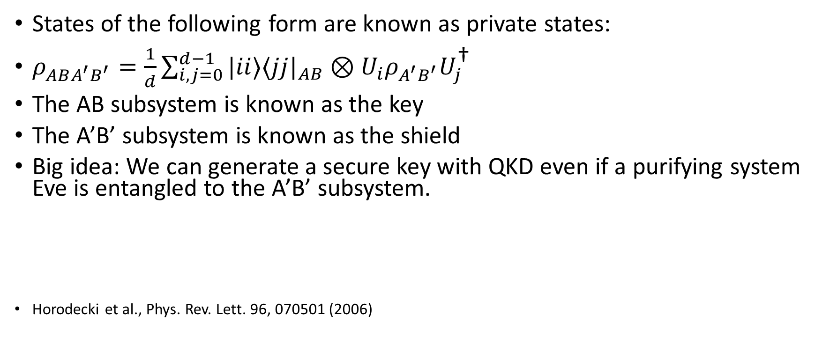
Private States
States of the following form are known as private states:
$ρ_{ABA^{′}B^{′}}=\frac{1}{d}\sum_{i,j=0}^{d−1}{|ii⟩⟨jj|_{AB}⊗U_{i}ρ_{A^{′}B^{′}}U_{j}^{\text{†}}}$
The AB subsystem is known as the key
The A’B’ subsystem is known as the shield
Big idea: We can generate a secure key with QKD even if a purifying system Eve is entangled to the A’B’ subsystem.
Horodecki et al., Phys. Rev. Lett. 96, 070501 (2006)

Slide 4
Goals
Understand the intricacies/potential applications of private states
Consider schemes utilizing hyperentangled photons to generate private states

