Slide 1
Microwave-optical Quantum Transduction
Changqing Wang and Silvia Zorzetti
Superconducting Quantum Materials and Systems (SQMS) Center, Fermi National Accelerator Laboratory

Slide 2
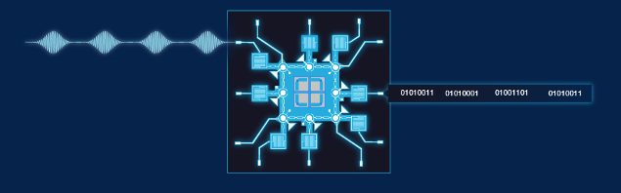


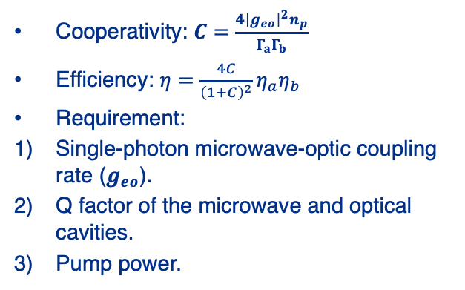





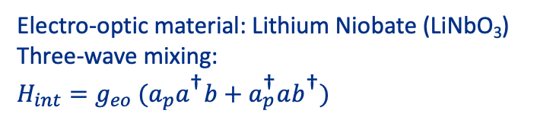
Introduction to Quantum Transduction
Cooperativity: $C=\frac{4{\left|g_{eo}\right|}^{2}n_{p}}{Γ_{a}Γ_{b}}$
Efficiency: $η=\frac{4C}{{\left(1+C\right)}^{2}}η_{a}η_{b}$
Requirement:
Single-photon microwave-optic coupling rate ($g_{eo}$).
Q factor of the microwave and optical cavities.
Pump power.
Superconducting qubits
Optical communication
Microwave
Microwave-optical transducers
Optical
∼GHz
~200 THz
Cryogenic temperature
Room temperature
Electro-optic material: Lithium Niobate (LiNbO₃)
Three-wave mixing:
$$H_{int}=g_{eo} ({a_{p}a}^{\text{†}}b+a_{p}^{\text{†}}ab^{\text{†}})$$
$$δ_{p}$$
Han, Xu, et al. Optica 8, 1050-1064 (2021).
Hease, William, et al. PRX Quantum 1, 020315 (2020):.
https://sqms.fnal.gov
https://www.antaira.com/Blog-Four-Advantages-of-Fiber-Optic-Communications
$$ω_{b}$$
$$ω_{b}$$
FSR
FSR
$$0$$
$$ω_{b}$$
$$ω_{a}$$

Slide 3
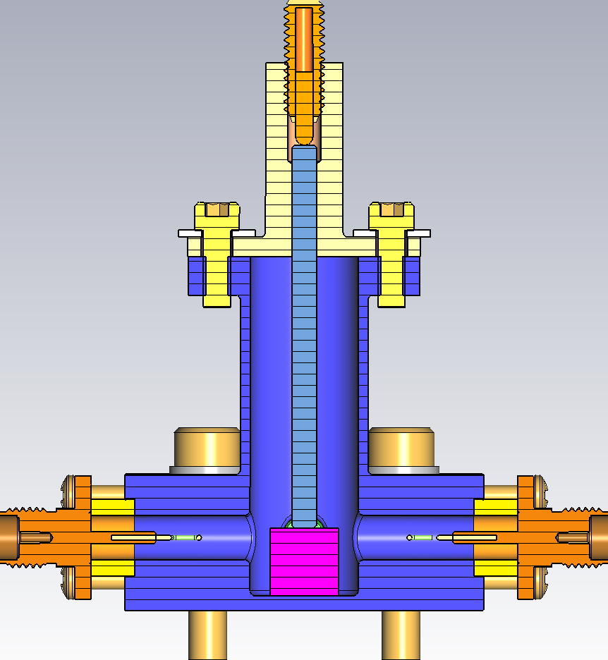
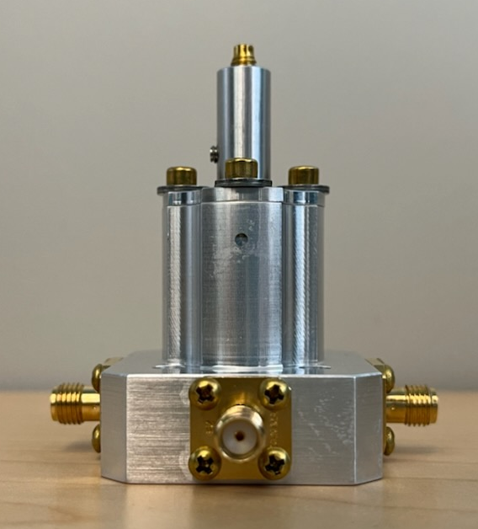
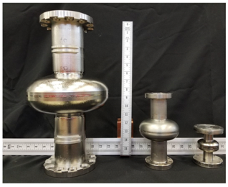
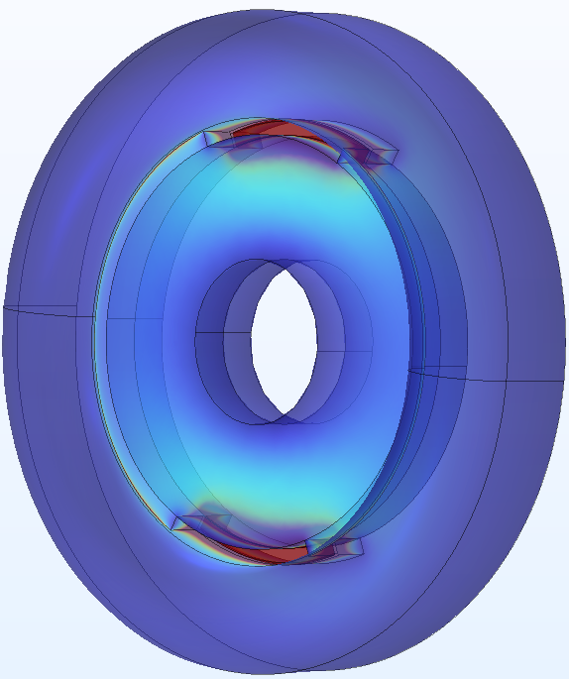
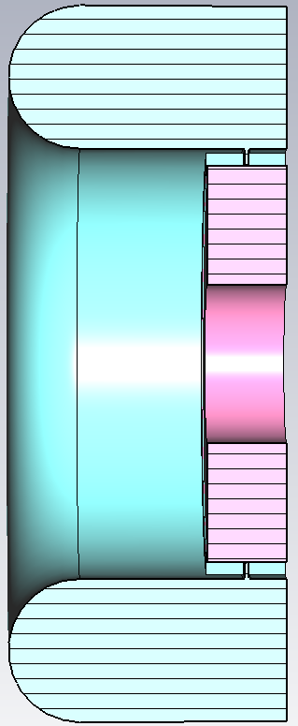

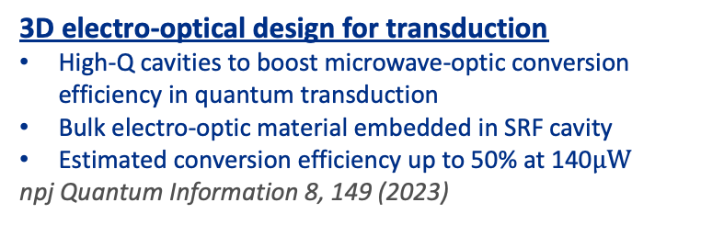
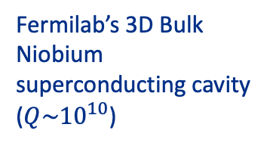

3D electro-optical quantum transduction
Fermilab’s 3D Bulk Niobium superconducting cavity ($Q\sim {10}^{10}$)
Characterization of Electro-optic materials
High-Q SRF cavity to characterize microwave properties of electro-optic materials (e.g., LN)
Phys. Rev. B 107, L220302
$$ε=\left(\begin{matrix}ε_{⊥} & 0 & 0 \\ 0 & ε_{⊥} & 0 \\ 0 & 0 & ε_{∥}\end{matrix}\right)$$
$$p×tanδ=\frac{1}{Q_{d}}=\frac{p}{Q_{crystal}}$$
3D electro-optical design for transduction
High-Q cavities to boost microwave-optic conversion efficiency in quantum transduction
Bulk electro-optic material embedded in SRF cavity
Estimated conversion efficiency up to 50% at 140$μW$
npj Quantum Information 8, 149 (2023)
Physical Review Applied, 13, 034032 (2020).

Slide 4
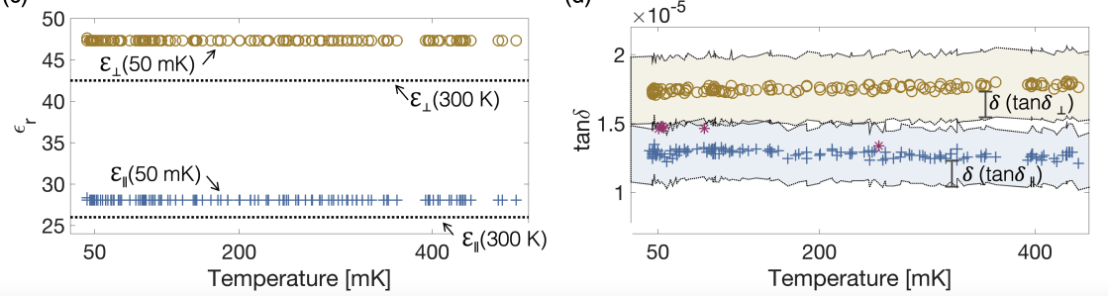


Measurement of LiNbO₃’s permittivity and loss tangent at mK
LiNbO₃ property at 50mK
Phys. Rev. B 107, L220302
$$\tan{δ_{⊥}}=(1.73±0.24)×{10}^{−5}$$
$$\tan{δ_{∥}}=(1.28±0.21)×{10}^{−5}$$
$(ε_{⊥},ε_{⊥}$, $ε_{∥})=\left(47, 47, 28\right)$
Relevant literature: Goryachev et al. Physical Review B 92, 060406(R) (2015)
Wollack et al. Appl. Phys. Lett. 118, 123501 (2021)
Hease et al. PRX Quantum 1, 020315 (2020)

Slide 5
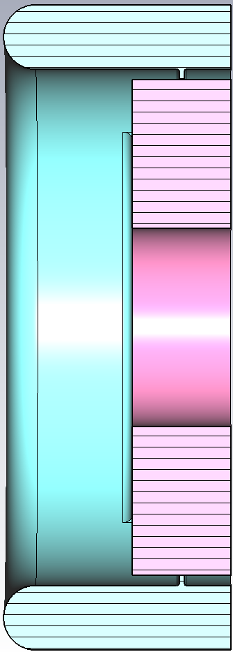
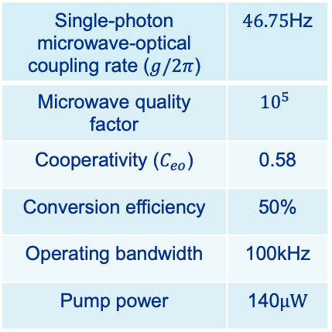

3D Design for transduction
Figures of merit
Single-photon microwave-optical coupling rate ($g/2π$) | $46.75$Hz
Microwave quality factor | $${10}^{5}$$
Cooperativity ($C_{eo}$) | 0.58
Conversion efficiency | 50%
Operating bandwidth | 100kHz
Pump power | 140$μW$
$L=$2.25 mm
Ø 5 mm
Ø 2 mm
npj Quantum Information 8, 149 (2023)
1 mm

Slide 6
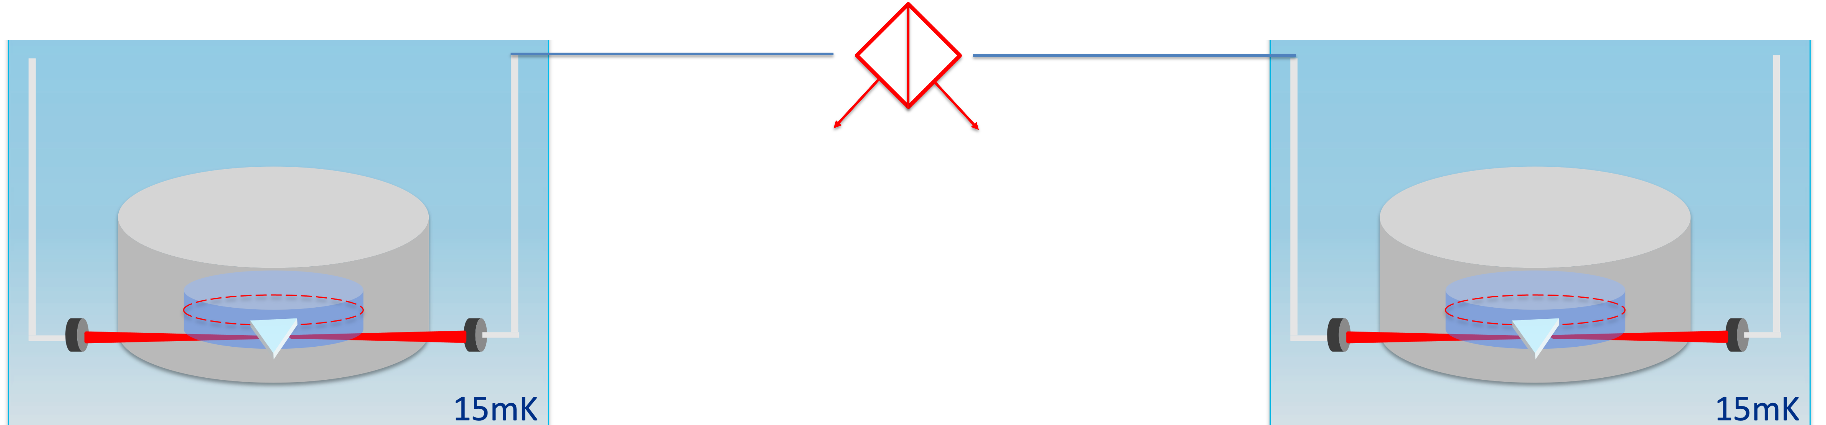
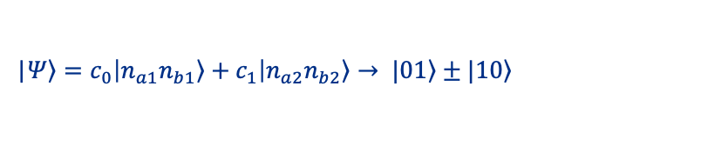
Transduction for Remote entanglement
  Entanglement between distant SRF cavities (qubit / qudit encoding) via optical photons
  Entanglement between distant transmon qubits via optical photons
Microwave Bell state generation:
|$\left.Ψ\right\rangle =c_{0}\left|\left.n_{a1}n_{b1}\right\rangle +c_{1}\right|\left.n_{a2}n_{b2}\right\rangle → |\left.01\right\rangle ±|\left.10\right\rangle$
Superconducting Transmon Qubit

