Slide 1
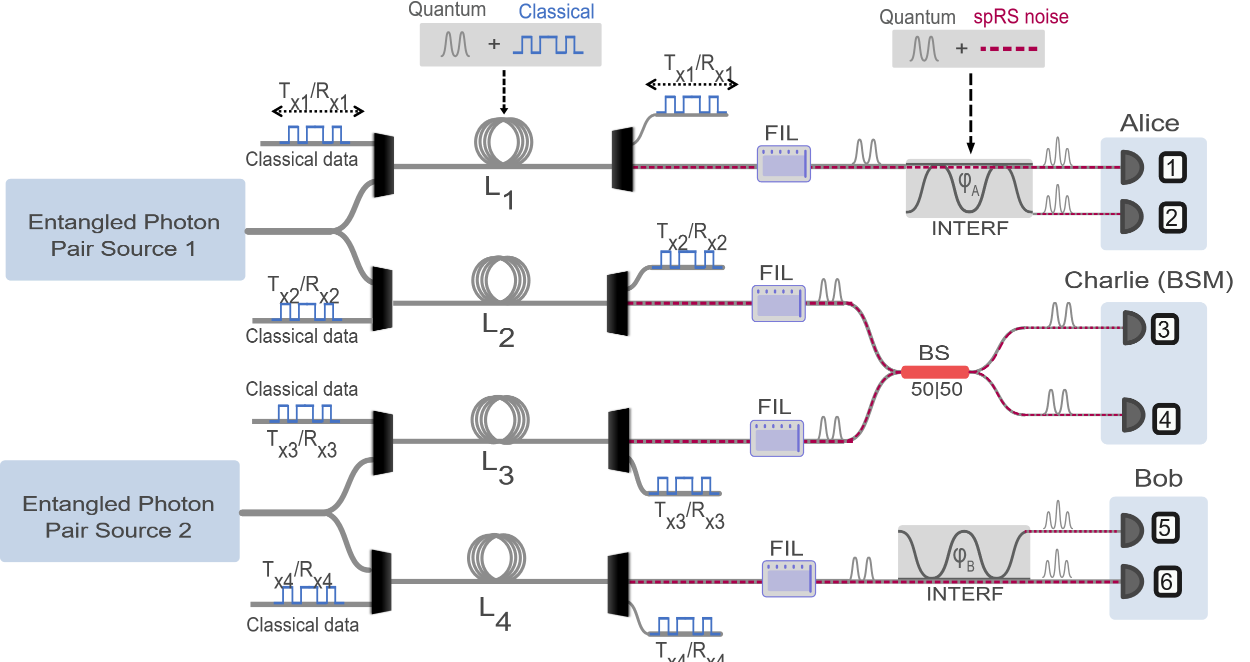
Swapping Quantum-Classical Coexistence Experiments at Fermi

Slide 2
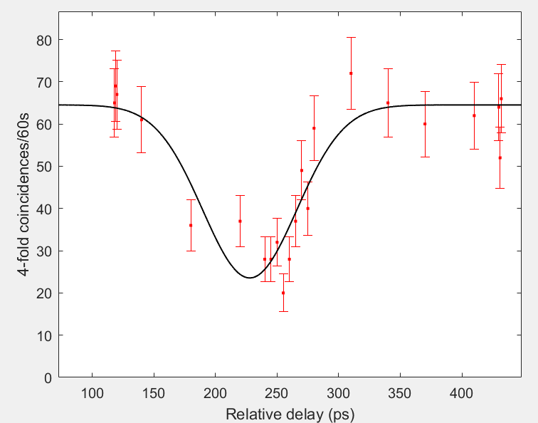
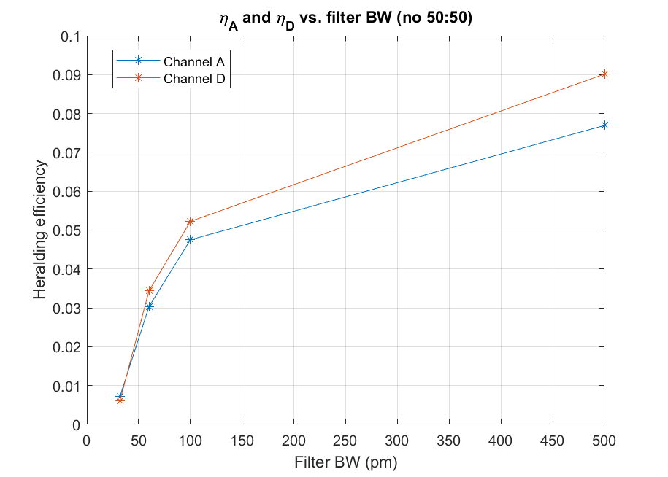
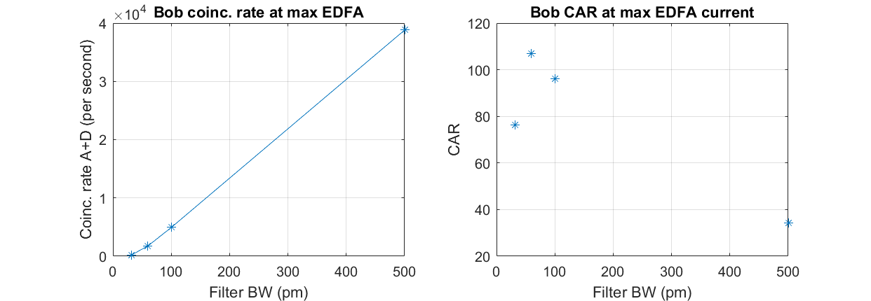
Characterization of current system
Spent first few weeks trying to re-create Caltech’s old results when they worked with this system
→ A lot of debugging various things at first
→ have characterized heralding efficiencies, entanglement visibility, HOM interference
HOM dip → Visibility ~ 65 +/- 5%
Caltech was able to get ~90%, so we are still investigating more optimization

Slide 3
Experiments over 10 km of fiber
We are beginning to do some coexistence experiments over ~10 km of spooled fiber
Step 1: entanglement distribution to the BSM node over 10.6 km fiber
Study the parameters in which Caltech was able to achieve good swapping fidelity to predict how noise may impact system
→ filter bandwidth for indistinguishability, mean photon pair numbers for multi-photon effects, …, as a function of classical power levels and classical source wavelength
Classical source

Slide 4
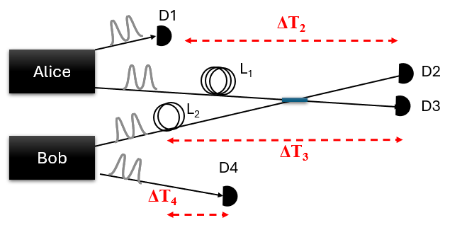
Coincidence detection with long time delays
To perform coincidence detection over longer fibers and large time delays between each photon,
→ need to allow the time-tags of the photons to have large delays to match up coincidences with correct time slot
Previous data collection only allowed small delays using hardware delay of time-tagger
→ We have implemented software delay feature of Swabbian time-tagger to allow for delaying each channel by arbitrary amounts
→ previously limited to ~nanosecond delays → now allow arbitrary delay (currently doing ~51 μs)
→ added into GUI data collection system
Record multi-photon coincidences
with software delay of time-tags
TDC
T = 0
-ΔT₂
4-fold
coincidence
-ΔT₃
-ΔT₄
SNSPDs

Slide 5
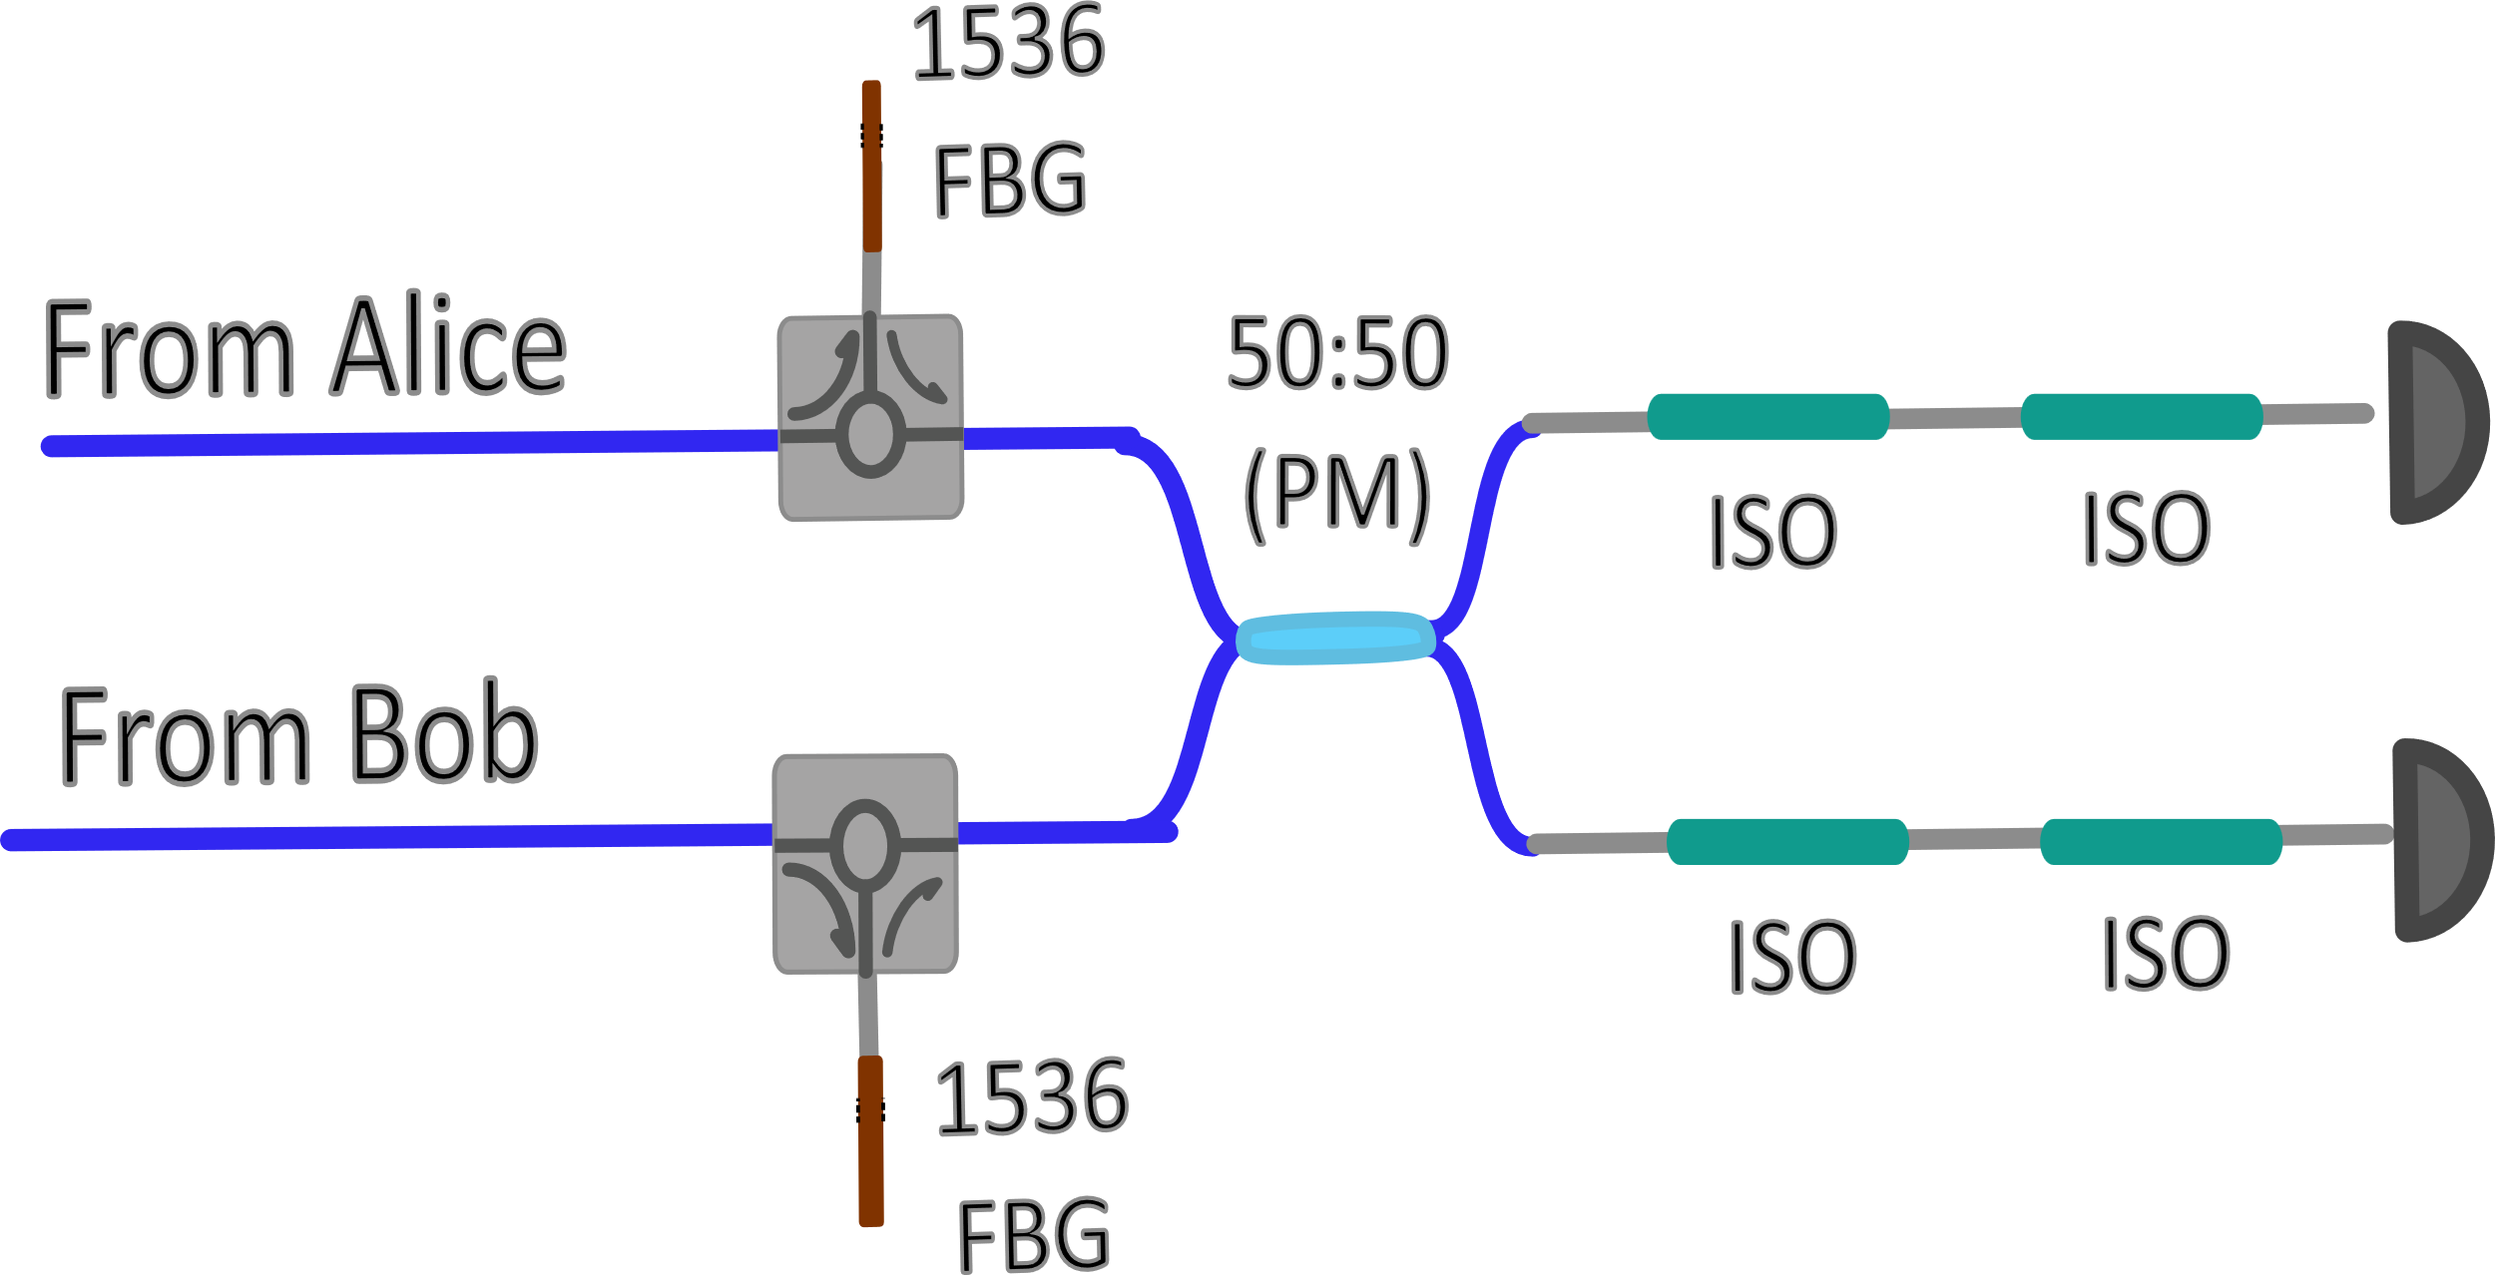
Modified Bell state analyzer for 10-km and coexistence
Allowing coexistence with WDMs
Added in WDMs to de-multiplex classical light and also provide high isolation of the classical light
Polarization control:
Previous system had polarization maintaining fiber throughout entire system
→ Not compatible with long distance non-PM fiber links
ii. Added in a FPC+PBS combination before a PM 50:50 splitter
→ guarantees polarization indistinguishability, polarization rotations should only impact rates (not fidelity)
Old setup
(PM fiber from source to BSM)
New BSM setup
L₁
Classical receiver
PM fiber
L₂
Classical receiver

Slide 6
Entanglement Distribution with Coexistence
First coexistence experiment:
Test impact of coexisting 1310-nm classical light on entanglement distribution to BSM
Investigate different filter bandwidths and mean photon pair numbers as a function of 1310-nm classical power levels

Slide 7
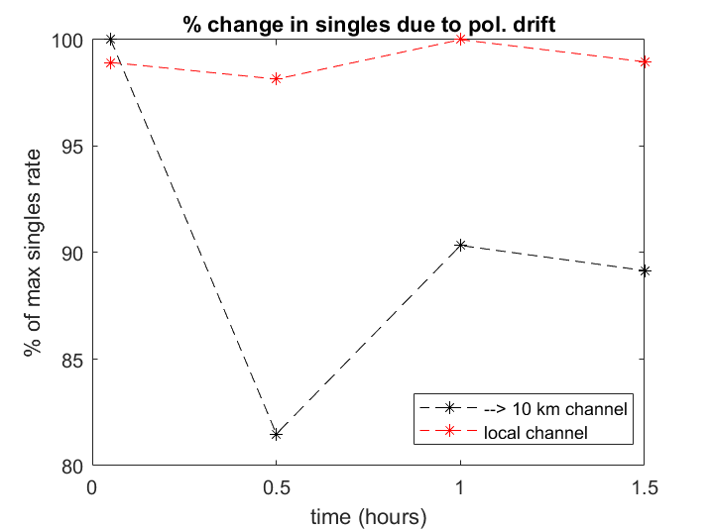
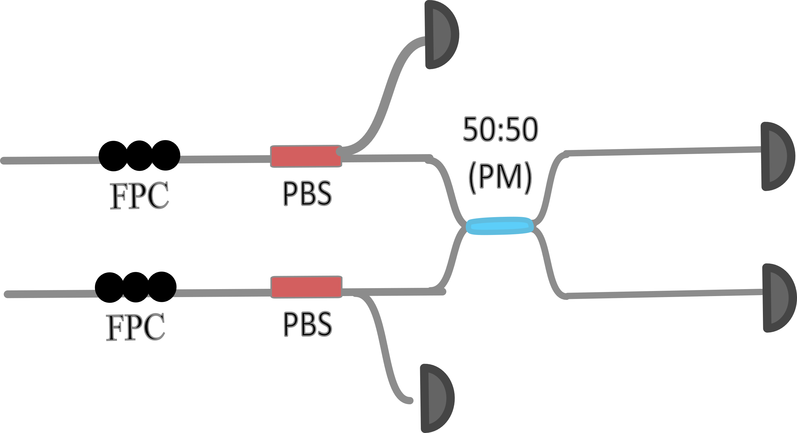
Polarization drift induced intensity changes
10 km (Pol. Drift)
Saw about 20% variation in singles rates in first experiments due to polarization drift over time (~1.5 hours)
Short term solution = tape all fiber down more, should be okay for initial experiments
Long-term solution = monitor other PBS port as feedback to electronic FPCs to keep singles counts minimized (i.e. maximizing rates in other port)
10-km channel
Source
PBS
“local channel”
Pol. drift
minimize
Pol. drift
minimize

Slide 8
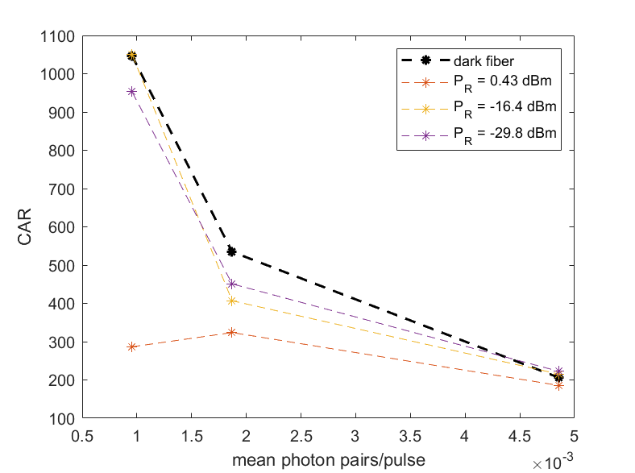
Varying mean photon pairs/pulse with different classical power levels
First measured coincidence to accidental ratio for photon pair source (not time-bin) as a function of mean photon pair/pulse at different received 1310-nm power levels
Filter BW = 100 pm
Pair source
Most of our classical systems can operate with < -20 dBm received power.
CAR not impacted significantly at minimum necessary 1310-nm classical powers
CAR = CC/AC
CC = coincidences in matched time slot
AC = accidental coincidences between un-matched time slots

Slide 9
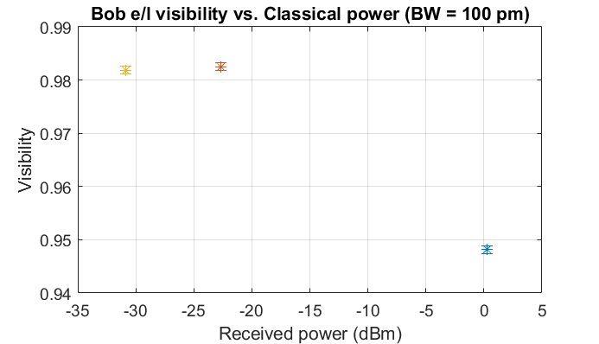
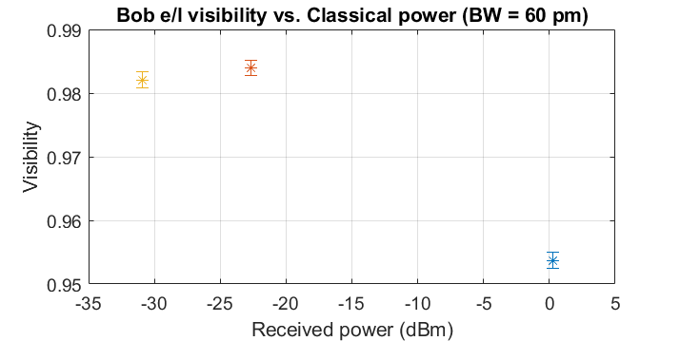
Entanglement Visibility vs. 1310-nm power
Switched to double pulse, measured Z-basis visibility for two different filter bandwidths (100 pm and 60 pm)
μ ≈ 0.01 pairs/pulse
μ ≈ 0.008 pairs/pulse
V_{dark fiber}
V_{dark fiber}
Based on this, we are confident that we should be able to perform swapping with coexistence without a large hit on fidelity if we use an optimized system

Slide 10
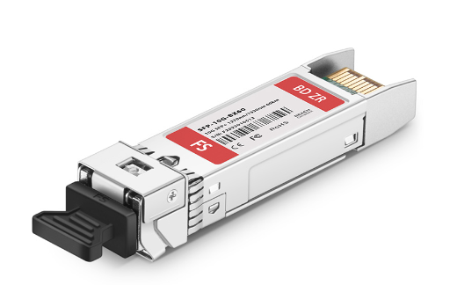
Next steps: New classical sources
Quantum signal = 1536 nm
1310
Want to investigate various possible coexistence sources
Beginning with 1310-nm laser that was used in previous time sync experiments
Bought 1270-nm SFPs capable of 10 Gbps classical data
Should have lower Raman noise compared to 1310 nm
Will eventually implement 10 Gbps classical channels alongside swapping signals
1270
TX Power
1~6dBm
Receiver Sensitivity
<-20dBm

Slide 11
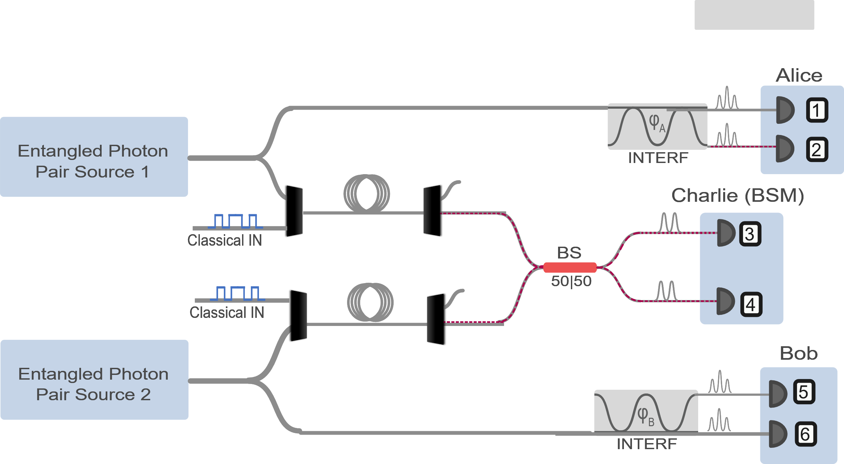
Next steps: move towards swapping over 20 km
- Go back to see if we can optimize HOM interference visibility
Try swapping in e/l basis with coexistence over 10 km+10 km, should be easier to manage
Investigate how including the 10-km may impact arrival time at the BSM node
Explore options in how to increase rates via getting lower loss FBGs?
Note: time-bin entanglement distribution coexistence has not been studied yet
10 km
10 km
>10 times lower heralding eff. at 32 pm BW
→10,000 lower 4-fold rates

