Slide 1
Mu2e report
Tom Diehl (FNAL), Greg Rakness (FNAL)
Friday 9am AD meeting
09-Feb-2024
https://indico.fnal.gov/event/63298/

Slide 2
Recall: 2024 is a busy year at the Mu2e building
Now: upstream Transport Solenoid is in the building
  Survey has confirmed location → studies underway to understand implications on target location
Week of 19-Feb: plan to move downstream Transport Solenoid from HAB
  ... depending on weather…
Later in 2024: Calorimeter to arrive, followed by Tracker
  Equipment Chilled Water procurement + fabrication ongoing
  Tracker chiller being installed at building
  Installation of Calo and Trk cables ongoing →→→→

Slide 3
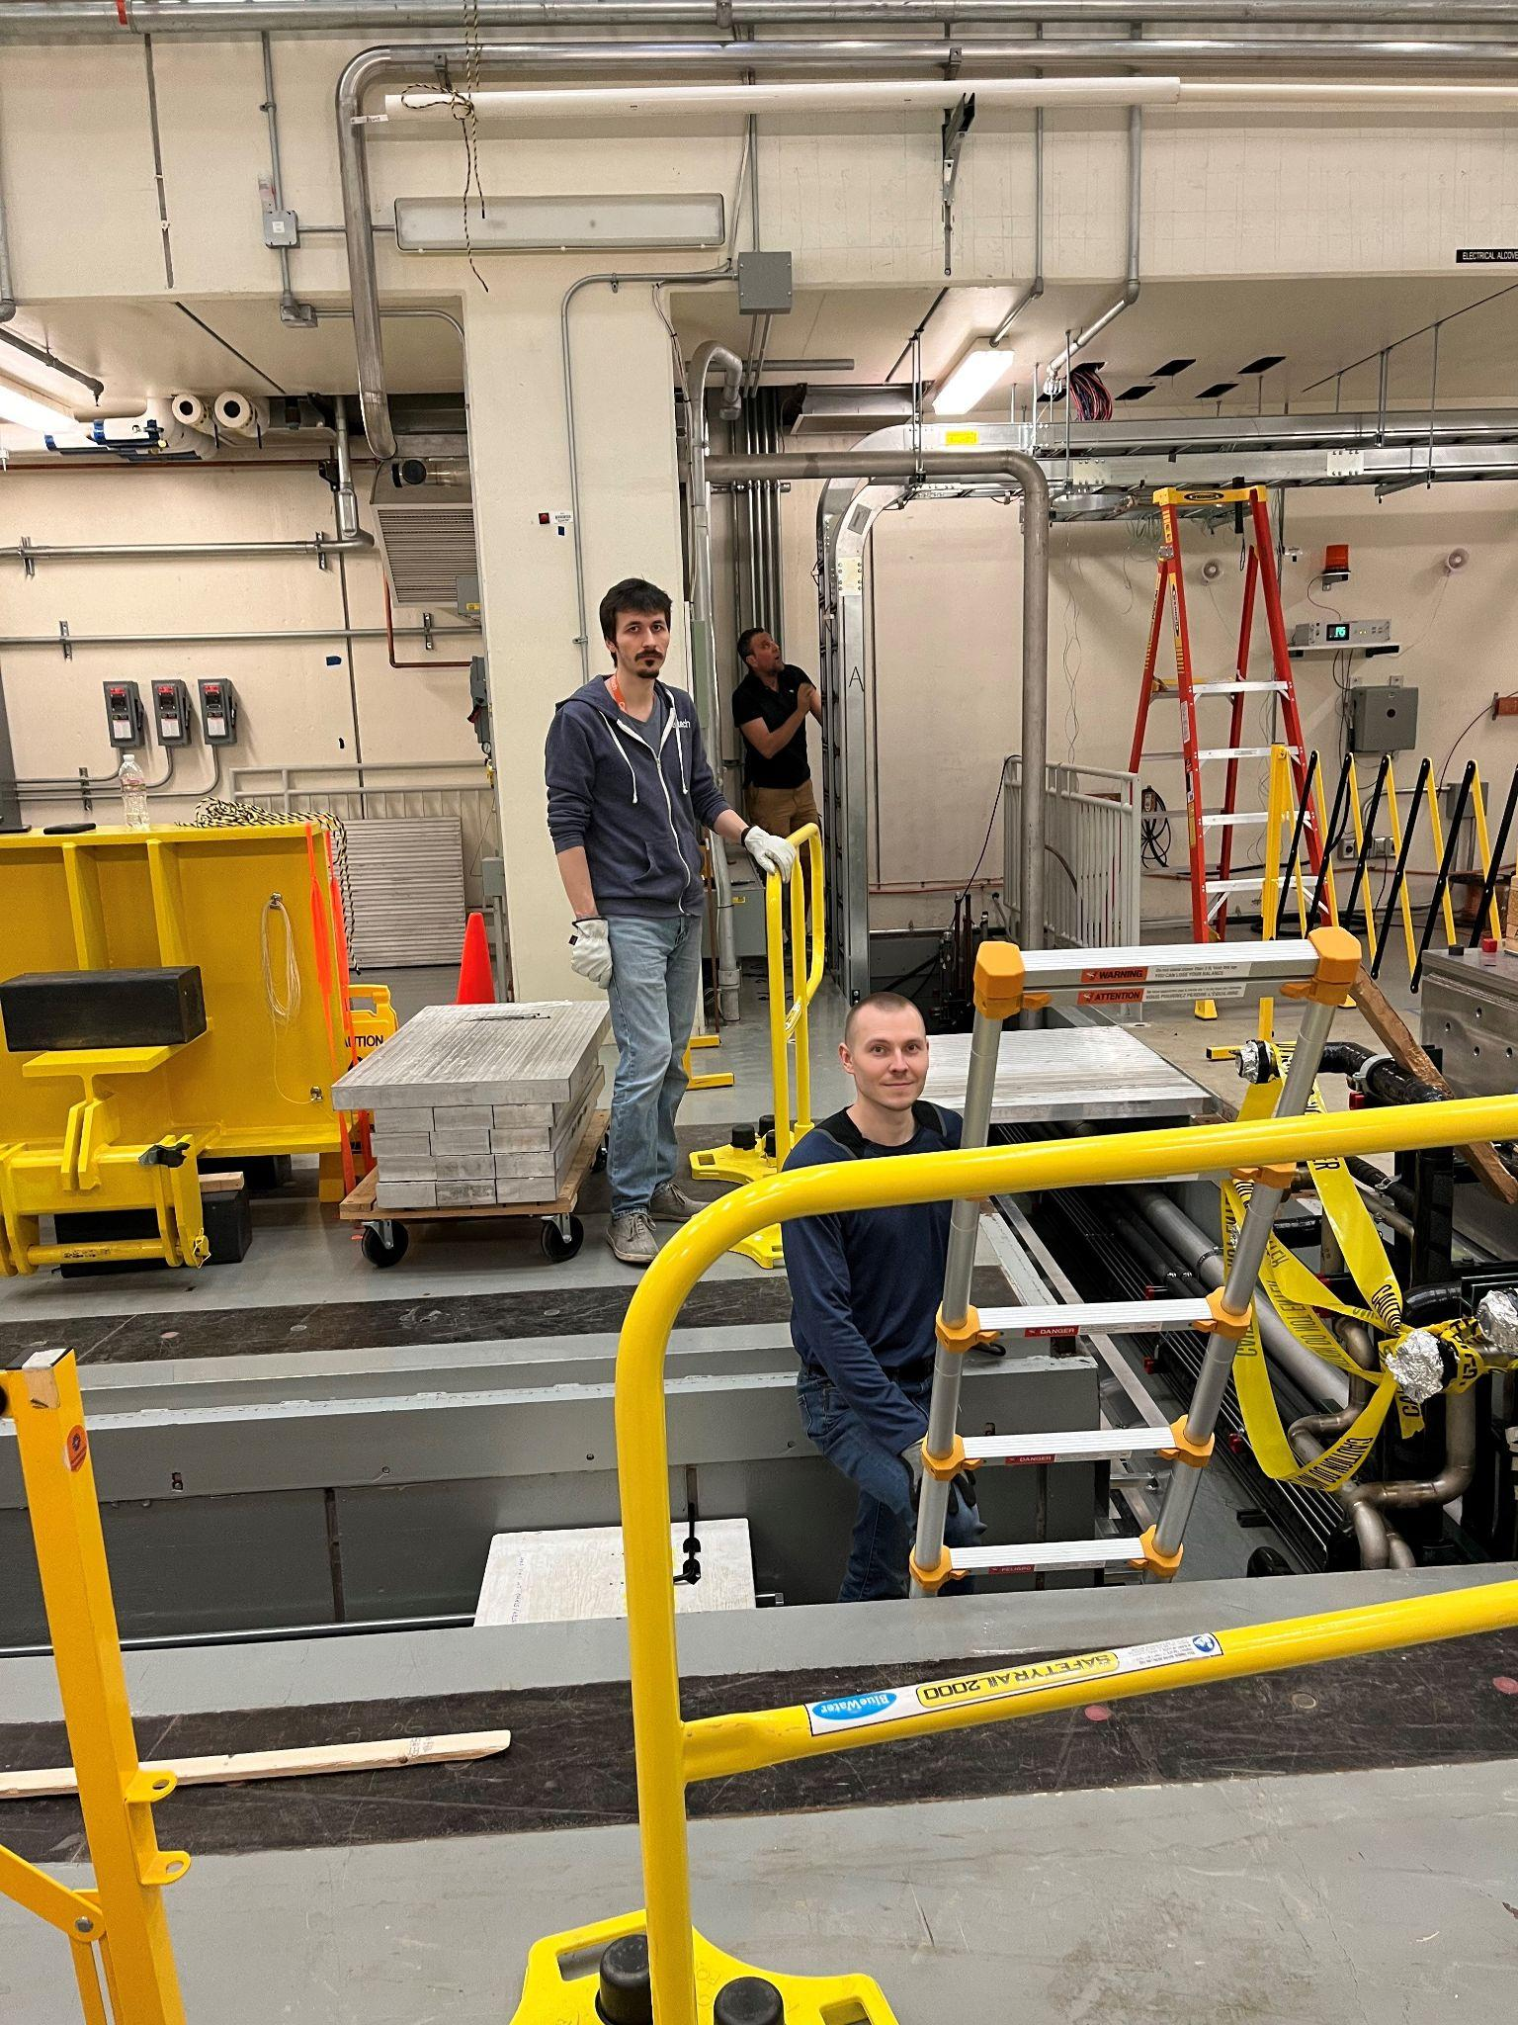
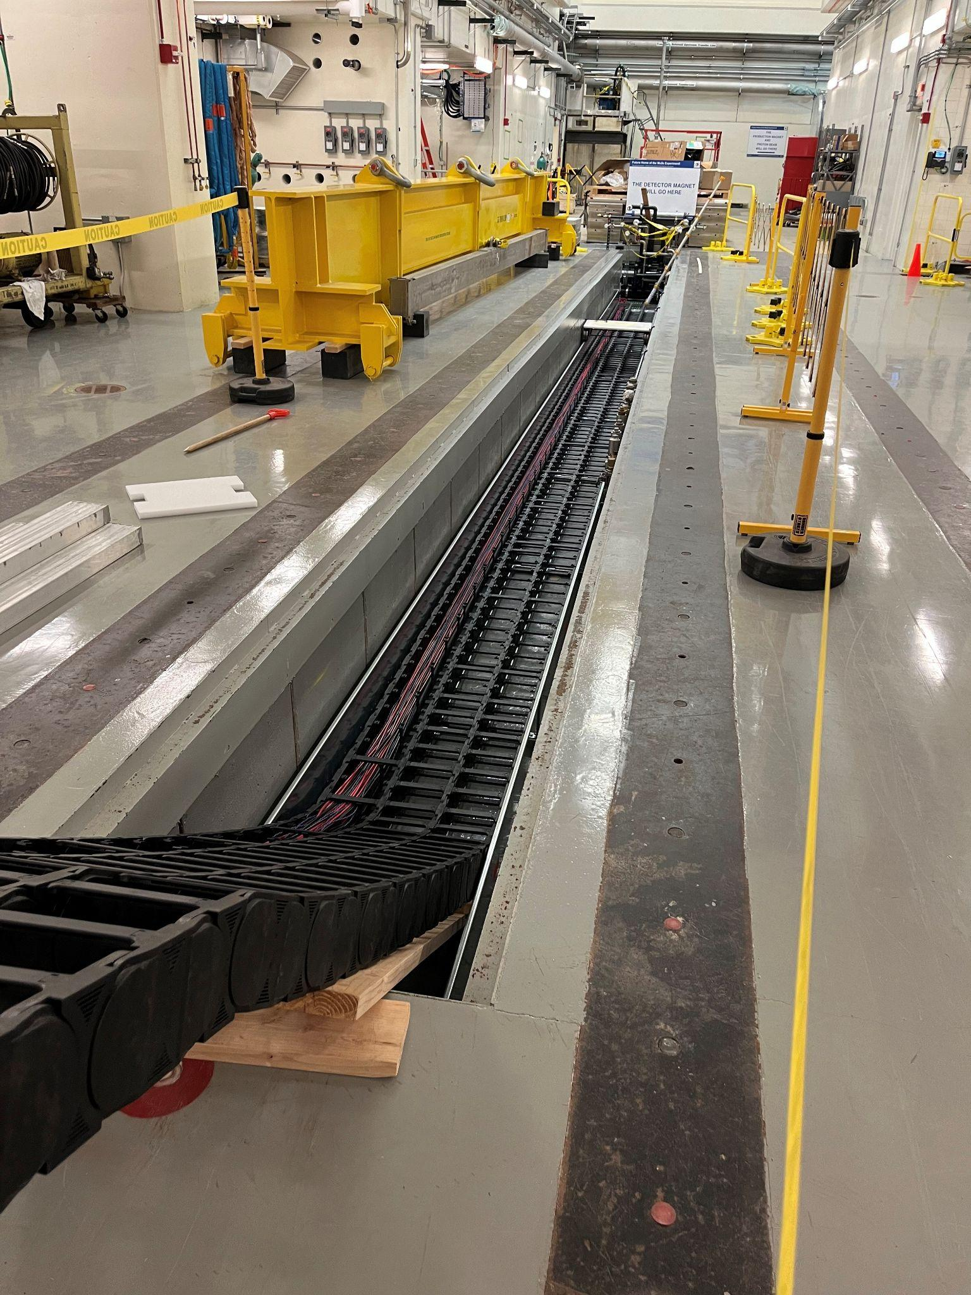
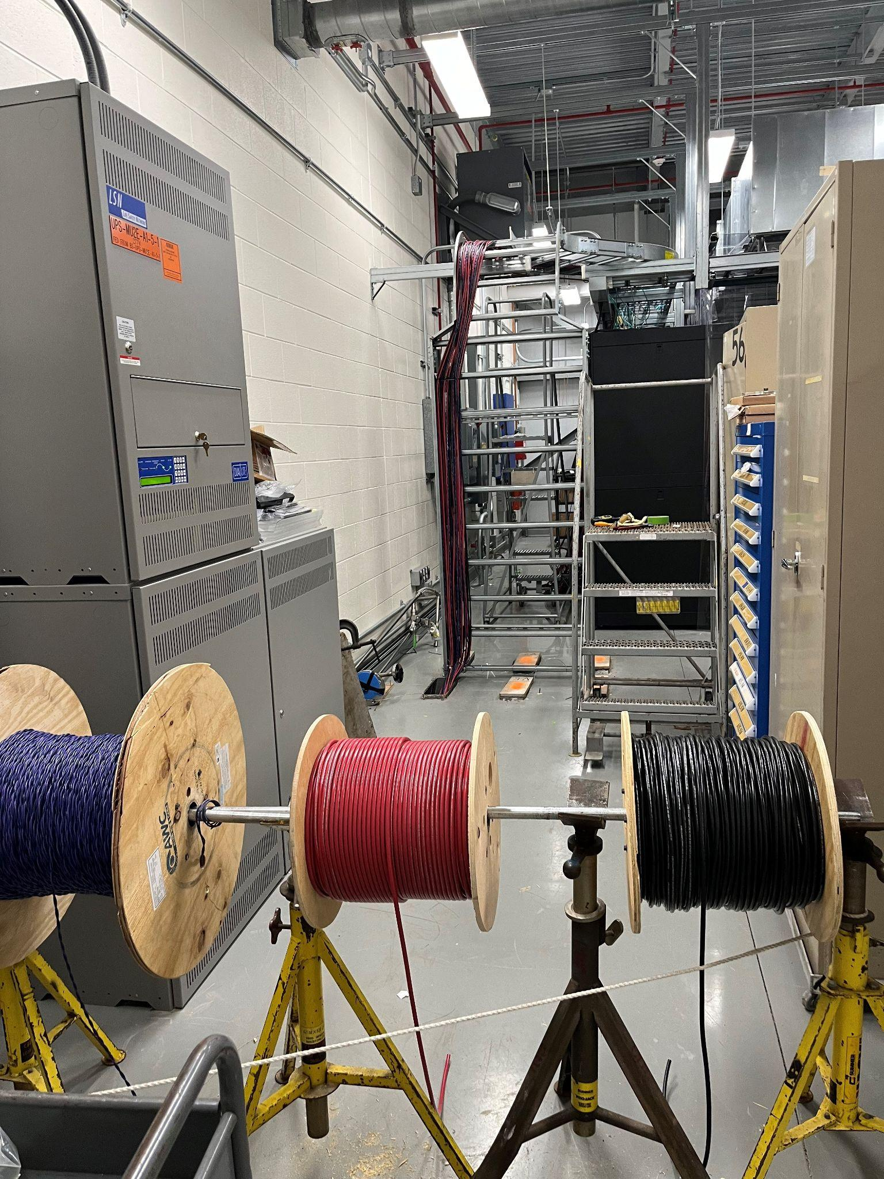
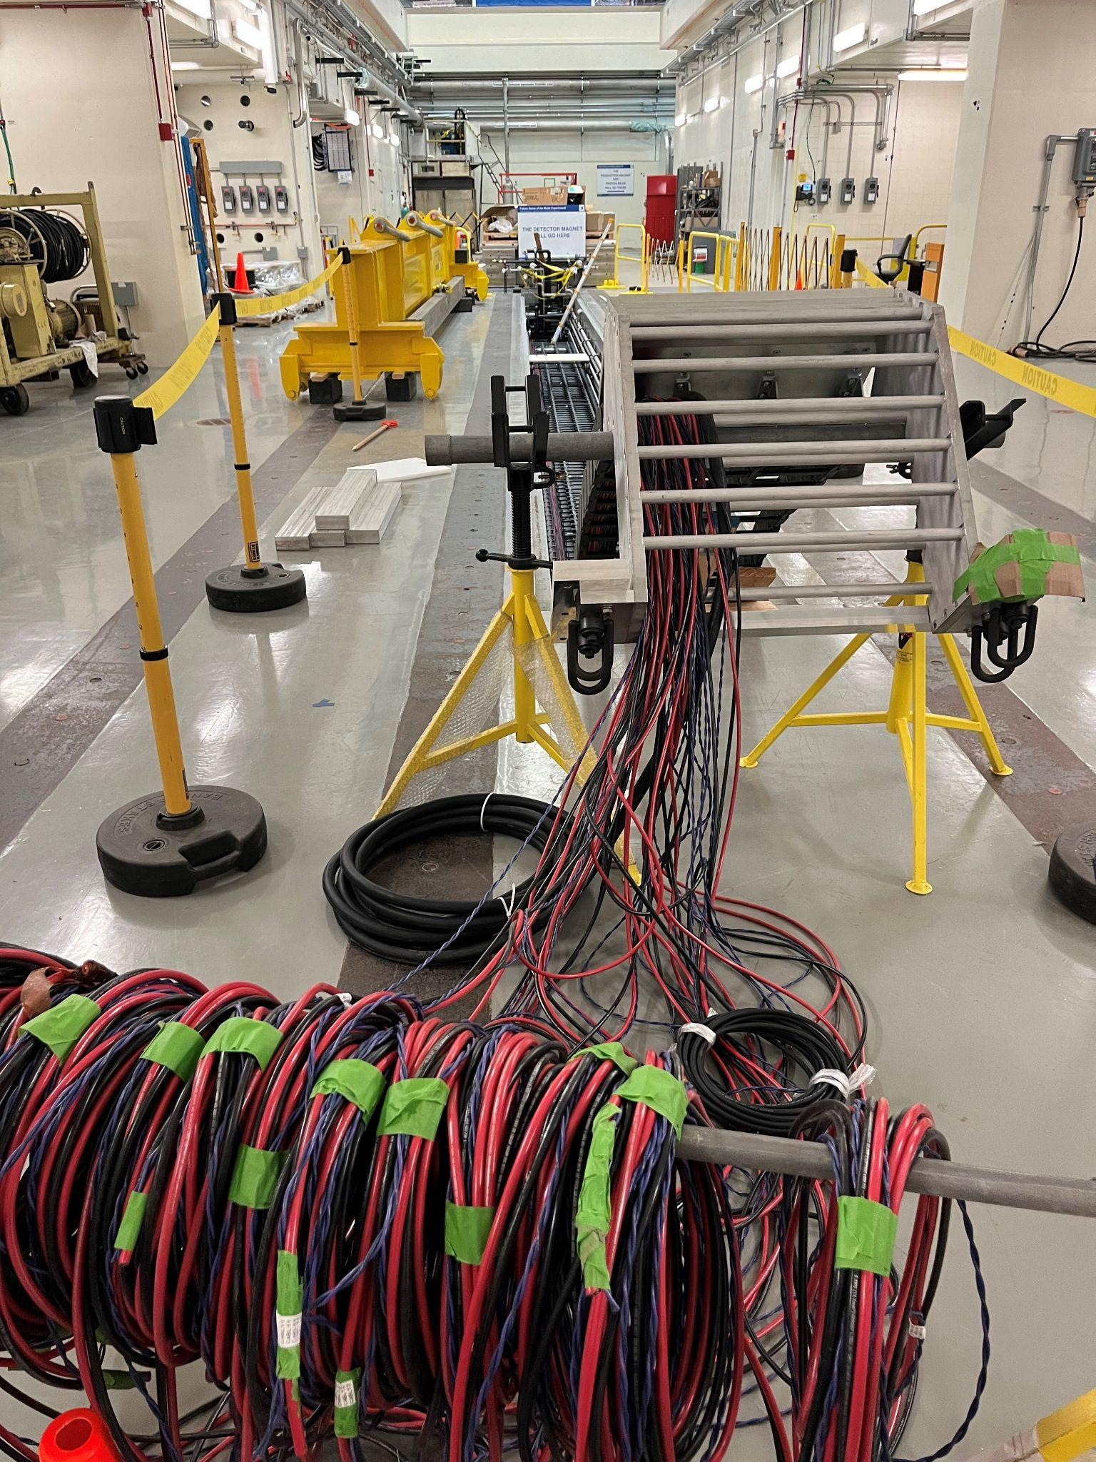
Cable Pulling Progress @ Mu2e
Teams of stalwarts have been installing Calorimeter cables from the DAQ room to the east end of the detector trench.
Next week we install Optical Fibers, then Tracker Cables

Slide 4
In addition…
Network issues observed 31-Jan evening
  VOIP phones weren’t working
A bird had found itself a home at Mu2e during the January cold spell… it has now been chased out of the building…
  A bird trap has been purchased to mitigate the impact of future infiltrations of feathered friends

