Slide 1
Project Activities for MSD
Mayling Wong-Squires
AD Operations Friday 9am Meeting
9 February 2024

Slide 2
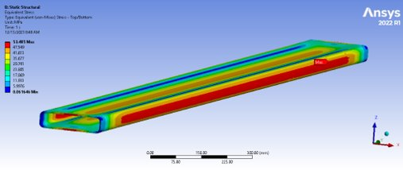
PIP-II Vacuum Systems Updates Raul Campos (L3/CAM), Lucy Nobrega* (Deputy L3), Alex Chen (Lead Vacuum Engineer), Rich Andrews (chamber design), Eric Pirtle (Design), Dirk Hurd (Design)
Working on
Procurement of Warm Front End vacuum equipment
Final design for Beam Transfer Line and Beam Absorber line
Detail BTL/BAL Vacuum CAD model and magnets interspaces configurations with input from stakeholders: MagPS, BI, BTL/BAL Installation
Vacuum chamber design for dipole magnets (quantity 40) in coordination with MagPS
Final design of interfaces with Beam Instrumentation devices, Booster vacuum, Beam Absorber Line
Validation of equipment selection with vacuum pressure and structural simulations
Addressing review recommendations
Coming up
Director’s Review – February 2024
Integrated Vacuum Systems FDR – March 2024
Department resources needed
Engineering (review vacuum analysis document)
Fabrication Procurement (BTL dipole & septum chambers)
Design/Drafting (BTL design & integration)
First dipole chamber structural verification
Typical BTL vacuum chamber assembly

Slide 3
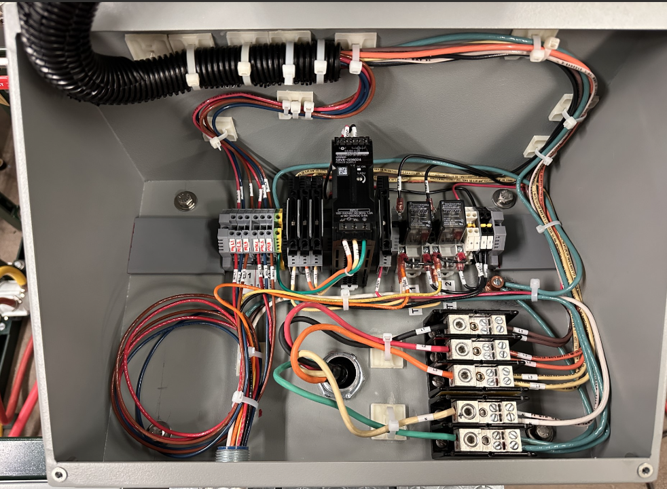
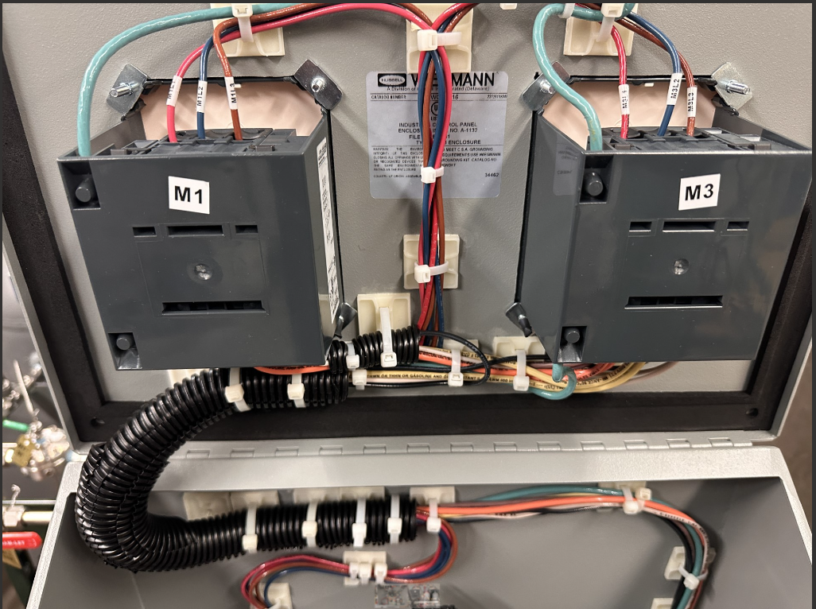
LBNF RAW Updates Abhishek (Des) Deshpande, Jennifer Chikelu
A technical design review for the Horn Test Cooling skid was completed yesterday. There were no show-stoppers.
Creating a purchase requisition for the Horn Test Cooling skid.
Argon/H2 prototype electrical work at C0 is complete; huge thanks to Chris Jensen and his team! Currently finishing up the ORC for this skid.
Reviewing fabrication drawing for the Horn B RAW system.
Working on the RAW systems section of the Technical Design Report (TDR).
C0 gas prototype work

Slide 4
LBNF LCW System Update Dave Hixson, Scott Oplt, Will Derylo
Preparing for CD-2 review
Going over LCW and bus Basis of Estimates (BOEs)
Going over LCW Project Design Report
Design engineering and drafting continue in all areas
Primary Water System and Bus: Flow Model​ and CAD model (mostly complete)
LBNF-05 Power Supply Room​, Pump Room, and the Primary Beam Line (PBE): CAD models in progress, with focus on components
LBNF-05 and PBE LCW and Bus: Flow Schematics in progress
Magnet LCW and bus connections: CAD model in progress
Planning of MI/LBNF Extraction Design rework starting with the planned hours complete.
Coming Up
Routing of LCW, fluroinert, and Bus from MI-10/-14 to PBE to start
Check drawings for the Target and Absorber Halls Intermediate Water Systems
Notes:
For the LBNF LCW systems, design engineering and drafting continue in all areas while at the same time engineering is preparing for the upcoming CD-2 review.

Slide 5
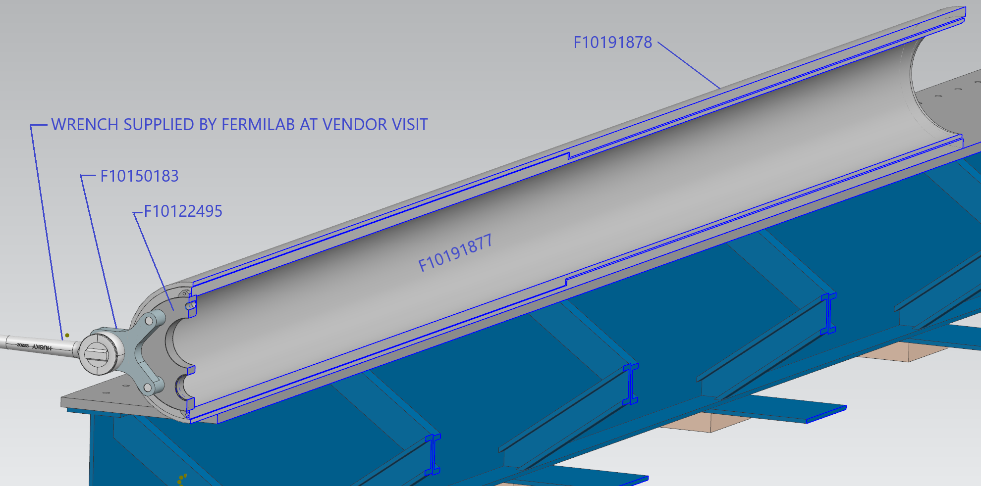
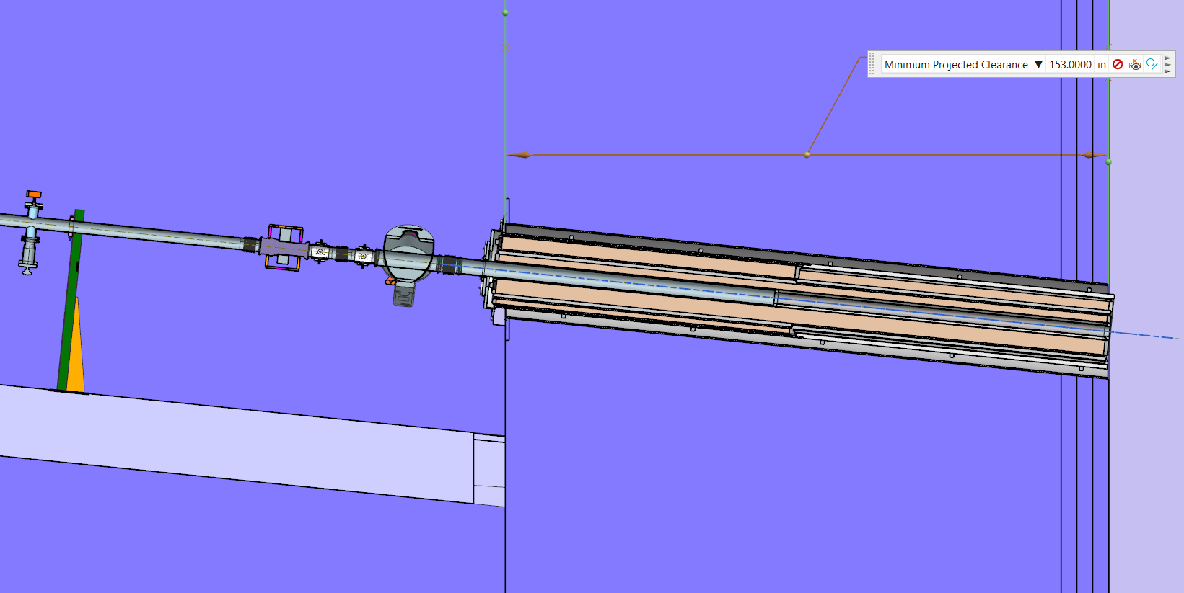
LBNF Primary Window Cartridge & Window Update Chris Ader (Lead Mechanical Engineer), Clark Reid (Design), Zhijing Tang (FEA Analysis), Greg Bulat (Procurement)
Working on
Addressed review recommendations on engineering note for cartridge
Procurement package of the rotating cartridge has been sent out for bid
Engineering note for the vacuum window
Installation plan of the cartridge assembly
Coming up
Testing of the rotation of the cartridge would occur at A-Zero with the help of the Beamlines techs later this year
Department resources needed
Engineering (vacuum window engineering note and installation planning)
Fabrication Procurement (rotating cartridge)
Design (installation and any needed vacuum window modifications)
Cutaway view of window cartridge being tested at vendor
Cartridge assembly inserted in wall

Slide 6
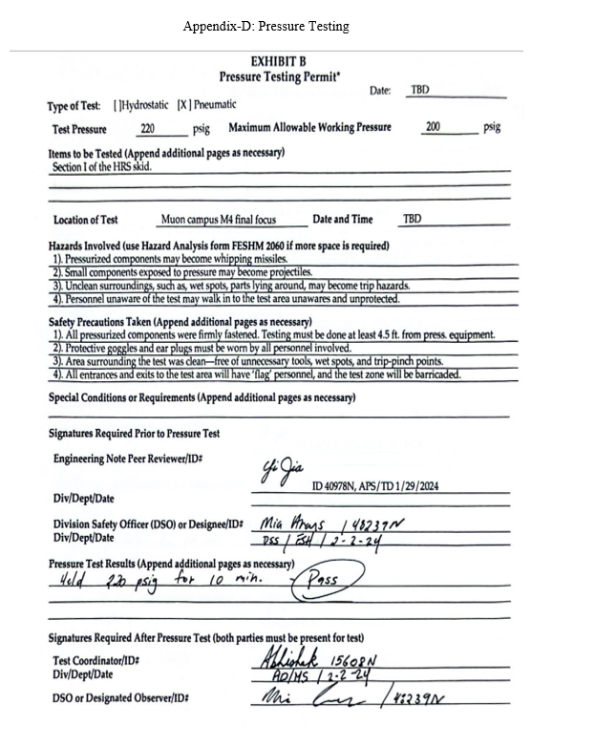
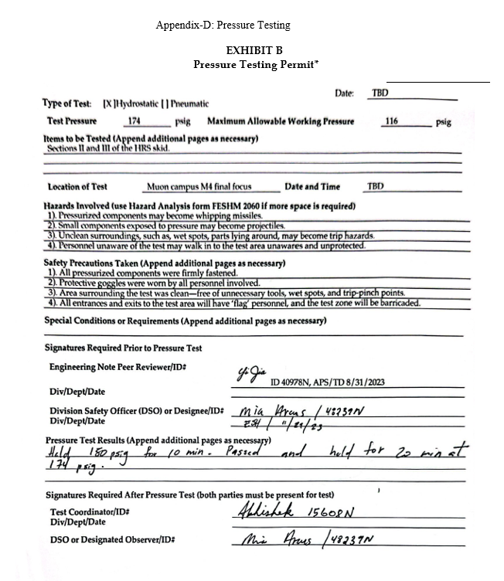
Mu2E LCW Updates Abhishek (Des) Deshpande, Frank Rios, Amos Horton, John Cody
Completed pressure test permits
Completed pressure testing of the HRS cooling skid.
LCW should be flowing through this soon.

