Slide 1
0900 AD Scheduling Meeting
Marty Murphy
07 February 2024

Slide 2
This Week
Monday:
Work planning for KPS3A-2 replacement continued; As-found Alignment was done in the afternoon.
Tuesday:
Kicker replacement work continued with alignment referencing the replacement magnet and other tunnel work.
The MI magnet LCW system sprung a leak inside the MI-10 pump room. 500-600 gallons of LCW were dumped. More on this later.
Wed.-Friday:
MI LCW system returned to service Wednesday minus MI-10 house; this held off BNB Horn RAW skid.
Thursday MI10 MCC inspected and deemed ready to energize by ISD electrician – they checked resistance to ground and continuity of wires to pump starters. Pumps #2 and #3 were restarted late morning.
Kicker rough vacuum leak check successful Thursday afternoon; final leak check Friday AM.

Slide 3
Current Status
MI in supervised access for KPS3A-2 magnet replacement.
MIRF work is on-going, specifically MIRF04 modulator work.
MIRF 12 & 13 are conditioning.
Plan for Friday & Next Week
Complete MI injection kicker magnet replacement.
Submit final SAD, ASE & MCI documents for Directorate and DOE approval.
Repair/testing of leaking magnets continues in F-Sector.
Work on any remaining RF issues while pulsing cavities.

Slide 4
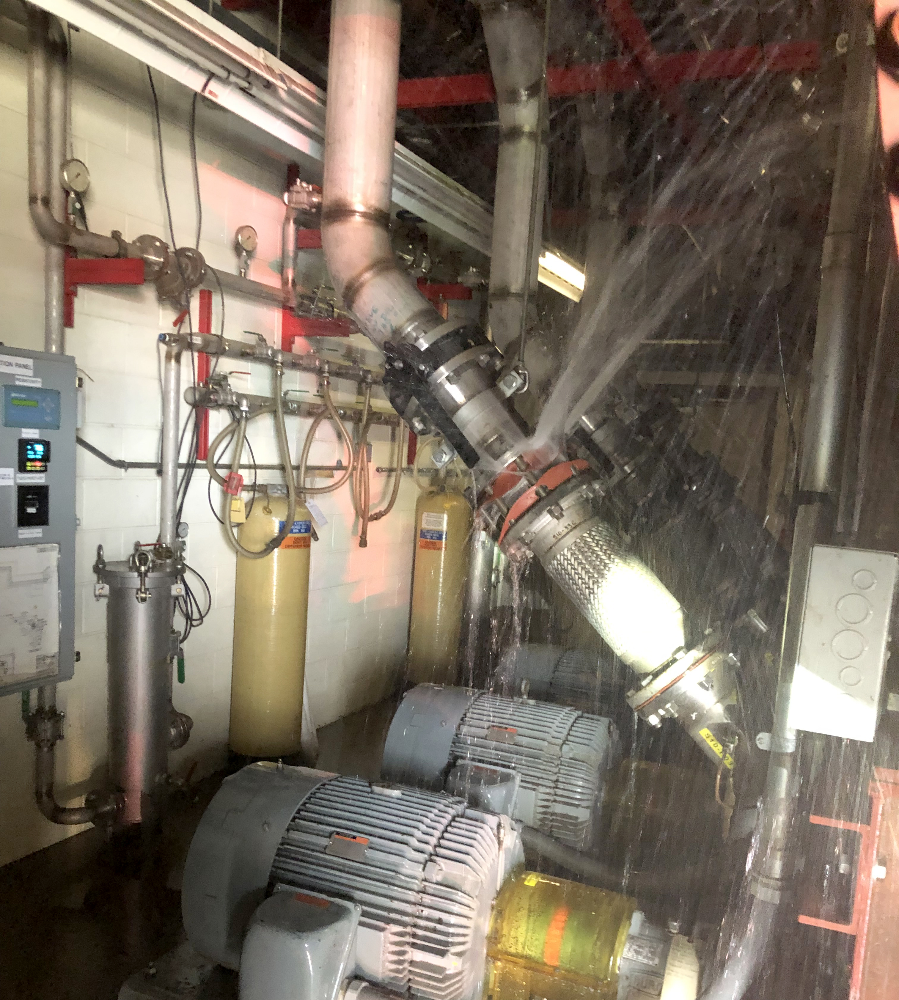
MI-10 LCW Leak
The MI uses 18 LCW pumps to move low conductivity cooling water around the ring to magnets and power supplies.
On Tuesday gaskets failed around the check-valve on pump #1 at the MI-10 service building tripping off the Ring LCW system.
MCR Ops caught the alarm immediately and called MI coordinator.
Shortly after pump trip there was a fire alarm at MI-10.
MCR Ops responded with FFD; Fire alarm was not real.
Inside of FIRUS control box got wet from the spraying water and that triggered spurious alarms.
We are investigating the root-cause.
Extent of Condition: A similar set of gaskets was installed on MI30#3 LCW pump. It has been removed from service and isolated from water flow.
Thanks to FFD, Ops, ISD duty personnel, and MSD for their prompt, safe and effective responses.
MI-10 LCW leak. Picture courtesy of Fermilab Fire Department

