Slide 1
Muon Campus Operation Report
Jim Morgan
Friday 09:00 Operations Meeting
February 9, 2024

Slide 2
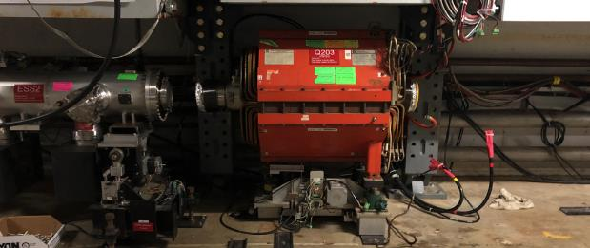
Muon Campus status
Working on recommendations from SAD/ASE Review
ARR scheduled for Next month
ESS1 Electrostatic Septum at A0 Clean Room
Metal objects found in septum were 86% Aluminum and 13% silver
Threaded holes in aluminum frame show clear signs of galling
Preparations for Electrostatic Septa installation
Mechanical techs installed new compact vacuum pipe in Q203
Waiting to remove blocks from D40 Hatch for incoming and outgoing magnets
8Q24 with rad hardened water lines at AP-50, ready to be lowered into tunnel
Forklift and rad hard 8Q24 will be lowered into tunnel for installation
Existing 8Q24 and four NSA sextupoles that had water leaks go to TD
Investigating source of chronic D50 ceiling tunnel ceiling leak
ICW valved out to AP-50 as a test, tunnel leak remained the same
Study – M1-M3 Optics
Study – Alternative M5 optics
KPS5A PFL Repair
MC-1 Controlled Access
G-2 Trolley Run
Intentional Accelerator
Standby Period
<------------Week Days -------------------→

Slide 3
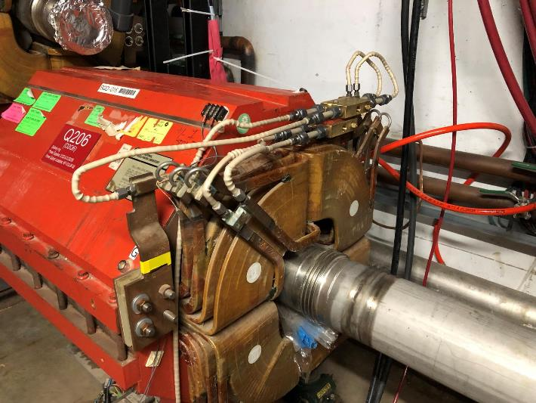
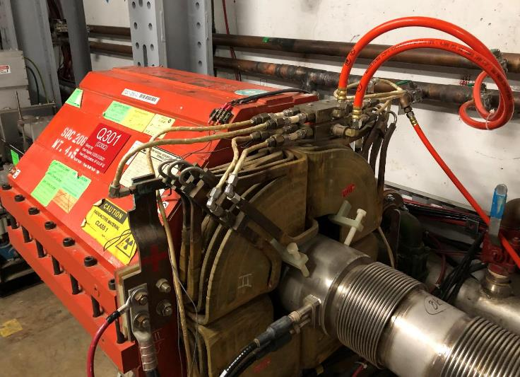
Q206 rad hard water line modifications
Notch where M4 Line pipe goes
Q206 modified rad-hard manifold
Q301 standard rad-hard manifold

Slide 4
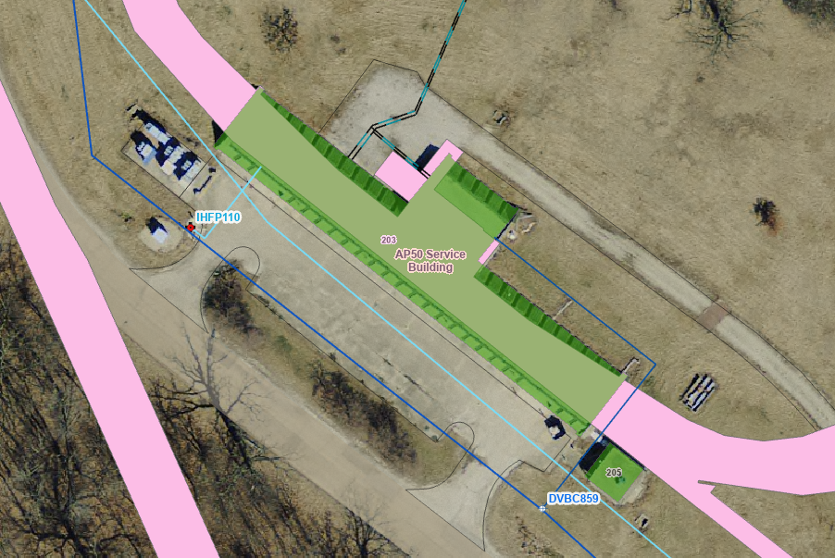
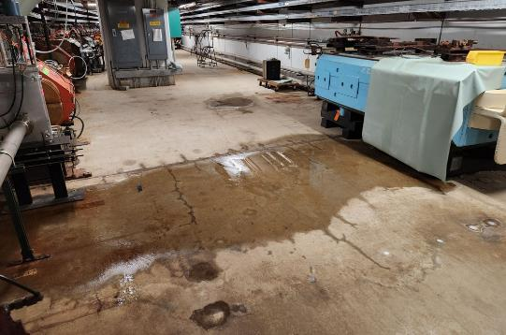
D50 tunnel ceiling leak
Chilled water lines
Location of ceiling leak
Domestic water lines
NuMI
Industrial Cold Water Lines
Ring Enclosure

Slide 5
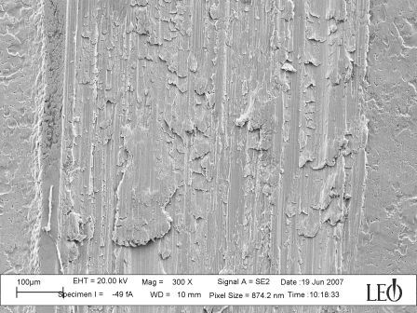
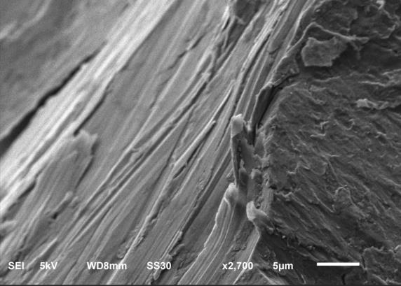
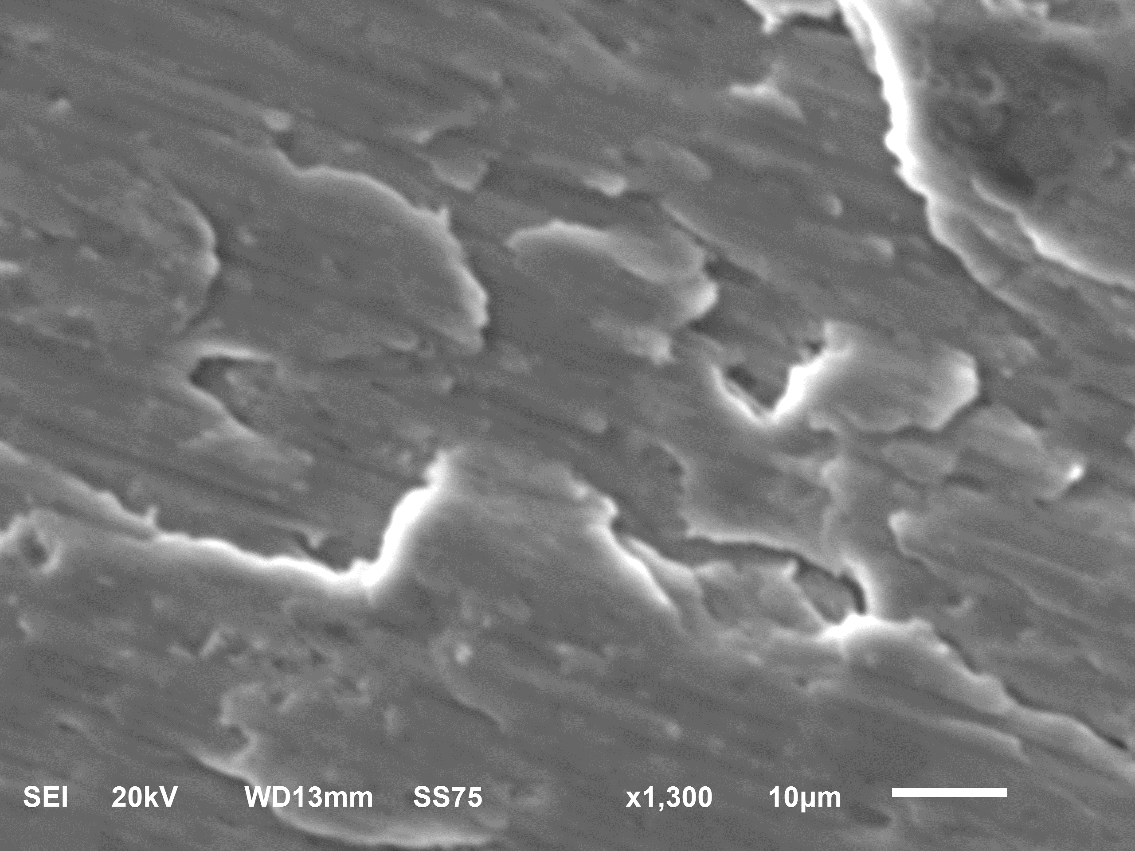
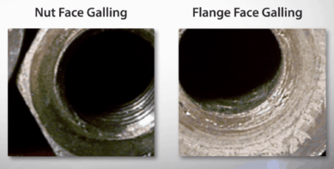
Examples of metal galling compared with ESS1 pieces
From Wikipedia entry on galling
Metal pieces found in ESS1
Caused by adhesion of contacting surfaces

Slide 6
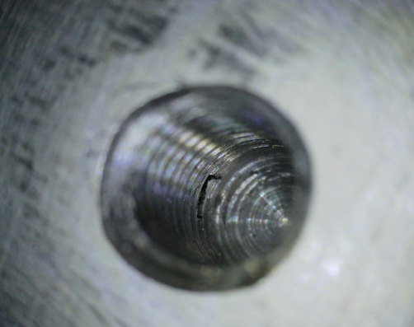
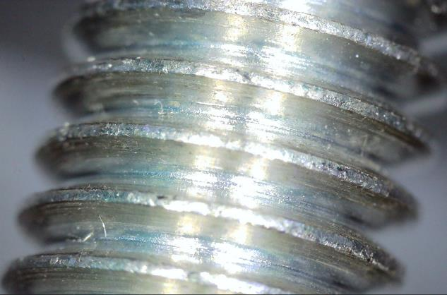
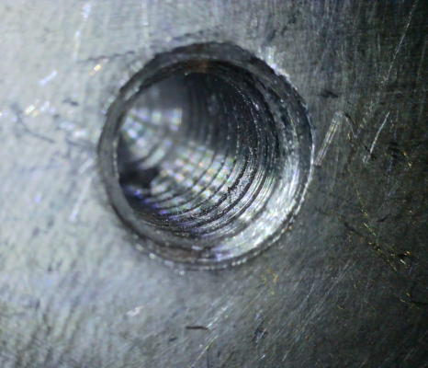
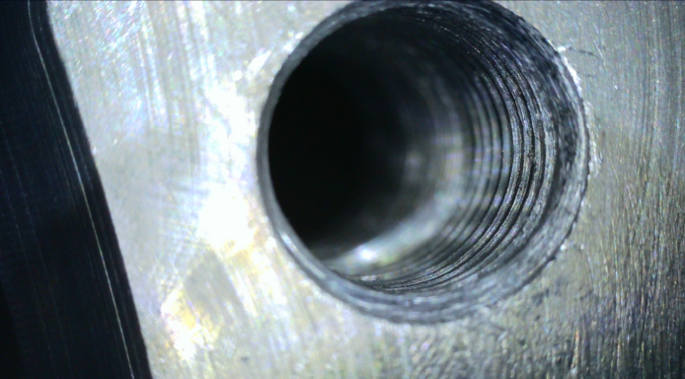
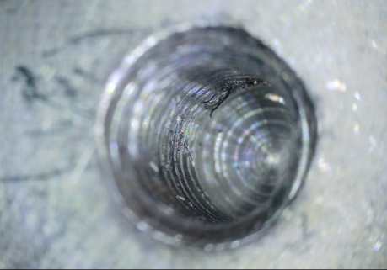
Galled threads in aluminum frame of ESS1 and fastener

Slide 7
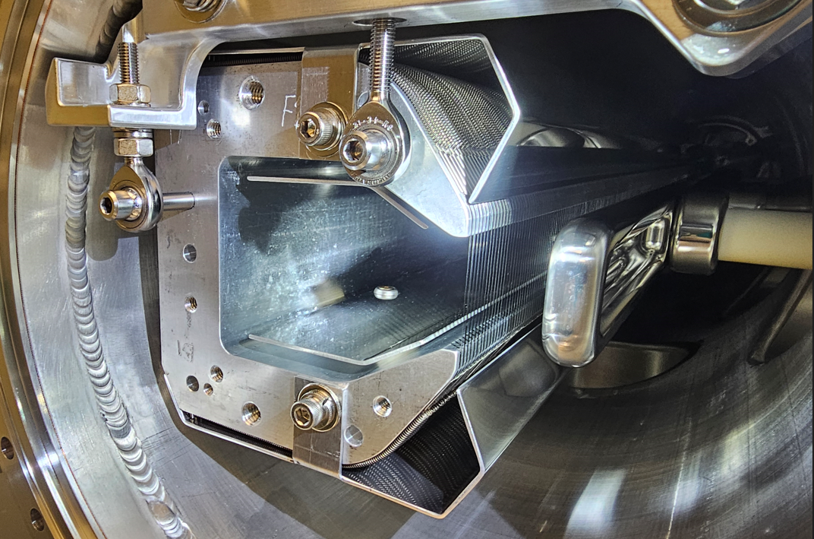
ESS1 end view, location of galled threads in frame

Slide 8
Upcoming work
ESS1 component replacement and assembly will continue at the A0 Clean Room
Could optimistically be ready for tunnel installation in mid-March (end of February in last week’s report)
Installation, leak-check and vacuum pump-down would follow
If delayed, vacuum spool will be installed in Delivery Ring
ARR Preparations
Q205 magnet swap and special vacuum pipe replacement
Waiting on parts to be machined for Q205 vacuum pipe
Opening of D40 Hatch has been delayed until parts are in hand
Q203 location ready to for ESS1 installation
Still some missing stand parts that should arrive soon
D50 tunnel water leak continues unabated
Valving out CW and ICW to AP-50 didn’t reduce leak or sump activity
No longer need ICW valved out for test, considering next move

