Slide 1
IOTA Proton Injector Update
Dean (Chip) Edstrom
02/09/2024

Slide 2
Points of Contact
There are lots of activities with more than one (valid & incompatible) opinions on how things should be done…
Overall Cable Pull – Chip Edstrom
Questions on cable list/labels/types/destinations/problems
Relying upon Jamie primarily as Electrician/contract liaison
Overall Beamline Component Installation – Sasha Romanov
Questions on beamline stand/components
Overall Support Department Liaison – Jinhao Ruan
Questions on support for Mechanical/Electrical/RF
Overall Commissioning – Chip Edstrom
RGD Registration, ORC, etc…
Source Commissioning / Characterization

Slide 3
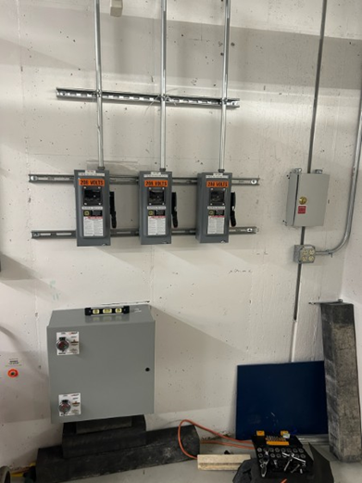
Electrical Status
Cable Pull Nearly Complete…
T&M update: WebReq 55913
RG58 / Safety / Fiber pulls remain
120 / 208 VAC beamline power
Routing cables along beamline
¼” Heliax & CAT5/6 (✔)
8-Pair (✔)
10-Cond & Motors
Safety Panel Installation (✔)
Lydon is back starting yesterday…
Please limit interactions
HLRF 600A Disconnect: Incorrect Kirk Key

Slide 4
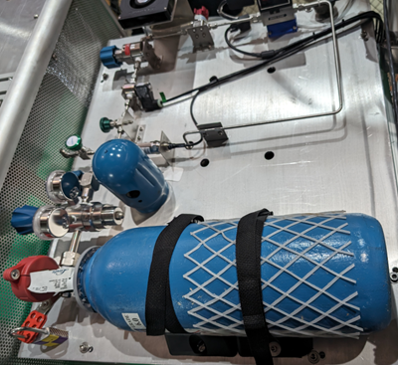
Commissioning Status
ORC Review for Full Source Operation
Source Ready™ for Operation, but…
HV Power Supply failure
Filament supply scaling questions
RGD Registration
Still waiting on FSO approval
Hydrogen iTrack issue resolved
ES&H Monitoring Plan
RCT presence for initial turn-on / for any increase in max voltage
Passive monitoring (badges in-place)

Slide 5
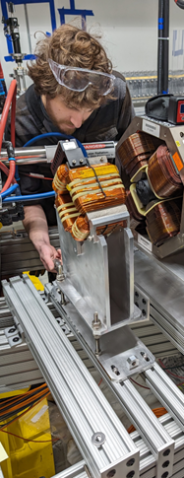
Next Steps
Beamline Component Installation (Dave Franck / Sasha R)
RFQ Placement (✔) / Anchoring (✔) / Alignment
LEBT Stand Placement (✔) / Anchoring (✔)
Quadrupole Installation (✔) / Rough Alignment (✔)
Multifunction Magnets Installation (✔) / Rough Alignment
MEBT Allison Scanner & Other beamline components
Cable Routing / Termination
500MCM into a box to be mounted to the cable tray (Daniel)
8-Pair Magnet (✔) / Turbo Breakouts (✔) (Chip)
Heliax (✔) (Brian Fellenz / Bogie) in progress
BPMs (will need to be phase-matched)
1 ⁵/₈” Buncher RF Heliax (✔)
6” RFQ Waveguide Installation (Rick & FAST Ops) in progress
Dress / Fill Penetration

Slide 6
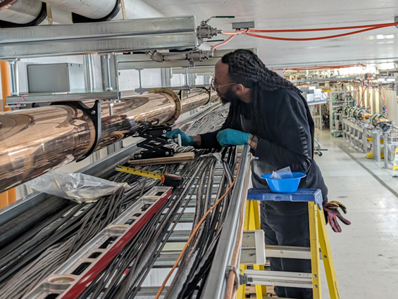
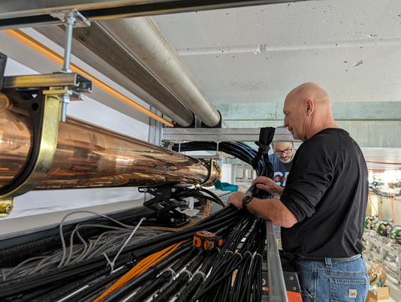
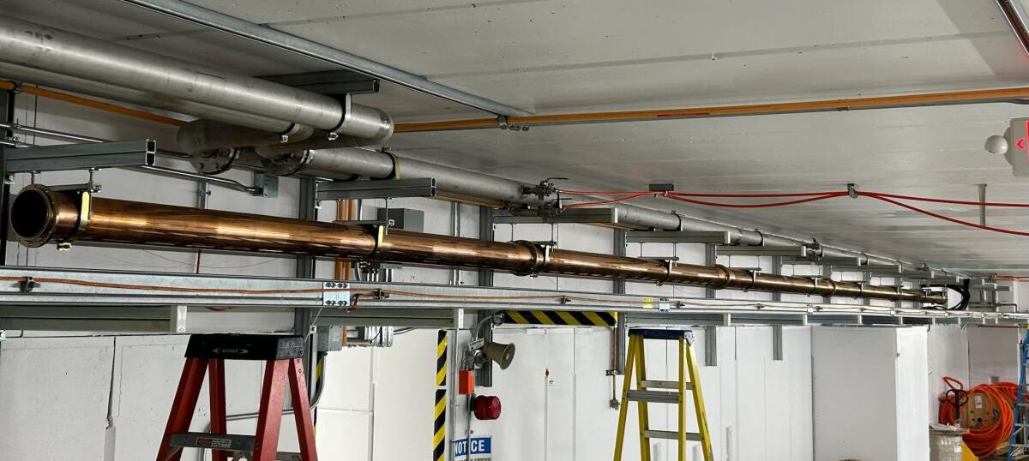
6” RFQ Waveguide
Progress!

Slide 7
Support Departments
EE Support
CDC Contactor Progress…
RF Support
Ding Sun
Mechanical Support
Steve Wesseln… Currently working on PIP2
Instrumentation
Bogie / Brian to assist with Heliax terminations, etc
Brian Felenz assisting with racktops / signal manifolds / pigtails
HLRF Fast Interlocks VME (Niral Patel / Steve Roccos)
Controls
EPICS integration (Pierrick Hanlet)

