Slide 1
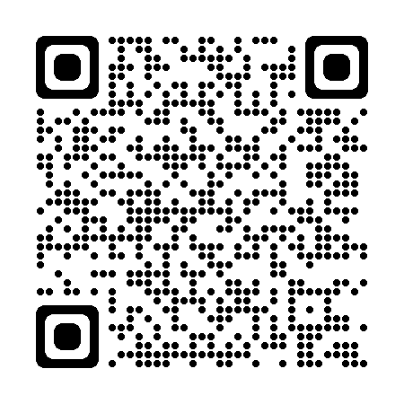
Welcome to Fermilab
U.S. Magnet Development Program Collaboration Meeting
April 30 – May 3, 2024

Slide 2
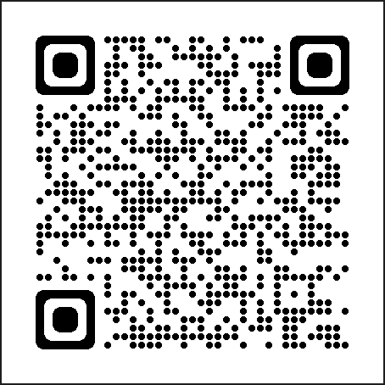
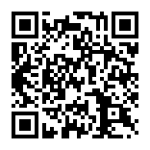
The meeting will begin at 8:40 A.M.
The meeting agenda can be found at:
https://indico.fnal.gov/event/63310/contributions/
For help please contact tgloss@fnal.gov, christym@fnal.gov or blodgett@fnal.gov

Slide 3
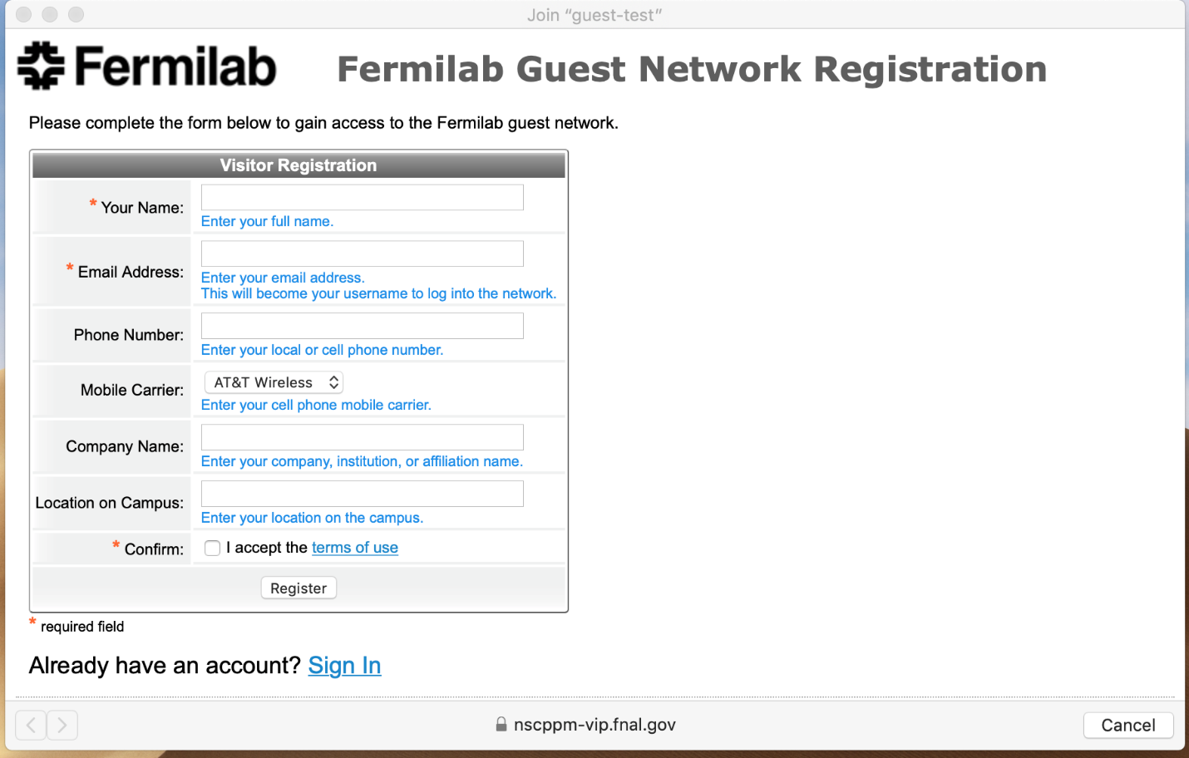
Fermilab Guest Wi-Fi Network Registration
All electronic devices connecting to the Fermilab Visitors wireless network must go through a self-registration process. Steps to self-register:
Associate your device with the “guest” network.
Complete the required fields marked by an * in the self-registration portal form.
After submitting the form, click the “log-in” button to connect to the network for 8 hours of access.
For access up to 1 week, check your e-mail with the subject “Confirmation Required” to confirm your registration. Use the credentials provided for future logins during that time.
Or you may use “eduroam” …

Slide 4
Safety Procedures
IARC & Alvin
Tollestrup Auditorium
Fire audio/visual emergency alerts:
steady horn and white strobe
Severe weather audio/visual emergency alerts:
siren followed by voice instructions
Notes:
In case of fire, the audio/visual alerts are a steady horn and white strobe. Occupants should evacuate the building at the nearest exit door. Go to the west parking lot and meet at the Emergency Assembly area located in the middle of the parking lot where signage is posted.
In case of severe weather, the audio/visual alerts are a siren followed by voice instructions. Occupants should evacuate the conference room and follow shelter signs. The shelter areas for the 1st floor of IARC OTE are in the Men’s and Women’s Washrooms and hallways marked as Storm Shelter Areas.

Slide 5
Room Locations
Coffee Breaks
Location: IARC Lobby, 1st Floor
Times: 10:30 - 10:50 A.M.
3:25 – 3:40 P.M.
Reception & Pre-Registered Tour
Reception: Wilson Hall Crossover, 2nd Floor
Thursday, 6:00 – 7:30 P.M.
Tour: IARC Lobby, 1st Floor
Friday, 1:15 – 2:30 P.M.
Pre-Registered Lunch
Location: IARC, 2nd Floor Cafeteria
(serving, seating)
Cafeteria, 2nd Floor Patio
(extra seating outside)
Time: 12:25 – 1:10 P.M.
Pre-Registered Dinner
Self Transport
Thursday, 6:30 – 9 PM
Meet: The Turf Room
1033 Kilbery Street, N. Aurora, IL 60542
Meeting Rooms
Alvin Tollestrup Auditorium: IARC 1st Floor

Slide 6
Fermilab Access Days 2+
Visitors may enter through Kirk Road/Pine Street or Batavia Road/Rt 59 entrances.
Present your Real ID and visitor badge* at the security gate.
Proceed directly to IARC Alvin Tollestrup Auditorium.
*If the visitor badge is misplaced, it is strongly recommended that visitors arrive at the Batavia Road/Rt 59 entrance, present their Real ID and QR code, and proceed to the Aspen East Welcome and Access Center.
If needed, see an LOC Member to coordinate rideshare service Campus Access.

Slide 7
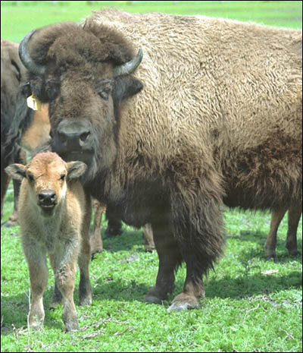
Welcome to Fermilab!

