Slide 1
MDP 2024 Collaboration Meeting
goals, charge and agenda
Soren Prestemon
US Magnet Development Program
Lawrence Berkeley National Laboratory

Slide 2
Outline
Welcome to the 8th Annual US MDP Collaboration Meeting!
Our Magnet Development Program vision and goals, & priorities of the current Roadmaps
Contributing to, and aligning with, the US High Energy Physics community
Our involvement in the international community
Leveraging synergistic activities
Goals for the collaboration meeting and charge to the TAC
Some guidance for this meeting

Slide 3
Recap of our MDP vision and goals
Maintain and strengthen US Leadership in high-field accelerator magnet technology for future colliders
Focus on the four primary goals identified in the the original MDP Plan
  Explore the performance limits of Nb₃Sn accelerator magnets, with a focus on minimizing the required operating margin and significantly reducing or eliminating training
  Develop and demonstrate an HTS accelerator magnet with a self-field of 5T or greater, compatible with operation in a hybrid HTS/LTS magnet for fields beyond 16T
  Investigate fundamental aspects of magnet design and technology that can lead to substantial performance improvements and magnet cost reduction
  Pursue Nb₃Sn and HTS conductor R&D with clear targets to increase performance and reduce the cost of accelerator magnets
Further develop and integrate the teams across the partner laboratories and Universities for maximum value and effectiveness to the program
Identify and nurture cross-cutting / synergistic activities with other programs to more rapidly advance progress towards our goals

Slide 4
Our Program was initiated as a result of the 2013 P5 report
Strategic priorities for the current plan:
  Probing stress management structures
  Hybrid HTS/LTS designs
  Understanding and impacting the disturbance-spectrum
  Advancing both LTS and HTS conductors, optimized for HEP applications
There is a schedule disconnect between our actual progress and many of the milestones in the 2020 Updated Roadmaps – we will see that throughout the CM
  Driven primarily by funding, program and lab priorities
    Our interest in maintaining a broad program also plays a role
Message from last MDP CM: Need to increase focus on hybrid magnets
- Intrinsically connects the core program priorities

Slide 5
Our structure was revised with the 2020 Updated Roadmaps
  Strategic Priorities:
  Probing stress management structures
  Hybrid HTS/LTS designs
  Understanding and impacting the disturbance-spectrum
  Advancing both LTS and HTS conductors, optimized for HEP applications

Slide 6
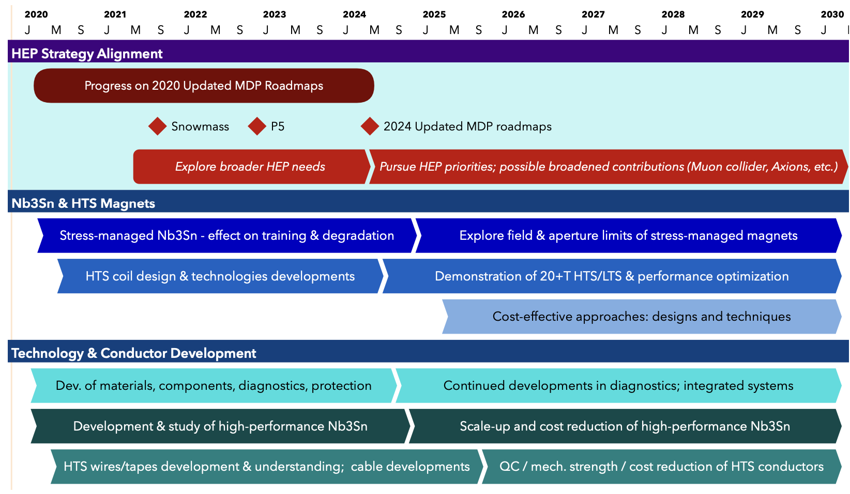
US MDP 2020 roadmaps – long range – time for an update!
Continue alignment with physics community needs
Focus on “stress-management” as well as hybrid HTS/LTS magnet technology
Continue to invest in the “science of magnets” and in improved conductors

Slide 7
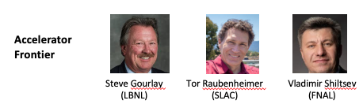
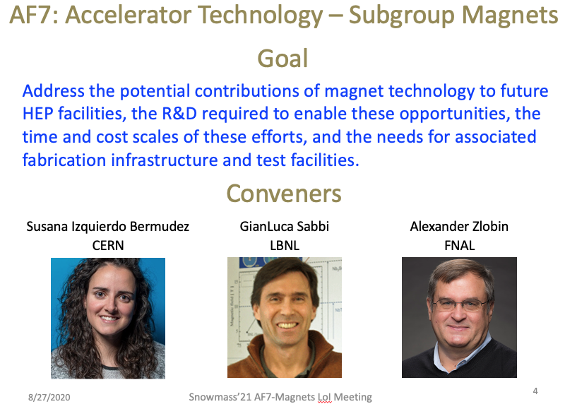
We have contributed significantly to the US HEP Community planning process – now we need to realign with HEP priorities
The US MDP resides under DOE-OHEP General Accelerator R&D
  Viewed as Long-term R&D – strength of DOE-OHEP, that has led to longstanding international leadership in the field
Contributed to the ”Snowmass” HEP community planning exercise
  Strong presence of MDP staff – excellent!
  Whitepapers submitted and discussed in Seattle
Contributed to the P5
  Via invited presentation at the SLAC Townhall
  Mark Palmer, Amalia Ballarino, and Tor Raubenheimer served on P5
  The Snowmass process, and especially the follow-on P5 report, provide critical input for an update to our roadmaps this year!

Slide 8
The good news – DOE-OHEP strengthened our program
Funding increased nearly 20% in FY23 – Thank you Ken and DOE-OHEP!!
Strong support for conductor procurement and R&D – increased from $500K to $1200K / year in 2023
Questions for discussion at this CM:
  Is the program seeing dividends from CPRD investments? See presentation from Ian, and follow on discussions
  We are pushing to get hybrid magnets built and tested
    Are we leveraging all the lessons learned over the last years?
    Are we leveraging expertise across the labs, e.g. modeling, diagnostics, testing, etc?
Keep an eye on our original questions: Ultimate Performance of Magnets
  What is the nature of accelerator magnet training? Can we reduce or eliminate it?
  How do we best define operating margin for Nb₃Sn and HTS accelerator magnets, and to what degree can and should it be minimized?
  Can we control the disturbance spectrum and engineer a magnet response to reduce operating margin and enhance reliable performance?
  What are the mechanical limits and possible stress-management approaches for Nb₃Sn, HTS, and 20 T hybrid LTS/HTS magnets, and do they have defined mechanical limits?
  Do hybrid designs benefit from the best features of LTS and HTS, or inherit the difficulties of both material technologies?

Slide 9
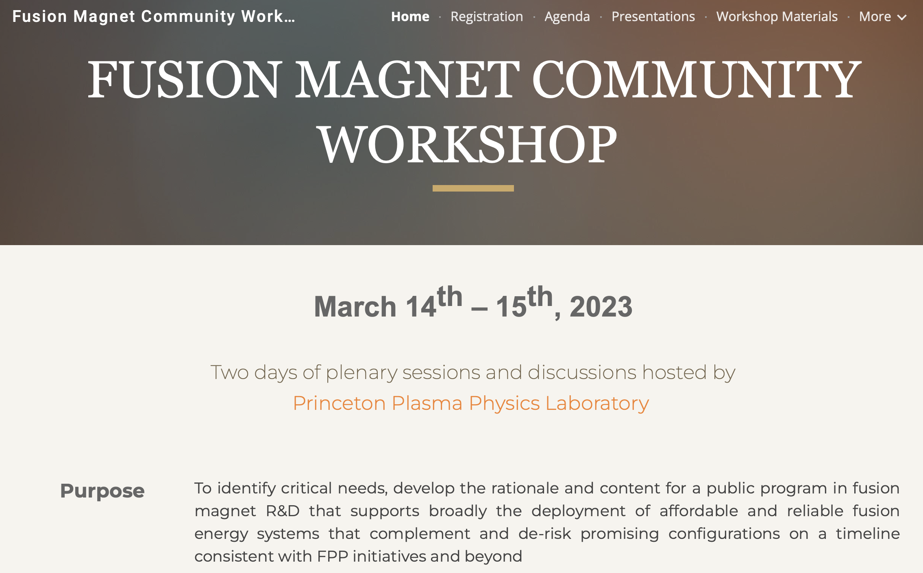
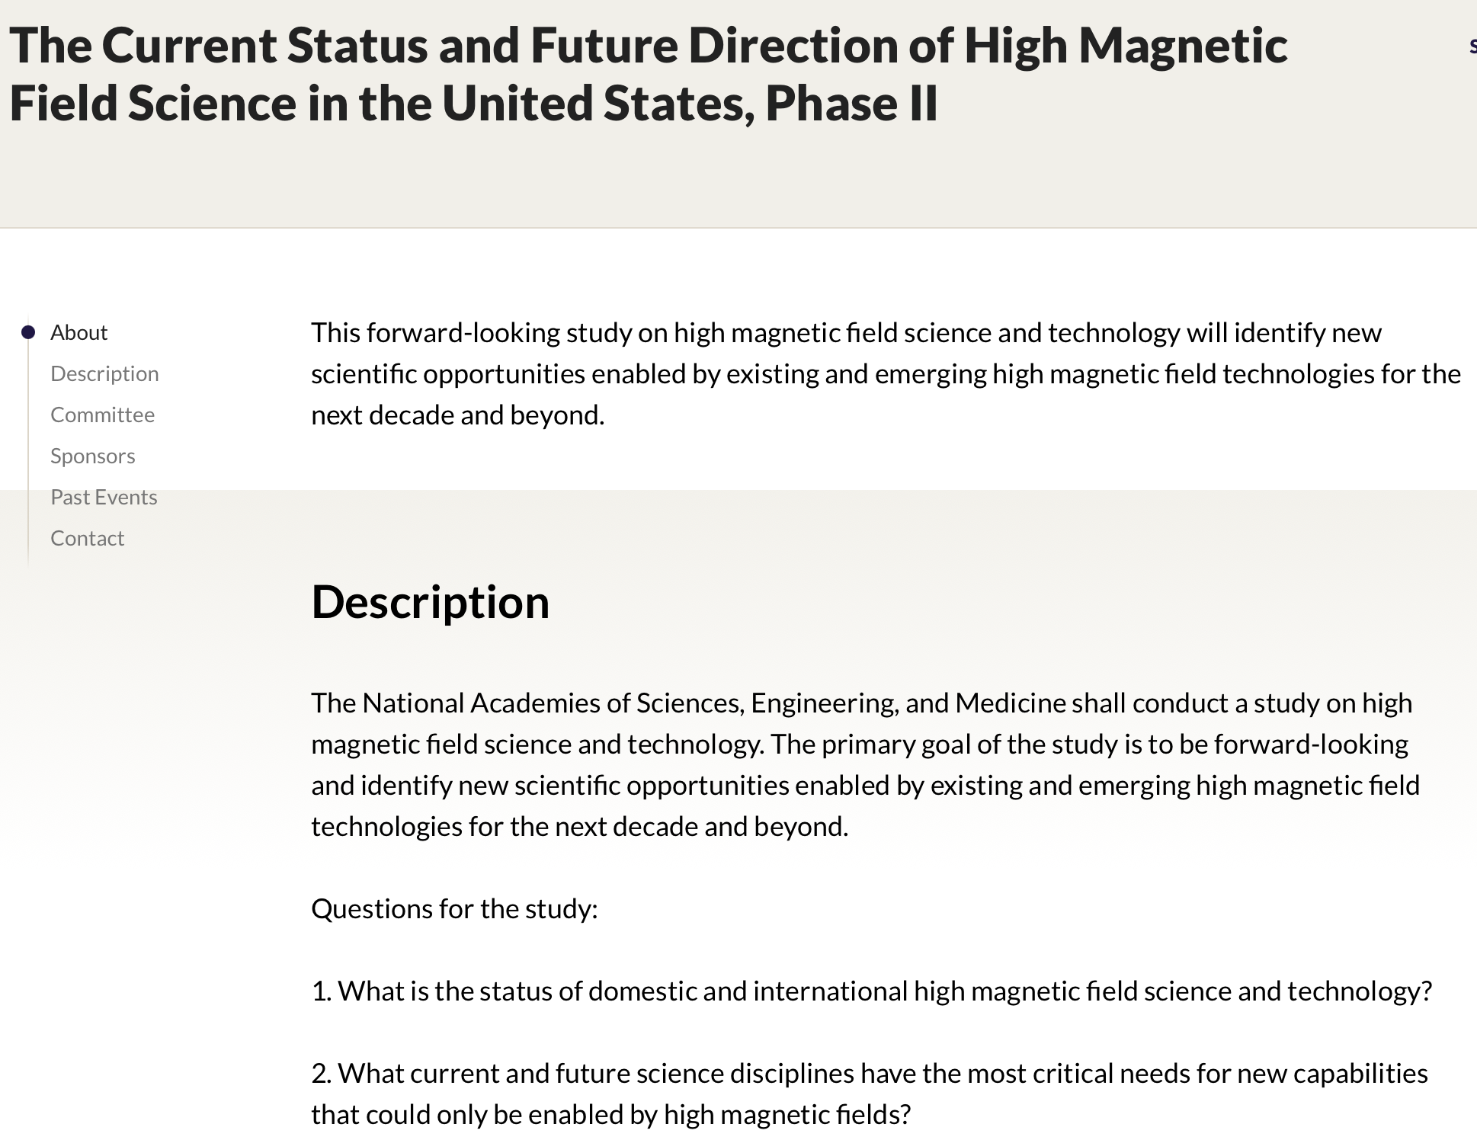
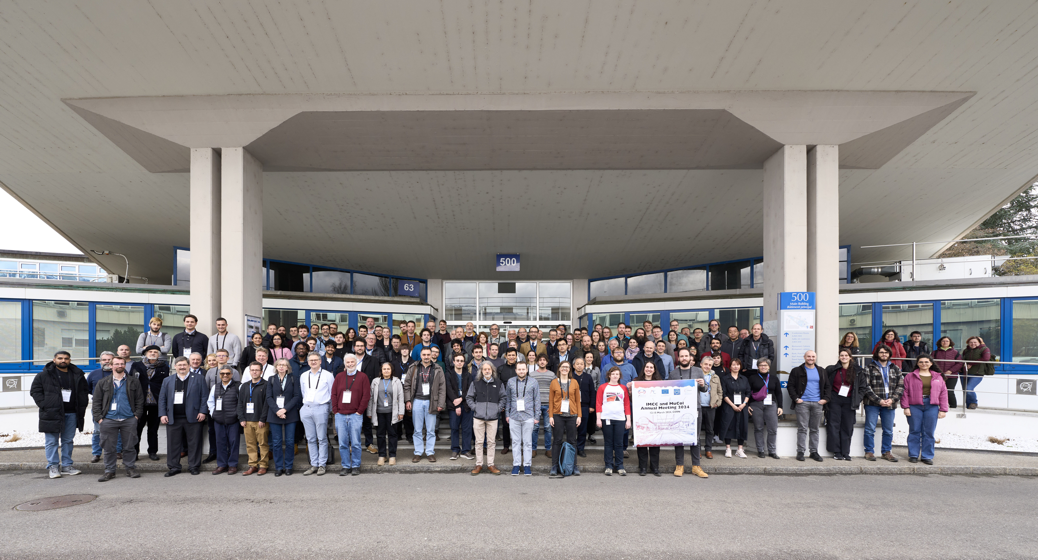
Our visibility in the International Community is strong… and important – lets target more intense engagement!
Strong Conference and workshop contributions, e.g.
  MT28
    More than 30 papers related to MDP R&D were presented!
    HEP Plenary “Progress and plans for the US Magnet Development Program”
National Academies Study in High Magnetic Field Science and Technology
  MDP NAS committee members: Kathleen Amm, Diego Arbelaez
    Presentations to the committee:
      D. Larbalestier, “Birthing new Superconducting Magnet Technologies with REBCO Coated Conductors and Round Multifilamentary Bi-2212”
      S. Prestemon, “Magnet technology for Energy Frontier Colliders”
      S. Gourlay, “Magnet Technology to Enable the Next Generation of Facilities for Particle Physics”
Invited and contributed talks at
  IMCC annual meeting
  HFM annual meeting
  International Superconductivity Symposium
RFI ongoing to guide FES Magnet R&D investments (see email from Yuhu Zhai)
IMCC 2024

Slide 10
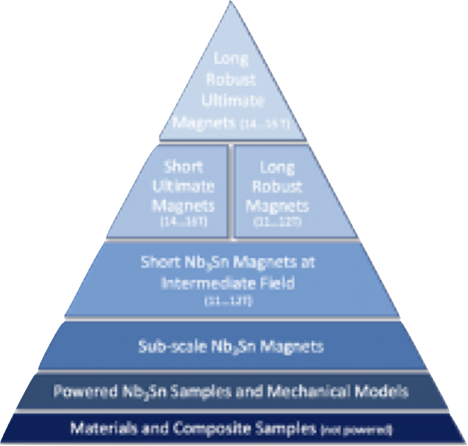
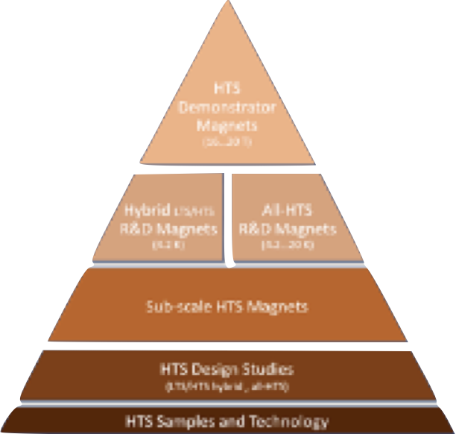
MDP plays an important role in the international context
European HFM–major elements similar to US MDP
  http://arxiv.org/abs/2201.07895
  Use of multi-lab teams, similar structure
Framework exists with CERN that enables collaboration
  HFM Leader Ezio Todesco, co-lead Bernhard Auchmann
DOE is supportive if additional framework is needed to enable collaborations
Continue to build collaborations that are mutually beneficial
  We want to be seen as partners-of-choice
  Always keep DOE-OHEP / MDP goals in mind
  Expect to establish robust connections with FCC and IMCC in coming years
  Expect enhanced connections with FES on synergistic magnet R&D

Slide 11
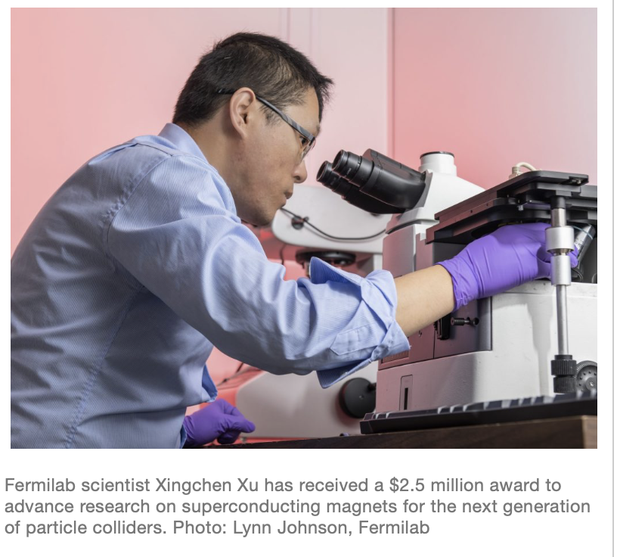

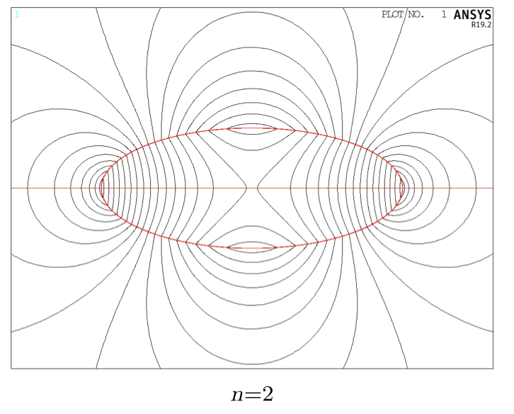
Leveraging synergistic activities to increase our effectiveness
We have various SBIRs, ARPA-E, Fusion & INFUSE, etc. projects underway
  From an MDP perspective:
      Be strategic, e.g. look for synergies between MDP needs and industry interests
      Use these public-private partnerships to forge relationships, identify strong partners
      Build relation of trust, insist on sufficient access to data for honest assessment
    It is sometimes difficult, but… be ready to say “no” if the “fit” is not right
  Let's continue to support DOE in identifying effective SBIR topics, grow “ecosystem”
Xingchen Xu, 2017:
“Development of Next-Generation Nb3Sn Superconductors for Energy-Frontier Circular Colliders”
Lucas Brouwer, 2023:
“Fixed-Field Superconducting Magnets for Rapid, High Power Accelera�on of Muons and Protons”

Slide 12
Goals for the collaboration meeting
Related to program roadmap:
  How have we progressed towards program milestones? Are the milestones still appropriate?
  What issues jeopardize success? How can we address them?
  What challenges were encountered over the last year? What lessons were learned?
Related to collaboration functioning:
  Where do we see opportunities to improve, e.g.
    Communication & coordination (e.g. within Areas, between Areas, with ”G7” management team)
    Leveraging of infrastructure; investment in, and development of, infrastructure, etc.
  What appears to be working well? How can we build on that?
  Are there lessons-learned that can/should influence how we collaborate more broadly, e.g. with HFM?
Related to long-term planning:
  Lets clarify the process to develop our updated roadmaps – goal is new document before end of 2024!
  How can we best impact HEP goals and strategic plans?

Slide 13
The MDP Technical Advisory Committee (TAC) is central to our program
Our Technical Advisory Committee provides critical guidance to / oversight of our program
  Andy Lankford (Chair), Giorgio Apollinari, Amalia Ballarino, Joe Minervini, Toru Ogitsu, Mark Palmer
For this year, we have some changes to the TAC:
  Andy is on vacation, so Giorgio Apollinari is Acting Chair
  Kathleen Amm is leaving BNL to become NHMFL Lab Director (Congratulations Kathleen!)
    Mark Palmer is serving as BNL’s interim MDP representative, so not on the TAC
  We have therefor asked for two scientists to step in as Interim TAC members:
    Mei Bai (SLAC)
    GianLuca Sabbi (LBNL)
Furthermore, we note that Amalia Ballarino and Toru Ogitsu will be attending remotely

Slide 14
Feedback from the Technical Advisory Committee (TAC) helps guide - and ground - our program
TAC Charge
Some questions for the TAC to consider as they seek to provide advice on Program progress
Are the MDP priorities being followed? Are the Areas monitoring and prioritizing their milestones?
Is each Area properly leveraging the capabilities within the collaboration to achieve their goals?
Is the MDP appropriately identifying, leveraging and developing synergistic activities, such as SBIR, DOE-FES, NP?
Is MDP community involvement appropriate, i.e. in the US HEP planning process and in the context of international collaborations? Are there further avenues that should be pursued?
Are the plans to develop updated MDP Roadmaps consistent with the P5 report?

Slide 15
Guidance for this week's meeting
See meeting site https://indico.fnal.gov/event/63310/ for presentations & meeting timeline
  This is primarily an in-person meeting. Nevertheless we will maintain a zoom connection
Speakers:
  Please stick to the time allotted – focus on the messages you are trying to convey
  More in-depth questions/discussions in the allotted discussion periods

Slide 16
Guidance for the meeting
Please see the US Magnet Development Program Code of Conduct on the Indico site
Keep discussions professional
  Do not seek to blame others,
  focus on technical and strategic aspects; be constructive
  Think through questions, keep them focused, and raise your hand; Keep your questions concise and to-the-point
  We value input from ALL members – students and junior/early career scientists and engineers are highly encouraged to contribute
  Thanks to all of you for attending - lets start the meeting!

