Slide 1
The 8th U.S. MDP Collaboration Meeting - Fermilab
Bonnie Fleming
30 April 2024

Slide 4
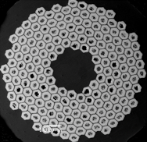
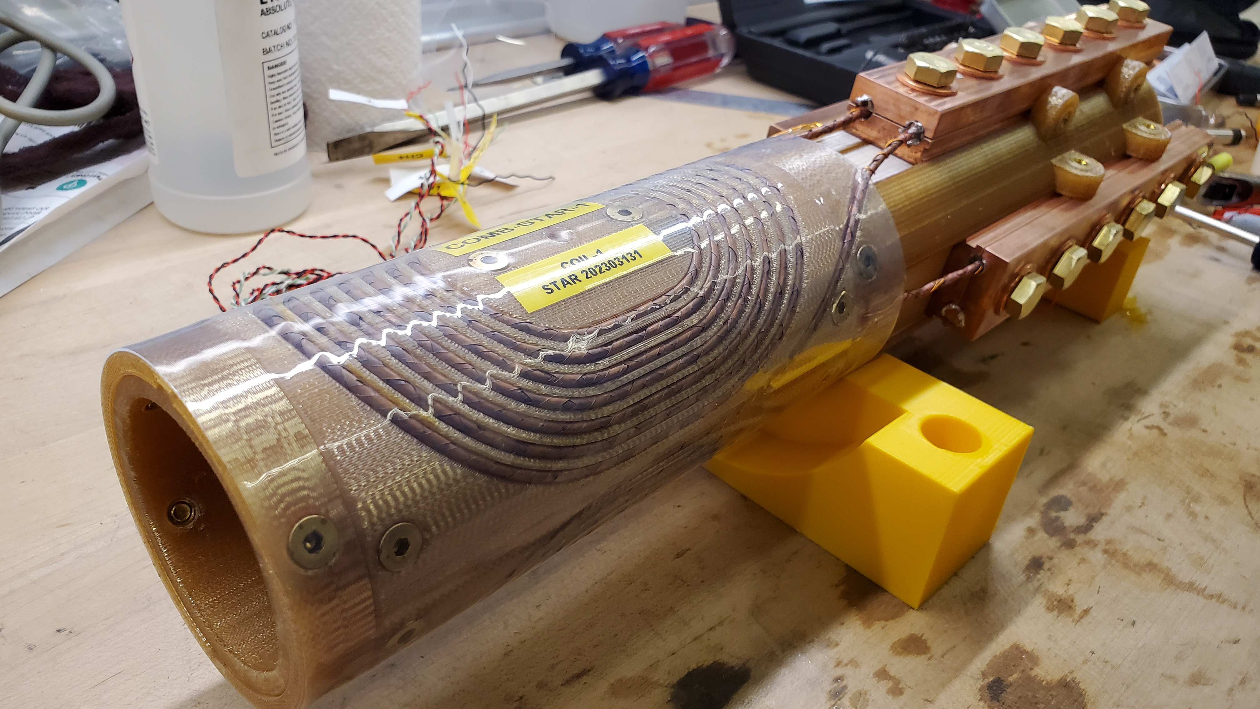
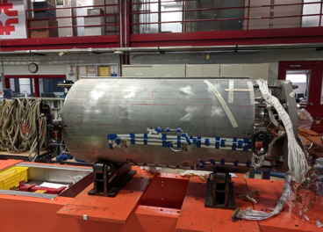
High Field Magnet Development
Recent Fermilab contributions to MDP
P5 report: “One of the most ambitious is a future 10 TeV pCM collider
Precision studies of Higgs self-interaction
Testing full range of WIMP theories
Search for Direct Evidence of New Particles
Many opportunities for Magnet R&D
Fermilab HTS magnet development (SBIR)
APC and High C_{p} Nb₃Sn
Fermilab roles capitalize on unique strengths, core infrastructure, Accelerator R&D, cryogenic test facilities, and a diverse pool of talent
Technical capabilities within the superconducting magnet program are applicable to other particle physics experiments, e.g,. axion searches, detector magnets and Office of Science Programs/Projects. For example, fusion magnet technology.
15 T dipole magnet world record magnet
Notes:
APC = Artificial Pinning Centers for higher current density
High Cp – high heat capacity to reduce magnet training (maybe) ☺
15T magnet made 14.5T

Slide 5
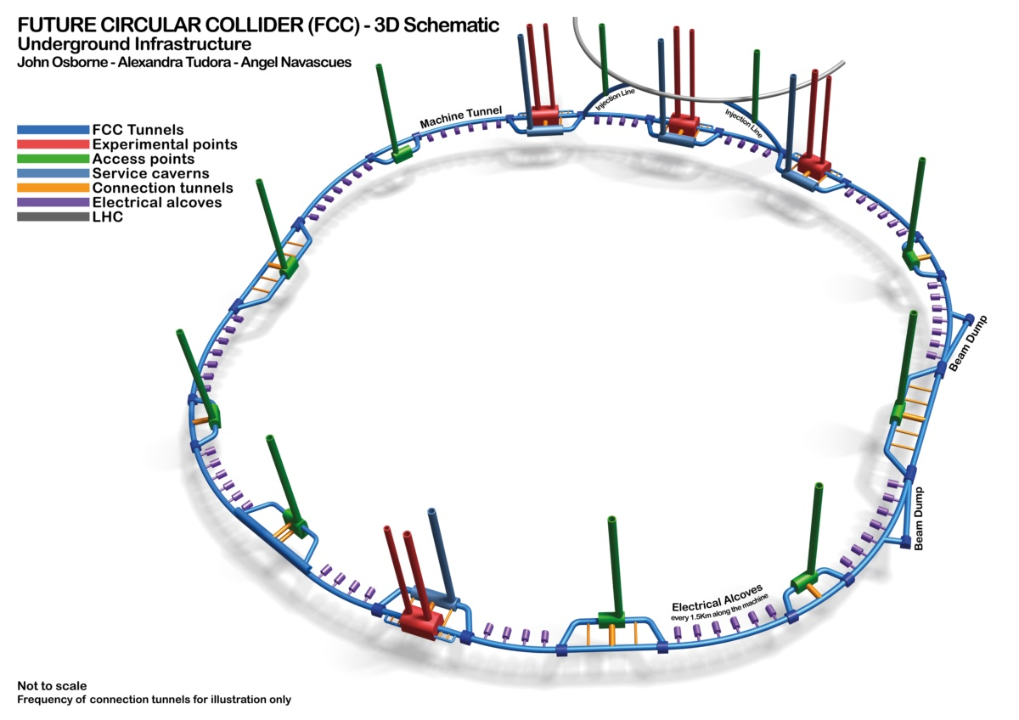
10 TeV parton center-of-momentum collider
P5: We do not yet have a technology capable of building a 10 TeV pCM energy machine, but the case for one is clear.
Examples are Muon Collider and FCC-hh
Superconducting magnets are a crucial part of these machines.
Extensive R&D is required to develop technically valuable and cost-effective options.
P5 recommends: ”targeted collider R&D to establish the feasibility of a 10 TeV pCM muon collider possibly on US soil
The contributions of MDP to these future projects are vital.

Slide 6
MDP will be vital for future HEP facilities
Notes:
OHEP has said more than once that the magnet community (MDP) sets an example for successful collaborations.

